Slide 1








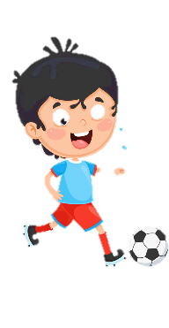
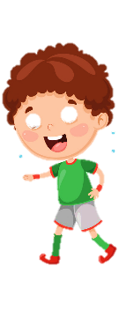











Notes:
Để nguyên trang bìa như này, chỉ thay đổi tên bài trong quá trình làm. Logo của sách Wonderful World

Slide 2


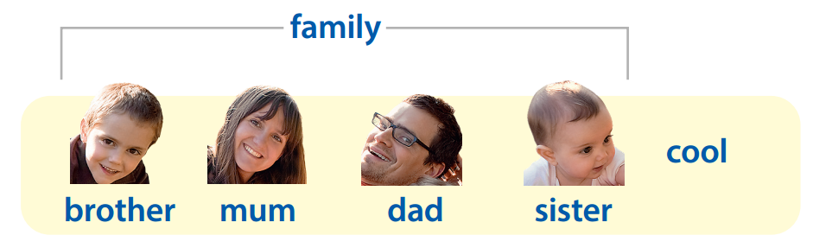



Warm up:
Review
Notes:
- Revise the words from Lesson 1 with the flashcards.

Slide 3
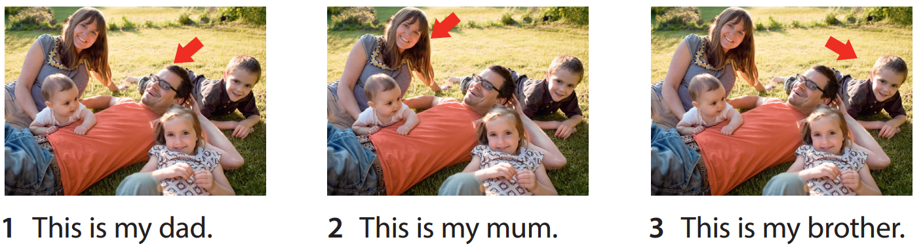

Review

Slide 4








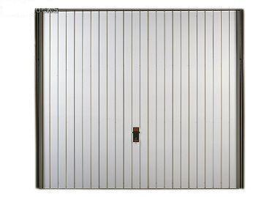
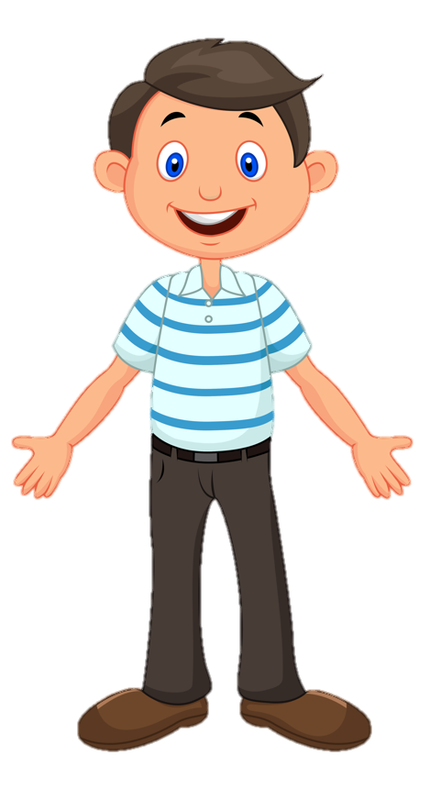

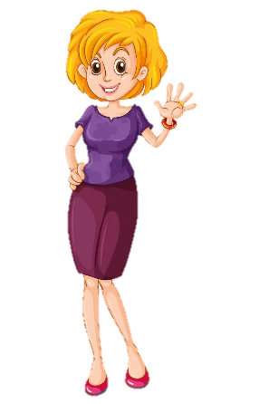
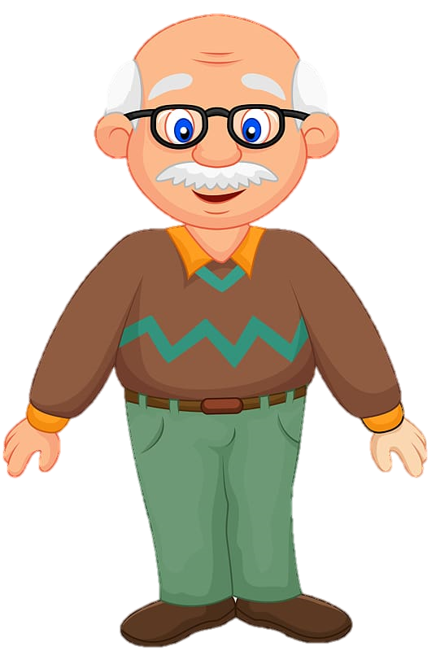
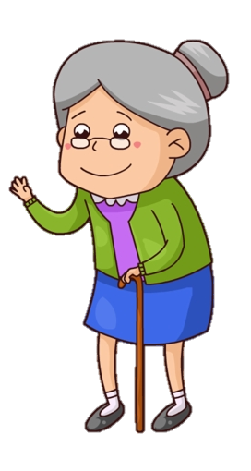



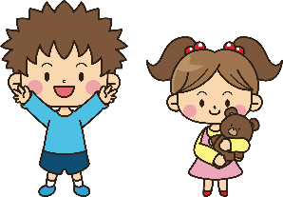

Notes:
Game: Family at home
- Revise the words from Lesson 1 with the flashcards.
- Divide class into 2 groups: Boys and Girls.
- Ask students to look at the picture. Then each group will answer who is in the room.
- Read out loud the sentence.

Slide 5
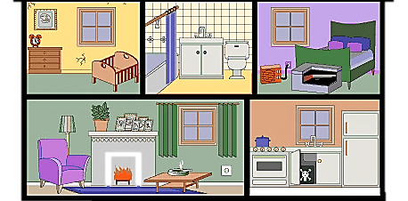






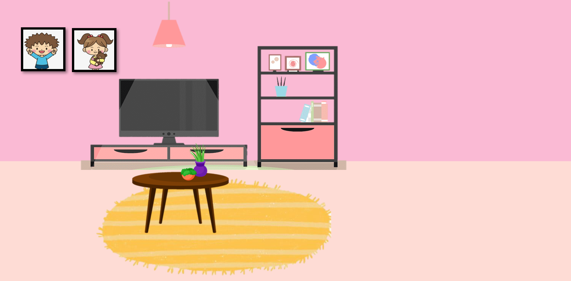
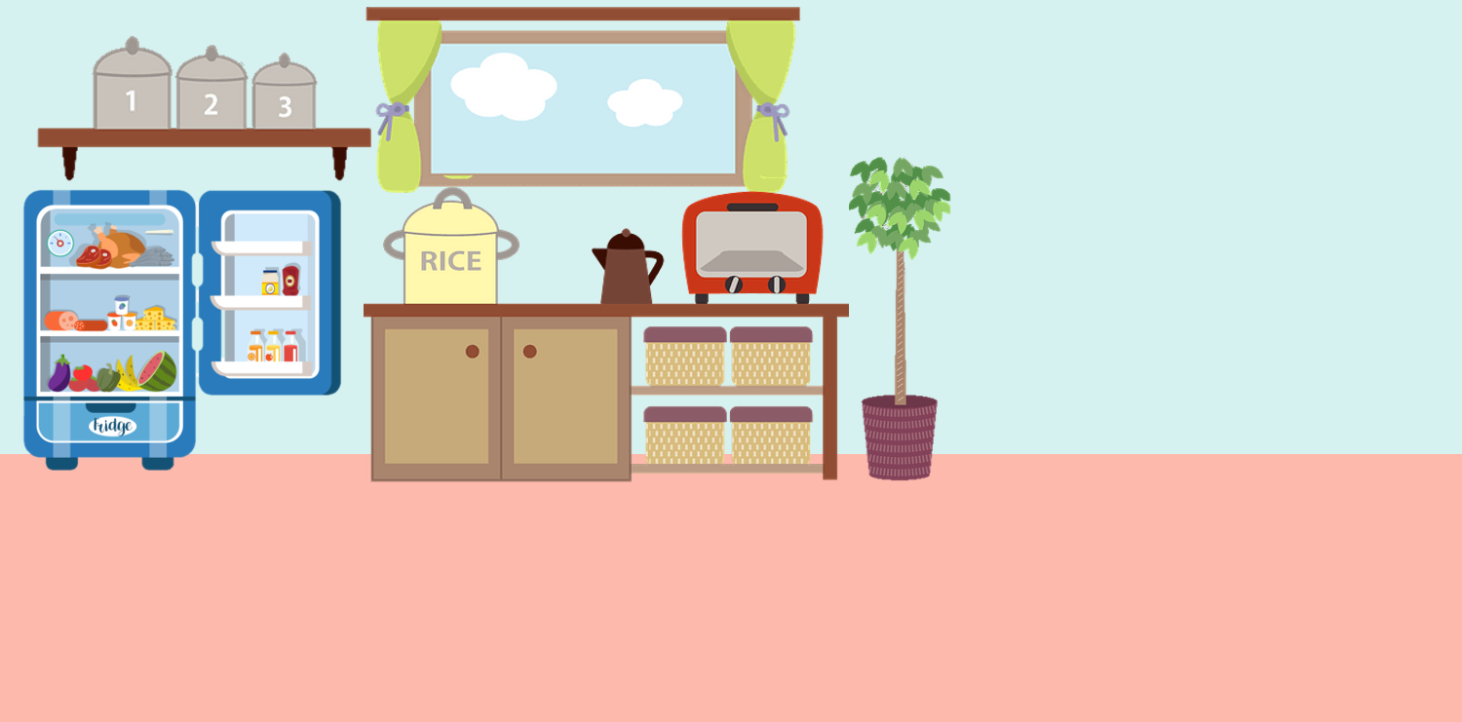
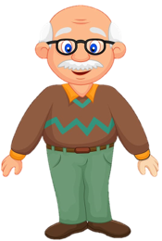
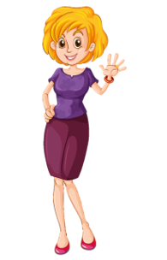
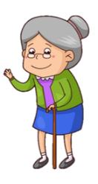


Sister
Brother
_______ is in the bedroom.

Slide 6
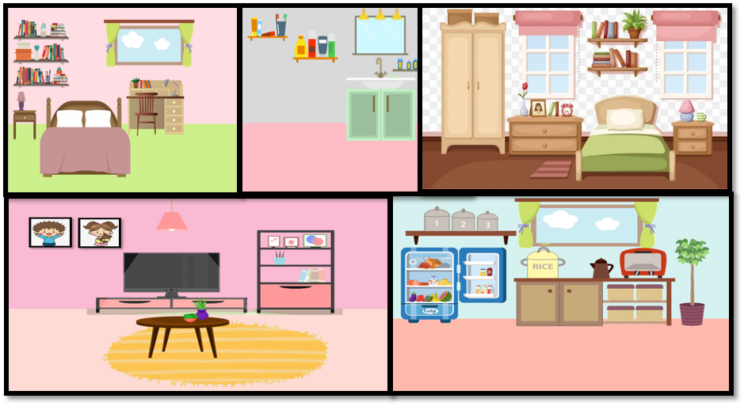


Mum
_____ is in the kitchen.

Slide 7
Dad
____ is in the bathroom.

Slide 8

Sister
Brother
_______ is in the bedroom.

Slide 9



Grandpa
________ is in the living room.

Slide 10
Grandma
_______ is in the garden.

Slide 11

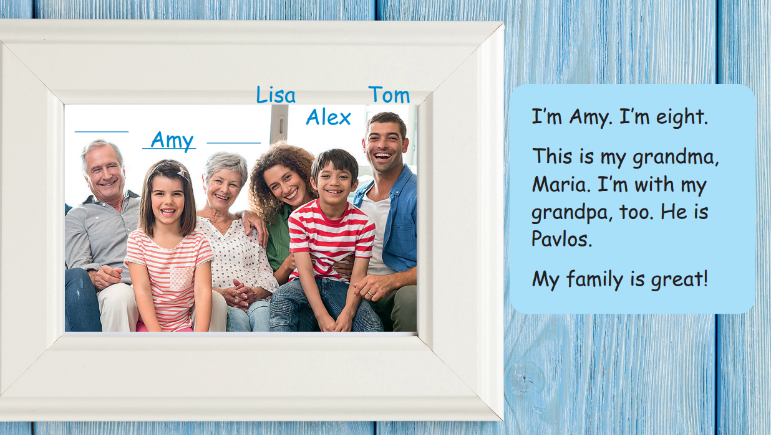
Notes:
- Teacher shows pictures of grandpa and grandma. Ask student if they know how to say them in English.
- Lead in the new lesson. Tell students they are going to learn more vocabulary about members in the family.

Slide 12


2 Presentatation

Slide 13
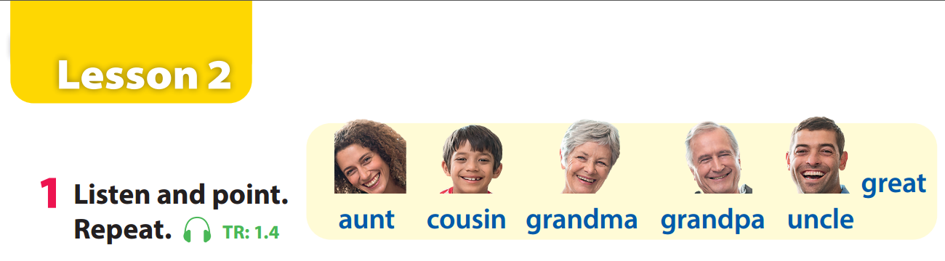

Notes:
Task 1: Listen and point. Repeat. (Track 1.4)
- Use flashcards to introduce the vocabulary and structure of lesson.
- Say the words for students to repeat in chorus.
- Play the recording for the students to listen to, point to, and repeat the words.
- Read out the new picture words in the vocabulary box in random order and ask students to point to the correct pictures.
- Read out the word great. Explain the meaning. Then say a student’s name, e.g. Bao’s great! and ask students to repeat. Ask volunteers to stand at the front and do the same with any name they like.

Slide 14
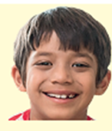
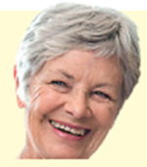



Slide 15



Slide 16
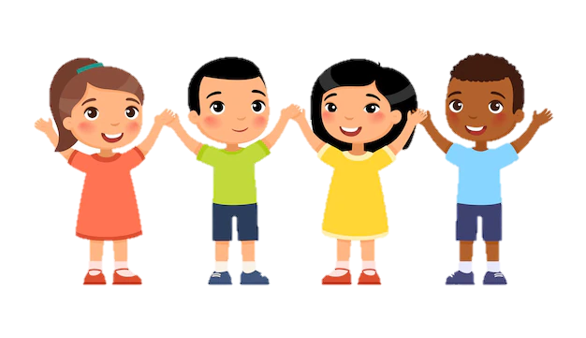


Touch the board
Notes:
Mini game: Touch the board
- Have 4 -5 students come to the board.
- Teacher calls out a word. Once the word has been called, have the students turn around and touch the correct picture.

Slide 17


3 Practice

Slide 18

Notes:
Task 2: Listen and write. (Track 1.2)
- Ask students to look at the family photo and count the number of members.
- Point to the names in the text. Read them out and ask students to repeat.
- Play the recording. Tell students to look at the picture and follow the text with their fingers.
- Play the recording again, pause after each sentence and ask students to repeat.
- Ask students to practice reading out the text individually and in pairs. Ask some volunteers to read it out in front of the whole class.
- Tell students to look at the photo and ask what should be filled in the gaps. Elicit “names”. Ask students to read the text again to find out information to fill in the gaps.
- Check answers as the whole class.

Slide 19
Pavlos
Maria
Notes:
Task 2: Listen and write. (Track 1.2)
- Ask students to look at the family photo and count the number of members.
- Point to the names in the text. Read them out and ask students to repeat.
- Play the recording. Tell students to look at the picture and follow the text with their fingers.
- Play the recording again, pause after each sentence and ask students to repeat.
- Ask students to practice reading out the text individually and in pairs. Ask some volunteers to read it out in front of the whole class.
- Tell students to look at the photo and ask what should be filled in the gaps. Elicit “names”. Ask students to read the text again to find out information to fill in the gaps.
- Check answers as the whole class.

Slide 20


How old is Amy?
How is her family?

Slide 21
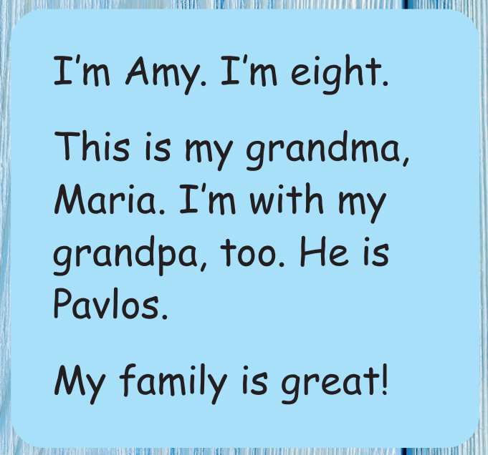
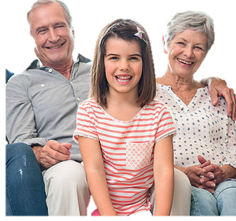

Notes:
T asks Ss to listen and look at the text. Then, Ss listen again and write.

Slide 22
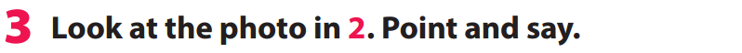

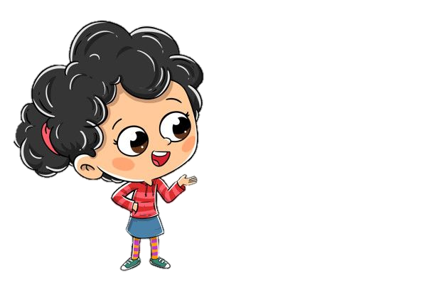
Notes:
Task 3: Point and say.
- Ask students to work pairs. Tell them they are going to say sentences based on the photo in Activity 2.
- Ask students to look back at the photo in Activity 2 and the sample sentences in Activity 3.

Slide 23







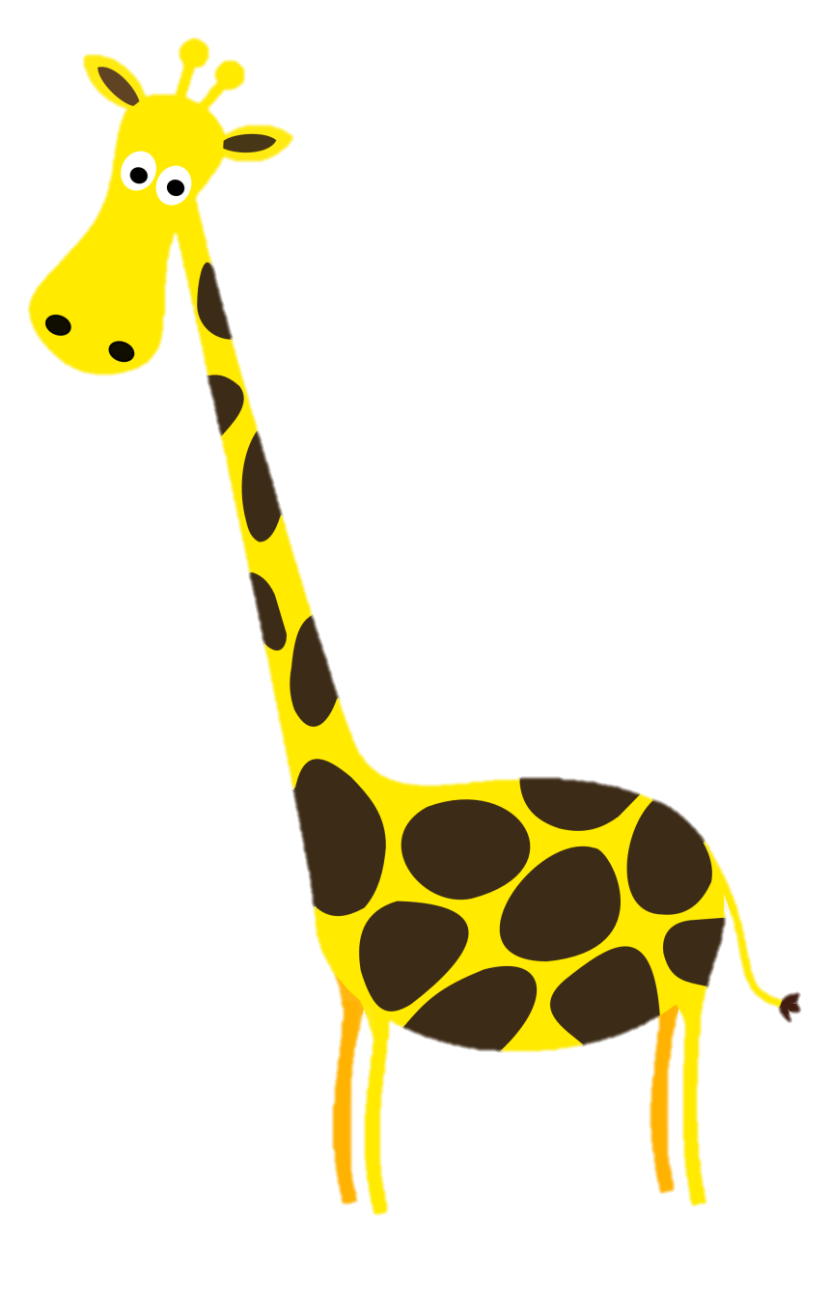







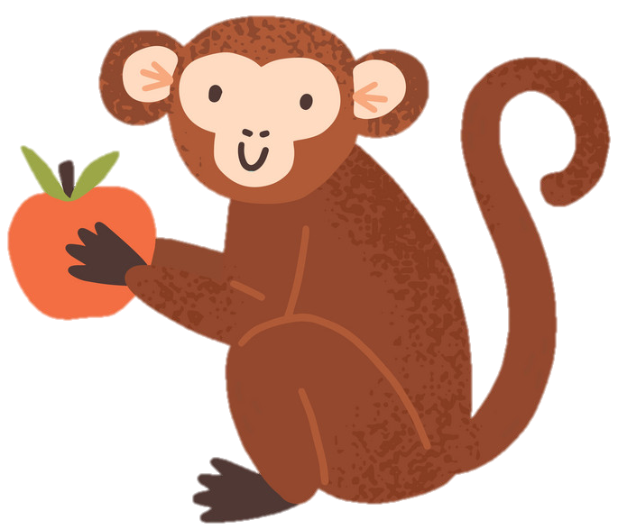

Picking apples

Slide 24



This is me, Amy.

Slide 25
This is my aunt, Lisa.

Slide 26
This is my cousin, Alex.

Slide 27
This is my grandma, Maria.

Slide 28
This is my uncle, Tom.

Slide 29
This is my grandpa, Pavlos.

Slide 30

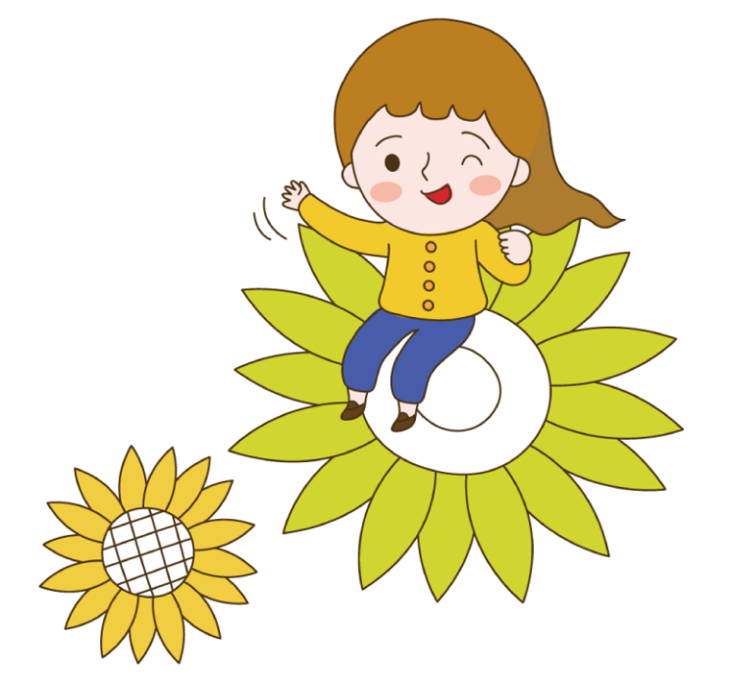

4 Production

Slide 31

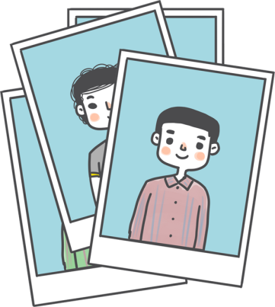

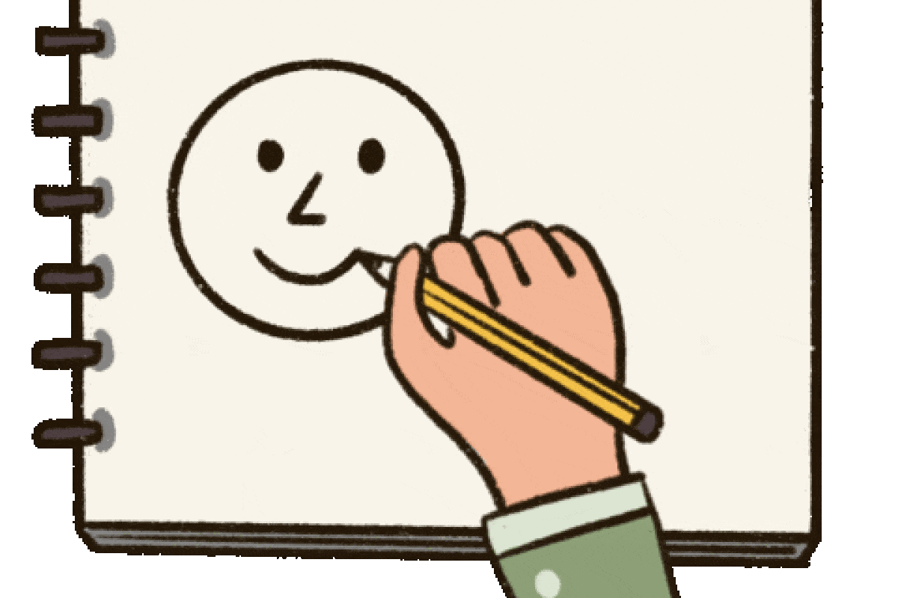
tree
1
draw
2
Notes:
Make "My Family Tree" Posters.
- Give out a piece of colored paper to each student.
- Write in large letters "My family " at the top. Then students draw pictures of members in their family (grandparents at the top, next parents and he/she and siblings at the bottom).
- Finally, under each family member photo/picture write the vocab (grandpa, grandma, etc.).

Slide 32


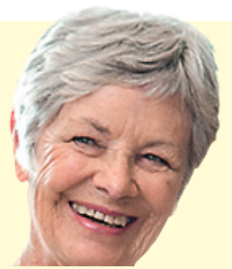
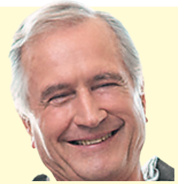
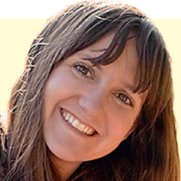

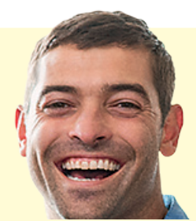
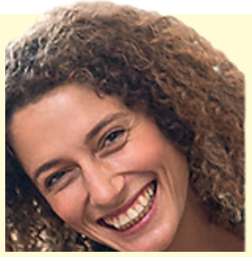
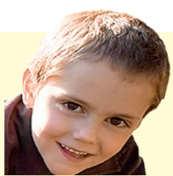
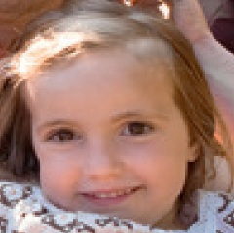

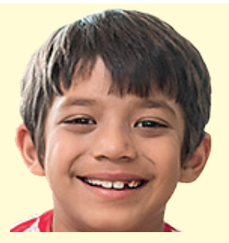

3
My family
grandma
grandpa
mum
dad
uncle
ant
brother
me
sister
cousin
Notes:
Make "My Family Tree" Posters.
- Give out a piece of colored paper to each student.
- Write in large letters "My family " at the top. Then students draw pictures of members in their family (grandparents at the top, next parents and he/she and siblings at the bottom).
- Finally, under each family member photo/picture write the vocab (grandpa, grandma, etc.).

Slide 33



5 Assessment

Slide 34
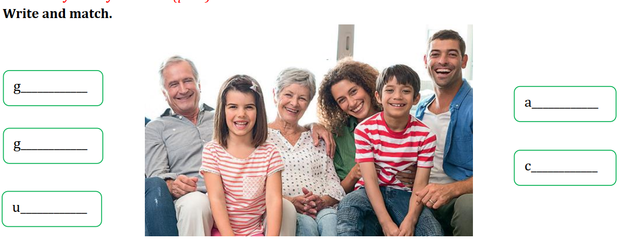
randma
unt
randpa
ousin
ncle
Notes:
Option 1: write and match
Sts look at the picture and say the words, one by one. Then write and match.

Slide 35

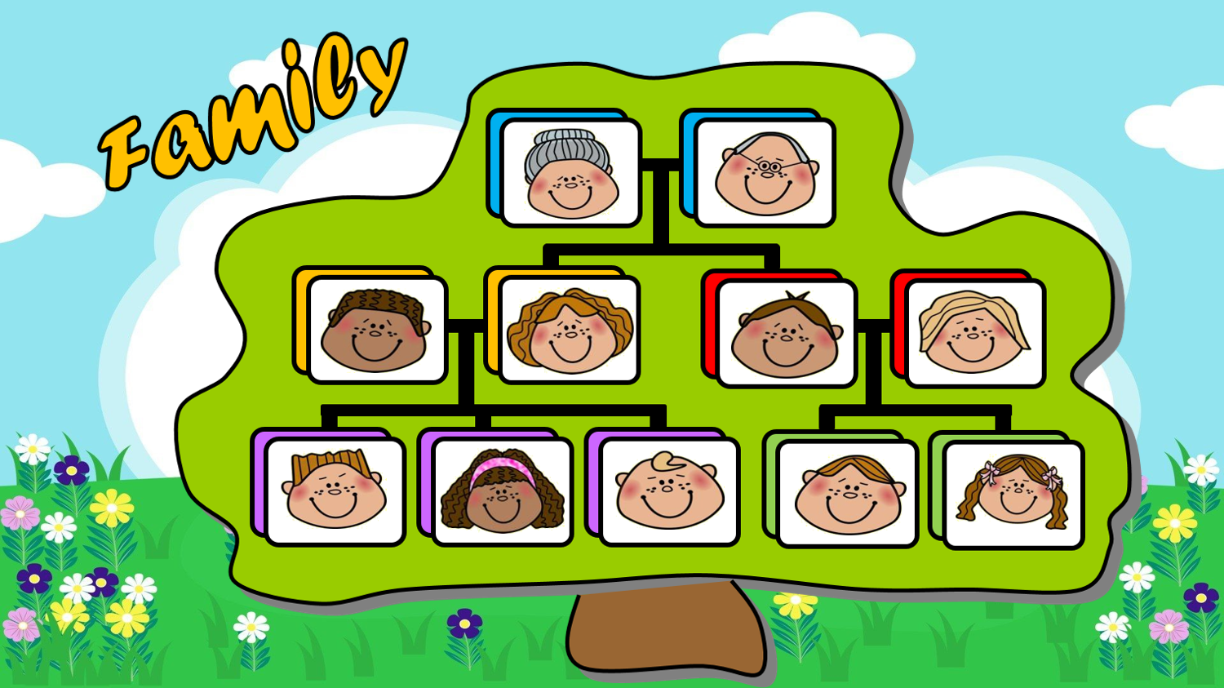
Notes:
Option 2:
Game: Who is Who?
- Ask students to look at the Family tree
- Read a sentence carefully and choose who is the correct answer.
1. Paul is Kate's brother.
2. Alice is Bill's aunt.
3. Jane is Grace's grandma.
4. Peter is Paul's dad
5. John is Kate's uncle.
6. Kate is Mark's cousin.
7. Mike is Bill's grandpa.
8. Carol is Paul's mum.
9. Carol is John's sister.

Slide 36






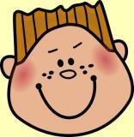





grandpa
brother
uncle
grandma
mum
sister
cousin
dad
Maria
Mike
aunt
GOOD JOB!
Peter
Carol
John
Alice
Paul
Kate
Bill
Mark
Grace
Paul is Kate's
brother.
Notes:
THIẾT KẾ HOẠT ĐỘNG TƯƠNG TÁC TỪ SLIDE 38 ĐẾN SLIDE 46. THEO ĐÁP ÁN Ở GHI CHÚ MỖI SLIDE
ĐÁP ÁN: brother

Slide 37
grandpa
brother
uncle
grandma
mum
sister
cousin
dad
Jane
Mike
aunt
GOOD JOB!
Peter
Carol
John
Alice
Paul
Kate
Bill
Mark
Grace
Alice is Bill's
aunt.
Notes:
ĐÁP ÁN:
aunt

Slide 38
grandpa
brother
uncle
grandma
mum
sister
cousin
dad
Jane
Mike
aunt
GOOD JOB!
Peter
Carol
John
Alice
Paul
Kate
Bill
Mark
Grace
Jane is Grace's
grandma.
Notes:
ĐÁP ÁN:
grandma

Slide 39
grandpa
brother
uncle
grandma
mum
sister
cousin
dad
Jane
Mike
aunt
GOOD JOB!
Peter
Carol
John
Alice
Paul
Kate
Bill
Mark
Grace
Peter is Paul's
dad.
Notes:
ĐÁP ÁN:
dad

Slide 40
grandpa
brother
uncle
grandma
mum
sister
cousin
dad
Jane
Mike
aunt
GOOD JOB!
Peter
Carol
John
Alice
Paul
Kate
Bill
Mark
Grace
John is Kate's
uncle.
Notes:
ĐÁP ÁN:
uncle

Slide 41
grandpa
brother
uncle
grandma
mum
sister
cousin
dad
Jane
Mike
aunt
GOOD JOB!
Peter
Carol
John
Alice
Paul
Kate
Bill
Mark
Grace
Kate is Mark's
cousin.
Notes:
ĐÁP ÁN:
cousin

Slide 42
grandpa
brother
uncle
grandma
mum
sister
cousin
dad
Jane
Mike
aunt
GOOD JOB!
Peter
Carol
John
Alice
Paul
Kate
Bill
Mark
Grace
Mike is Bill's
grandpa.
Notes:
ĐÁP ÁN:
grandpa

Slide 43
grandpa
brother
uncle
grandma
mum
sister
cousin
dad
Jane
Mike
aunt
GOOD JOB!
Peter
Carol
John
Alice
Paul
Kate
Bill
Mark
Grace
Carol is Paul's
mum.
Notes:
ĐÁP ÁN:
mum

Slide 44
grandpa
brother
uncle
grandma
mum
sister
cousin
dad
Jane
Mike
aunt
GOOD JOB!
Peter
Carol
John
Alice
Paul
Kate
Bill
Mark
Grace
Carol is John's
sister.
Notes:
ĐÁP ÁN:
sister

Slide 45

Good
bye!

