Slide 1
Unit9: What are they doing?
Lesson 3
Teacher: Ngoc Khue

Slide 2
Objectives
- Use the words and phrases related to the School subjects.
- Pronounce the sounds of the letters “ct ” and “cts”.
Mục đích bài học:
Sử dụng các từ và cụm từ liên quan đến chủ đề các môn học ở trường học.
Phát âm chính xác 2 âm sau: “ct” và “cts”.

Slide 3
Here is what you are going to learn in this lesson:
01.Review
02. Phonics
03. Practice
04. Homelink

Slide 4
01
Review

Slide 5




1
1
ant
2
mouse
3
elephant
4
dog
5
fish
6
iguana
7
hen
8
pet
9

Slide 6


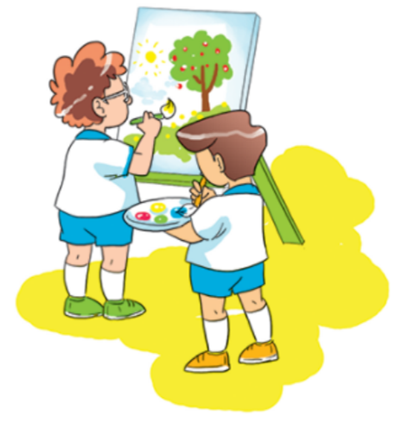


What ___ they doing?
1
2
3
4
5
6
7
8
9
10
Time’s up
are
Answer
Back

Slide 7
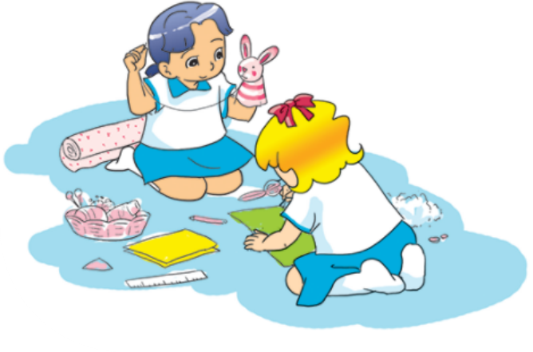
1
2
3
4
5
6
7
8
9
10
What are they doing?
_____ making puppets.
Time’s up
They’re
Answer
Back

Slide 8
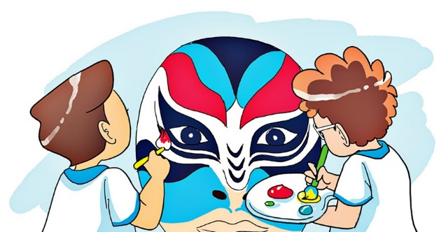
What are they doing?
1
2
3
4
5
6
7
8
9
10
Time’s up
They’re painting a mask.
Answer
Back

Slide 9
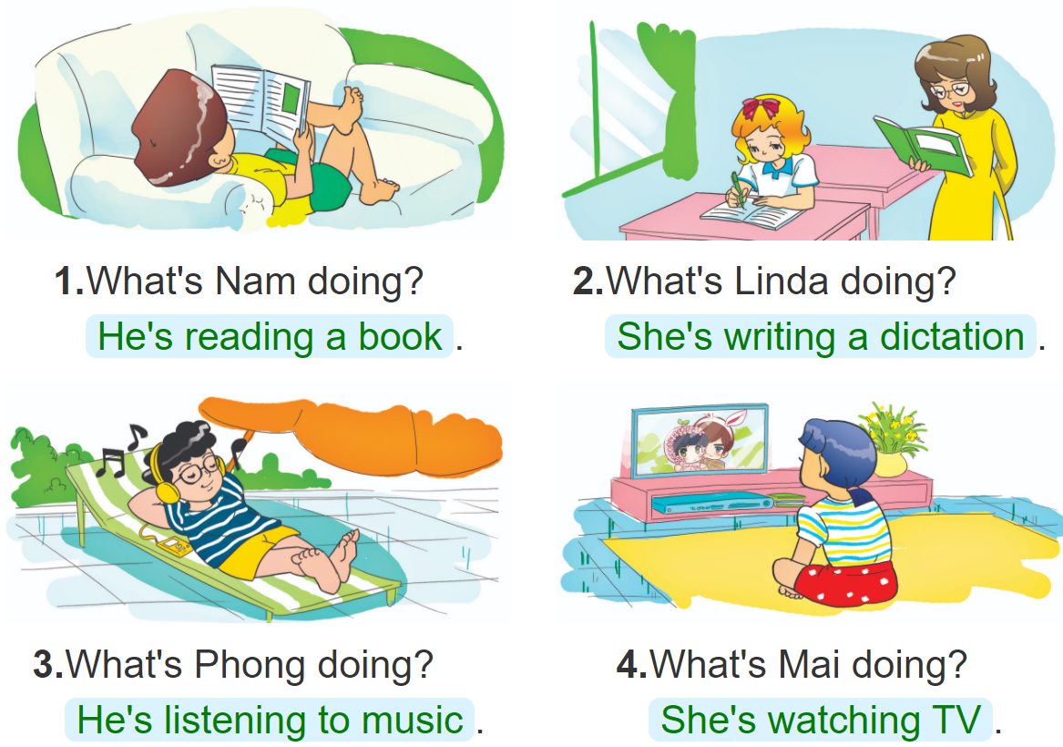
1
2
3
4
5
6
7
8
9
______________?
He is reading book.
10
Time’s up
What is he doing?
Answer
Back

Slide 10
What is she doing?
1
2
3
4
5
6
7
8
9
10
Time’s up
She is writing a dictation.
Answer
Back

Slide 11
1
2
3
4
5
6
7
8
9
10
What ___ he doing?
Time’s up
is
Answer
Back

Slide 12
1
2
3
4
5
6
7
8
9
10
Time’s up
What ___ she doing?
is
Answer
Back

Slide 13
1
2
3
4
5
6
7
8
9
10
Time’s up
are
What _____ you doing?
I’m playing football with
my friends.
Answer
Back

Slide 14
1
2
3
4
5
6
7
8
9
10
Time’s up
I’m
What are you doing?
______ taking photos.
Answer
Back

Slide 15
02
PHONICS

Slide 16
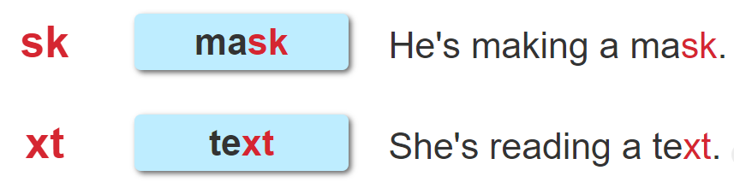

1. Listen and repeat.

Slide 17
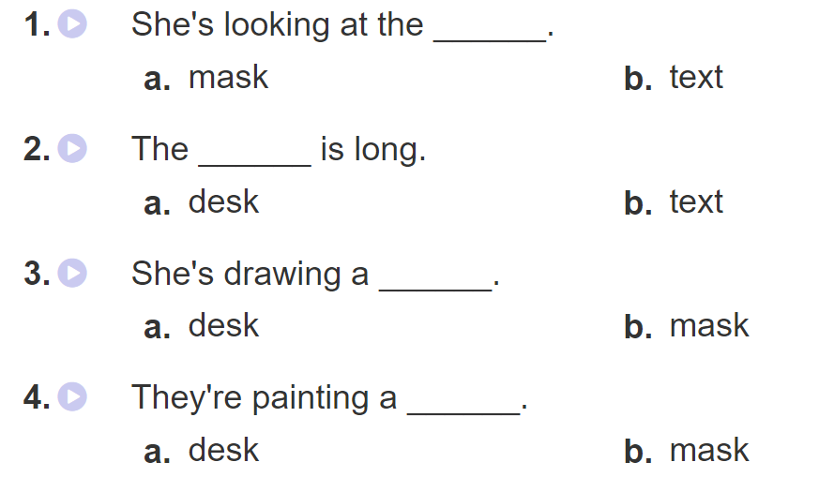

2. Listen and tick. Then write and say aloud

Slide 18
03
Practice

Slide 19


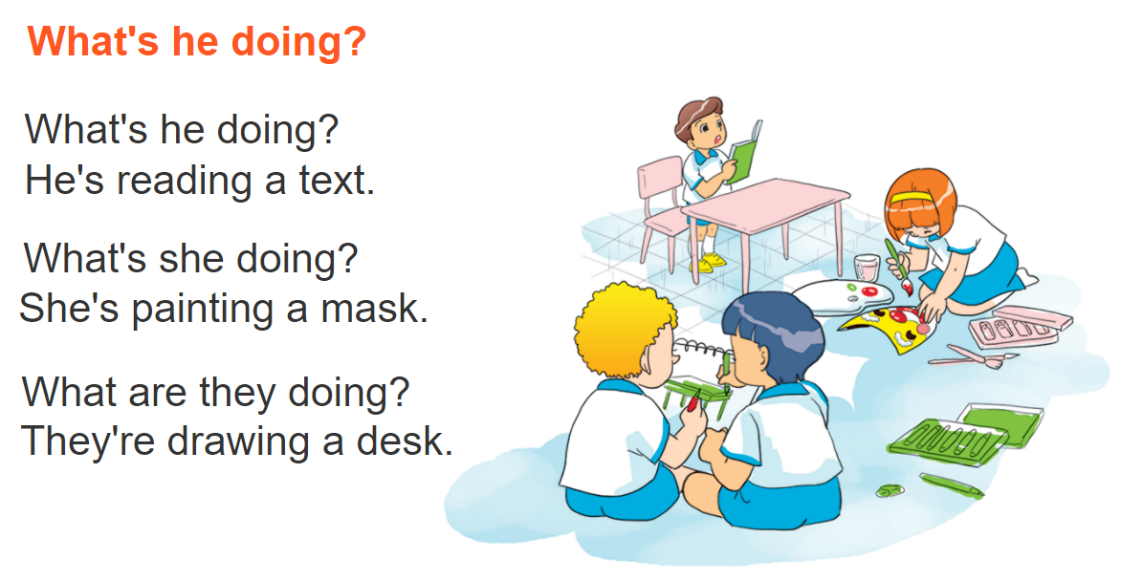

3. Let’s chant

Slide 20
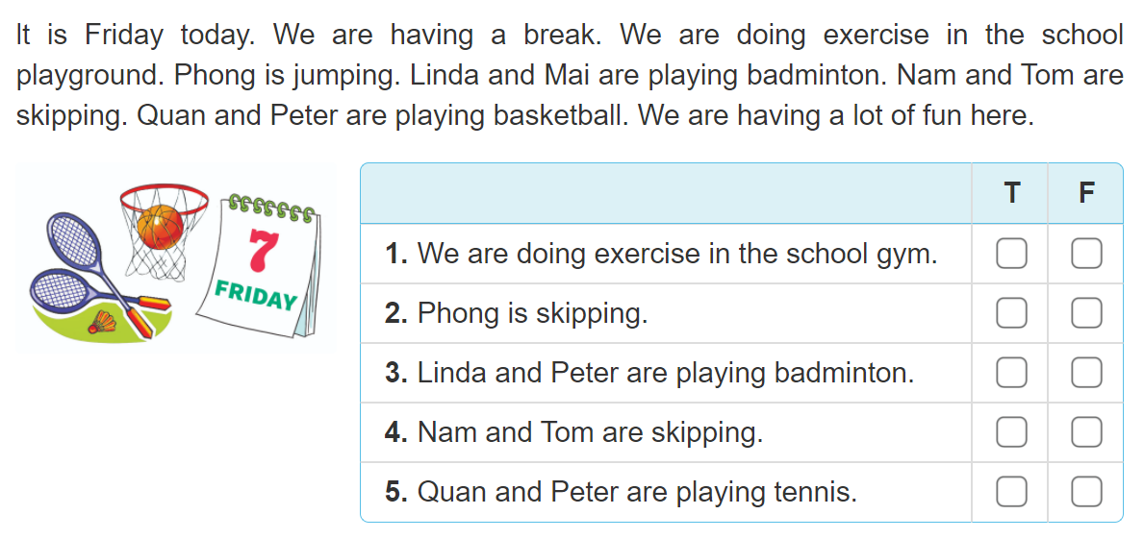

4. Read and tick

Slide 21
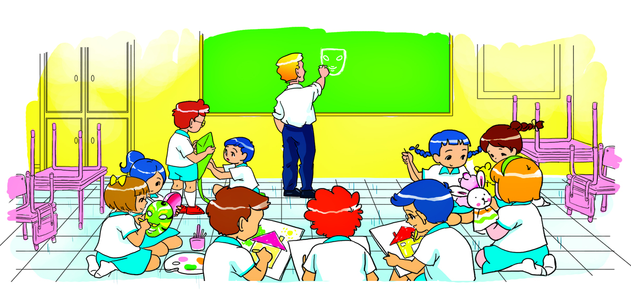
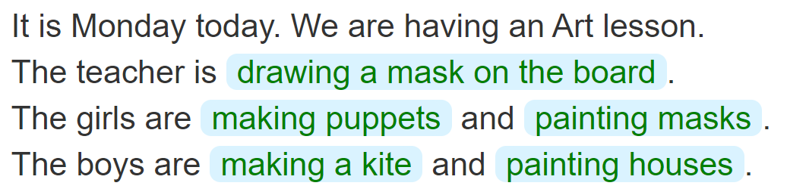
5. Write about the picture
____________________________________
____________________
______________________
________________
__________________

Slide 22
Homelink
04

Slide 23
Thursday, December 9th 2021
Unit 9: What are they doing?
Lesson 3
1. Phonics:
2. Homework:
Learn by heart the phonics.
Do WB (SBT): part A-1,2 (page 36)

