Slide 1
Unit 10: Where were you yesterday?
Lesson 1
Teacher: Ngoc Khue

Slide 2
Objectives
- Use the words and phrases related to the topic Past activities.
- Ask and answer about where someone was in the past.
Mục đích bài học:
Sử dụng các từ liên quan đến các hoạt động trong quá khứ.
Hỏi và trả lời về ai đó đã ở đâu trong quá khứ.

Slide 3
CONTENT
01
New words
Model sentence
02
03
Practice
04
Homelink

Slide 4

WARM UP!

Slide 5
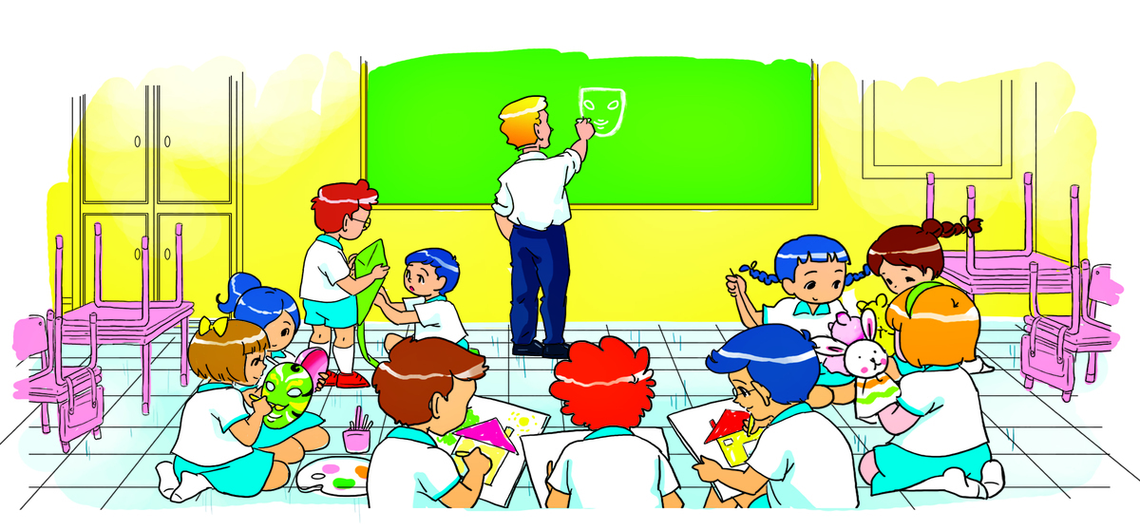
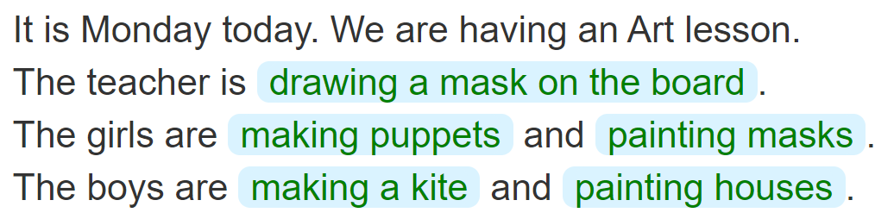
5. Write about the picture
____________________________________
____________________
______________________
________________
__________________

Slide 6
New words
1
Let’s start with the vocabulary

Slide 7

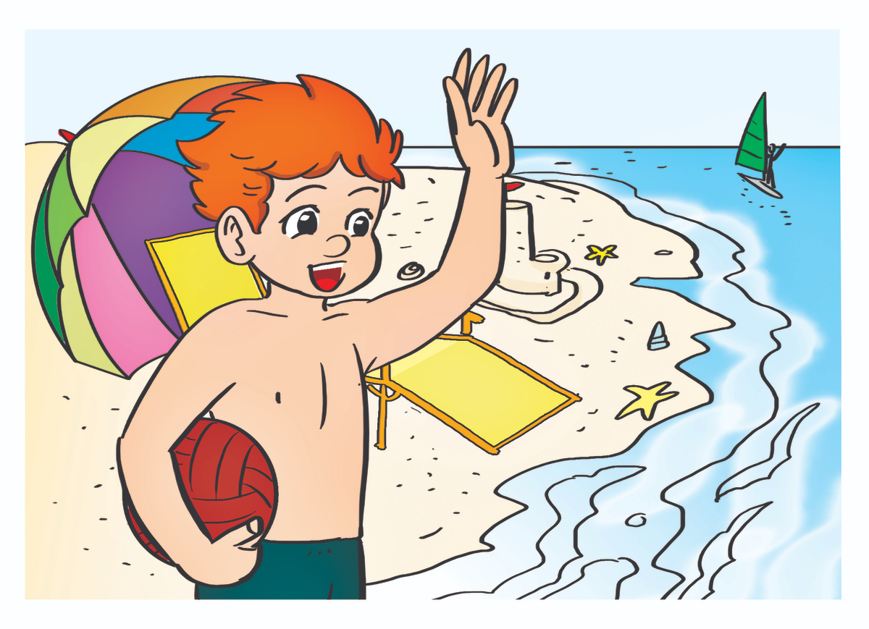

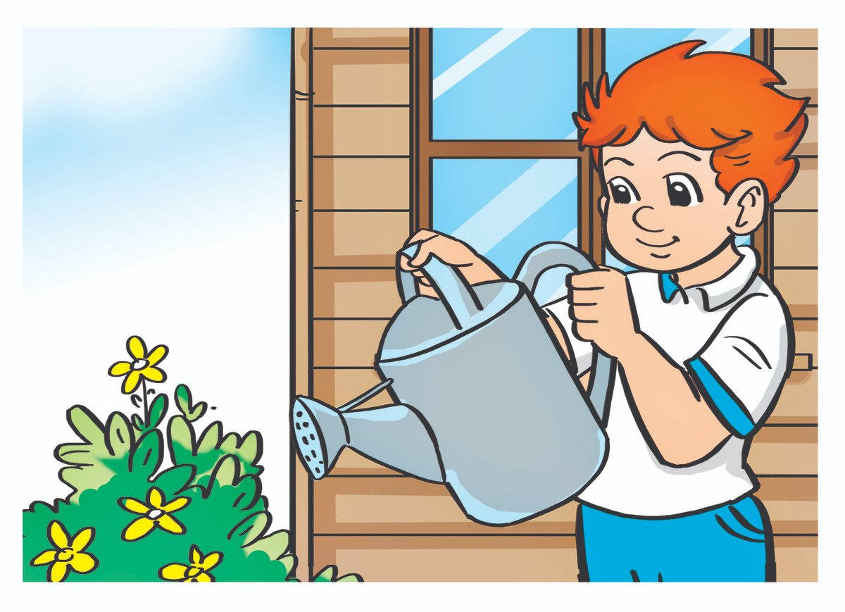


Verd – (v)
at the zoo
on the beach
in the school library
Ở sở thú
Ở bãi biển
Ở thư viện trường
Yesterday
at home
at school
/ˈjestərdeɪ/
Ở nhà
Ở trường
Hôm qua

Slide 8
at
at
at
____ school
_____ the zoo
_________
Yesterday
in
on
at
___ the school library
_____ the beach
____ home

Slide 9
02. Model sentence

Slide 10
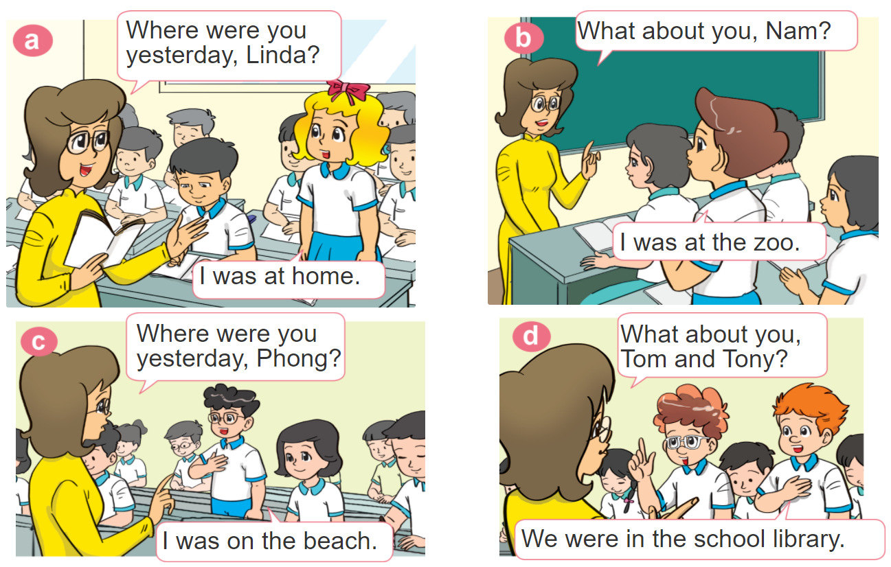

1. Look, listen and repeat.

Slide 11


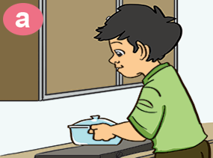
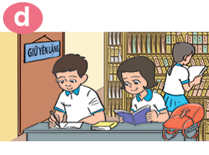

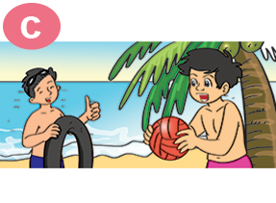
2. Point and say
Where were you yesterday?
I was _________.
at home
in the
school libray
at the zoo
on the beach

Slide 12

B. Grammar
Hỏi và trả lời bạn đã ở đâu:
(Bạn đã ở đâu ngày hôm qua?)
Where were you yesterday?
I was _______________.
+ cụm từ chỉ địa điểm
(Tớ đã ở ___________)

Slide 13
PRACTICE
3

Slide 14


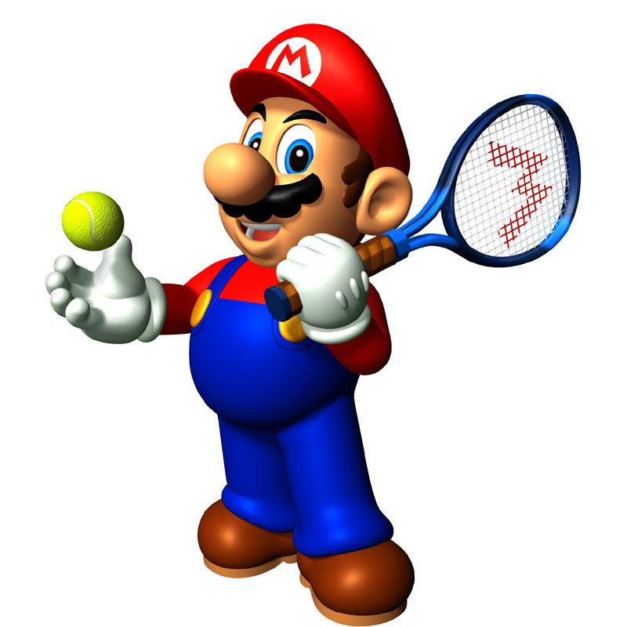





Slide 15
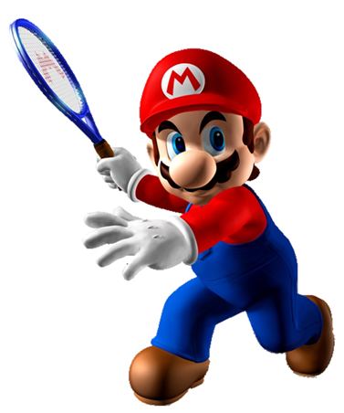
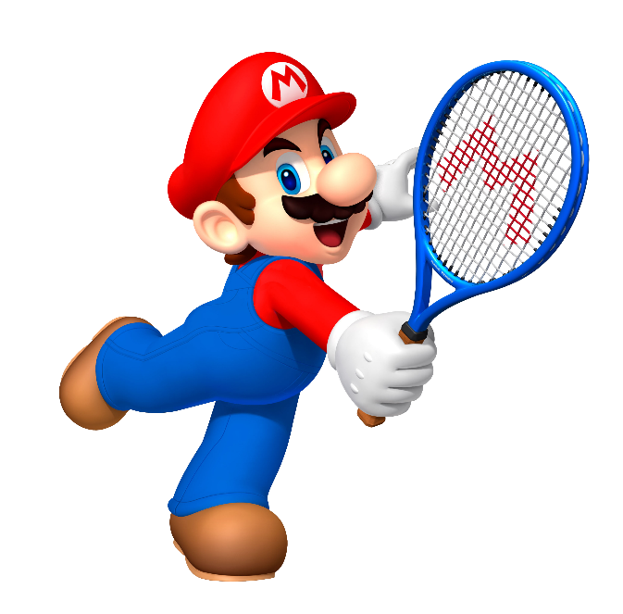


I was at home.
Where were you yesterday?
I was at school.
I wants

Slide 16
I was at school.
Where were you yesterday?
I was at the zoo.
Intelligent

Slide 17
Next
I was on the beach.
Where were you yesterday?
I was in the school library.

Slide 18
I was on the beach.
Where were you yesterday?
do
I was at the zoo.

Slide 19
I was at the zoo.
Where were you yesterday?
I was at home.
cat

Slide 20
at
on
Where were you yesterday?
I was ___ the school library.
in

Slide 21
are
was
Where _____ you yesterday?
I was at school.
were

Slide 22
am
was
Where were you yesterday?
I _____ on the beach.
were

Slide 23
Yesterday
Today
Where were you _________?
Sunday

Slide 24
Time’s up!

Slide 25
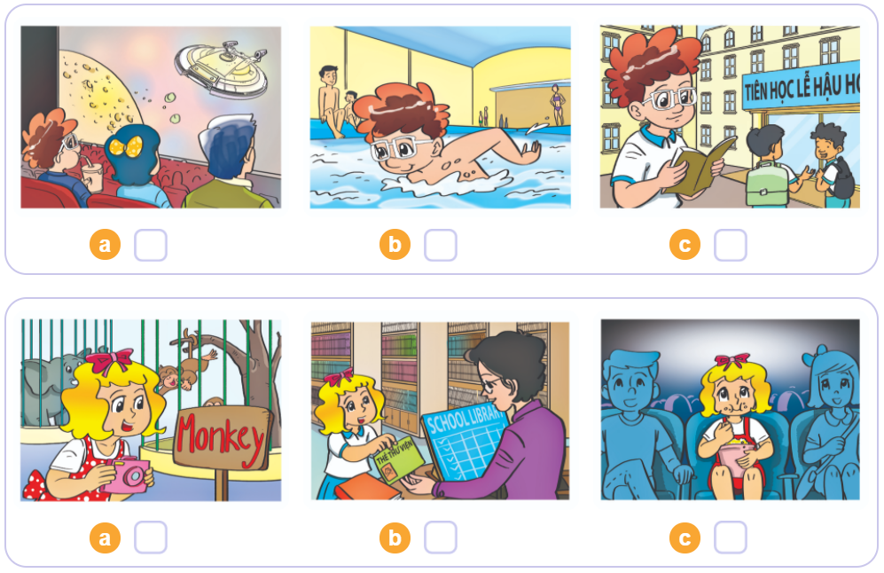


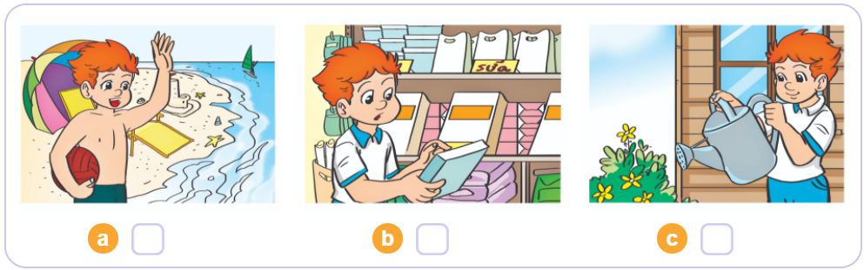
3. Listen and tick
1
2
3

Slide 26
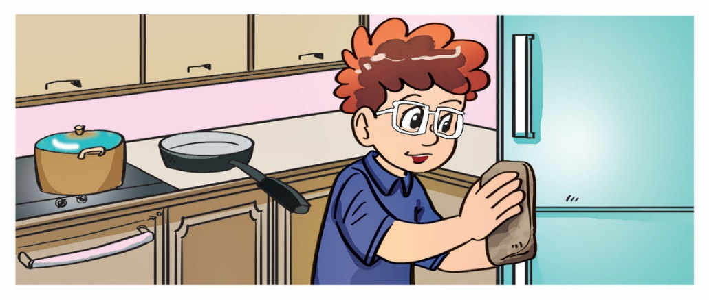

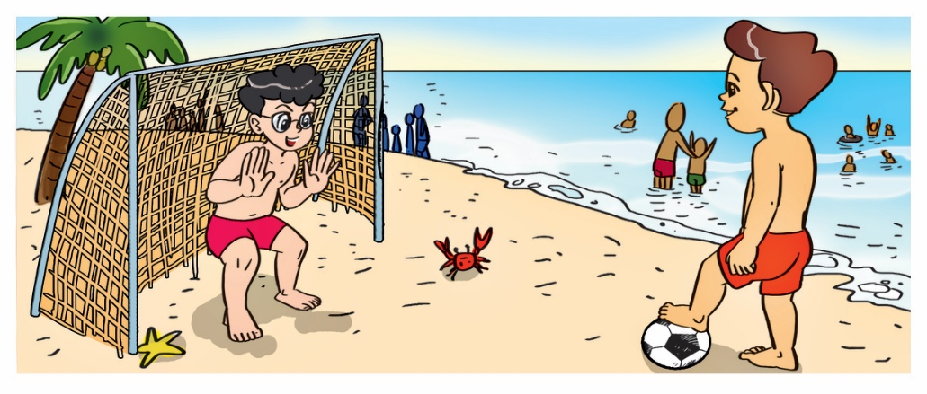
4. Look and write
1. A: Where was Tom yesterday?
B: He was at home. / in the kitchen.
___________.
2. A: Where was Linda yesterday?
B: She was in the library / at school.
_____________.
3. A: Where were Phong and Nam yesterday?
B: They were on the beach.
_________________.

Slide 27


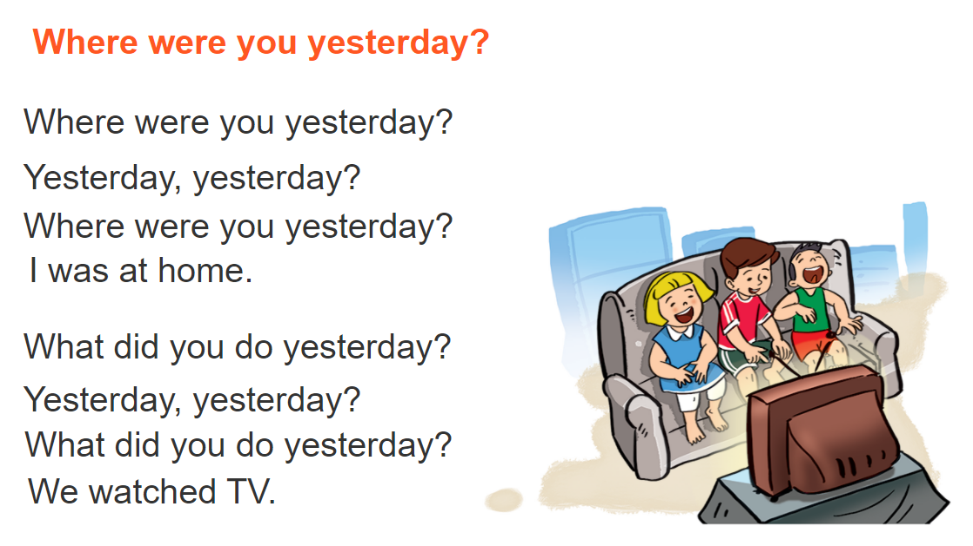

5. Let’s sing

Slide 28

04. HOMELINK

Slide 29
Monday, December 13th 2021
Unit 10: Where were you yesterday?
Lesson 1
1. New words
2. Model sentence:
Where were you yesterday?
I was at school.
At home: ở nhà
At the zoo: ở sở thú
On the beach: ở bãi biển
Yesterday: ngày hôm qua
At the school library: ở thư viện trường
3. Homework:
New words x 2 lines.
Do WB: part C- 1,2 (page 41)
part E – 1,2 (page 42)

