Slide 1
Unit 10
When will
Sports Day be?
Lesson 1

Slide 2
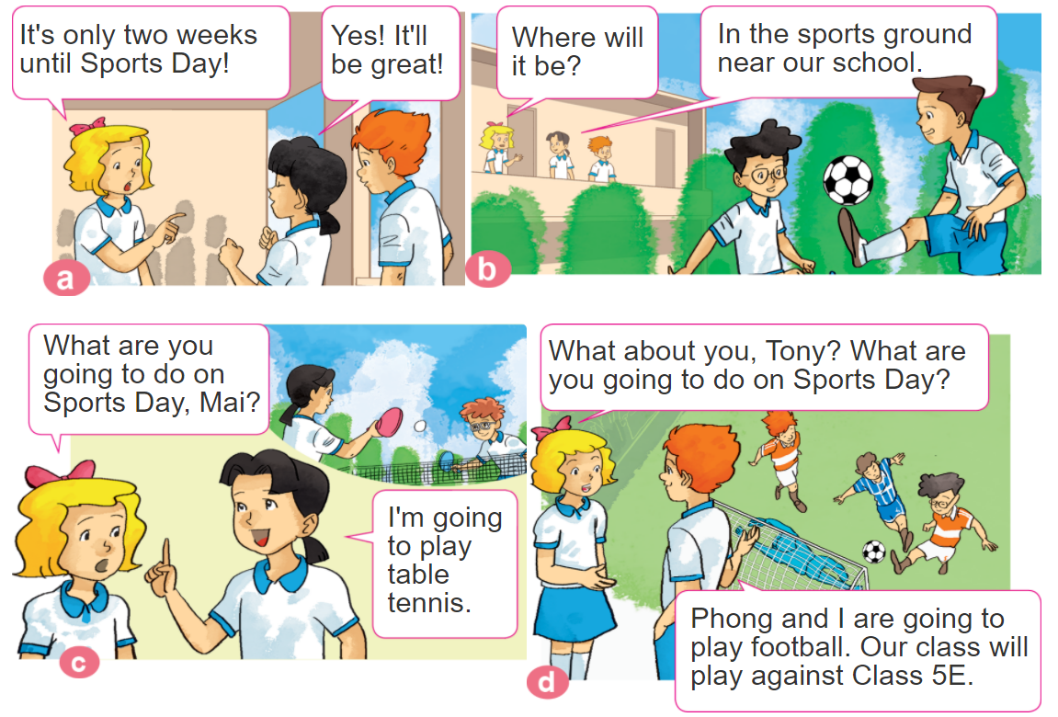

1. Look, listen and repeat.

Slide 3
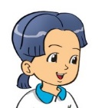
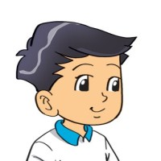
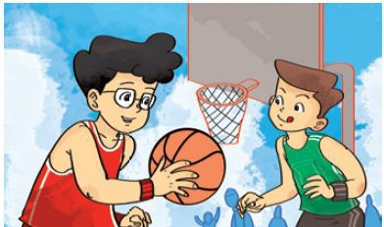
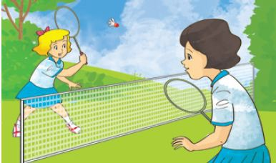
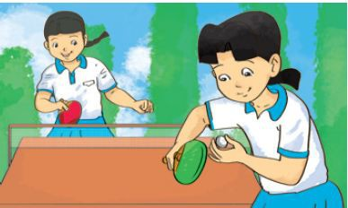
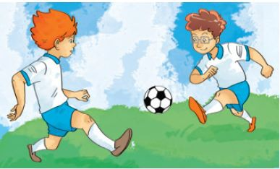
2. Point and say
What are you going to do on Sports Day?
I'm going to _________.
play
basketball
play badminton
play
table tennis
play
football

Slide 4


B. Grammar
Hỏi và đáp bạn sẽ làm gì:
(Bạn sẽ làm gì vào ngày hội thể thao?)
What are you going to do on Sports Day?
I'm going to _________.
+ hoạt động
(Tớ sẽ ______)

Slide 5

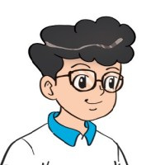


3. Let’s talk
When will Sports Day be?
It'll be on ________
What are you going to do?
I'm going to ______.

Slide 6





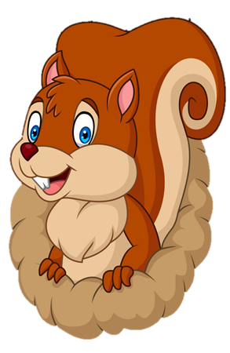
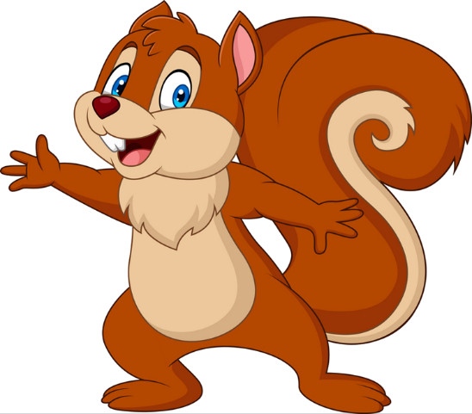
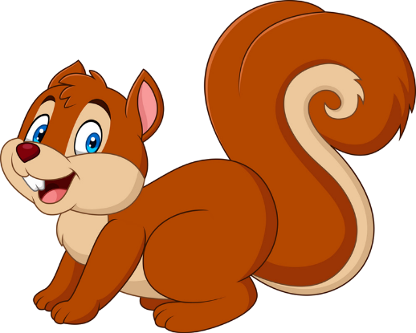
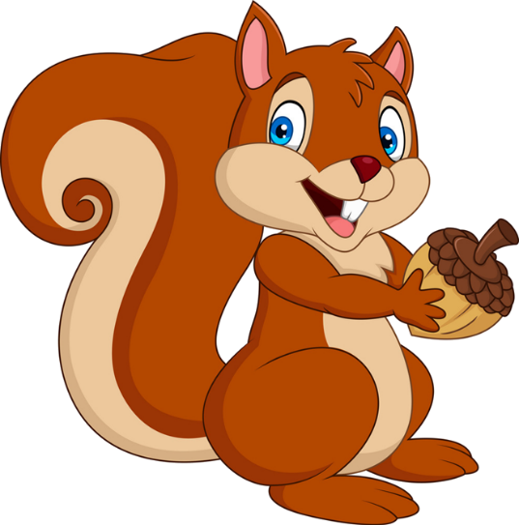


PLAY
NEXT
Brown squirrel
& acorn

Slide 7


What do you think of Tam?
I think _________.
She’s kind.
She’s intelligent.
farm
zoo

Slide 8
What do you think of An Tiem?
I think _________.
He’s hard-working.
She’s hard-working.
farm
zoo

Slide 9
What do you think of Snow White?
I think _________.
She’s greedy.
She’s kind.
farm
farm

Slide 10
What do you think of the mouse?
I think _________.
She’s intelligent.
It’s intelligent.
farm
farm

Slide 11
What _____ you think of the older brother?
I think he’s greedy.
does
do
farm
zoo

Slide 12
What do you think of An Tiem?
I ______ he’s kind.
think
think of
Next
farm
zoo

Slide 13
What do you think ____ Cam?
I think she’s not kind.
about
of
farm
zoo

Slide 14
What do you think of the older brother?
I think _________.
He’s greedy.
He’s kind.
Next
farm
zoo

Slide 15


Good job!

Slide 16
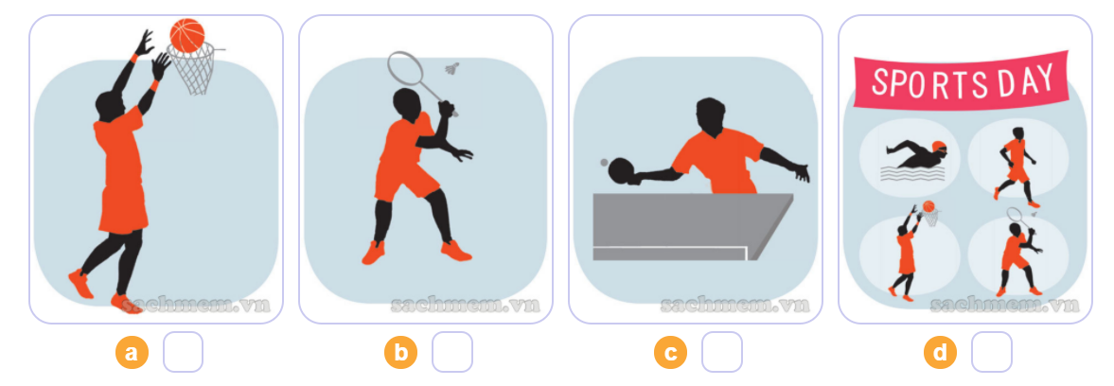
4. Listen and circle a or b.
4
2
3
1
1
2
3
4

Slide 17
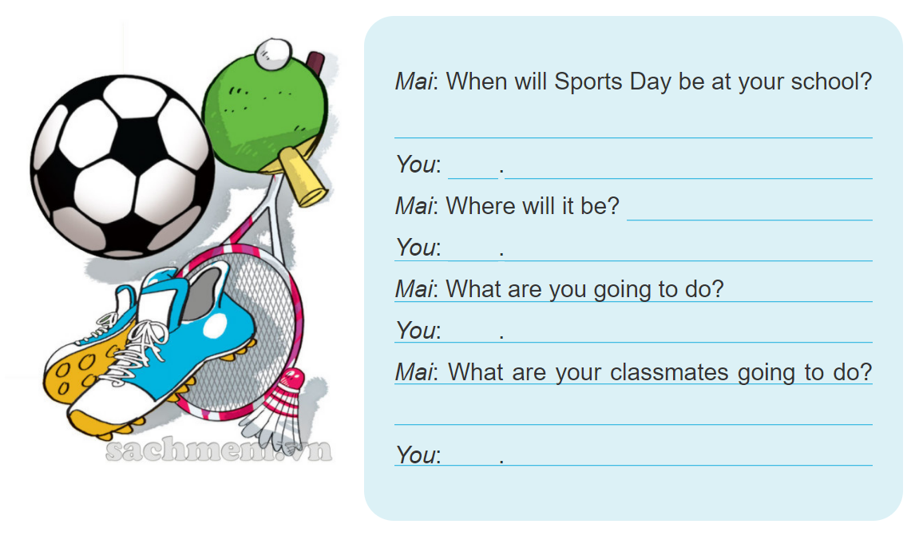
5. Write about you.

Slide 18
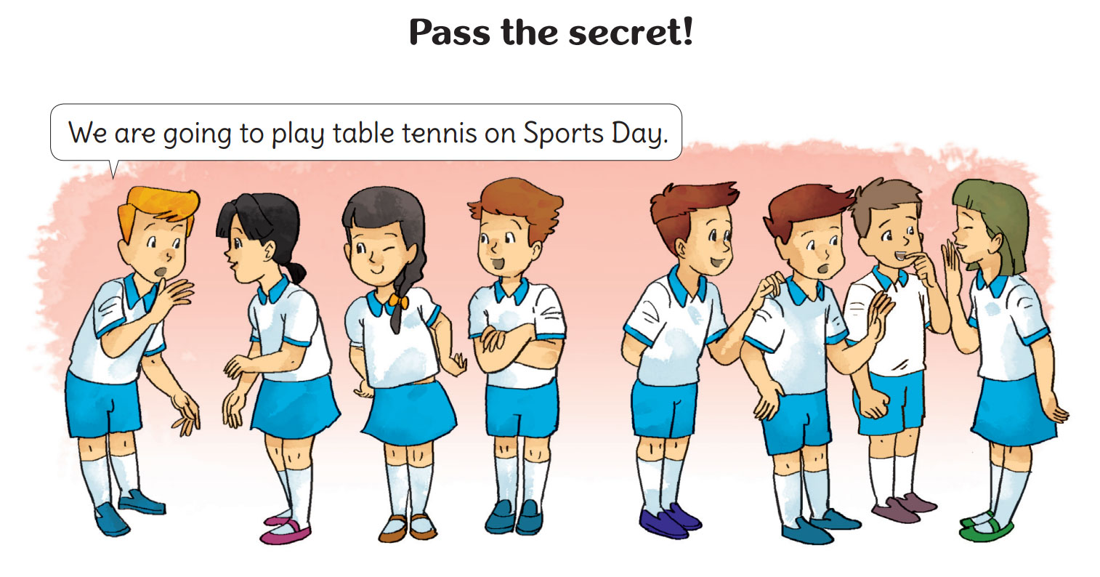
6. Let’s play

