Slide 1








Welcome to our class
Book: Englis 3
Teacher: Miss Linh

Slide 2




Unit 9:
What colour is it?
Lesson 3

Slide 3



01
Review the words about colour.
03
02
Learn the new phonics “i” and “o”.
Review the sentences to ask about colour.

Slide 4

Warm-up
Play
game

Slide 5








Is this your rubber?
Yes, is it.
Yes, it is.
Yes, this is.

Slide 6
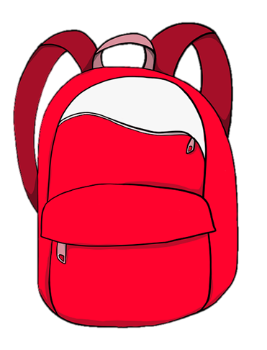
What colour is your____?
school bag
pencil
rubber

Slide 7

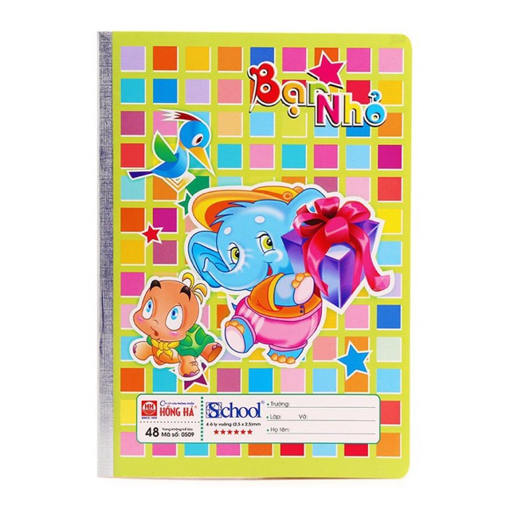
Thanh Am Primary School
Is that your book?
No, I.m not.
No, it not.
No, it isn’t.

Slide 8
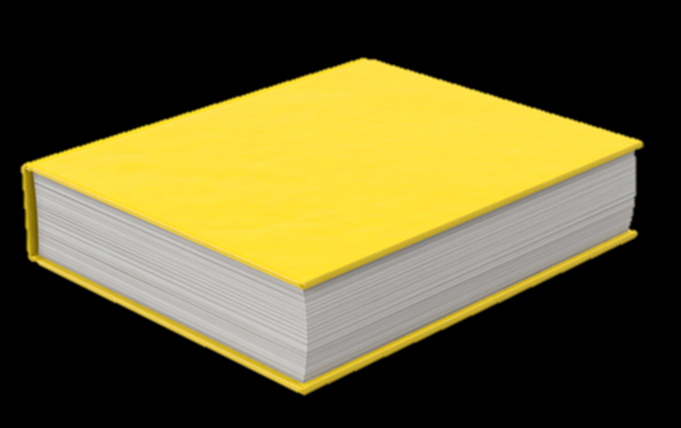
______ are your books?
What colour
What colours
What

Slide 9

What colour ____ your pencil case?
is
are
isn’t

Slide 10


What colour are your ____?
ruler
rulers
the rulers

Slide 11

What colour ___ your pen?
is
are
do

Slide 12

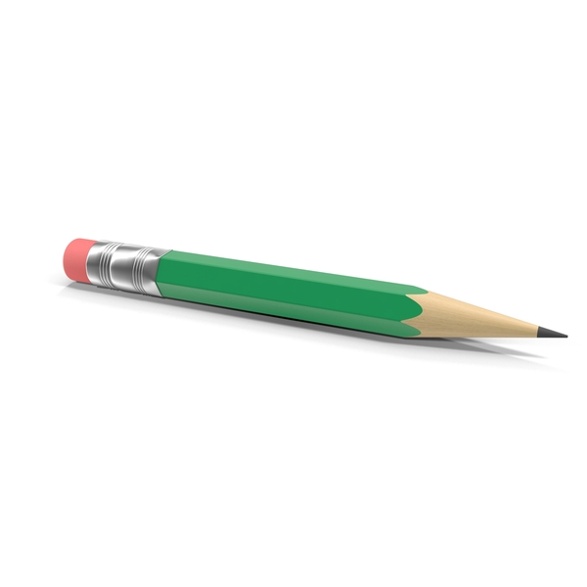
Thanh Am Primary School
It’s green.
What colour
are your pencils?
Is this
your pencil?
What colour
is your pencil?

Slide 13

What colour is your ____?
desks
desk
box

Slide 14
What colour is your desk?
It’s brown
It’s black
It’s blue

Slide 15
PHONICS
“i” and “o”

Slide 16
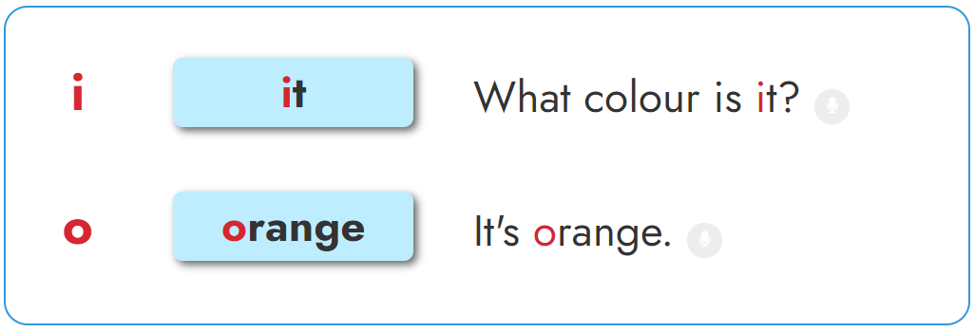



1. Listen and repeat.

Slide 17


Slide 18
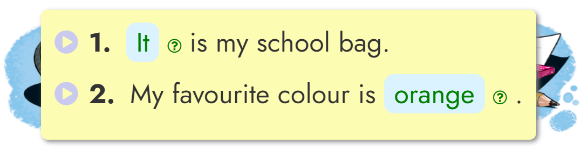

2. Listen and write.
_______
It
__________________
orange

Slide 19
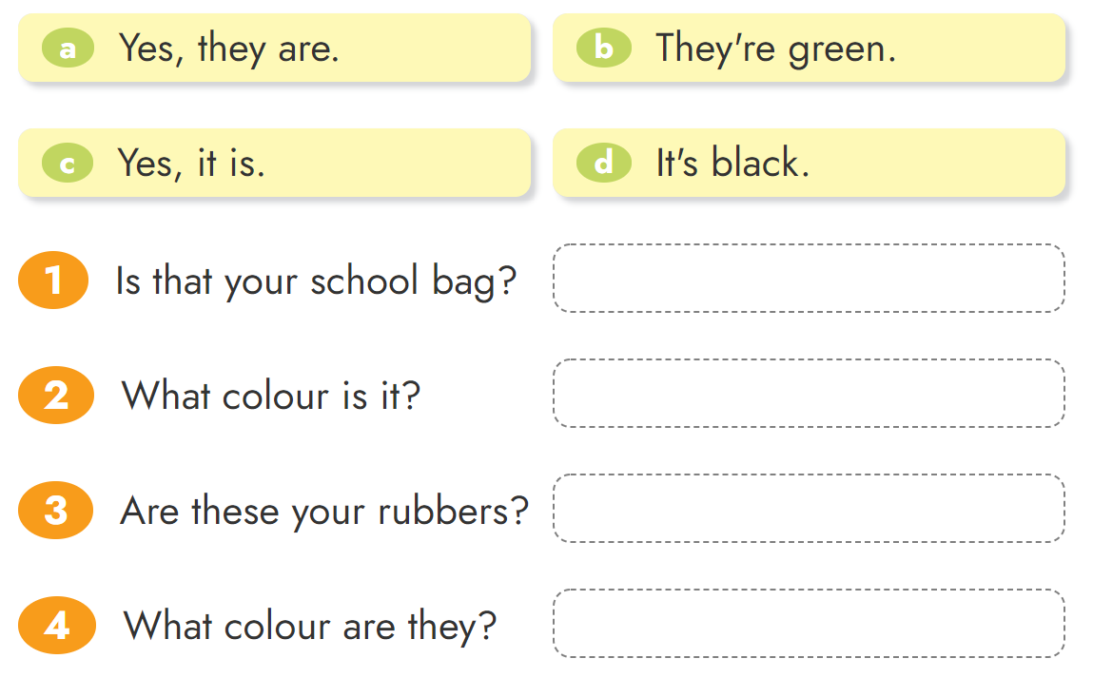

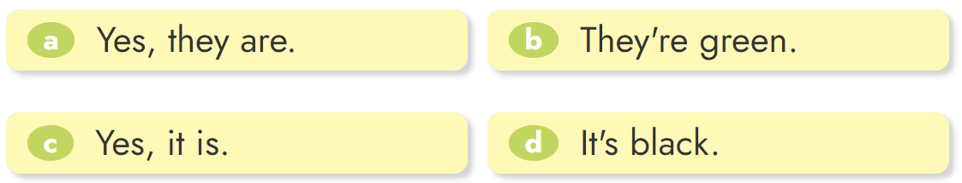
4. Read and match.

Slide 20
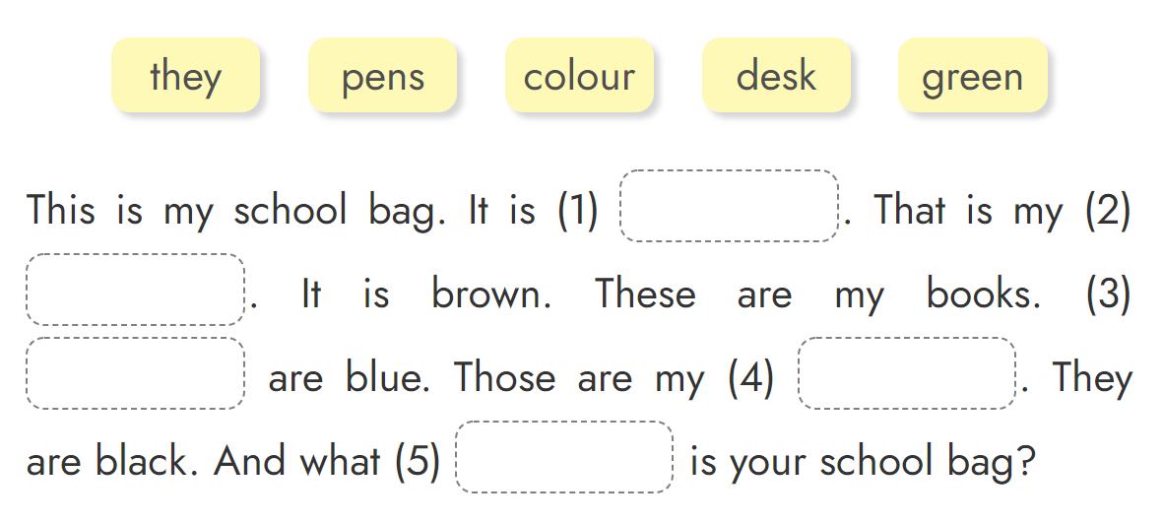
5. Read and complete.
green
desk
They
pens
colour

Slide 21

Review the new phonics
“i” and “o”
01
02
Do the homework:
Page 38 - 39
03
Prepare: Unit 10 - Lesson 1

Slide 22


Thursday, December 9 2021
Unit 9: What colour is it? - Lesson 3
1. Phonics
- phonic “i” : it -> What colour is it?
- phonic “o” : orange -> It’s orange.
2. Homework
- Do WB : Page 38 - 39
- Prepare: Unit 10 - Lesson 1
th

Slide 23



THANK YOU

