Slide 1

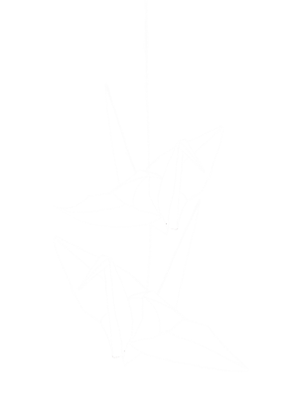
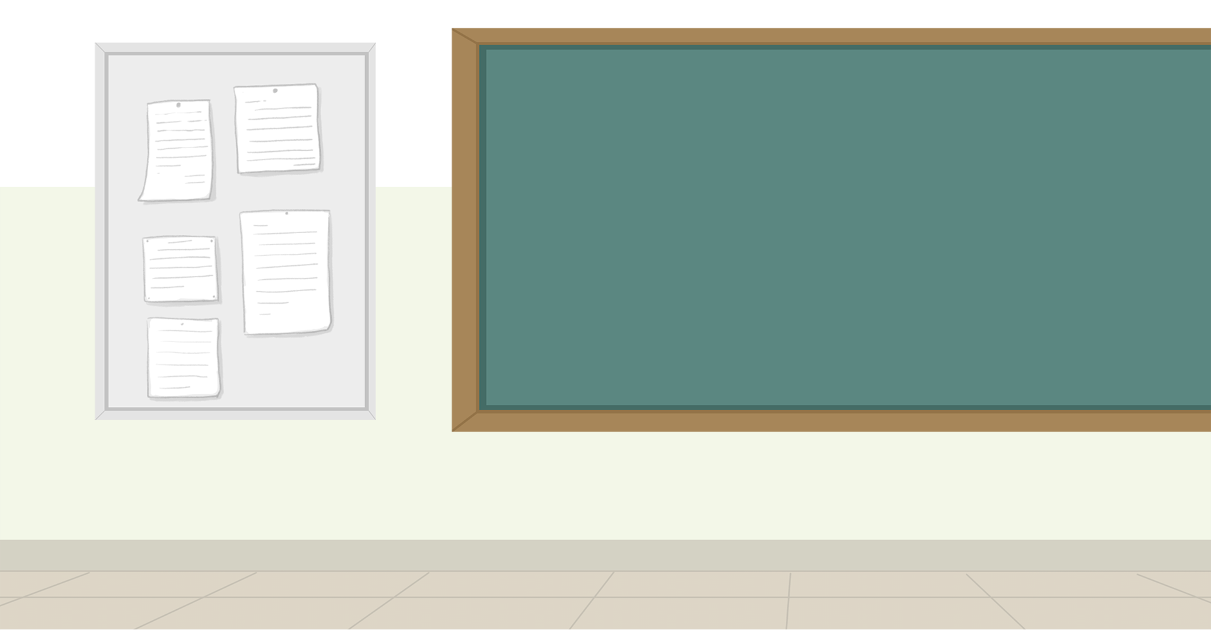




Welcome
to our Class!
Book: English 3
Teacher: Miss Linh

Slide 2


Lesson 2
Unit 9:
What colour is it?

Slide 3
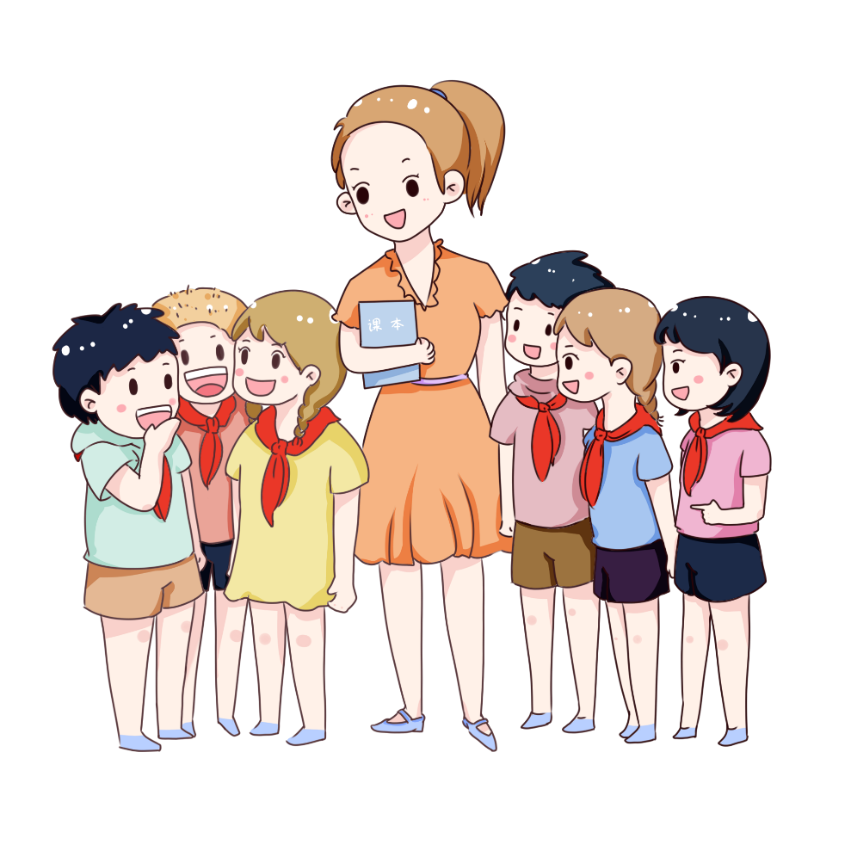
Objectives
Review the words and sentences.
Ôn tập lại từ vựng và mẫu câu.
Learn the words about colours.
Học từ mới về chủ đề màu sắc.
Learn the sentence to ask (colours).
Học từ mẫu câu hỏi về màu sắc.

Slide 4






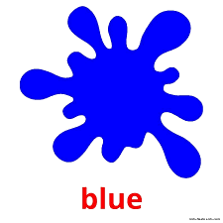





Colours

Slide 5

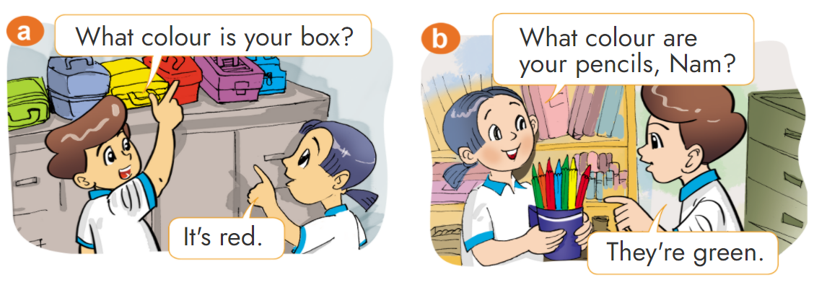

1. Look, listen and repeat.

Slide 6
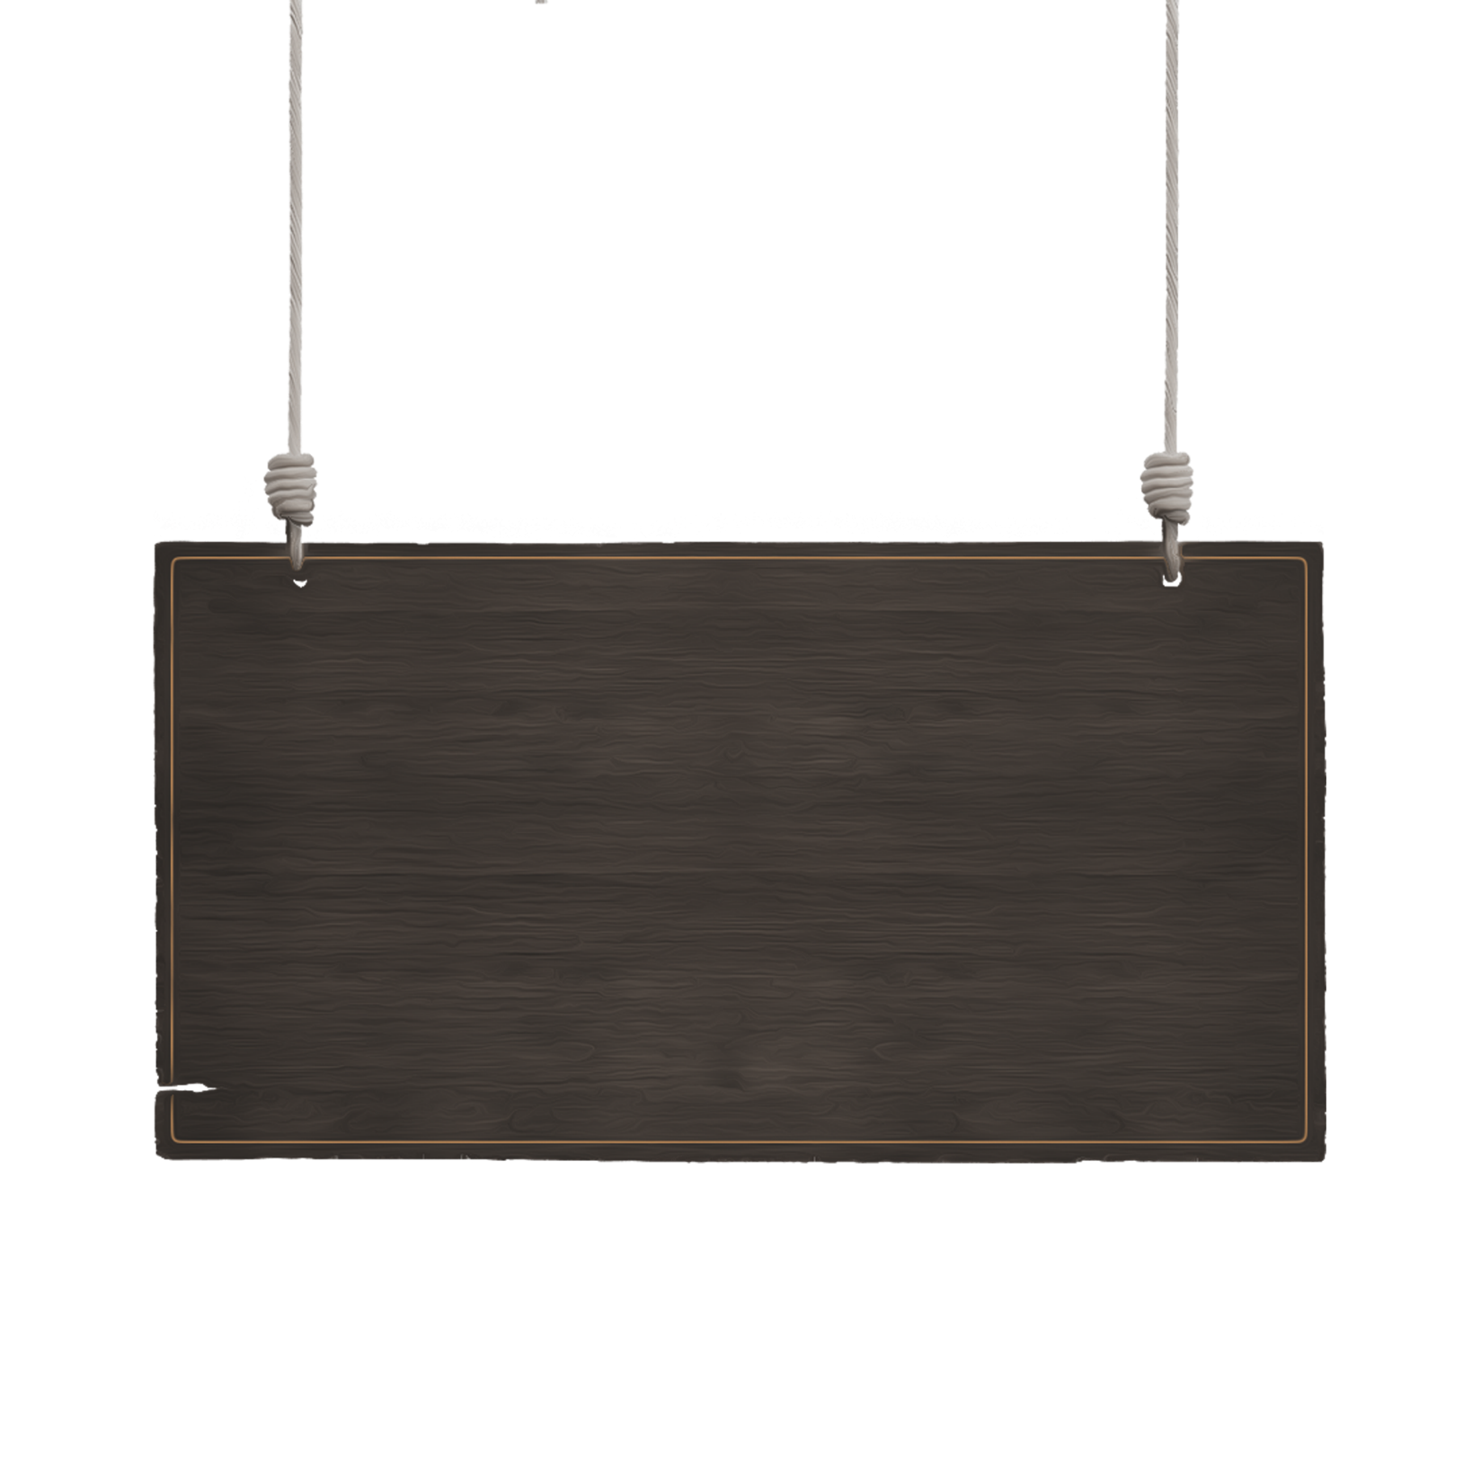

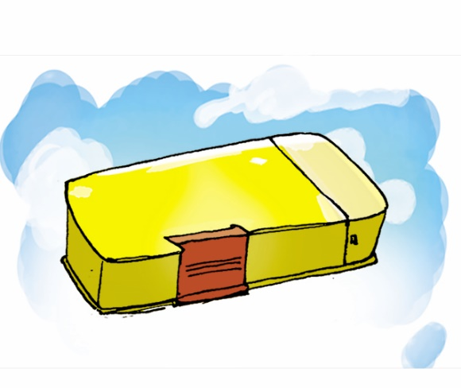


2. Point and say
What colour is your ________?
It's ____________.
pencil case,
yellow
pen, blue
ruler, white

Slide 7
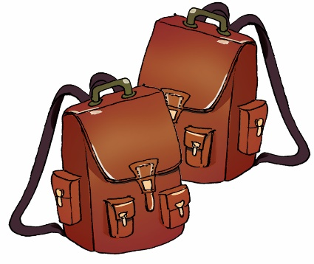
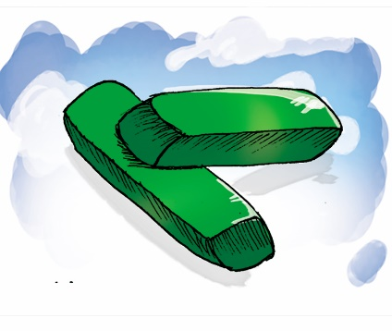

What colour are your ______?
They’re ____________.
school bags,
brown
rubbers,
green
notebooks,
orange

Slide 8
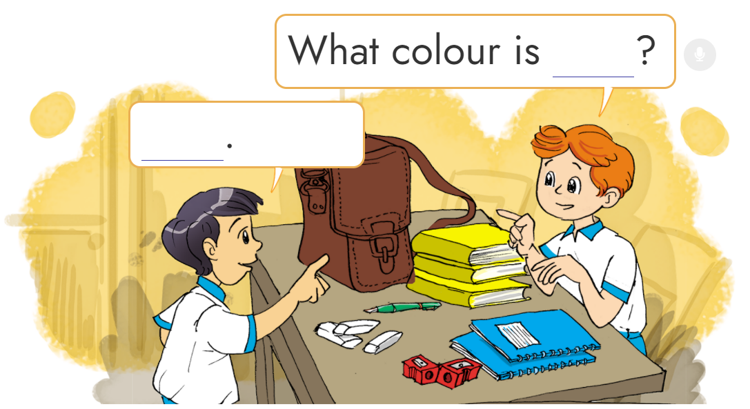
3. Let’s talk
1
6
3
2
4
5

Slide 9
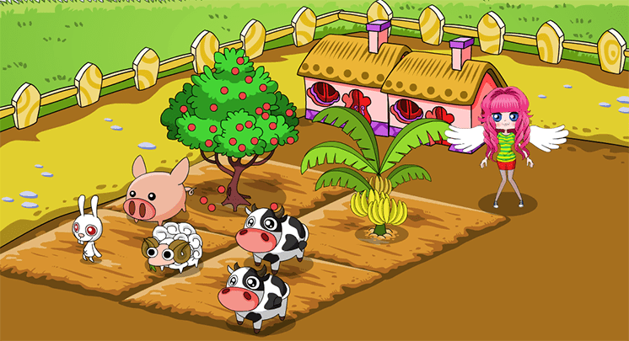


FARM
FAMILY

Slide 10
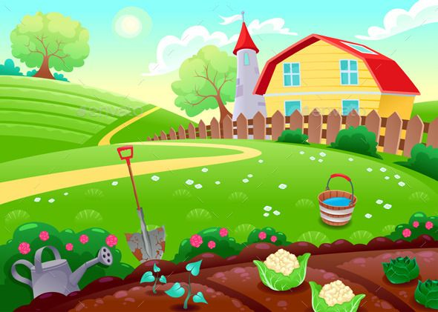




















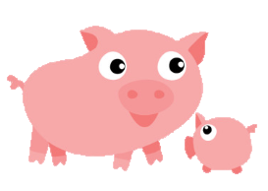



Slide 11



What colour are your school bags?
They’re yellow.

Slide 12
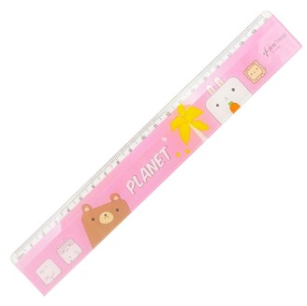
What colour is your ruler?
It’s pink.

Slide 13

What colour are your pens?
They’re red.

Slide 14
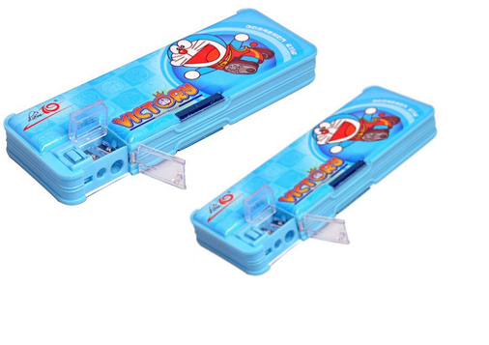
What colour are your pencil cases?
They’re blue.

Slide 15

What colour are your pencils?
They’re purple.

Slide 16
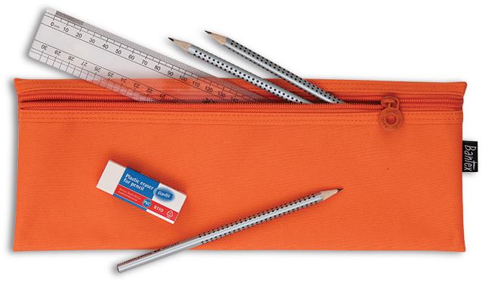
What colour is your pencil case?
It’s orange.

Slide 17

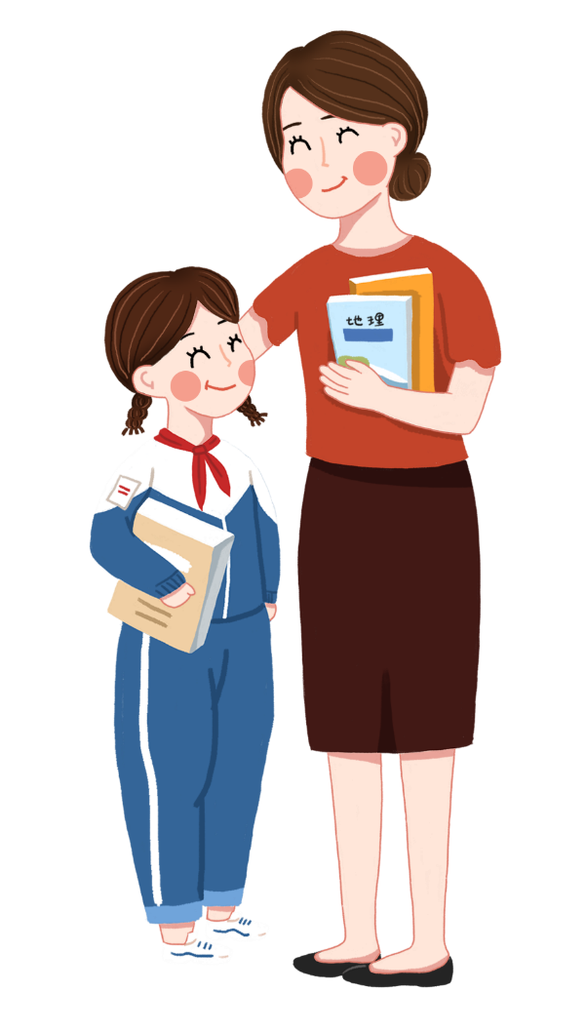
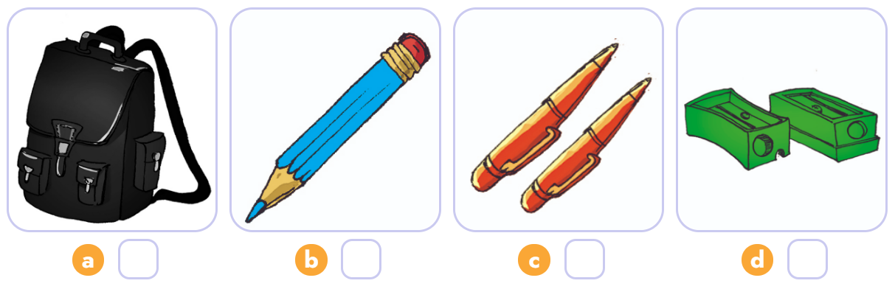

4. Listen and number.
3
2
4
1
1
2
3
4

Slide 18

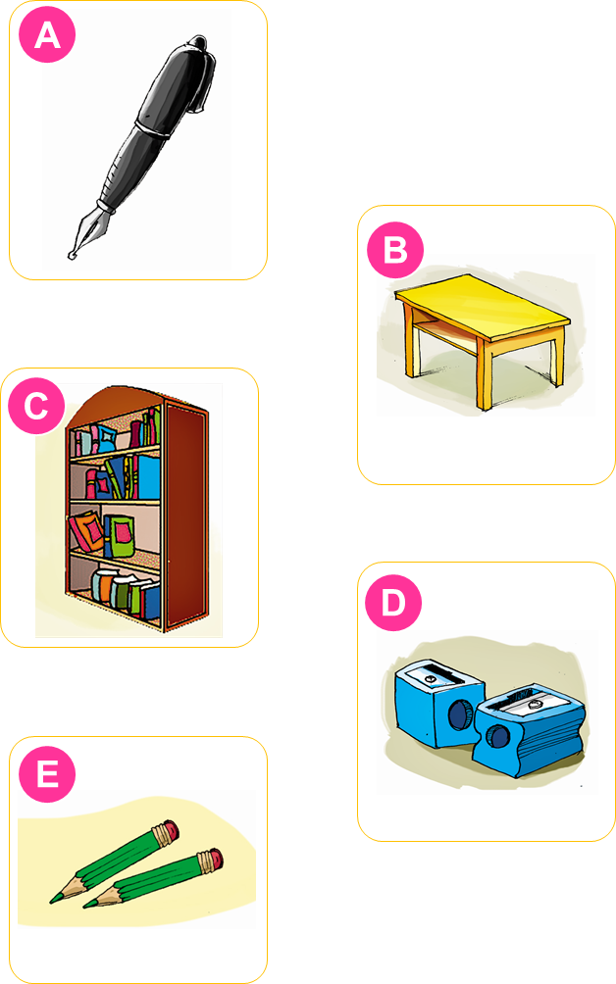

5. Read and match.
This is my desk. It is yellow.
These are my pencil sharpeners. They are blue.
That is my pen. It is black.
Those are my pencils. They are green.
That is my bookcase. It is brown.
1
2
3
4
5

Slide 19
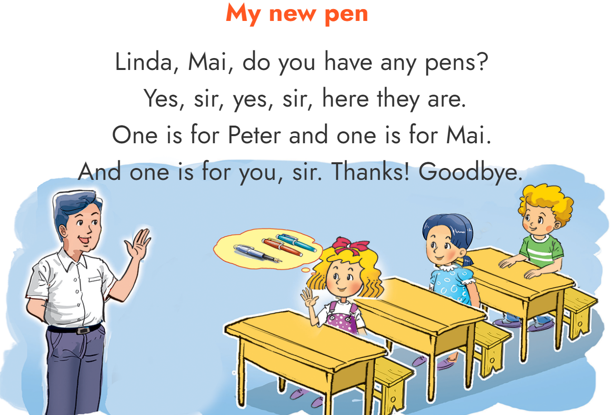
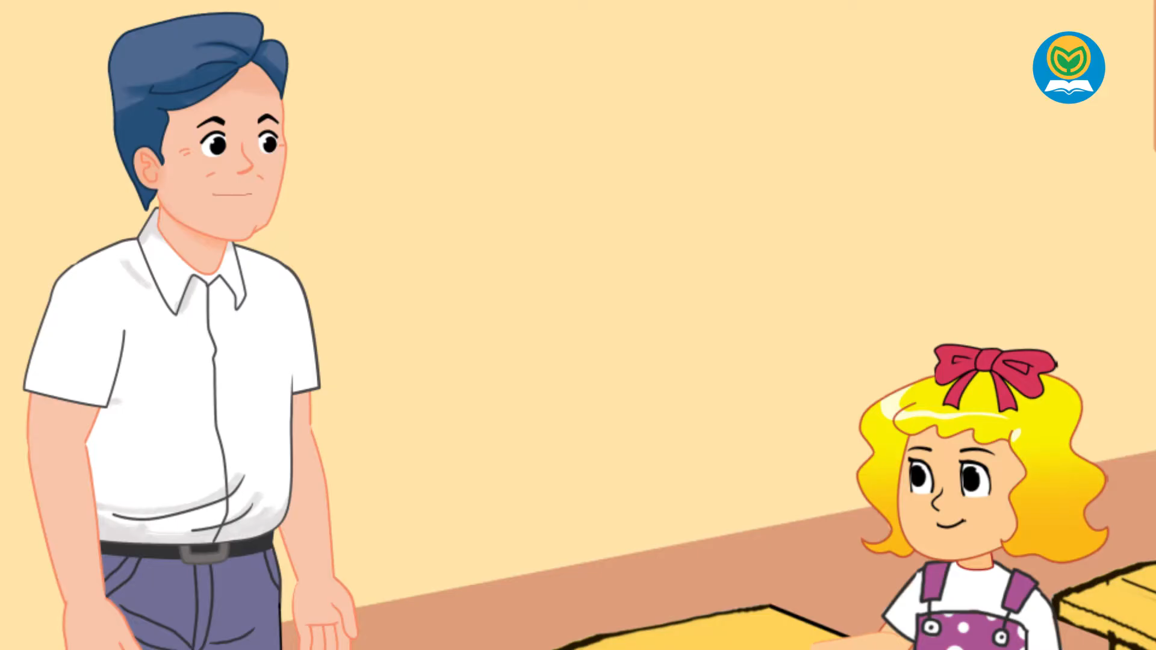

6. Let’s sing.

Slide 20
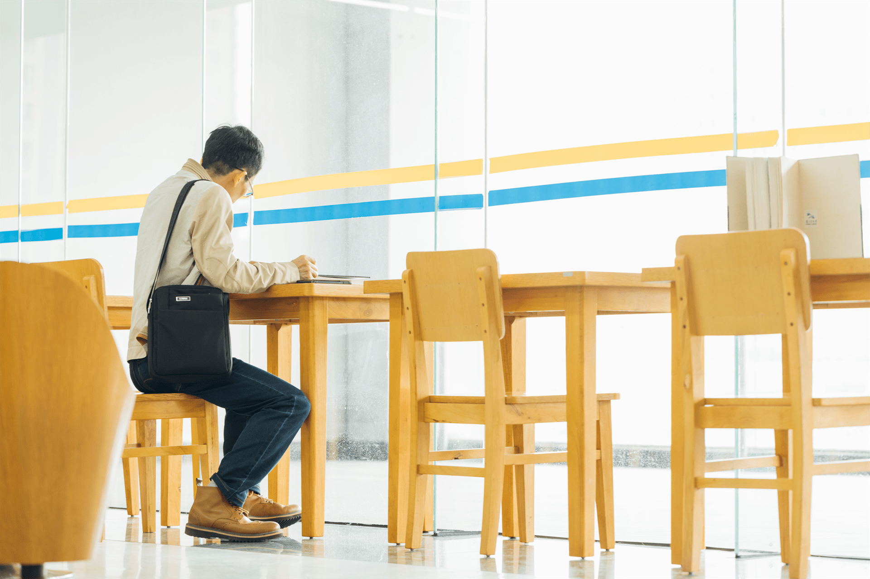
Home link
01
02
03
Review the words and sentences .
Do the homework in WB (SBT): B(1,2,3) page 37
Prepare the new lesson : Unit 9: Lesson 3

Slide 21
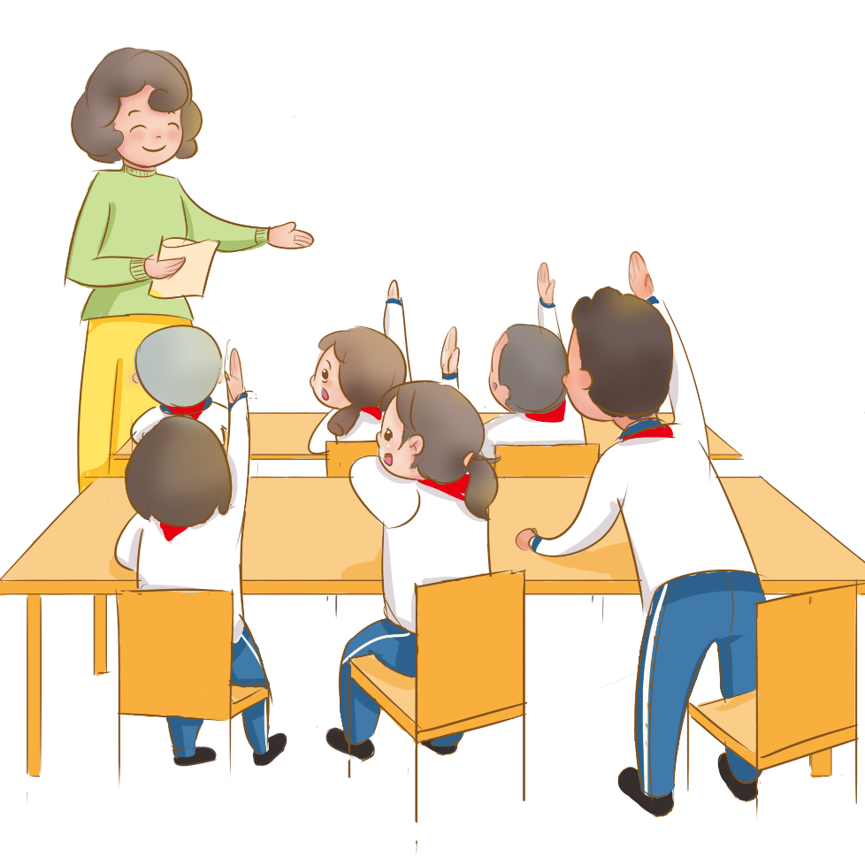
Tuesday, December 7 2021
Unit 9: What colour is it? - Lesson 2
1. New words
- red : đỏ
- yellow : vàng
- pink : hồng
- orange : cam
- blue : xanh nước biển
- green : xanh lá cây
2. Model Sentences
What colour is your .......... (school thing) ?
What colour are your ....... (school things) ?
th
- brown : nâu
- purple : tím
- gray : xám
- white : trắng
- black : đen

Slide 22
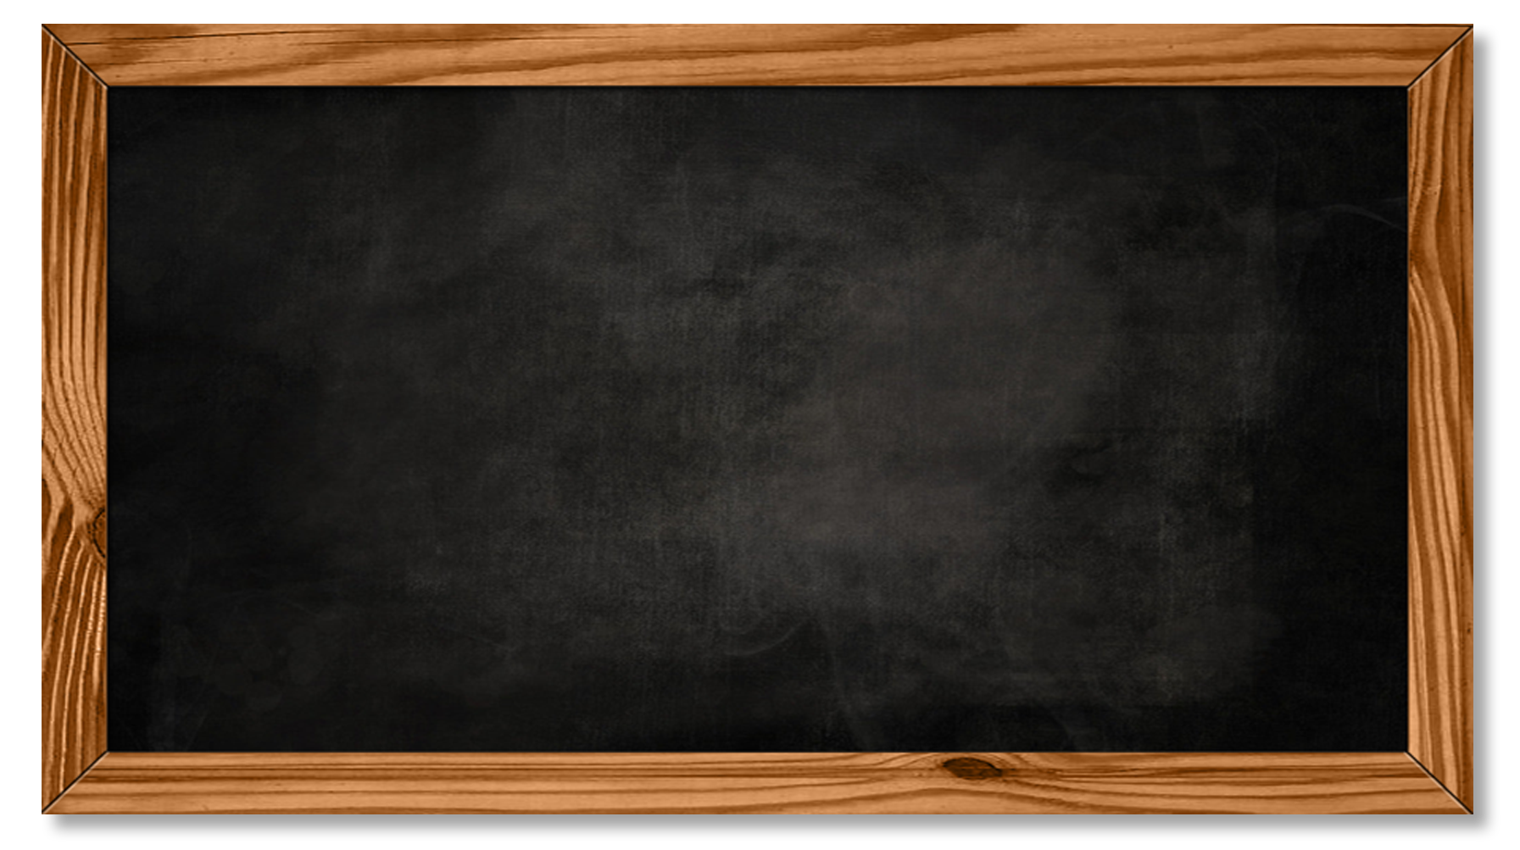

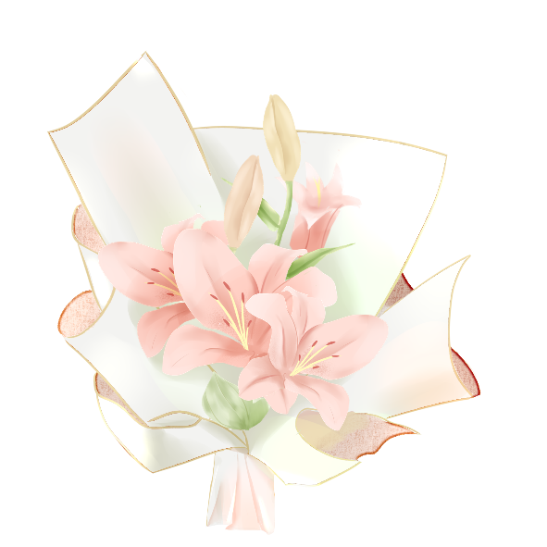
THANK YOU

