Slide 1


WELCOME TO OUR CLASS
Book: English 3
Teacher : Miss Linh

Slide 2


Unit 10
Unit 10
What do you do at break time?
Lesson 2

Slide 3
Objectives
Review the words and sentences.
Learn the new words and new sentences.

Slide 4






VOCABULARY
hide-and-seek
skating
skipping
blind man’s
bluff

Slide 5


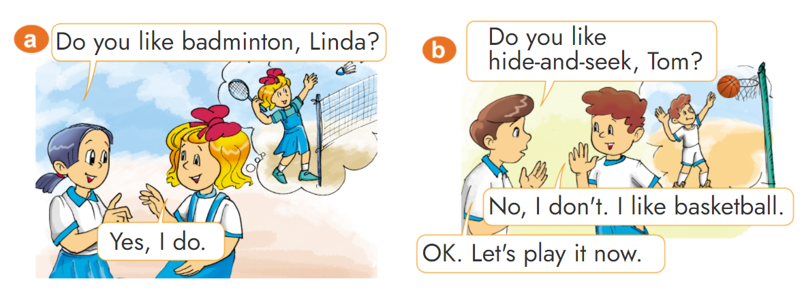

1. Look, listen and repeat.

Slide 6


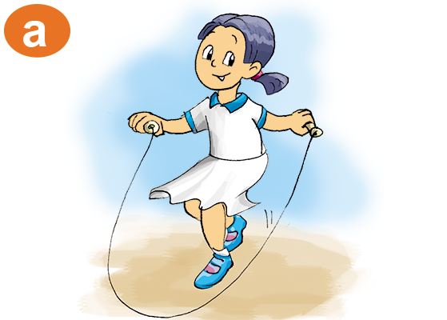
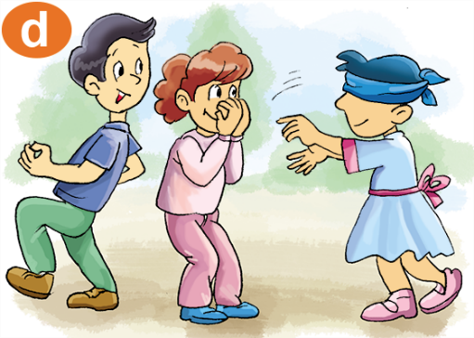
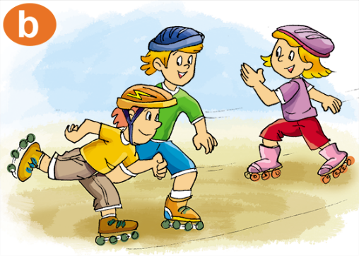
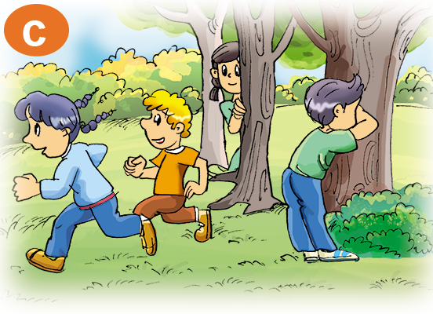
Grammar
Yes, I do.
Do you like________?
(Bạn có thích ____ không?)
No, I don’t.
blind man’s bluff
skipping
skating
hide-and-seek

Slide 7





Game
Who is faster?

Slide 8












Well done
Well done

Slide 9



Blind man’s bluff
Do you like ________?
Yes, I do.

Slide 10
skating
Do you like ________?

Slide 11
skipping
Do you like ________?

Slide 12
No, I don’t.
What do you like hide-and-seek?

Slide 13
Yes, I do.
Do you like skipping?

Slide 14


hide-and-seek
Do you like ________?

Slide 15
No, I don’t.
Do you like blind man’s bluff?

Slide 16
skating
Do you like ________?

Slide 17
Yes, I do.
Do you like skating?

Slide 18
skipping
Do you like ________?
Yes, I do.

Slide 19

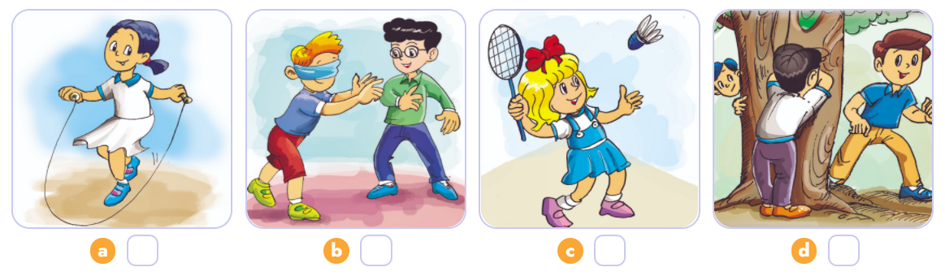


4. Listen and number.
4
2
1
3
1
2
3
4

Slide 20
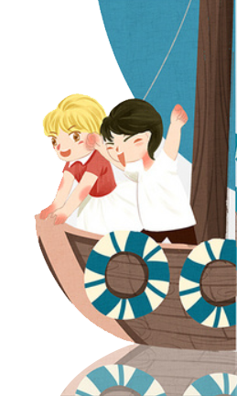
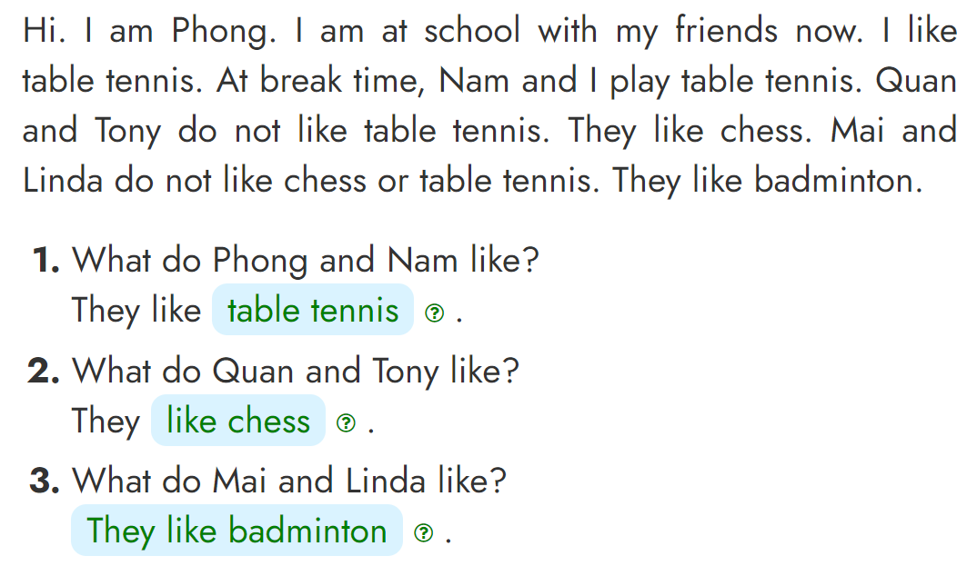
5. Read and write.
table tennis
------------------
like chess
------------------
They like badminton
------------------

Slide 21



Home link
02
03
01
Using the words and
sentences in real life
Do homework :
B (1,2,3) - Page 41
Prepare : Unit 10
Lesson 3

Slide 22

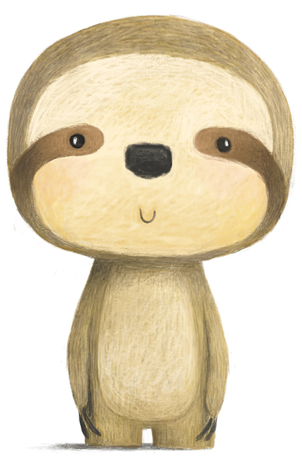
Thursday, December 16 2021
Unit 10: What do you do at break time? - Lesson 1
1. New words
- skipping : nhảy dây
- skating : trượt pa - tanh
- hide - and - seek : trốn tìm
- blind man’s bluff : bịt mắt bắt dê
2. Model Sentences
Do you like skipping?
-> Yes, I do. / No, I don’t.
3. Homework
th

Slide 23


THANK YOU

