Slide 1


Welcome to
our class
Book: English 3
Teacher: Miss Linh

Slide 2
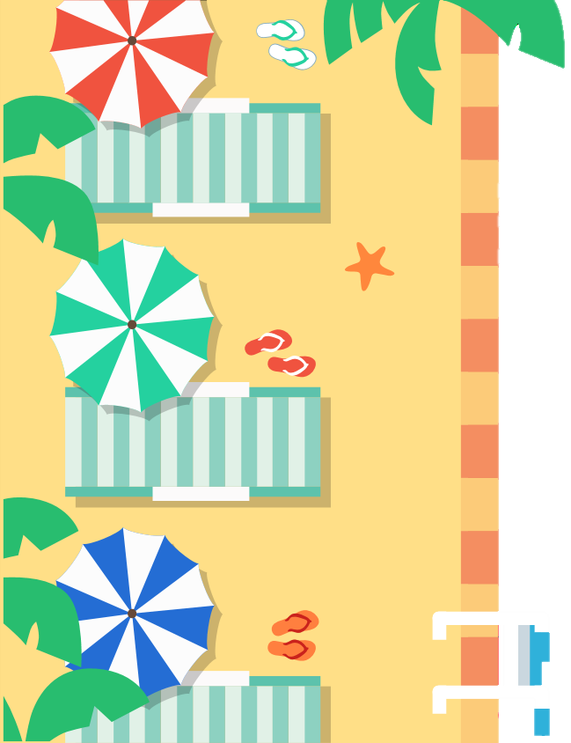



Unit 10:
What do you do at
break time?
Lesson 1

Slide 3



objectives
Learn the new sentence.
“What do you do at break time?
Review the last Unit
(words and sentences)
Learn the new words about sports.

Slide 4
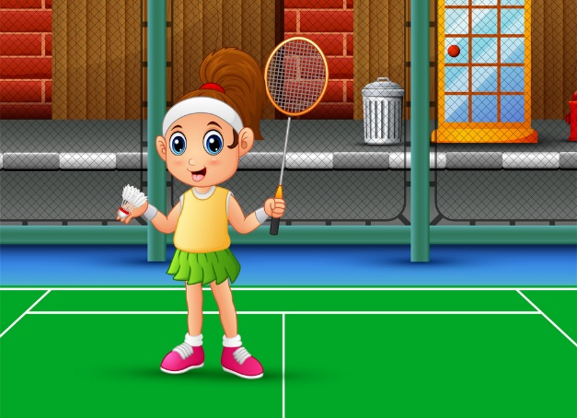

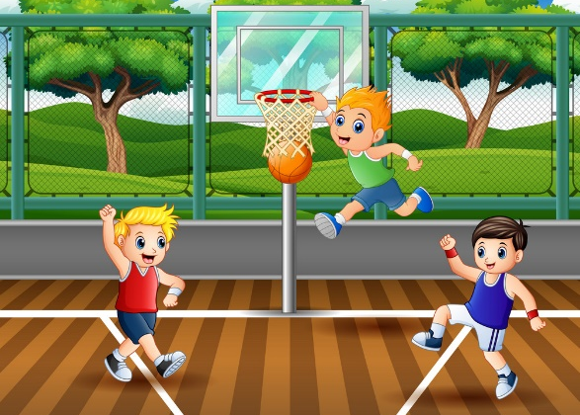
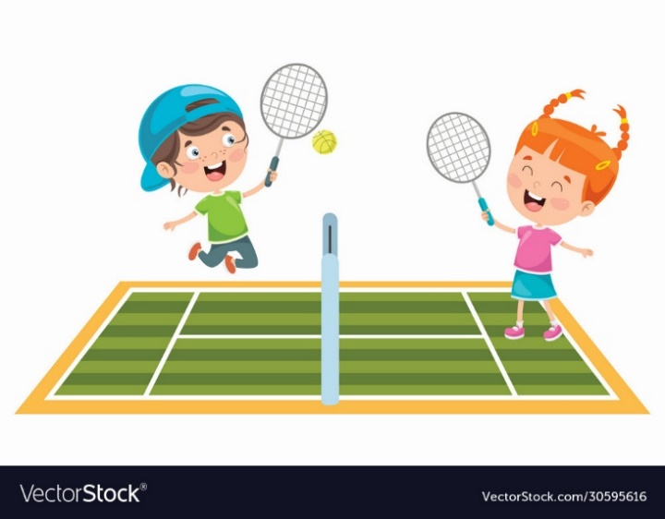
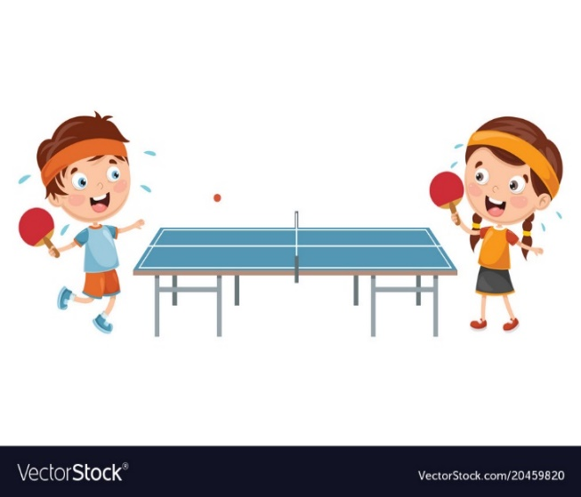
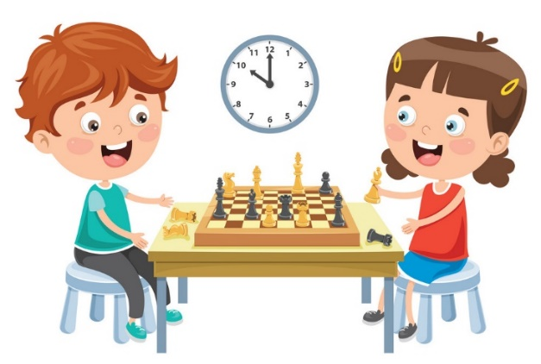
New words
football
badminton
basketball
tennis
table tennis
chess

Slide 5


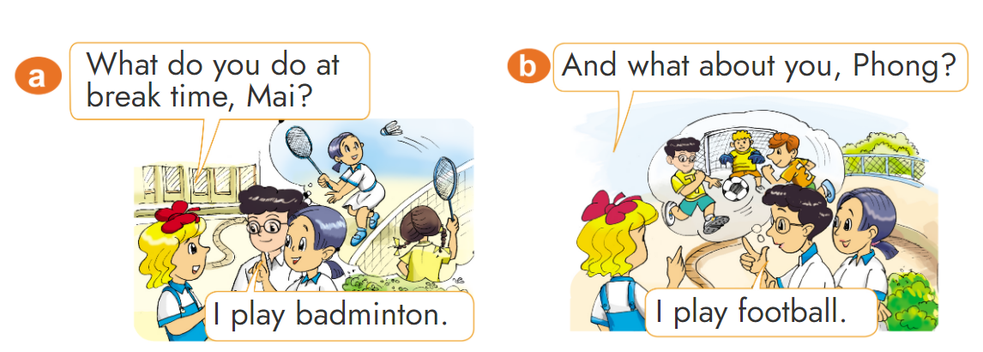
1. Look, listen and repeat.

Slide 6




GRAMMAR

Slide 7
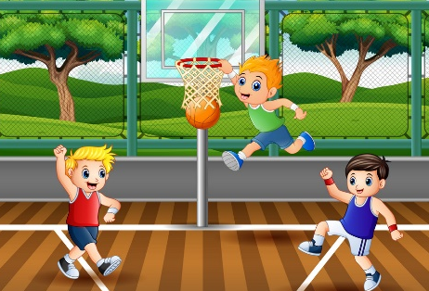




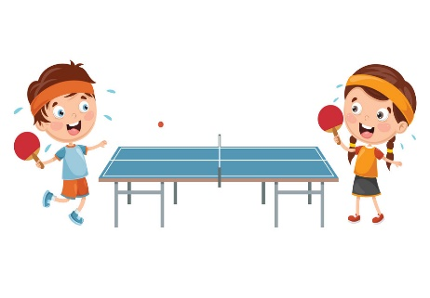
Structure
What do you do at break time?
(Bạn làm gì vào giờ ra chơi?)
I play _______.
(Tớ chơi _____.)
basketball
chess
tennis
badminton
table tennis
football

Slide 8
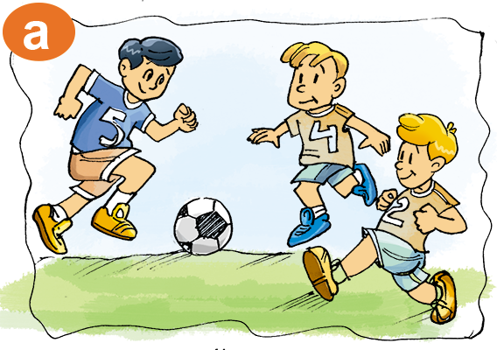



What do you do at break time?
I play football.

Slide 9
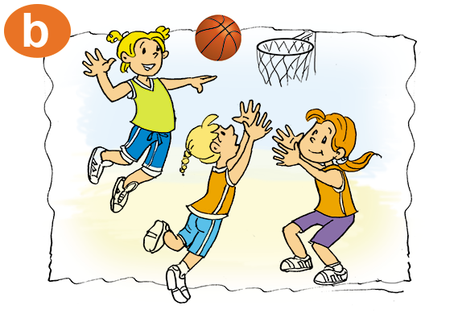

What do you do at break time?
I play basketball.

Slide 10
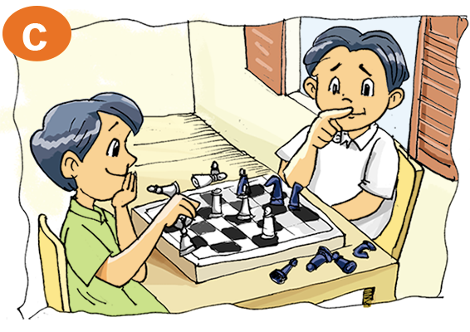

What do you do at break time?
I play chess.

Slide 11
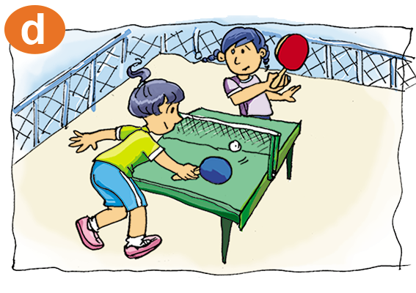

What do you do at break time?
I play table tennis.

Slide 12
















Cloud Garden

Slide 13








What do you do at break time?
I play tennis.
I play table tennis.
A.
B.
I play badminton
I play football.
C.
D.

Slide 14

What do you do at break time?
I play basketball.
I play football.
A.
B.

Slide 15

What do you do at break time?
I play tennis.
I play basketball.
A.
B.
I play table tennis.
I play chess.
C.
D.

Slide 16

What do you do at break time?
I play badminton.
I play football.
A.
B.
I play table tennis.
I play tennis.
A.
B.

Slide 17

What do you do at break time?
I play badminton.
I play chess.
A.
B.
I play tennis.
I play basketball.
C.
D.

Slide 18
What do you do at break time?
I play tennis.
I’m play tennis.
A.
B.

Slide 19
__________ at break time?
I play football.
What do you do
What do you
A.
B.
What are you do
What’s do you do
C.
D.

Slide 20
What do you do at break time?
I ___ chess.
lay
fly
A.
B.
play
plane
C.
D.

Slide 21

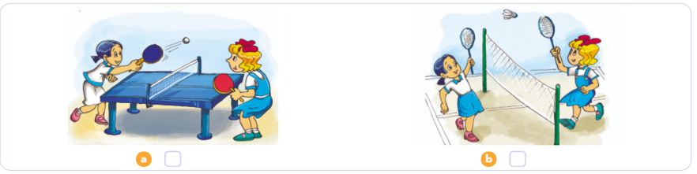
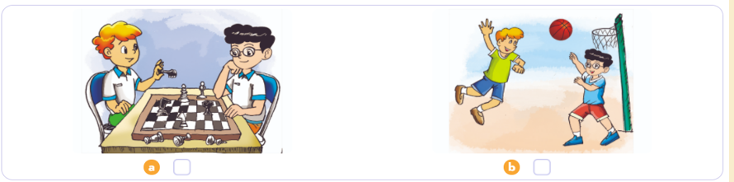

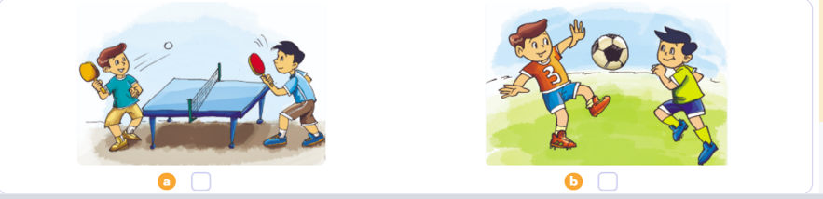
4. Listen and tick
1
2
3

Slide 22
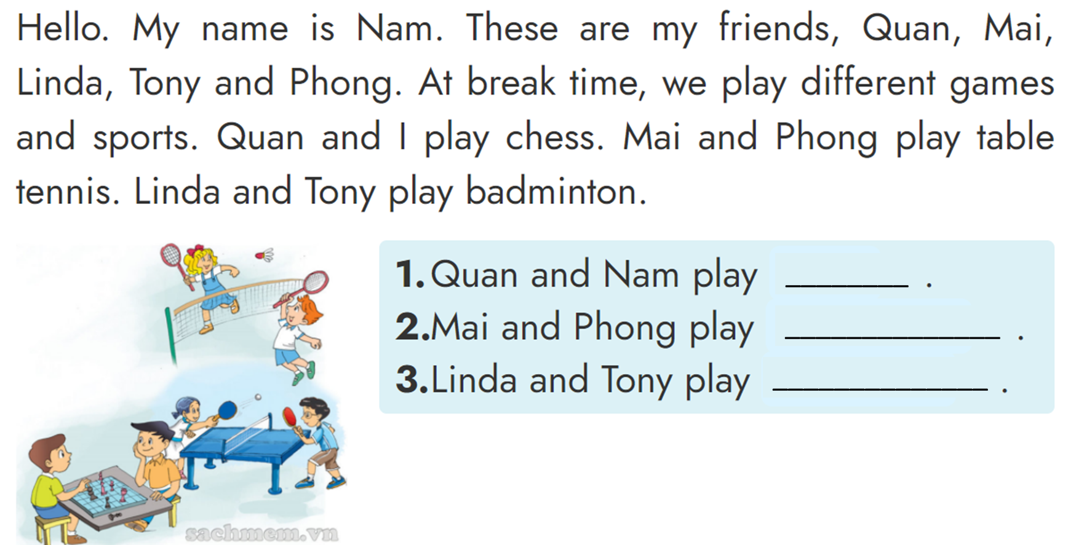
5. Look, read and write.
chess
table tennis
badminton

Slide 23

Using the new words and sentences in the real life.
Prepare : Unit 10 - Lesson 2.
Do homework:
A (1,2,3) - page 40

Slide 24

Tuesday, December 14 2021
Unit 10: What do you do at break time? - Lesson 1
1. New words
- break time : giờ ra chơi
- chess : cờ vua
- tennis : quần vợt
- table tennis : bóng bàn
- badminton : cầu lông
- basketball : bóng rổ
- football : bóng đá
2. Model Sentences
What do you do at break time?
-> I play badminton.
3. Homework
th

Slide 25


THANK YOU

