Slide 1





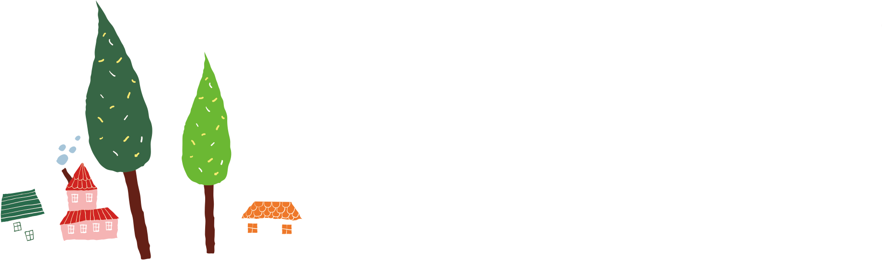
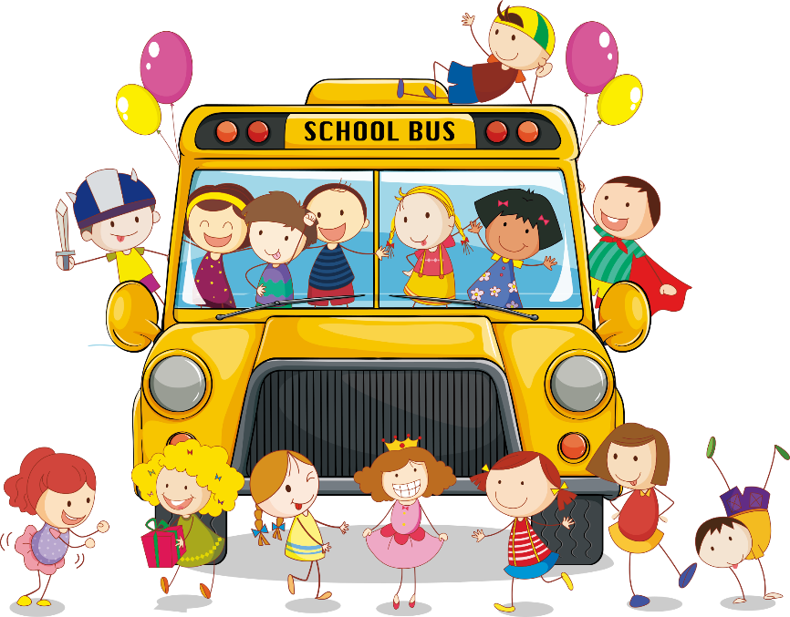
Unit 7: What do you like doing?
Lesson 3
Teacher: Ngoc Khue

Slide 2


Content
01
Warm up
02
Phonics
0 3
Practice
04
Homelink

Slide 3


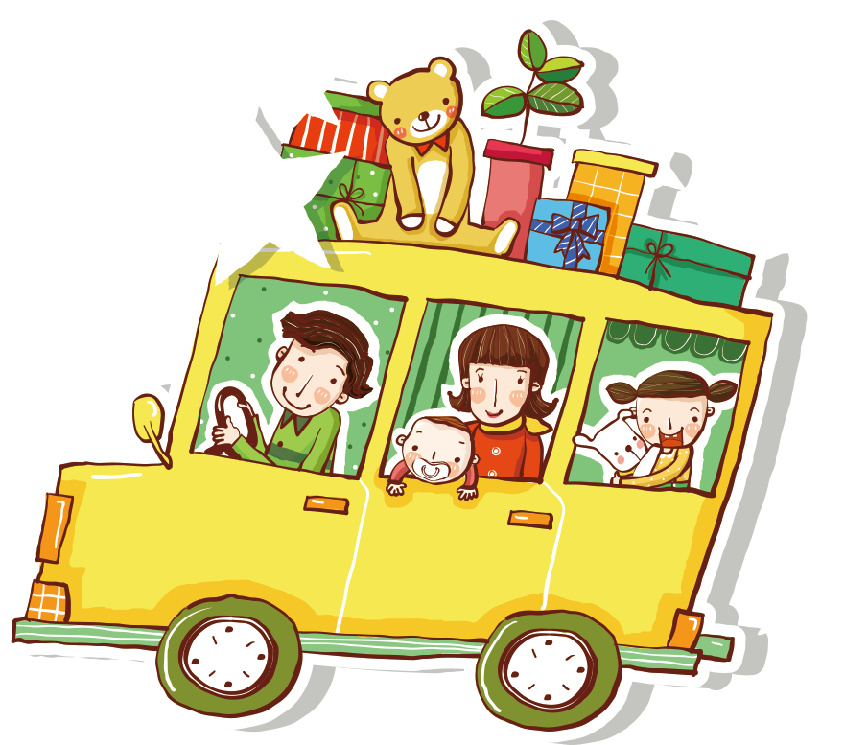
PART 01
Warm Up

Slide 4


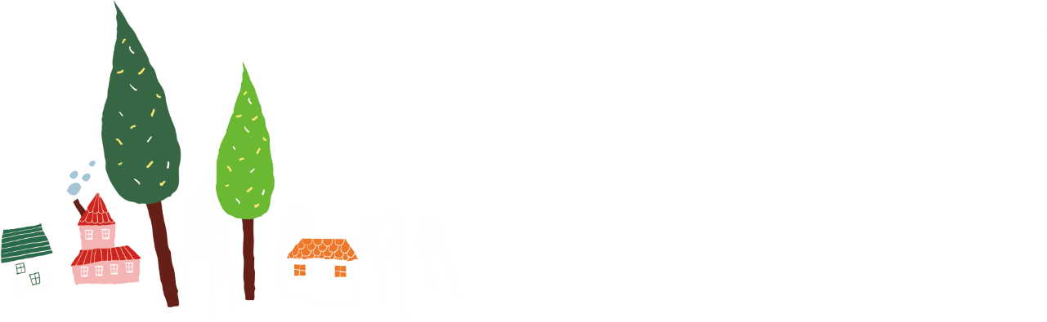
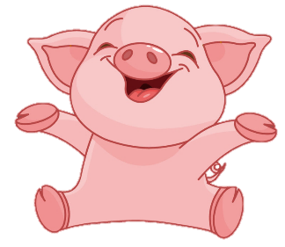
BOMSTAR
PLAY

Slide 5










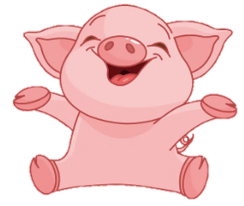

10
10
10
20
20
10
20
20

Slide 6

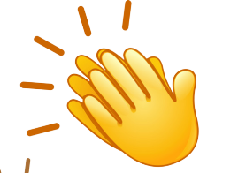
One more turn
Back

Slide 7
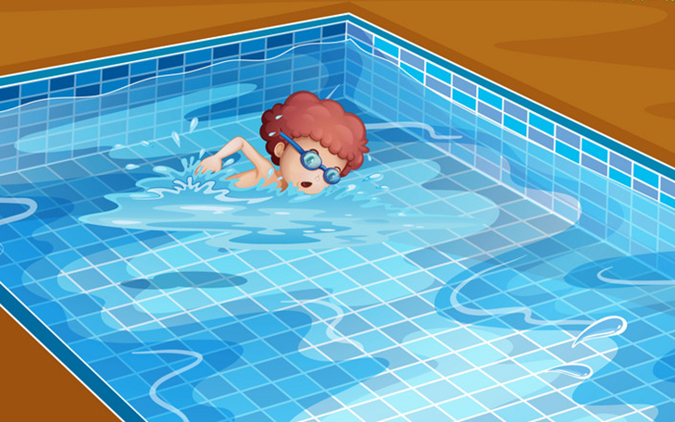


What's your hobby?
Back
I like swimming.
I like swim.
I like go swimming.

Slide 8
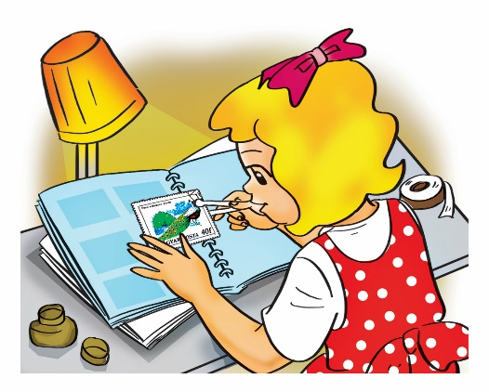
What's your hobby?
Back
I like collect stamps.
I like collecting stamps.
I like to
collecting stamps.

Slide 9
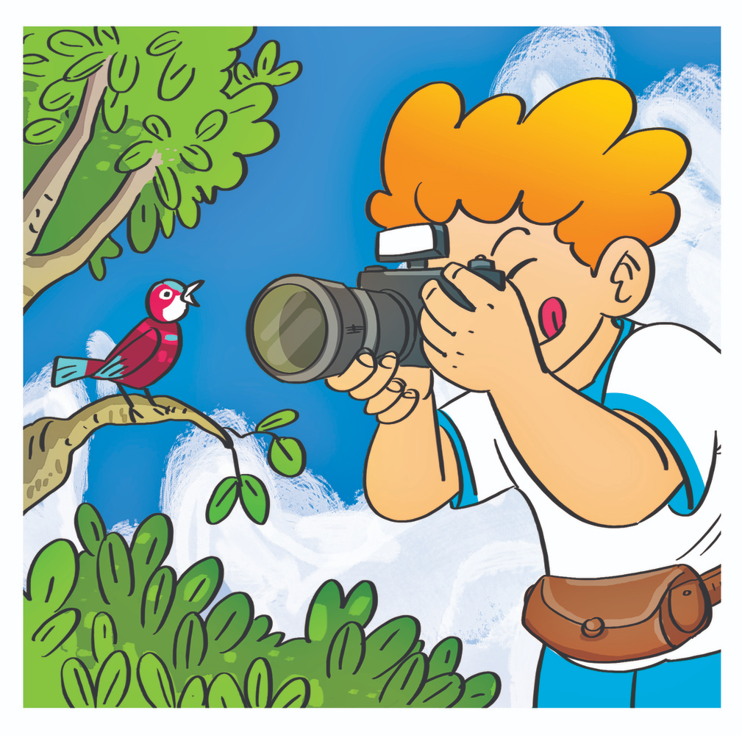
What do you
like doing?
Back
I like photos.
I taking photos.
I like taking photos.

Slide 10
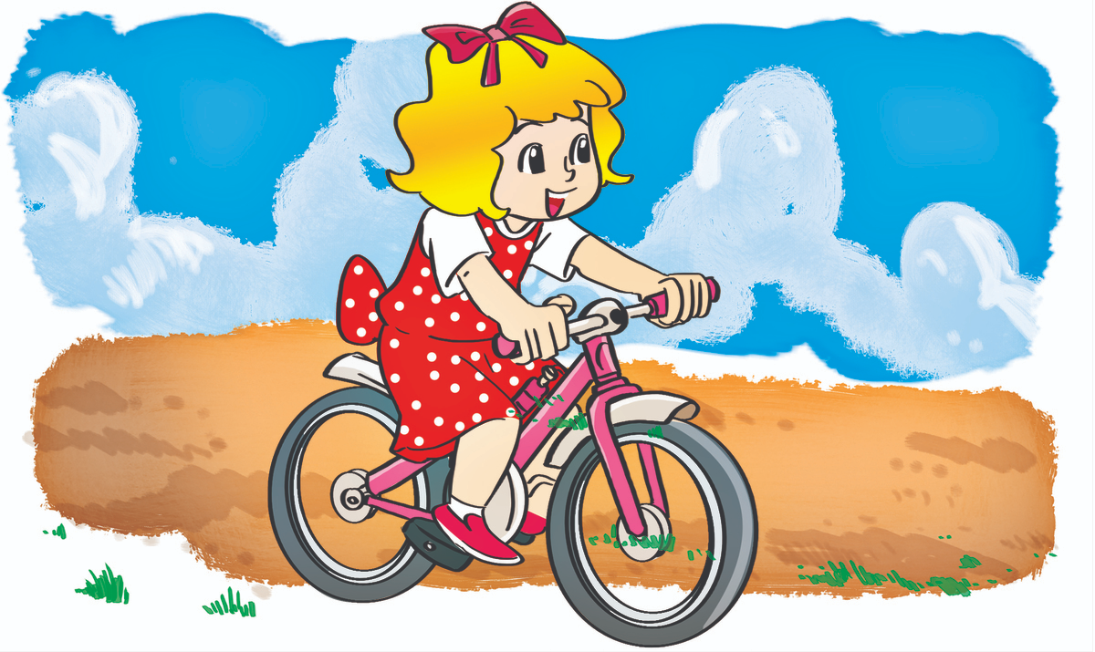
What do you
like doing?
Back
I riding
a bike.
I like riding
a bike.
I like ride
a bike.

Slide 11
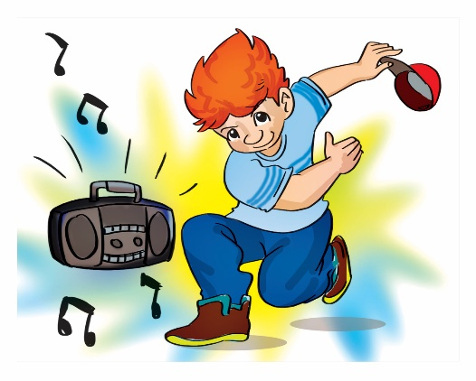
I like dancing.
Back
What do you
like doing?
What do you
like hobby?
What are you
hobby?

Slide 12
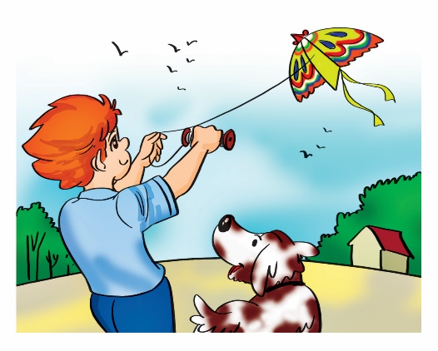
I like flying a kite.
Back
What is your
like doing?
What is your hobby?
What do your hobby?

Slide 13
PART 02
Phonics

Slide 14
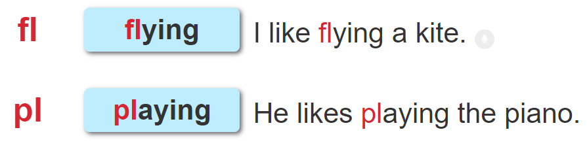


1. Listen and repeat.

Slide 15
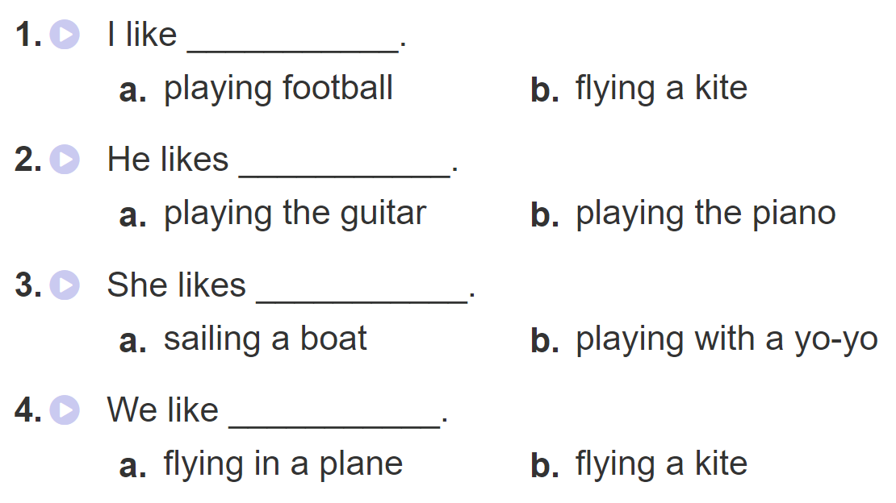
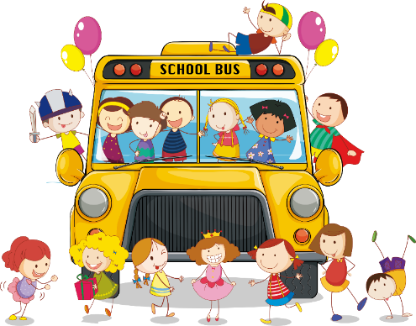
2. Listen and circle. Then say aloud

Slide 16
PART 03
Practice

Slide 17
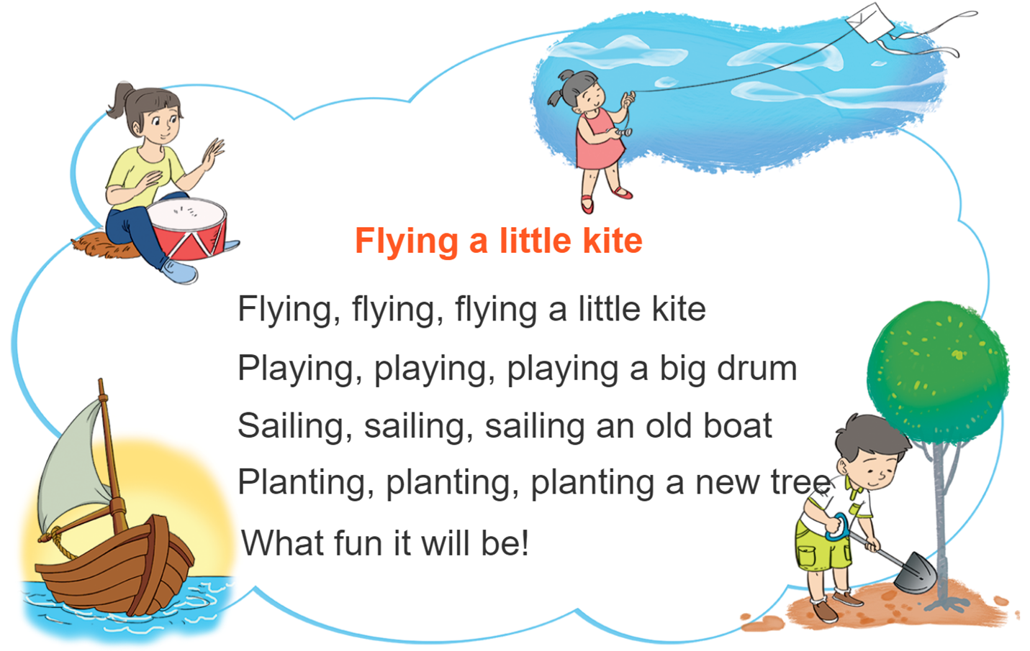
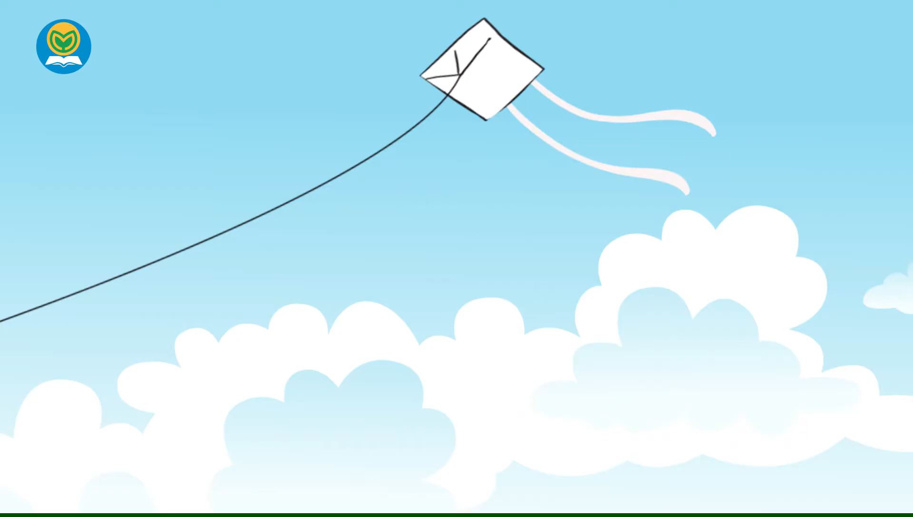


3. Let’s chant

Slide 18
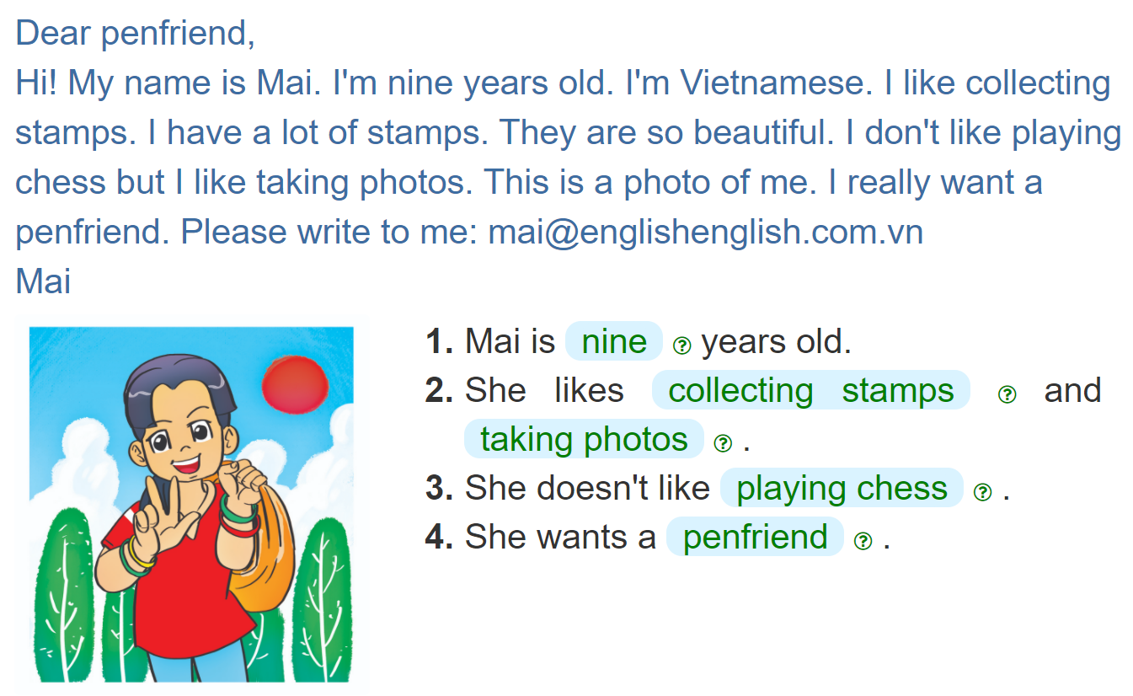
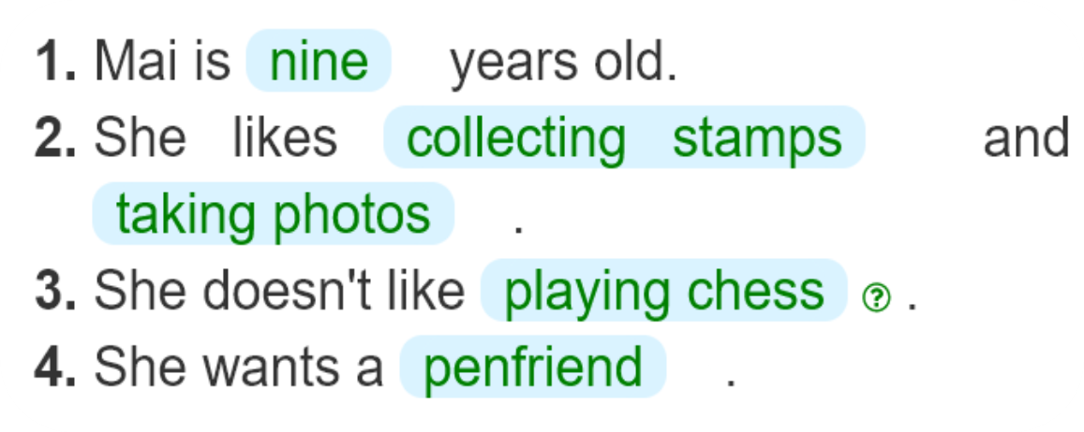

4. Read and complete

Slide 19
PART 04
Homelink

Slide 20

Monday, November 8th 2021
Unit 6: Where’s your school?
Lesson 3
1. Phonics:
fl | pl
flying | playing
2. Homework:
Learn by heart the phonics.
Do WB (SBT): part A-1,2 (page 28)

Slide 21
Thank you!

