Slide 1



Unit 7:
What do you like doing?
Lesson 2
Teacher: Ngoc Khue

Slide 2
Objectives
- Use the words and phrases related to the topic My hobby.
- Ask and answer about someone’s hobbies.
Sử dụng các từ và cụm từ về chủ đề sở thích.
Hỏi và trả lời về sở thích của ai đó.

Slide 3

Contents
01
New words
02
Model sentence
03
Practice
04
Homelink

Slide 4


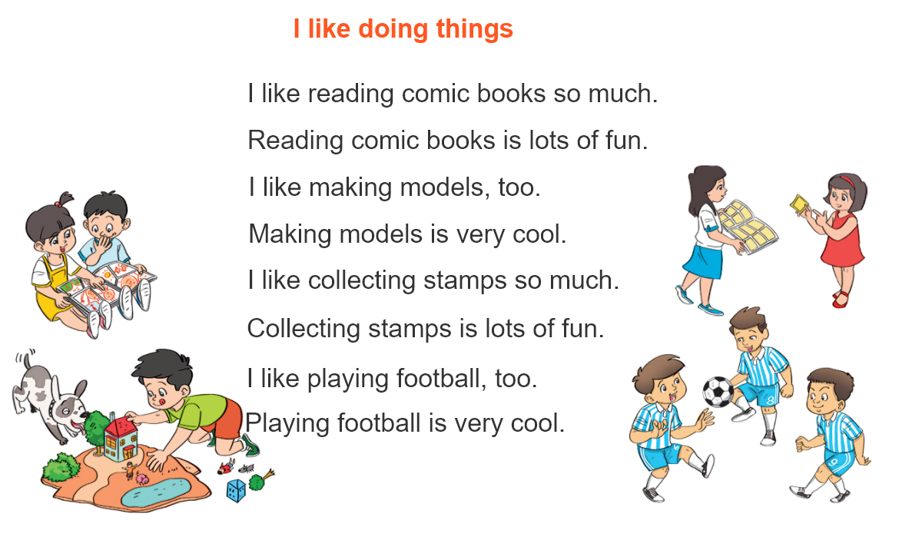
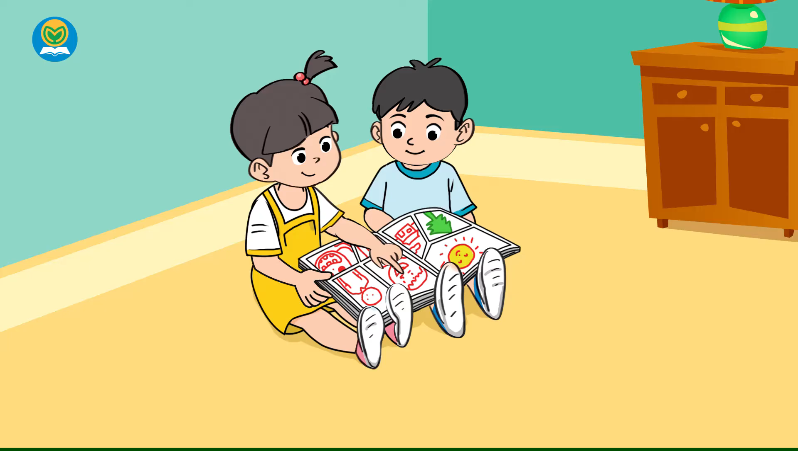

Warm Up!

Slide 5

1
New words

Slide 6




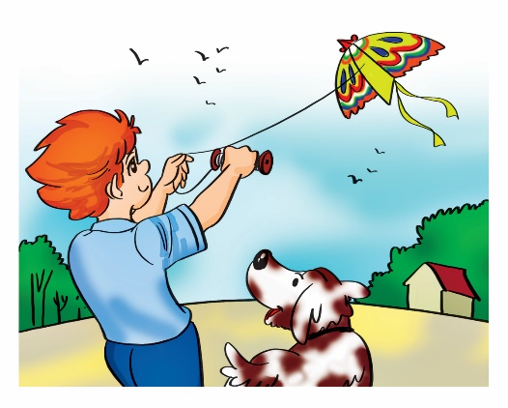
Verb (v)
A. Vocabulary
hobby
club
ride a bike
/ˈhɒb.i/
/klʌb/
/raɪd ə baɪk/
Sở thích
Câu lạc bộ
Đi xe đạp
take photos
fly a kite
/teɪk ˈfəʊ.təʊz/
/flaɪ ə kaɪt/
Chụp ảnh
Thả diều

Slide 7
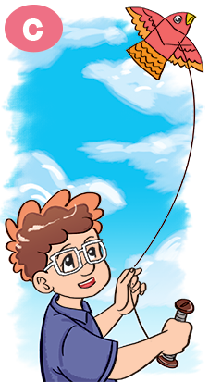
A. Vocabulary
Verb (v)
V-ing
riding
taking
flying
ride
take
fly

Slide 8
Model sentence
2

Slide 9

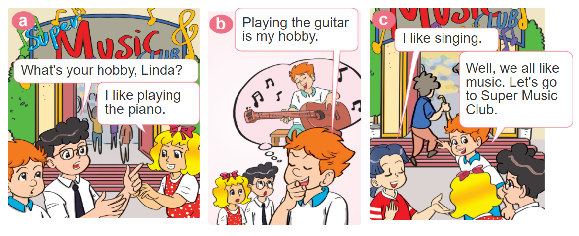
1. Look, listen and repeat.

Slide 10

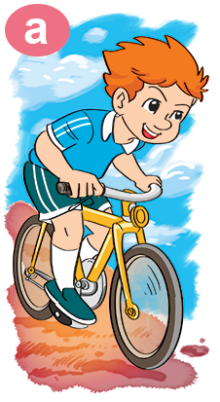
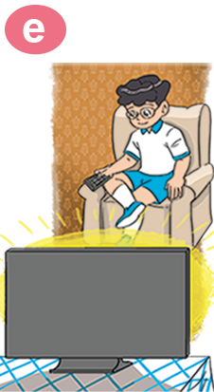


2. Point and say
What's your hobby?
I like ___________.
riding
a bike
watching TV
taking
photos
playing
badminton
flying a kite

Slide 11


Structures:
Hỏi và trả lời sở thích của bạn là gì:
What's your hobby?
(Sở thích của bạn là gì?)
I like ______.
V-ing
(Tớ thích___.)

Slide 12
3
Practice

Slide 13


Ex 4
3. Let’s talk
What do you
like doing?
I like _________.
What's your hobby?
I like _________.

Slide 14






Notes:
Ms Huyền Phạm - 0936.082.789 – YOUTUBE: MsPham. Facebook: Dạy và học cùng công nghệ.

Slide 15




What ____ your hobby?
I like watching TV.
are
is
+5
-1
-1
-1
do
does
Notes:
Ms Huyền Phạm - 0936.082.789 – YOUTUBE: MsPham. Facebook: Dạy và học cùng công nghệ.

Slide 16
What is your hobby?
I like flying kites.
I like watching TV.
+5
-1
-1
-1
I like swimming.
I like riding the bike.
Notes:
Ms Huyền Phạm - 0936.082.789 – YOUTUBE: MsPham. Facebook: Dạy và học cùng công nghệ.

Slide 17
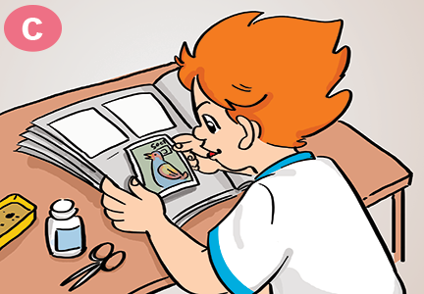

Câu hỏi 2
What is your hobby?
I like riding the bike.
I like dancing.
+5
-1
-1
-1
I like collecting stamps.
I like cooking.
Notes:
Ms Huyền Phạm - 0936.082.789 – YOUTUBE: MsPham. Facebook: Dạy và học cùng công nghệ.

Slide 18
What is your hobby?
I like collecting stamps.
I like playing with cats.
+5
-1
-1
-1
I like taking photos.
I like eating.
Notes:
Ms Huyền Phạm - 0936.082.789 – YOUTUBE: MsPham. Facebook: Dạy và học cùng công nghệ.

Slide 19
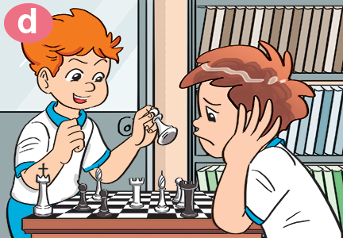
What is your hobby?
I like playing
badminton.
I like playing
Chess.
+5
-1
-1
-1
I like taking
photos.
I like watching TV.
Notes:
Ms Huyền Phạm - 0936.082.789 – YOUTUBE: MsPham. Facebook: Dạy và học cùng công nghệ.

Slide 20
I like flying a kite.
What is your hobby?
What are you hobby?
+5
-1
-1
-1
What your hobby?
What do you hobby?
Notes:
Ms Huyền Phạm - 0936.082.789 – YOUTUBE: MsPham. Facebook: Dạy và học cùng công nghệ.

Slide 21
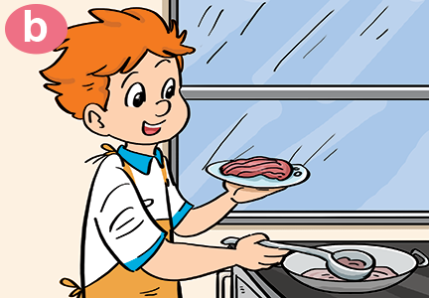
Câu hỏi 1
What is your_____?
I like cooking.
hobby
cooking
+5
-1
-1
-1
like
do
Notes:
Ms Huyền Phạm - 0936.082.789 – YOUTUBE: MsPham. Facebook: Dạy và học cùng công nghệ.

Slide 22
What is your hobby?
I ____ playing badminton.
do
am
+5
-1
-1
-1
hobby
like
I like riding
a bike.
I like watching TV.
I like taking
photos.
I like playing
badminton.
I like flying a kite.
Notes:
Ms Huyền Phạm - 0936.082.789 – YOUTUBE: MsPham. Facebook: Dạy và học cùng công nghệ.

Slide 23
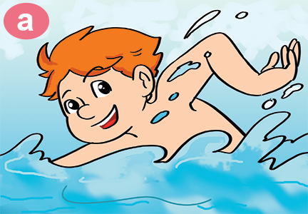
Câu hỏi 4
What is your hobby?
I like ________.
swim
go swimming
+5
-1
-1
-1
going swim
swimming
Notes:
Ms Huyền Phạm - 0936.082.789 – YOUTUBE: MsPham. Facebook: Dạy và học cùng công nghệ.

Slide 24



Great job!
Exit
8
13
Notes:
Ms Huyền Phạm - 0936.082.789 – YOUTUBE: MsPham. Facebook: Dạy và học cùng công nghệ.

Slide 25
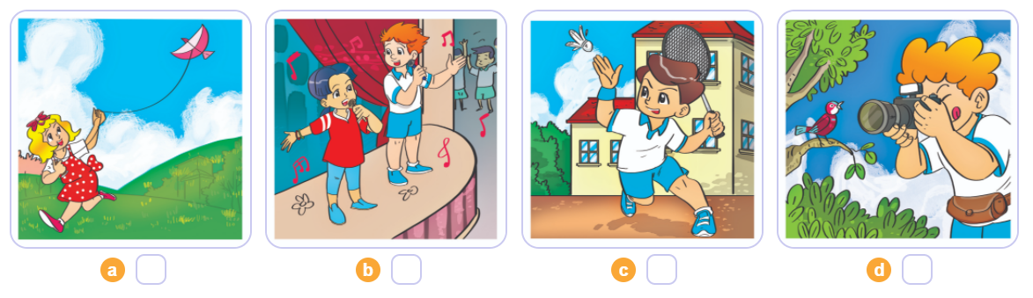

4. Listen and number
2
4
1
3
1
2
3
4

Slide 26
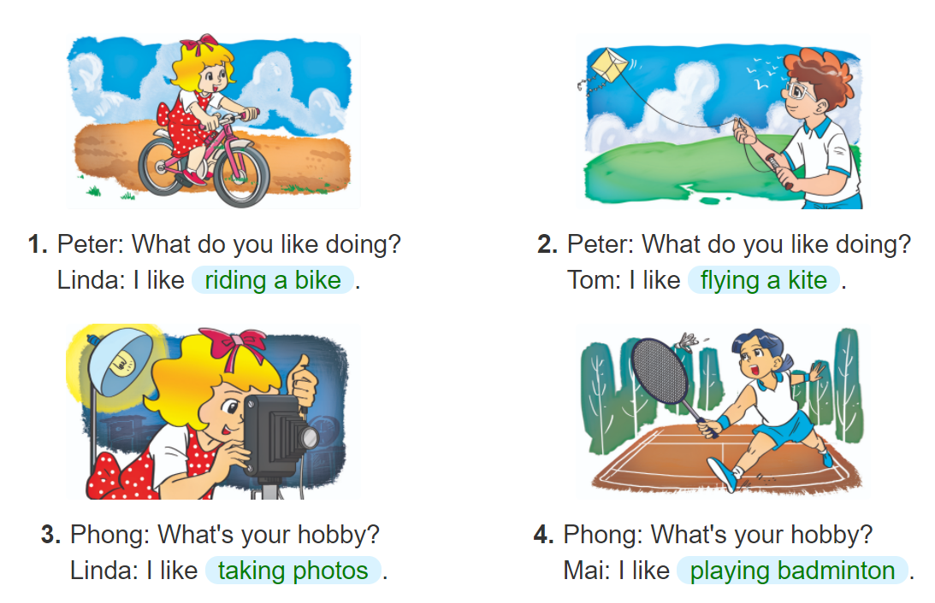

5. Look and write

Slide 27
4
Homelink

Slide 28
Monday, November 15th 2021
Unit 7: What do you like doing?
Lesson 2
1. New words:
2. Model sentence:
- hobby: sở thích
Club: câu lạc bộ
Ride a bike:đi xe đạp
Fly a kite: thả diều
Take photos:chụp ảnh
What’s your hobby?
I like taking photos.
3. Homework:
Write NW x 2 lines.
Do WB (SBT): part C -1,2 (page 29).
part E- 1,2 (page 30).

Slide 29


Slide 30
Thanks

