Slide 1
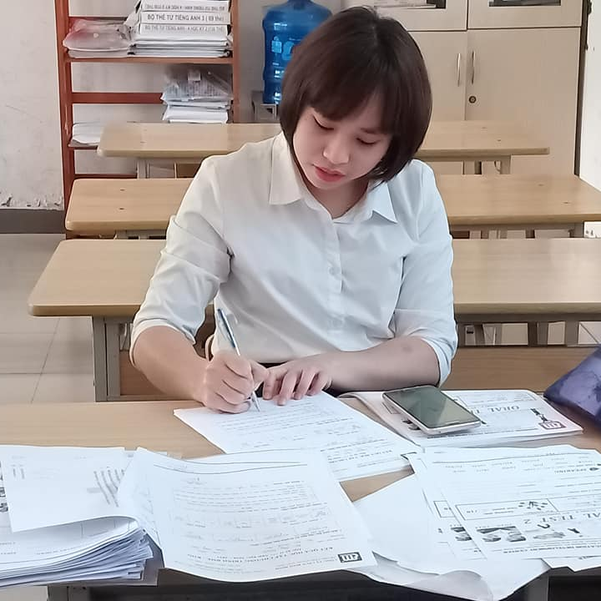
Hello! I’m Teacher Ngoc Khue!
Nice to see you again!
Hope you to pass the first Mid-term Test!

Slide 2
Unit 7: What do you like doing?
Lesson 1
Teacher: Ngoc Khue

Slide 3
Objectives
- Use the words and phrases related to the topic My hobby.
- Ask and answer about what someone likes doing.
Mục đích bài học:
Ms. Ngoc Khue
Sử dụng các từ liên quan đến sở thích của mình.
Hỏi và trả lời về ai đó thích làm gì.

Slide 4
Here is what you are going to learn in this lesson:
01
02
03
04
New words
Model sentence
Practice
Homelink

Slide 5
Warm Up!
https://wordwall.net/resource/24627849/copy-of-unit-6-ls-2

Slide 6
01
New words
Ms. Ngoc Khue

Slide 7
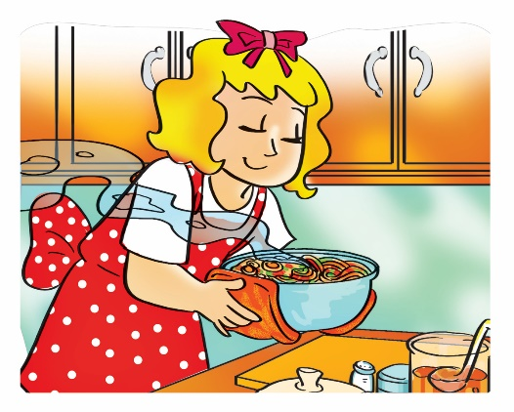
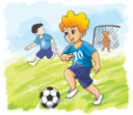
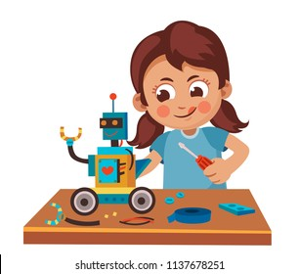
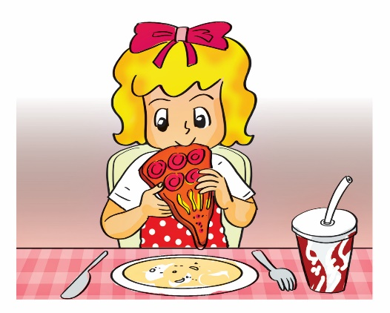
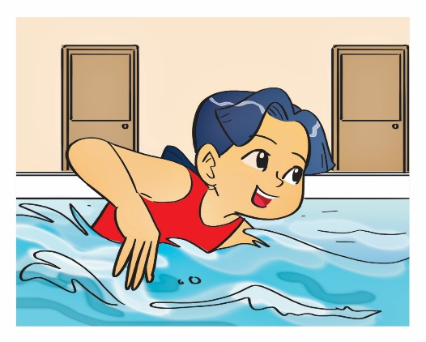
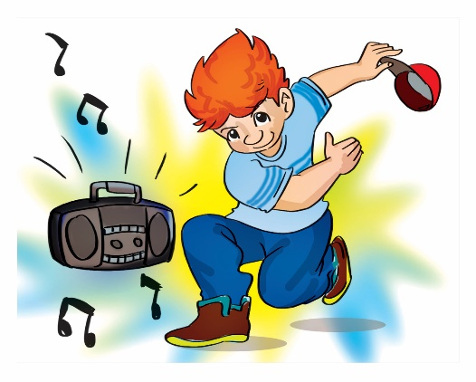
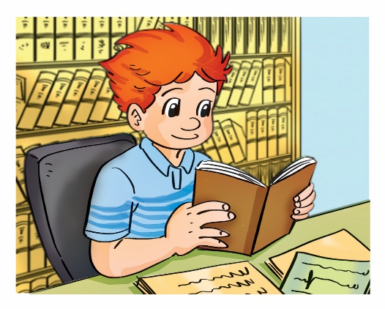
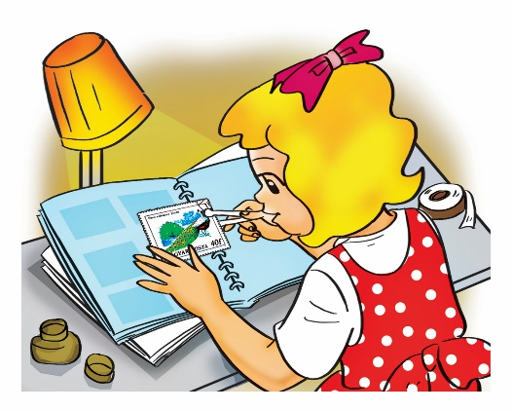
MsPham-0936082789
Verb (v)
cook
Play football
Make models
eat
/kʊk/
/pleɪ ˈfʊt.bɔːl/
/meɪkˈmɒd.əz/
/iːt/
Nấu ăn
Chơi đá bóng
Lắp mô hình
Ăn
swim
dance
Read comic books
Collect stamps
/swɪm/
/dæns/
/riːd ˈkɒm.ɪk bʊks/
/kəˈlekt stæmps/
Bơi
Nhảy
Đọc truyên tranh
Sưu tầm tem

Slide 8
MsPham-0936082789
Verb (v)
V-ing
cooking
playing
making
eating
cook
play
make
eat
swimming
dancing
reading
collecting
swim
dance
read
collect

Slide 9
02
Model sentence

Slide 10
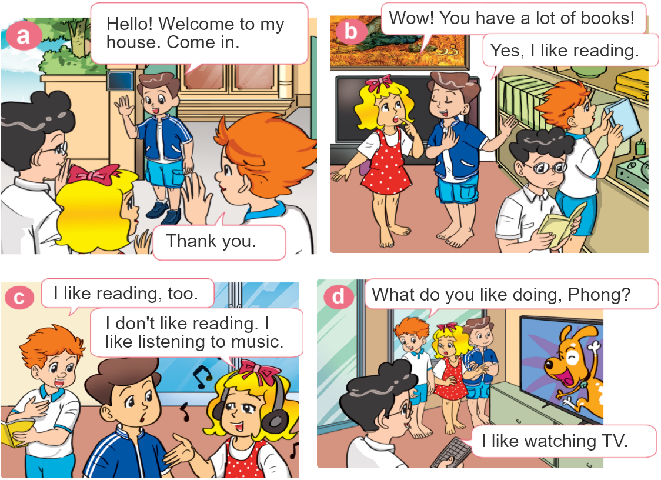

1. Look, listen and repeat.

Slide 11


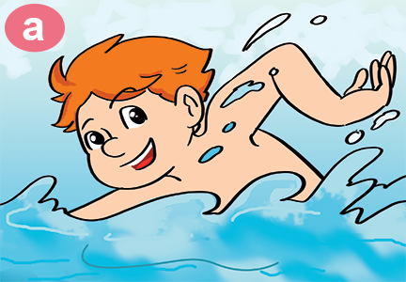
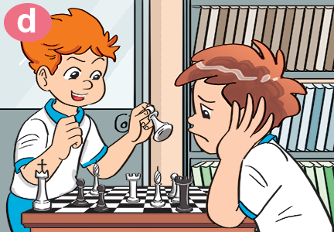
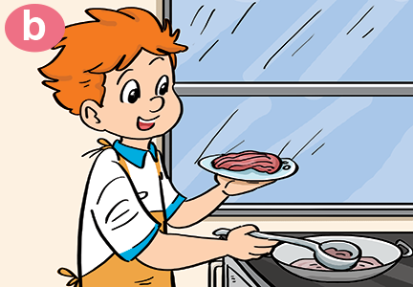
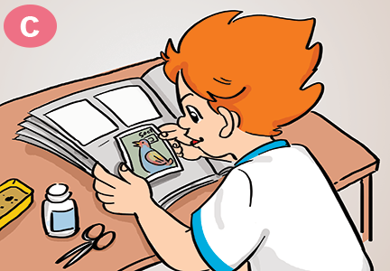
2. Point and say
What do you like doing?
I like ___________.
swimming
playing
chess
cooking
collecting
stamps

Slide 12

Hỏi và trả lời bạn THÍCH làm gì:
What do you like doing?
(Bạn thích làm gì?)
MS. Ngoc Khue
I like ______.
V-ing
(Tớ thích___.)

Slide 13






Slide 14




What ___ you like doing?
are
do

Slide 15

What do you like _____?
doing
eating

Slide 16

What do you like doing?
I’m collecting stamps.
I like collecting stamps.

Slide 17
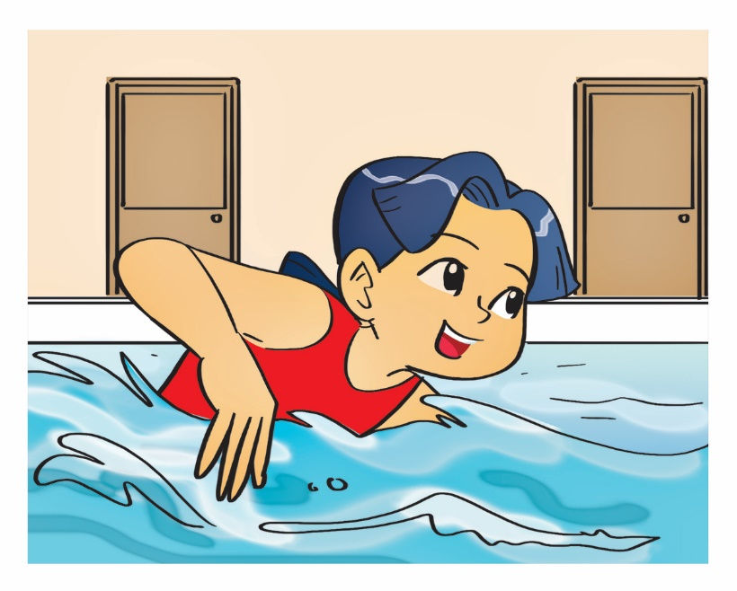
What do you like doing?
I like swimming.
She likes swimming.

Slide 18

What do you like doing?
I like dancing.
I like singsing.

Slide 19
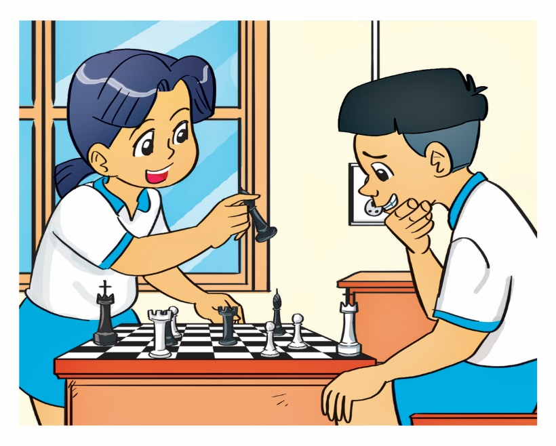
What do you like doing?
They like playing chess.
I like playing chess.

Slide 20

What do you like doing?
I like reading books.
I like read a book.

Slide 21
I like making models.
What do you like doing?
What do you like going?

Slide 22
What do you like _____?
doing
eating

Slide 23
What ___ you like doing?
are
do

Slide 24


Slide 25
03
Practice

Slide 26
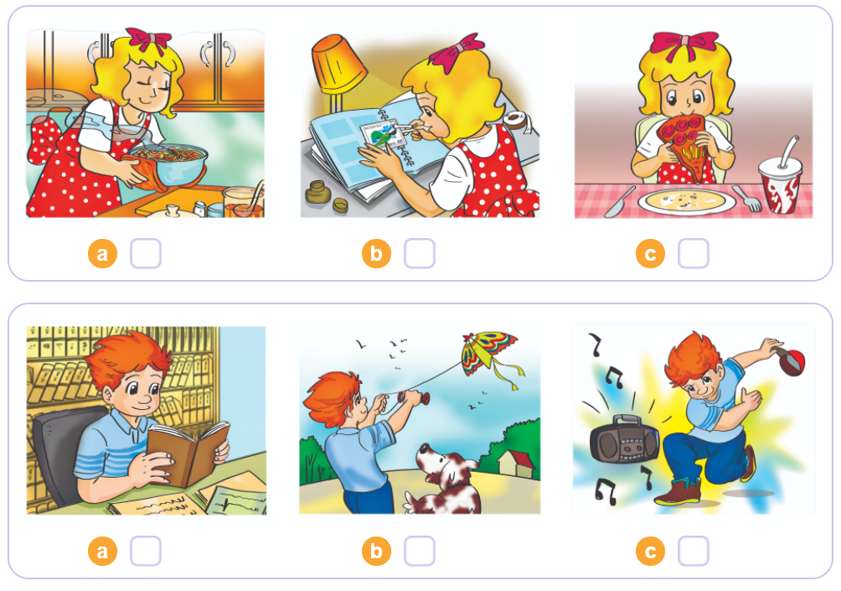


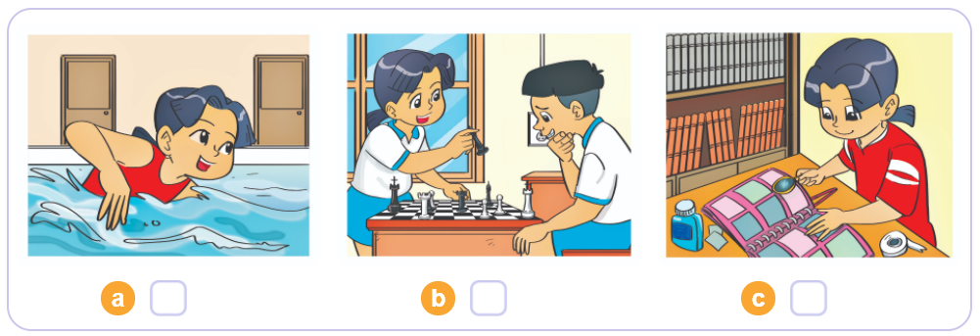
1
4. Listen and tick
2
3

Slide 27
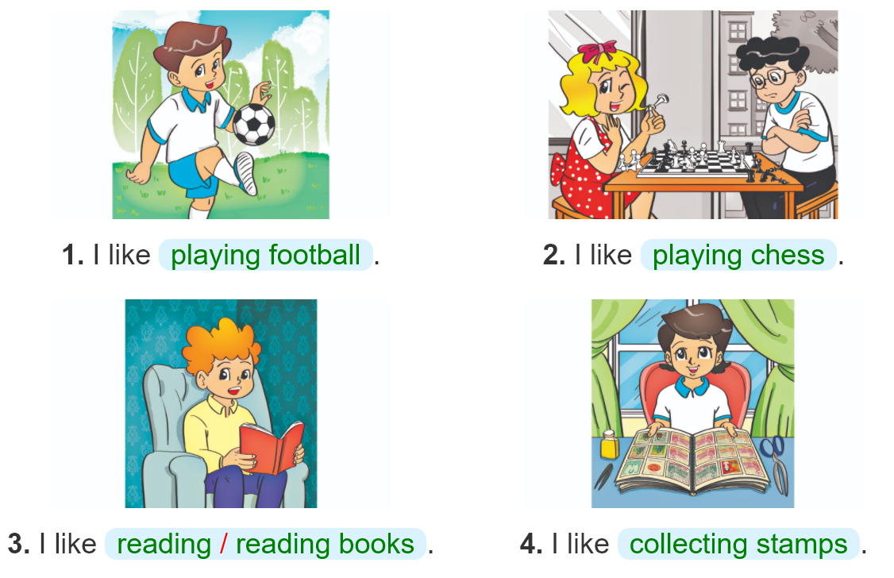

5. Look and write

Slide 28
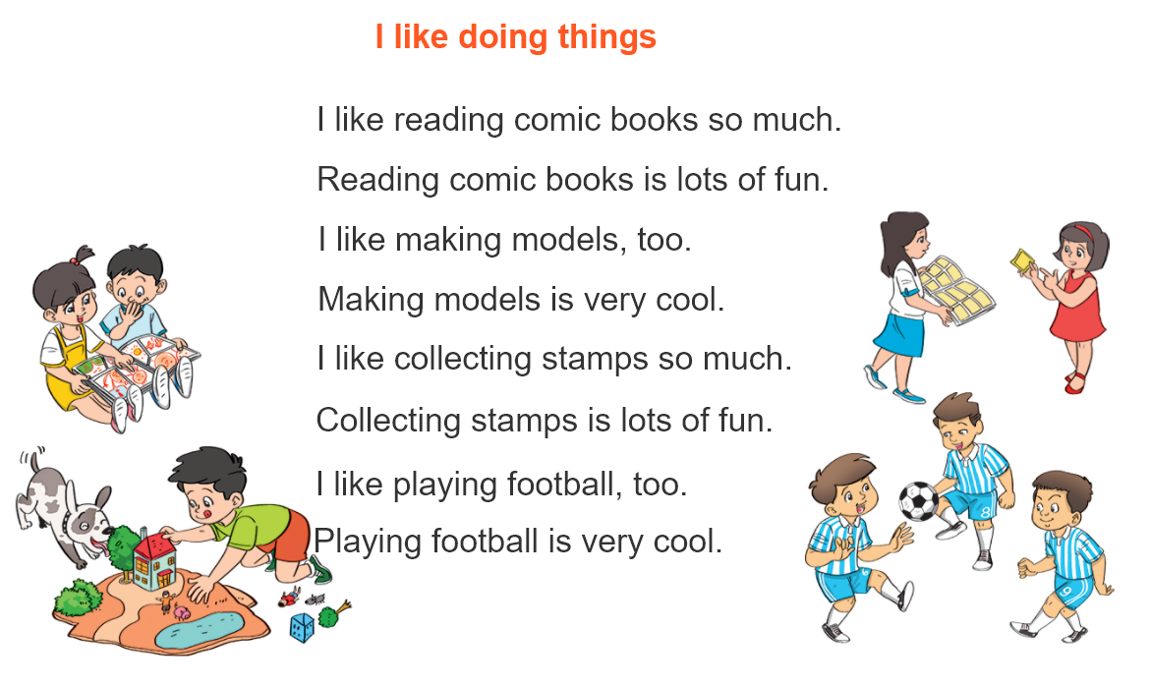


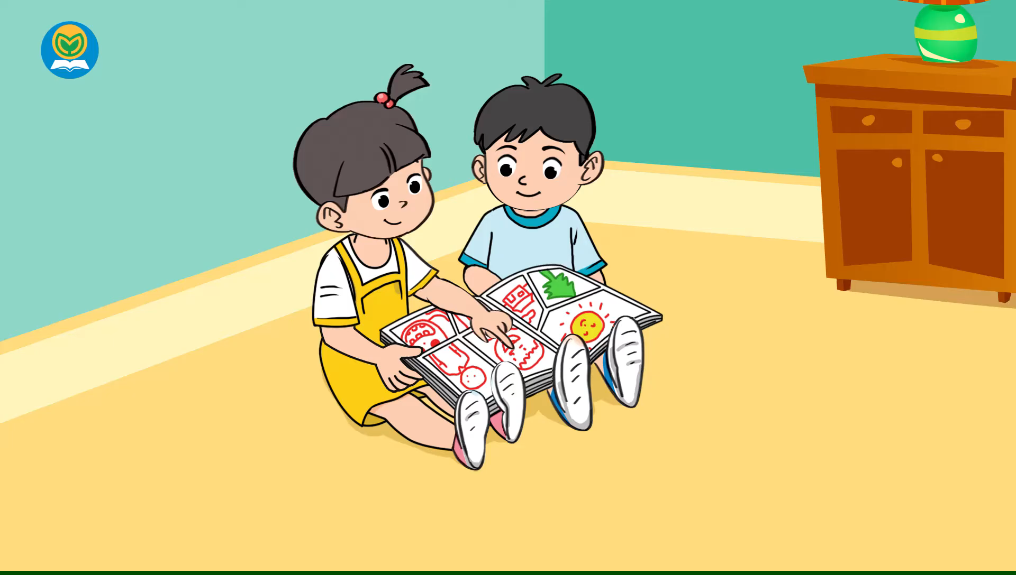
6. Let’s sing

Slide 29
04
MS. Ngoc Khue
Homelink

Slide 30
Thursday, November 11th 2021 Unit 7: What do you like doing? Lesson 1
1. New words:
2. Model sentence:
swim: bơi
Cook: nấu ăn
Collect stamps: sưu tầm tem
Play chess: chơi cờ
Make models: lắp mô hình
Read comic books: đọc truyện tranh
What do you like doing?
I like making models.
3. Homework:
NW x 2 lines and learn by heart.
Do WB (SBT): part B- 1,2 (page 28,29)
part F-1,2 (page 31)

Slide 31
Thanks!

