Slide 1
Unit 8
What are
you reading?
Lesson 1

Slide 2
REVIEW

Slide 3






PRERENT WHEEL
10
50
30
30
20
Good job!
SPIN/STOP
SPIN/STOP
SPIN/STOP
SPIN/STOP
SPIN/STOP
SPIN/STOP
SPIN/STOP
SPIN/STOP
SPIN/STOP
SPIN/STOP
SPIN/STOP
SPIN/STOP
SPIN/STOP
SPIN/STOP
SPIN/STOP
40
SPIN/STOP
60
60
40
20
30
10
50
Notes:
Ms Huyền Phạm - 0936.082.789 – YOUTUBE: MsPham. Facebook: Dạy và học cùng công nghệ.

Slide 4


What time do you go to school?
I go to school at
six forty-five.
He goes to school at
six forty-five.
Notes:
Ms Huyền Phạm - 0936.082.789 – YOUTUBE: MsPham. Facebook: Dạy và học cùng công nghệ.

Slide 5
What time does he go to bed?
I go to bed at
six o’clock.
He goes to bed at
six o’clock.
Notes:
Ms Huyền Phạm - 0936.082.789 – YOUTUBE: MsPham. Facebook: Dạy và học cùng công nghệ.

Slide 6
have breakfast
What time does he _______?
He has breakfast at six fifteen.
has breakfast
haves breakfast
Notes:
Ms Huyền Phạm - 0936.082.789 – YOUTUBE: MsPham. Facebook: Dạy và học cùng công nghệ.

Slide 7
six twenty
I get up at ___________.
six ten
six forty
Notes:
Ms Huyền Phạm - 0936.082.789 – YOUTUBE: MsPham. Facebook: Dạy và học cùng công nghệ.

Slide 8
six fifteen
I have breakfast at _________.
six thirty
six forty-five
Notes:
Ms Huyền Phạm - 0936.082.789 – YOUTUBE: MsPham. Facebook: Dạy và học cùng công nghệ.

Slide 9
get up
I __________at
seven o'clock.
have breakfast
go to school
Notes:
Ms Huyền Phạm - 0936.082.789 – YOUTUBE: MsPham. Facebook: Dạy và học cùng công nghệ.

Slide 10
get home
I ___________ at seven five.
have dinner
watch TV
Notes:
Ms Huyền Phạm - 0936.082.789 – YOUTUBE: MsPham. Facebook: Dạy và học cùng công nghệ.

Slide 11
I go to bed at nine fiveteen.
True
False
Notes:
Ms Huyền Phạm - 0936.082.789 – YOUTUBE: MsPham. Facebook: Dạy và học cùng công nghệ.

Slide 12
What time it is?
True
Flase
Notes:
Ms Huyền Phạm - 0936.082.789 – YOUTUBE: MsPham. Facebook: Dạy và học cùng công nghệ.

Slide 13
Answer
What time does she go home?
___________________?
She goes home at four o’clock?
Notes:
Ms Huyền Phạm - 0936.082.789 – YOUTUBE: MsPham. Facebook: Dạy và học cùng công nghệ.

Slide 14
Answer
What time does your father watch TV?
He watches TV at eight fifteen
Notes:
Ms Huyền Phạm - 0936.082.789 – YOUTUBE: MsPham. Facebook: Dạy và học cùng công nghệ.

Slide 15
Answer
What time do you have dinner?
I have dinner at seven thirty.
Notes:
Ms Huyền Phạm - 0936.082.789 – YOUTUBE: MsPham. Facebook: Dạy và học cùng công nghệ.

Slide 16
Answer
What time is it?
It’s eight fifty.
Notes:
Ms Huyền Phạm - 0936.082.789 – YOUTUBE: MsPham. Facebook: Dạy và học cùng công nghệ.

Slide 17

Answer
What time is it?
It’s twelve forty.
Notes:
Ms Huyền Phạm - 0936.082.789 – YOUTUBE: MsPham. Facebook: Dạy và học cùng công nghệ.

Slide 18
Answer
What time is it?
It’s ten twenty.
Notes:
Ms Huyền Phạm - 0936.082.789 – YOUTUBE: MsPham. Facebook: Dạy và học cùng công nghệ.

Slide 19
PRONUNCIATION

Slide 20
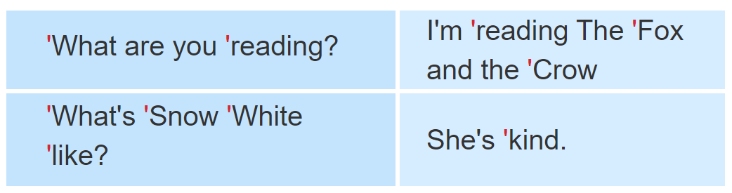

1. Listen and repeat.

Slide 21
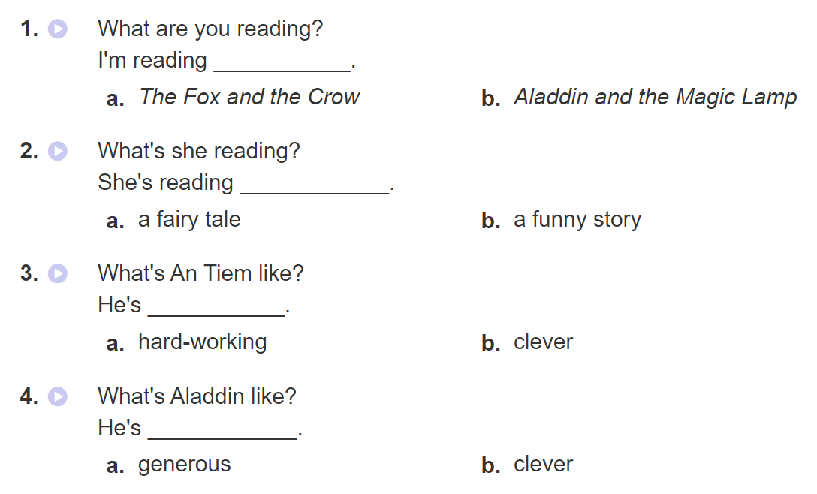

2. Listen and circle a or b. Then say the sentences aloud.

Slide 22
PRACTISE

Slide 23
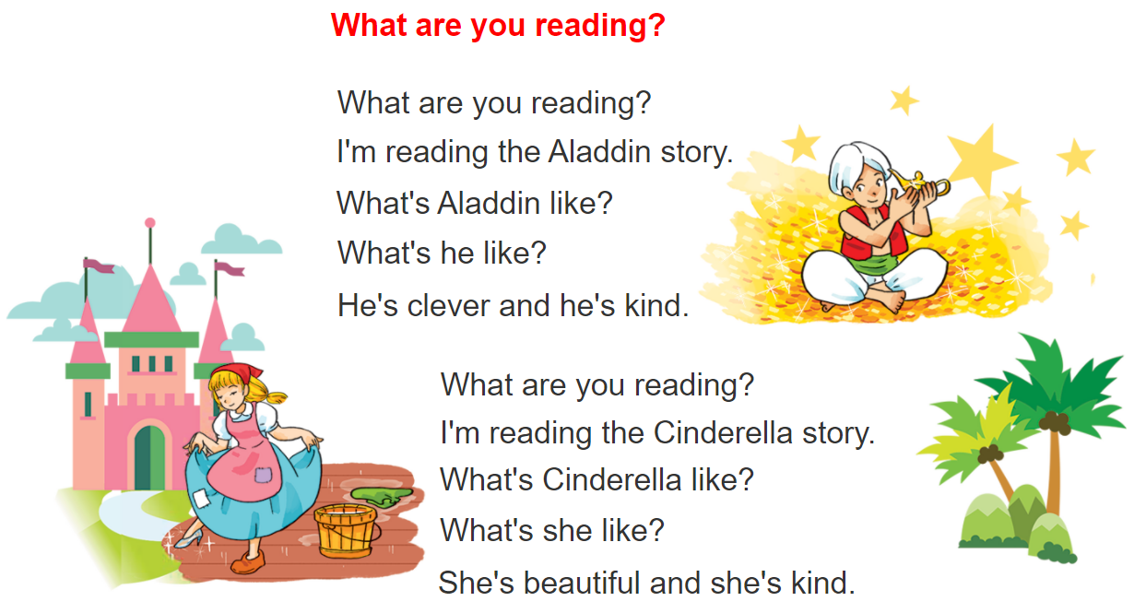


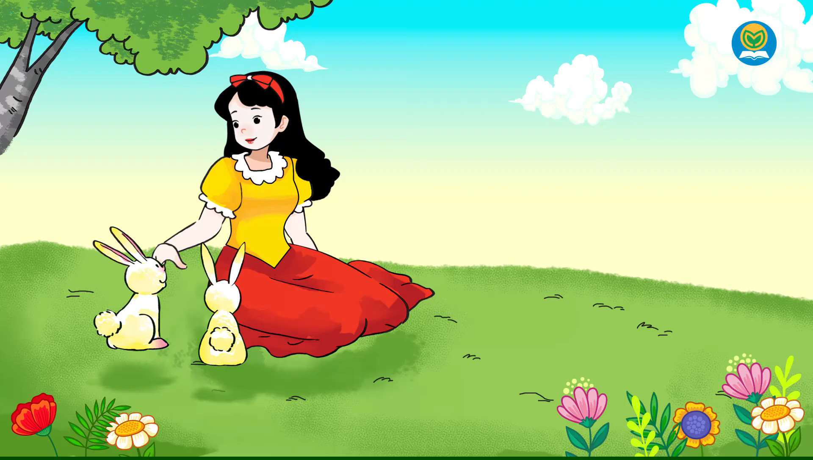
3. Let’s chant

Slide 24
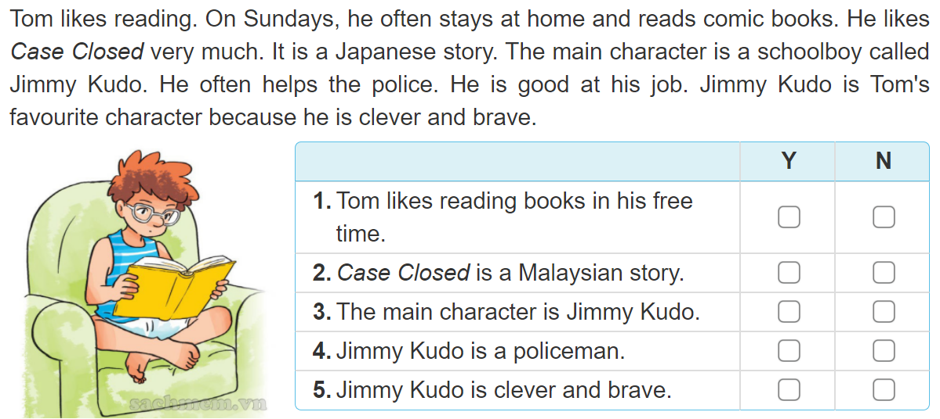
4. Read and complete
✔
✔
✔
✔
✔

Slide 25
5. Write about your school and lessons.
I like reading ___________ in my free time.
My favourite book is___________________.
The main character is ___________________.
I like him/her very much because __________ _______________________________________.

Slide 26
6. Project
Interview three classmates about their favourite books and characters.

