Slide 1
Unit 8
What are
you reading?
Lesson 1

Slide 2
VOCABULARY

Slide 3
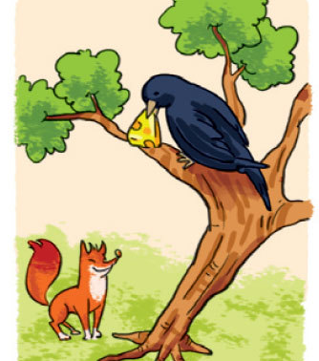
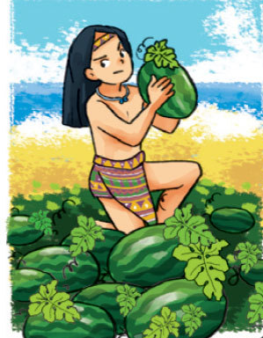
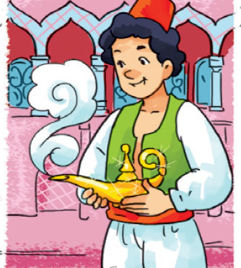
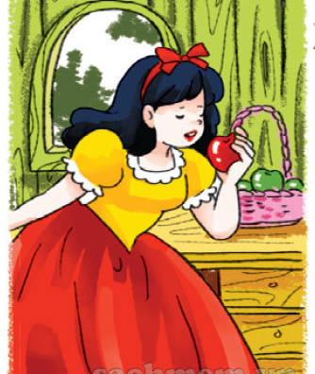
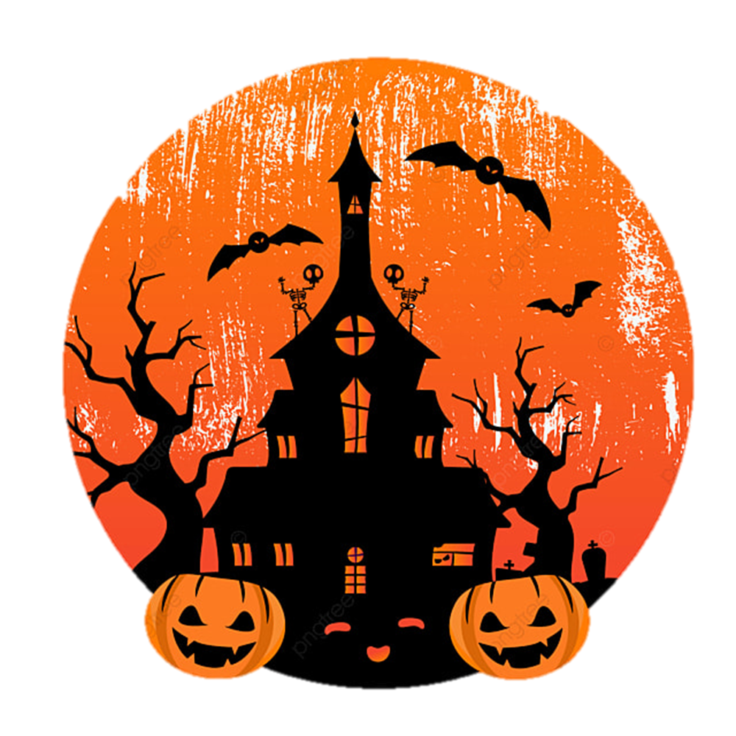
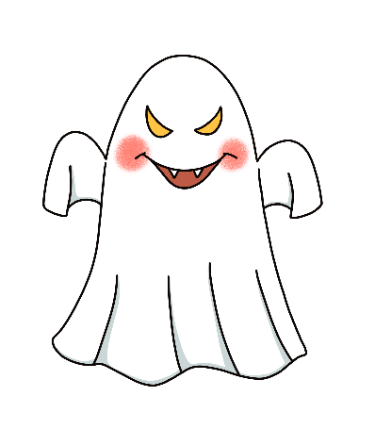
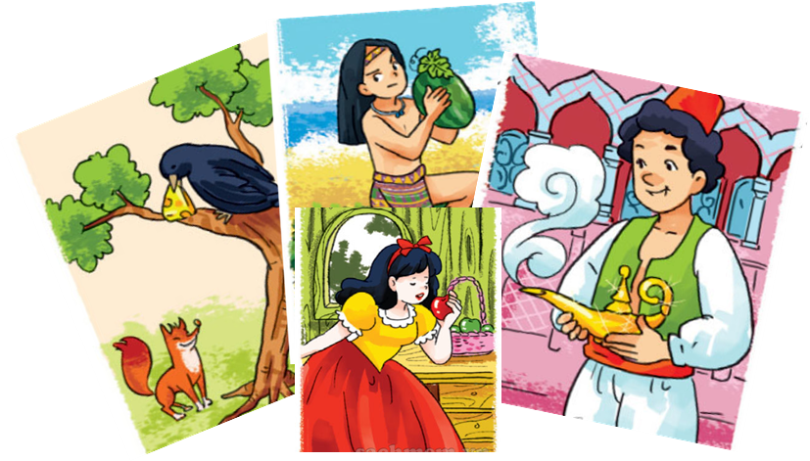
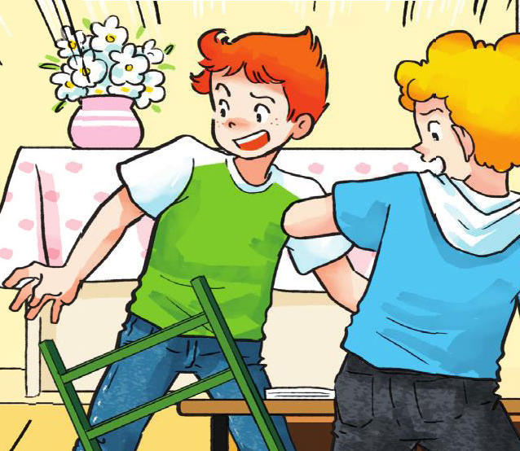
A. Vocabulary
The Fox and the Crow
The Story of Mai An Tiem
Aladdin and
the Magic Lamp
Snow White and
the Seven Dwarfs
fairy tale
Halloween
ghost
scare
/ˈferi teɪl/
/ˌhæləʊˈiːn/
/ɡəʊst/
/sker/
Truyện cổ tích
Lễ hội hóa trang
Con ma
Sợ

Slide 4
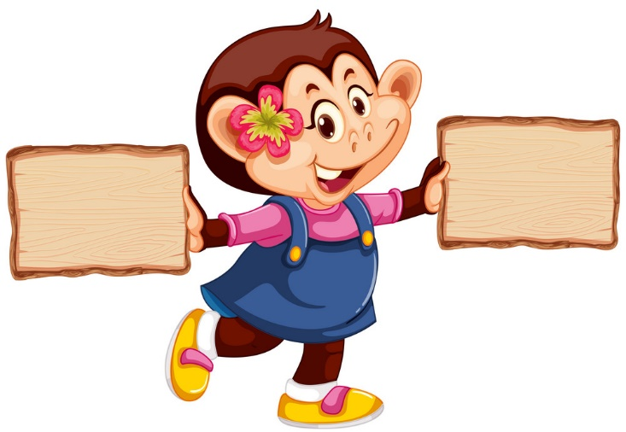

right
left

Slide 5
Snow White and the Seven Dwarfs
The Fox and the Crow

Slide 6
The Story of Mai An Tiem
The Fox and the Crow

Slide 7
Hallo
ween
fairy tale

Slide 8
The Story of Mai An Tiem
Aladdin and the Magic Lamp

Slide 9
Snow White and the Seven Dwarfs
The Fox and the Crow

Slide 10
ghost
scare

Slide 11
ghost
Halloween

Slide 12
scare
fairy tale

Slide 13
GRAMMAR

Slide 14

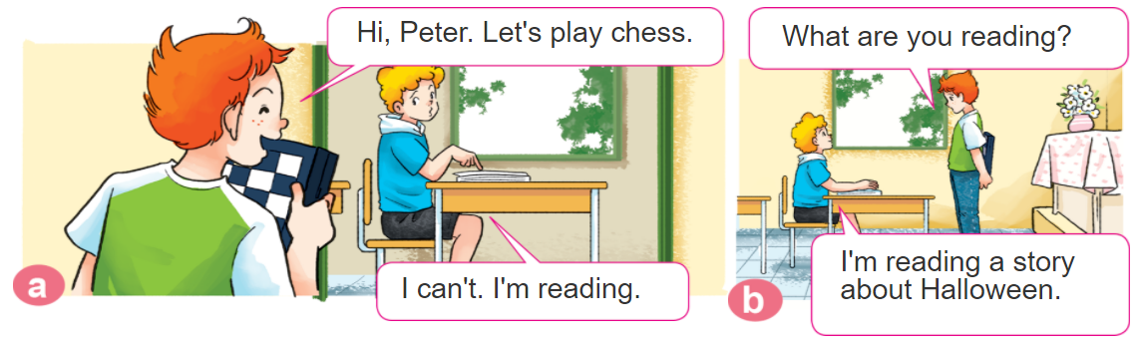
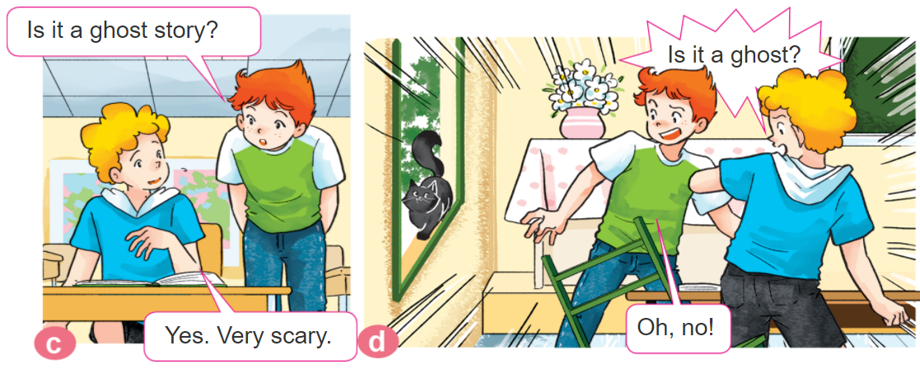
1. Look, listen and repeat.

Slide 15

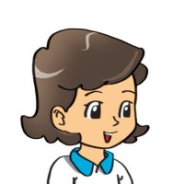
2. Point and say
What are you reading?
I'm reading ______.
Snow White and the Seven Dwarfs
The Fox and the Crow
The Story of Mai An Tiem
Aladdin and the Magic Lamp

Slide 16

B. Grammar
Hỏi và đáp bạn mình đang đọc gì:
(Bạn đang đọc gì thế)
What are you reading?
(Tớ đang đọc _______.)
I’m reading ________.
+ tên truyện/
tên sách
Hỏi và đáp câu chuyện/quyển sách bạn thích là gì?
(Bạn bạn thích quyển sách/câu chuyện nào)
What's your favourite book/story?
It’s _________.
+ tên truyện/
tên sách
(Đó là)

Slide 17

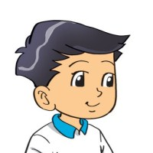
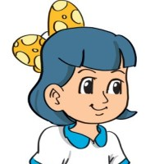


3. Let’s talk
Do you read books in your free time?
Yes, I do.
/ No, I don’t.
What are you reading now?
I'm reading ______.
What's your favourite book/story?
It's ________.

Slide 18


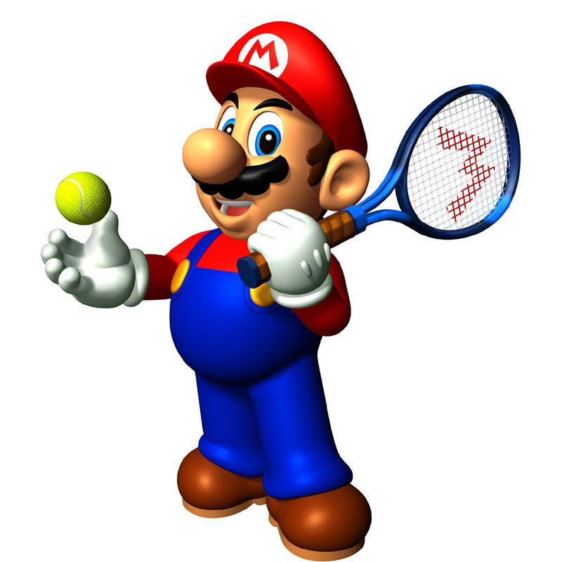





Slide 19
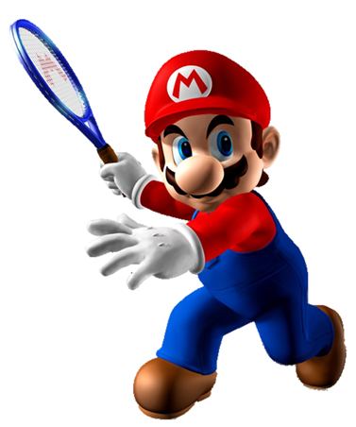
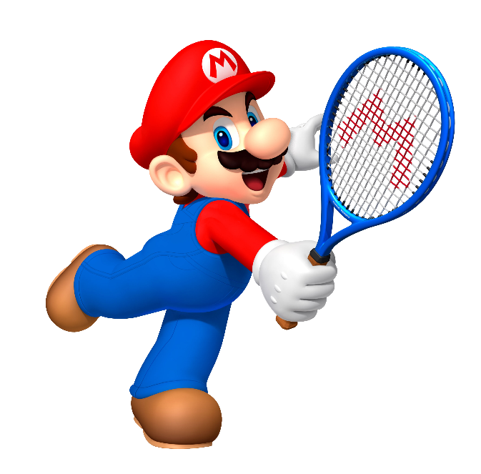


I’m reading The Fox and the Crow.
I’m reading The Story of Mai An Tiem.
What are you reading?
I’m reading Snow White and the Seven Dwarfs.

Slide 20
I’m reading The Story of Mai An Tiem.
I’m reading Aladdin and the Magic Lamp.
What are you reading?
I’m reading The Fox and the Crow.

Slide 21
I’m reading The Story of Mai An Tiem.
I’m reading The Fox and the Crow.
What are you reading?
I’m reading Snow White and the Seven Dwarfs.

Slide 22
I’m reading Aladdin and the Magic Lamp.
I’m reading Snow White and the Seven Dwarfs.
What are you reading?
I’m reading The Fox and the Crow.

Slide 23
I’m reading The Fox and the Crow.
I’m reading Aladdin and the Magic Lamp.
What are you reading?
I’m reading fairy tales.

Slide 24
I’m reading Snow White and the Seven Dwarfs
What's your favourite story?
It’s Snow White and the Seven Dwarfs.
I wants

Slide 25
I’m reading Aladdin and the Magic Lamp
What's your favourite story?
It’s Aladdin and the Magic Lamp.
Intelligent

Slide 26
Next
I’m reading The Story of Mai An Tiem.
What's your favourite story?
It’s The Story of Mai An Tiem.

Slide 27
It’s The Fox and the Crow.
What's your favourite story?
I’m reading The Fox and the Crow.
do

Slide 28
Time’s up!

Slide 29

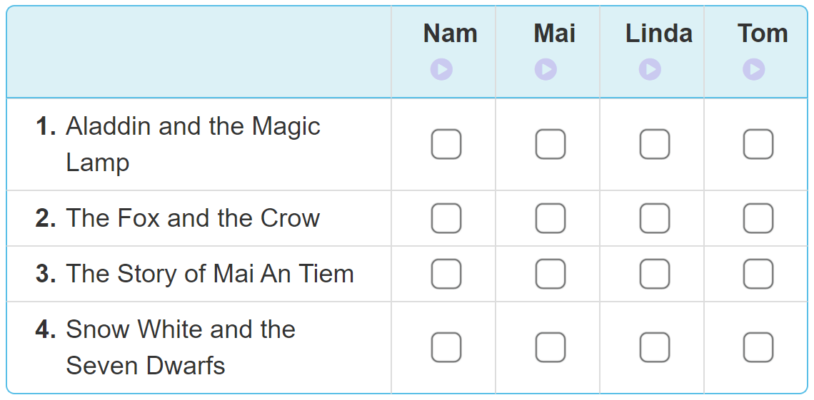
4. Listen and tick
✔
✔
✔
✔

Slide 30
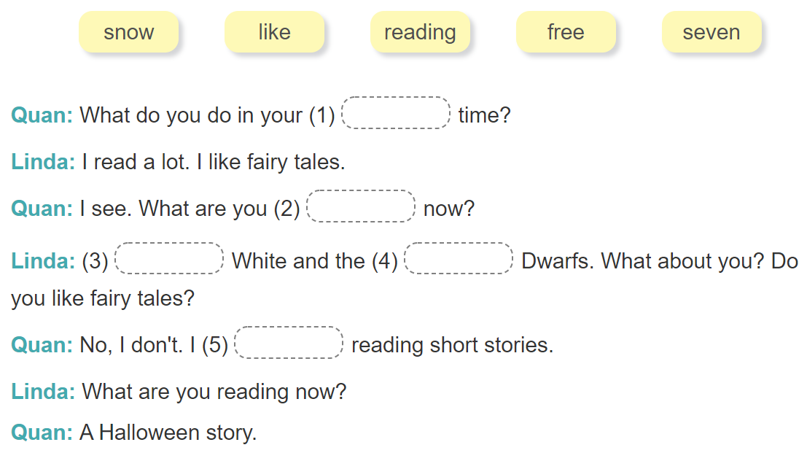
5. Read and complete
free
reading
Snow
seven
like

Slide 31
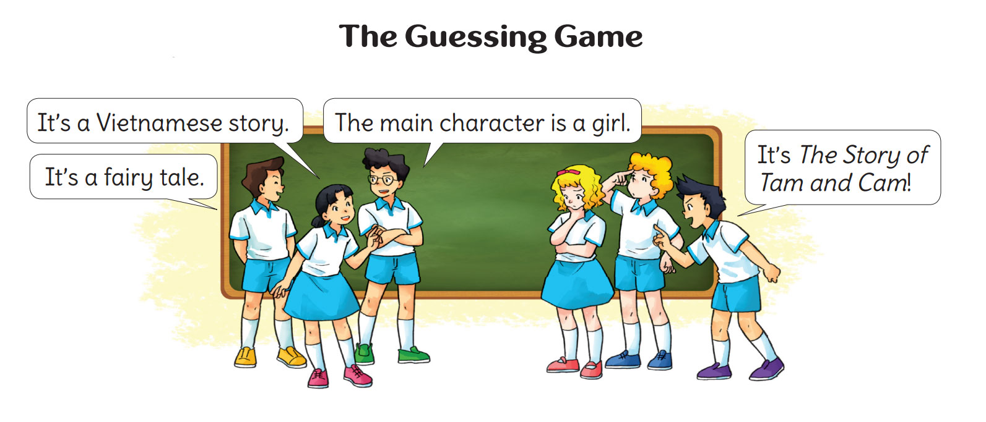
6. Let’s play

