Slide 1
Unit 7
How do you
lern English
Lesson 3

Slide 2
REVIEW

Slide 3



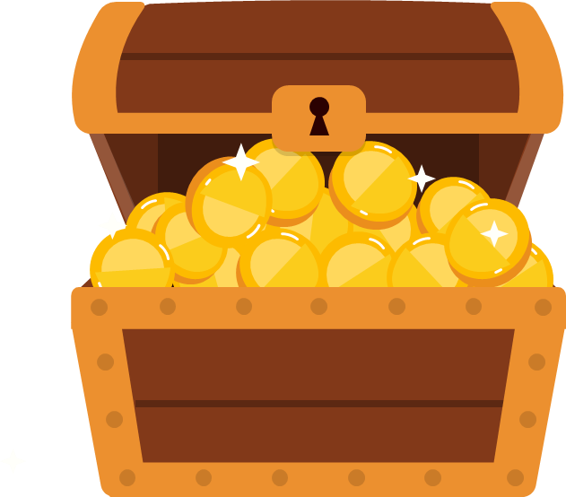
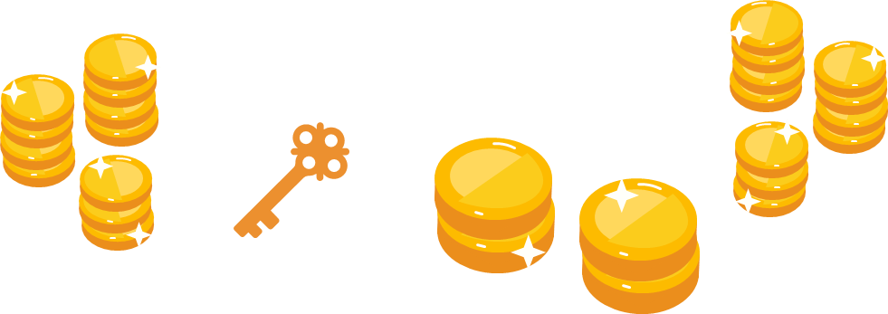
Play

Slide 4
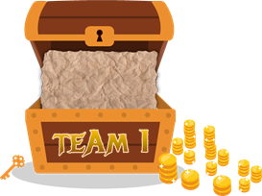

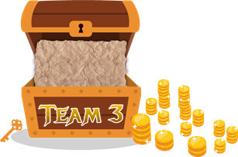



1
2
3
4
5
6
7
8
1
2
3
4
5
6
7
8
1
2
3
4
5
6
7
0
8
1
0
2
3
4
5
6
7
8
0
Exit

Slide 5

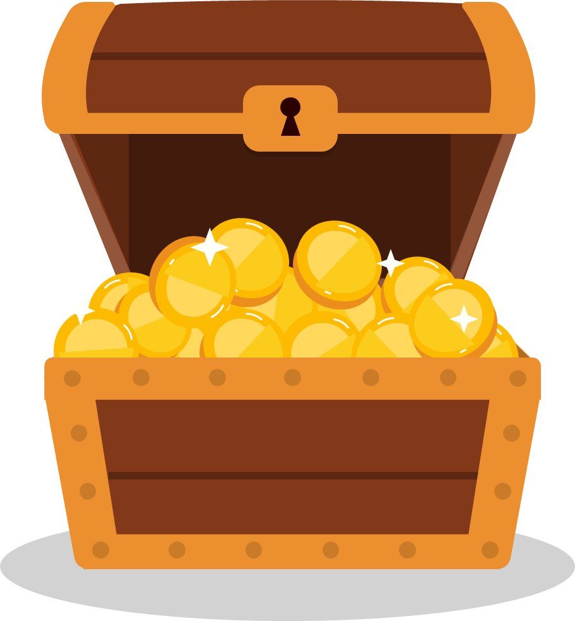

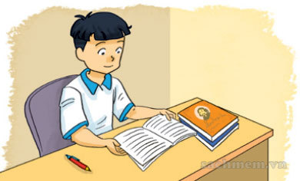

reading
XEM ĐÁP ÁN
How do you practise
______ English?
Back

Slide 6

writting
XEM ĐÁP ÁN
How do you practise
______ English?
Back

Slide 7
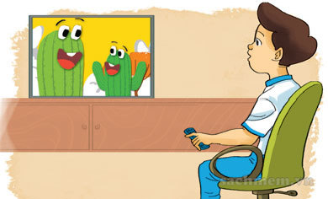
listening
XEM ĐÁP ÁN
How do you practise
______ English?
Back

Slide 8
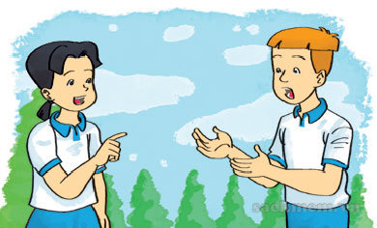
speaking
XEM ĐÁP ÁN
How do you practise
______ English?
Back

Slide 9
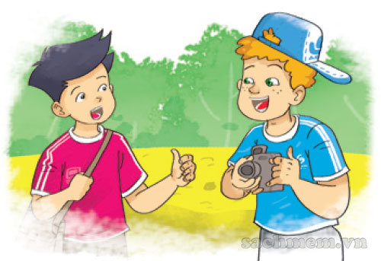
Because I want to
XEM ĐÁP ÁN
Why do you learn English?
________ talk with
my foreign friends
Back

Slide 10
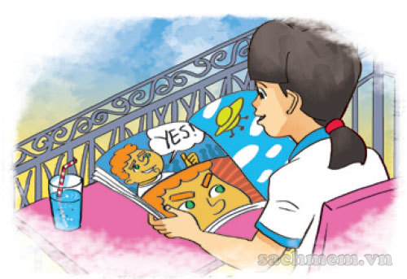
read
XEM ĐÁP ÁN
Why do you learn English?
Because I want to _____
the comic books.
Back

Slide 11
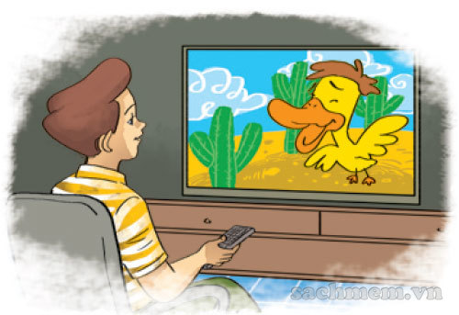
watch
XEM ĐÁP ÁN
Why do you learn English?
Because I want to _____
English cartoons on TV.
Back

Slide 12
sing
XEM ĐÁP ÁN
How do you learn English?
I _____ English songs.
Back

Slide 13
PRONUNCIATION

Slide 14

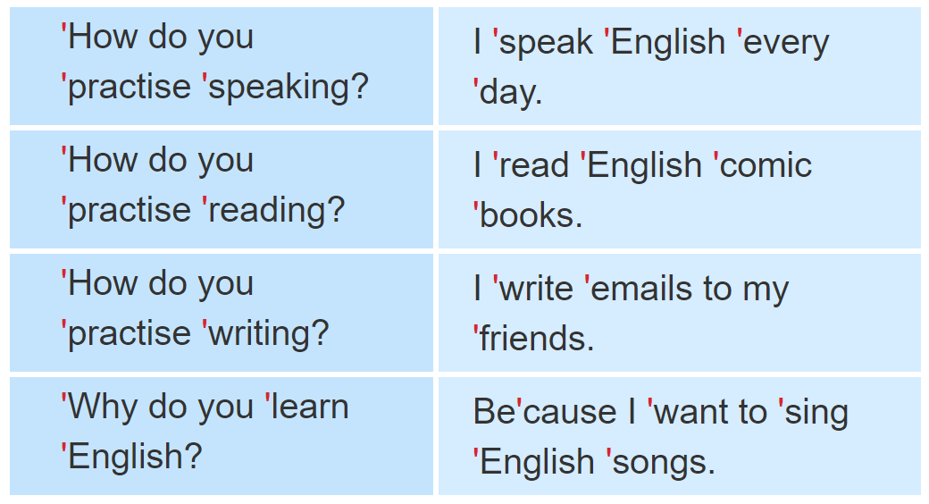
1. Listen and repeat.

Slide 15

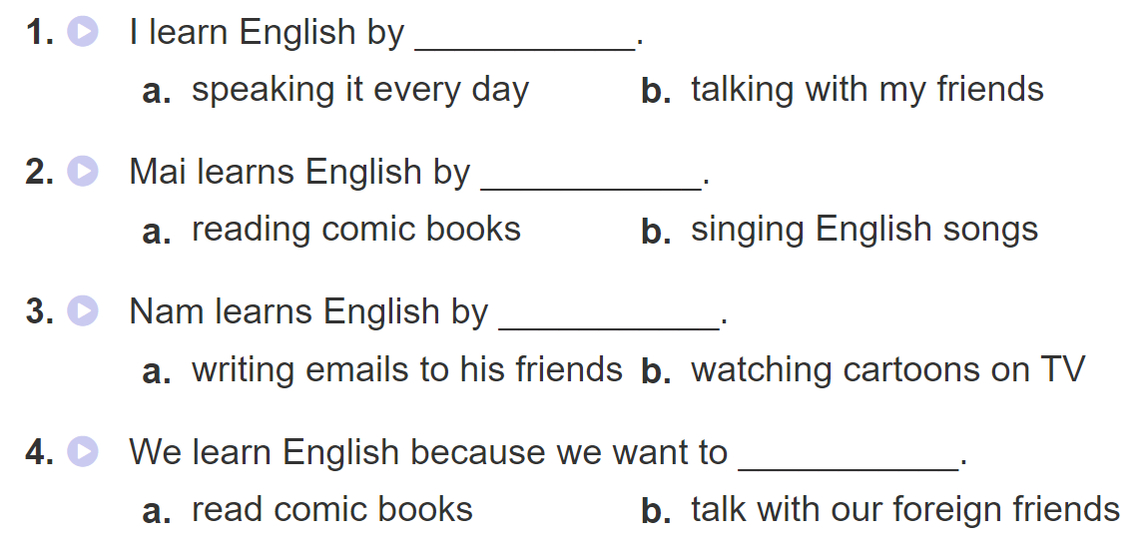
2. Listen and tick. Then write and say aloud

Slide 16
PRACTISE

Slide 17
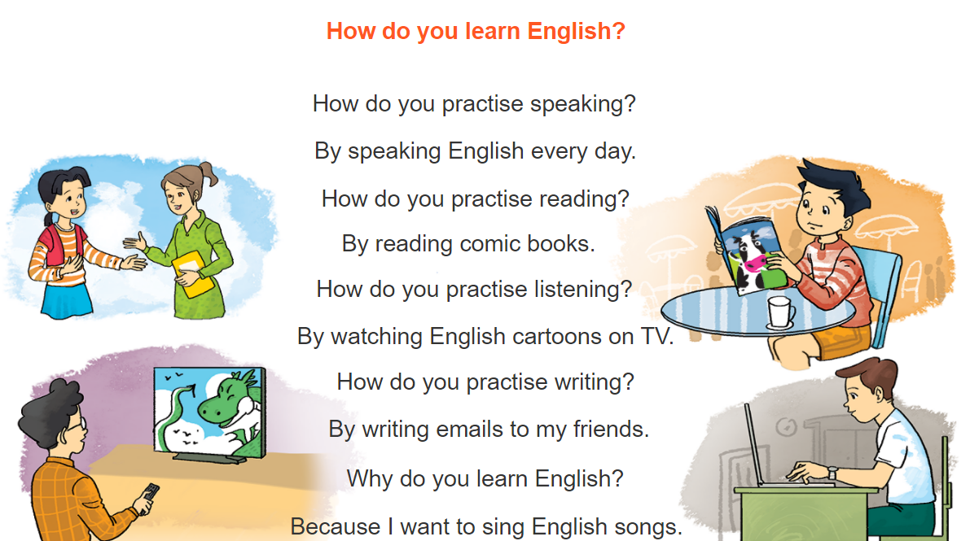



3. Let’s chant

Slide 18
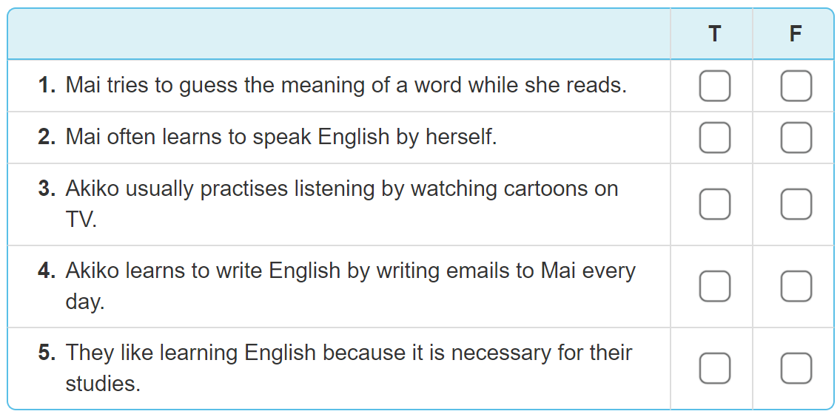
4. Read and tick True (T) or False (F)

Slide 19
4. Read and tick True (T) or False (F)
✔
✔
✔
✔
✔

Slide 20

4. Read and tick True (T) or False (F)
My name is Mai. I love reading English comic books. When I see a new word, I try to guess its meaning. I write the word in my notebook and say it a few times. I often stick new words on my bedroom walls and practise reading them aloud. I learn to speak English by talking with my foreign friends in my free time. My friend Akiko is good at English. She usually practises listening by watching cartoons on TV. She learns to write by writing emails to me every day. We are happy because we can understand each other. English is necessary for communication.

Slide 21
4. Read and tick True (T) or False (F)
✔
✔
✔
✔
✔

Slide 22
5. Write about how your friend learns English.
My friend is _______________.
He/She learns to read English by _______________.
He/She learns vocabulary by _______________.
He/She learns English because_______________.

Slide 23
6. Project
Discuss how you practise listening, speaking, reading and writing English.

