Slide 1


Slide 2
Monday, November 8th, 2021
Unit 6: How many lessons do you have today?
Lesson 3- p44,45

Slide 3

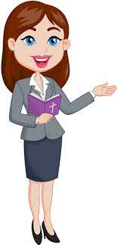
OBJECTIVES
(Mục tiêu của bài học hôm nay)
01
- Review the vocabularies and grammar in Lesson 1 and Lesson 2.
(Ôn tập từ vựng và cấu trúc ngữ pháp đã học trong Tiết 1 và 2)
- Identify the word stress of words in sentences
(Xác định được trọng âm của từ trong câu
02
- Practice speaking, listening and reading skills.
(Luyện tập các kĩ năng nói, nghe và đọc hiểu.)
03
Notes:
Thanh Yến Trần 0967 255 149 zalo/ FB https://www.facebook.com/thanhyentrananhngutaymy/

Slide 4
REVIEW

Slide 5


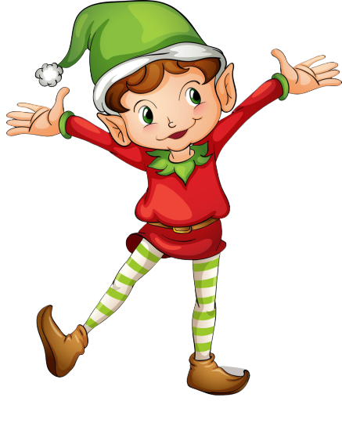
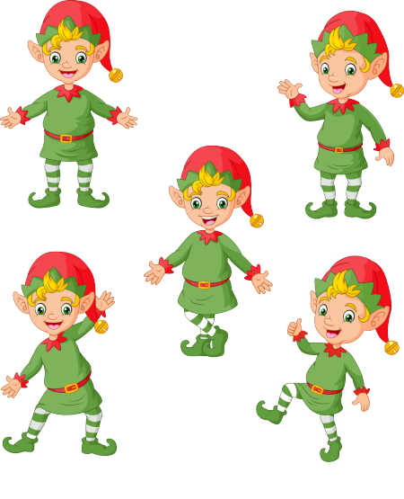
RING THE GOLDEN BELL
Notes:
Ms Huyền Phạm - 0936.082.789 – YOUTUBE: MsPham. Facebook: Dạy và học cùng công nghệ.

Slide 6



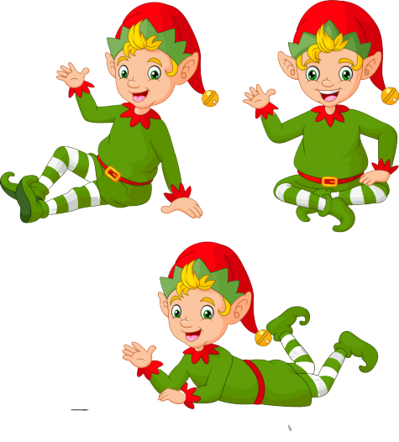
Ring The Golden Bell
Question 1
Answer
___________?
I have four: Maths, English, Art, IT.
How many lessons do you have today
1
2
3
4
5
6
7
8
9
10
Next
Notes:
Ms Huyền Phạm - 0936.082.789 – YOUTUBE: MsPham. Facebook: Dạy và học cùng công nghệ.

Slide 7
Ring The Golden Bell
Question 2
Answer
________________?
I have Maths everyday.
How often do you have Maths
1
2
3
4
5
6
7
8
9
10
Next
Notes:
Ms Huyền Phạm - 0936.082.789 – YOUTUBE: MsPham. Facebook: Dạy và học cùng công nghệ.

Slide 8
Ring The Golden Bell
Question 3
Answer
________________?
I have English four times a week.
How often do you have English
1
2
3
4
5
6
7
8
9
10
Next
Notes:
Ms Huyền Phạm - 0936.082.789 – YOUTUBE: MsPham. Facebook: Dạy và học cùng công nghệ.

Slide 9
Ring The Golden Bell
Question 4
Answer
________________?
I have Art twice a week.
How often do you have Art
1
2
3
4
5
6
7
8
9
10
Next
Notes:
Ms Huyền Phạm - 0936.082.789 – YOUTUBE: MsPham. Facebook: Dạy và học cùng công nghệ.

Slide 10
Ring The Golden Bell
Question 5
Answer
___________?
I have three: Vietnamese, Music, PE, Maths.
How many lessons do you have today
1
2
3
4
5
6
7
8
9
10
Next
Notes:
Ms Huyền Phạm - 0936.082.789 – YOUTUBE: MsPham. Facebook: Dạy và học cùng công nghệ.

Slide 11
Ring The Golden Bell
Question 6
Answer
___________?
I have five: Music, Science, Maths, English, Art.
How many lessons do you have today
1
2
3
4
5
6
7
8
9
10
Next
Notes:
Ms Huyền Phạm - 0936.082.789 – YOUTUBE: MsPham. Facebook: Dạy và học cùng công nghệ.

Slide 12
Ring The Golden Bell
Question 7
Answer
________________?
I have Science once a week.
How often do you have Science
1
2
3
4
5
6
7
8
9
10
Next
Notes:
Ms Huyền Phạm - 0936.082.789 – YOUTUBE: MsPham. Facebook: Dạy và học cùng công nghệ.

Slide 13
Ring The Golden Bell
Question 8
Answer
___________?
I have four: Maths, English, Art, IT.
How many lessons do you have today?
1
2
3
4
5
6
7
8
9
10
Next
Notes:
Ms Huyền Phạm - 0936.082.789 – YOUTUBE: MsPham. Facebook: Dạy và học cùng công nghệ.

Slide 14
Ring The Golden Bell
Question 9
Answer
___________?
I have six books.
How many books do you have today
1
2
3
4
5
6
7
8
9
10
Next
Notes:
Ms Huyền Phạm - 0936.082.789 – YOUTUBE: MsPham. Facebook: Dạy và học cùng công nghệ.

Slide 15
Ring The Golden Bell
Question 10
Answer
___________?
I do morning exercises everyday.
How often do you do morning exercise
1
2
3
4
5
6
7
8
9
10
Next
Notes:
Ms Huyền Phạm - 0936.082.789 – YOUTUBE: MsPham. Facebook: Dạy và học cùng công nghệ.

Slide 17
PRONUNCIATION

Slide 18
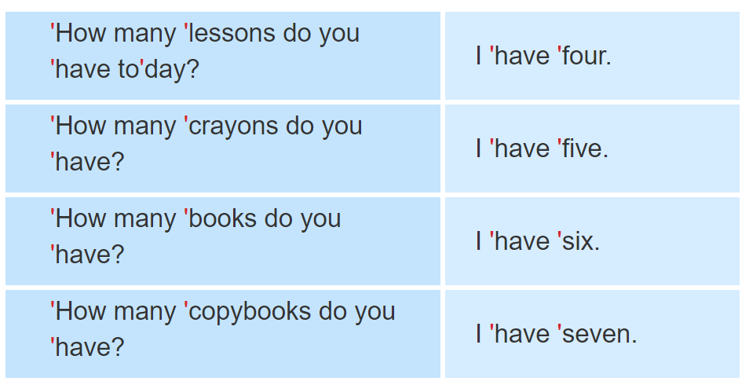

1. Listen and repeat.

Slide 19
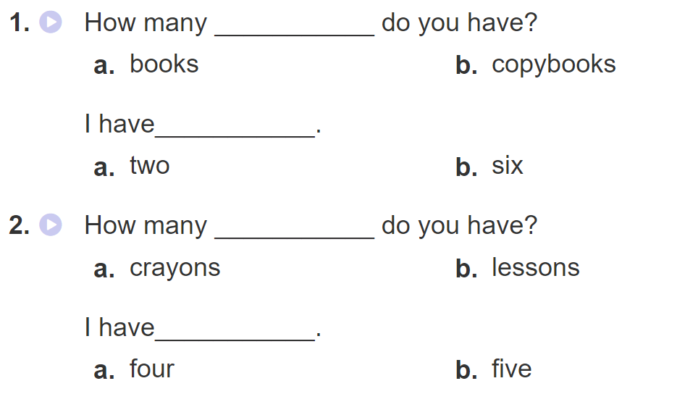
2. Listen and circle a or b. Then say the sentences aloud.

Slide 20
PRACTISE

Slide 21
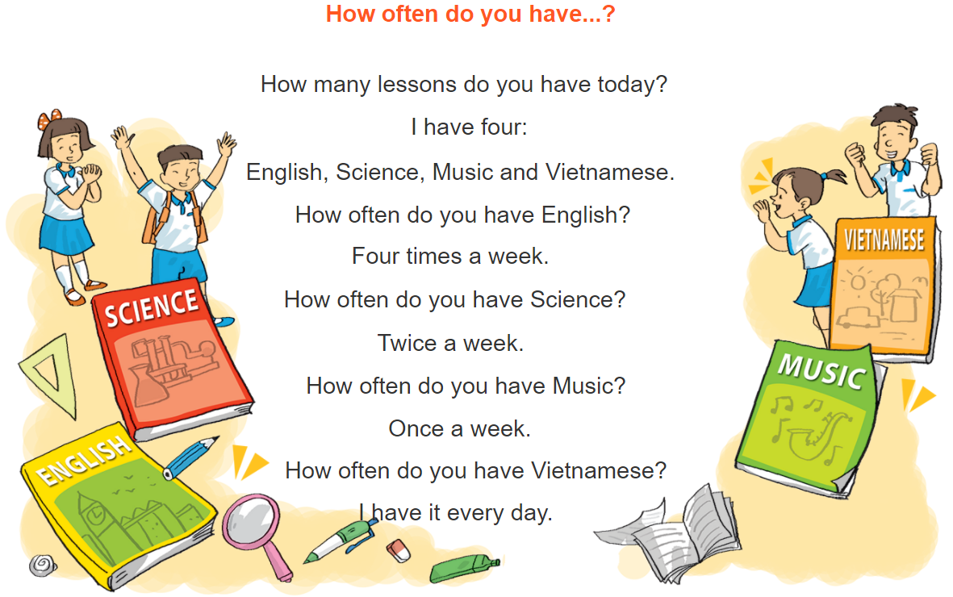
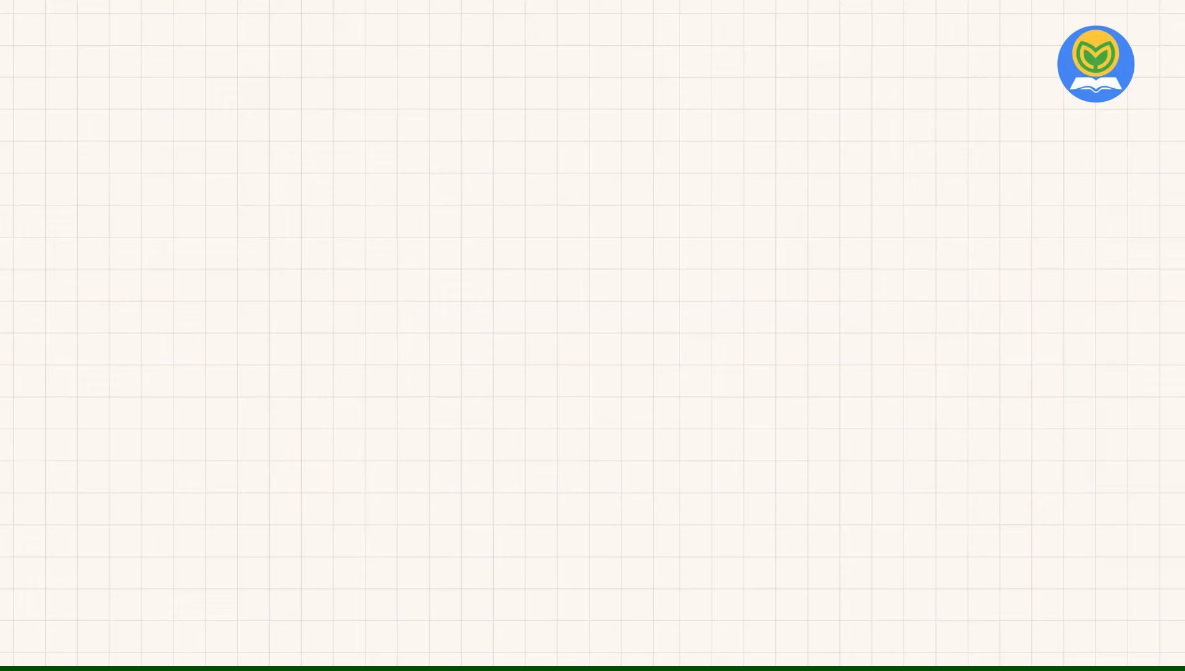


3. Let’s chant

Slide 22
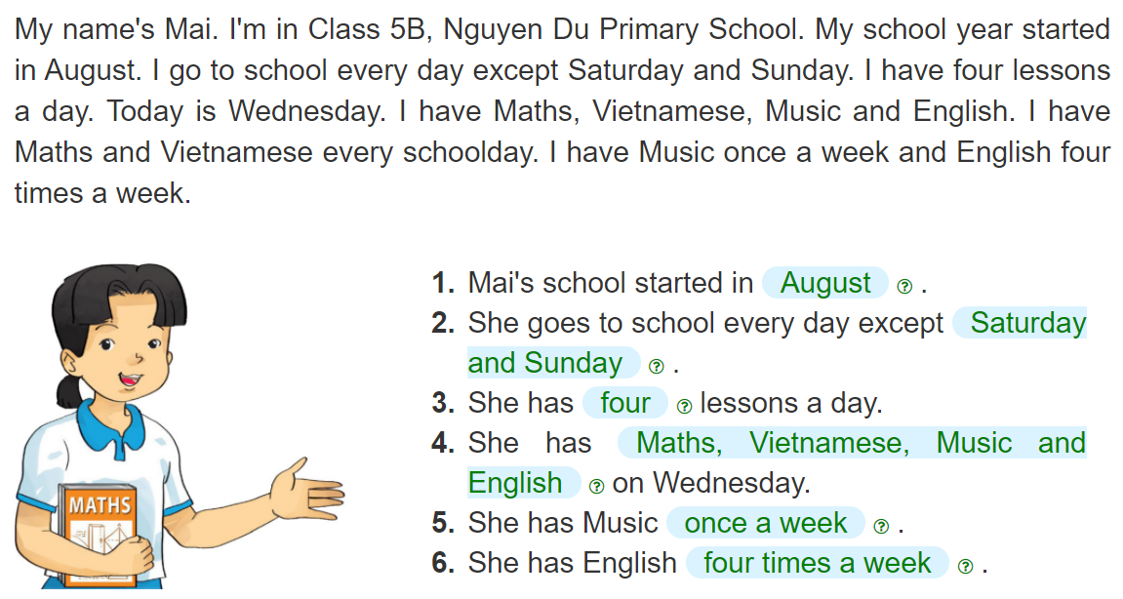
4. Read and complete
__________
__________
______________
______
________________________________________
________
______________
_____________________

Slide 23
5. Write about your school and lessons.
My school started in_________________.
I go to school _________________.
I have_______ lessons a day. I have _______________
_____________________________________________
on Wednesday. I have Music_____________________.
I have English _____________________.

Slide 24



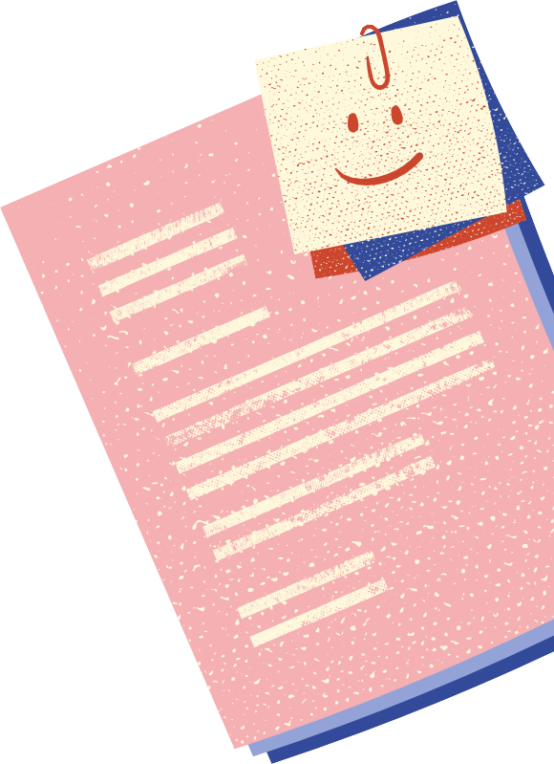
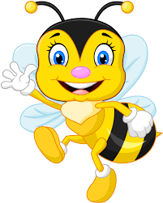


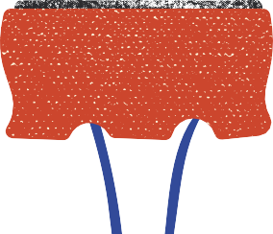
Let’s remember!
(Cùng ghi nhớ nhé!)
Write about 10 sentences about your school and your lessons on Padlet.
(Viết khoảng 10 câu về ngôi trường và các môn học.
Review the words, model sentences and dialogues in Unit 6.
(Ôn lại từ vựng và mẫu câu trong Bài 6)
PREVIEW
(Xem trước)
SB: Unit 7 – Lesson 1

Slide 25
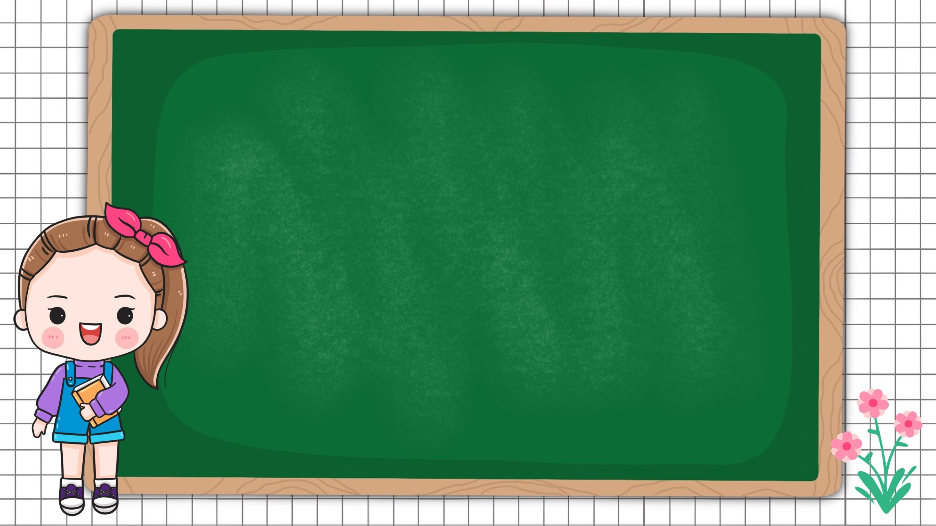

Monday, November 8th, 2021
Unit 6: Lesson 3 – p44,45
1. Word stress
A: How many lessons do you have today?
B: I have four: Maths, Vietnamese, Art and PE.
2. Practice
3. Homelink
Writing on Padlet/ WB (SBT): p26,27
SB: Unit 7 – Lesson 1

Slide 26
6. Project
Write a letter to a pen friend to talk
about your timetable.

