Slide 1

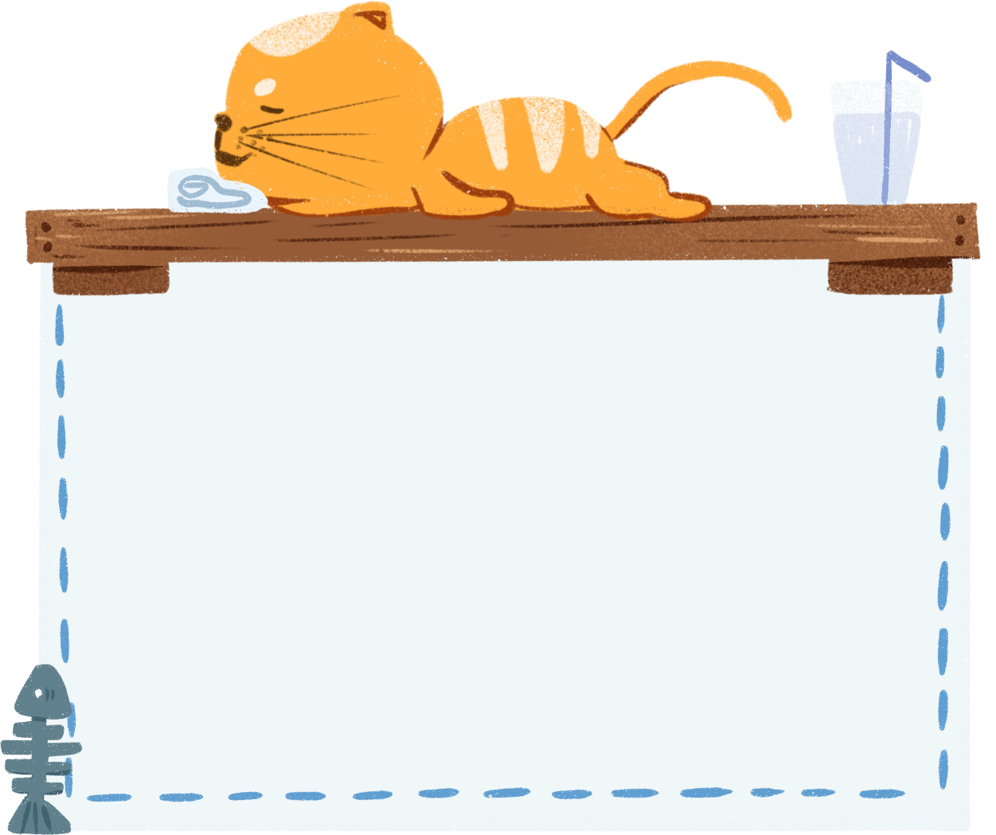
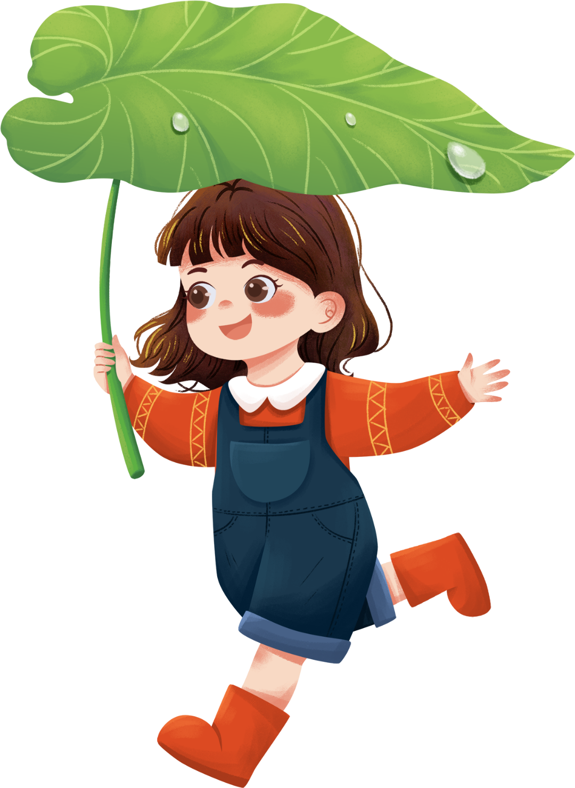

Welcome to
our class
Book : English 3
Teacher : Miss Linh

Slide 2
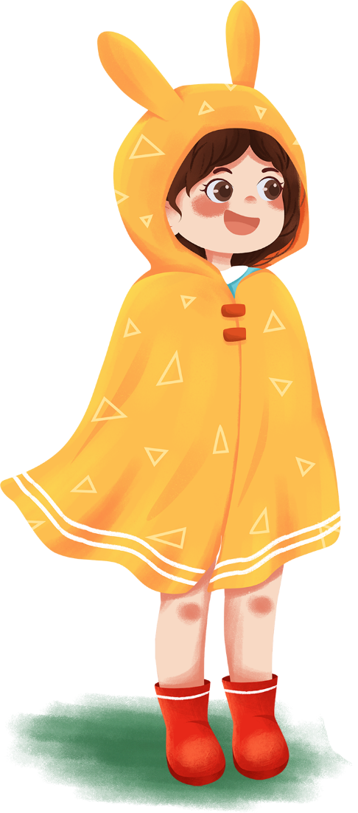
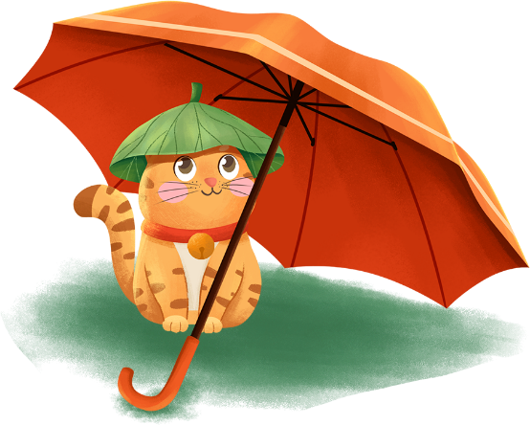
Unit 8:
This is my pen
Lesson 3

Slide 3
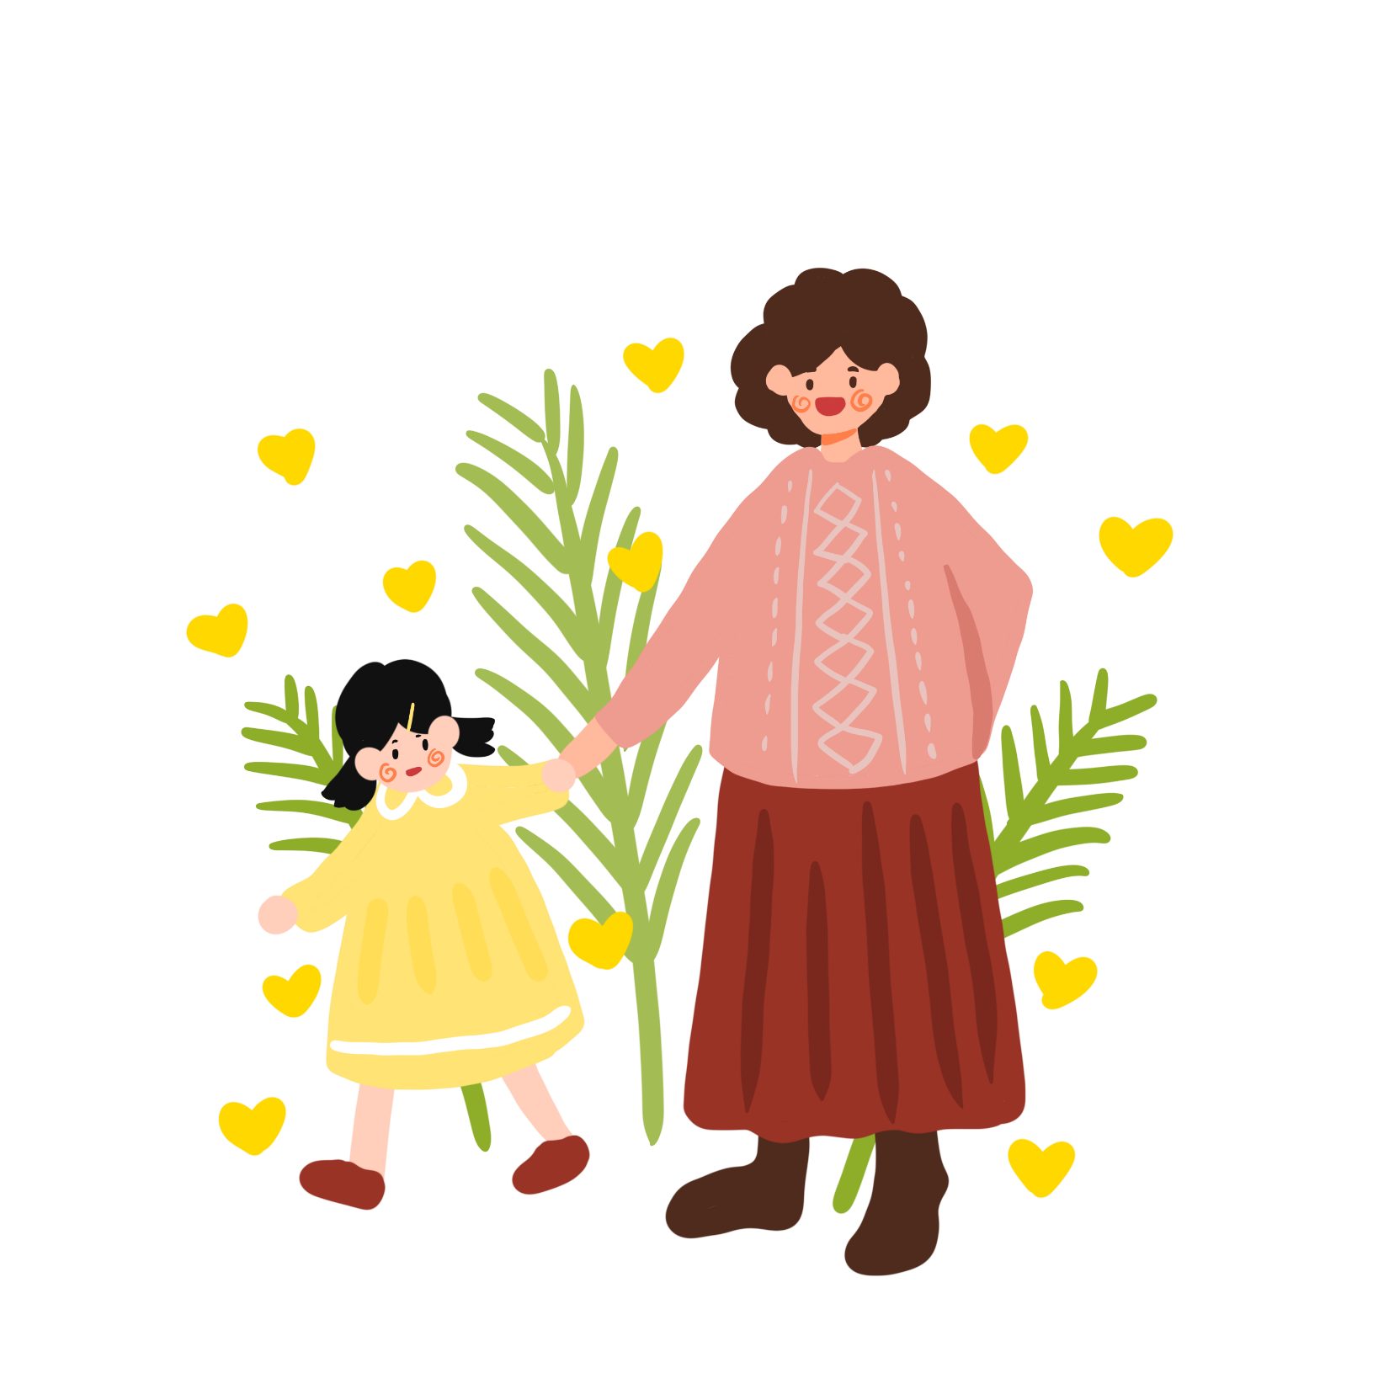
Objectives
2.
Learn the phonics “r” and “th” .
1.
Review the words and sentences.
Chúng ta sẽ học 2 âm mới “r” and “th” .
Ôn tập lại từ vựng và mẫu câu.

Slide 4
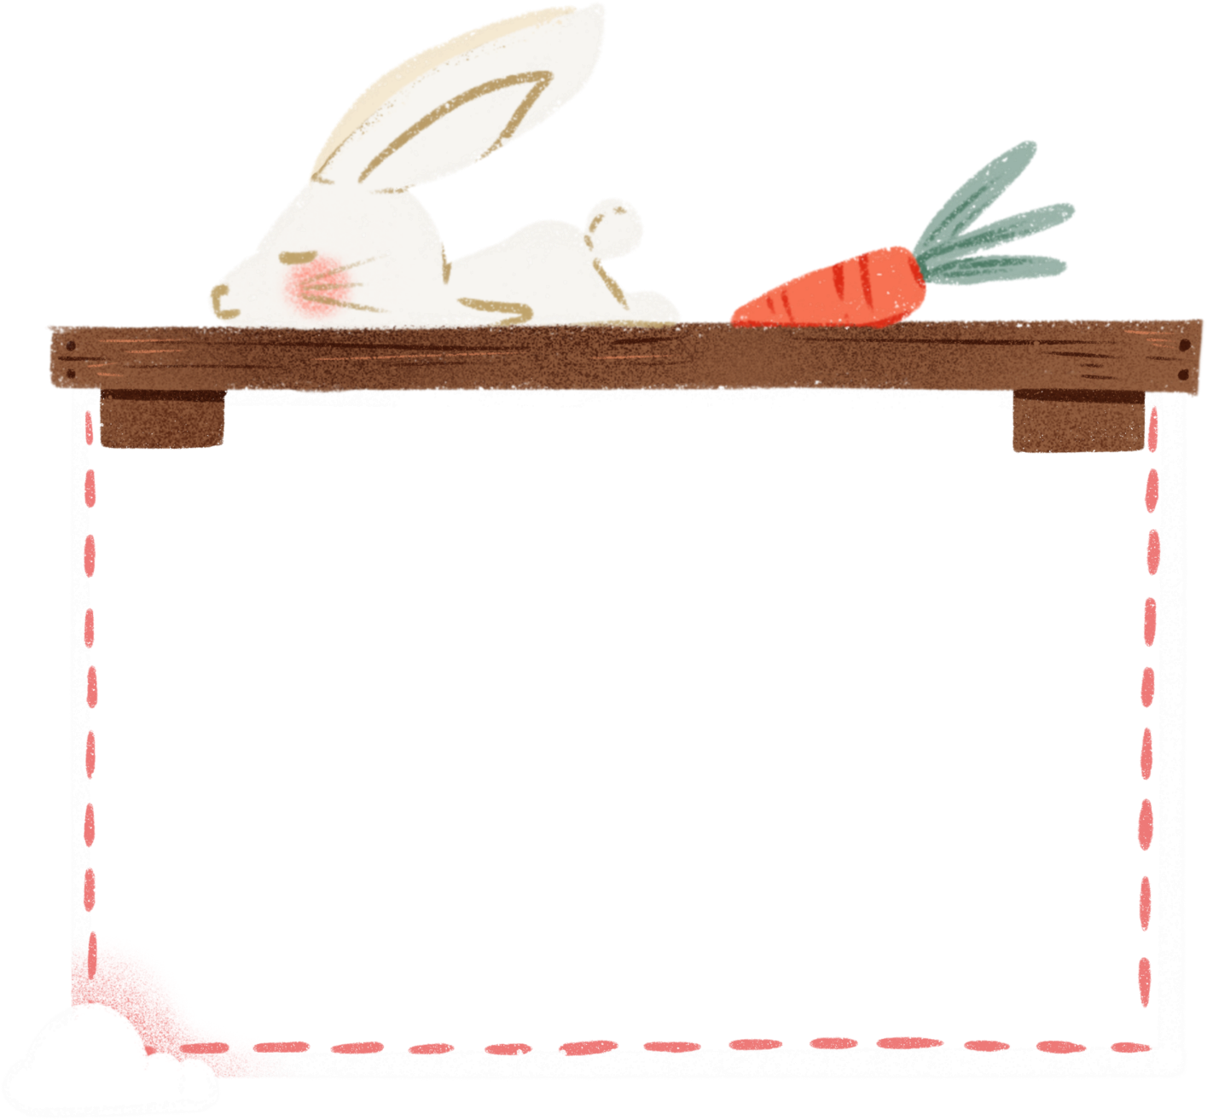
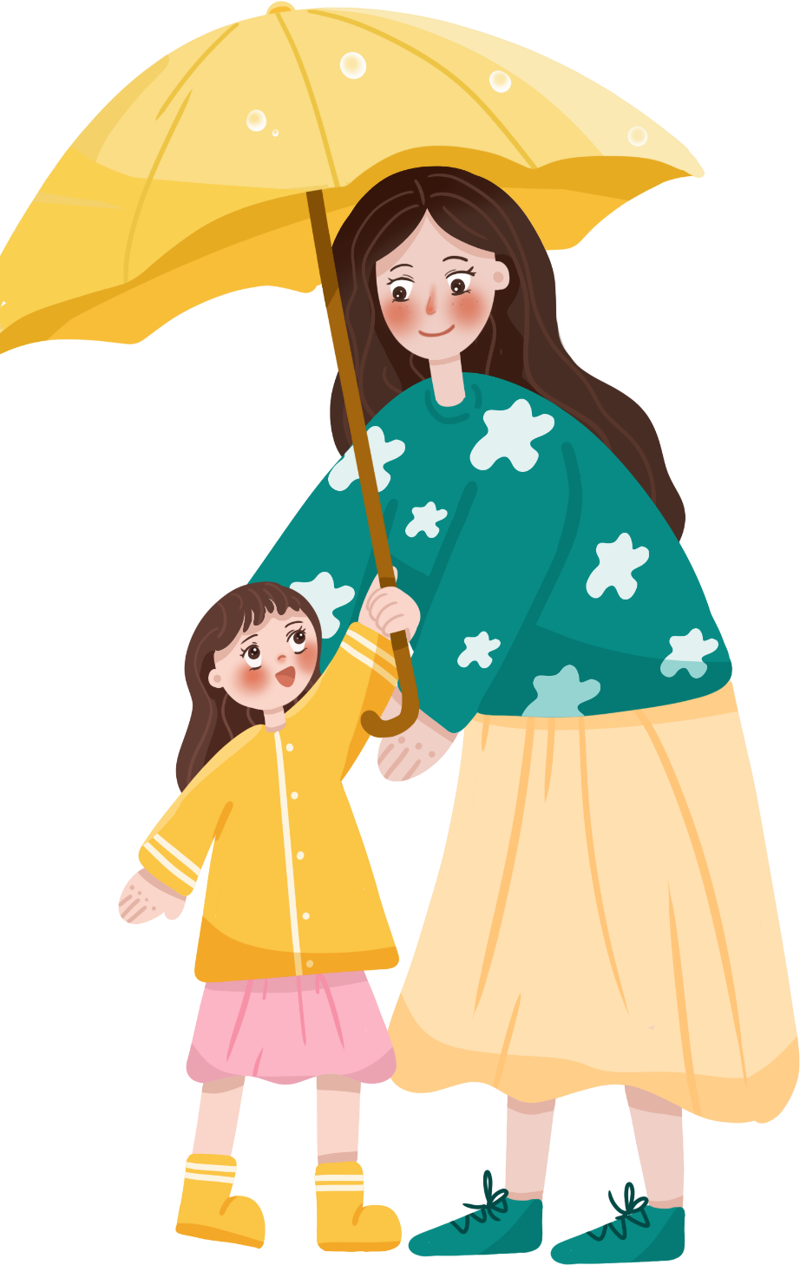
Warm up

Slide 5
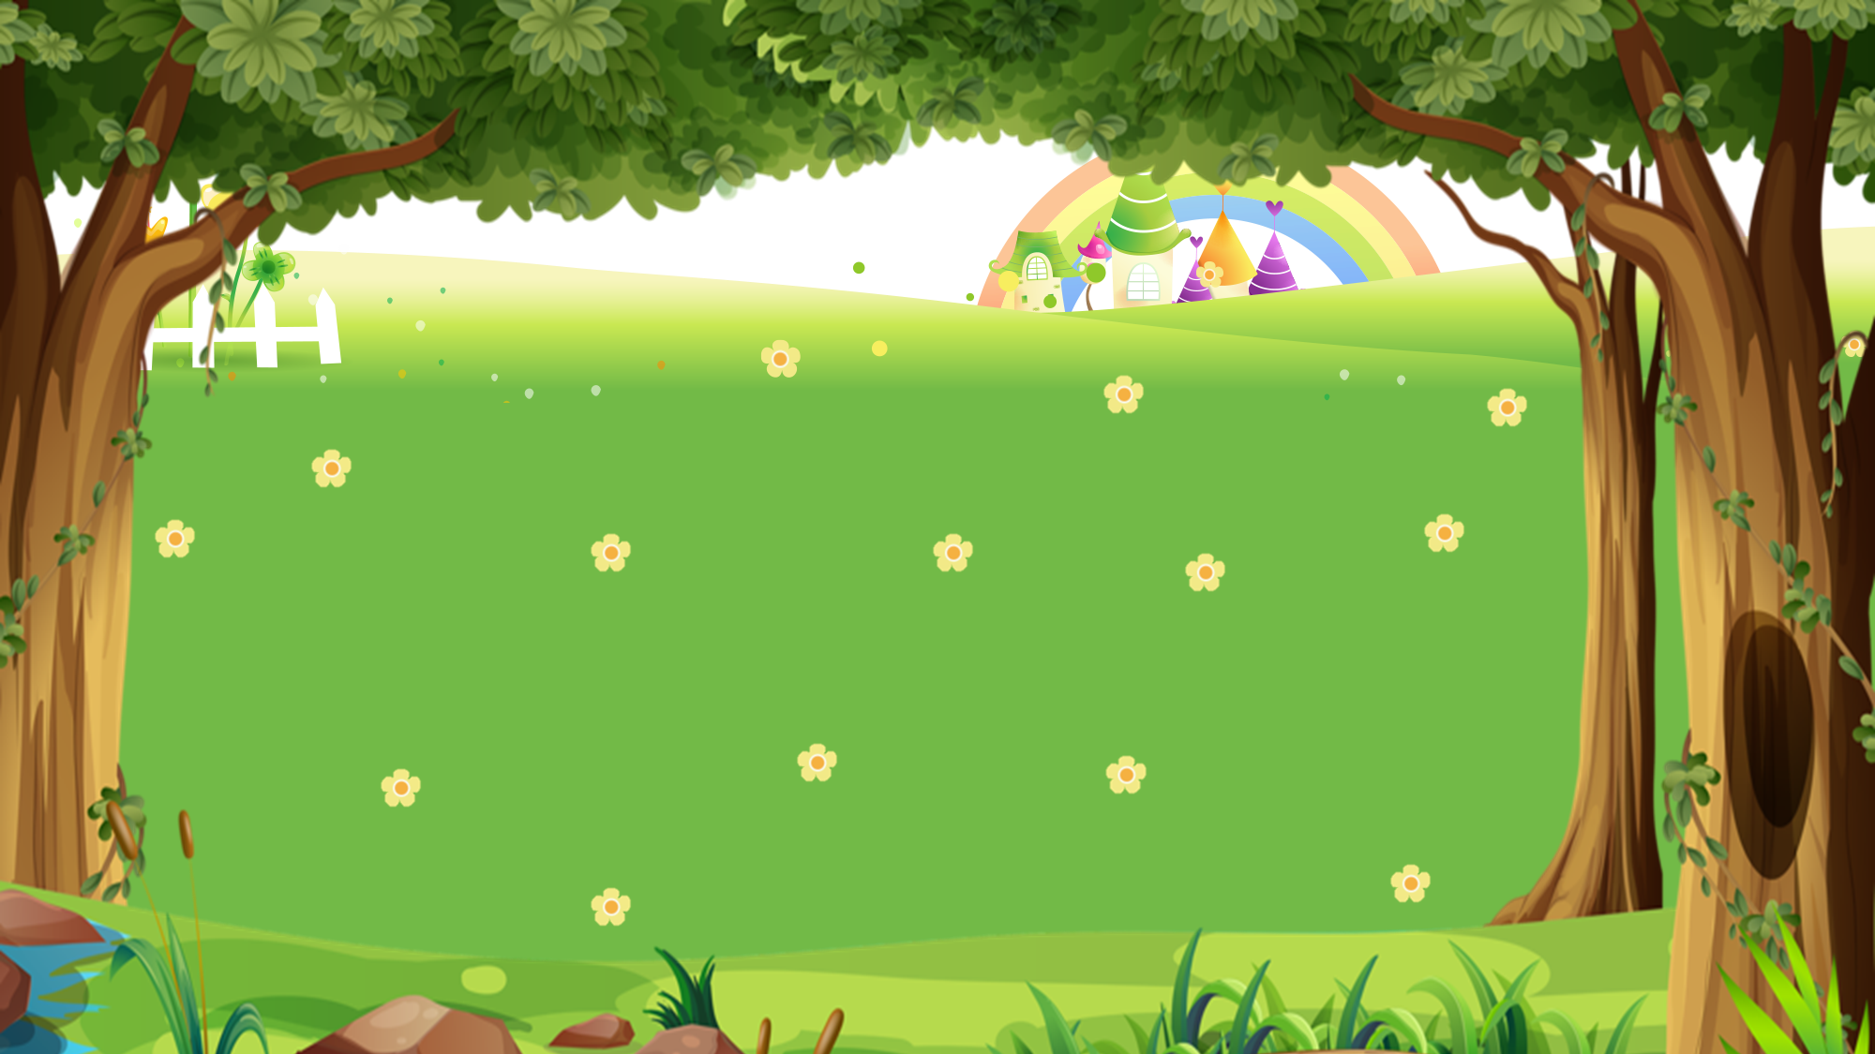
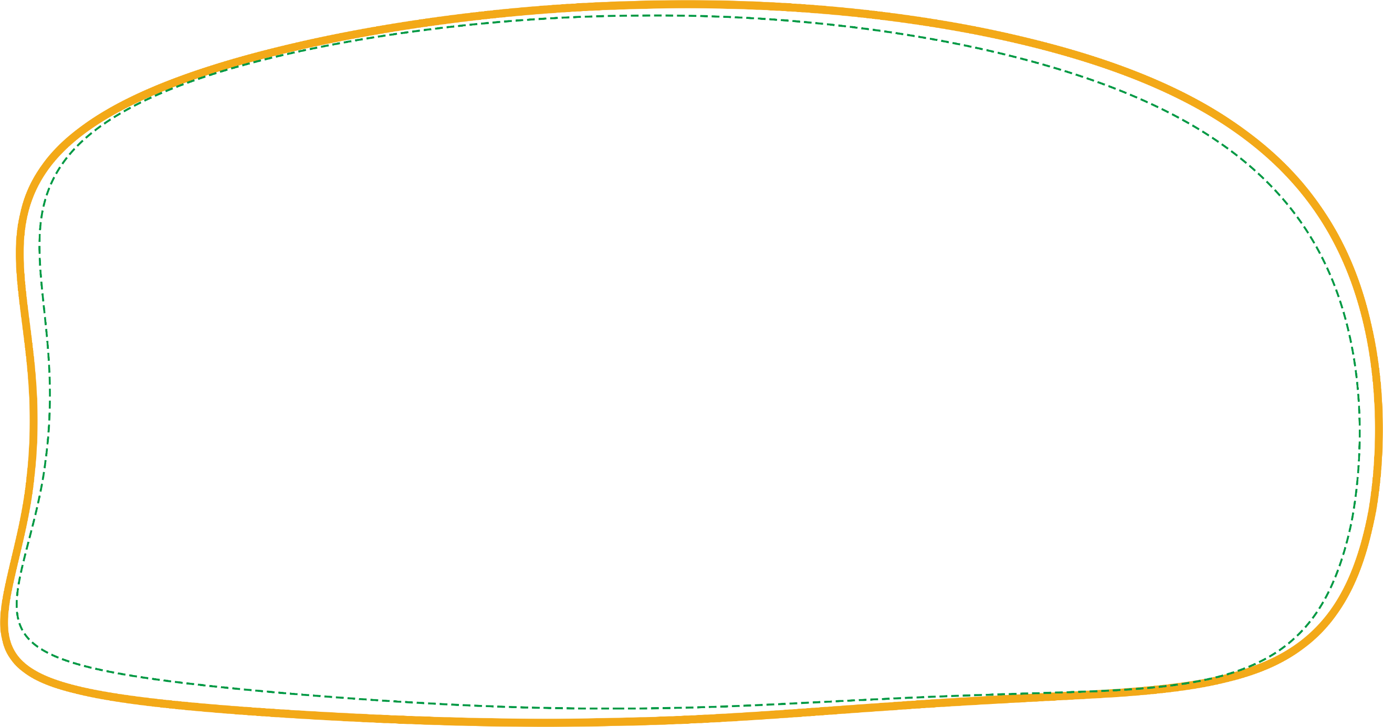


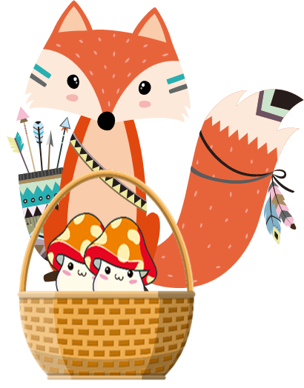

PICKING MUSHROOMS

Slide 6



1
2
3
4
5
6
7
8
9
10
End

Slide 7


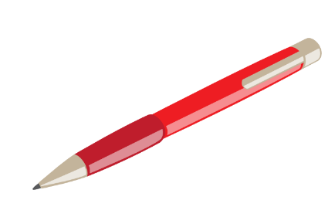






Thanh Am Primary School
Time’s up
1
2
3
4
5
6
7
8
9
10
This is my _____.
Back
A. pen
B. pens
C. pencil
A.

Slide 8

Thanh Am Primary School
Time’s up
1
2
3
4
5
6
7
8
9
10
_____ are my pencil sharpeners.
Back
A. This
B. Those
C. That
A.

Slide 9
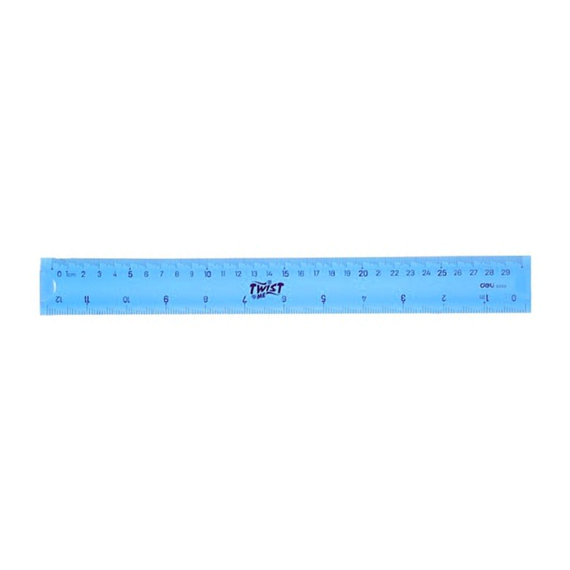
Thanh Am Primary School
Time’s up
1
2
3
4
5
6
7
8
9
10
That is my _____.
Back
A. rubber.
B. pen.
C. ruler
A.

Slide 10
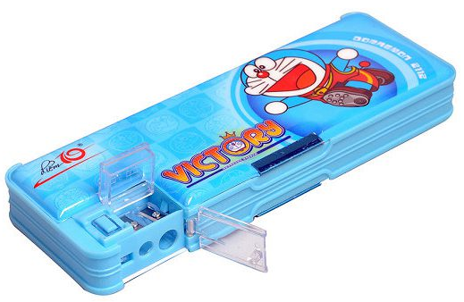
Thanh Am Primary School
Time’s up
1
2
3
4
5
6
7
8
9
10
_____ is my pencil case.
Back
A. Those
B. These
C. That
A.

Slide 11
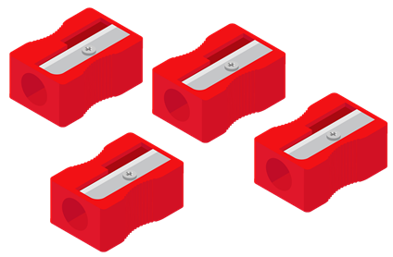
Thanh Am Primary School
Time’s up
1
2
3
4
5
6
7
8
9
10
_____ are my pencil sharpeners.
Back
A. That
B. These
C. This
A.

Slide 12

Thanh Am Primary School
Time’s up
1
2
3
4
5
6
7
8
9
10
____ is my school bag.
Back
A. These
B. This
C. Those
A.

Slide 13

Thanh Am Primary School
Time’s up
1
2
3
4
5
6
7
8
9
10
These are my_____.
Back
A. Pencil cases
B. rulers
C. rubbers
A.

Slide 14
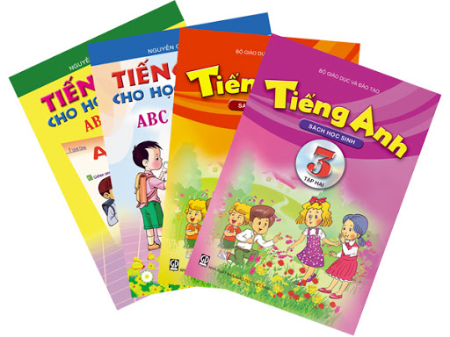
Thanh Am Primary School
Time’s up
1
2
3
4
5
6
7
8
9
10
Those are my_____.
Back
A. book
B. books
C. notebooks
A.

Slide 15
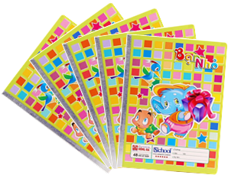
Thanh Am Primary School
Time’s up
1
2
3
4
5
6
7
8
9
10
These are my_____.
Back
A. notebook
B. notebooks
C. books
A.

Slide 16
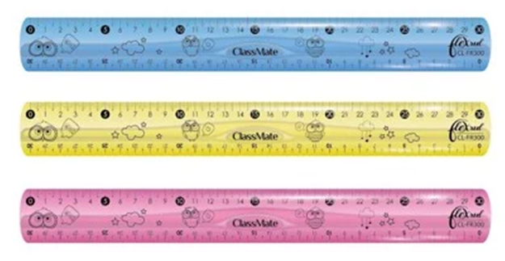
Thanh Am Primary School
Time’s up
1
2
3
4
5
6
7
8
9
10
Those are my _____.
Back
A. pen
B. ruler
C. rulers
A.

Slide 17
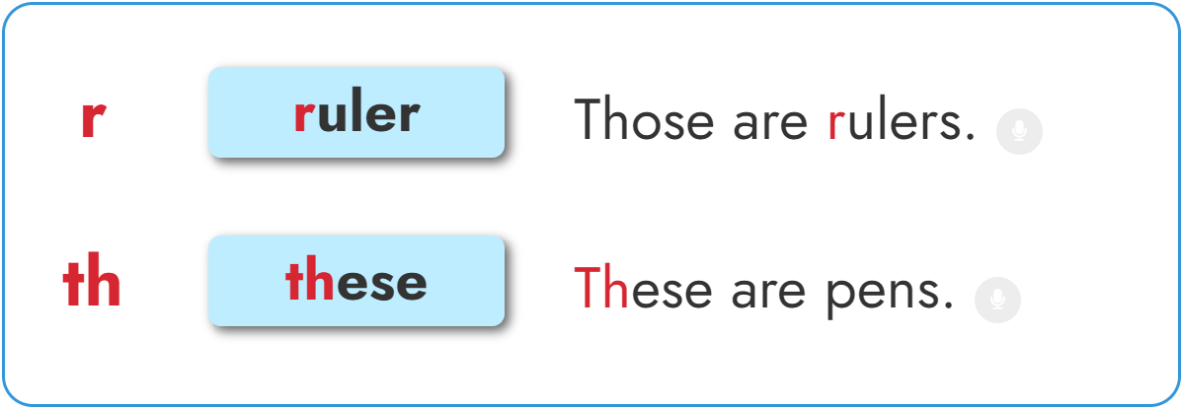


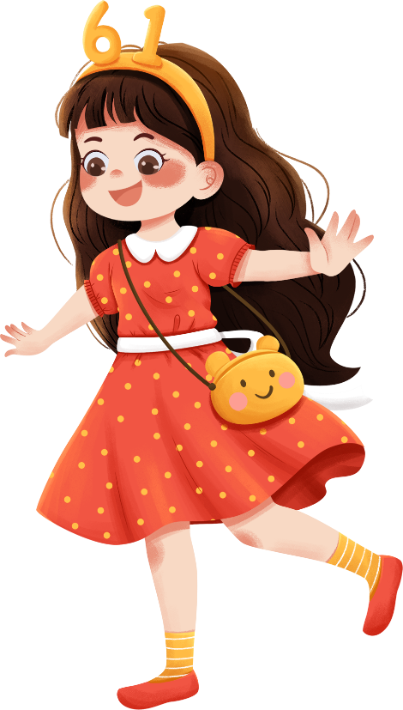

1. Listen and repeat.

Slide 18

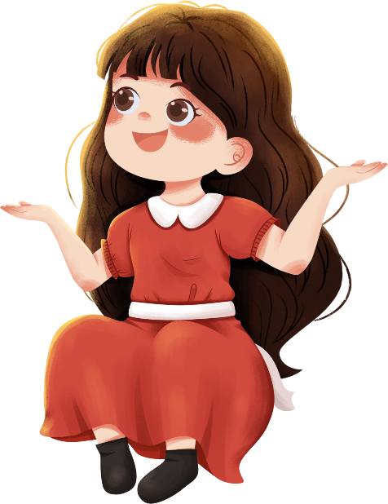
1. Listen and repeat.

Slide 19
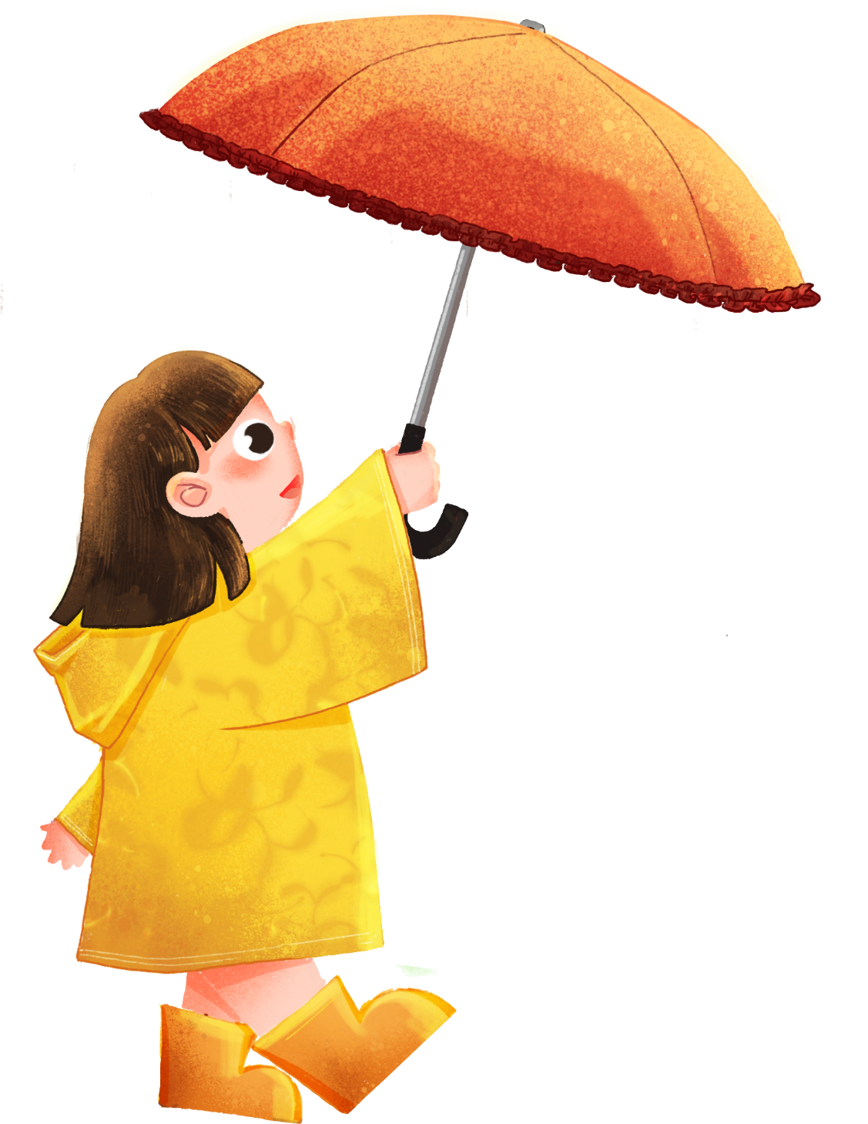
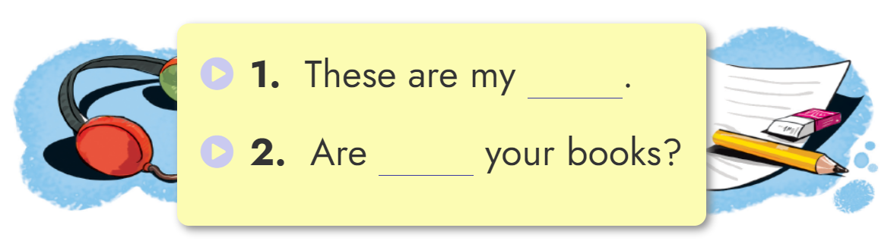

2. Listen and write.
rulers
these

Slide 20
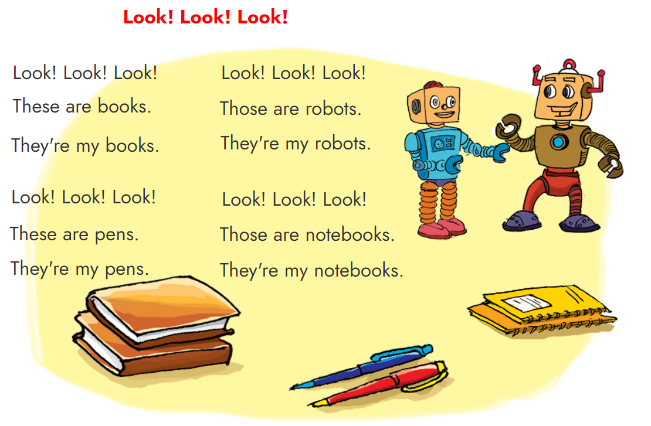


3. Let’s sing.

Slide 21
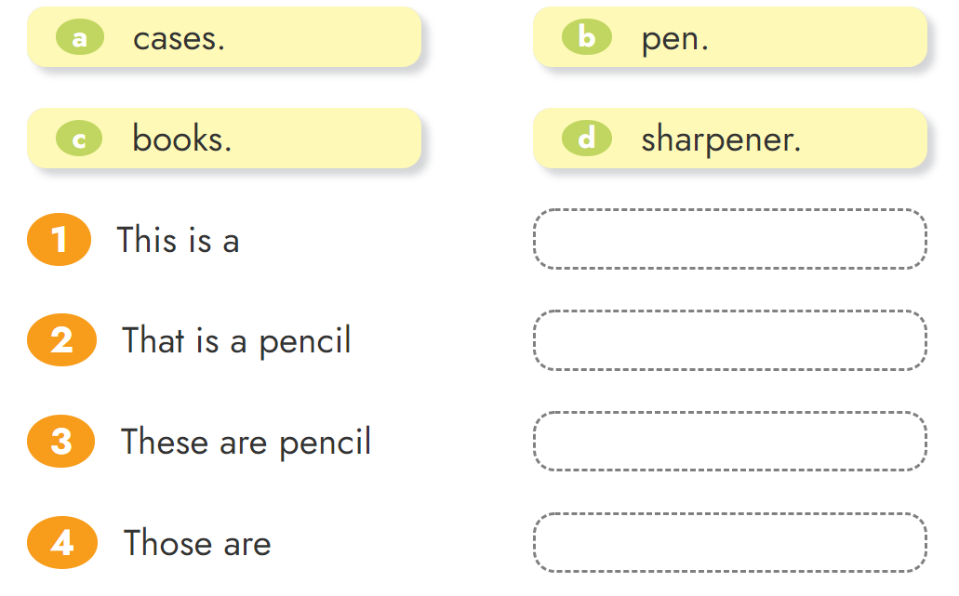





4. Read and match.

Slide 22
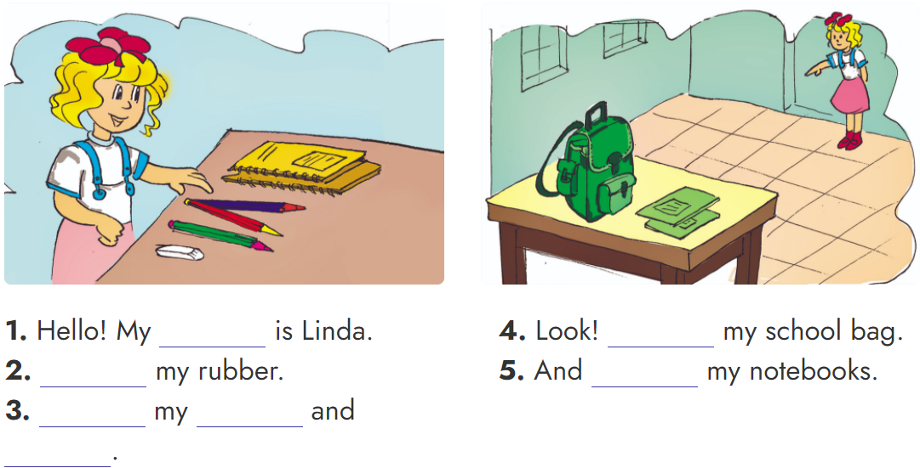
5. Read and match.
name
That is
This is
Those are
These are
notebooks
pencils

Slide 23
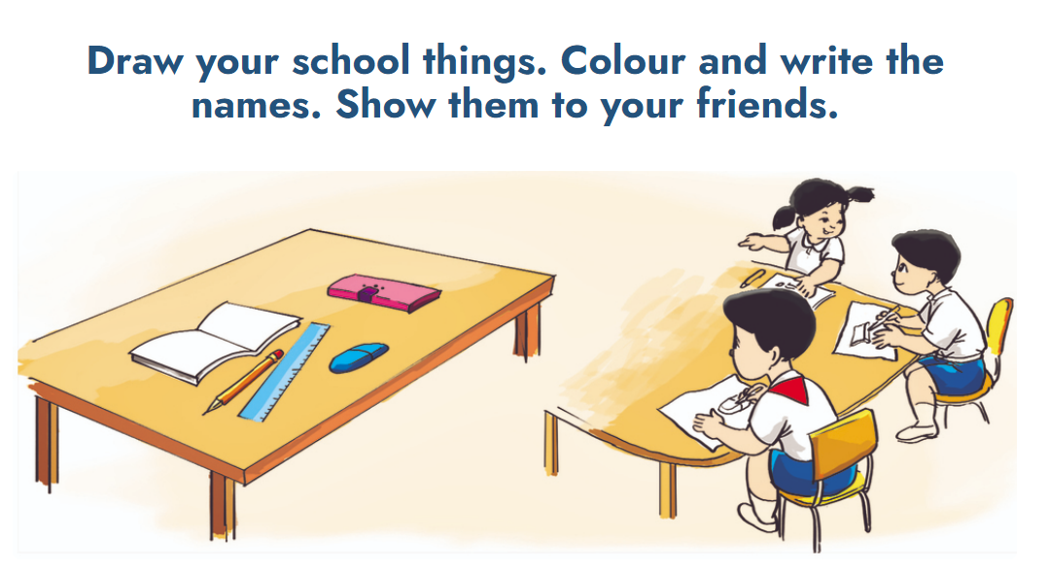
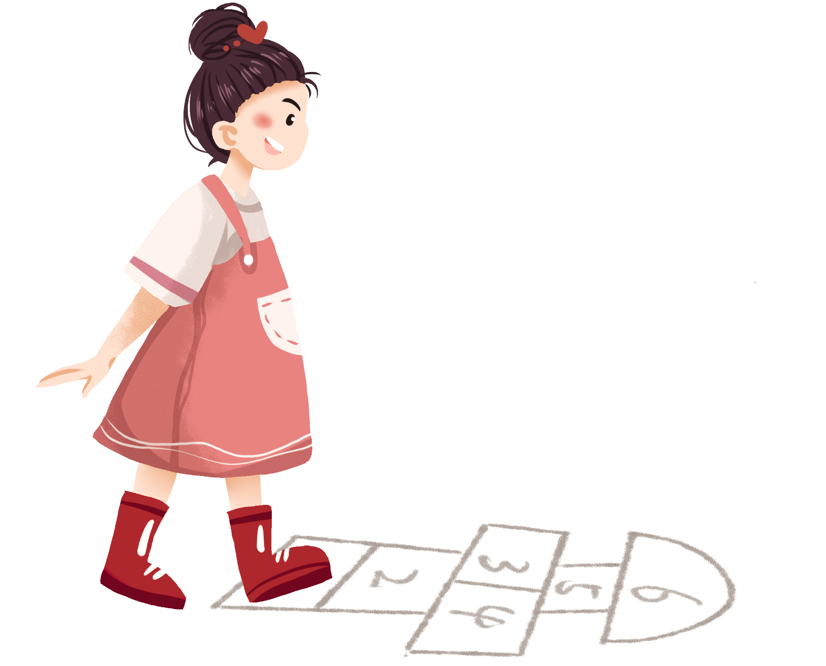
6. Project

Slide 24

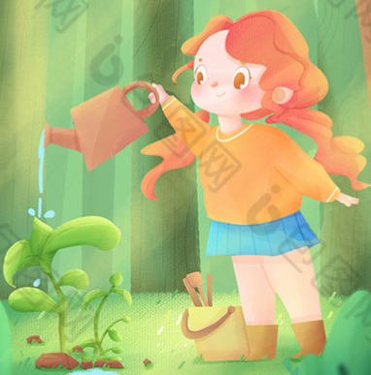
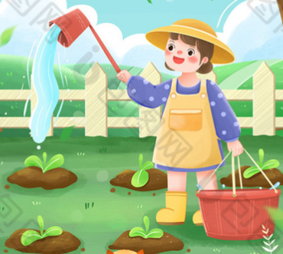
1.
Using the new phonics “r” and “th” .
2.
Do the homework in WB (SBT): page 34 - 35
3.
Prepare the new lesson : Unit 9 Lesson 1

Slide 25

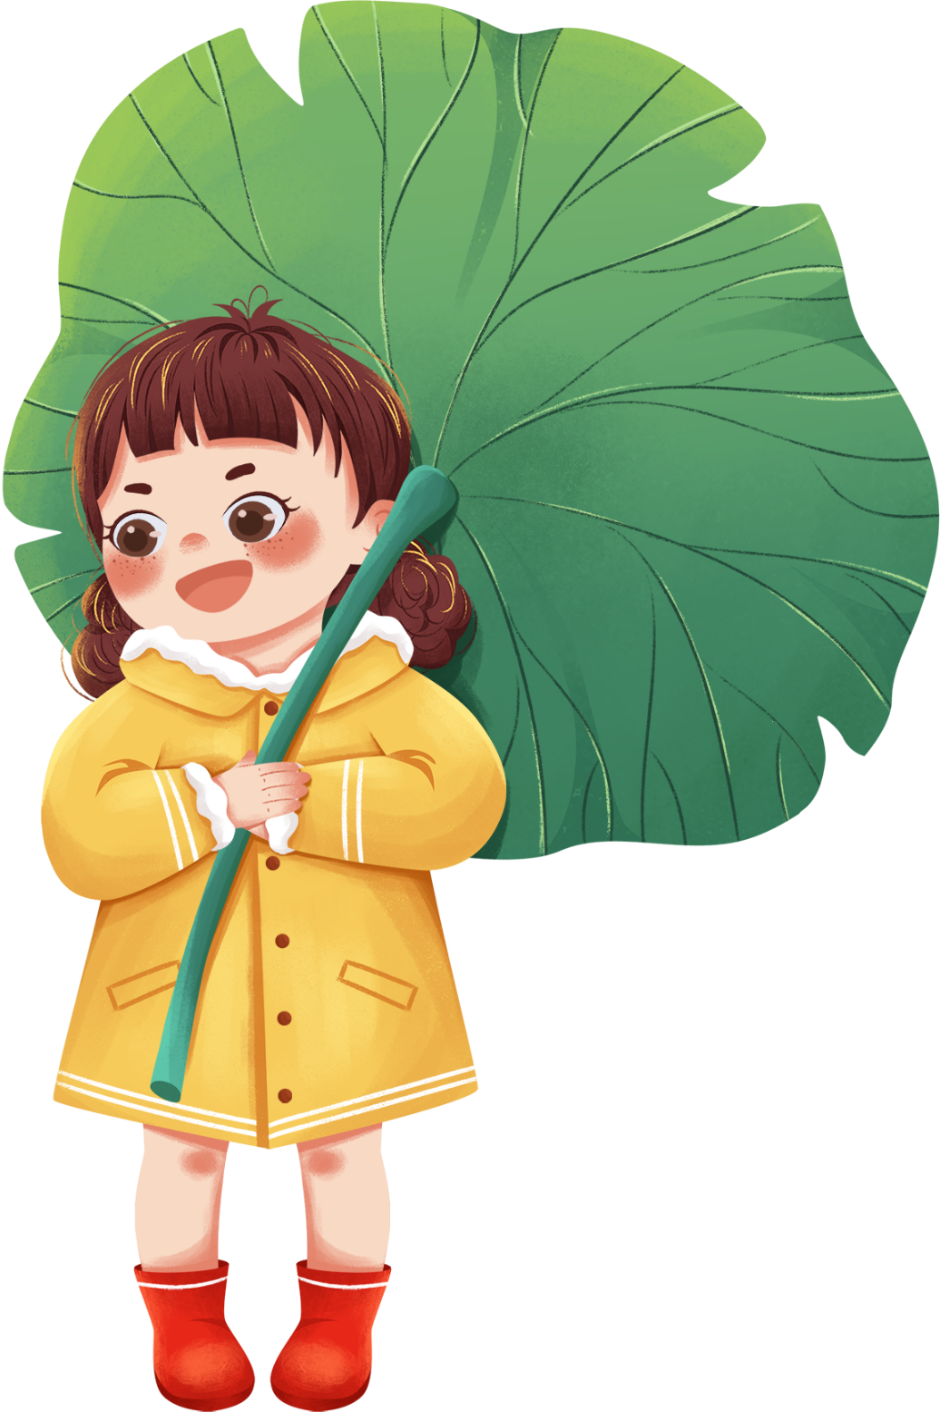
Tuesday, November 30 2021
Unit 8: This is my pen - Lesson 3
1. Phonics
- Phonic “r” : ruler -> Those are rulers.
- Phonic “th” : these -> These are pens.
2. Homework
- WB (SBT) : Page 34 - 35
- Prepare : Unit 9 - Lesson 1
th

Slide 26


