Slide 1



Welcome
to our Class!
Book: English 3
Prepared by Miss Linh

Slide 2
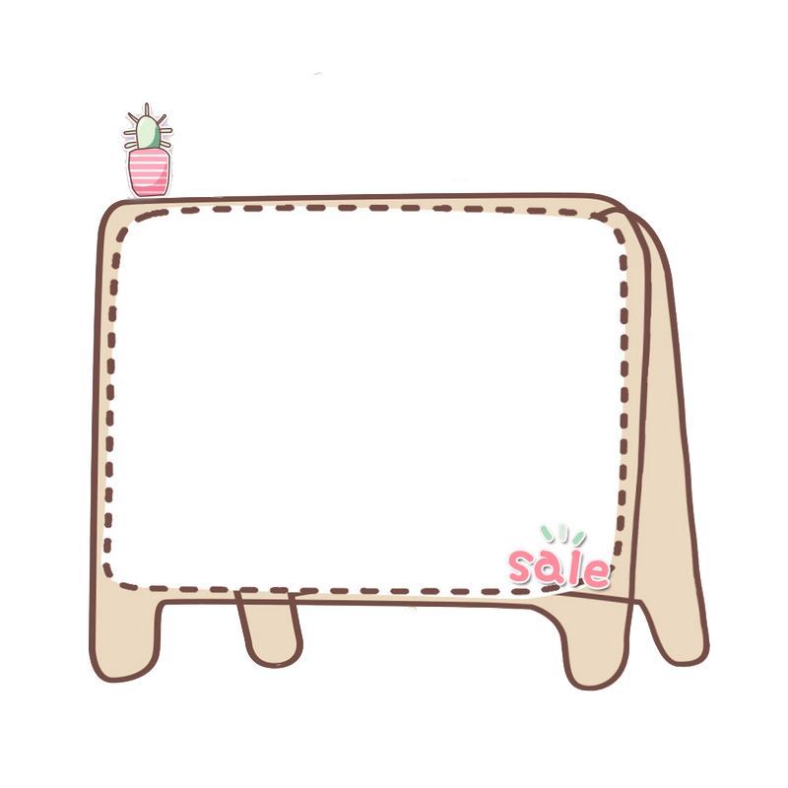

Unit 8:
This is my pen
Lesson 1

Slide 3


Objectives
01.
Review the last Unit
Learn the new words and sentences about the school.
02.

Slide 4


New words
pen

Slide 5

eraser
rubber

Slide 6

school bag

Slide 7

pencil

Slide 8

notebook

Slide 9

pencil sharpener

Slide 10
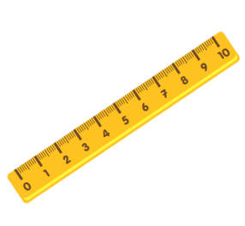
ruler

Slide 11

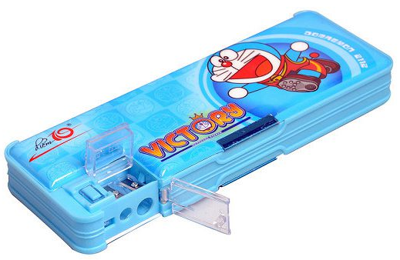
Review
eraser/ rubber
pencil sharpener
notebook
pen
pencil
pencil case
school bag

Slide 12

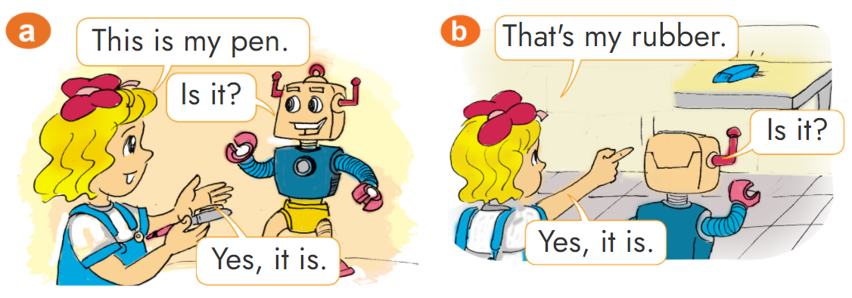
1. Look, listen and repeat.

Slide 13

2. Point and say
This is my _____.
pencil sharpener
pencil
pencil case
school bag
notebook

Slide 14
2. Point and say
That is my _____.
pencil sharpener
pencil
pencil case
school bag
notebook

Slide 15
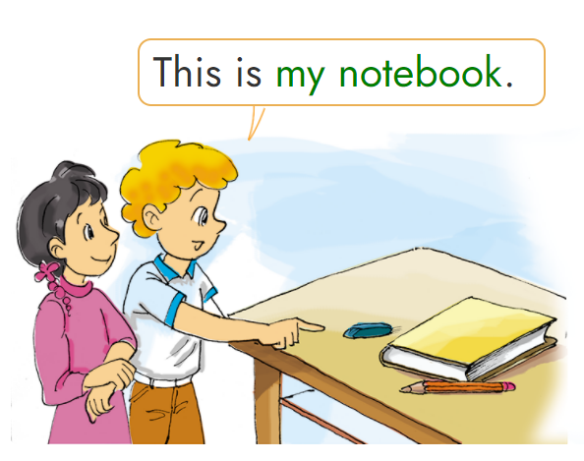
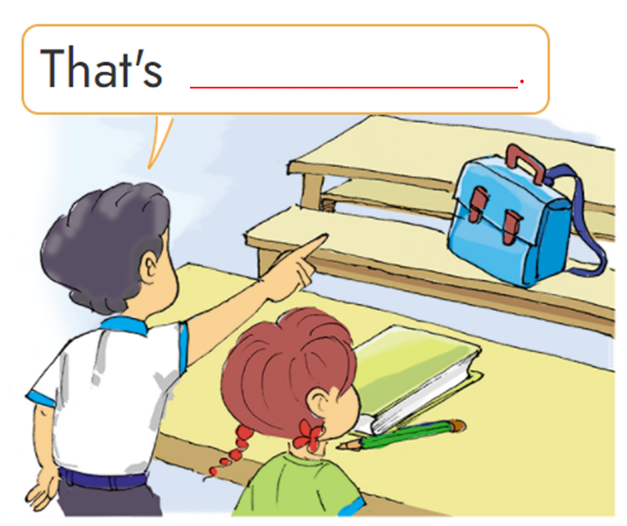


3. Let’s talk
my school bag
my notebook
my pencil
my pencil
my notebook
my rubber
_________________.
6
5
4
2
1
3

Slide 16







Thanh Am Primary School
Sun flowers
Notes:
Ms Huyền Phạm - 0936.082.789 – YOUTUBE: MsPham. Facebook: Dạy và học cùng công nghệ.

Slide 17



Thanh Am Primary School
A
B
That is my bag.
This is my bag.
Notes:
Ms Huyền Phạm - 0936.082.789 – YOUTUBE: MsPham. Facebook: Dạy và học cùng công nghệ.

Slide 18
A
B
That is my pencil.
This is my pencil.
Notes:
Ms Huyền Phạm - 0936.082.789 – YOUTUBE: MsPham. Facebook: Dạy và học cùng công nghệ.

Slide 19

A
B
That is my notebook.
This is my notebook.
Notes:
Ms Huyền Phạm - 0936.082.789 – YOUTUBE: MsPham. Facebook: Dạy và học cùng công nghệ.

Slide 20
A
B
That is my pencil sharpener.
This is my pencil sharpener.
Notes:
Ms Huyền Phạm - 0936.082.789 – YOUTUBE: MsPham. Facebook: Dạy và học cùng công nghệ.

Slide 21
A
B
That is my pencil case.
This is my pencil case.
Notes:
Ms Huyền Phạm - 0936.082.789 – YOUTUBE: MsPham. Facebook: Dạy và học cùng công nghệ.

Slide 22
A
B
That is my notebook.
This is my notebook.
Notes:
Ms Huyền Phạm - 0936.082.789 – YOUTUBE: MsPham. Facebook: Dạy và học cùng công nghệ.

Slide 23
A
B
This is my pencil.
This is my pencil.
Notes:
Ms Huyền Phạm - 0936.082.789 – YOUTUBE: MsPham. Facebook: Dạy và học cùng công nghệ.

Slide 24
A
B
That is my sharpener.
This is my sharpener.
Notes:
Ms Huyền Phạm - 0936.082.789 – YOUTUBE: MsPham. Facebook: Dạy và học cùng công nghệ.

Slide 25


Notes:
Ms Huyền Phạm - 0936.082.789 – YOUTUBE: MsPham. Facebook: Dạy và học cùng công nghệ.

Slide 26

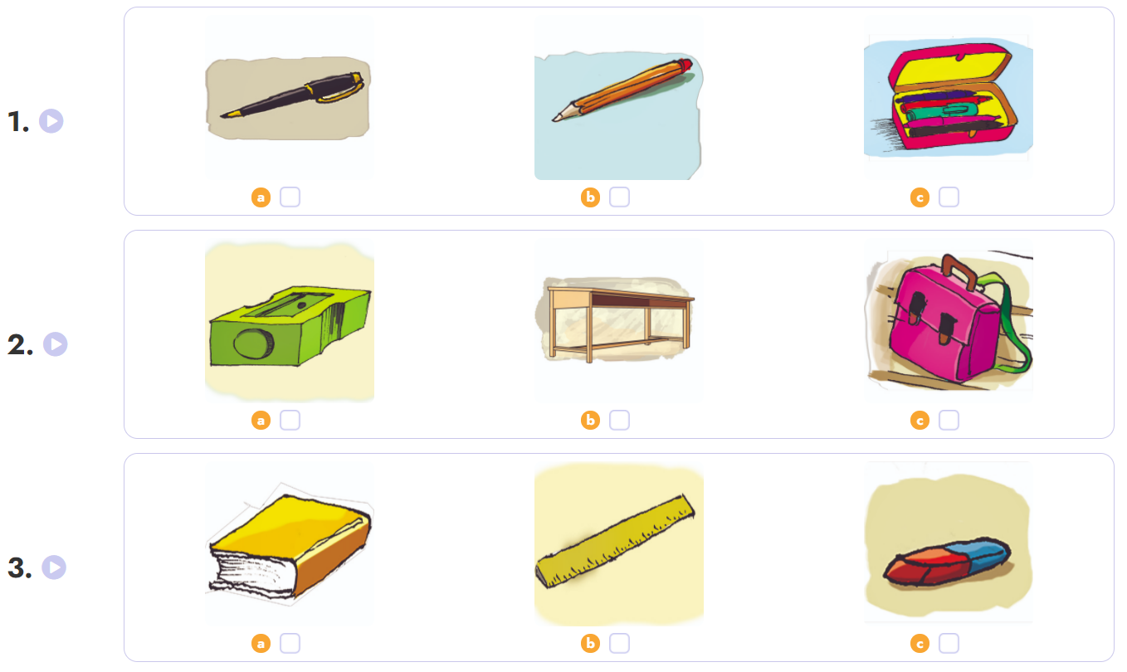

4. Listen and tick.

Slide 27
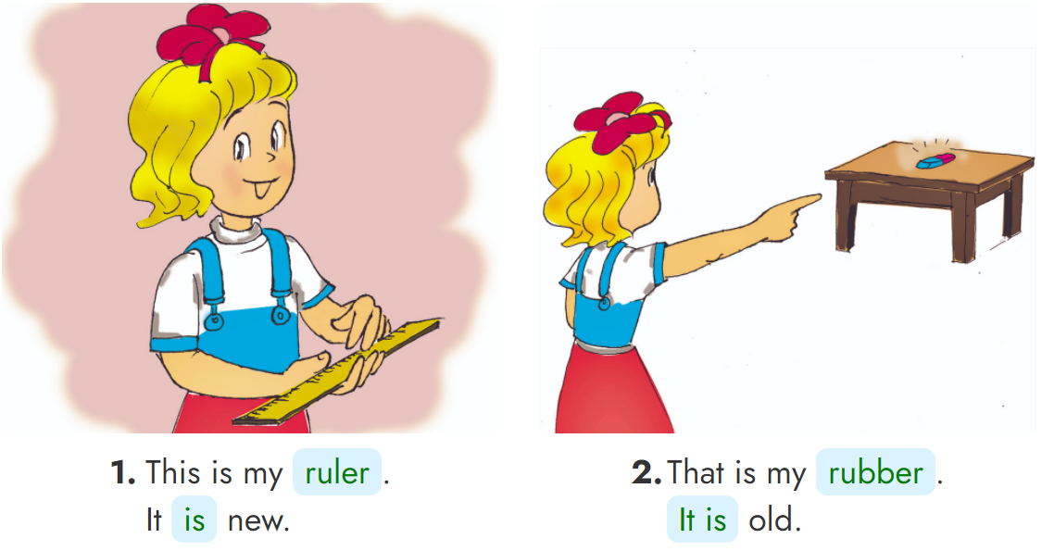
5. Look, read and write.
_____
______
___
_____

Slide 28

2.
Do the homework in WB (SBT): A(1,2,3) page 32
1.
Review the new words and sentences .
3.
Prepare the new lesson : Unit 8
Lesson 2
Home link

Slide 29

Tuesday, November 23 2021
Unit 8: This is my pen - Lesson 1
1. New words
- school things : dụng cụ học tập
- pen : bút mực
- pencil : bút chì
- pencil case : hộp bút
- pencil sharpener : gọc bút chì
- rubber : tẩy
- ruler : thước kẻ
- school bag : cặp sách
- book : sách
- notebook : vở
2. Model Sentences
This / That is my .......... (school things)
rd

Slide 30



