Slide 1


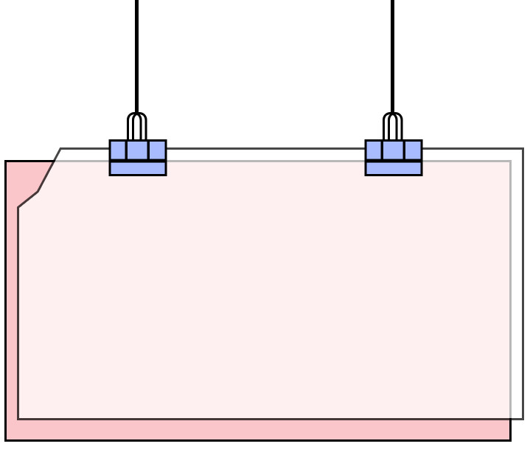


Welcome
to our Class!
Book: English 3
Prepared by Miss Linh

Slide 2



Lesson 3
Unit 7:
Unit 7:
That’s my
school
That’s my
school

Slide 3

Objectives
01
02
2. Learn the phonics “g” and “l” .
Review the words and sentences.
Chúng ta sẽ học 2 âm mới “g” and “l” .
Ôn tập lại từ vựng và mẫu câu.

Slide 4

Warm up

Slide 5





Thanh Am Primary School
Play

Slide 6






Thanh Am Primary School
1
2
3
4
5
6
7
8
1
2
3
4
5
6
7
8
1
2
3
4
5
6
7
0
8
1
0
2
3
4
5
6
7
8
0
Exit

Slide 7



Thanh Am Primary School
A
No, it isn’t.
It’s old.
Is the library new?
B
Wow, it isn’t.
C
No, it isn’t.
It’s beautiful.
Back

Slide 8
Thanh Am Primary School
A
Wow. It’s beautiful.
Is the playground large?
B
Yes, it is.
C
Oh, no. It’s beautiful.
Back

Slide 9
Thanh Am Primary School
A
Oh. It’s big.
B
Yes, It’s small
Is the computer game big?
C
No, it’s small.
Back

Slide 10
Thanh Am Primary School
A
Is that my school.
B
That is school my.
Is / school / that / my .
C
That is my school.
Back

Slide 11
Thanh Am Primary School
A
Is this the gym.
B
This is the gym.
Gym / this / the / is.
C
This the gym.
Back

Slide 12
Thanh Am Primary School
A
The library is large?
B
Is the large library?
Large / library / is / the ?
C
Is the library large?
Back

Slide 13
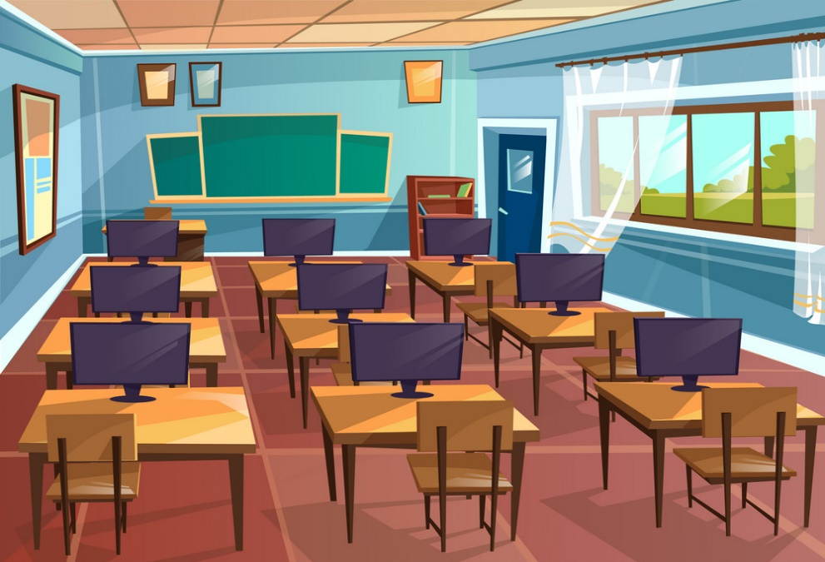
Thanh Am Primary School
A
Yes, it is
Is the computer room
new?
B
No, it isn’t.
C
Wow, it’s new.
Back

Slide 14
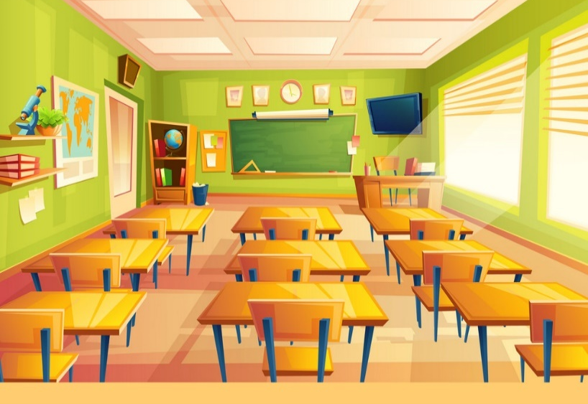
Thanh Am Primary School
A
nice
Is the classroom _____?
B
old
C
small
Yes, it is.
Back

Slide 15
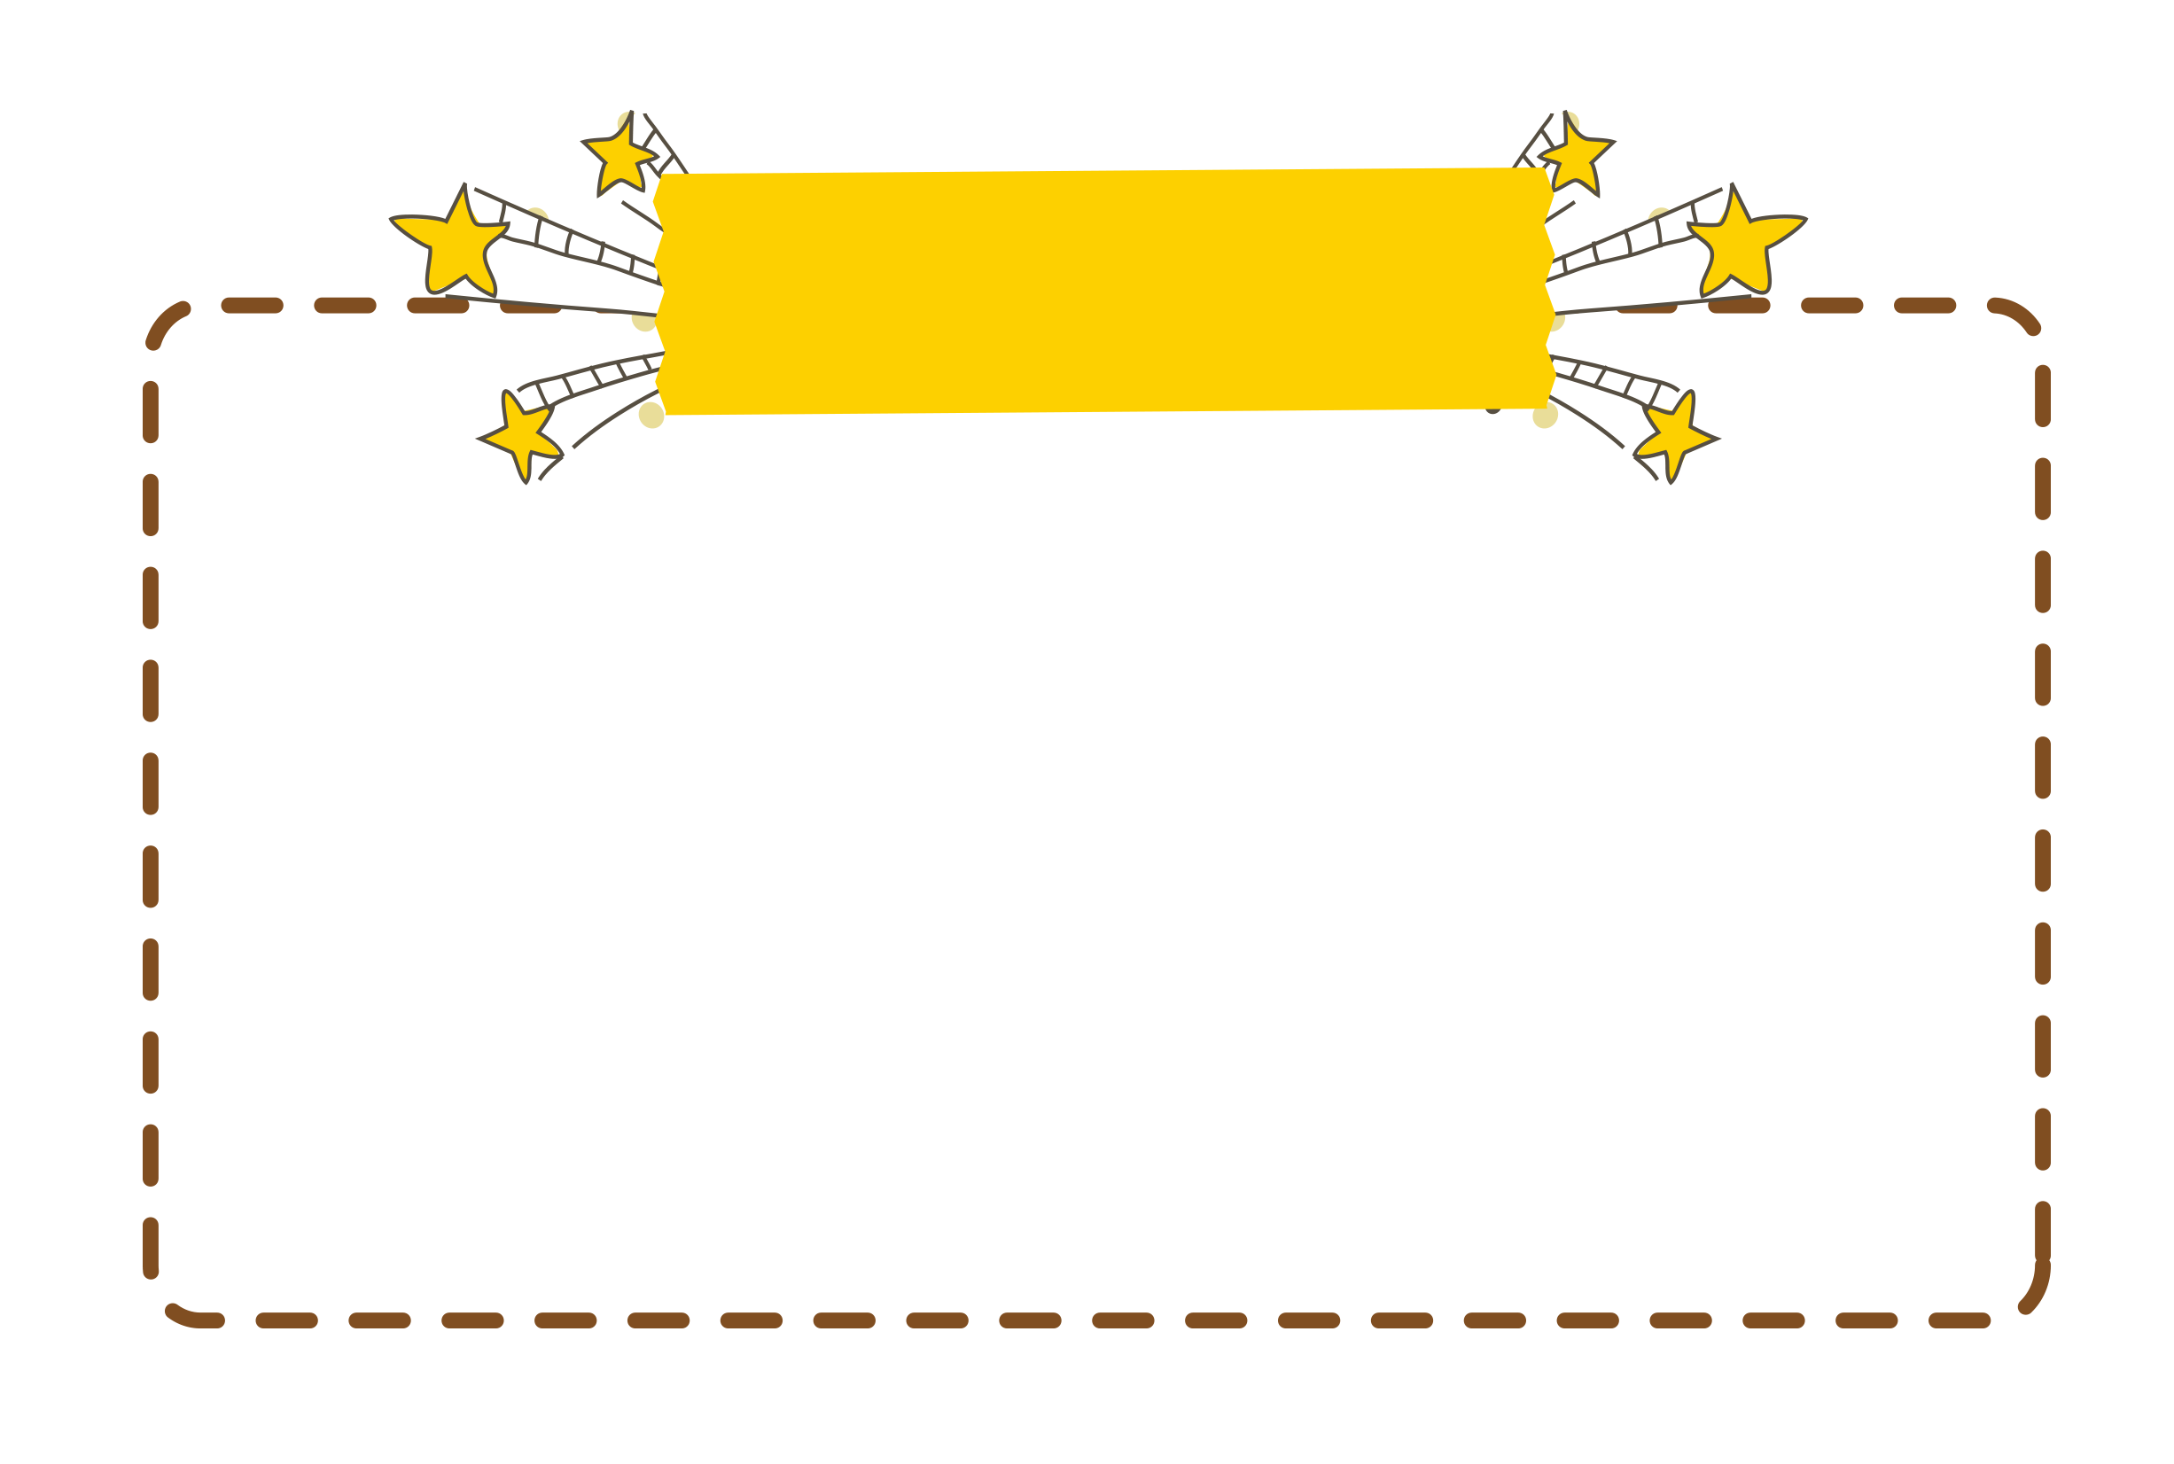

“g” and “ l”
Phonics

Slide 16

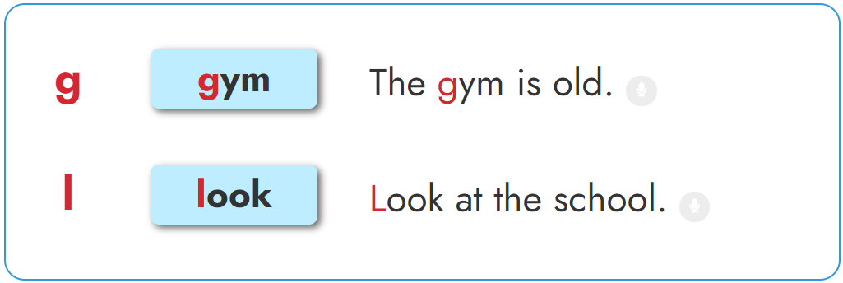


1. Listen and repeat.

Slide 17

1. Listen and repeat.

Slide 18
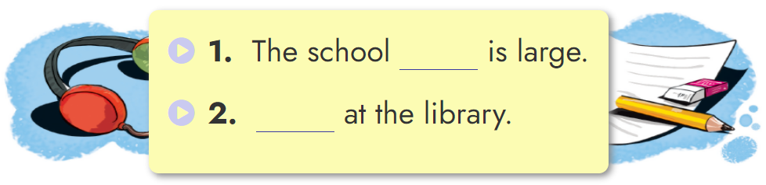
2. Listen and write.
gym
Look

Slide 19
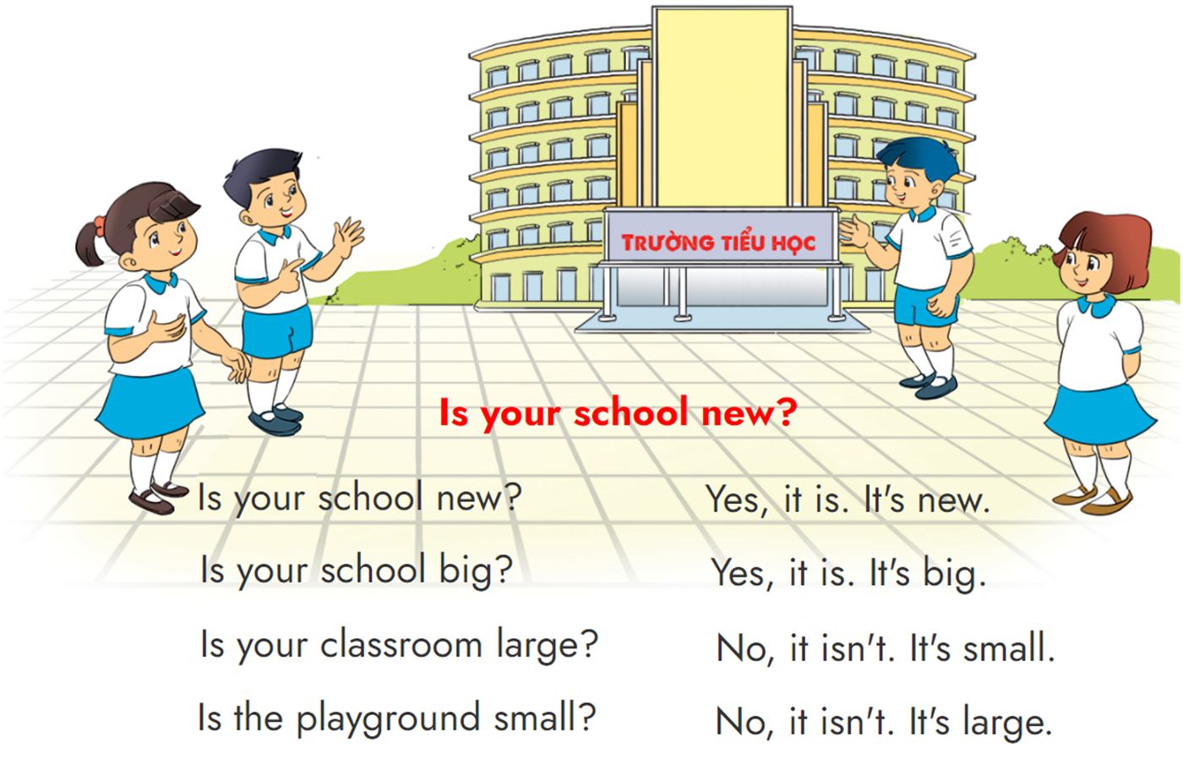


3. Let's chant.

Slide 20
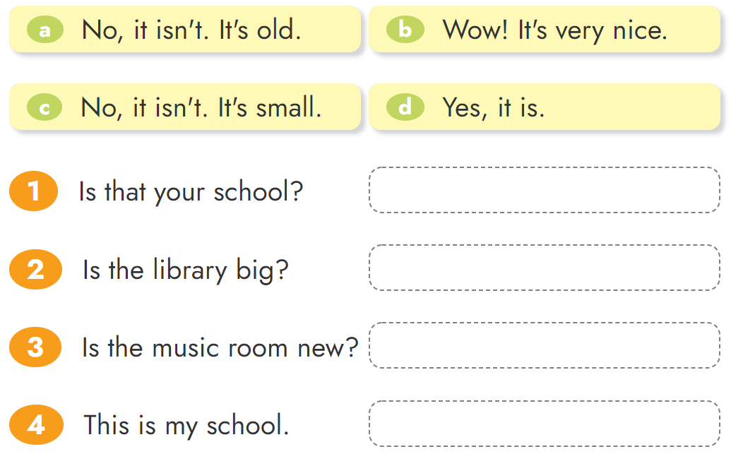





4. Read and match.

Slide 21
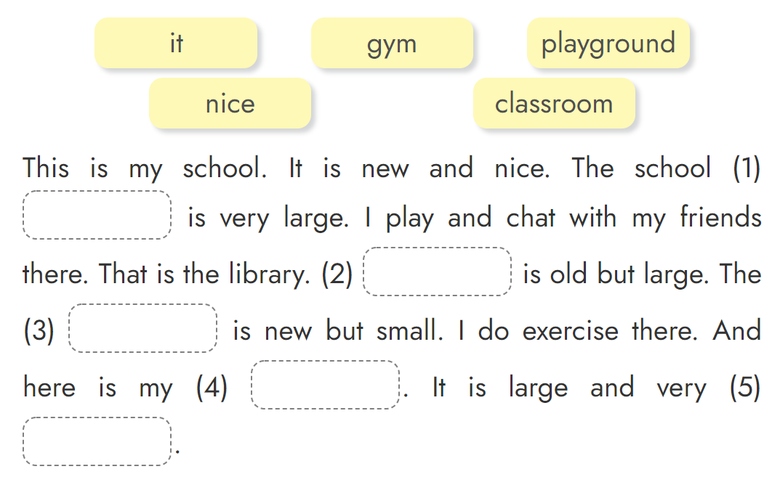
5. Read and complete.
playground
It
gym
classroom
nice

Slide 22


Home link
1.
Using the new sentences in the real life .
2.
Do the homework in WB (SBT): page 30 - 31
3.
Prepare the new lesson : Unit 8 Lesson 1

Slide 23
Thursday, November 18 2021
Unit 7: That’s my school - Lesson 3
1. Phonics
- Phonic “g” : gym -> The school gym is large.
- Phonic “l” : look -> Look at the library.
2. Homework
- WB (SBT) : Page 30 - 31
- Prepare : Unit 8 - Lesson 1
th

Slide 24




Thanh Am Primary School

