Slide 1



THANH AM PRIMARY SCHOOL
Welcome
to our Class!
Book: English 3
Prepared by Miss Linh

Slide 2






Lesson 2
Unit 7
That’s my school
Page 48-49

Slide 3
Objectives
Mục tiêu của bài học
03
02
01
Learn the new words about adjectives
Learn the sentences
Is the school new?
Review the words and sentences.
Chúng ta sẽ học những từ chỉ tính chất (Tính Từ).
Chúng ta sẽ học mẫu câu hỏi mới.
Ôn tập lại từ vựng và mẫu câu.

Slide 4



Unit 7
THAT’S MY SCHOOL
Lesson 2

Slide 5


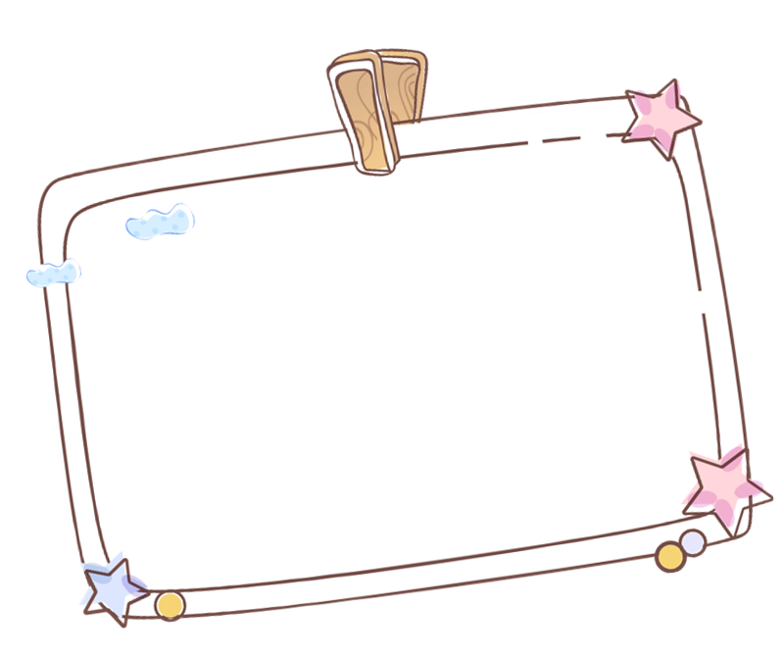
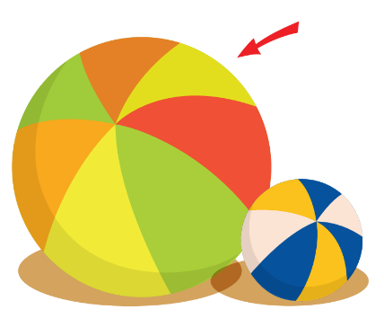
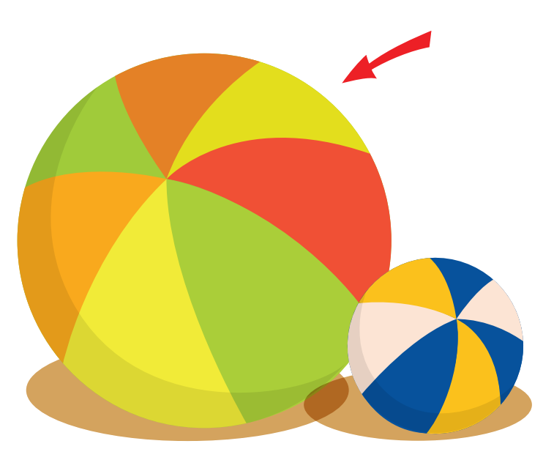


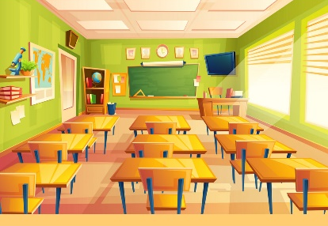
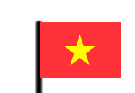
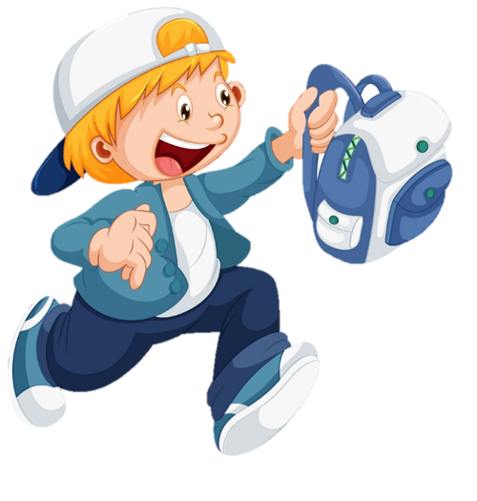



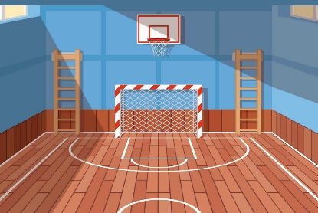



Thanh Am Primary School
Review
Small
School
Classroom
Big
Library
Playground
Computer room
Gym

Slide 6

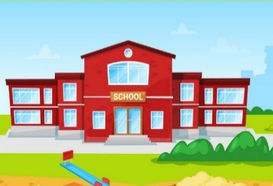
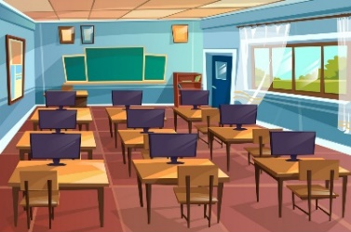
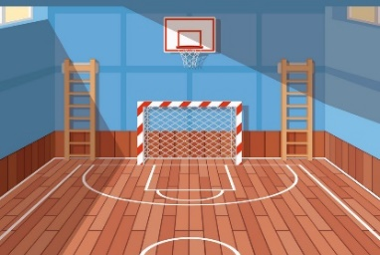
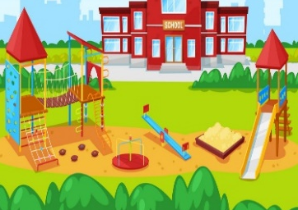
That’s the ___________.
(Kia là ____________.)
Structure
classroom
school
gym
computer
room
library
playground

Slide 7
Vocabulary
small
big

Slide 8

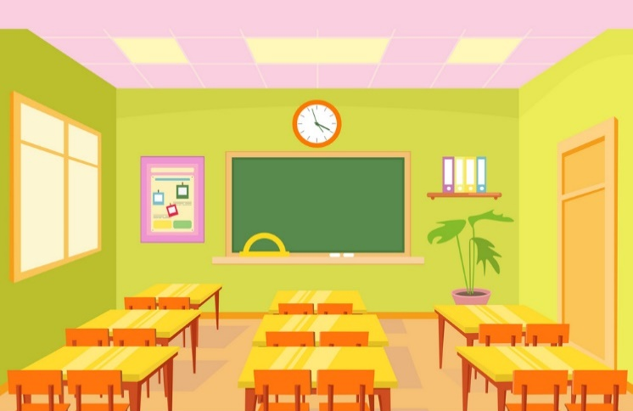
Vocabulary
small
large

Slide 9
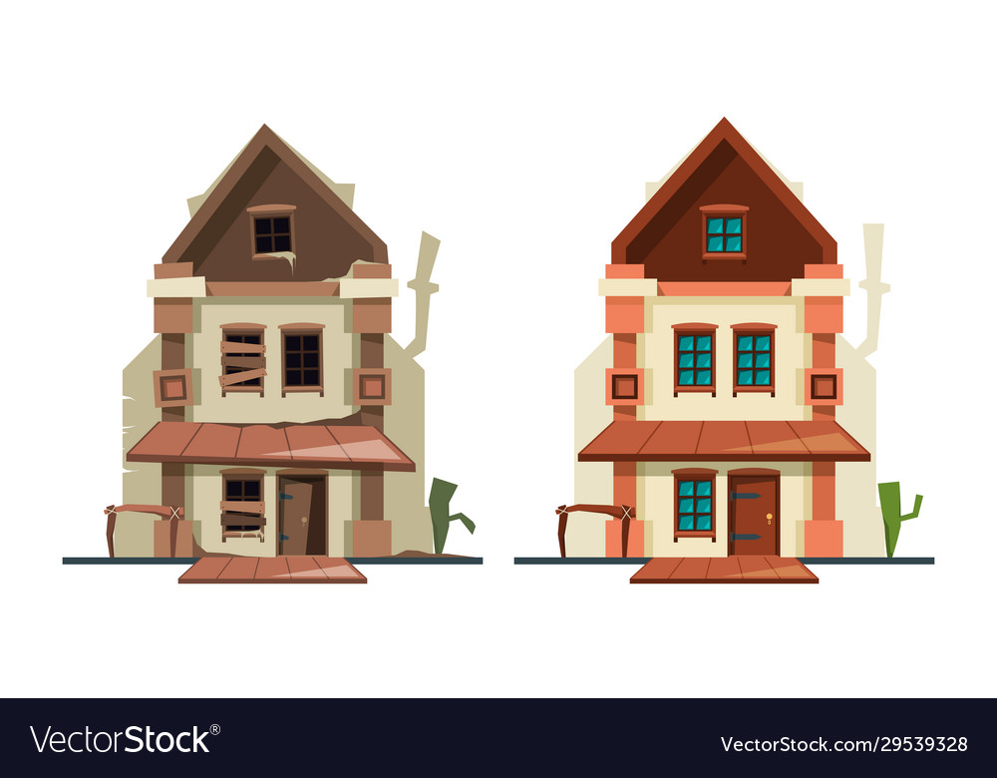
Vocabulary
new
old

Slide 10
Vocabulary
nice
beautiful

Slide 11

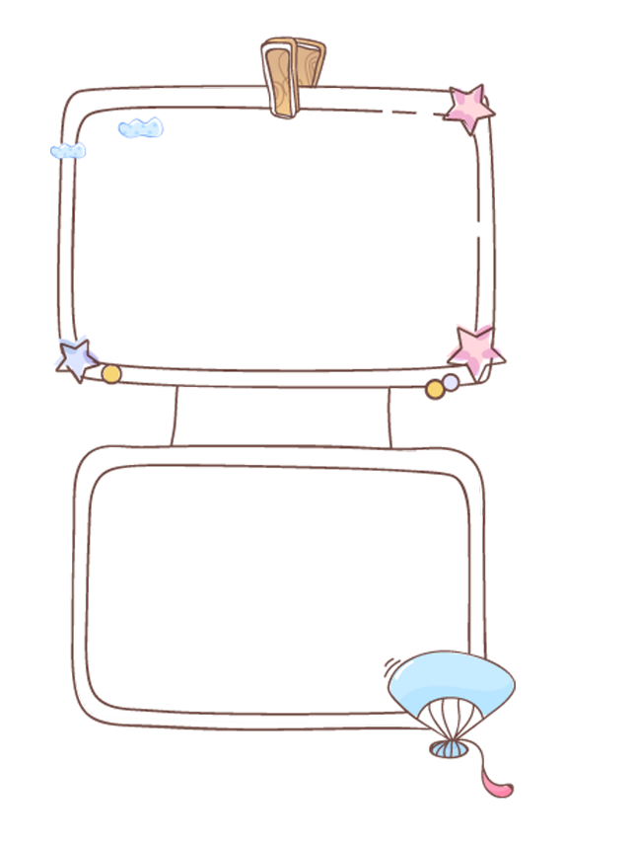

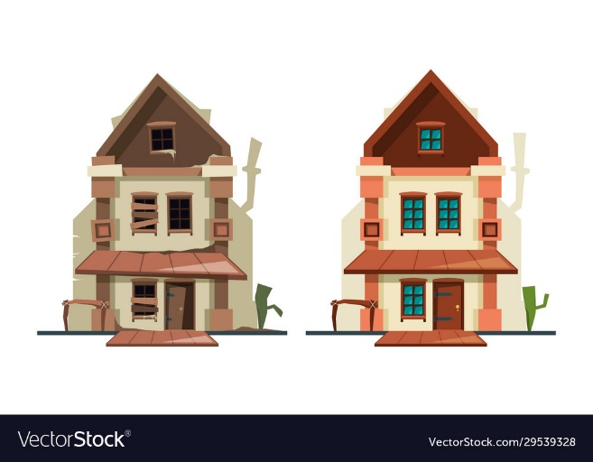




Thanh Am Primary School
Review
large
big
new
Nice
Beautiful
Small
Small
Old

Slide 12

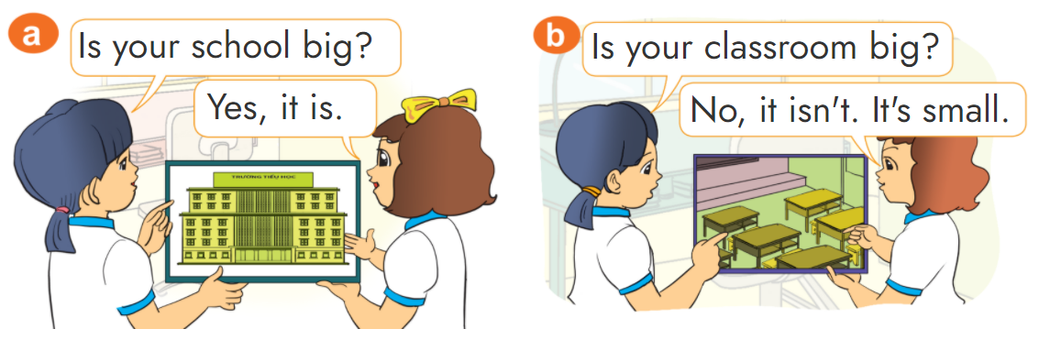

1. Look, listen and repeat.

Slide 13


Structure
Yes, it is.
Is ______ ____?
(________ _______ có phải không?)
No, it isn’t.
classroom
school
beautiful
big
computer
room
gym
library
playground
small
new
old
large

Slide 14
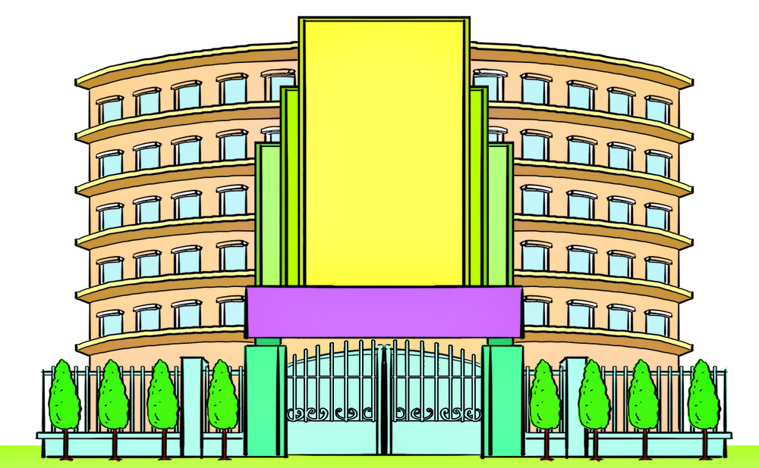


2. Point and say
school new
Is the __________?
Yes, it is.

Slide 15
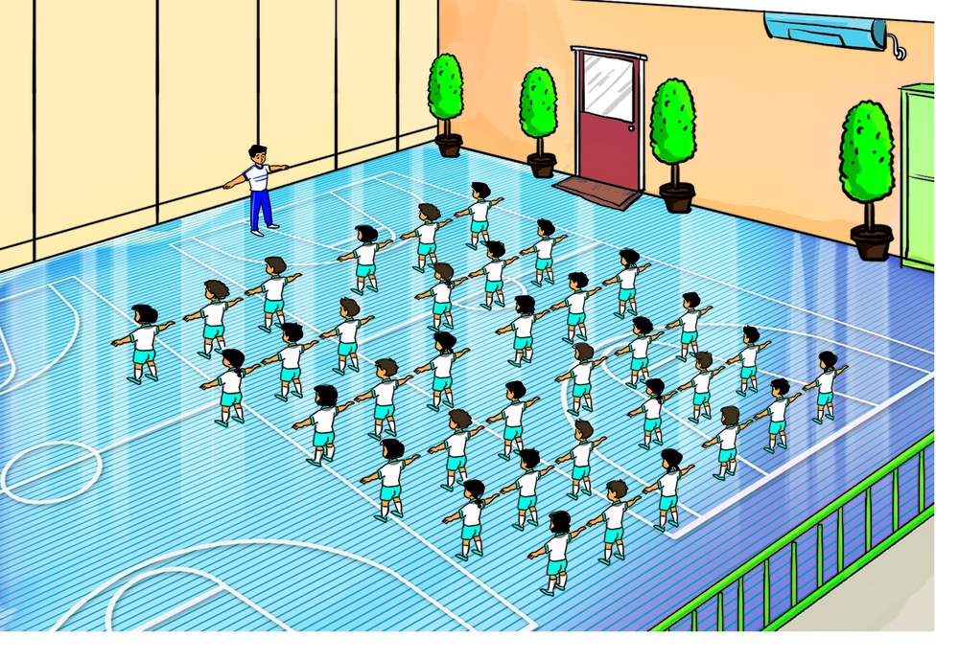
2. Point and say
gym big
Is the __________?
Yes, it is.

Slide 16
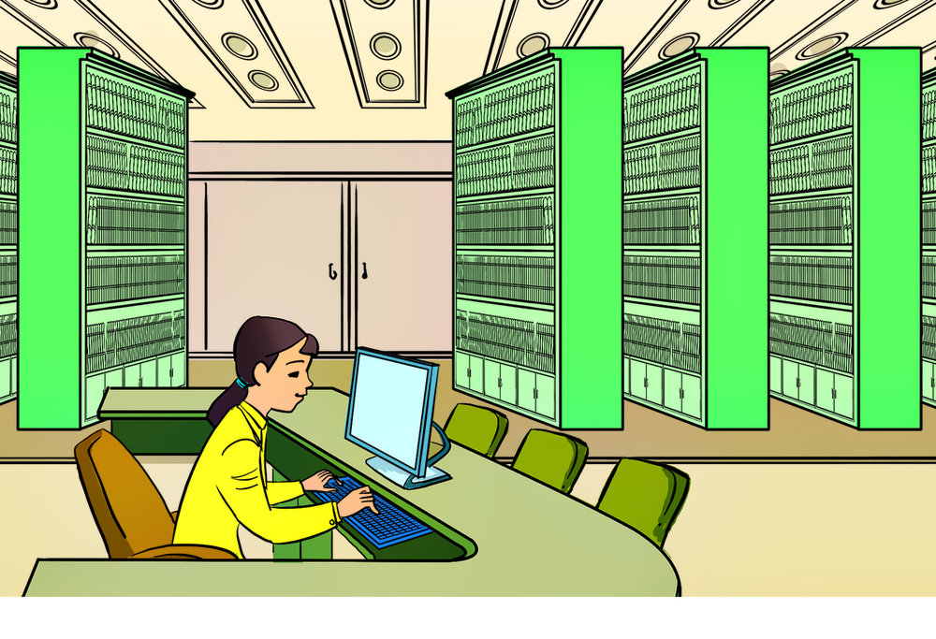
2. Point and say
library old
Is the __________?
No, it isn’t.

Slide 17
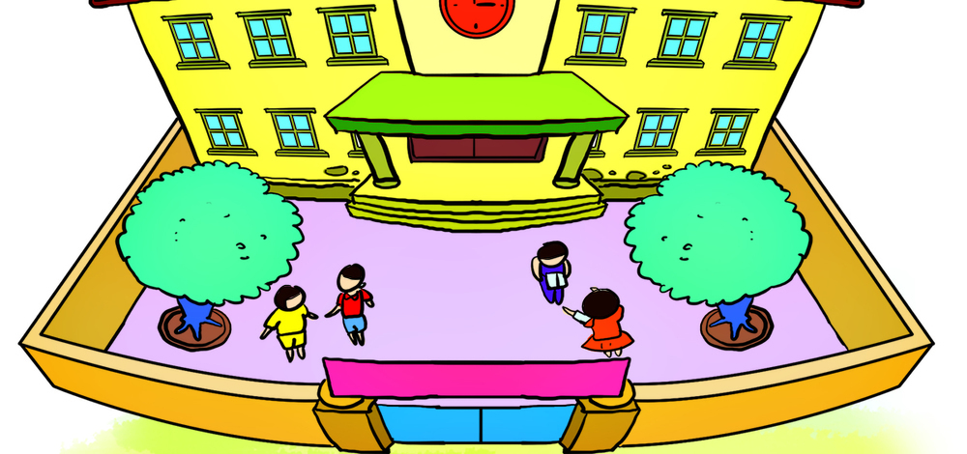
2. Point and say
playground large
Is the _____________?
No, it isn’t.

Slide 18










Thanh Am Primary School
Notes:
Ms Huyền Phạm - 0936.082.789 – YOUTUBE: MsPham. Facebook: Dạy và học cùng công nghệ.

Slide 19

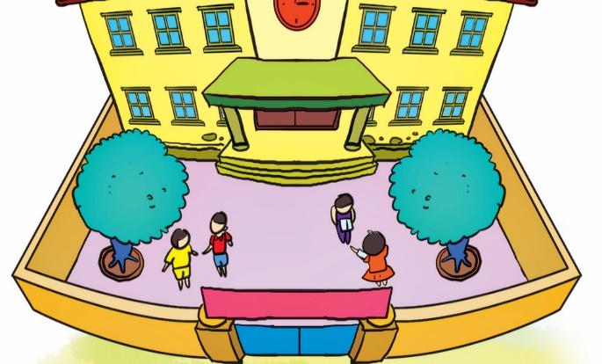





Thanh Am Primary School
Is the playground small?
Next
No, it is.
Yes, it is.
No, it isn’t.
Yes, it isn’t.
Notes:
Ms Huyền Phạm - 0936.082.789 – YOUTUBE: MsPham. Facebook: Dạy và học cùng công nghệ.

Slide 20
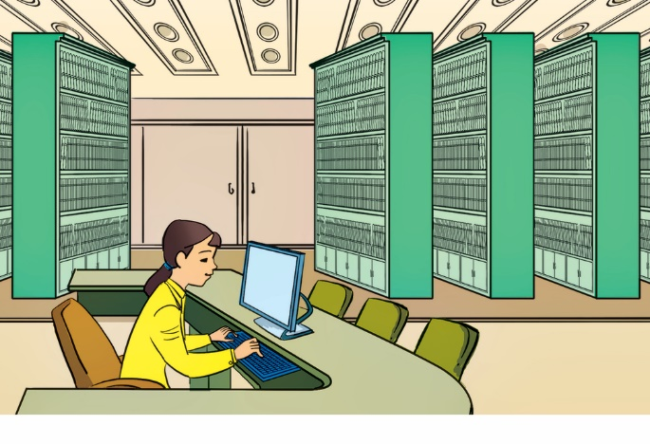
Thanh Am Primary School
Is the library new?
Next
Yes, please.
Yes, you can.
Yes, it is.
No, it isn’t.
Notes:
Ms Huyền Phạm - 0936.082.789 – YOUTUBE: MsPham. Facebook: Dạy và học cùng công nghệ.

Slide 21
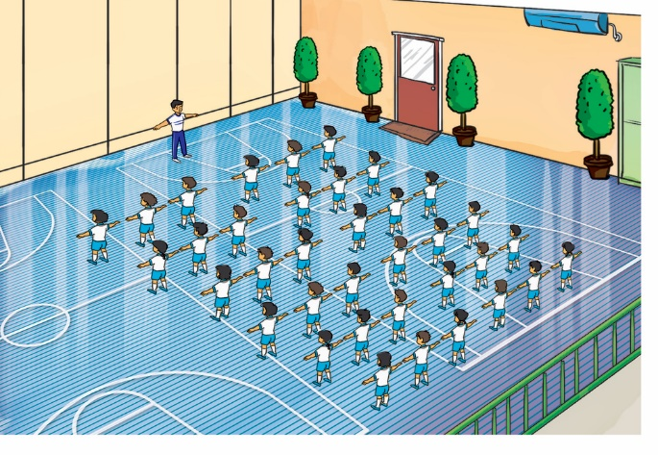
Thanh Am Primary School
Is the gym old?
Next
No, it isn’t.
Yes, it is.
No, it aren’t.
Yes, it are.
Notes:
Ms Huyền Phạm - 0936.082.789 – YOUTUBE: MsPham. Facebook: Dạy và học cùng công nghệ.

Slide 22
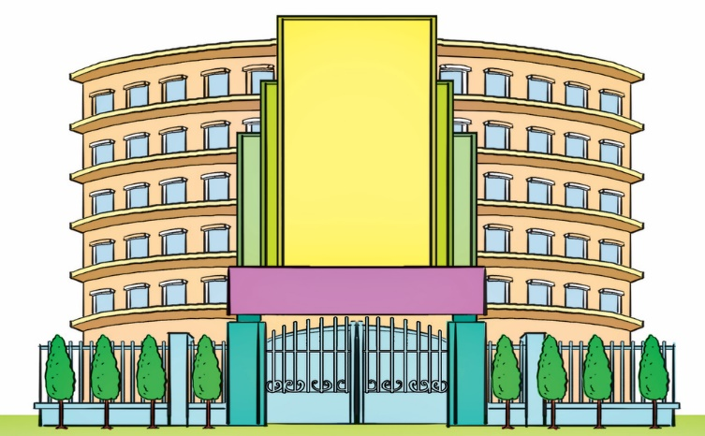
Thanh Am Primary School
Is the school big and new?
Next
Yes, it is.
Yes, you can.
No, it isn’t.
No, you can’t.
Notes:
Ms Huyền Phạm - 0936.082.789 – YOUTUBE: MsPham. Facebook: Dạy và học cùng công nghệ.

Slide 23
Thanh Am Primary School
Is the classroom beautiful?
Next
Yes, please.
No, thanks.
No, it isn’t.
Yes, it is.
Notes:
Ms Huyền Phạm - 0936.082.789 – YOUTUBE: MsPham. Facebook: Dạy và học cùng công nghệ.

Slide 24
Thanh Am Primary School
Is the computer room old?
Next
No, isn’t.
Yes, I am.
No, it isn’t.
Yes, it is.
Notes:
Ms Huyền Phạm - 0936.082.789 – YOUTUBE: MsPham. Facebook: Dạy và học cùng công nghệ.

Slide 25
Thanh Am Primary School
__________?
Yes, it is.
Next
Is the
school new
The school
new
The school
is new
That’s the
school new
Notes:
Ms Huyền Phạm - 0936.082.789 – YOUTUBE: MsPham. Facebook: Dạy và học cùng công nghệ.

Slide 26
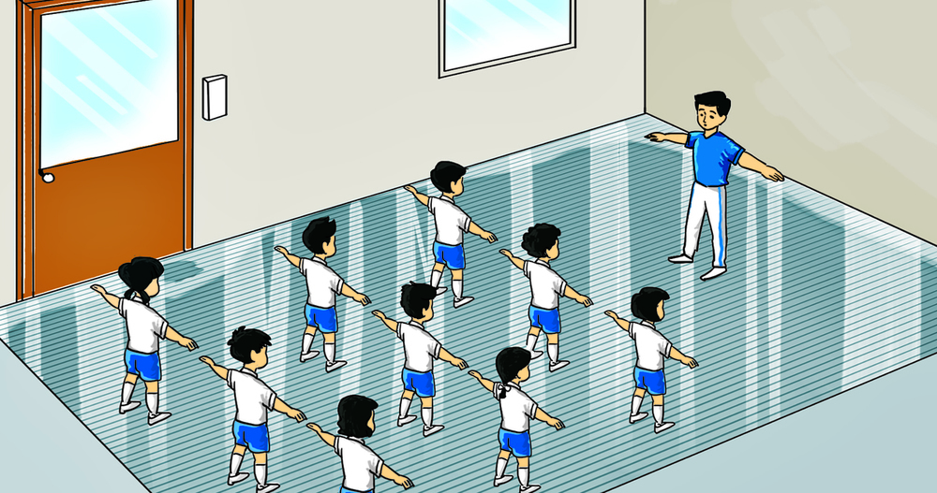
Thanh Am Primary School
______________?
No, it isn’t.
Next
The gym big
Is the
big gym
The gym is big
Is the
gym big
Notes:
Ms Huyền Phạm - 0936.082.789 – YOUTUBE: MsPham. Facebook: Dạy và học cùng công nghệ.

Slide 27
Thanh Am Primary School
Is the playground large?
Yes, _________.
Next
is it
it is
ok
true
Notes:
Ms Huyền Phạm - 0936.082.789 – YOUTUBE: MsPham. Facebook: Dạy và học cùng công nghệ.

Slide 28
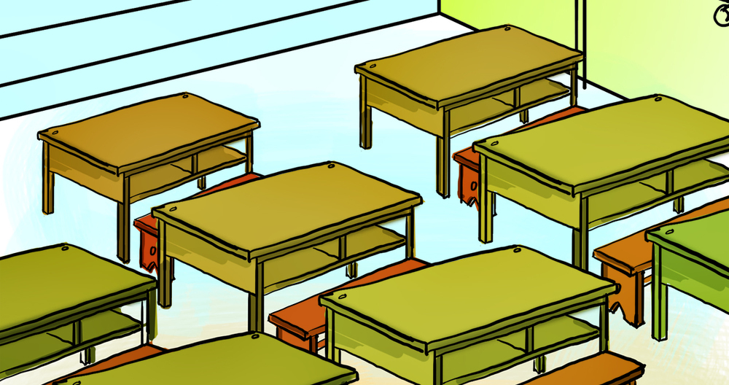
Thanh Am Primary School
Is the classroom nice?
No, it ________.
Next
I’m not
not
aren’t
isn’t.
Notes:
Ms Huyền Phạm - 0936.082.789 – YOUTUBE: MsPham. Facebook: Dạy và học cùng công nghệ.

Slide 29








Thanh Am Primary School
Notes:
Ms Huyền Phạm - 0936.082.789 – YOUTUBE: MsPham. Facebook: Dạy và học cùng công nghệ.

Slide 30
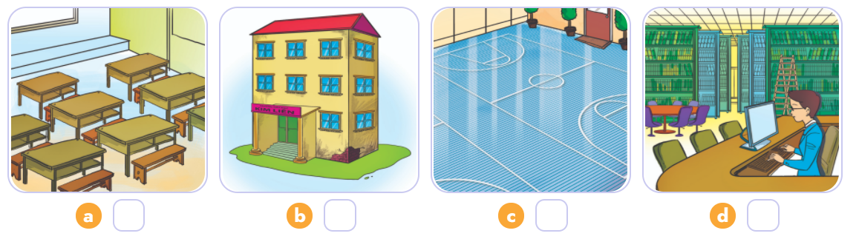
4. Listen and number.
3
1
4
2
1
2
3
4

Slide 31
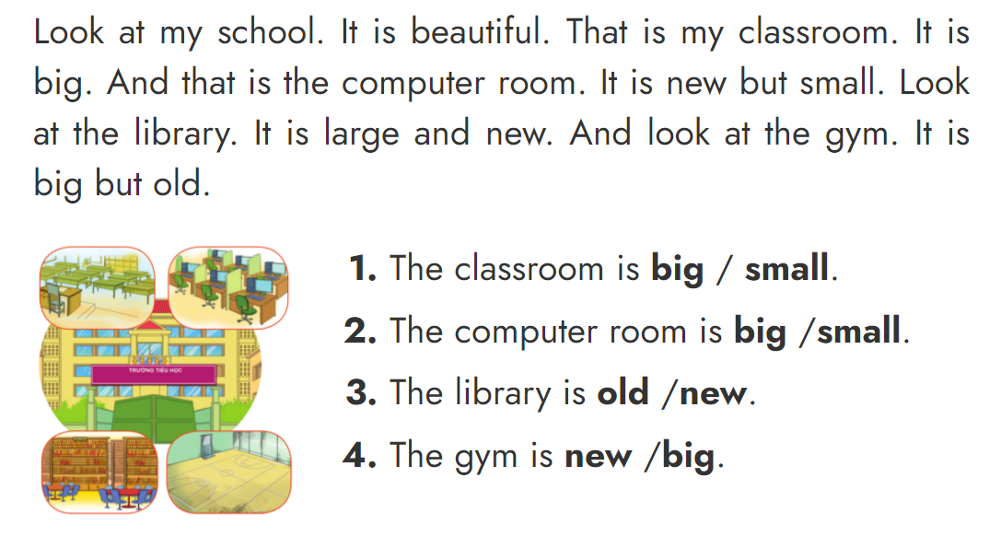
5. Read and circle.

Slide 32

6. Write about your school
Is your school big?
_______________________________.
2. Is the computer room new?
_______________________________.
3. Is the gym large?
_______________________________.
4. Is the library big?
_______________________________.
Yes, it is.
/
No, it isn’t.
Yes, it is.
/
No, it isn’t.
Yes, it is.
/
No, it isn’t.
Yes, it is.
/
No, it isn’t.

Slide 33

Home link
Thanh Am Primary School
Dặn dò
2. Do the homework in WB (SBT): B(1,2,3) - page 29
1. Using the new sentences in the real life .
3. Prepare the new lesson : Unit 7 - Lesson 3

Slide 34









th
Tuesday, November 16 2021
Unit 7: That’s my school - Lesson 2
1.New words
- large : rộng
- small : nhỏ, hẹp
- big : to
- new : mới
- old : cũ
- nice : đẹp
- beautiful : đẹp, xinh
2. Model Sentences
Is the school new? -> Yes, it is. / No, it isn’t. It’s old.
3. Homework
- WB (SBT) : B(1,2,3) - page 29
- Prepare : Unit 7 - Lesson 3
th

Slide 35



Thanh Am Primary School

