Slide 1


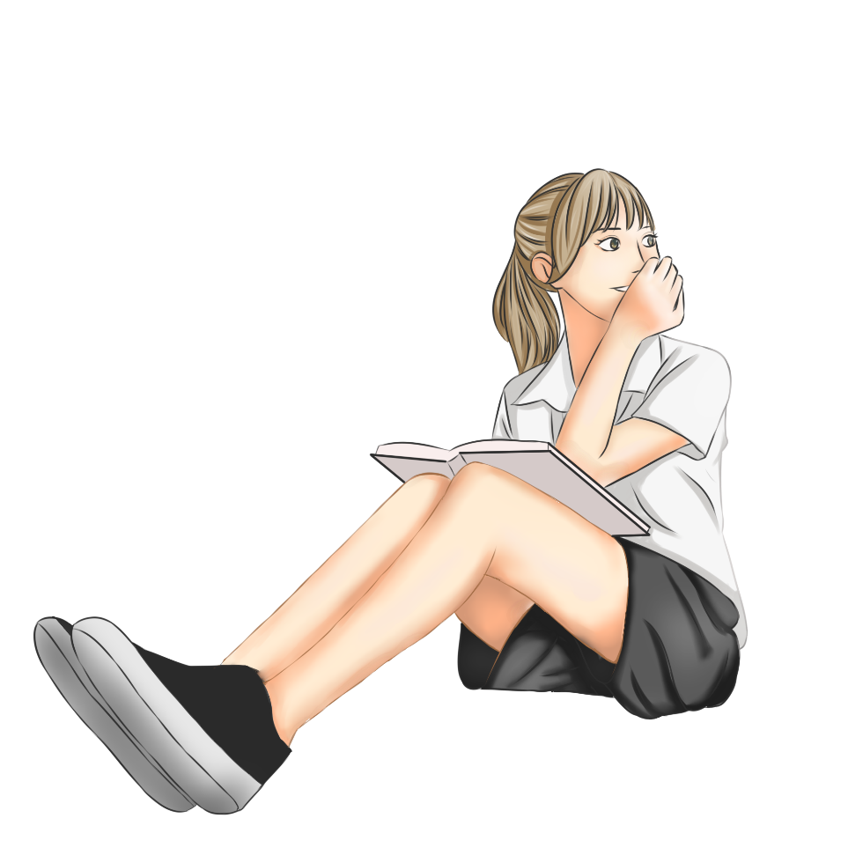
Synergistically utilize technically sound portals with frictionless chainsSynergistically
Welcome
to our Class!
Book: English 3
Prepared by Miss Linh
Notes:
Pexels.com

Slide 2


Unit 7
That’s my
school
Lesson 3
Notes:
Pexels.com

Slide 3
Review the last Unit
01.
Review the last Unit
01.
Ojbectives
Learn the new words and sentences about the school.
02.
02.
Notes:
Pexels.com

Slide 4
Synergistically utilize technically sound portals with frictionless chainsSynergistically
New words
Notes:
Pexels.com

Slide 5


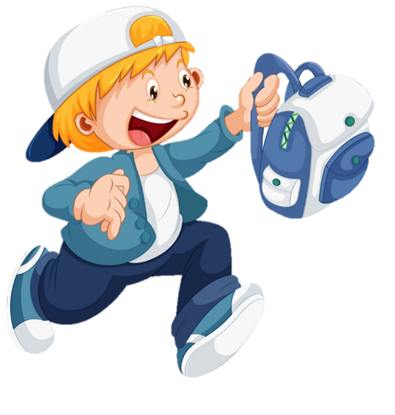




School

Slide 6
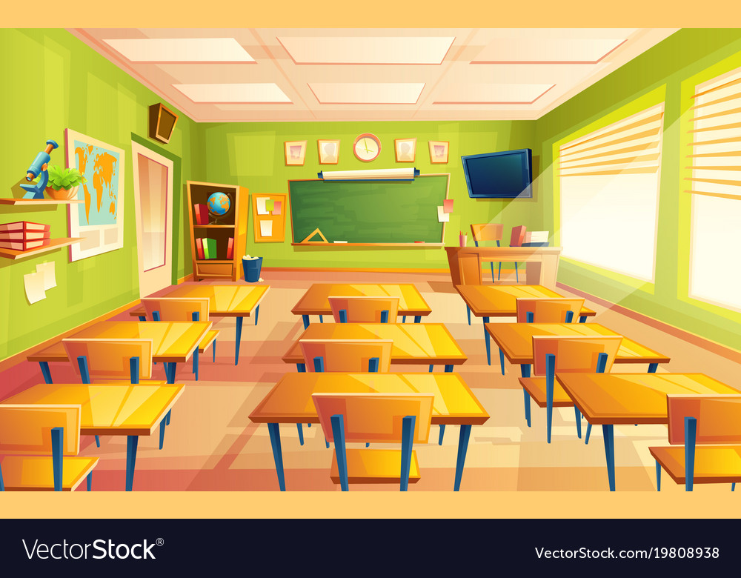
Classroom

Slide 7

Playground

Slide 8

Computer room

Slide 9

Library

Slide 10
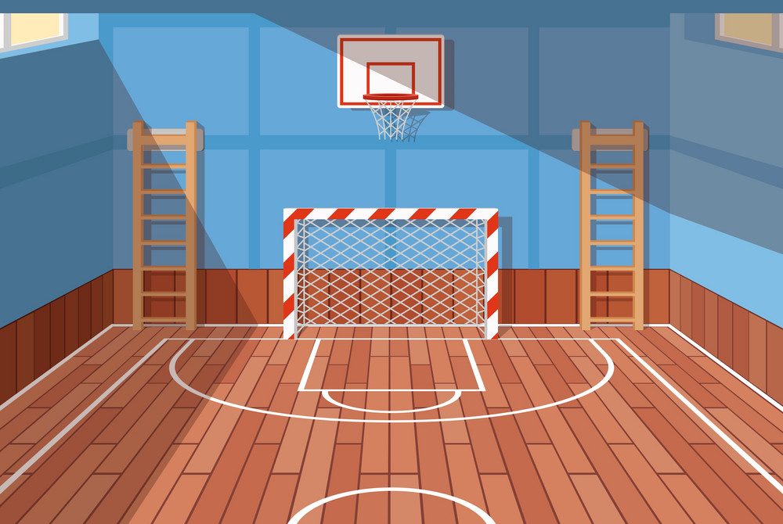
Gym

Slide 11

Small
Big

Slide 12









Review
Small
School
Classroom
Big
Library
Playground
Computer room
Gym

Slide 13

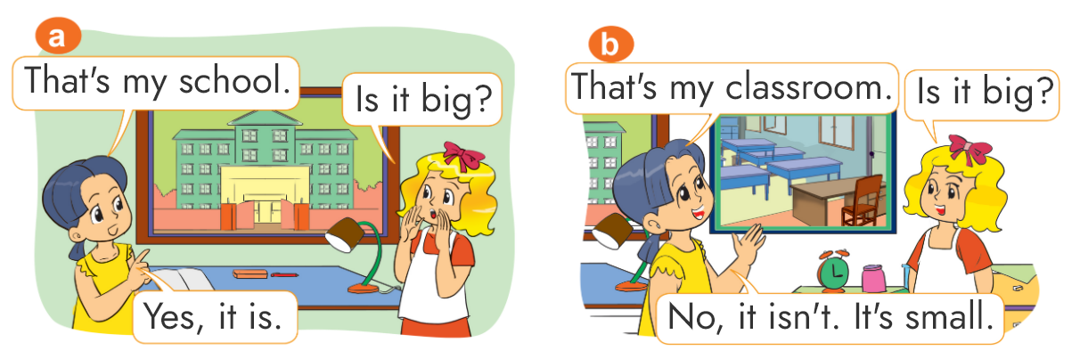
1. Look, listen and repeat.

Slide 14
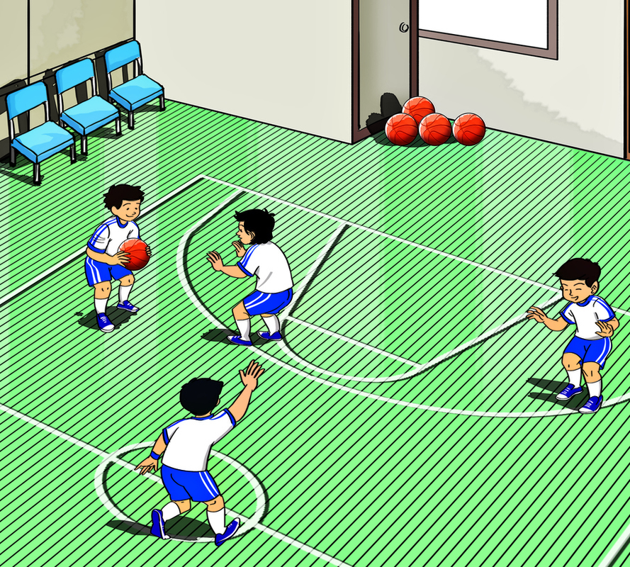

2. Point and say
gym
That’s the ____________.

Slide 15
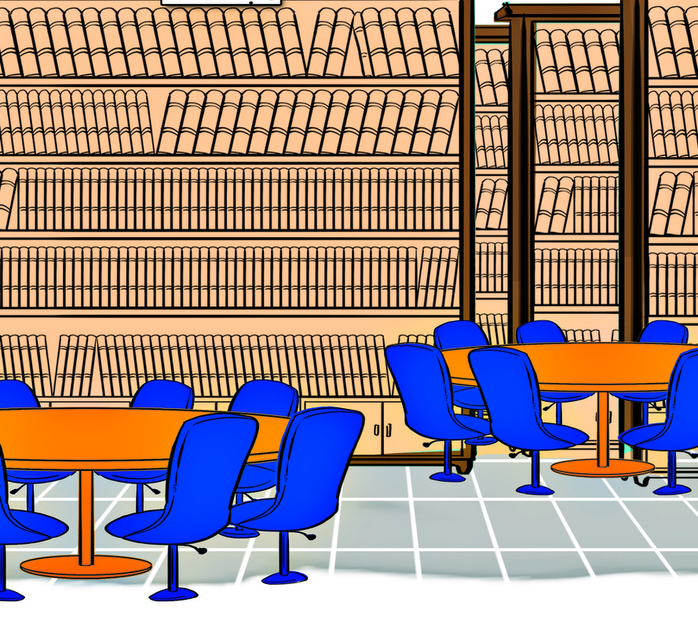

2. Point and say
library
That’s the ____________.

Slide 16
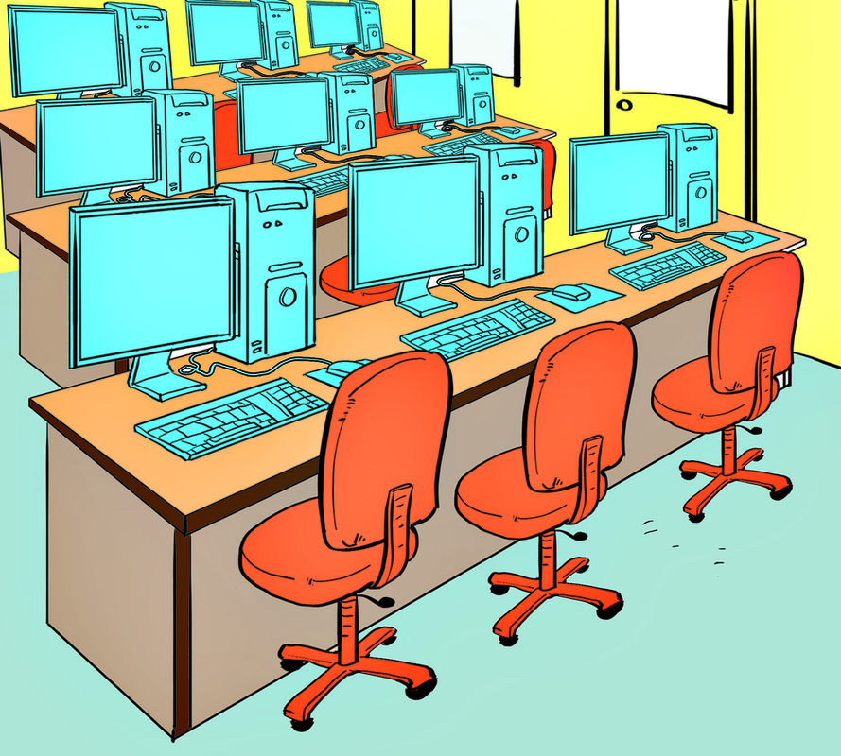
2. Point and say
computer room
That’s the _________________.

Slide 17
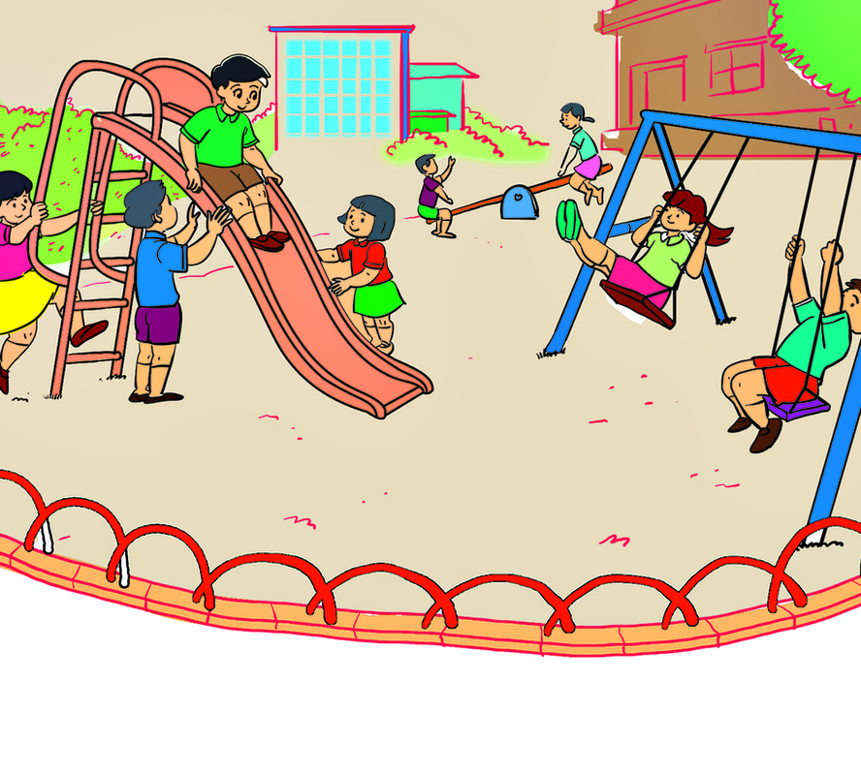

2. Point and say
playground
That’s the _________________.

Slide 18



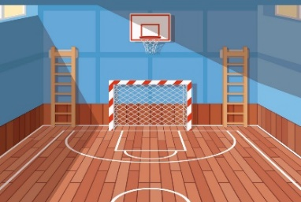

Structure
That’s the ___________.
(Kia là ____________.)
Classroom
School
Gym
Computer
room
Library
Playground

Slide 19
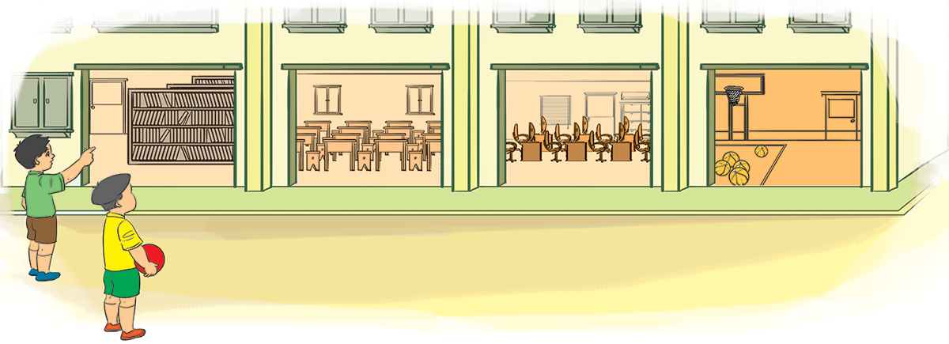
3. Let's talk.
1
2
3
4
That’s the _________________.

Slide 20
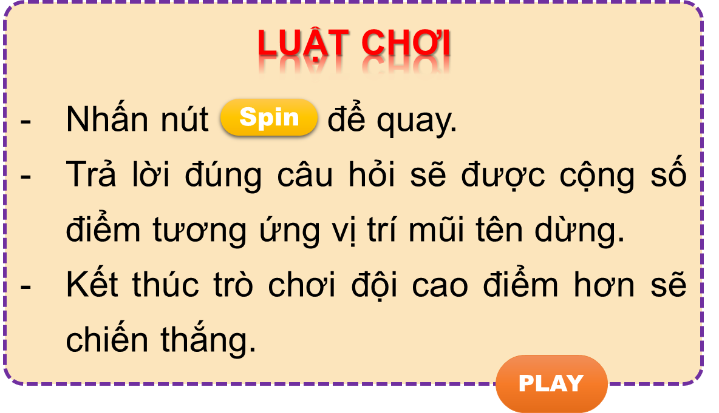


Thanh Am Primary School
Magic Wheel
50
10
20
30
10
20
30
40
Notes:
Ms Huyền Phạm - 0936.082.789 – YOUTUBE: MsPham. Facebook: Dạy và học cùng công nghệ.

Slide 21
Thanh Am Primary School
50
10
20
30
10
20
30
40
That’s the playground.
Xem đáp án
Notes:
Ms Huyền Phạm - 0936.082.789 – YOUTUBE: MsPham. Facebook: Dạy và học cùng công nghệ.

Slide 22
Thanh Am Primary School
50
10
20
30
10
20
30
04
That’s the computer room.
Xem đáp án
Notes:
Ms Huyền Phạm - 0936.082.789 – YOUTUBE: MsPham. Facebook: Dạy và học cùng công nghệ.

Slide 23
Thanh Am Primary School
50
10
20
30
10
20
30
04
That’s the library.
Xem đáp án
Notes:
Ms Huyền Phạm - 0936.082.789 – YOUTUBE: MsPham. Facebook: Dạy và học cùng công nghệ.

Slide 24
Thanh Am Primary School
50
10
20
30
10
20
30
40
That’s the gym.
Xem đáp án
Notes:
Ms Huyền Phạm - 0936.082.789 – YOUTUBE: MsPham. Facebook: Dạy và học cùng công nghệ.

Slide 25

Thanh Am Primary School
50
10
20
30
10
20
30
40
That’s the (my) school.
Xem đáp án
Notes:
Ms Huyền Phạm - 0936.082.789 – YOUTUBE: MsPham. Facebook: Dạy và học cùng công nghệ.

Slide 26
Thanh Am Primary School
50
10
____________
I go to the zoo.
20
30
10
20
30
40
That’s the (my) classroom.
Xem đáp án
Notes:
Ms Huyền Phạm - 0936.082.789 – YOUTUBE: MsPham. Facebook: Dạy và học cùng công nghệ.

Slide 27
Thanh Am Primary School
50
10
Kia là ngôi trường của tớ.
20
30
10
20
30
40
That’s my school.
Xem đáp án
Notes:
Ms Huyền Phạm - 0936.082.789 – YOUTUBE: MsPham. Facebook: Dạy và học cùng công nghệ.

Slide 28

Thanh Am Primary School
50
10
20
30
10
20
30
40
Notes:
Ms Huyền Phạm - 0936.082.789 – YOUTUBE: MsPham. Facebook: Dạy và học cùng công nghệ.

Slide 29

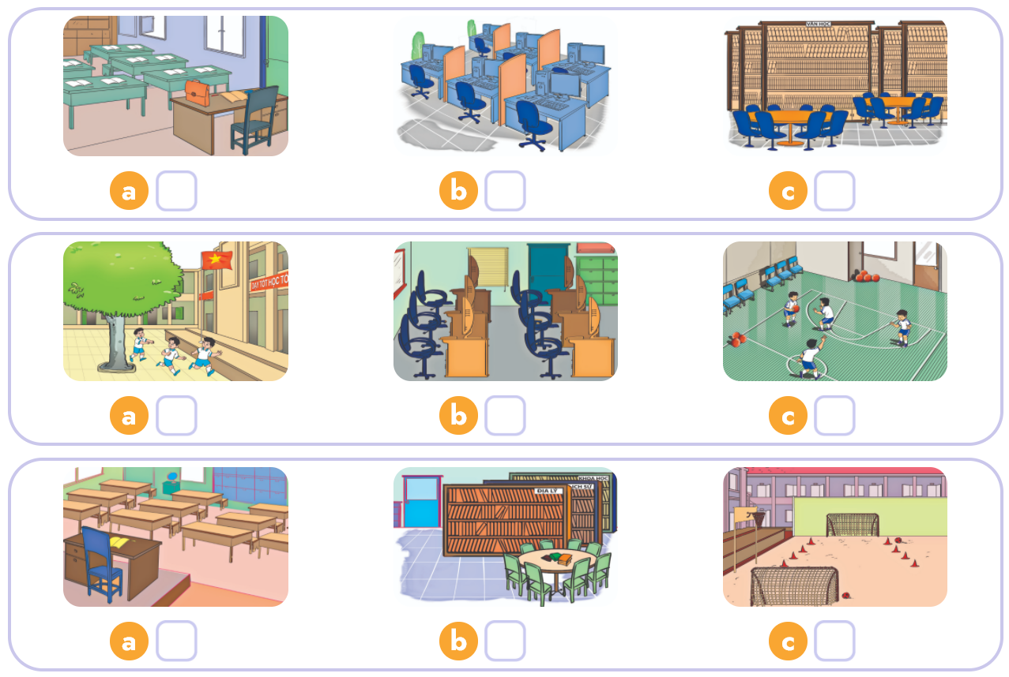

4. Listen and tick.
1
2
3

Slide 30
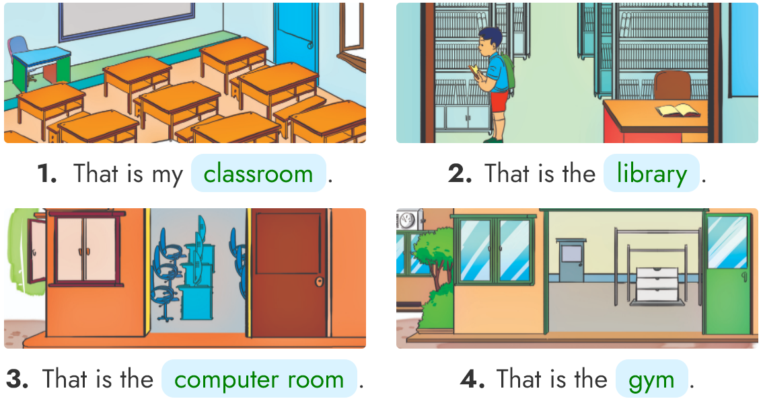
5. Look, read and write.
_____________
________
__________________
______

Slide 31

6. Let’s sing

Slide 32
2. Do the homework in WB (SBT): A(1,2,3) page 28
3. Prepare the new lesson : Unit 7
Lesson 2
1. Review the new words and sentences .
Home link
Notes:
Pexels.com

Slide 33









th
Wednesday, November 10 2021
Unit 7: That’s my school - Lesson 1
1. New words
- school : trường học
- classroom: phòng học
- computer room : phoòng máy tính
- gym : phòng thể dục
- library : thư viện
- playground : sân chơi
- big : to / lớn
- small : nhỏ
2. Model Sentences
That’s the / my .......... (place) địa điểm ở trường
3. Homework
- WB (SBT) : A(1,2,3) - page 28
- Prepare : Unit 7 - Lesson 2

Slide 34



