Slide 1







Welcome to
our class!

Slide 2



Unit 6: Stand up!
Unit 6: Stand up!
Unit 6: Stand up!
Lesson 3
Lesson 3

Slide 3



Objectives
02
Learn the new phonics “c” and “d”
01
Review the words and sentences.
Chúng ta sẽ học 2 âm mới “c” và “d”.
Ôn tập lại từ vựng và mẫu câu.

Slide 4

Warm up

Slide 5
















Game
Pick apples
Notes:
Ms Huyền Phạm - 0936.082.789 – YOUTUBE: MsPham. Facebook: Dạy và học cùng công nghệ.

Slide 6
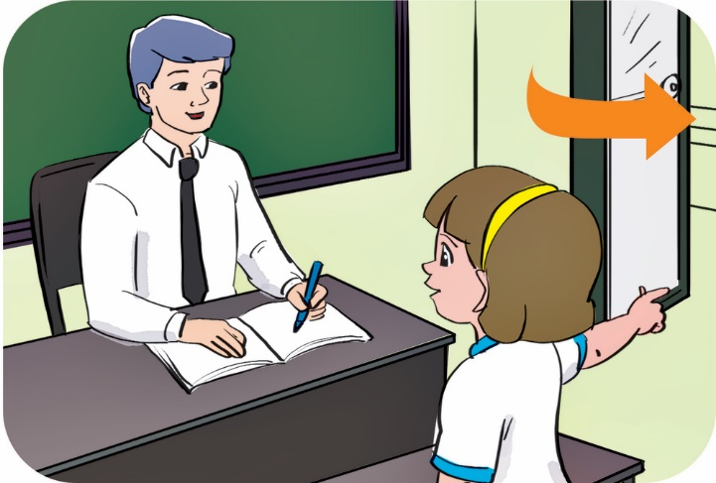

May I come in?
A
May I go out?
B
May I sit down?
Yes, you can.
C
Notes:
Ms Huyền Phạm - 0936.082.789 – YOUTUBE: MsPham. Facebook: Dạy và học cùng công nghệ.

Slide 7
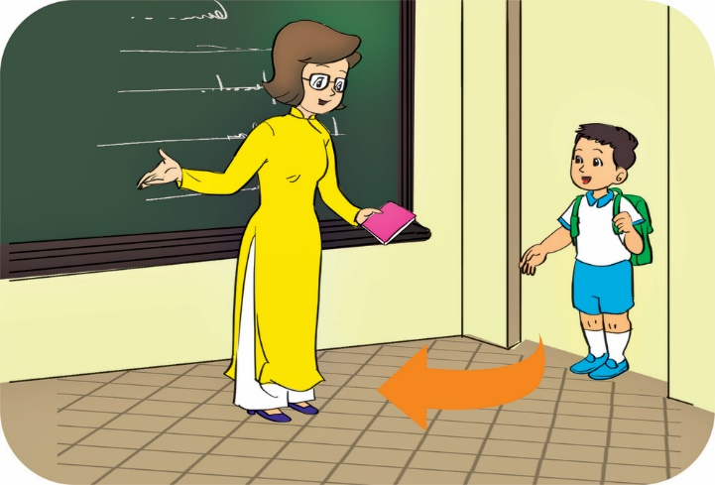
May I come in?
A
May I come out?
B
Come in, please.
Yes, you can.
C
Notes:
Ms Huyền Phạm - 0936.082.789 – YOUTUBE: MsPham. Facebook: Dạy và học cùng công nghệ.

Slide 8
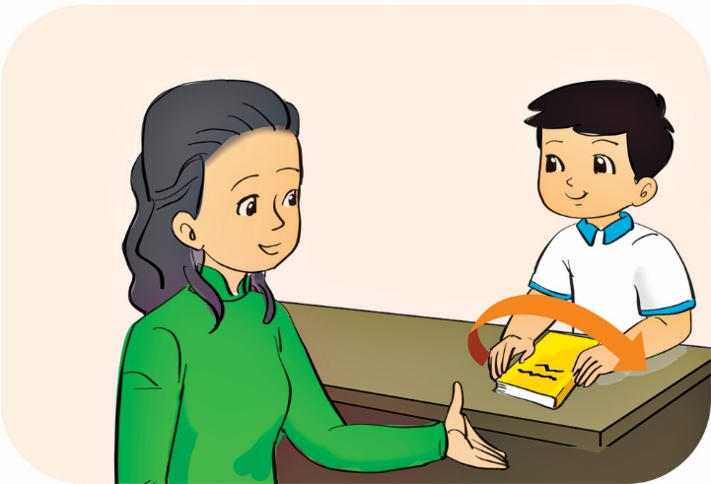
Yes, please.
A
No, you can’t.
B
May I open my book?
Yes, you can.
C
Notes:
Ms Huyền Phạm - 0936.082.789 – YOUTUBE: MsPham. Facebook: Dạy và học cùng công nghệ.

Slide 9
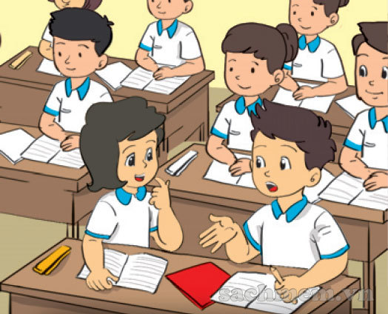
Yes, you can’t.
A
No, you can’t.
B
No, thanks.
May I speak?
C
Notes:
Ms Huyền Phạm - 0936.082.789 – YOUTUBE: MsPham. Facebook: Dạy và học cùng công nghệ.

Slide 10
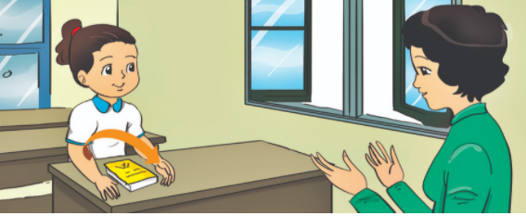
ok
A
too
B
please
Stand up, _______.
C
Notes:
Ms Huyền Phạm - 0936.082.789 – YOUTUBE: MsPham. Facebook: Dạy và học cùng công nghệ.

Slide 11

_____, please.
Don’t quiet
A
Be not quiet.
B
Be quiet
C
Notes:
Ms Huyền Phạm - 0936.082.789 – YOUTUBE: MsPham. Facebook: Dạy và học cùng công nghệ.

Slide 12
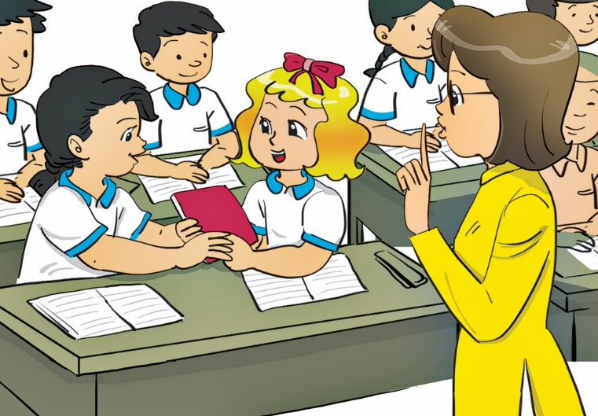
Be
A
_____ talk.
Don’t
B
May I
C
Notes:
Ms Huyền Phạm - 0936.082.789 – YOUTUBE: MsPham. Facebook: Dạy và học cùng công nghệ.

Slide 13
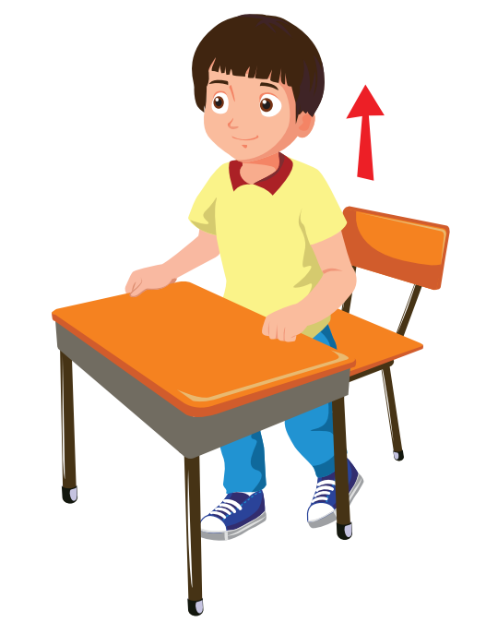
May I stand in?
A
Yes, you can.
May I stand out?
B
May I stand up?
C
Notes:
Ms Huyền Phạm - 0936.082.789 – YOUTUBE: MsPham. Facebook: Dạy và học cùng công nghệ.

Slide 14
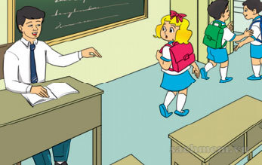
please
A
Come here, _____.
May I
B
ok
C
Notes:
Ms Huyền Phạm - 0936.082.789 – YOUTUBE: MsPham. Facebook: Dạy và học cùng công nghệ.

Slide 15
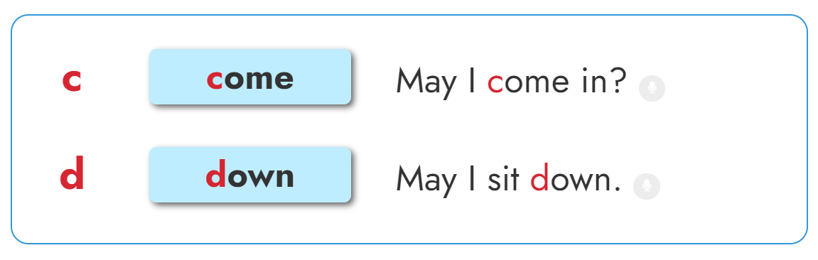


1. Listen and repeat

Slide 16


Slide 17
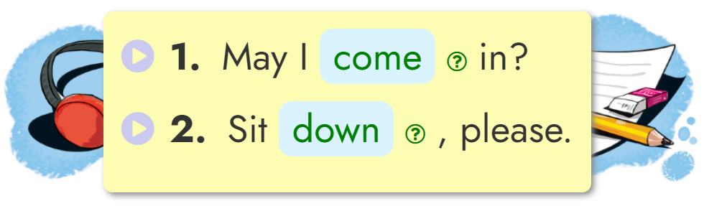
2. Listen and write.
____________
____________

Slide 18

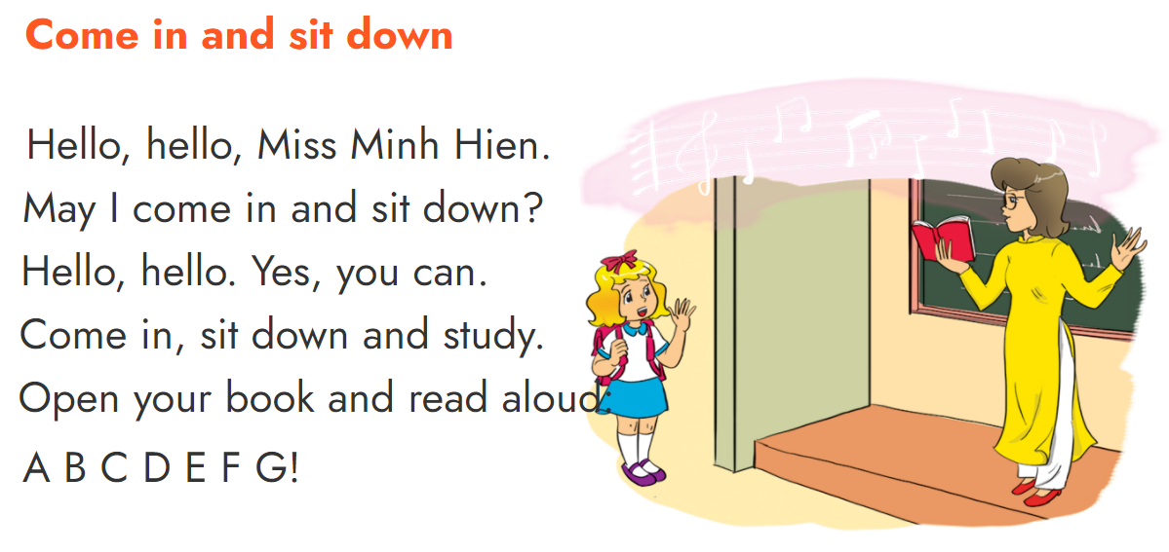

2. Let’s sing.

Slide 19
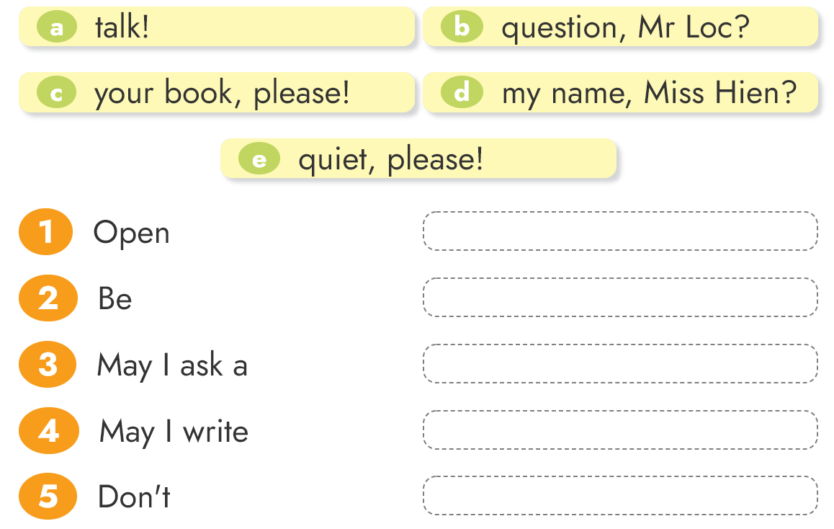





4. Read and match

Slide 20
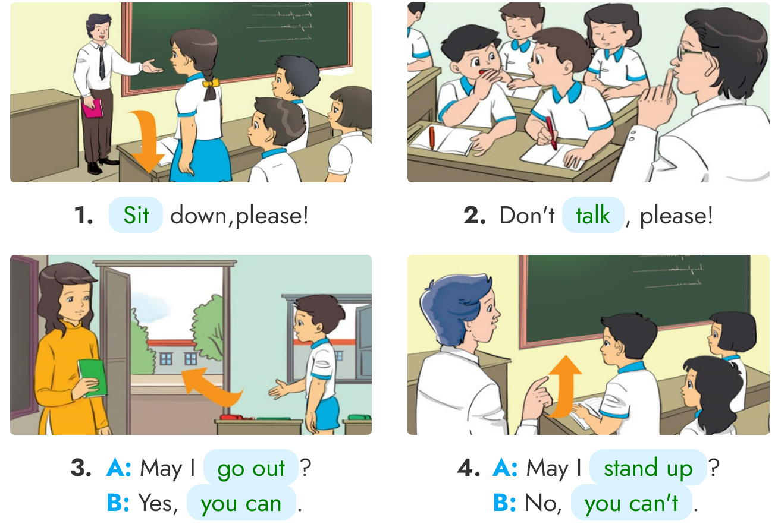
3. Look, read and write
____
____
______
______
______
______

Slide 21
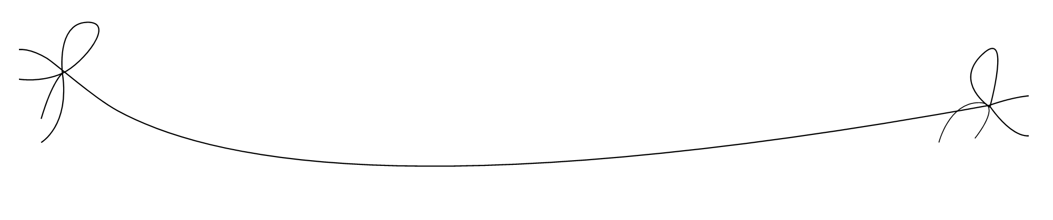

Home link
3.
Prepare the new lesson : Unit 7 Lesson 1
2.
Do the homework in WB (SBT):
page 26 - 27
1.
Using the new sentences in the real life .

Slide 22


Tuesday, November 09 2021
Unit 6: Stand up! - Lesson 3
1. Phonics
- Phonic “c” : come -> May I come in?
- Phonic “d” : down -> May I sit down?
2. Homework
- WB (SBT) : Page 26 - 27
- Prepare : Unit 7 - Lesson 1
th

Slide 23





