Slide 1







THANH AM PRIMARY SCHOOL
Welcome
to our Class!
Book: English 3
Prepared by Miss Linh

Slide 2






Lesson 2
Unit 6
Stand up!
Page 42-43

Slide 3
Objectives
Mục tiêu của bài học
03
02
01
Learn the sentences to ask “May be + Verb ?”
Learn the new words about action
Review “Command sentences” in the classroom.
Chúng ta sẽ học về từ chỉ hành động.
Chúng ta sẽ học về câu hỏi “Xin phép việc gì đó”.
Ôn tập lại các câu mệnh lệnh (yêu cầu) trong lớp học.

Slide 4





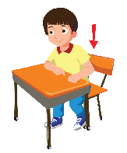




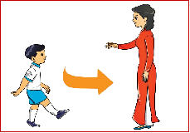


Warm up
Sit down!
Stand up!
Don’t talk!
Teacher says:
Open your book!
Close your book!
Come here!

Slide 5
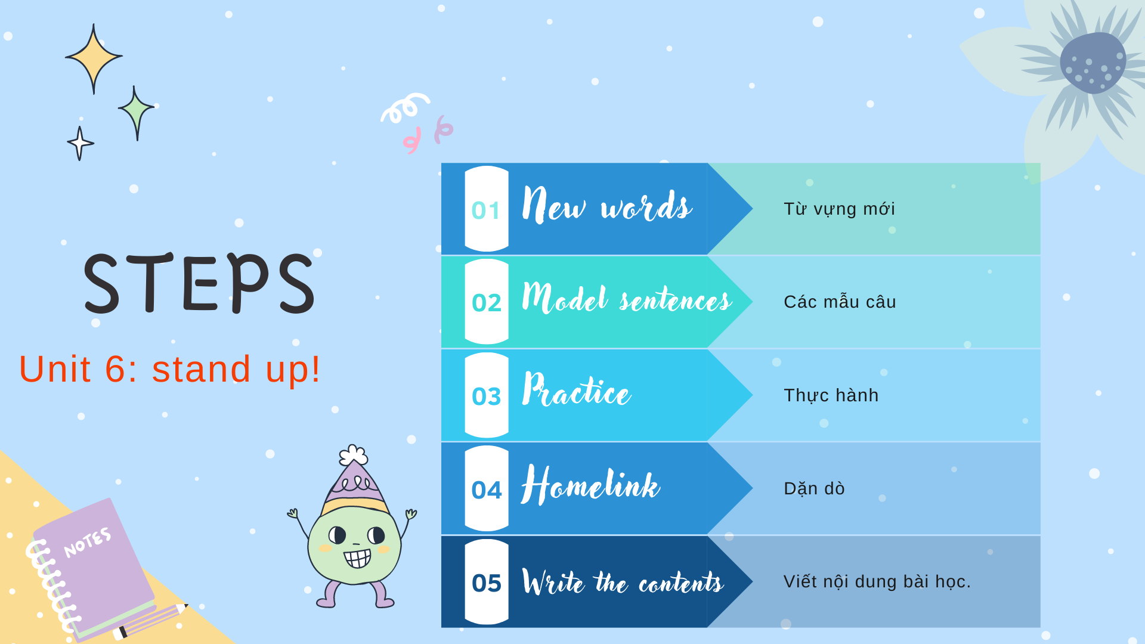
Thanh Am Primary School

Slide 6


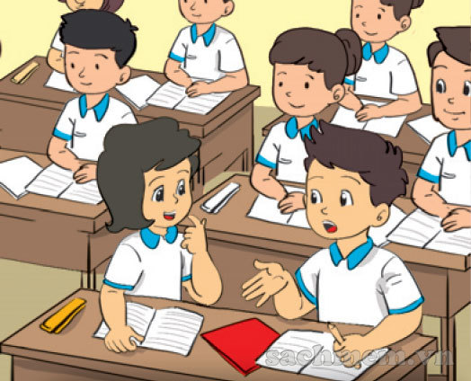

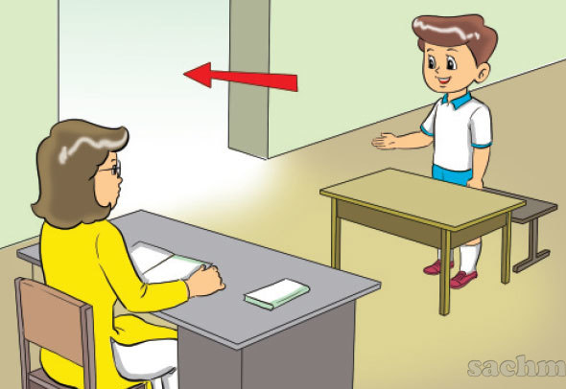
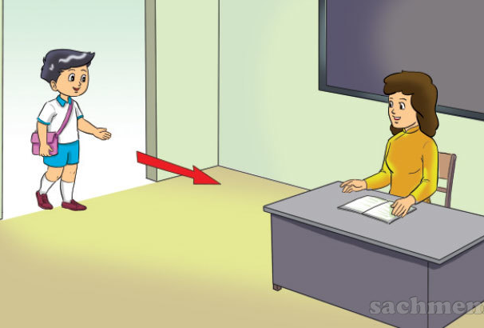
New words
Write
Speak
Go out
Come in

Slide 7


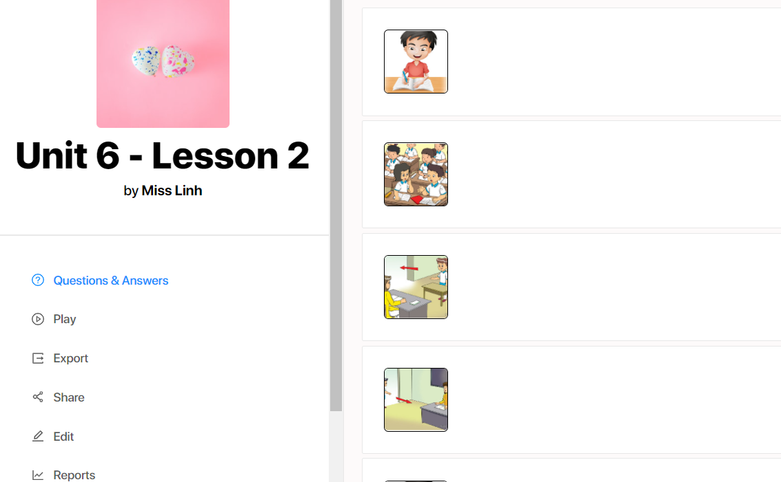

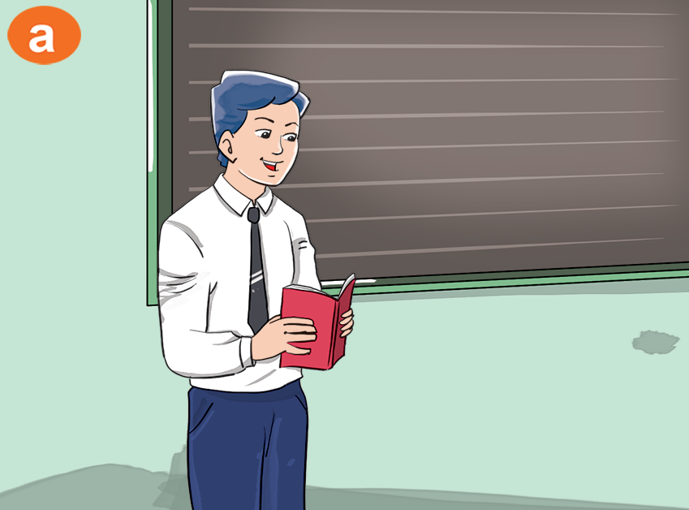









Thanh Am Primary School
Write
Who’s this?
Speak
It’s Mr. Loc
Go out
Come in

Slide 8











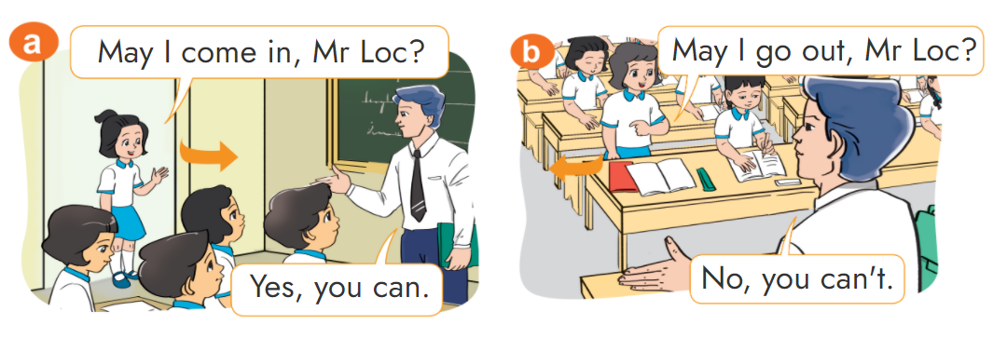







Thanh Am Primary School
Look, listen and repeat.

Slide 9

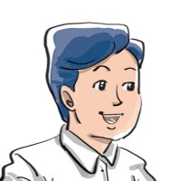
Sentence
come in
May I ___________?
Yes, you can.
No, you can’t.

Slide 10


Point and say
Yes, you can.
May I ______?
No, you can’t.
Come in
Write
Write
Speak
Go out

Slide 11






Thanh Am Primary School
3
4
7
8
1
2
5
6
Bee games
Back to the hive

Slide 12








Thanh Am Primary School
Question 1:
write
May I ?
come in
write
speak

Slide 13
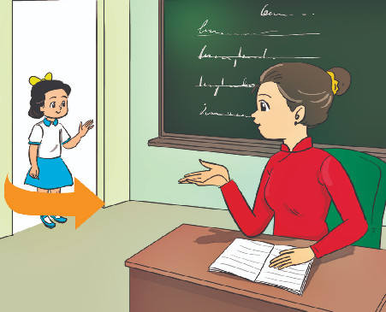
Thanh Am Primary School
Question 2:
come in
May I ?
come here
come in
write

Slide 14
Thanh Am Primary School
Question 3:
come here
May I ?
come here
speak
talk

Slide 15
Thanh Am Primary School
Question 4:
speak
May I ?
write
speak
come in

Slide 16

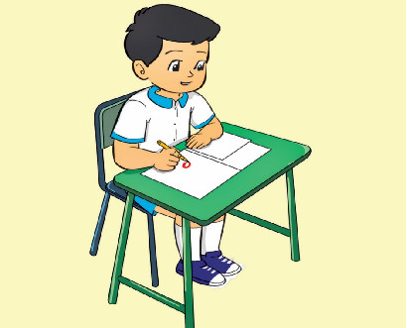
Thanh Am Primary School
Question 5:
May I write?
No, you can’t.
Yes, you can.
Yes, I can.
No, it isn’t.
Notes:
Ms Huyền Phạm - 0936.082.789 – YOUTUBE: MsPham. Facebook: Dạy và học cùng công nghệ.

Slide 17
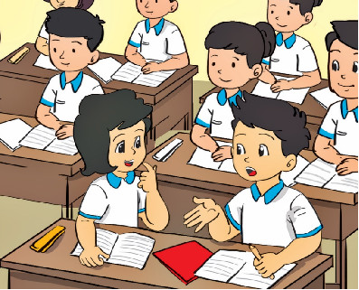
Thanh Am Primary School
Question 6:
________?
No, you can’t.
May I write?
May I speak?
May I come in?
May I go out?
Notes:
Ms Huyền Phạm - 0936.082.789 – YOUTUBE: MsPham. Facebook: Dạy và học cùng công nghệ.

Slide 18
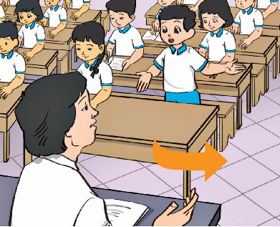
Thanh Am Primary School
Question 7:
May I go out?
Yes, it is.
No, you can.
Yes, you can.
No, it isn’t.
Notes:
Ms Huyền Phạm - 0936.082.789 – YOUTUBE: MsPham. Facebook: Dạy và học cùng công nghệ.

Slide 19
Thanh Am Primary School
Question 8:
___________?
Yes, you can.
May I go out?
May I come in?
May I come
here?
May you come in?
Notes:
Ms Huyền Phạm - 0936.082.789 – YOUTUBE: MsPham. Facebook: Dạy và học cùng công nghệ.

Slide 20

Thanh Am Primary School

Slide 21
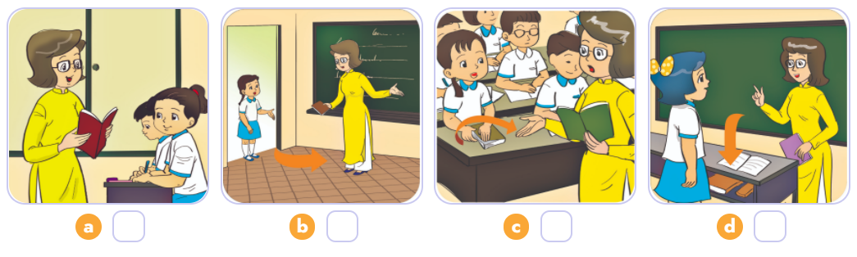

Listen and number.
4
1
2
3
1
2
3
4

Slide 22

Home link
Thanh Am Primary School
Dặn dò
1. Using the new sentences in the real life .
Sử dụng mẫu câu đã học vào thực tế
2. Do the homework in WB (SBT): B(1,2,3) - page 25
Làm bài tập về nhà trang 25
3. Prepare the new lesson : Unit 6 - Lesson 3
Chuẩn bị bài học mới:
Bài 6 - Tiết 3

Slide 23














Thanh Am Primary School
Thursday, November 4 2021
Unit 6: Stand up ! - Lesson 2
1.New words
- come in : đi vào
- go out : đi ra / ra ngoài
- write : viết
- speak : nói
2. Model Sentence0s
May I ..........? -> Yes, you can. / No, you can’t.
3. Homework
- WB (SBT) : B(1,2,3) - page 25
- Prepare : Unit 6 - Lesson 3
th

Slide 24


Thanh Am Primary School

