Slide 1







THANH AM PRIMARY SCHOOL
Welcome
to our Class!
Book: English 3
Long Bien, November 3 2021
Prepared by Miss Linh
rd

Slide 2






Lesson 1
Unit 6
Stand up!
page 40-41

Slide 3



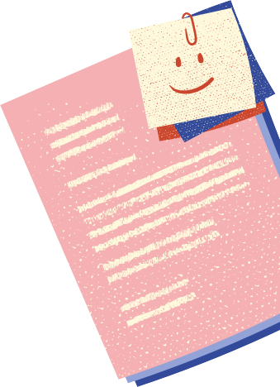







Objectives
Unit 6
Mục tiêu của bài học
1. Review the sentence
Are they your friends?”.
2. We will learn about “Command Sentences” in the classroom.
1. Ôn tập mẫu câu “ Họ là những người bạn của bạn phải không?”.
2. Chúng ta sẽ học về “các câu mệnh lệnh (yêu cầu) trong lớp học.
Stand up!

Slide 4



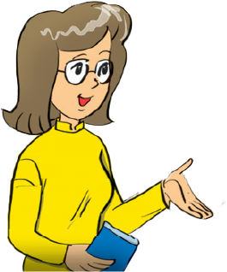

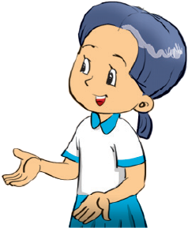


Warm up
Are they your friends?
Yes, they are.
_________________
No, they aren’t.
_________________

Slide 5
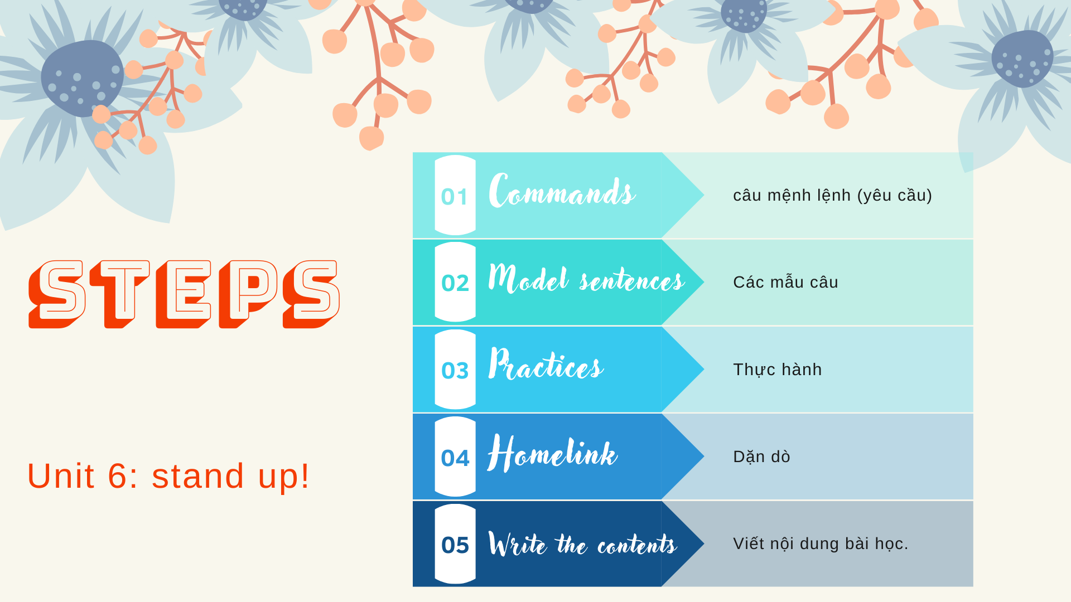
Thanh Am Primary School

Slide 6





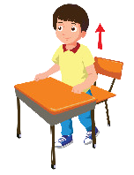
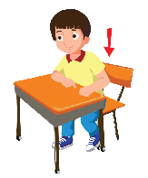

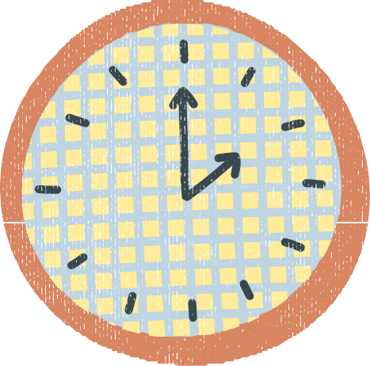



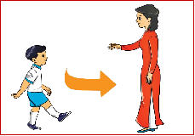

Commands:
Sit down!
Stand up!
Don’t talk!
Open your book!
Close your book!
Come here!

Slide 7


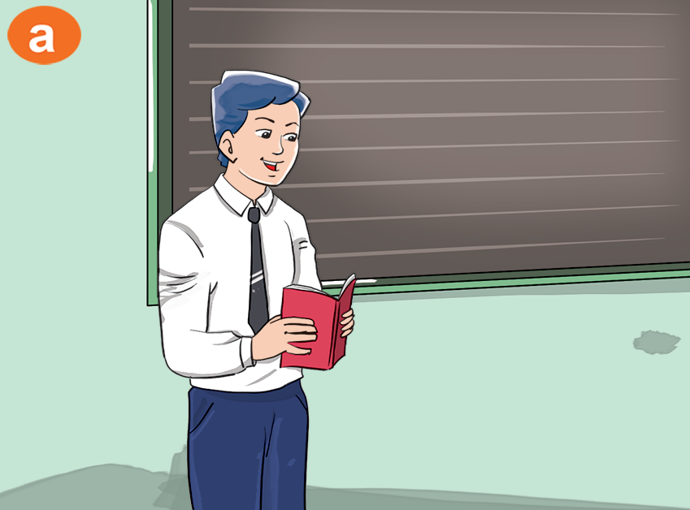









Thanh Am Primary School
Who’s this?
It’s Mr. Loc

Slide 8



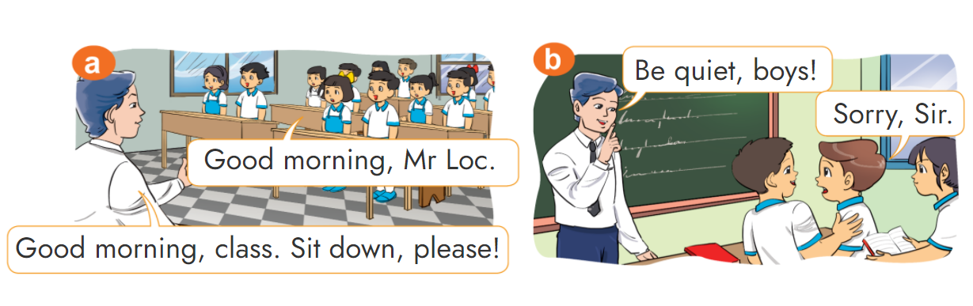






1. Look, listen and repeat.

Slide 9
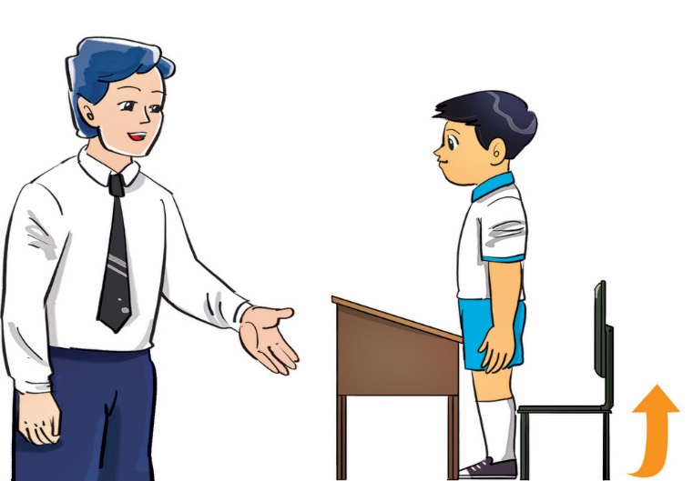
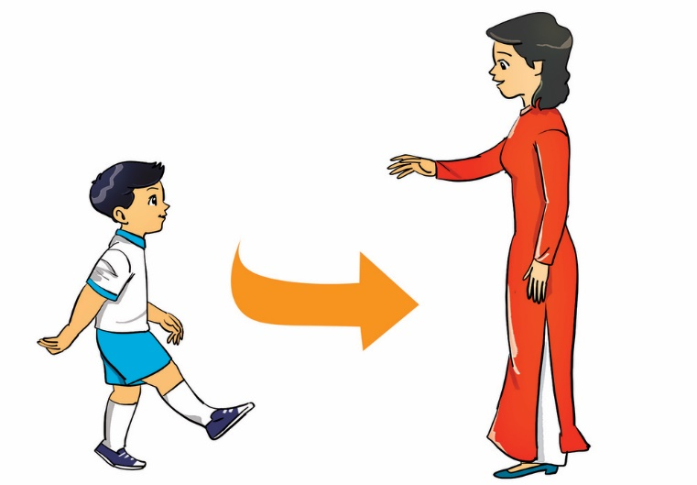
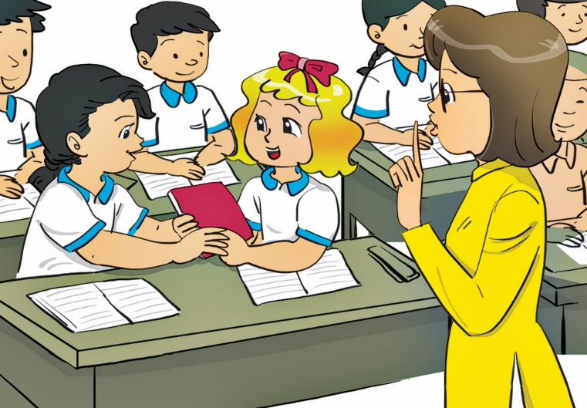






2. Point, say and do the actions.
Stand up, please!
Come here, please!
Don’t talk, please!
Open your book, please!
Close your book, please!

Slide 10
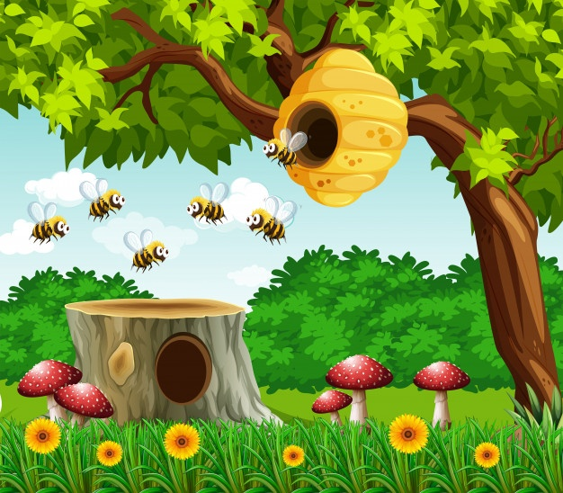

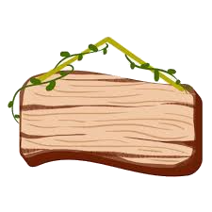



5
9
4
1
10
7
3
8
2
6
Bee games
Back to the hive

Slide 11







Question 1:
talk
Don’t !
sit
up
talk

Slide 12
Question 2:
Open
your book, please!
close
Open
down

Slide 13
Question 3:
Come
here, please !
come
don’t
stand

Slide 14
Question 4:
Sit
down, please !
stand
sit
Up

Slide 15
Question 5:
Close
your book, please!
close
open
don’t

Slide 16
Question 6:
Stand
up, please !
sit
talk
stand

Slide 17

Question 7:
Sit down, please.
Don’t talk!
Come here, please.
Stand up, please.
Notes:
Ms Huyền Phạm - 0936.082.789 – YOUTUBE: MsPham. Facebook: Dạy và học cùng công nghệ.

Slide 18

Question 8:
Stand up, please.
Open your book, please!
Don’t talk!
Come here!
Notes:
Ms Huyền Phạm - 0936.082.789 – YOUTUBE: MsPham. Facebook: Dạy và học cùng công nghệ.

Slide 19

Question 9:
Close your book, please.
Stand up, please.
Come here, please.
Don’t talk!
Notes:
Ms Huyền Phạm - 0936.082.789 – YOUTUBE: MsPham. Facebook: Dạy và học cùng công nghệ.

Slide 20

Question 10:
Stand up, please.
Come here, please.
Sit down, please.
Don’t talk!
Notes:
Ms Huyền Phạm - 0936.082.789 – YOUTUBE: MsPham. Facebook: Dạy và học cùng công nghệ.

Slide 21

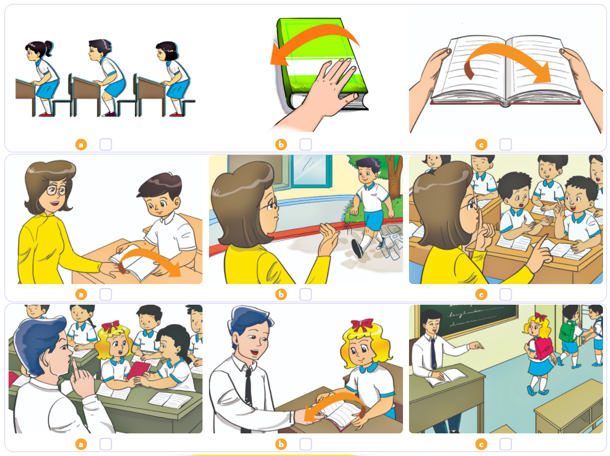


3. Listen and tick.
1
2
3

Slide 22

Homelink
Thanh Am Primary School
Dặn dò
2. Do the homework in WB (SBT): A(1,2,3) - page 24
1. Review the “Commands sentences” .
3. Prepare the new lesson : Unit 6 - Lesson 2

Slide 23















Thanh Am Primary School
Wednesday, November 3 2021
Unit 6: Stand up ! - Lesson 1
1. Model Sentences
Commands : Câu mệnh lệnh (yêu cầu)
- Stand up, please!
- Sit down, please!
- Don’t talk!
- Come here!
- Open your book, please!
- Close your book, please!
2. Homework
- WB (SBT) : A(1,2,3) - page 24
- Prepare : Unit 6 - Lesson 2
rd

Slide 24



Thanh Am Primary School

