Slide 1

Welcome to our class
2A1

Slide 2

Bài 13: Học từ vựng về hình dạng.

Slide 3
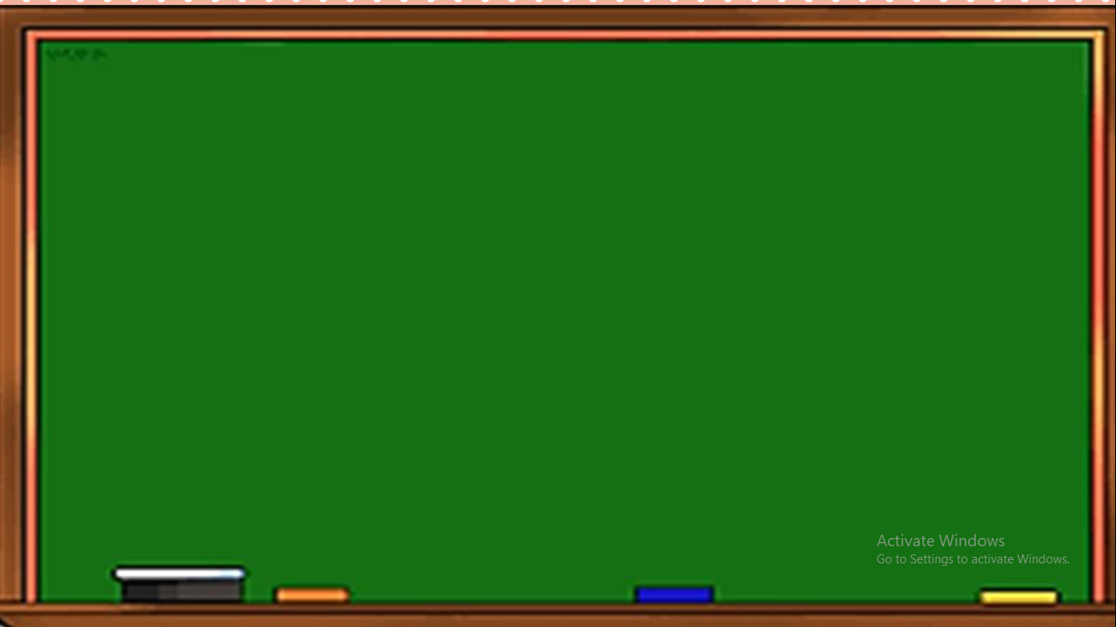
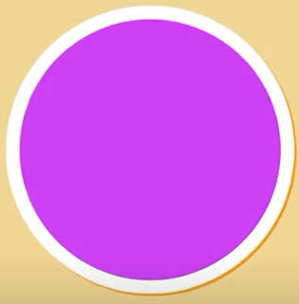
This is a circle.

Slide 4

This is a square.

Slide 5
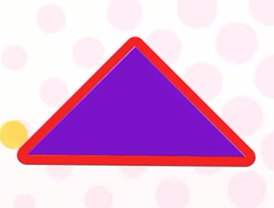
This is a triangle.

Slide 6
Quan sát các đồ vật sau có hình dạng gì?

Slide 7
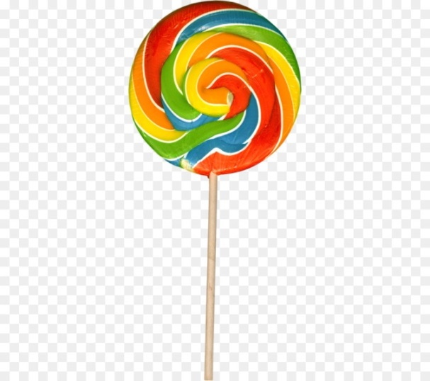


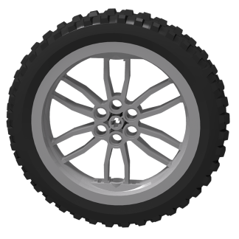
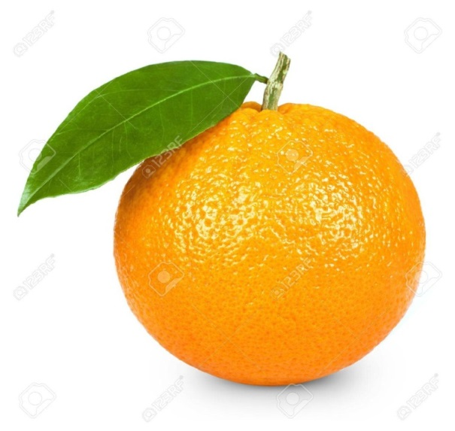
circle

Slide 8

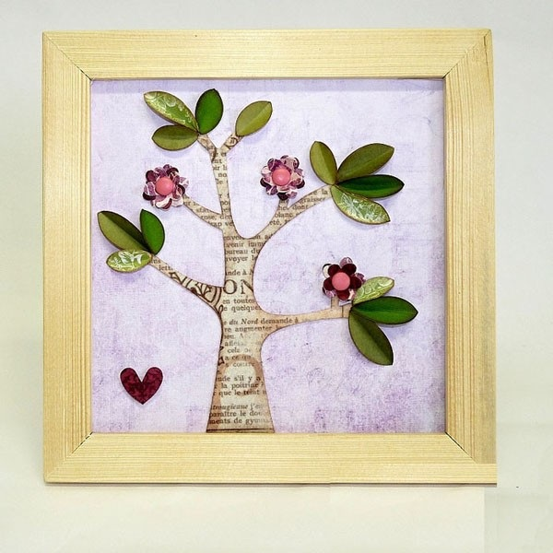
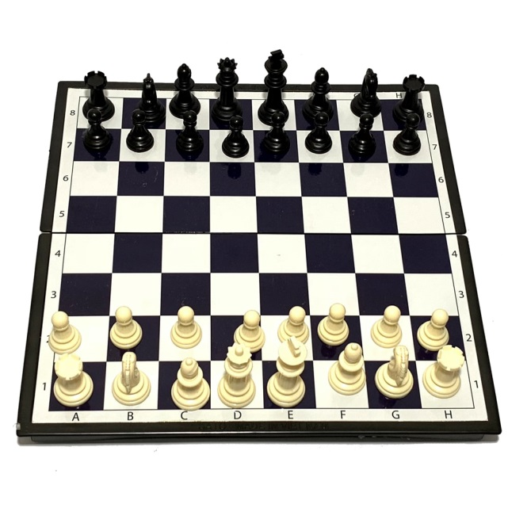

square

Slide 9
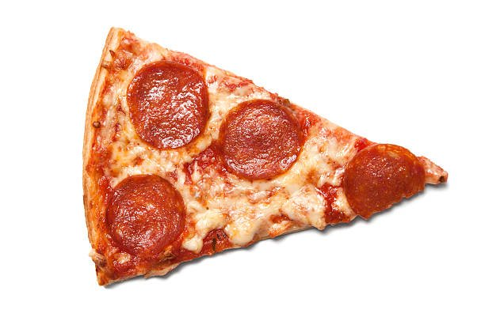
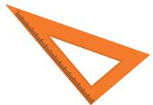
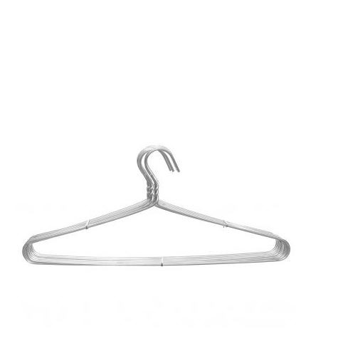

triangle

Slide 10
Hỏi đáp với câu hỏi: How many…?

Slide 11
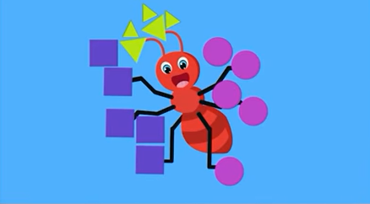
How many circles are there?

Slide 12
How many squares are there?

Slide 13
How many triangles are there?

Slide 14

Fishing Game

Slide 15











FISHING GAME
GO

Slide 16




C. A triangle
NEXT
A. a circle
D. A square
B. Three triangles
C. A triangle

Slide 17
A. A circle
NEXT
This is …
A. A circle
D. A triagle
C. two circles
B. A square

Slide 18
B. A square
NEXT
A. A circle
This is ______
C. Two cirlces
B. A square
D. A triagle

Slide 19
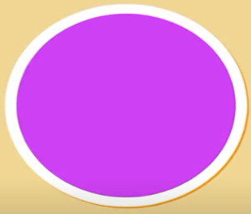
NEXT
D. Three circles
A. One circle
C. Two circles
D. Three circles
B. Four circles

Slide 20
C. Five squares
NEXT
A. Six squares
D. Seven squares
B. Eight squares
C. Five squares

Slide 21
B. Six triagles
A. four triagles
I have ______
C. Ten triagles
B. Six triagles
D. Five triagles

Slide 22


