Slide 1

Welcome to our class
2A2

Slide 2

Bài 12: Học cách hỏi đáp với “Where”?

Slide 3

Review

Slide 4
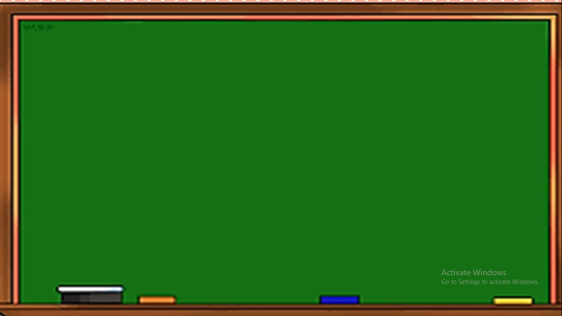


castle

Slide 5
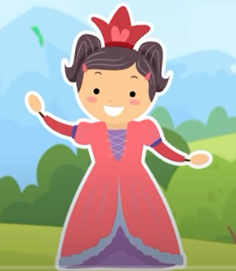
princess

Slide 6
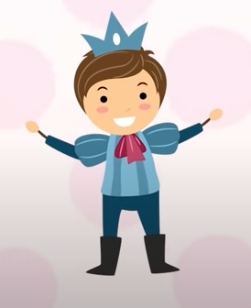
prince

Slide 7
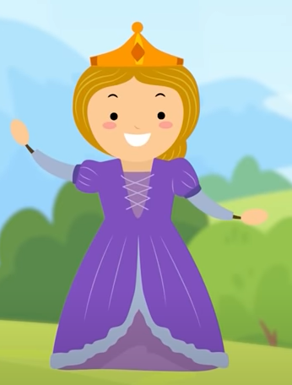
queen

Slide 8
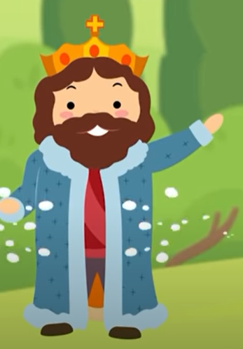
king

Slide 9
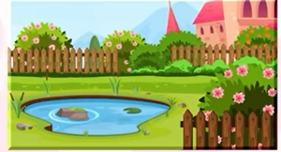
garden

Slide 10
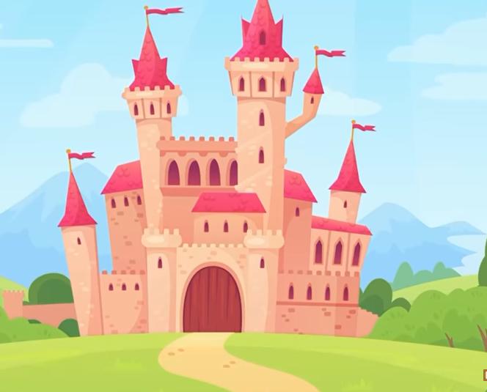
king
queen
castle
garden
prince
princess

Slide 11
Who’s/What’s missing?
Game

Slide 12
Who’s missing?
king
queen
castle
garden
prince
princess

Slide 13
Who’s missing?
king
queen
castle
garden
prince
princess

Slide 14
What’s missing?
king
queen
castle
garden
prince
princess

Slide 15
Who’s missing?
king
queen
castle
garden
prince
princess

Slide 16
What’s missing?
king
queen
castle
garden
prince
princess

Slide 17
king
queen
castle
garden
prince
princess

Slide 18
The King is in the castle.

Slide 19
in the castle

Slide 20
in the garden

Slide 21
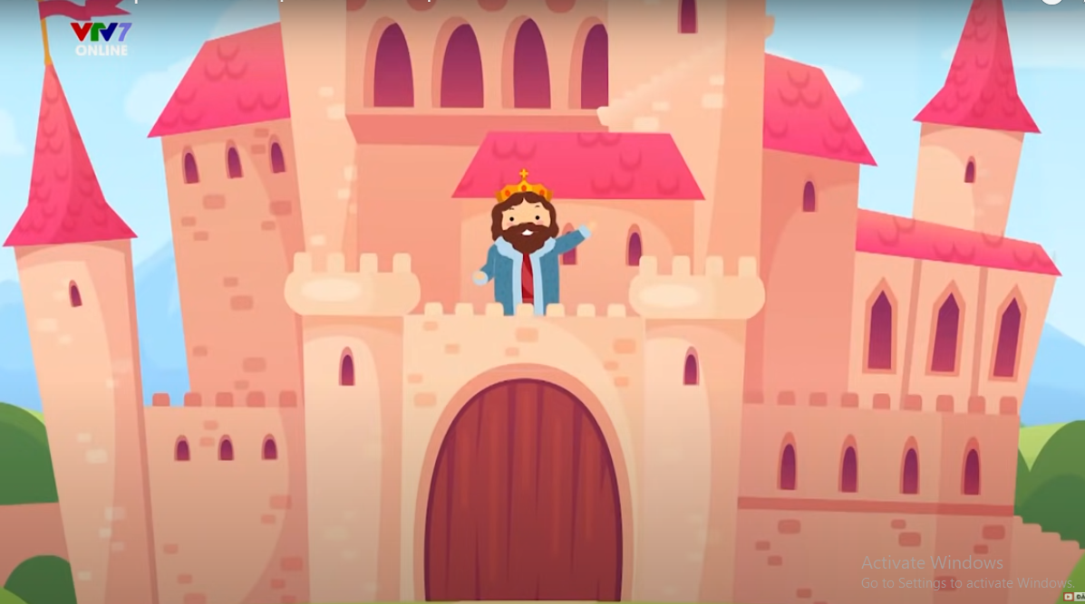
Where is ______________?
the King
in the castle .
________ is __________
The King

Slide 22
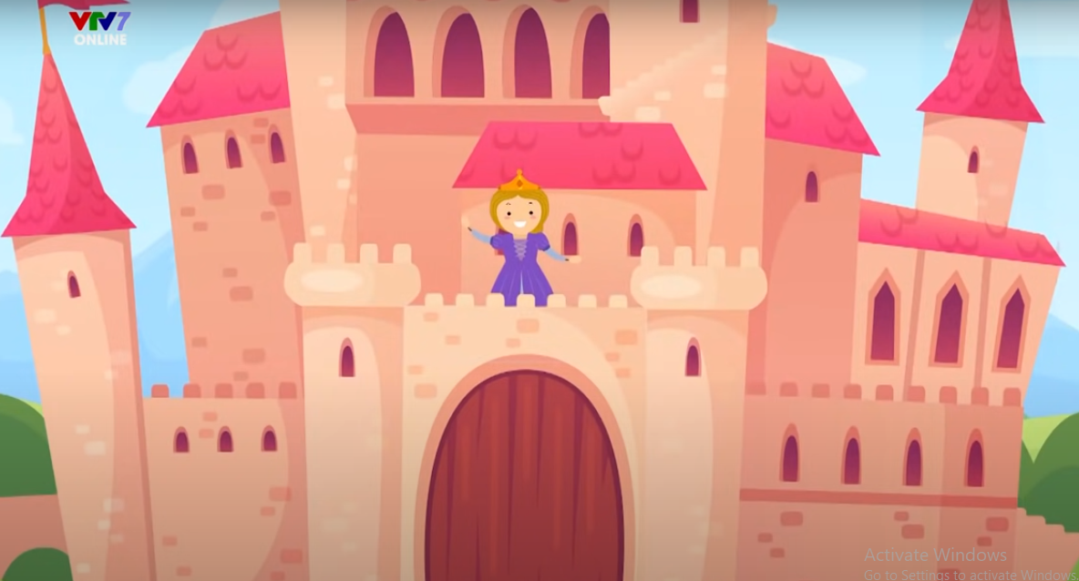
Where is ______________?
the Queen
The Queen
in the castle .
________ is __________

Slide 23
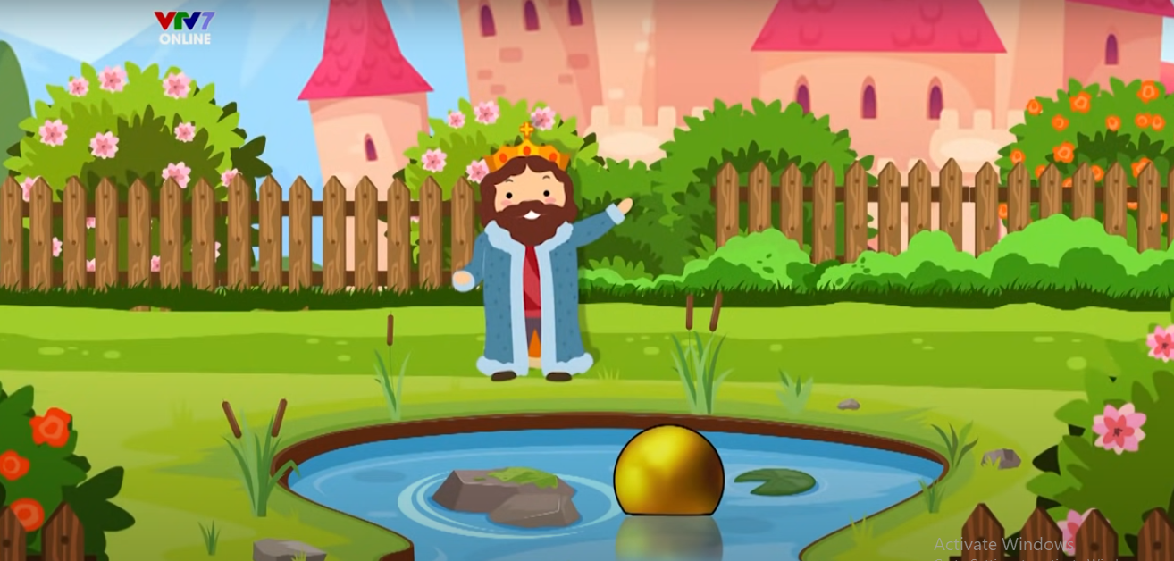
Where is ______________?
the King
in the garden
________ is ____________ .
The King

Slide 24
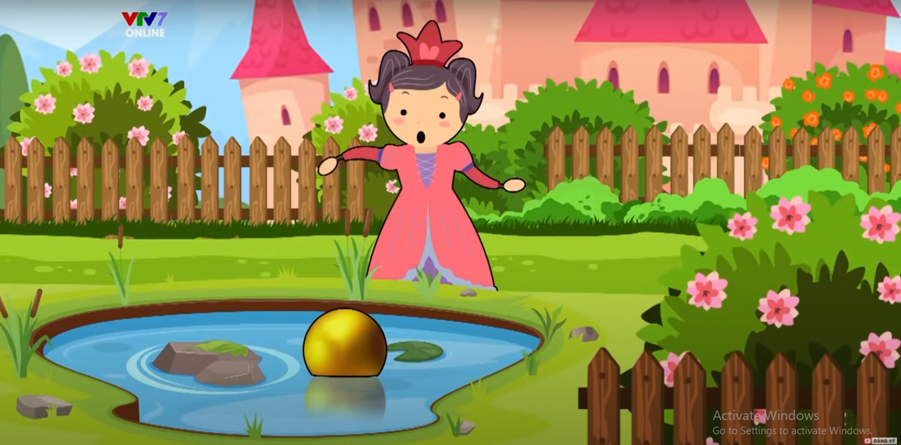
Where is ______________?
the Princess
in the garden
________ is ____________ .
The Princess

Slide 25
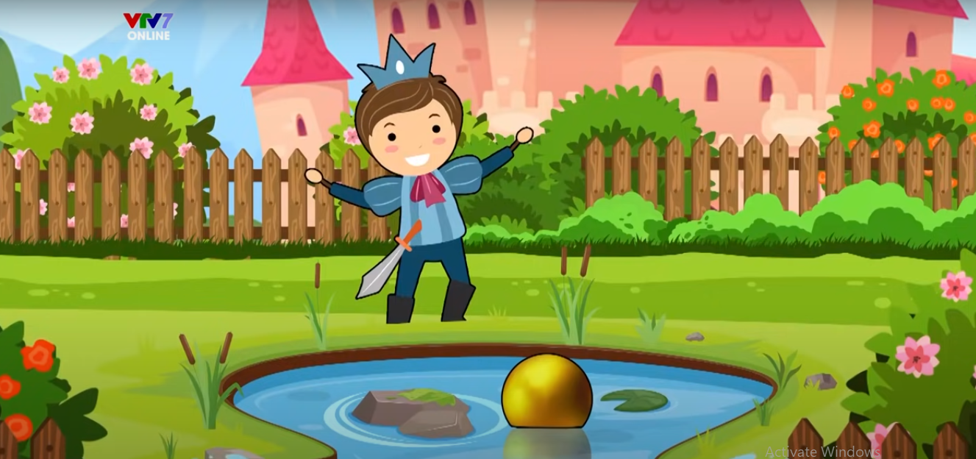
Where is ______________?
the Prince
in the garden
________ is ____________ .
The Prince

Slide 26
Make sentences
and Get stars

Slide 27



The King
The Queen
The Prince
The Princess
Q.1
Q.2
Q.3
Q.4
in the castle
Q.5
Q.6
Q.7
Q.8
in the garden
________ is ________

Slide 28
The King is in the castle
with the Queen.

Slide 29
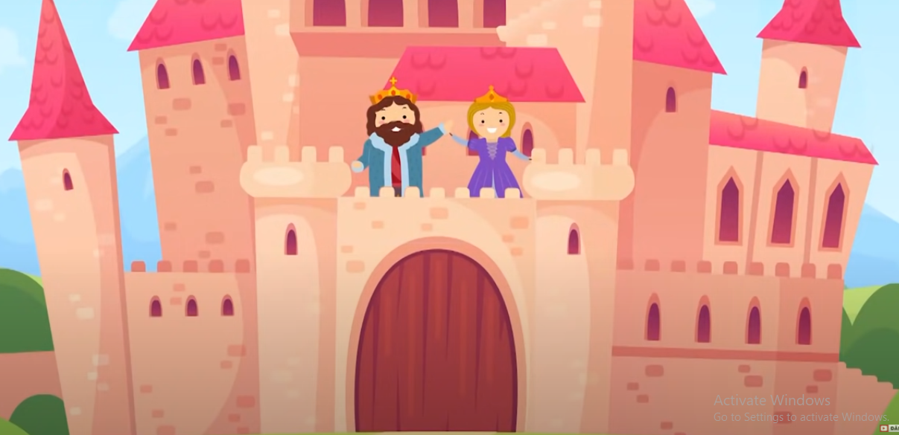
________ is in the castle ______________ .
The King
with the Queen

Slide 30
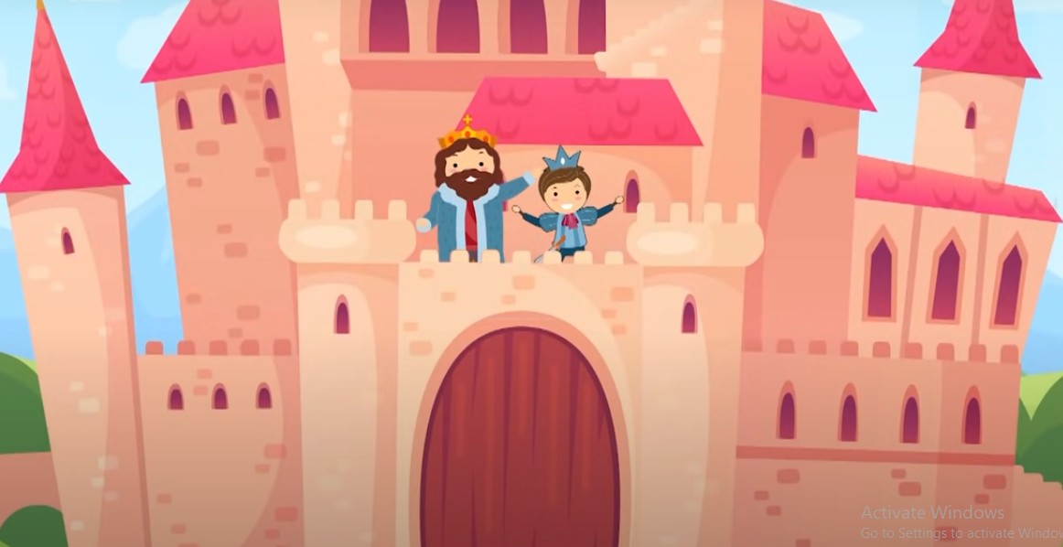
________ is in the castle ______________ .
The King
with the Prince

Slide 31
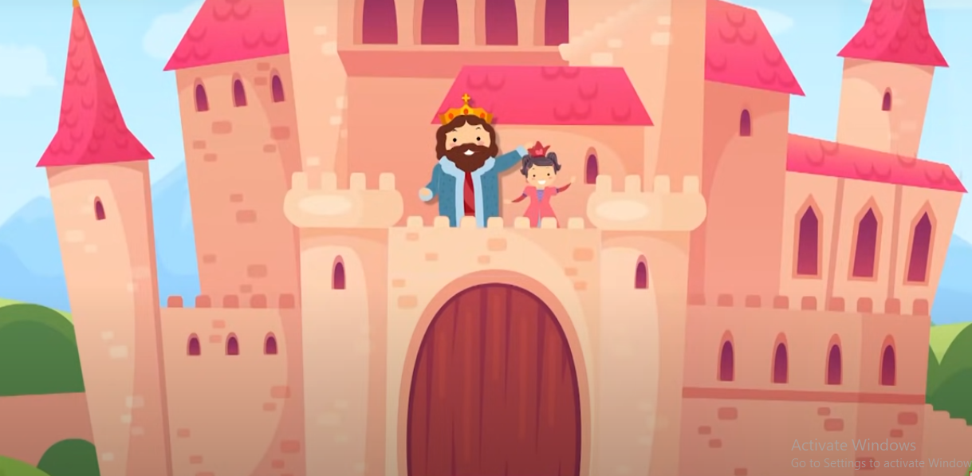
________ is in the castle ______________ .
The King
with the Princess

Slide 32
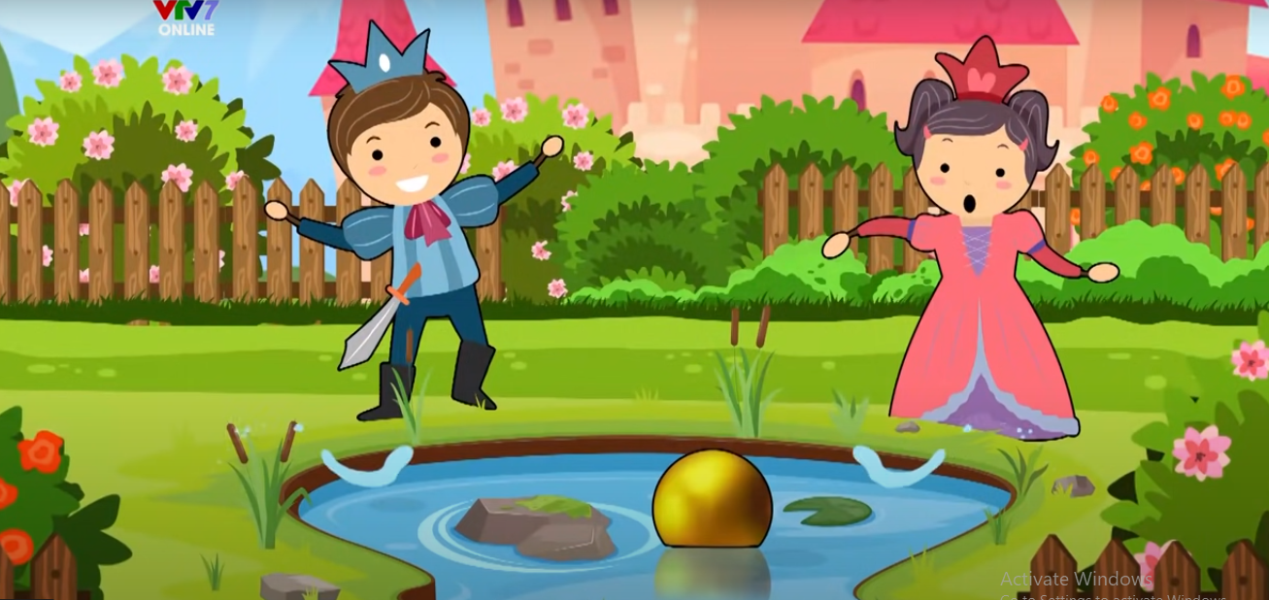
________ is in the garden ______________ .
The Prince
with the Princess

Slide 33
True or False

Slide 34

The King is in the garden.

Slide 35
The Queen is in the castle.

Slide 36
The Prince is in the garden with the Queen.

Slide 37
The Princess is in the garden.

Slide 38
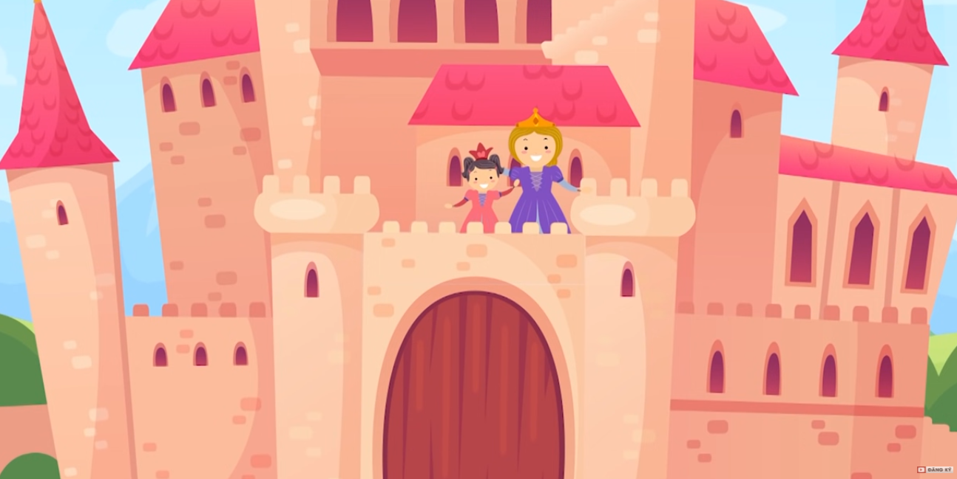
The Queen is in the garden with the Princess.

Slide 39


