Slide 1
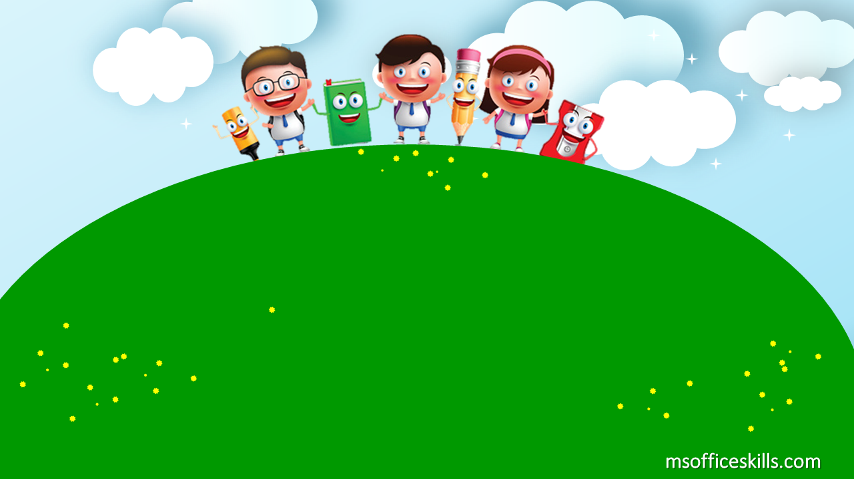
Welcome to our class
2A1

Slide 2

Bài 11:Học phát âm phonic Q

Slide 3
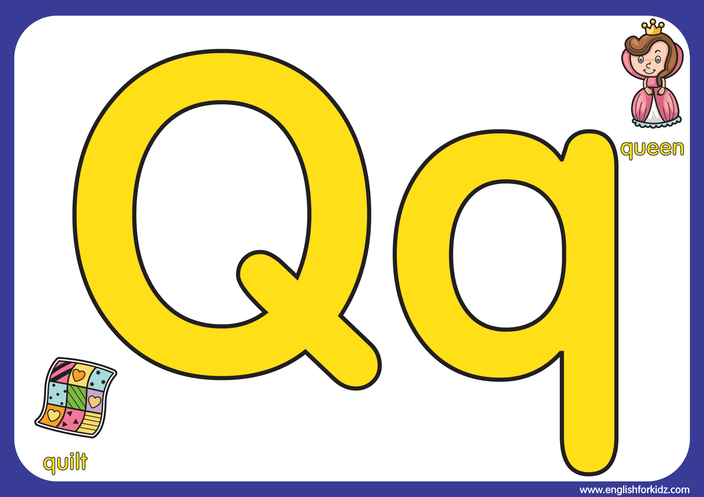

Slide 4

This is a big Q

Slide 5
This is a small q

Slide 6
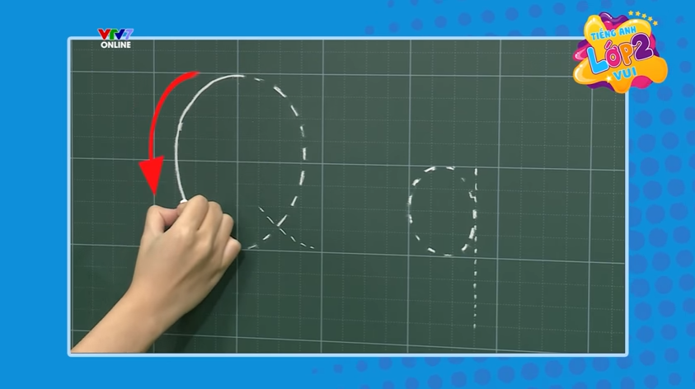

Slide 7
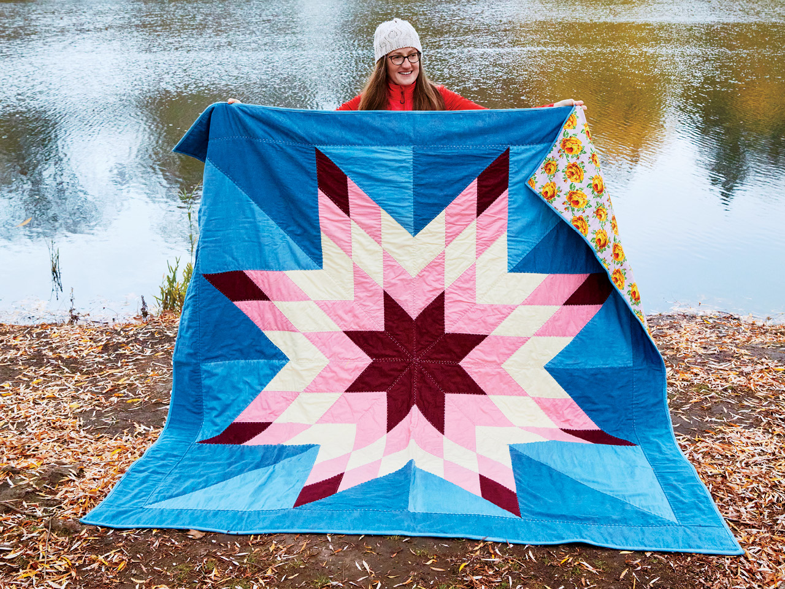
Q-q-quilt / A big quilt

Slide 8
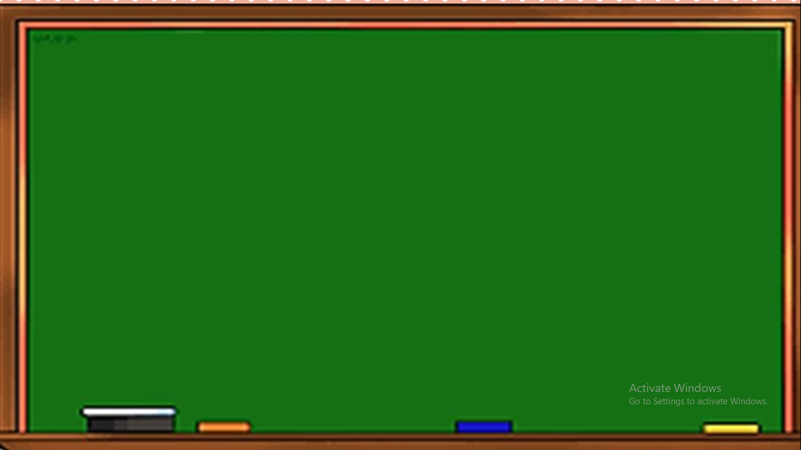
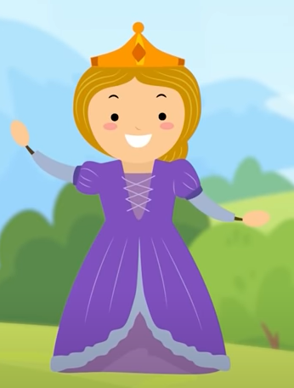
Q-q- queen- A nice queen

Slide 9

castle

Slide 10
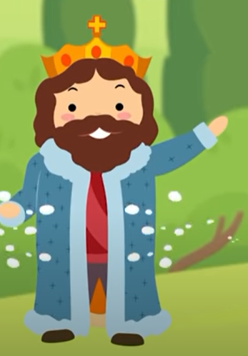
king

Slide 11
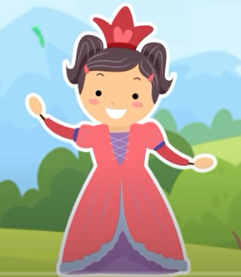
princess

Slide 12
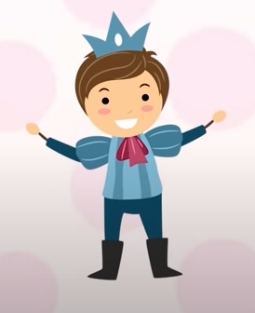
prince

Slide 13
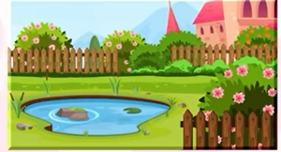
Garden

Slide 14
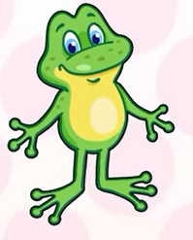
frog

Slide 15
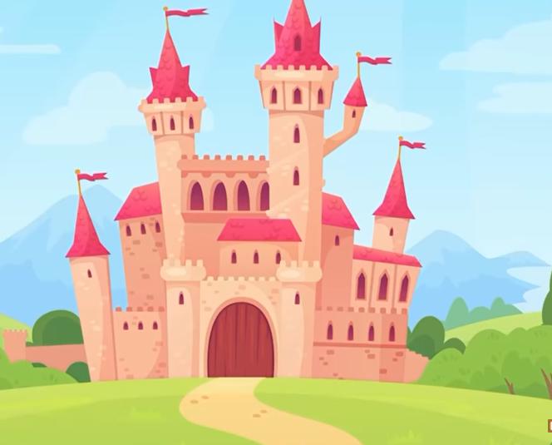


Slide 16


Slide 17
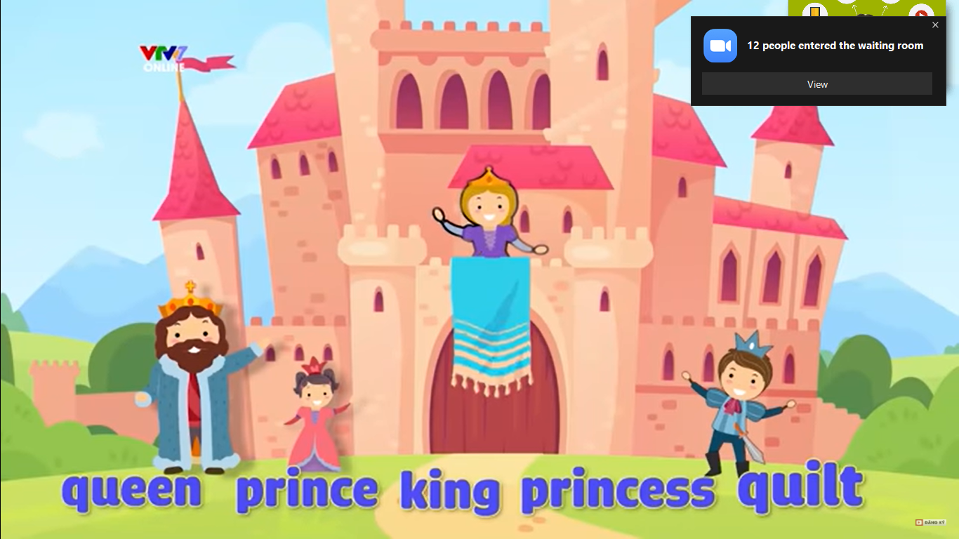

Slide 18
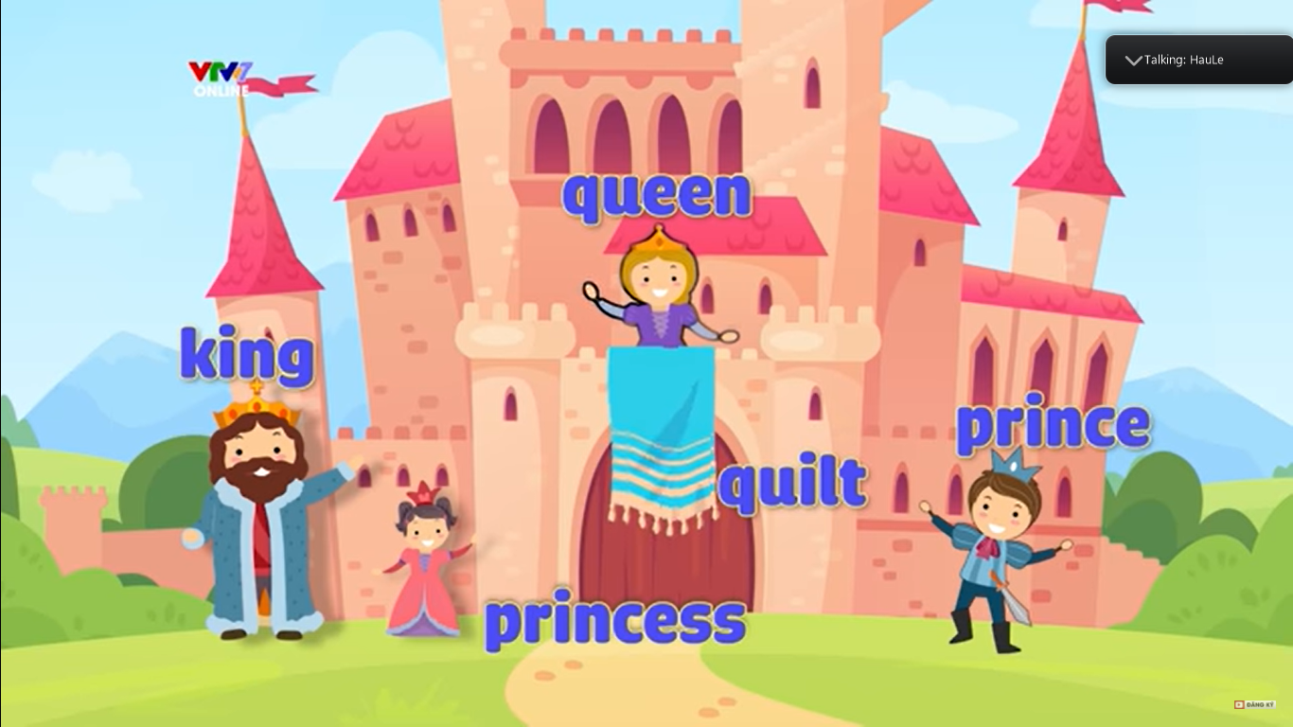

Slide 19




FROG PRINCE

Slide 20






















Slide 21


king
queen
prince

Slide 22
king
prince
princess

Slide 23
flower
garden
catsle

Slide 24
tree
castle
Garden

Slide 25
bee
frog
butterfly

Slide 26
prince
princess
king

Slide 27
quilt
princess
king

Slide 28
A BIG Q
A SMALL q
princess

Slide 29
queen
king
princess

Slide 30
prince
king
princess

Slide 31


