Slide 1
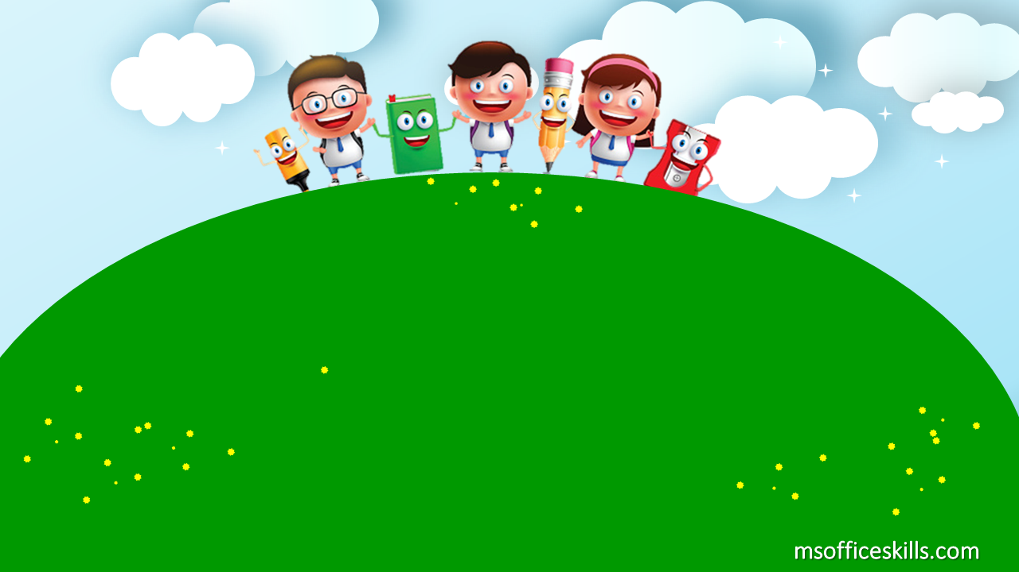
Welcome to our class 1A3

Slide 2



Slide 3

Bài 13: Học từ vựng về chủ đề động vật

Slide 4
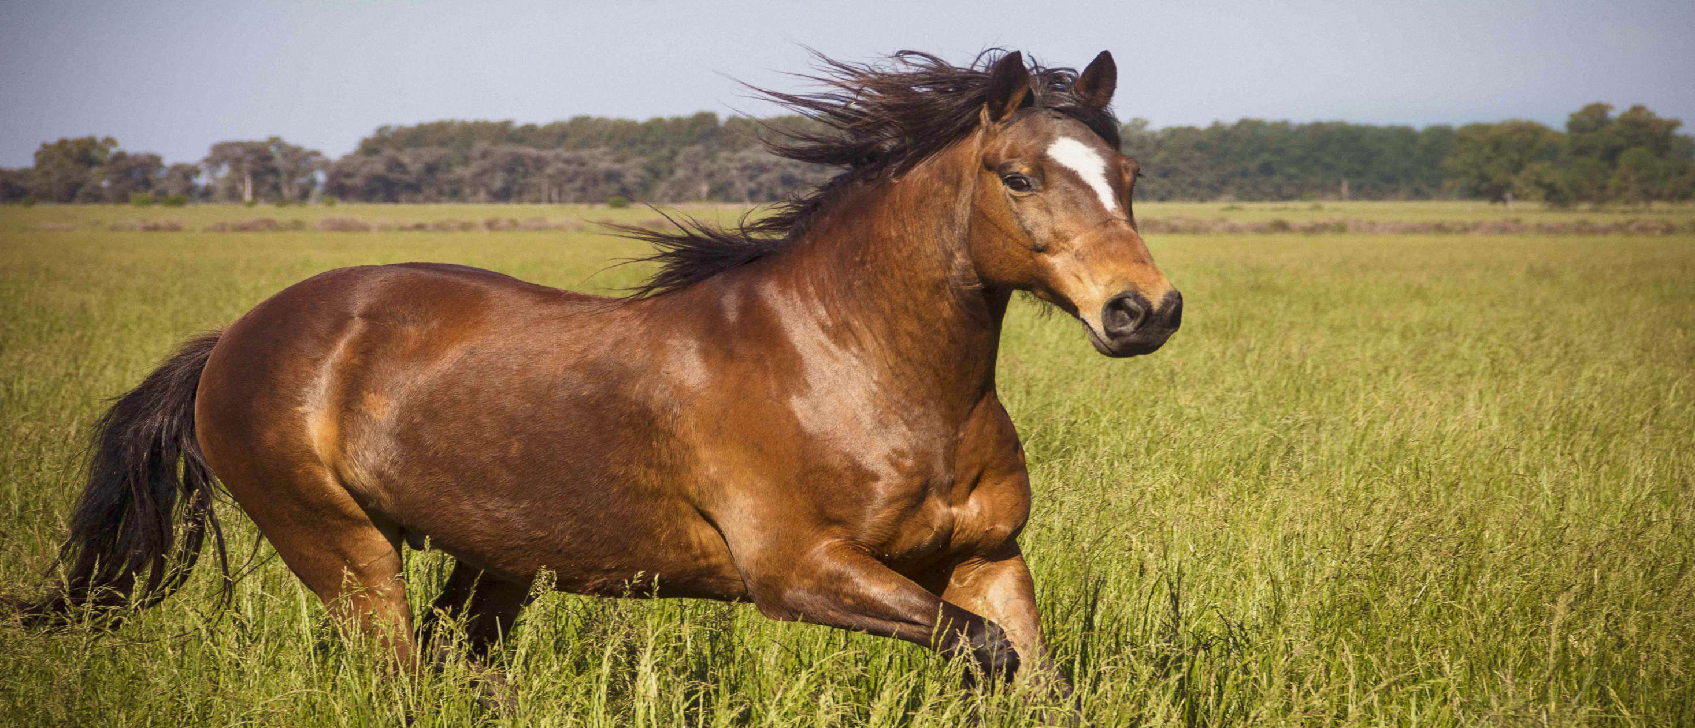
It’s a horse.

Slide 5
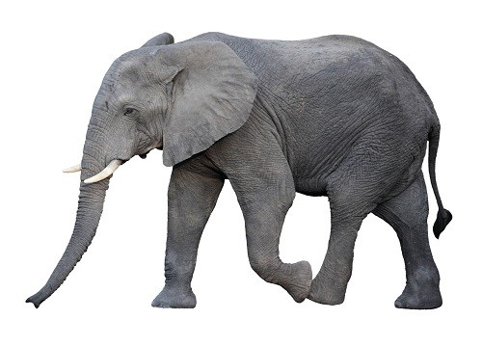
It’s an elephant.

Slide 6
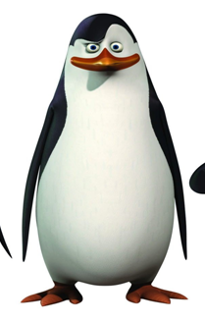
It’s a penguin.

Slide 7

It’s a fish.

Slide 8



horse
elephant
penguin
fish

Slide 9

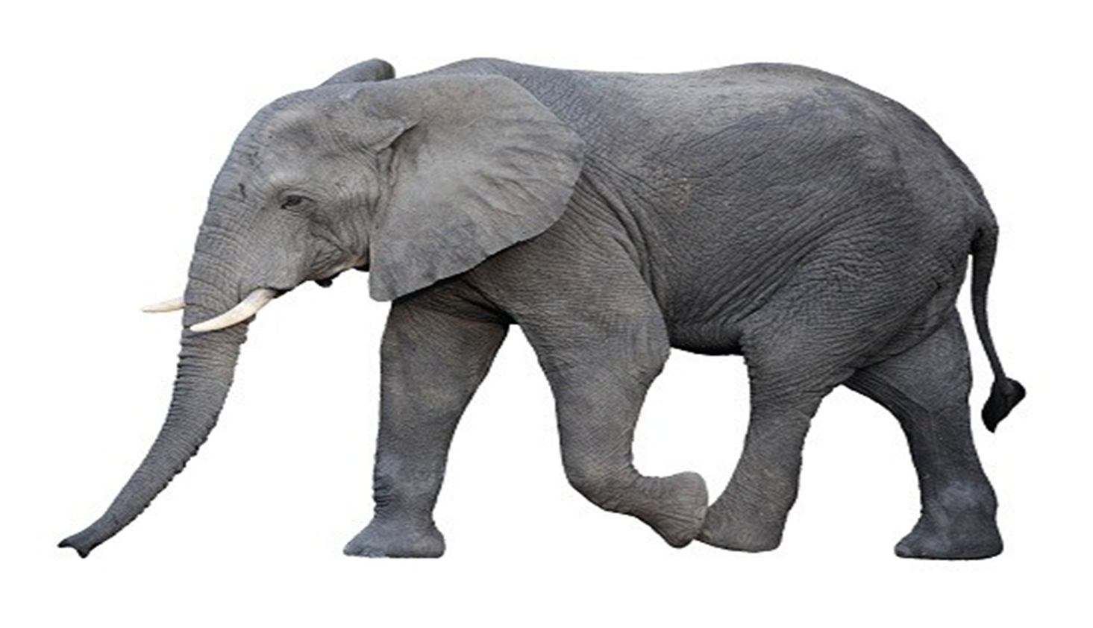
1
2
3
4
It’s an elephant.

Slide 10

1
2
3
4
It’s a horse.

Slide 11
1
2
3
4
It’s a penguin.

Slide 12

1
2
3
4
It’s a fish.

Slide 13

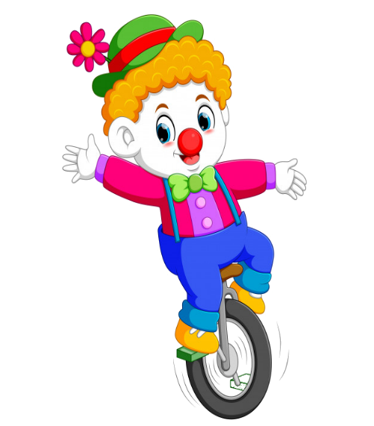



PLAY

Slide 14



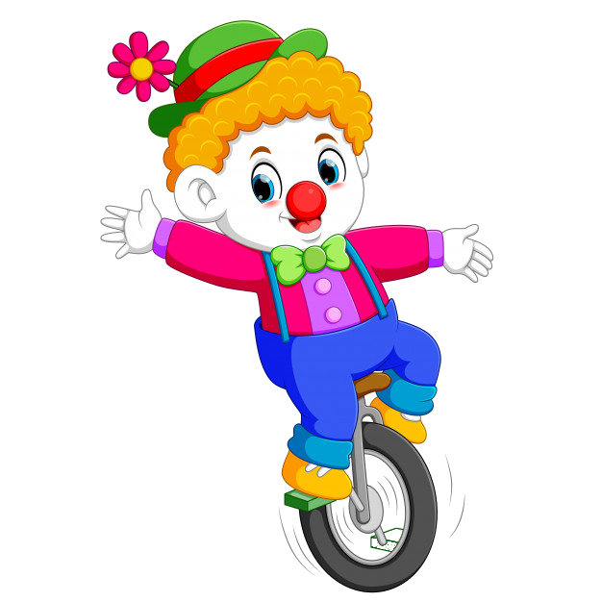
It’s a …..
A. fish
B. penguin
C. elephant
D. horse

Slide 15
It’s a …
A. fish
B. elephant
C. bee
D. horse

Slide 16

It’s an …
A. horse
B. elephant
C. penguin
D. lion

Slide 17

: tìm
It’s a …..
A. horse
B. dog
C.penguin
D. fish

Slide 18


EXIT

