Slide 1
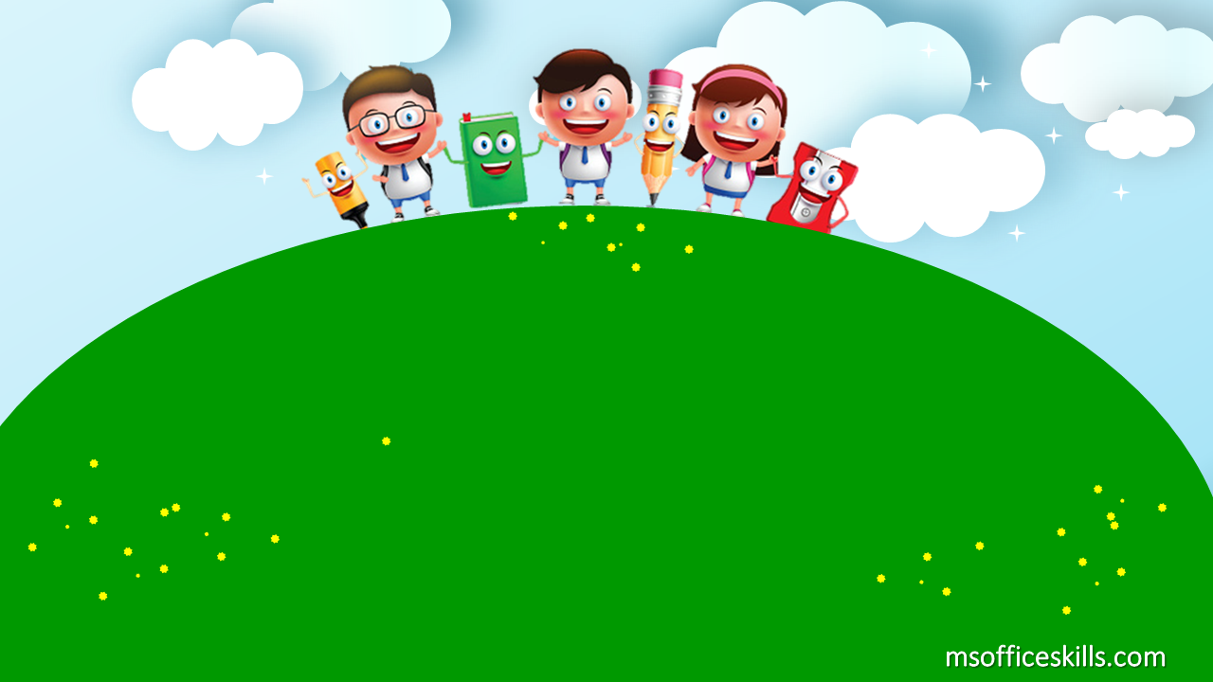
Welcome to our class
1A3

Slide 2



Slide 3

Bài 12: Học cách diễn đạt “This is…”

Slide 4
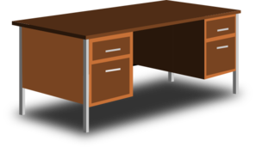
This is a desk

Slide 5

This is a door

Slide 6
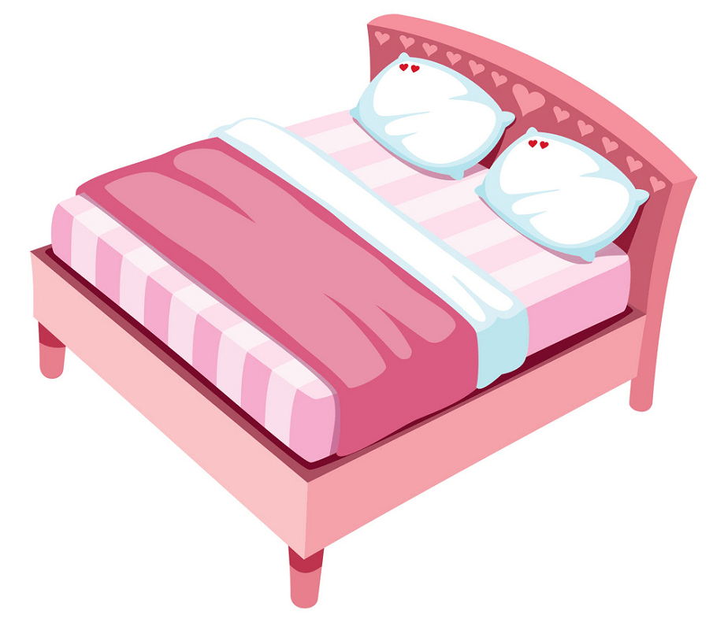
This is a bed

Slide 7
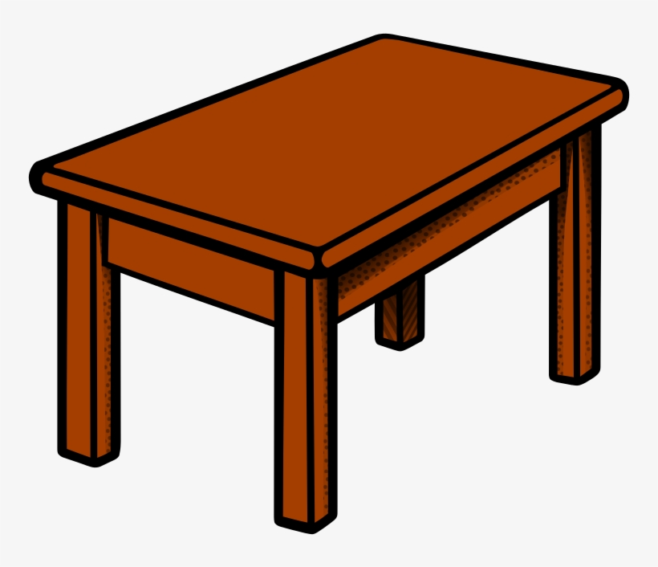
This is a table

Slide 8

This is a dog

Slide 9
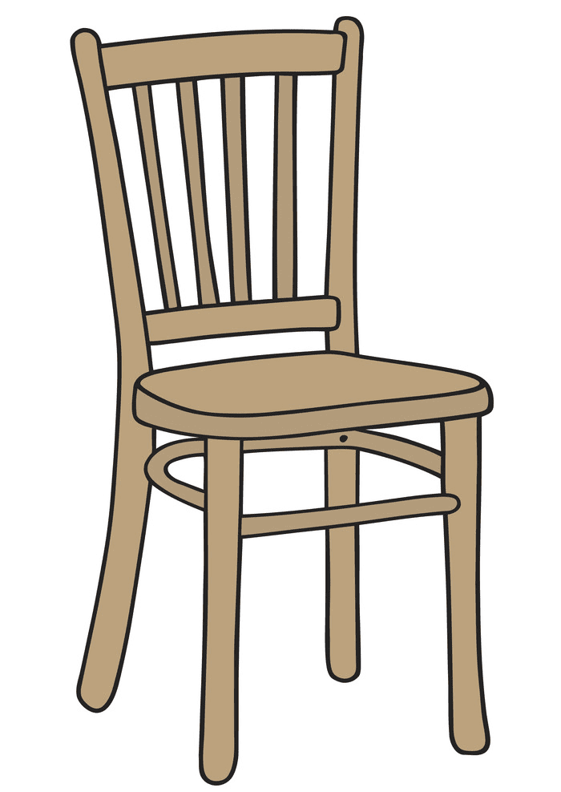
This is a chair

Slide 10

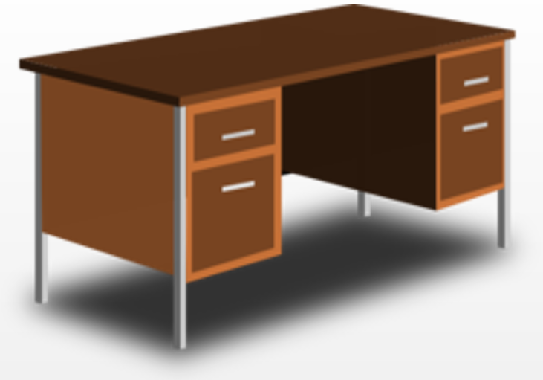
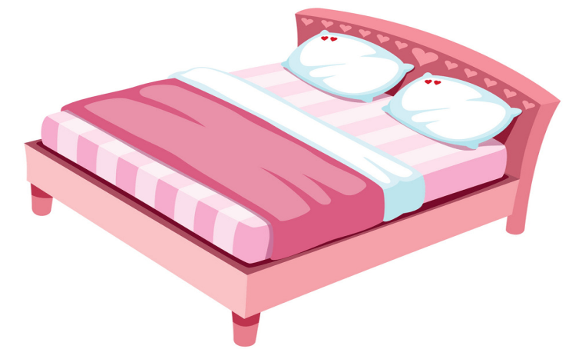


This is a desk
This is a door
This is bed
This is a table
This is a dog
This is a chair

Slide 11

1
2
3
4
This is a table

Slide 12
1
2
3
4
This is a chair

Slide 13
1
2
3
4
This is a bed

Slide 14
1
2
3
4
This is a desk

Slide 15
1
2
3
4
This is a dog

Slide 16
1
2
3
4
This is a door

Slide 17

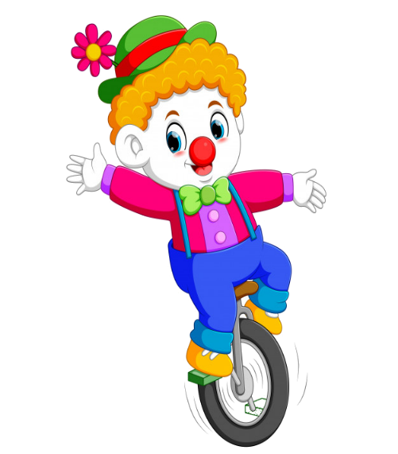



PLAY

Slide 18




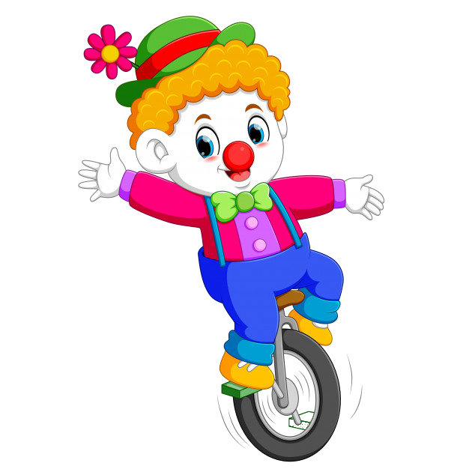
This is a…
A. dog
B. bird
C. bee
D. butterfly

Slide 19
This is a…
A. chair
B. doll
C. table
D. door

Slide 20

This is a…
A. Bye
B. desk
C. Nice to meet you
D. bed

Slide 21

: tìm
This is a…
A. desk
B. dog
C. bed
D. princess

Slide 22
This is a…
A. chair
B. queen
C. king
D. table

Slide 23

This is a…
A. desk
B. chair
C. table
D. bed

Slide 24


EXIT

