Slide 1

Welcome to our class
2A1

Slide 2

Bài 14:Học phát âm phonic R

Slide 3


Slide 4
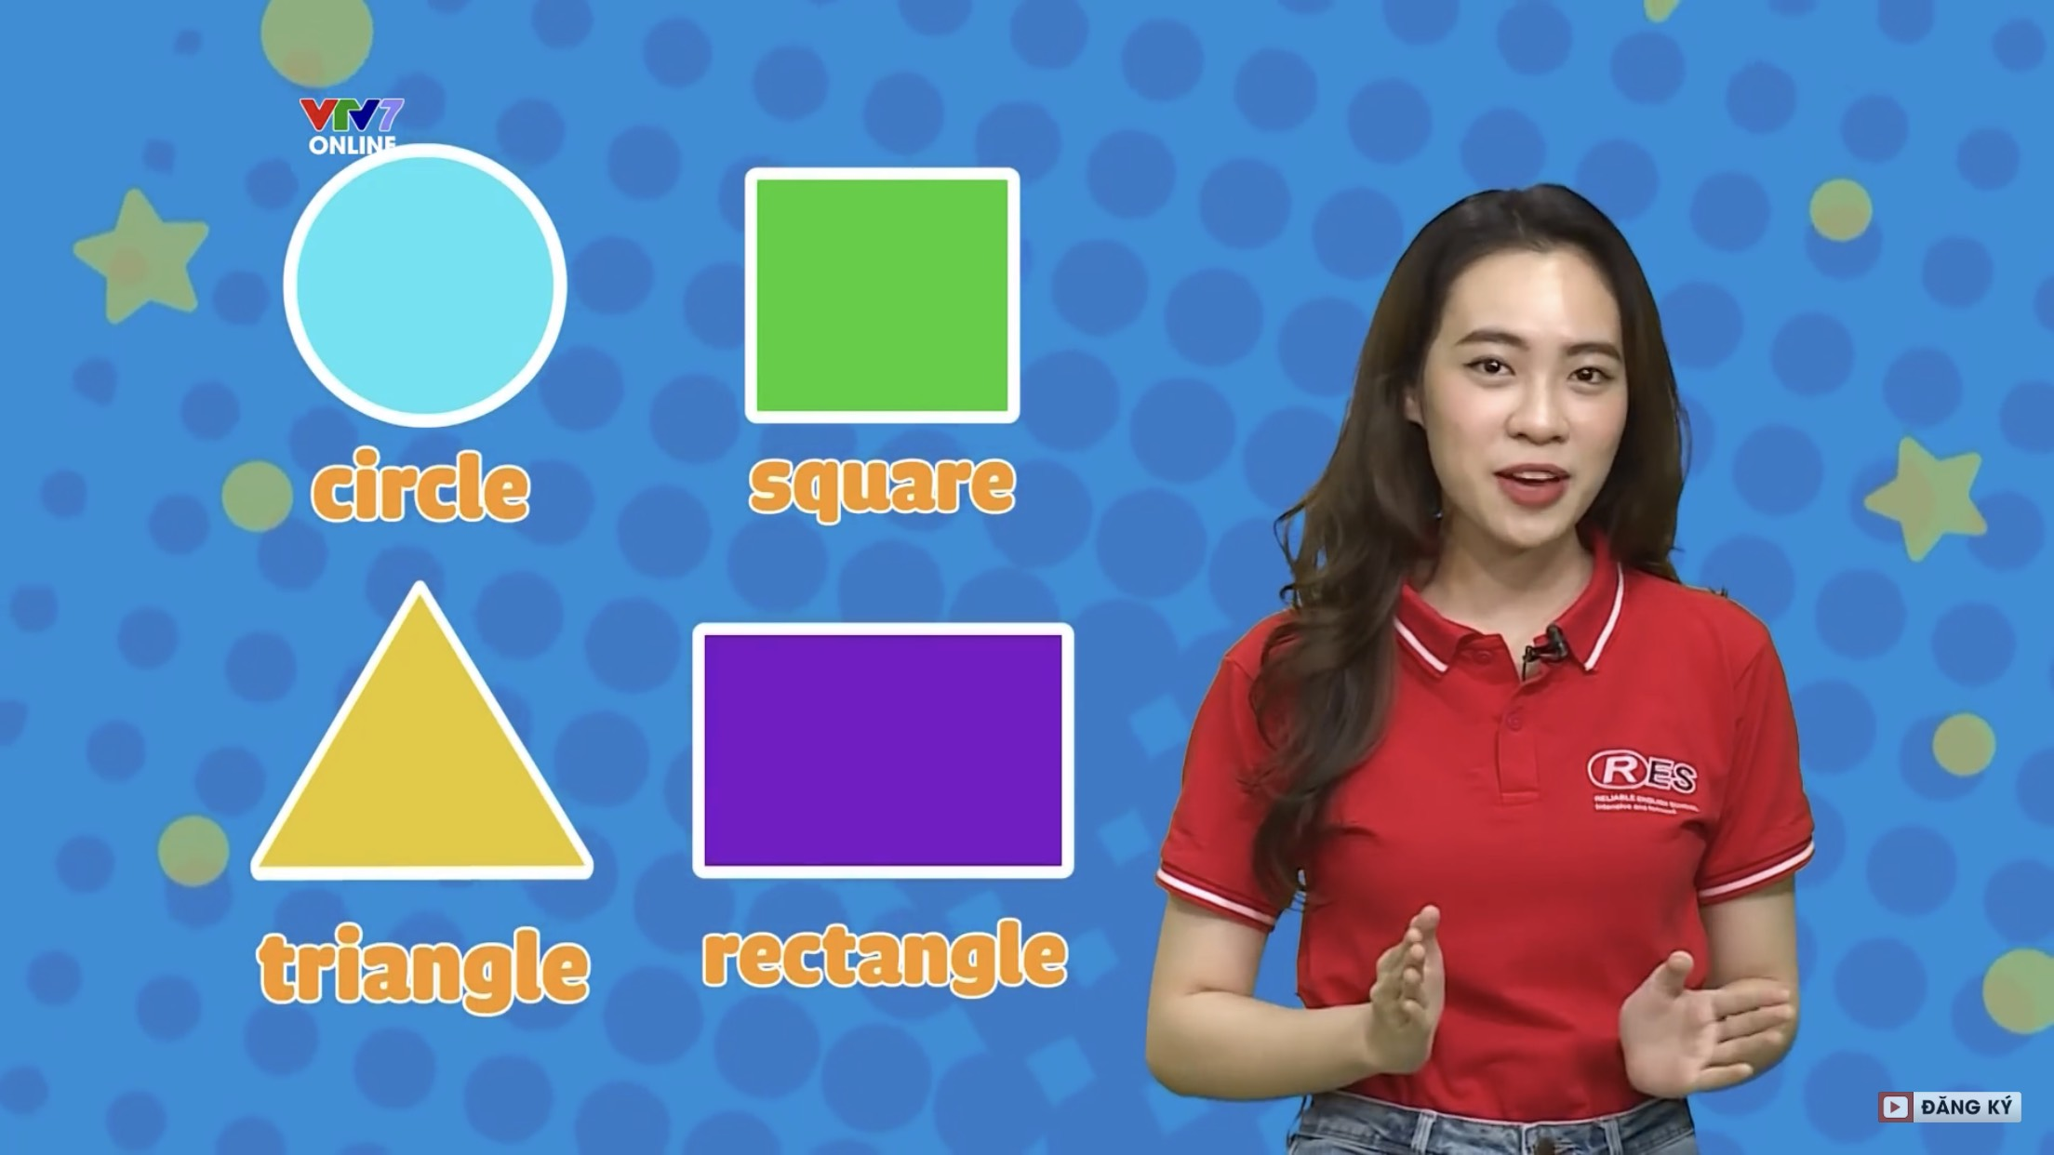
What shape is it ?

Slide 5
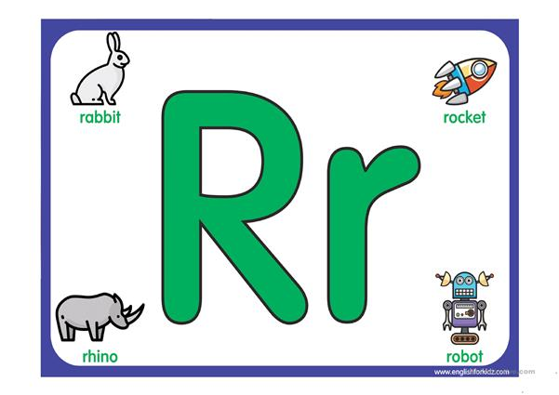

Slide 6
This is a BIG….

Slide 7
This is a SMALL…

Slide 8
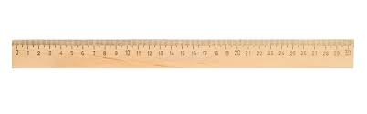
R-r-Ruler

Slide 9
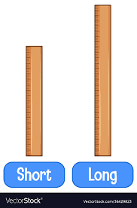
A short ruler
A long ruler

Slide 10
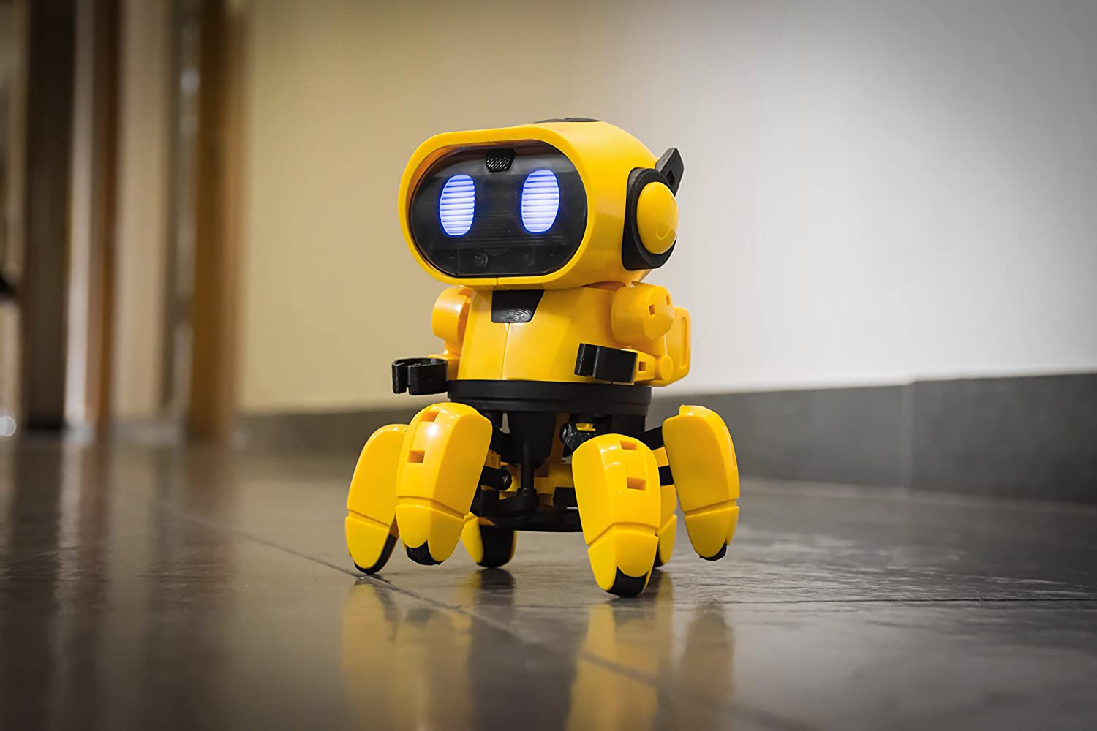
R-r- robot

Slide 11

R-r-Round

Slide 12
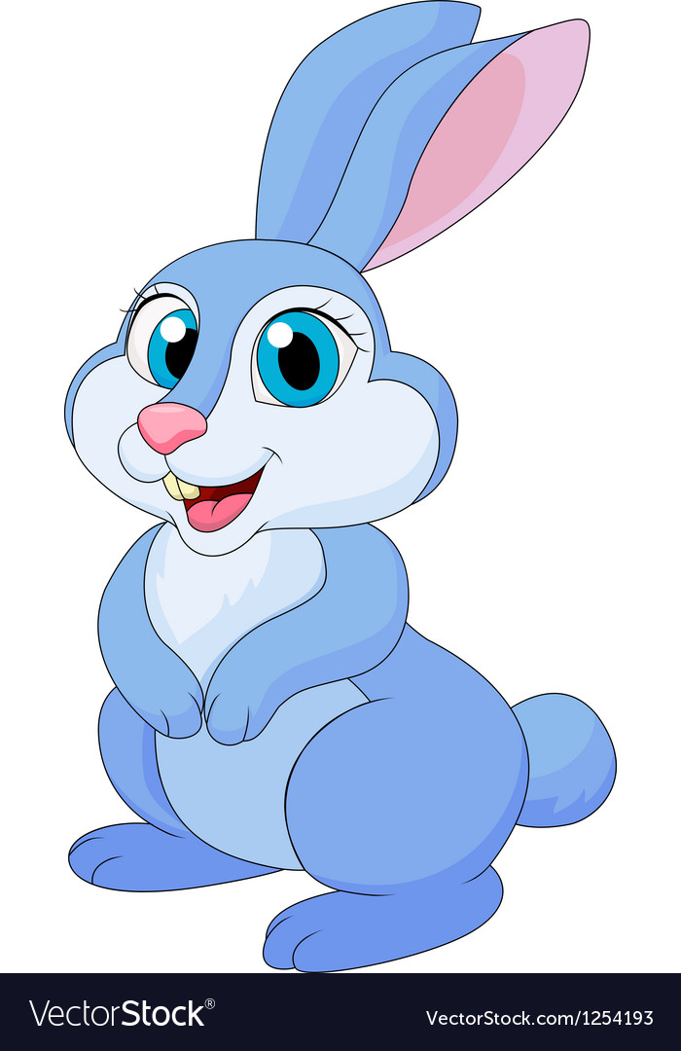
R-r-rabbit

Slide 13

R-r-rocket

Slide 14


What’s this ?

Slide 15


Slide 16




FROG PRINCE

Slide 17




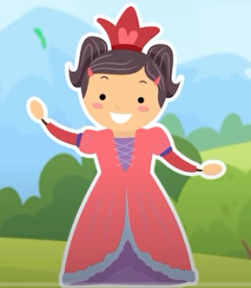


















Slide 18



Round
Ruler
rabbit

Slide 19
ruler
round
rocket

Slide 20
Rabbit
Robot
Round

Slide 21
Round
Ruler
Rabbit

Slide 22
A ruler
A long ruler
A short ruler

Slide 23
round
robot
ruler

Slide 24


