Slide 1


Unit 7- Grade 4
Teacher : Linh

Slide 2
Welcome my class !

Slide 3

Nội quy lớp học:

Slide 4

Tuesday, September 28 th 2021 Unit 7: What do you like doing? Lesson 1
I.New words:
Swimming
Cooking
Collecting stamps
Playing chess
II. Structures:
What do you like doing ? Bạn thích làm điều gì?
I like + động từ- ing …: Tôi thích ….

Slide 5
Warm up:
Tuesday, September 7th 2021
Tuesday, September 7th 2021

Slide 6






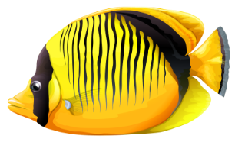
FISHING GAME
GO

Slide 7
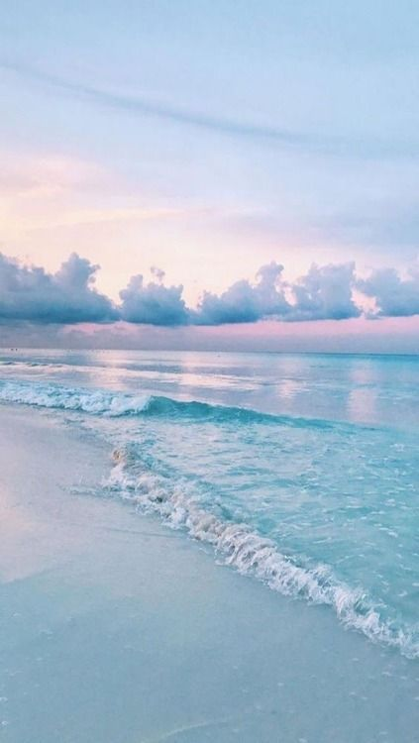



Question 1: What is he doing?
C. Studying
A. Playing
D. Going out
B.Watching TV
C. Studying

Slide 8
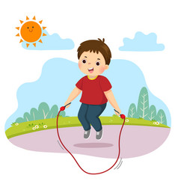
Question 2: What can you see?
A. Skip
A. Skip
D. Play
C. Skate
B. see

Slide 9
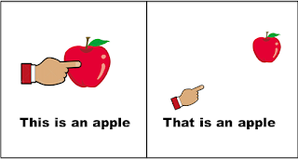
Question 3: What can you see ?
C. That
A. this
D. These
C. That
B. Those

Slide 10
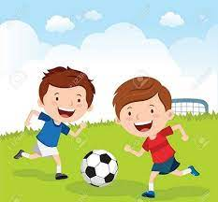
Question 4: What can you see?
C. Play football
A. Play guitar
D. Play tennis
C. Play football
B. Play piano

Slide 11

Question 5: What is this ?
C. Books
A.pen
D. School
C. Books
B. Box

Slide 12
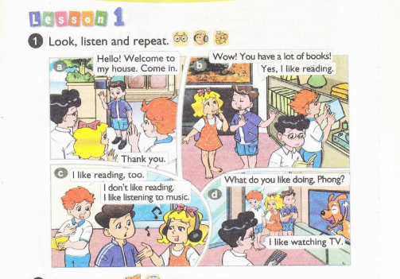


Slide 13
Vocabulary :

Slide 14
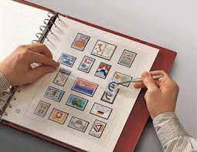
collecting stamps : Sưu tập tem

Slide 15
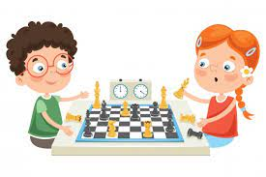
playing chess: chơi cờ

Slide 16

Cooking : Nấu ăn

Slide 17
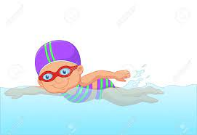
Swimming : Bơi lội

Slide 18
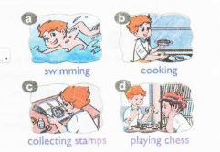

2.Point and say
What do you like doing?
I like _________________.
Swimming

Slide 19
II. Structures: Question : What do you like doing? Bạn thích làm điều gì …? Answer : I like + Động từ - ing ( Swimming, cooking, collecting stamps, playing chess…) Tôi thích….

Slide 20
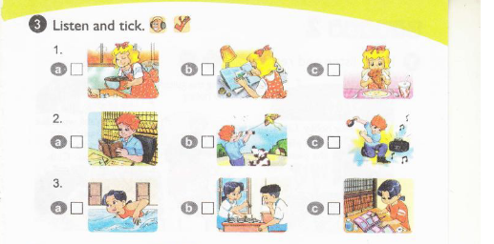
Ans : 1.b 2.c 3.a

Slide 21
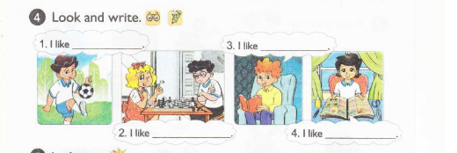
Answer :
1. I like playing football.
3. I like reading a book.
2. I like playing chess.
4. I like collecting stamps

Slide 22
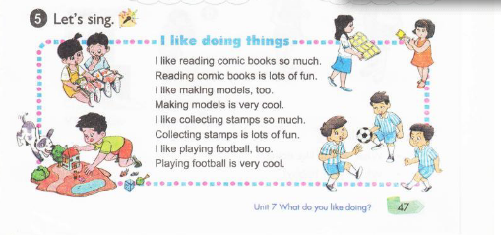

Slide 23
Unit 7: What do you like doing ? Lesson 2: I. New words: Riding a bike Playing badminton flying a kite taking photos Watching TV II.Structures: Qs : What is your hobby? ( what is = What’s ) Ans: I like + động từ- ing

Slide 24
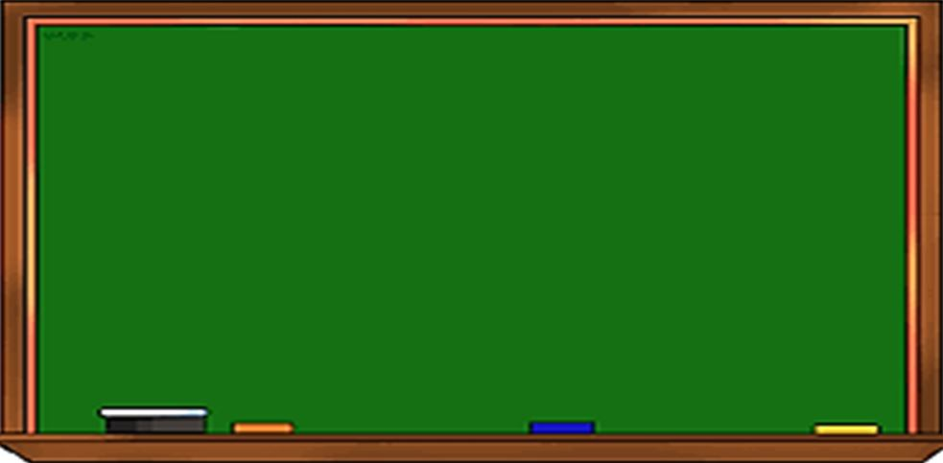
Tuesday, November 23rd 2021
Unit 7: Lesson 1,2-P46,48
like(s) + Ving: Thích (làm gì…)
hobby: sở thích
swimming
cooking
collecting stamps
playing chess
I. New words: từ mới
III. Model sentences: mẫu câu
1- What do you like doing?
I like taking photos.
2- What’s your hobby?
I like taking photos.
My hobby is taking photos.
**Note: What’s = What is
riding a bike playing badminton flying a kite taking photos watching TV
III. Homelink: BTVN
1-Luyện đọc P46,48 theo video, viết từ mới (2d)+ Mẫu câu(2d) + PH kí+ Chụp bài
2- Làm SBT P28,29 + Luyện hết V15-IOE

Slide 25
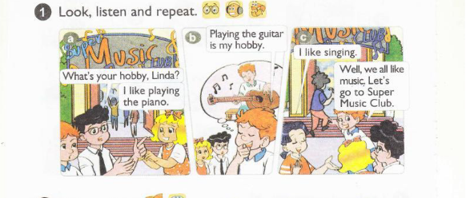

Slide 26
Vocabulary:

Slide 27

riding a bike : Đi xe đạp

Slide 28
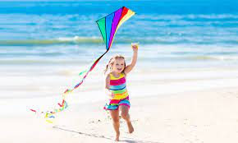
flying a kite : Thả diều

Slide 29
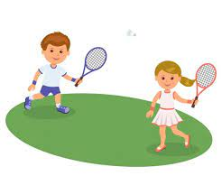
playing badminton : Chơi cầu lông

Slide 30
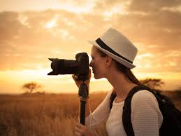
taking photos : Chụp ảnh

Slide 31
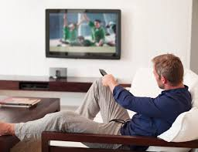
watching TV : Xem ti vi

Slide 32
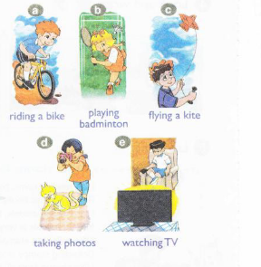
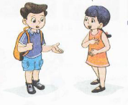
2. Point and say
What’s your hobby ?
Playing badminton
I like__________.
____

Slide 33
II. Structures: Question : What’s your hobby ? : Sở thích của bạn là gì ? Answer: I like + động từ -ing : Tôi thích ….

Slide 34


Slide 35
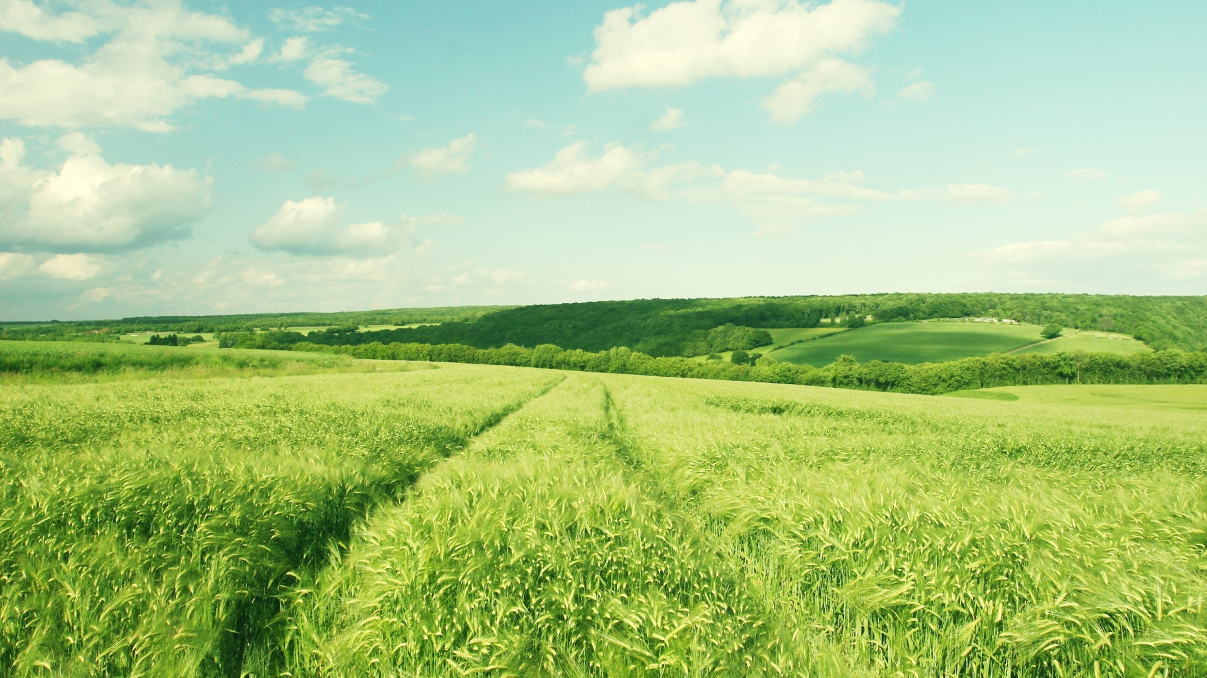
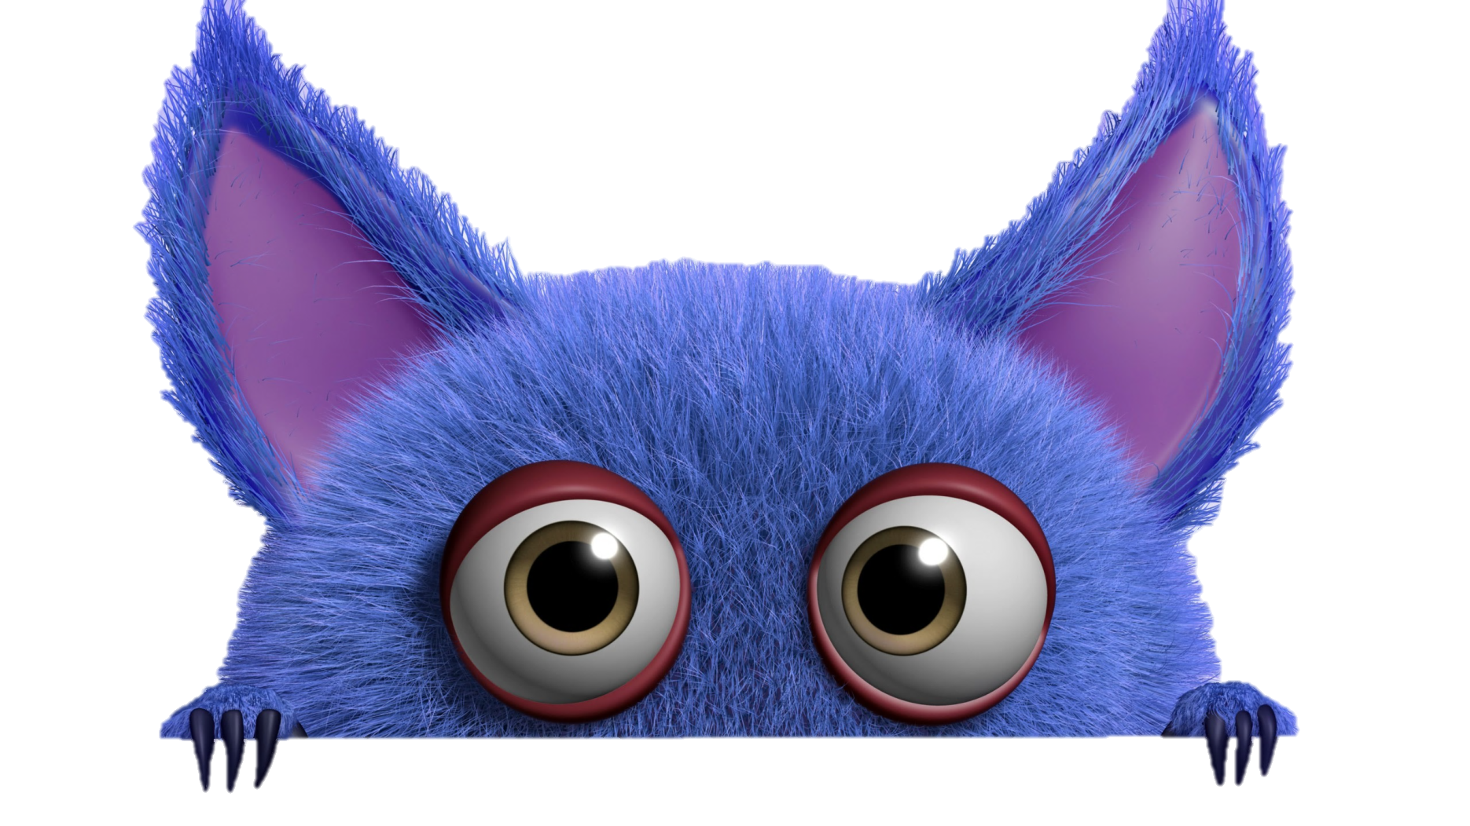


TRÒ CHƠI HỘP QUÀ BÍ MẬT
Gift box secret game

Slide 36








Riding a bike
9 Điểm

Slide 37
flying a kite
9 Điểm

Slide 38
Playing badminton
9 Điểm

Slide 39
taking photos
9 Điểm

Slide 40
Watching TV
9 Điểm

Slide 41
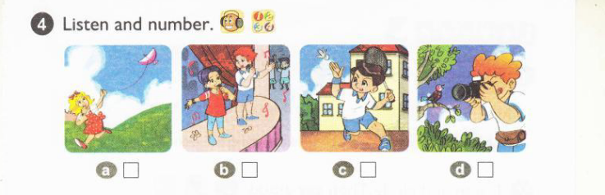
Ans : a. 2 b. 4 c. 1 d. 3

Slide 42
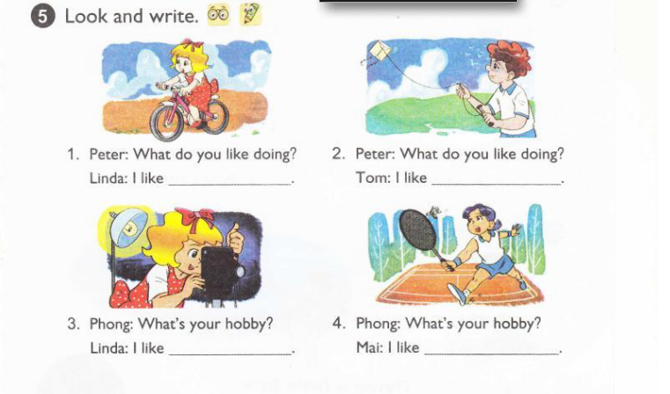
Ans : 1. Peter: What's your hobby? Linda: I like riding a bike. 2. Peter: What's your hobby? Tom: I like flying a kite. 3. Phong: What's your hobby? Linda: I like taking photos. 4. Phong : What's your hobby? Mai: I like playing badminton.

Slide 43
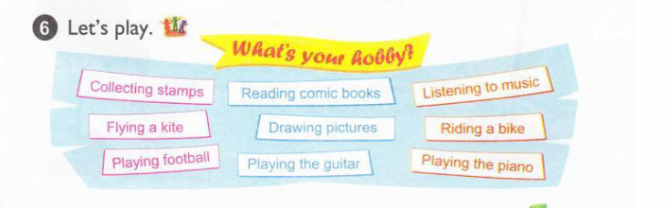
Từng người một hỏi và trả lời về sở thích ( work in group ( 3 people ).

Slide 44

Tuesday, September 28th 2021 Unit 7: What do you like doing? Lesson 3: Pronunciation and Practise

Slide 45
Warm up

Slide 46
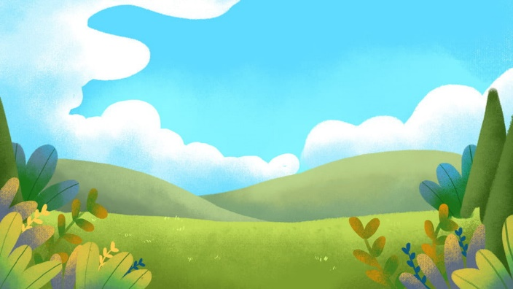

Can you guess?
Ms Huyền Phạm
0936.082.789
START

Slide 47




Ms Huyền Phạm
0936.082.789
Morning
Evening
At night

Slide 48
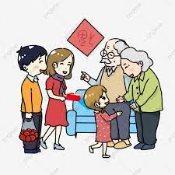
Ms Huyền Phạm
0936.082.789
Visit my friends
Visit my grandparents
Go to the zoo

Slide 49
What do you do …. Mondays ?
Ms Huyền Phạm
0936.082.789
in
on
at

Slide 50

What is the date today?
Ms Huyền Phạm
0936.082.789
The first of October
The second of October
The third of October

Slide 51
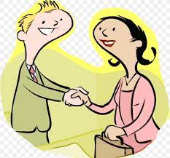
Ms Huyền Phạm
0936.082.789
Goodbye
See you later
Nice to meet you

Slide 52
Ms Huyền Phạm
0936.082.789
Visit my friends
Visit my grandparents
Go to the zoo

Slide 53
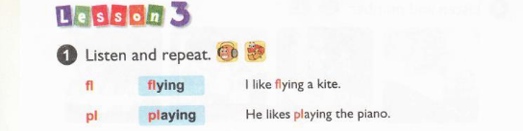

Slide 54
Tuesday, November 30th 2021
Unit 7: Lesson 3-P50 , Unit 8: Lesson 1-P52
I. Phonics: ngữ âm
III. Model sentences: mẫu câu
/fl/: fly, floor, flat
/pl/: play, plane
1- What do you like doing?
I like taking photos.
2- What’s your hobby?
I like taking photos.
My hobby is taking photos.
**Note: What’s = What is
I. New words: từ mới
riding a bike playing badminton flying a kite taking photos watching TV
III. Homelink: BTVN
1-Luyện đọc P50,52 theo video, viết từ mới (2d)+ Mẫu câu(2d) + PH kí+ Chụp bài
2- Làm SBT P32,33 + Luyện thi IOE

Slide 55
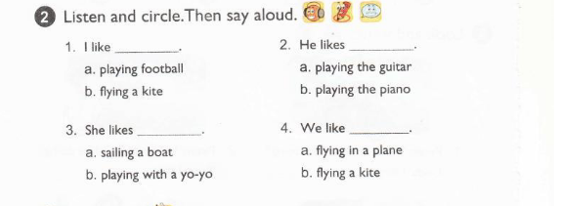
Ans :1. b 2. a 3. b 4. a

Slide 56
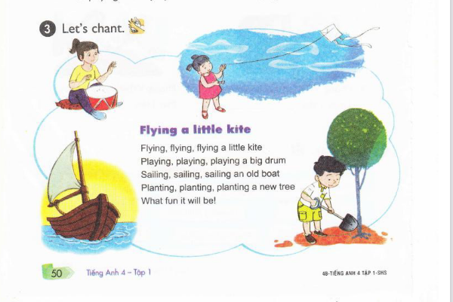

Slide 57
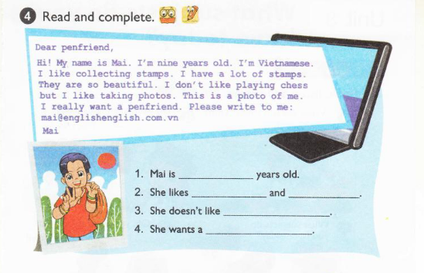
Ans
1. Mai is nine years old.
2. She likes collecting stamps and taking photos.
3. She doesn't like playing chess.
4. She wants a penfriend.

Slide 58
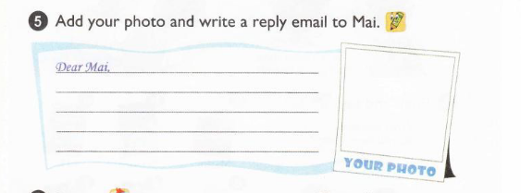
Example : Dear Mai, Nice to meet you! My name's is Sara and I'm nine years old, too. I'm English. I live in London with my family. I live near my school so I walk to school every day. I like taking photos, too. I like playing the piano but I don't like playing football. I really want a pen-friend. Let's be friends.

Slide 59
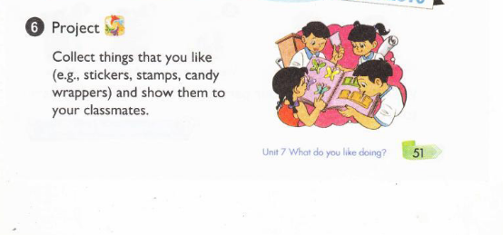
Sưu tầm những thứ mà em thích (ví dụ: nhãn dán có hình, tem, giấy gói kẹo,...) và trình bày chúng cho cả lớp xem.

Slide 60


