Slide 1
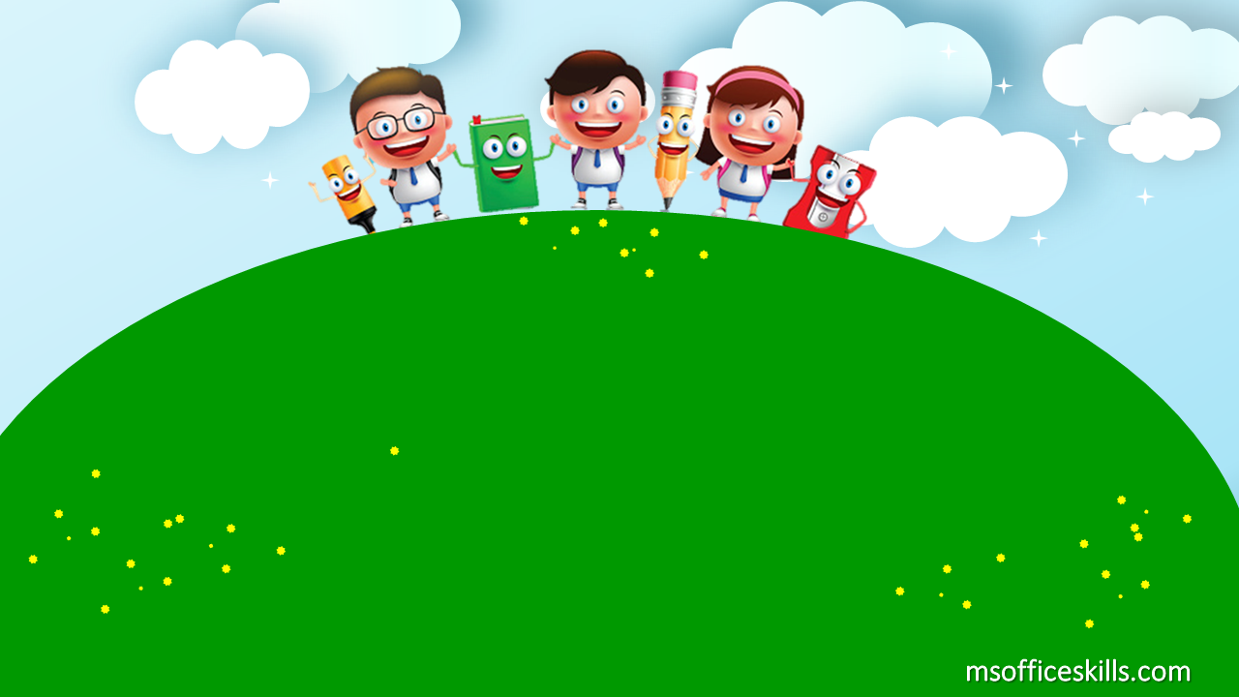
Welcome to our class
3A1

Slide 2

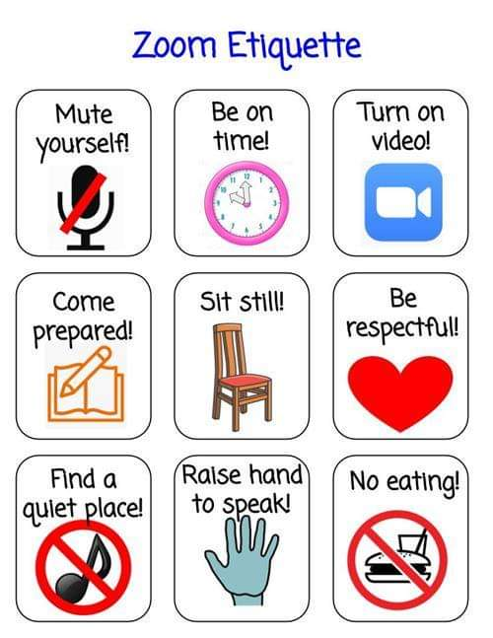

Slide 3

Bài 7: Bạn làm gì trong thời gian rảnh rỗi?

Slide 4
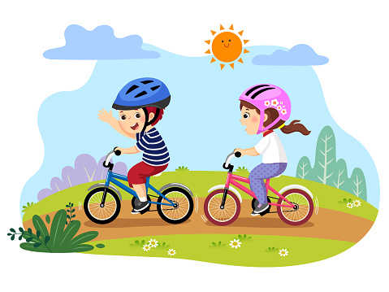
What do you do in your free time?
I ride a bike

Slide 5
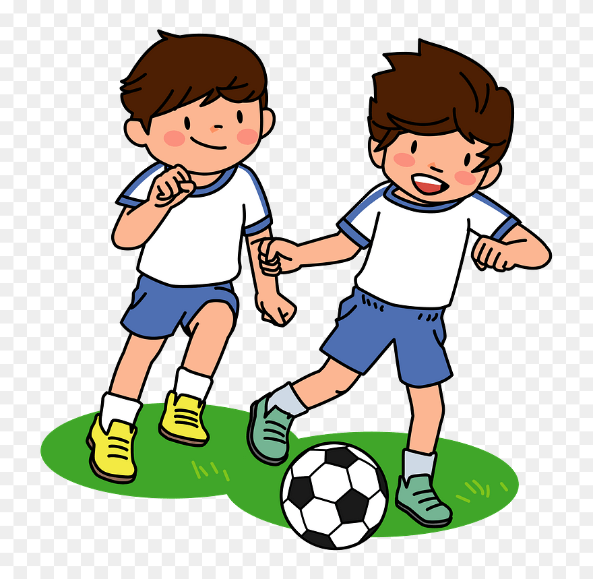
What do you do in your free time?
I play football

Slide 6

What do you do in your free time?
I sing a song

Slide 7
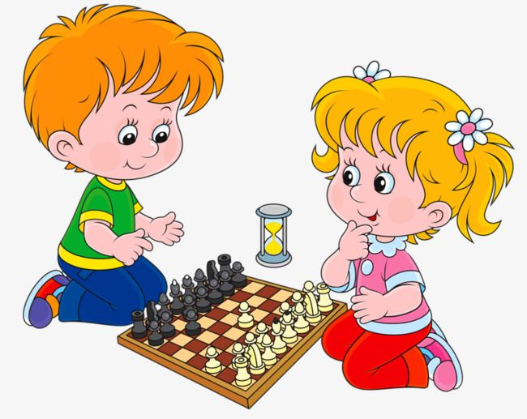
What do you do in your free time?
I play chess

Slide 8


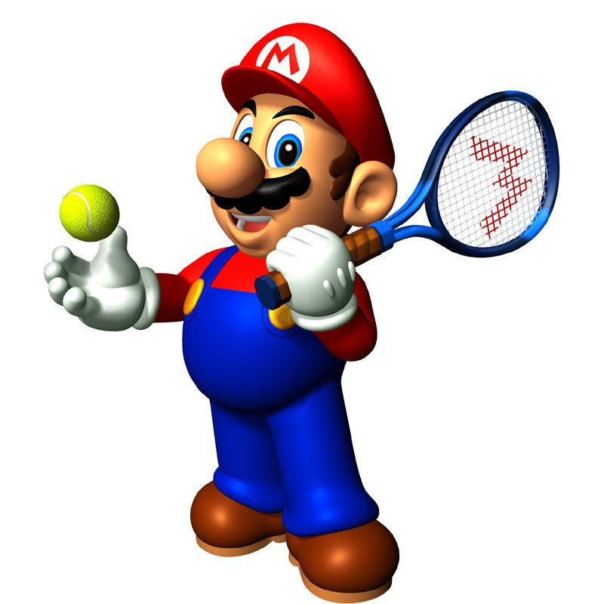





Slide 9
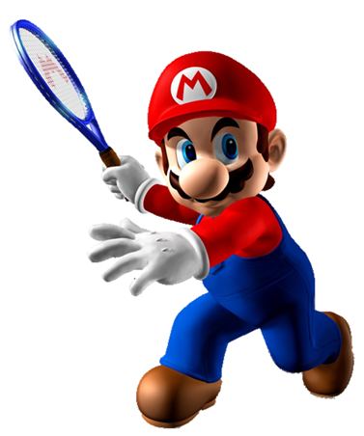
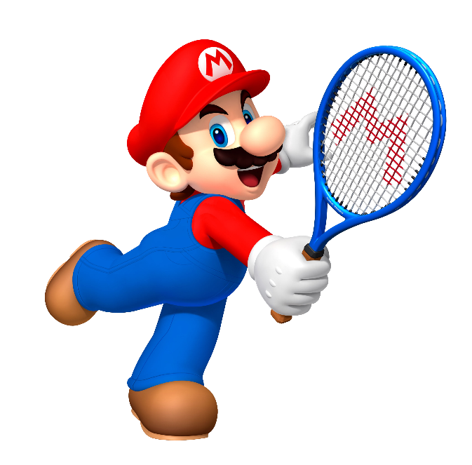


A. I play football
Intelligent
B. I ride a bike

Slide 10
Next
A. I ride a bike
B. I play football

Slide 11

A. I sing a song
I wants
B. I ride a bike

Slide 12
A. I sing a song
Intelligent
B. I play chess

Slide 13
A. I ride a bike
do
B. I sing a song

Slide 14
A. I play chess
cat
B. I ride a bike

Slide 15
Next
A. I sing a song
B. I play football

Slide 16
Time’s up!

Slide 17

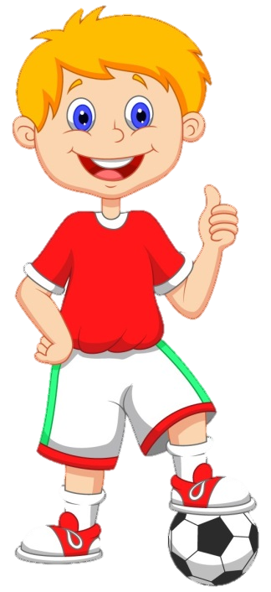


FOOTBALL
QUIZ

Slide 18

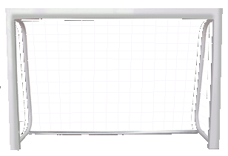

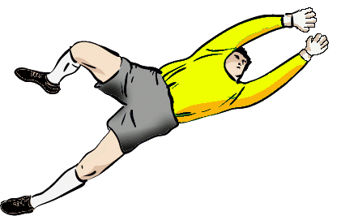
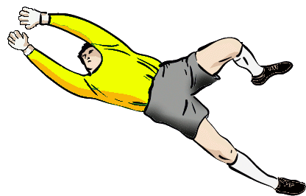
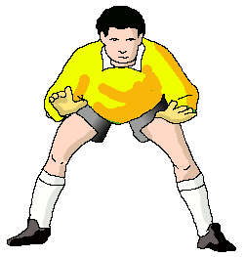
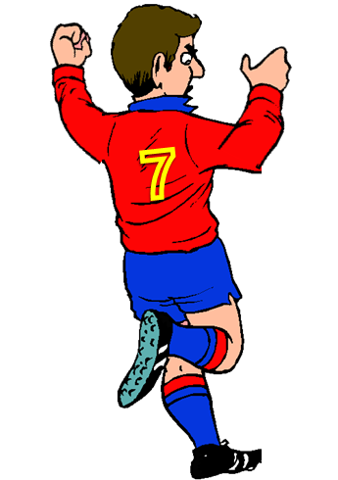
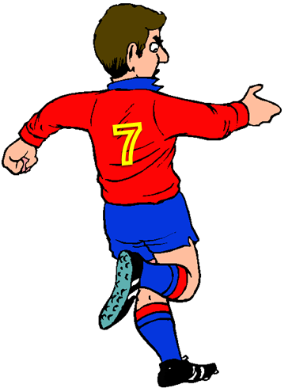

FAIR PLAY
NO TO RACISM
NEXT
A- I play football
B- I play chess
C- I ride a bike

Slide 19

FAIR PLAY
NO TO RACISM
NEXT
A- I play football
B- I play chess
C- I sing a song

Slide 20
FAIR PLAY
NO TO RACISM
NEXT
A- I play football
B- I ride a bike
C- I sing a song

Slide 21
FAIR PLAY
NO TO RACISM
NEXT
A- I sing a song
B- I ride a bike
C- I play chess

Slide 22
Good Job

Slide 23

GOODBYE!

