Slide 1
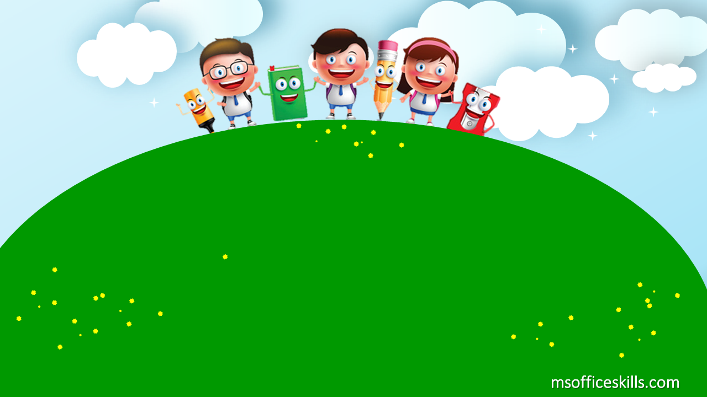
Welcome to our class
1A3

Slide 2

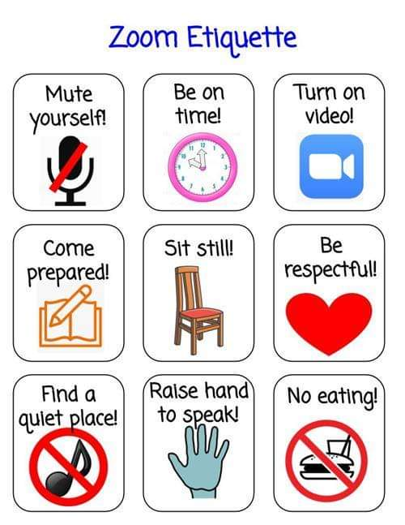

Slide 3


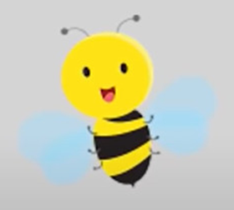

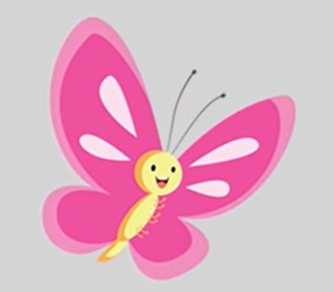
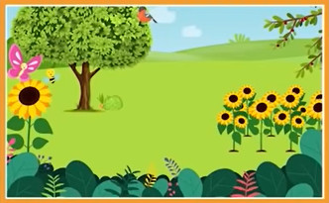
my garden

Slide 4

Bài 3: Học phát âm phonic B

Slide 5



Slide 6
B – b - bee

Slide 7
B - b- butterfly

Slide 8
B – b - bird

Slide 9

B – b - Big

Slide 10

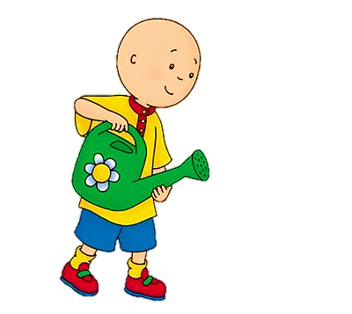
Can you hear B?

Slide 11


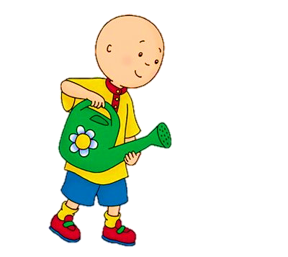
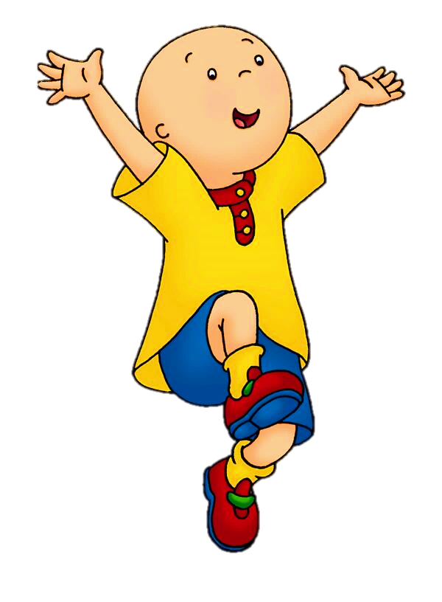
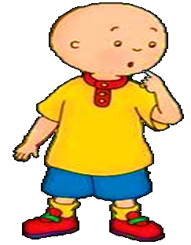


Can you hear B?
Yes
No
NEXT
Bird

Slide 12
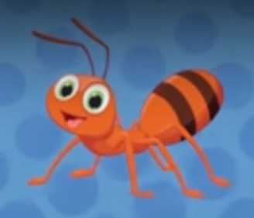
Can you hear B?
Yes
No
NEXT
ant

Slide 13
Can you hear B?
Yes
No
NEXT
Bee

Slide 14
Can you hear B?
Yes
No
NEXT
Butterfly

Slide 15
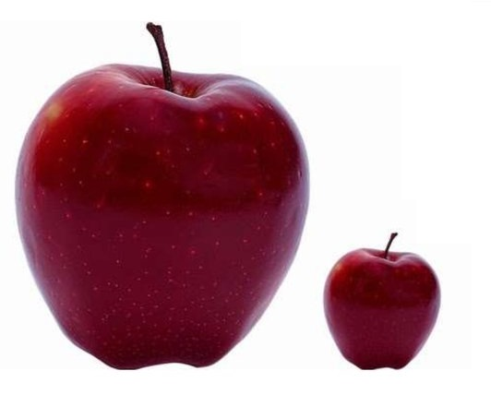
Can you hear B?
Yes
No
NEXT
small

Slide 16

Can you hear B?
Yes
No
NEXT
Big

Slide 17
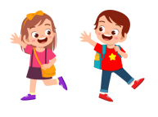
Can you hear B?
Yes
No
NEXT
Bye

Slide 18
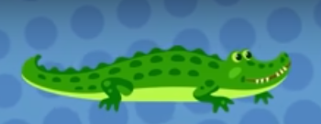
Can you hear B?
Yes
No
NEXT
aligator

Slide 19


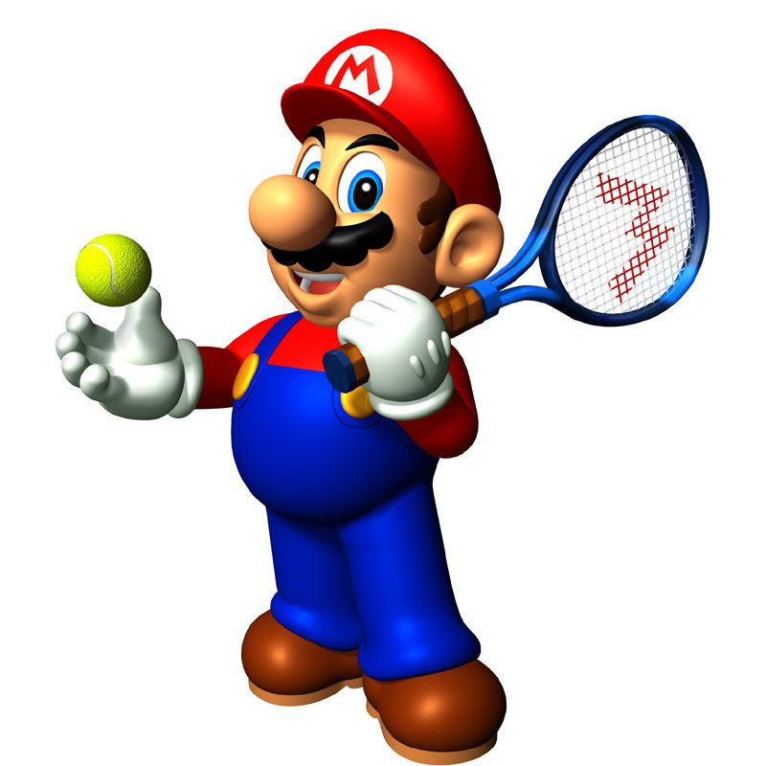





Slide 20
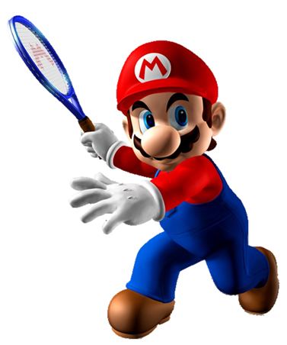
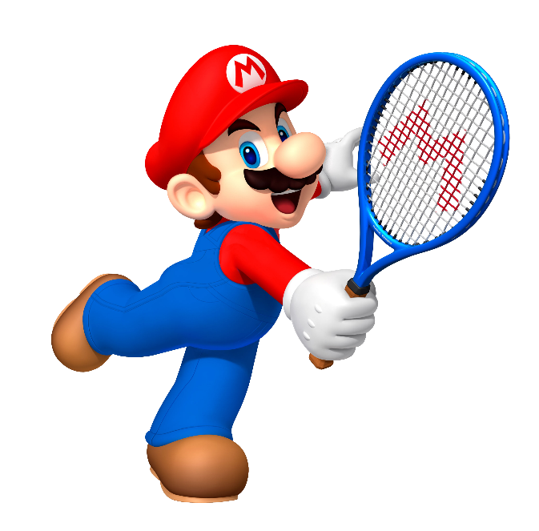

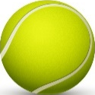
A
B
B
Intelligent
__ird

Slide 21
Next
A
B
__utterfly
B

Slide 22
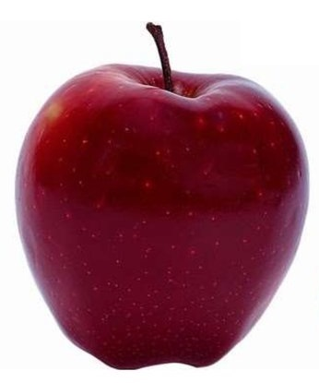
A
I wants
A
__pple
B

Slide 23
A
__ee
B
Intelligent
B

Slide 24
A
A
B
do
__ligator

Slide 25
A
A
___nt
B
cat

Slide 26
Next
A
B
__ig
B

Slide 27
A
B
B
Intelligent
__ye

Slide 28
Time’s up!

