Slide 1
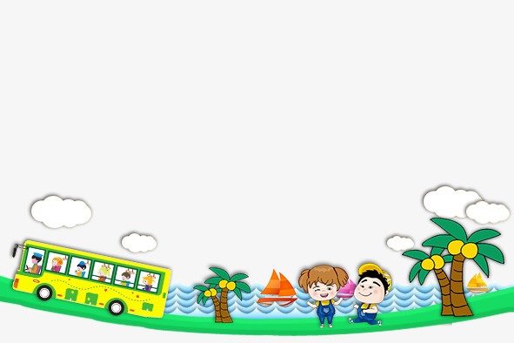
UNIT8 ̃. What are you reading?
LESSON 2

Slide 2
New words

Slide 3
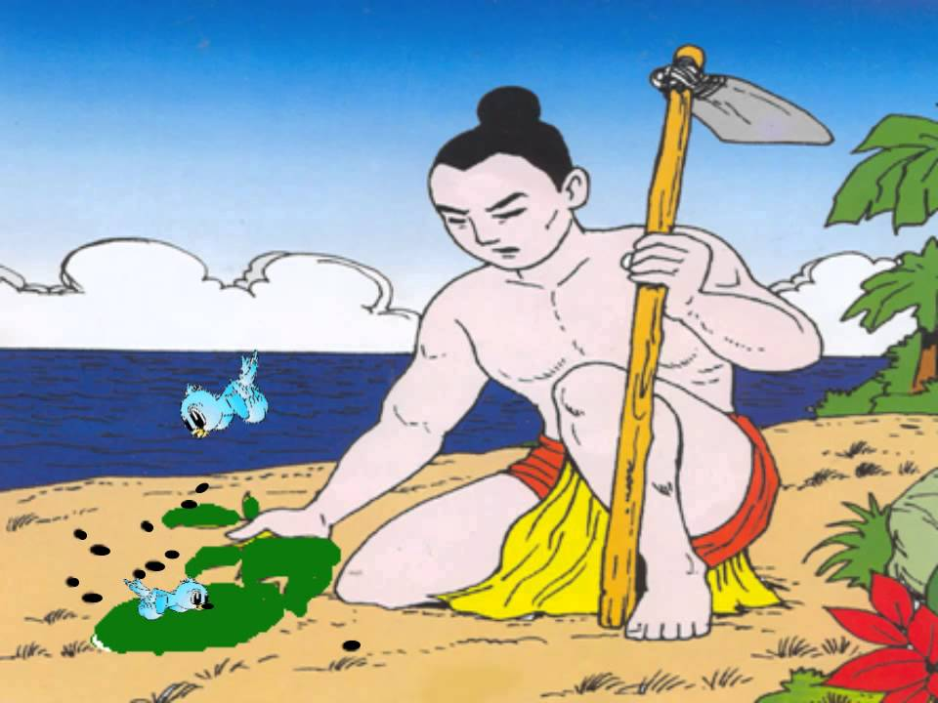
MAI AN TIEM / HARD-WORKING

Slide 4
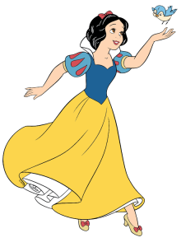
SNOW WHITE / KIND

Slide 5
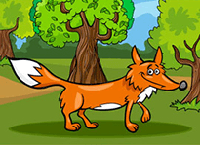
THE FOX/ CLEVER

Slide 6
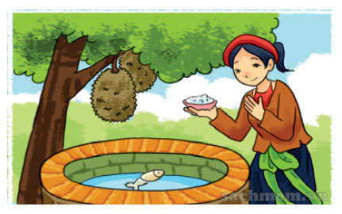
TAM/ GENTLE

Slide 7
Model Sentence

Slide 8
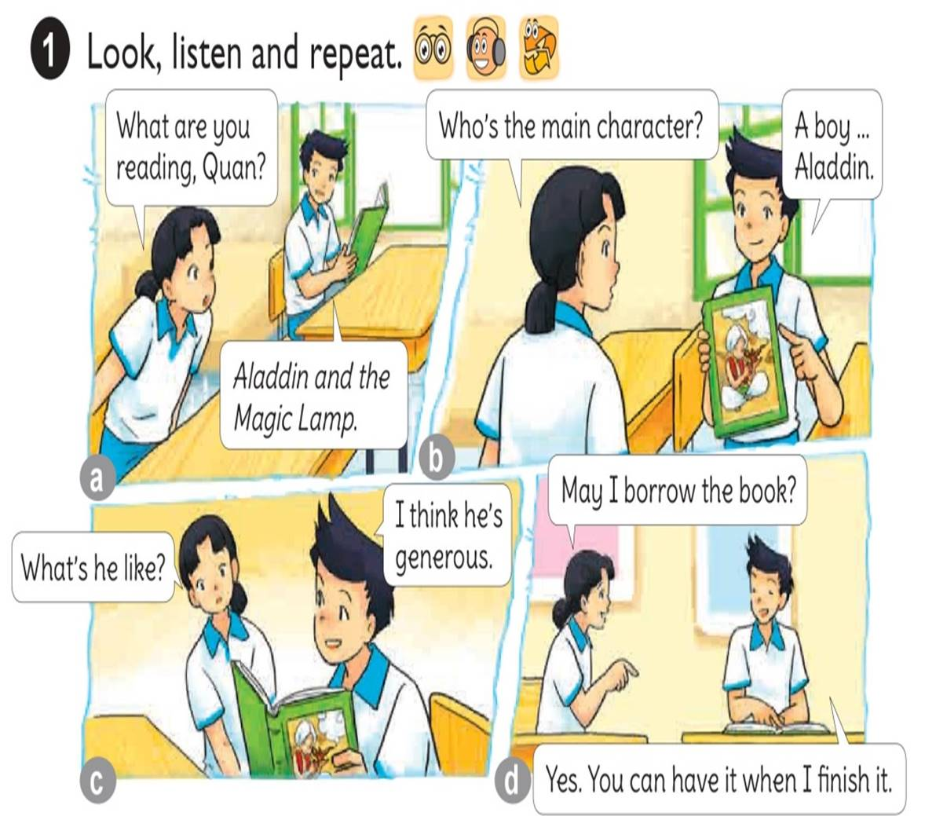



Slide 9
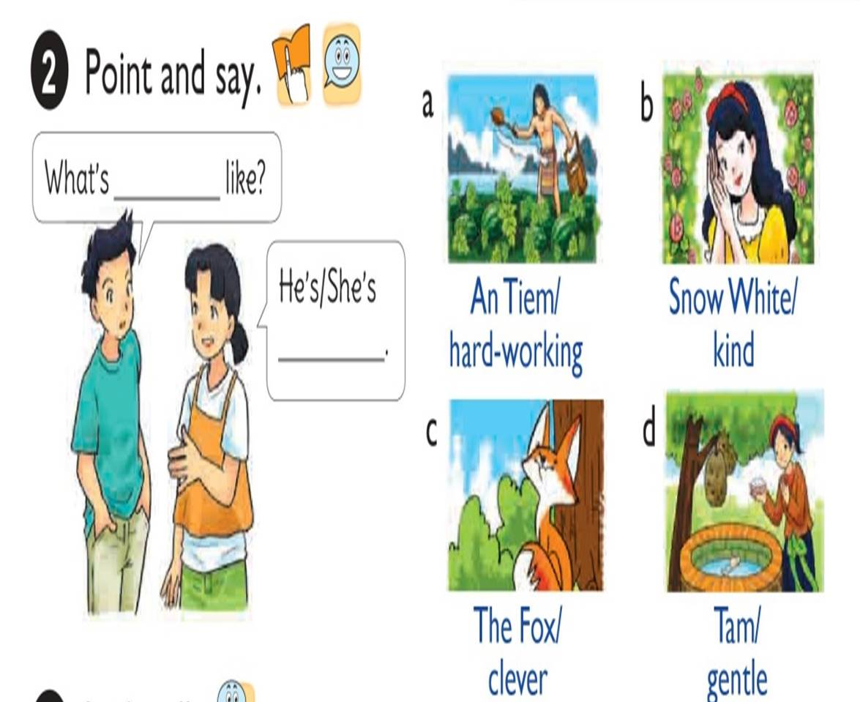

Slide 10


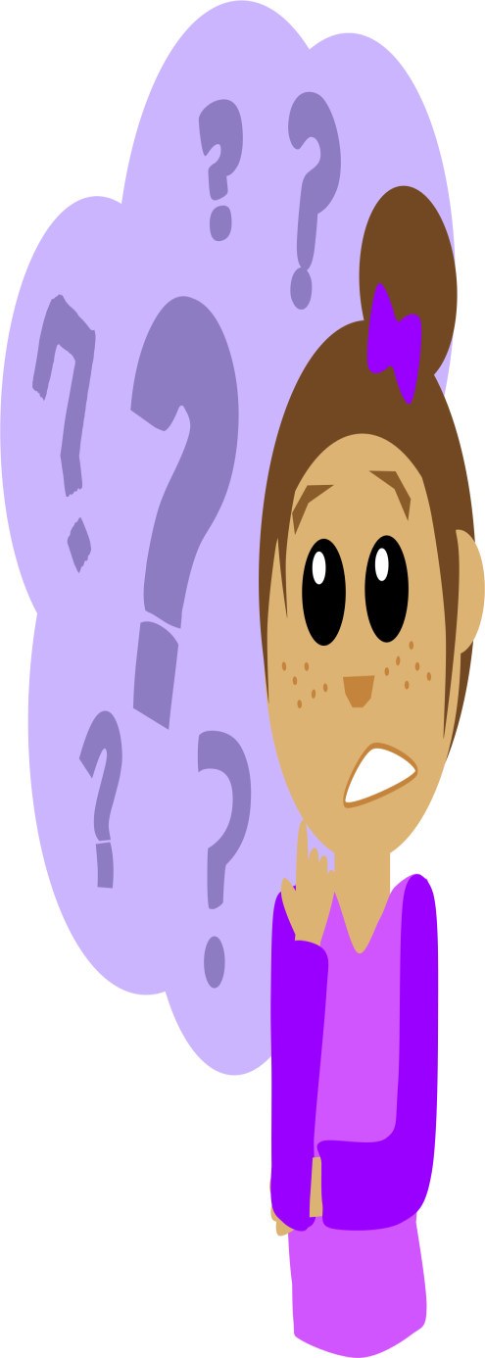
What’s like?
Mai An Tiem
He’s
hard-working.

Slide 11
What’s like?
Snow White
She’s
kind.

Slide 12
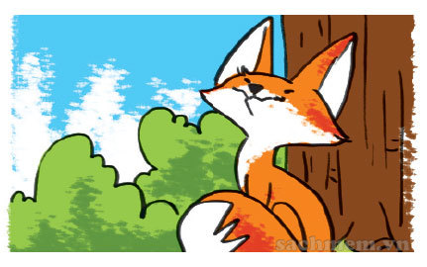
What’s like?
The Fox
He’s
clever.

Slide 13
What’s like?
Tam
She’s
gentle.

Slide 14

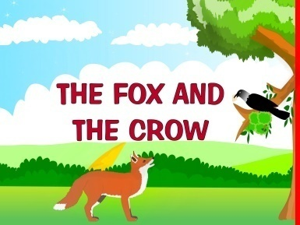
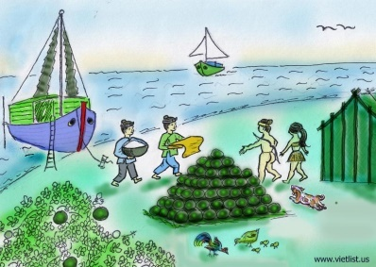

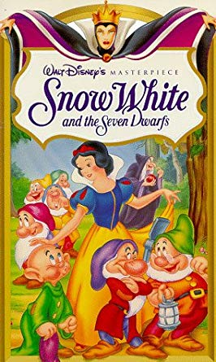
1. Vocabulary
- hard-working
- kind
- clever
- gentle
2. Model sentence
What’s Snow White like?
She’ kind and beautiful.

Slide 15

LISTEN AND WRITE
1
2
3
4
1. What’s Tam in The Story of Tam and Cam like? She’s
2. What’s Doraemon like? He’s
3. What are the Seven Dwarfs like? They’re short and
4. What’s An Tiem like? He’s clever and
kind
clever
hard-working
generous

Slide 16
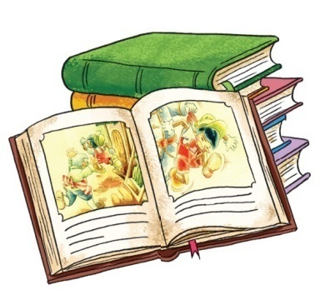
NUMBER THE SENTENCES IN THE CORRECT ORDER
4
A.It’s a Vietnamese story about two girls.
2
B.She likes reading fairy tales in her free time.
5
C.Their names are Tam and Cam.
1
D.Minh’s my classmate.
3
E.Her favourite fairy tale is The Story of Tam and Cam.

Slide 17
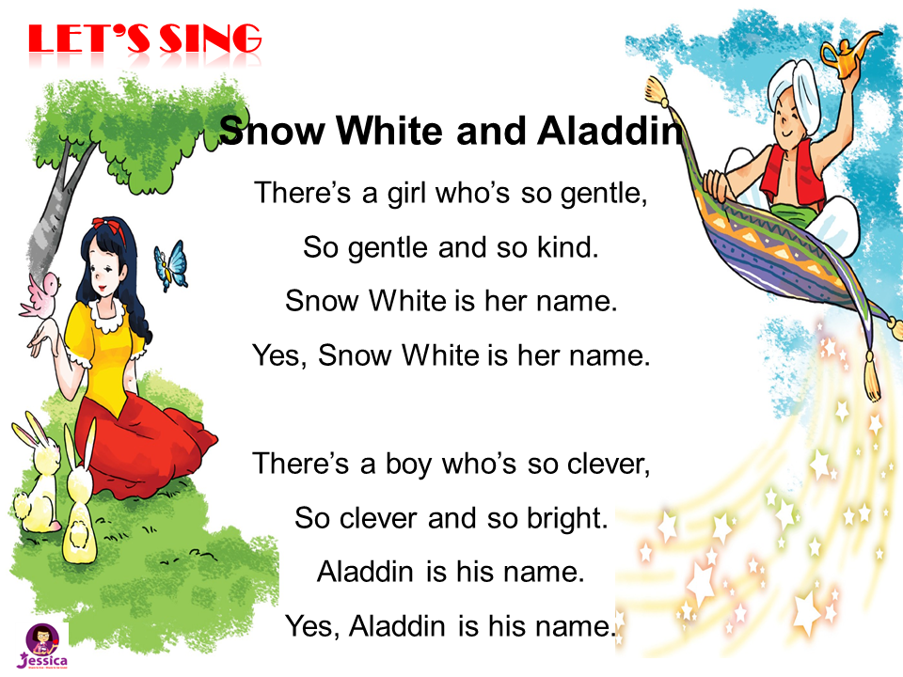

LET’S SING

