Slide 1
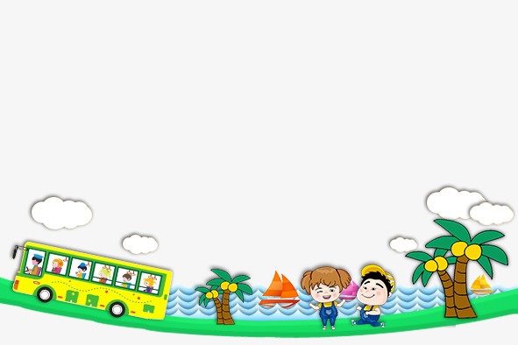

UNIT8 ̃. What are you reading?
LESSON 1

Slide 2
New words

Slide 3
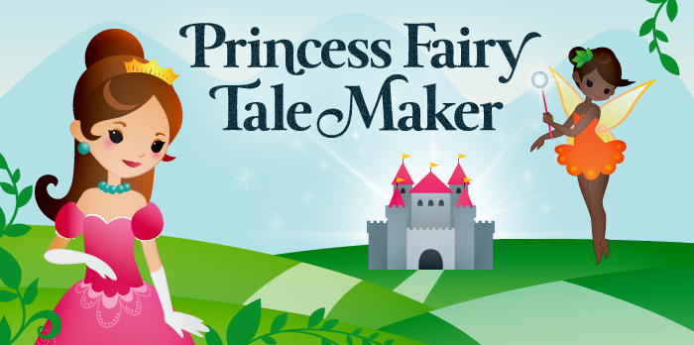
Fairy tales

Slide 4
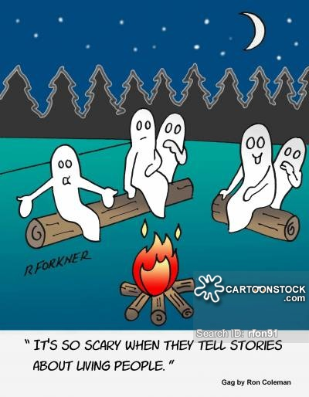
SPEAK ENGLISH EVERY DAY
Ghost story

Slide 5
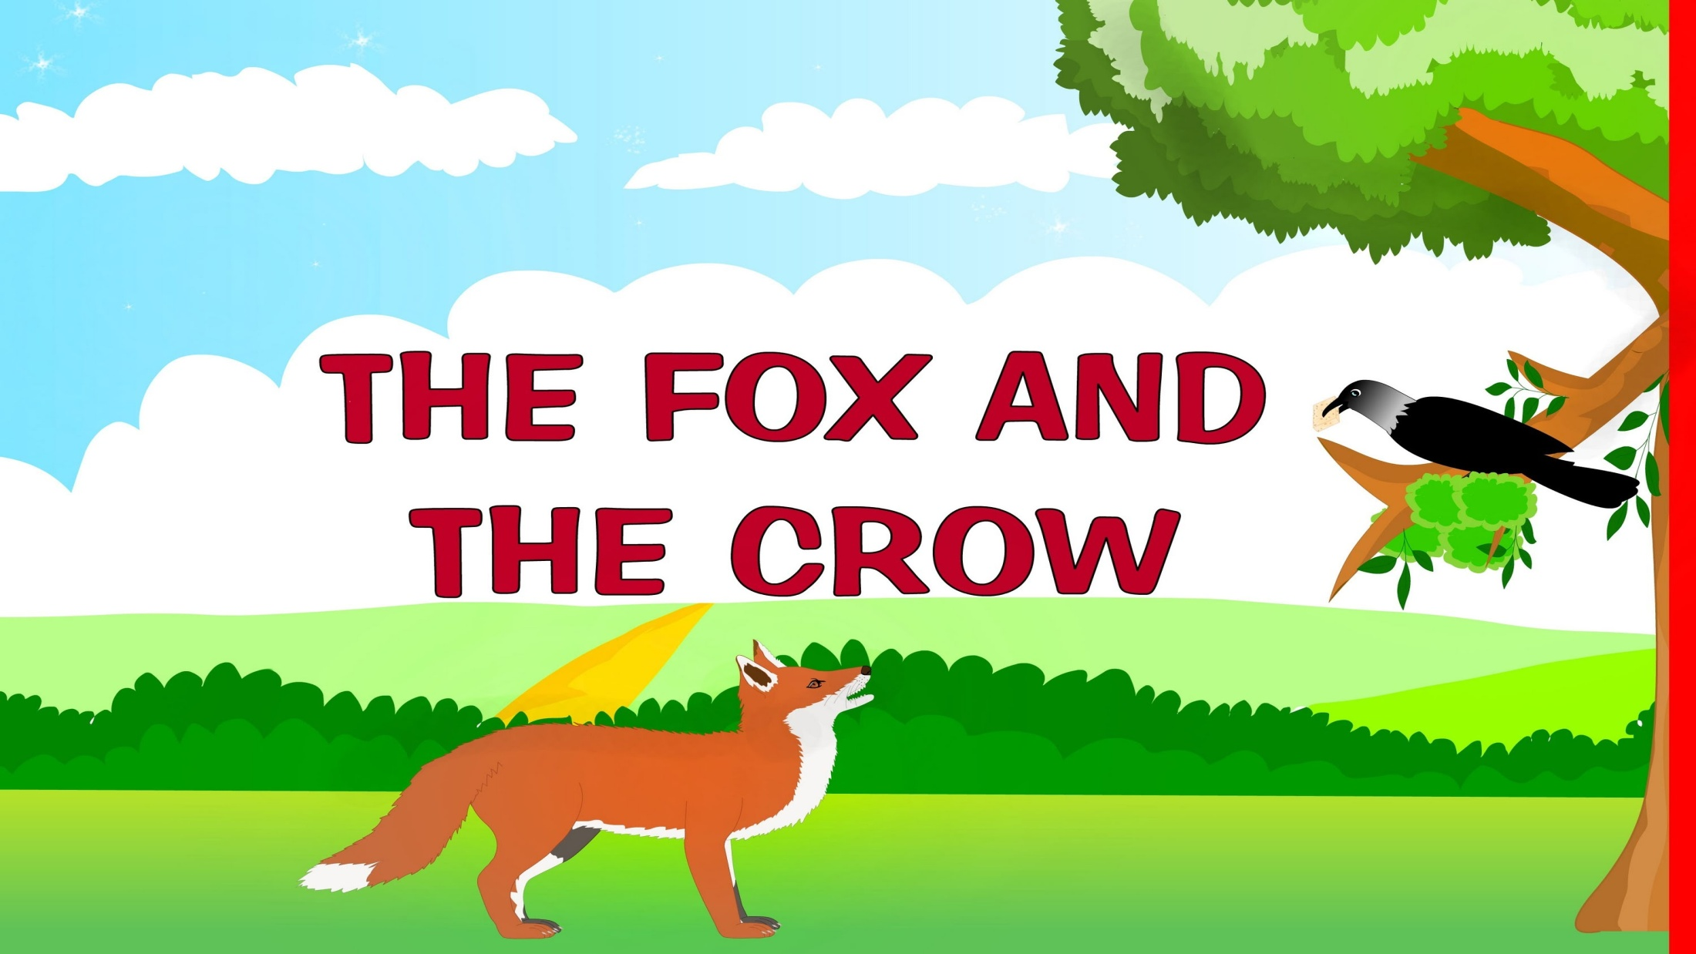

Slide 6
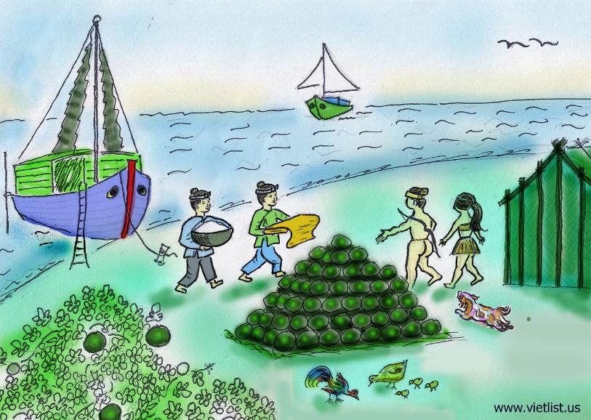
The story of mai an tiem

Slide 7
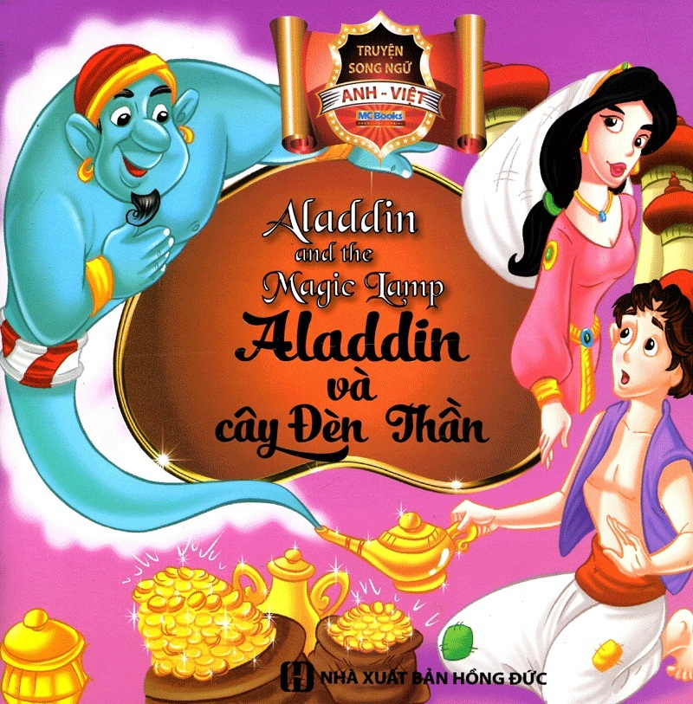

Slide 8
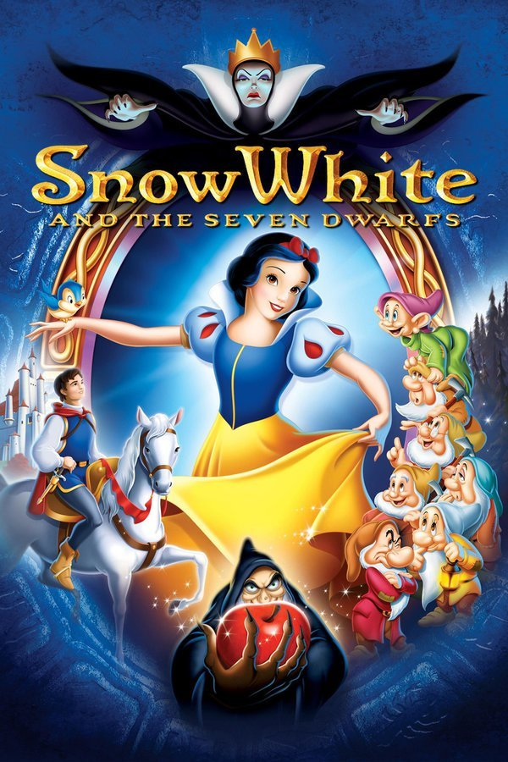

Slide 9
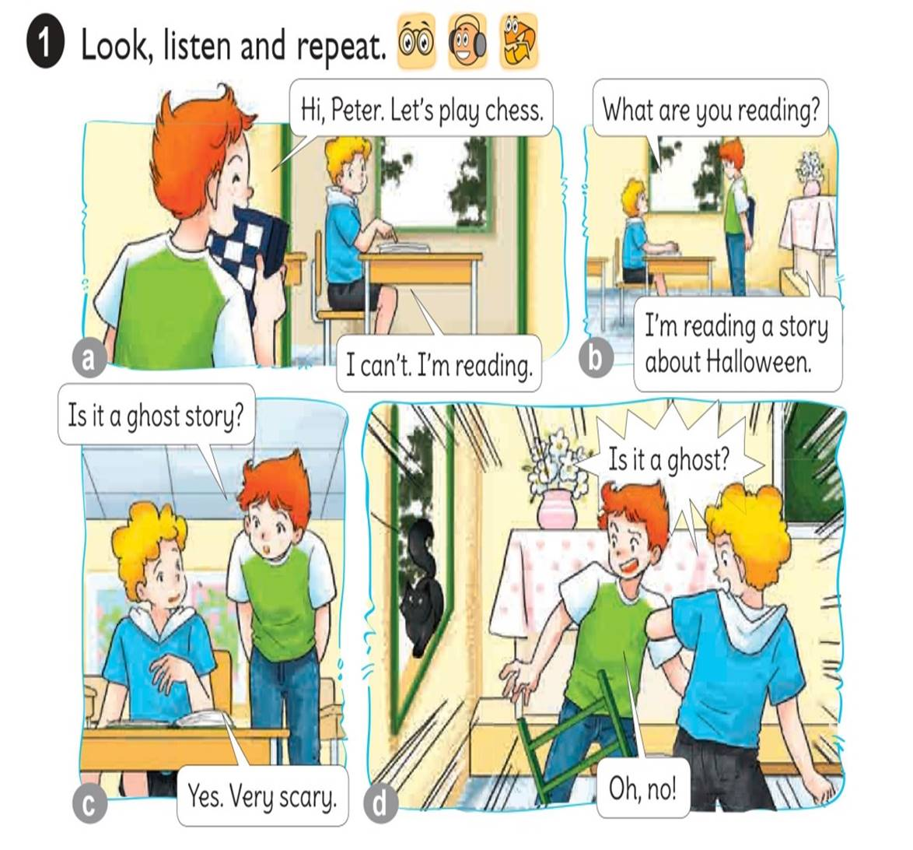


Slide 10
Model Sentence

Slide 11
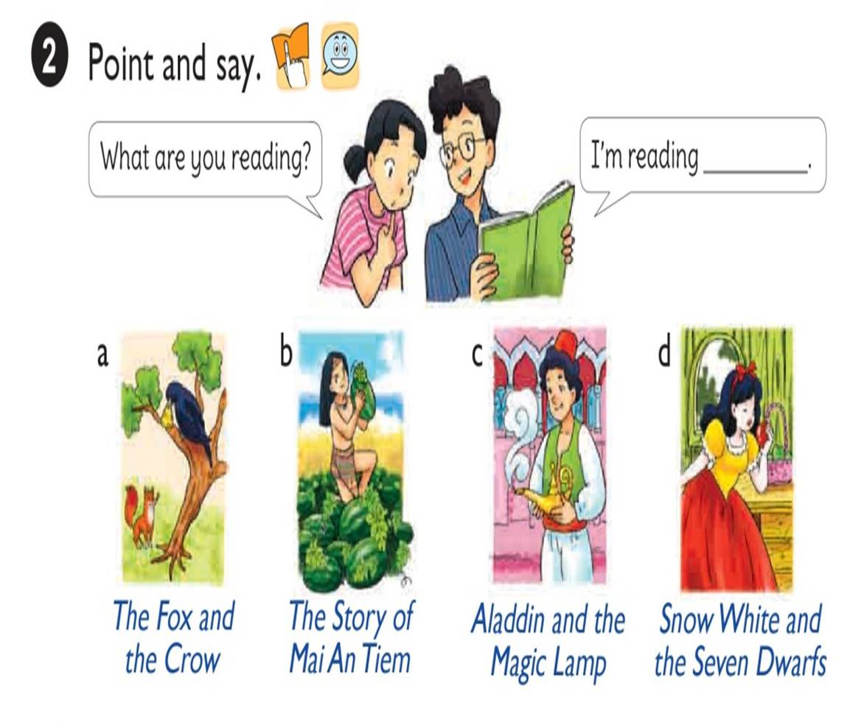

Slide 12


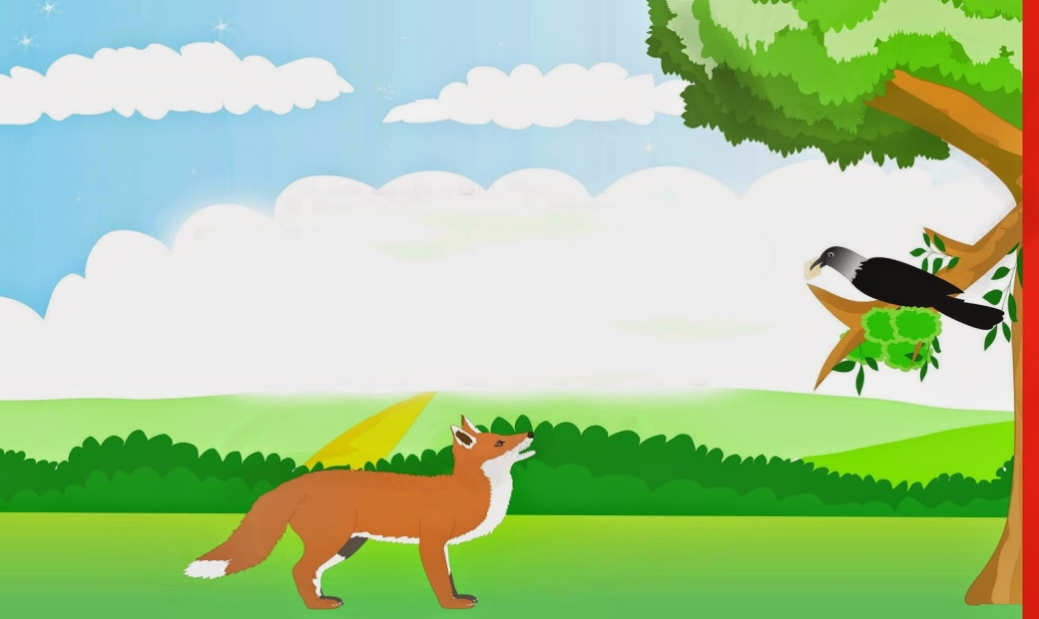
What are you reading?
I’m reading
the fox and crow.

Slide 13

What are you reading?
I’m reading
the story of Mai An Tiem.

Slide 14

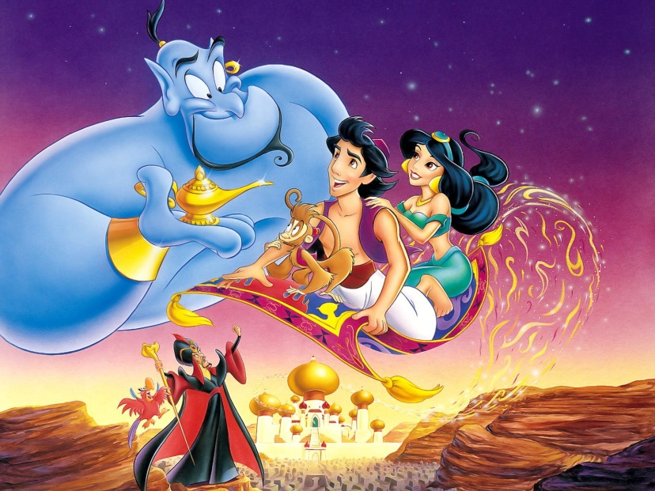
What are you reading?
I’m reading
Aladdin and the Magic Lamp.

Slide 15

What are you reading?
I’m reading
Snow White and the Seven
Dwarfs.

Slide 16
1. Vocabulary
- Fairy tale
- Ghost story
- The Fox and the Crow
- The story of Mai An tiem
- Aladdin and the Magic Lamp
- Snow White and the Seven Dwarfs
2. Model sentence
What are you reading?
I’m reading Snow White and the Seven Dwarfs

Slide 17
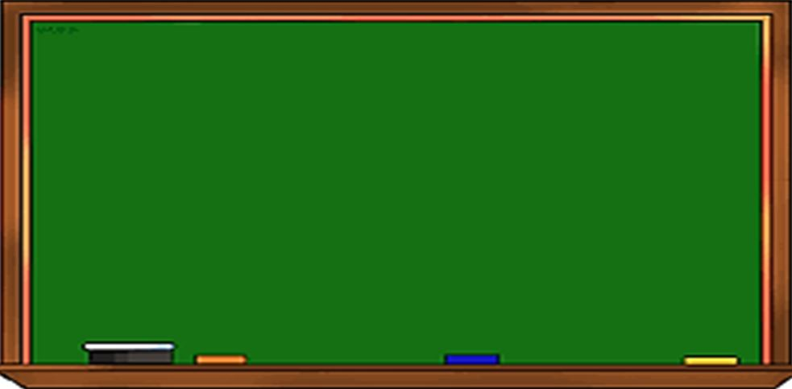
Wednesday, December 8th 2021
Unit 8: Lesson 1,2-52,54
I. New words: từ mới
- Fairy tale: truyện cổ tích
- Ghost story: truyện ma
- The Fox and the Crow: Cáo và quạ
- The story of Mai An Tiem
- Aladdin and the Magic Lamp
- Snow White and the Seven Dwarfs
II. Model sentences: mẫu câu
1- What are you reading?
I’m reading Tam and Cam.
2- What’s Tam like?
She’s gentle.
- Main character: nhân vật chính
- hard-working: chăm chỉ
- kind: tốt bụng
- clever: thông minh
gentle: dịu dàng
generous: hào phóng
III. Homelink: BTVN
1-Luyện đọc P52,54 theo video, viết từ mới(2d)+ Mẫu câu(2d) + Tổ 1 chụp bài
2- Làm SBT P32,33 + luyện IOE vòng 16 và thi thử
*** Dặn dò: Tuần sau học chiều thứ 2 lúc 2h30
vì thứ 4 cô bận đi họp.

Slide 18
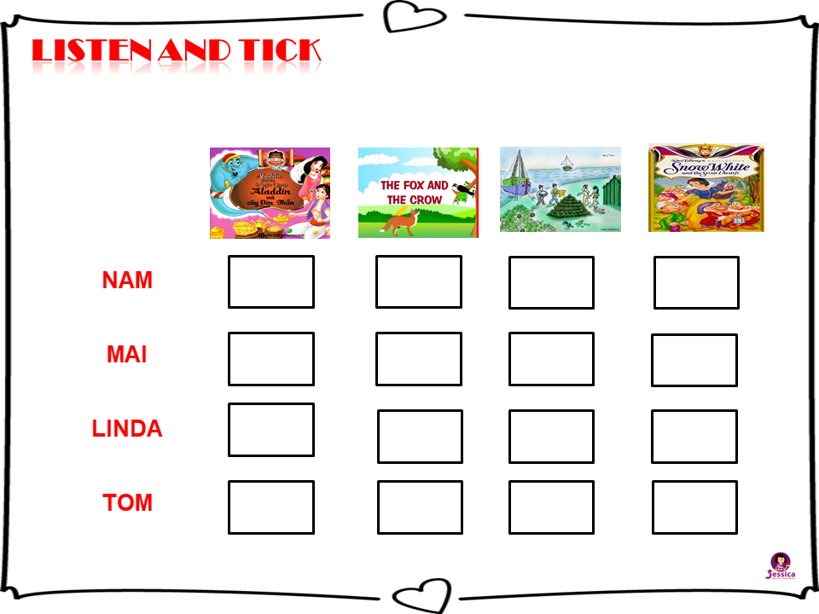



NAM
MAI
LINDA
TOM

Slide 19
READ AND COMPLETE
Quan: What do you do in your (1) time?
Linda: I read a lot. I like fairy tales.
Quan: I see. What are you (2) now?
Linda: (3) White and the (4) Dwarfs. What about you? Do you like fairy tales?
Quan: No, I don’t. I (5) reading short stories.
Linda: What are you reading now?
Quan: A Halloween story.
snow
free
like
reading
reading
Snow
Seven
free
like
seven

Slide 20
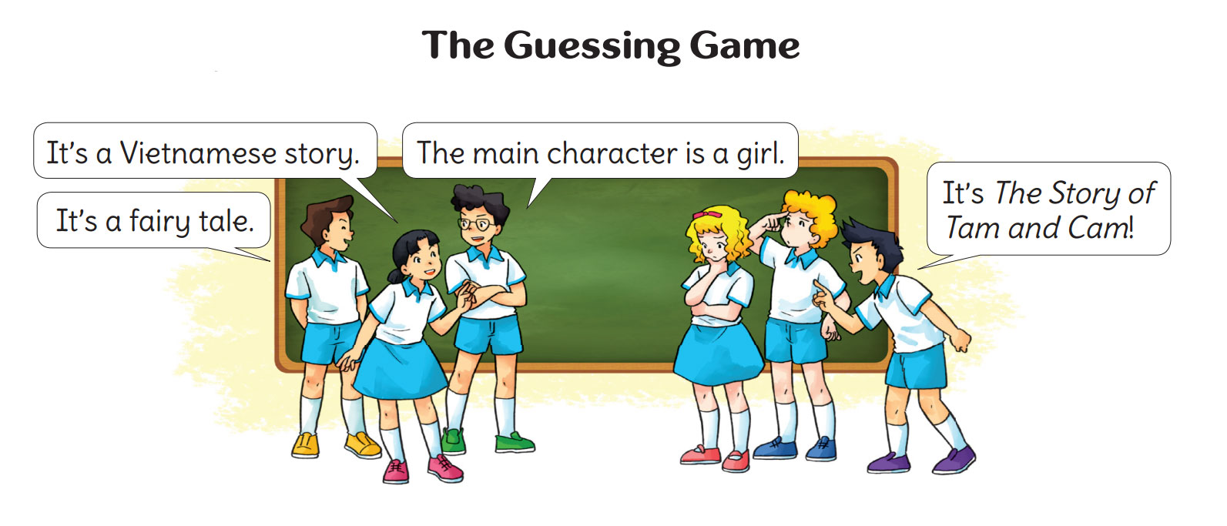
Let’s PLAY

Slide 21




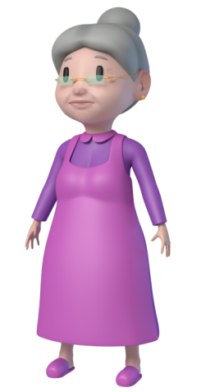
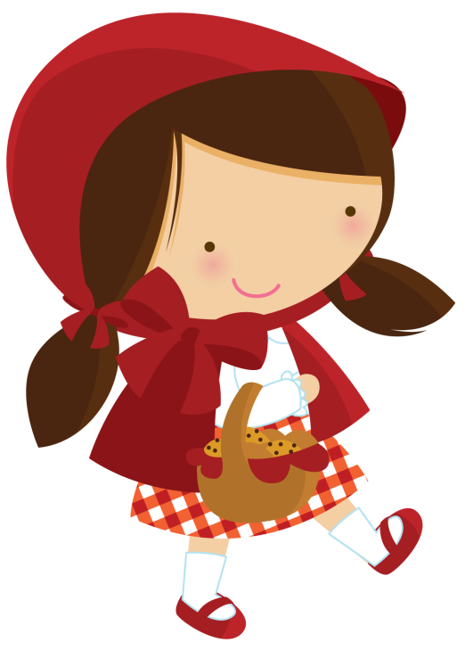

PLAY
Little
Red

Slide 22

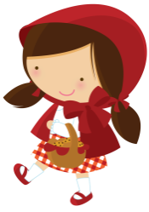


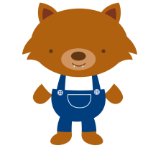






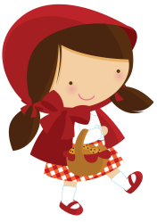

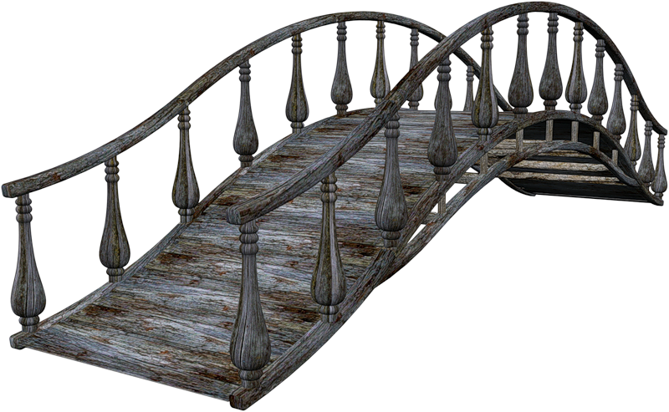







Slide 23


I’m reading … and the Crow
Snow White
Aladdin
The Fox

Slide 24
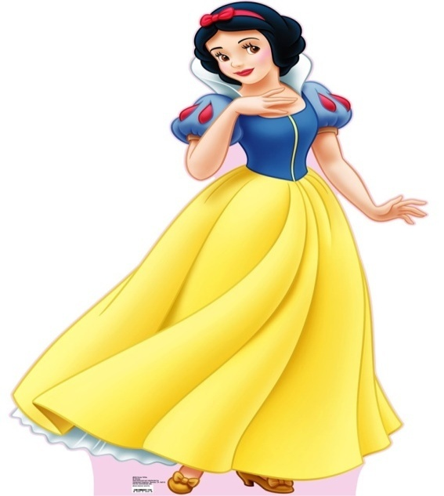
… White
Smart
Slow
Snow

Slide 25
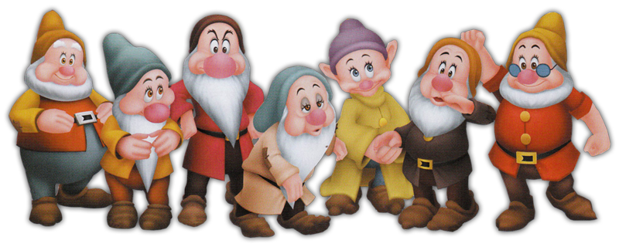
Snow White and Seven …
Princes
Dwarfs
Princess

Slide 26

Aladdin and the … Lamp
Magic
Huge
Real

Slide 27
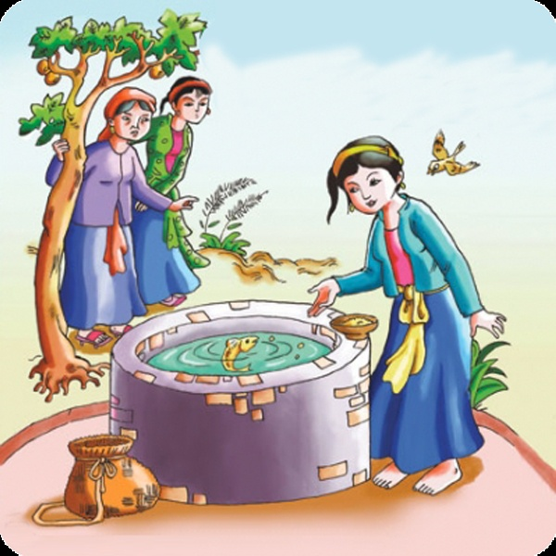
I’m reading …
Tam Cam
Cinderella
Snow White

Slide 28
… many lessons do you have today?
Aladdin and the Magic Lamp
Cinderella
Snow White and the Seven Dwarfs

Slide 29

I’m reading …
The Fox and the Crow
The Snake and the Crow
The Fox and the Parrot

Slide 30
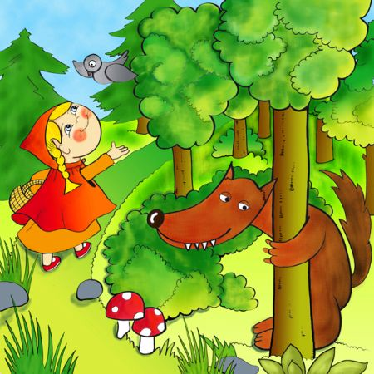
I’m reading …
Little Red
Cinderella
Snow White

Slide 31
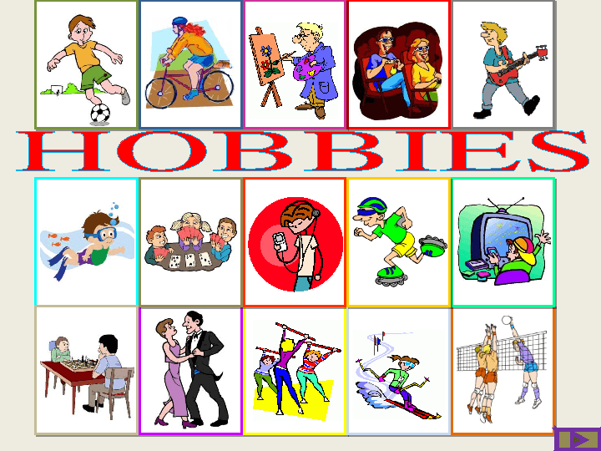
you/ do/ what/ do/ your/ free/ in/ time/?
What do you do in your freetime?
What do you do in freetime your?
What do your do in you freetime?

Slide 32
you/ do/ what/ do/ your/ free/ in/ time/?
Aladdin and the Magic Lamp
The Fox and the Crow
The story of Mai An Tiem

Slide 33





