Slide 1

Wednesday, 24th November 2021
UNIT ̃7. HOW DO YOU LEARN ENGLISH?
LESSON 1

Slide 2

WARM UP

Slide 3


Slide 4
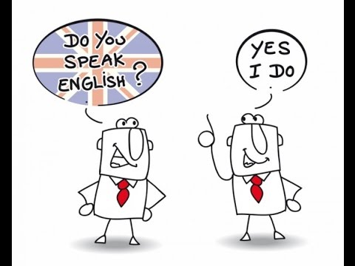
SPEAK ENGLISH EVERY DAY

Slide 5
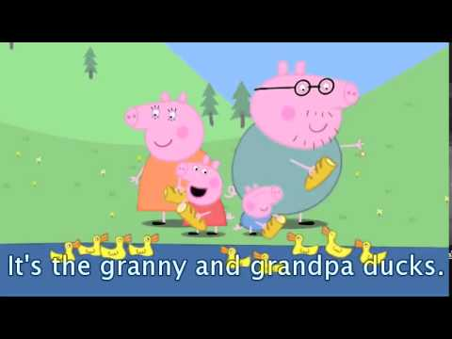
SPEAK ENGLISH EVERY DAY
WATCH ENGLISH CARTOONs

Slide 6
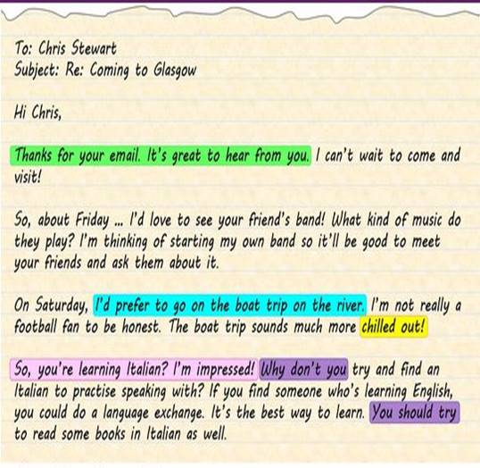
WRITE EMAILS TO MY FRIENDS

Slide 7

READ SHORT STORIES

Slide 8
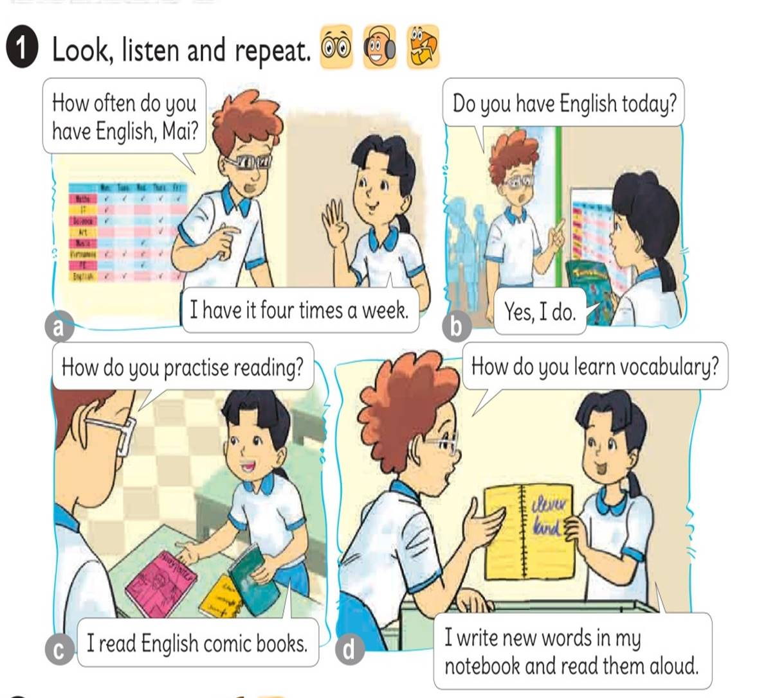




Slide 9
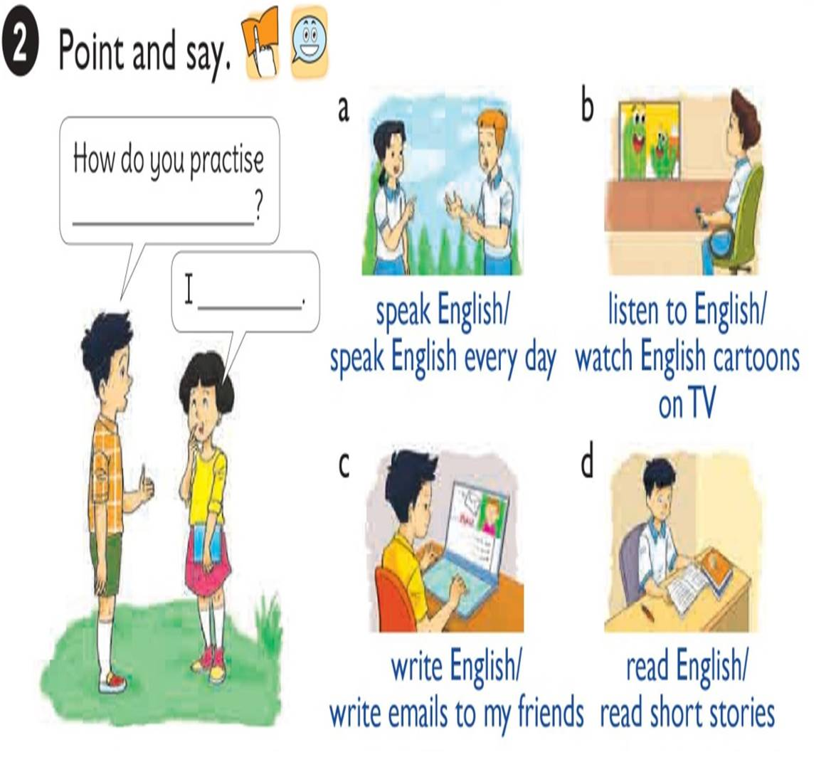

Slide 10

How do you practise
speaking English?
I
speak English every day.

Slide 11
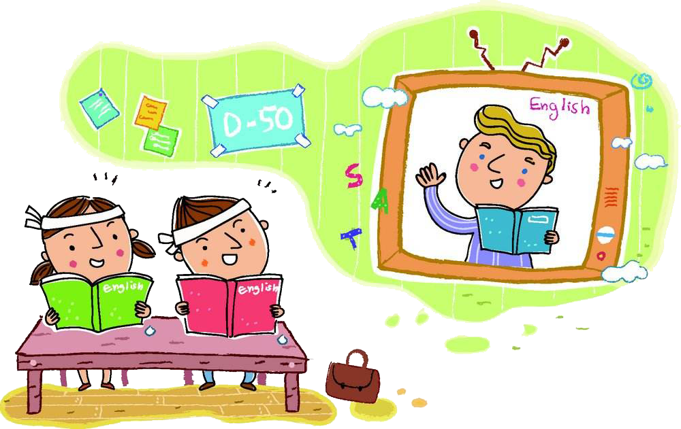
How do you practise
listening to English?
I
watch English cartoons on TV.

Slide 12

How do you practise
writing English?
I
write emails to friends.

Slide 13

How do you practise
reading English?
I
read short stories.

Slide 14
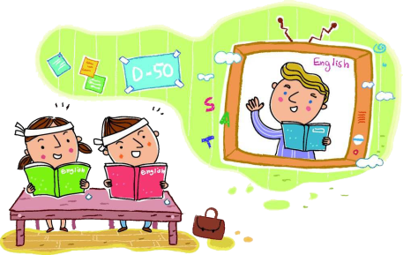

1. Vocabulary
- speak English
- listen to English
- write English
- read English
2. Model sentence
How do you practise speaking English?
I speak English every day.

Slide 15
Unit 6: Lesson 3 – P44
'How many 'lessons do you 'have to'day?
I 'have 'four.
'How many 'crayons do you 'have?
I 'have 'five.
'How many 'books do you 'have?
I 'have 'six.
'How many 'copybooks do you 'have?
I 'have 'seven.

Slide 16

Wednesday, November 24th 2021
Unit 6: Lesson 3-P44 ,Unit 7: Lesson 1-46
I. New words: từ mới
II. Model sentences: mẫu câu
- practise: thực hành, luyện tập
- speak English
- listen to English
- write English
read English
speak English every day
watch English cartoons on TV
write emails to my friends
read short stories
1-How do you practise speaking English?
I English every day.
2- How do you practise writing English?
I write emails to my friends.
III. Homelink: BTVN
1-Luyện đọc P44,46 theo video, viết từ mới (2d)+ Mẫu câu(2d)
2- Làm SBT P28,29 + Luyện IOE hết vòng 15
2 TK trước ngày 28/11 để được thi cấp Trường

Slide 17
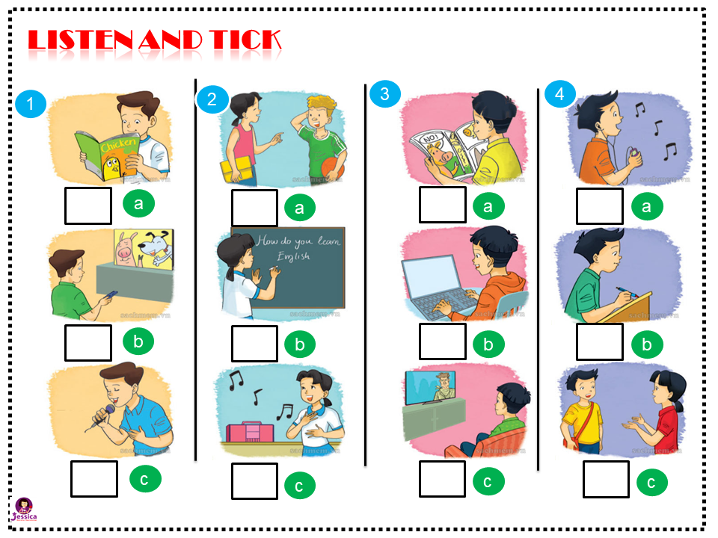


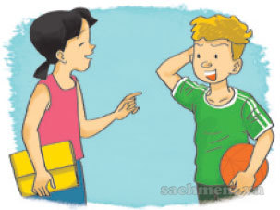

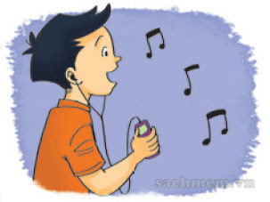

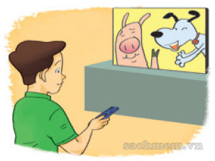
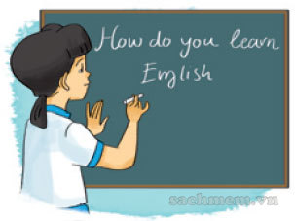




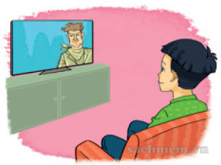
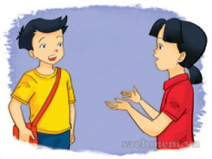
LISTEN AND TICK
1
2
3
4
1
2
3
4
a
a
a
a
b
b
b
b
c
c
c
c

Slide 18
READ AND COMPLETE
Trung is a newcomer in Class 5B. Today, he’s happy (1) he has two English lessons. To practise speaking English, he (2) it every day with his friends. To learn vocabulary, he (3) new words and reads them aloud. He also learns English by (4) English songs. His (5) is singing English songs!
hobby
Because
singing
speaks
writes
writes
Because
singing
speaks
hobby

Slide 19

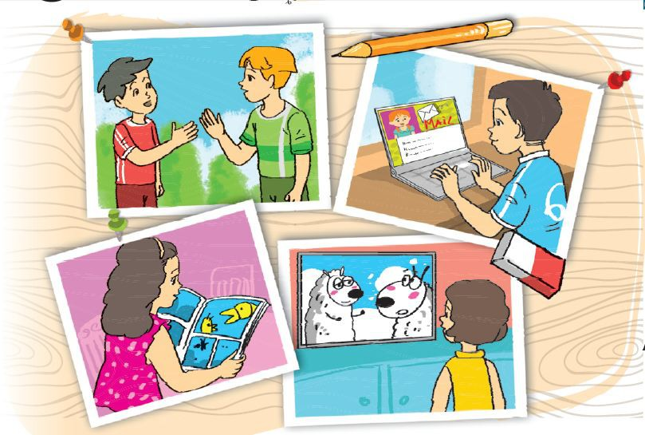
Let’s sing
How do you learn English?
How do you learn English?
How do you practise speaking?
I speak to my friends every day.
How do you practise reading?
I read English comic books.
How do you practise writing?
I write emails to my friends.
And how do you practise listening?
I watch English cartoons on TV.

Slide 20



