Slide 1


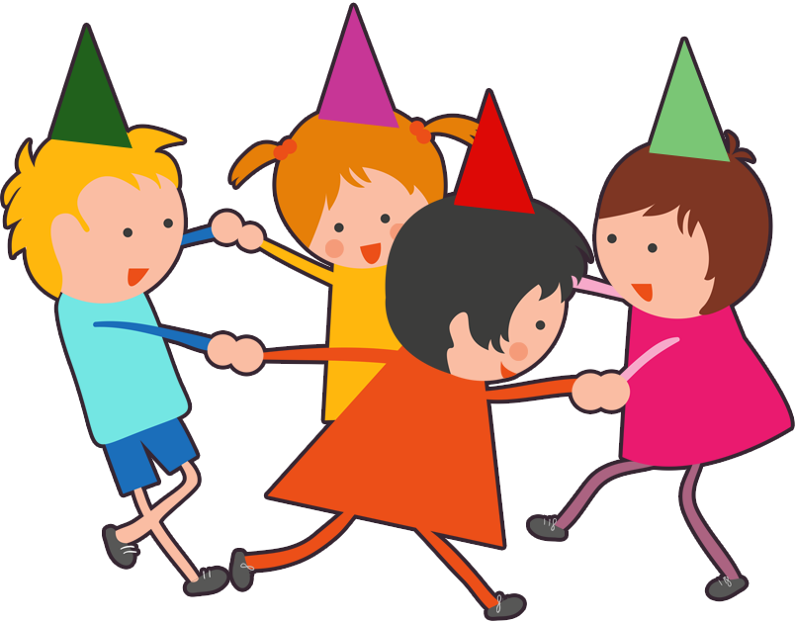
UNIT 11. WHAT’S THE MATTER
WITH YOU?
LESSON 1

Slide 2
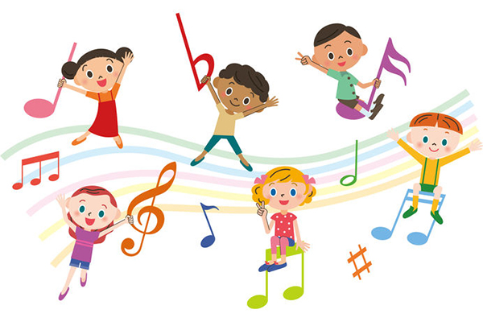


Slide 3


Slide 4
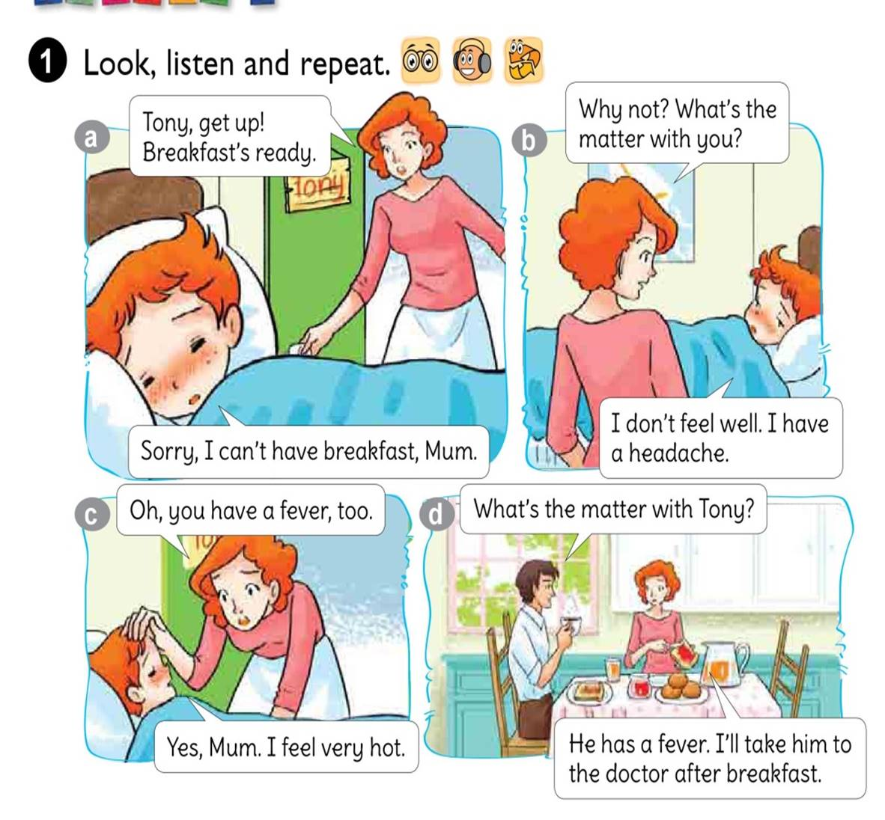



Slide 5
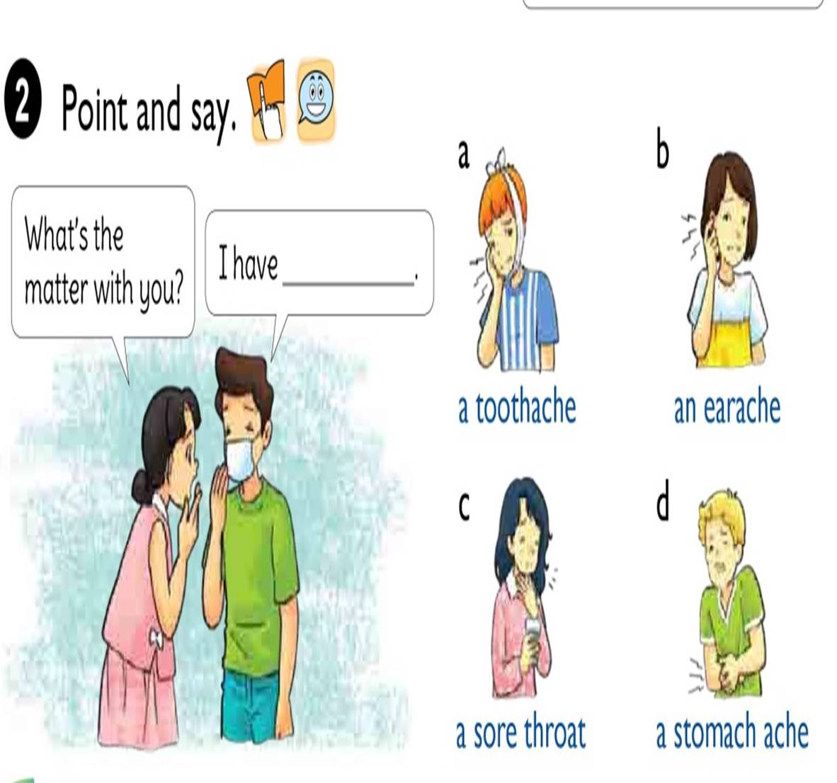

Slide 6

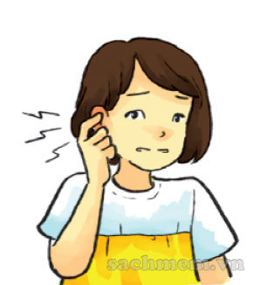
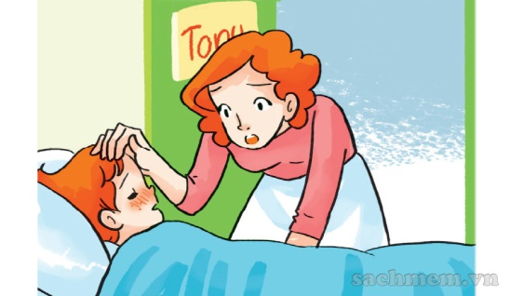
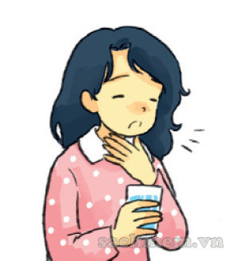
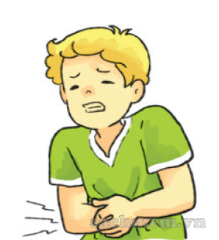
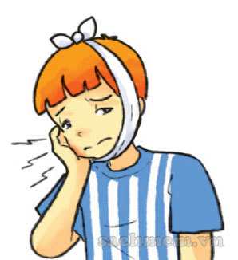
1. Vocabulary
- a fever
- a toothache
- an earache
- a sore throat
- a stomach ache
2. Model sentence
What’s the matter with you?
I have a toothache.

Slide 7

What’s the matter with you?
I have
a toothache.

Slide 8
What’s the matter with you?
I have
an earache.

Slide 9
What’s the matter with you?
I have
a sore throat.

Slide 10
What’s the matter with you?
I have
a stomach ache.

Slide 11
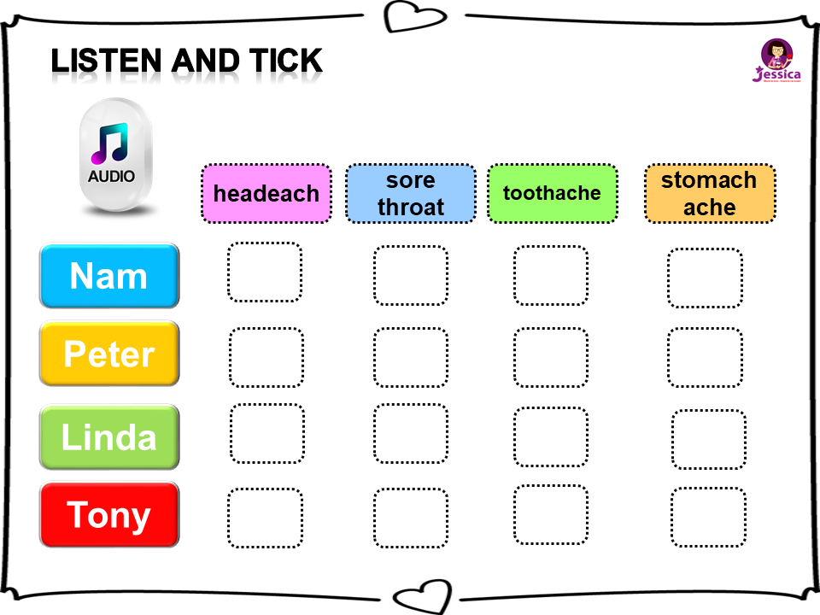


Listen and TICK
headeach
sore throat
toothache
stomach
ache
Nam
Peter
Linda
Tony

Slide 12
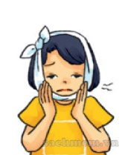
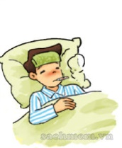
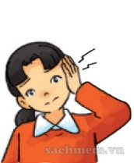
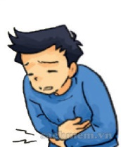

READ AND COMPLETE
earache
sore throat
stomach ache
fever
toothache
She has a pain in her tooth. She has a
toothache
Nam has a high temperature. He has a
fever
Mai has a pain in her ear. She has an
earache
Quan has a pain in his stomach.
He has a
stomach ache
Linda has a pain in her throat.
She has a
sore throat

Slide 13
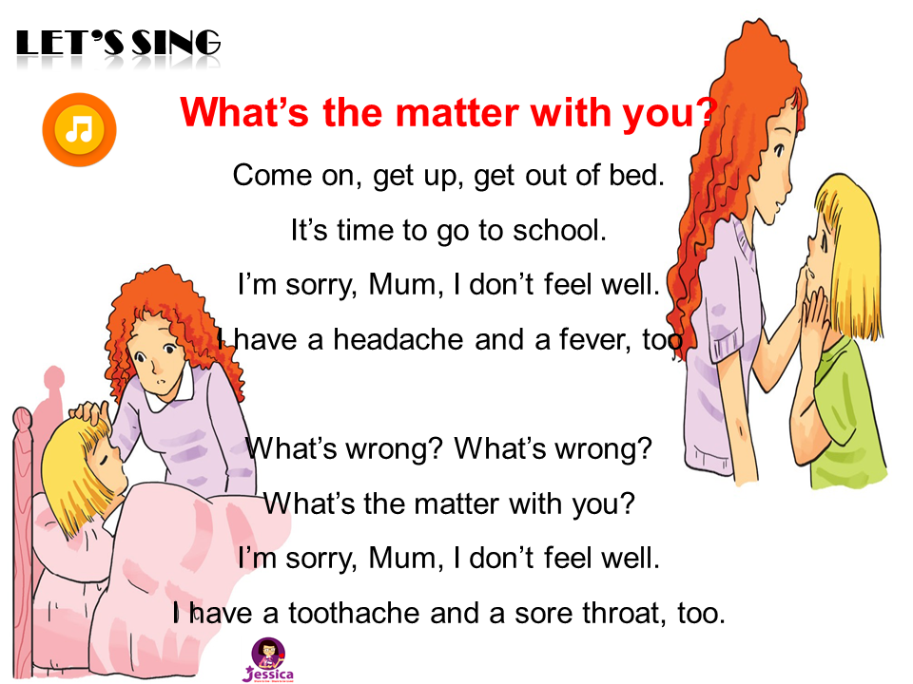

LET’S SING

Slide 14


Slide 15











MAGIC GIFT BOX

Slide 16
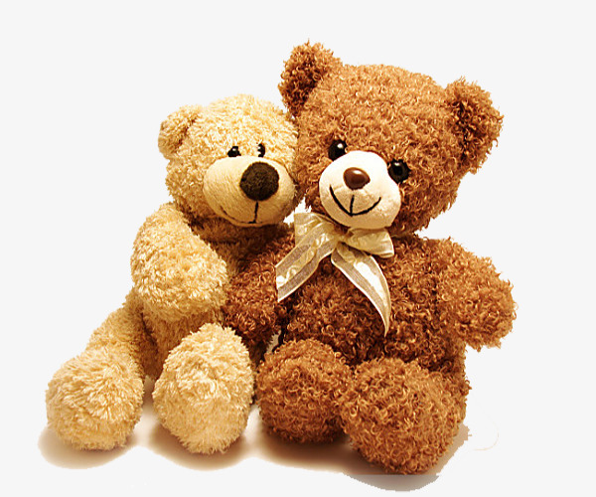

an earache
a toothache
a stomach ache

Slide 17
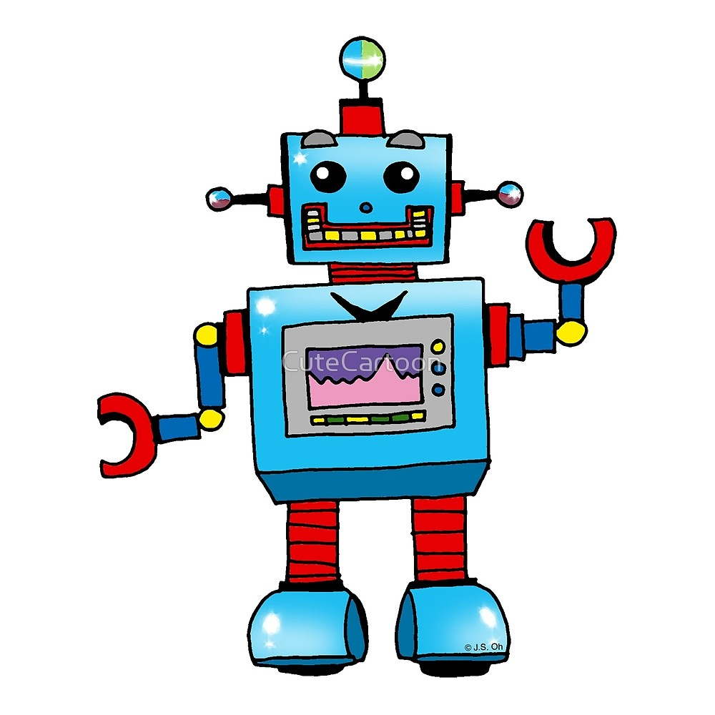
an earache
a toothache
a sore throat

Slide 18
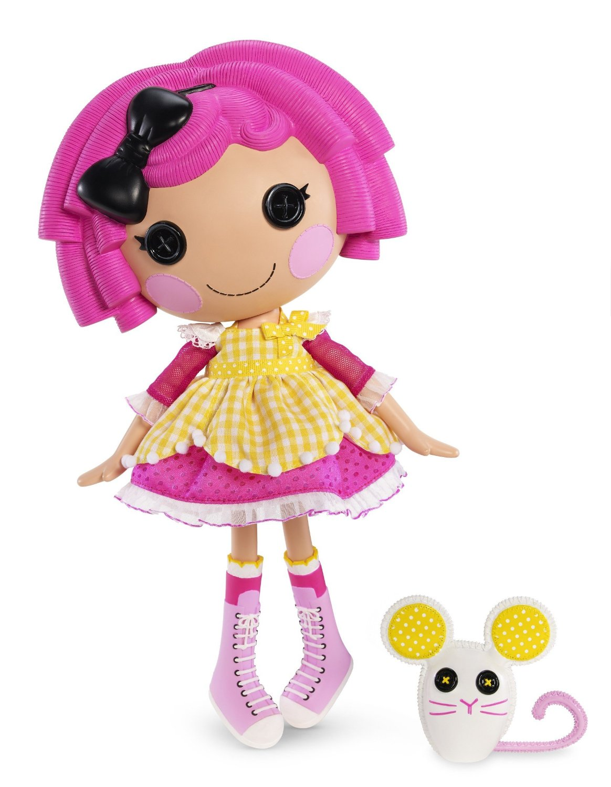
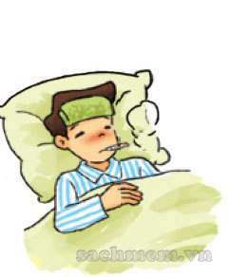
A sore throat
A stomach ache
A fever

Slide 19
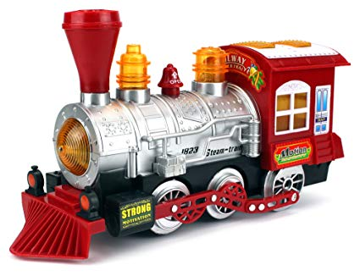
An earache
A fever
A stomach ache

Slide 20

A farmer
A doctor
A teacher

Slide 21
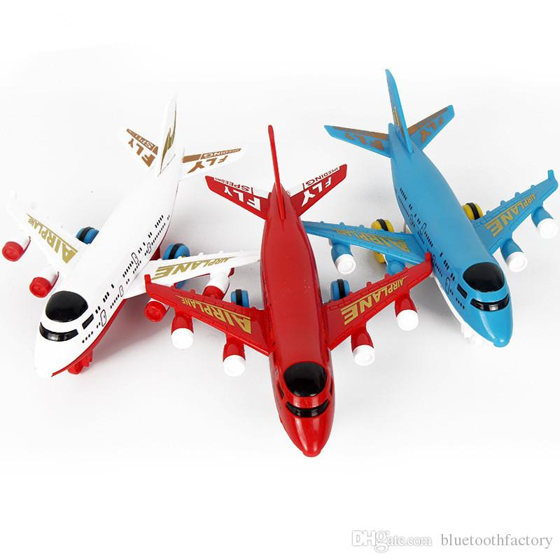

Linda … a sore throat
has
have
is

Slide 22
matter/ What/ you/ with/ is/ the?
What is the matter with you?
What the matter is with you?
What matter is the with you?

Slide 23
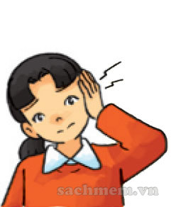
has/She/an/earache
She has earache an
She has an earache
She an has earache

Slide 24
A sore throat
An earache
A toothache

Slide 25


A stomach ache
A toothache
A headache

