Slide 1
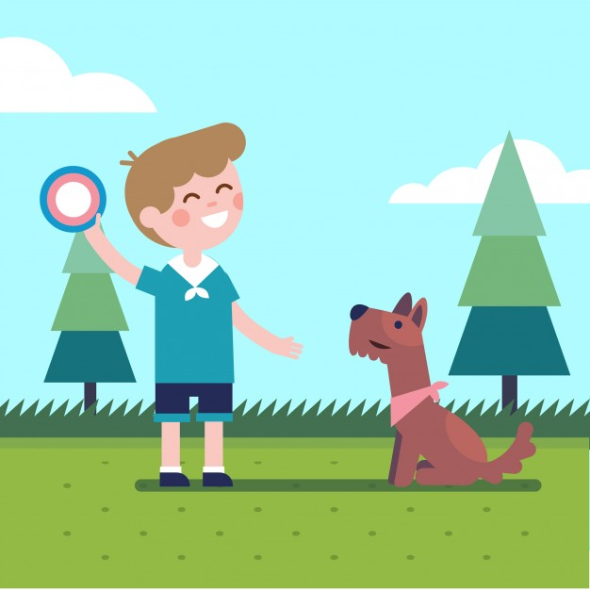
UNIT 6. WHERE’S YOUR SCHOOL?
LESSON 2

Slide 2
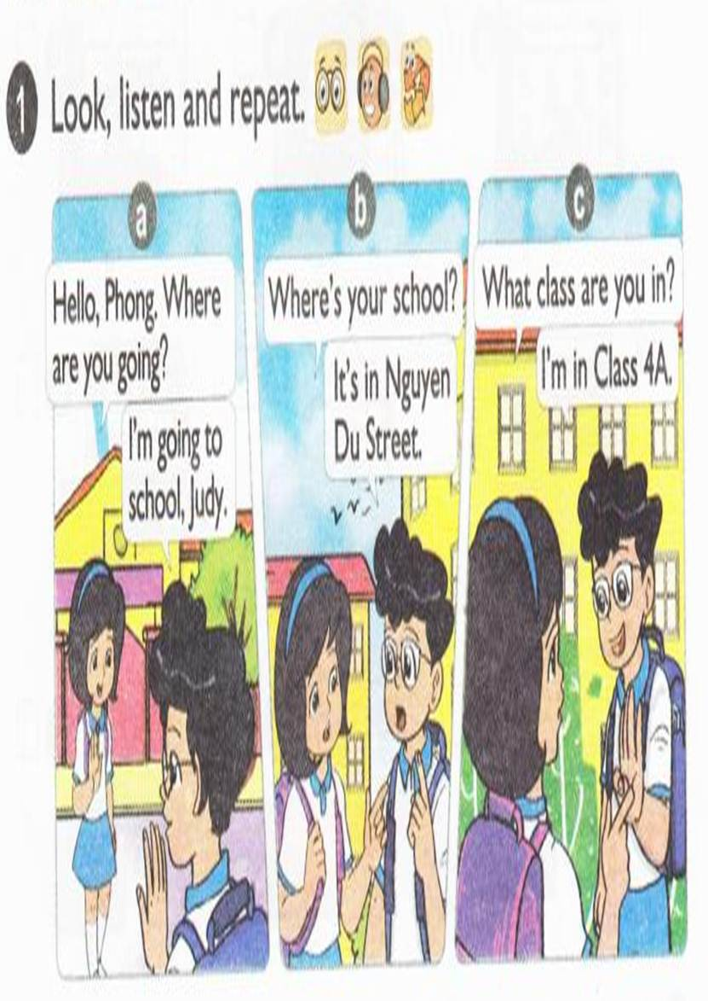





Slide 3
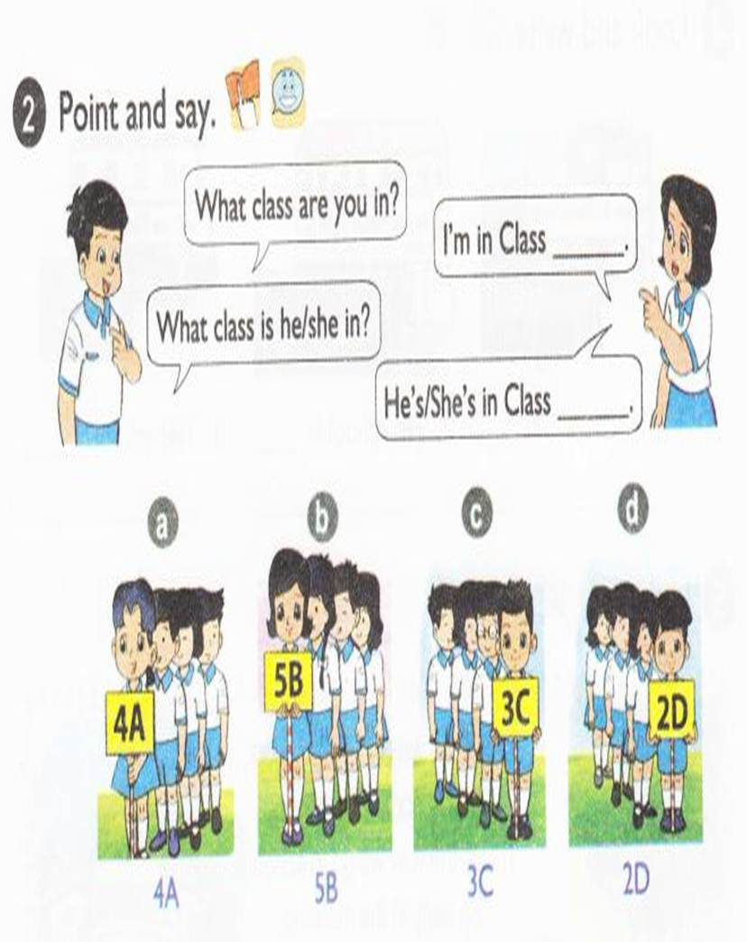

Slide 4


It
What class is she in?
It
She’s in
Class 4A

Slide 5

It
What class is she in?
It
She’s in
Class 5B

Slide 6

It
What class is he in?
It
He’s in
Class 3C

Slide 7

It
What class is he in?
It
He’s in
Class 2D

Slide 8


Model sentence
What class are you in?
I’m in Class 4A.
What class is she in?
She’s in Class 3C.
He’s in Class 5B.

Slide 9


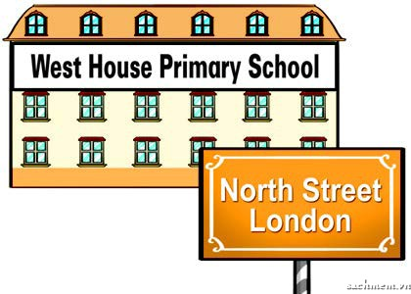

LISTEN AND NUMBER
1
2
3
1
3
4
4
2
By Jessica

Slide 10

LOOK & WRITE
1
A: Where's his school?
B: It's in .
Chu Van An Street

Slide 11

2
LOOK & WRITE
A: Where's her school?
B: It's in .
South Street London

Slide 12
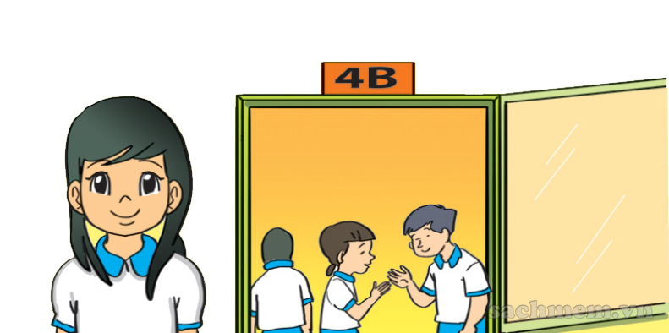
LOOK & WRITE
3
A: What class is she in?
B: She’s in .
Class 4B

Slide 13

4
LOOK & WRITE
A: What class is he in?
B: He’s in .
Class 4C

Slide 14
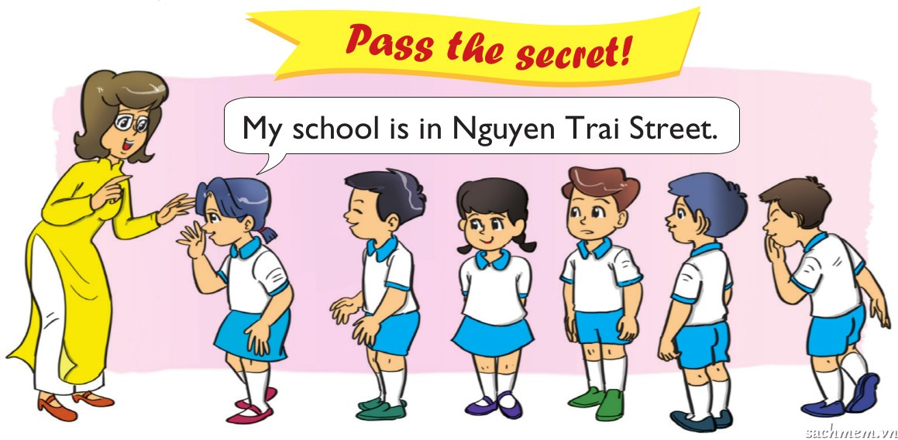

LET’S PLAY

Slide 15
Tuesday, 9th November 2021
Unit 6: Where’s your school?
Lesson 2
I. Model sentences:
What class are you in ?
I’m in Class 3A4.
What class is he/she in ?
He’s/ She’s in Class 3A6.
II. Homelink
Luyện tập hỏi và trả lời với mẫu câu đã học.
Làm phần B, D trong SBT.

Slide 16
UNIT 6. WHERE’S YOUR SCHOOL?
LESSON 3

Slide 17


WARM UP

Slide 18
Sch-
Sk-
Str-

Slide 19
Sch-
school
This is our school
By Jessica

Slide 20
skipping
Sk-
Mai likes skipping.
By Jessica

Slide 21
Str-
street
My school is in Nguyen Du street.
By Jessica

Slide 22





LISTEN & CIRCLE
1. This is a ___________.
a.School b.street
2.The ___________ is beautiful.
a.School b.street
3.The ___________ is long.
a.Street b.stream
4. I love my ___________.
a.School b.street
5.Linda likes ___________.
a.Skating b.skipping
1
2
3
4
5

Slide 23
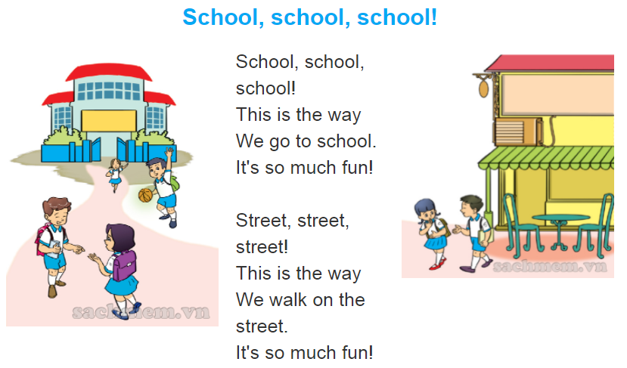


Slide 24
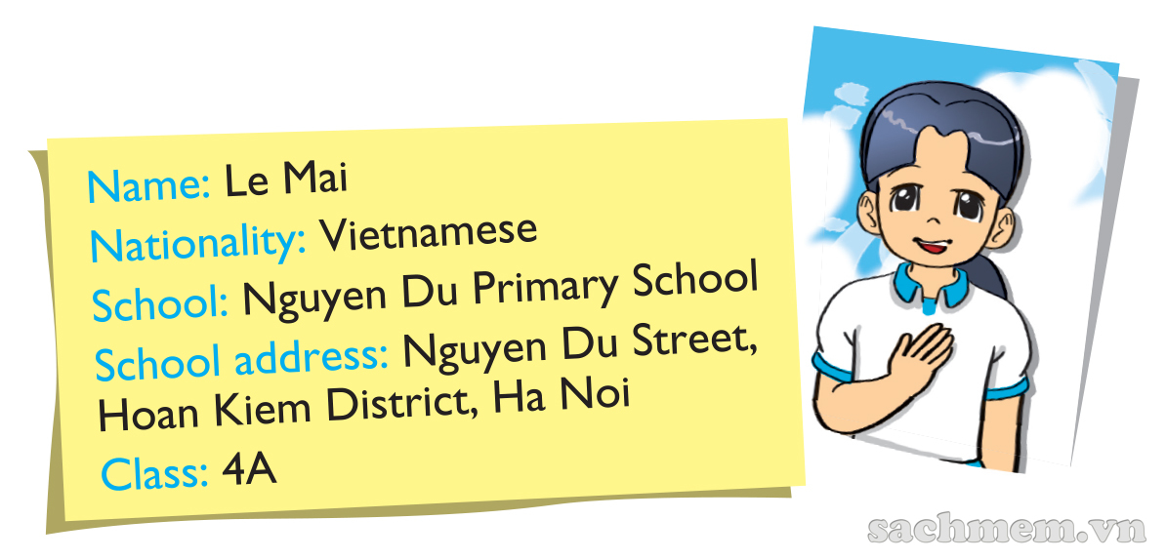
READ & COMPLETE
Hello. My name's (1) . I'm from Ha Noi, Viet Nam. I'm (2) . I study at (3) . It's a big school in (4) .
I'm in Class (5) .
Le Mai
Vietnamese
Nguyen Du Primary School
Nguyen Du Street, Hoan Kiem District, Ha Noi
4A

Slide 25
WRITE ABOUT YOUR SCHOOL
I study at Chau Son Primary School.
It’s a small school in Chau Son Village, Ba Vi District, Ha Noi.
I’m in class 4A.
I study at

Slide 26
PROJECT
Friend's name:
School:
School address:
Class:
Linda
Sunflower Primary School
South Street, London
4A
MAKE A CARD ABOUT YOUR FRIEND

Slide 27

Tuesday, November 16th 2021
Unit 6: Lesson 2,3-P42,44
I. New words: từ mới
III. Model sentences: mẫu câu
what...? gì, cái gì
class: lớp
1- What class are you in ?
I’m in class 4A .
2- What class is he/she in?
He’s/ She’s in class 3A.
II. Phonics: ngữ âm
/sch/: school, schoolar,
/sk/: skipping, skate, skirt, ski, sky
/str/: street, stream,
III. Homelink: BTVN
1-Luyện đọc P42,44 theo video, viết từ mới (2d)+ Mẫu câu(2d)
2- Làm SBT P26,27 + Luyện hết V14-IOE

Slide 28
Tuesday, 9th November 2021
Unit 6: Where’s your school?
Lesson 3
Sound
/sch/: school
/sk/: skipping
/str/: street
III. Homelink
- Làm phần E trong SBT.

Slide 29





