Slide 1

UNIT 6. WHERE’S YOUR SCHOOL?
LESSON 1

Slide 2


WARM UP

Slide 3

street

Slide 4


road
Hoa Binh

Slide 5

village

Slide 6


class

Slide 7
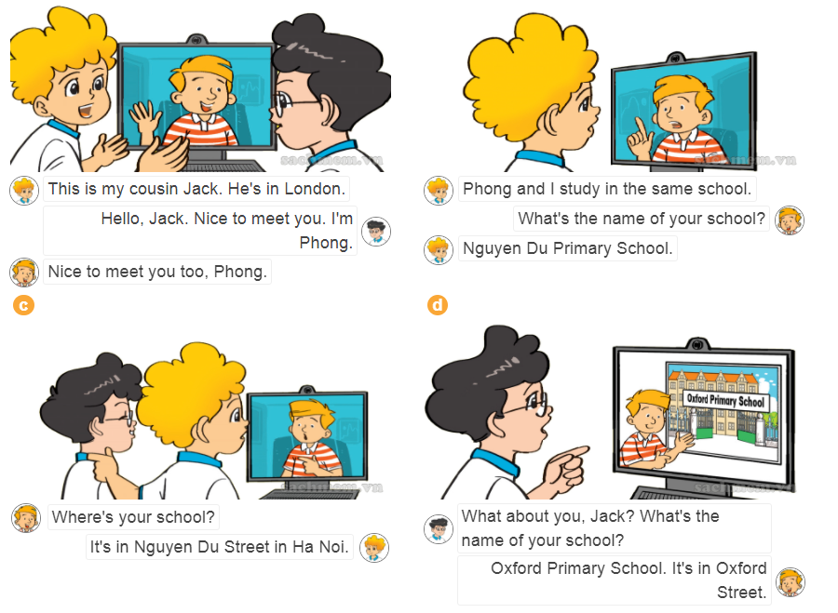





Slide 8
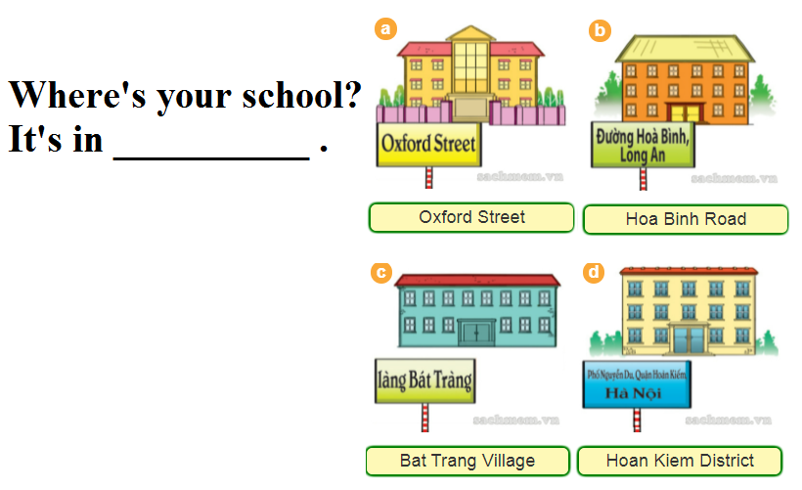


Slide 9


It
Where’s your school?
It
It’s in
Oxford street

Slide 10

It
Where’s your school?
It
It’s in
Hoa Binh Road

Slide 11

It
Where’s your school?
It
It’s in
Bat Trang Village

Slide 12

It
Where’s your school?
It
It’s in
Hoan Kiem District

Slide 13


Model sentence
Where’s your school?
It’s in Oxford Street.
Where’s your school?
It’s in Hoa Binh Road.

Slide 14

LISTEN & TICK
1
a
b
c

Slide 15



LISTEN & TICK
2
a
b
c

Slide 16



LISTEN & TICK
3
a
b
c

Slide 17

LOOK & WRITE
1
My school is in .
Nguyen Trai Street

Slide 18

LOOK & WRITE
2
My school is in .
Van Noi Village

Slide 19
LOOK & WRITE
3
My school is in .
South Street, London

Slide 20
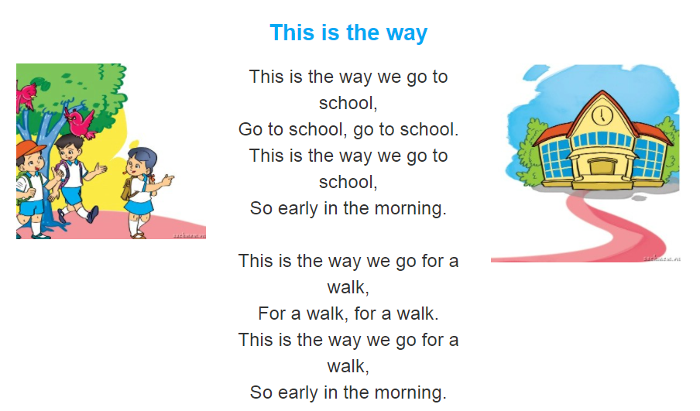


Slide 21

Tuesday, November 9th 2021
Unit 6: Lesson 1-P40 + Khảo sát GK1 ..... /10
I. New words: từ mới
II. Model sentences: mẫu câu
Where...? Ở đâu
your school: trường của bạn
street: phố
road: đường
village: làng
district: quận, huyện
Where’s your school ?
It’s in Hoang Nhu Tiep Street.
III. Homelink: BTVN
1-Luyện đọc P40 theo video, viết từ mới (2d)+ Mẫu câu(2d)
2- Làm SBT P24,25 + Làm trên olm.vn

