Slide 1
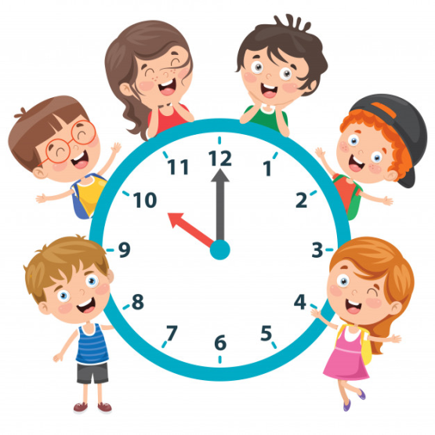
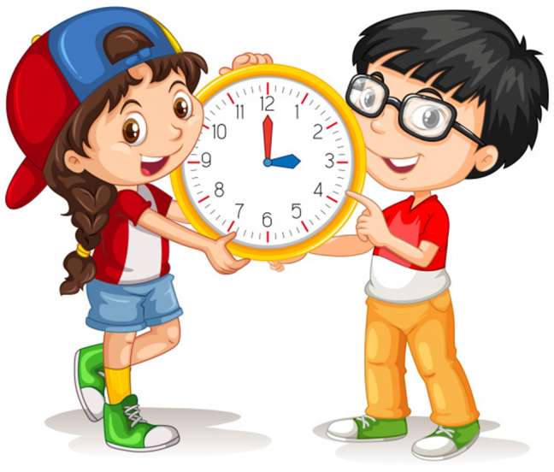
Unit 11
What time is it?
Lesson 2

Slide 2
Vocabulary

Slide 3
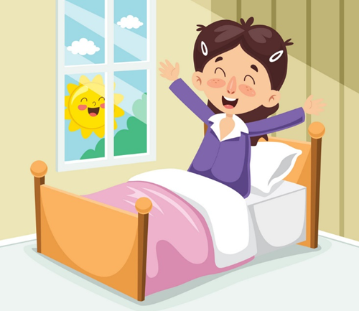

Get up

Slide 4
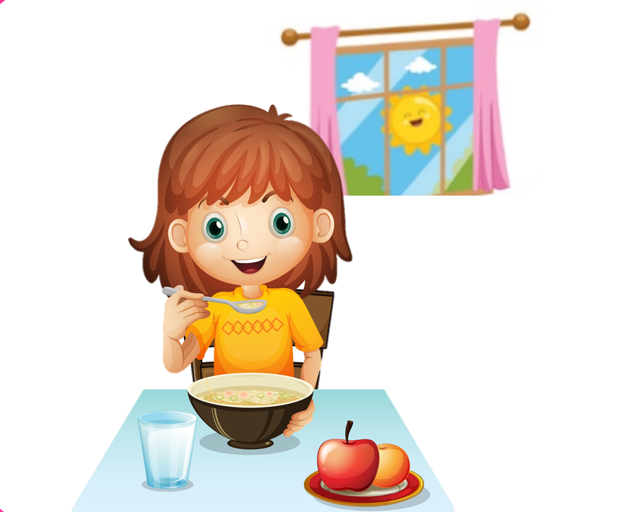
Have breakfast

Slide 5

Go to school

Slide 6

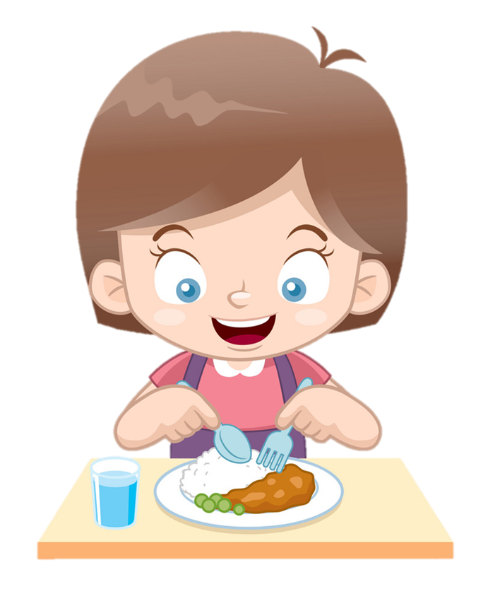
Have dinner

Slide 7
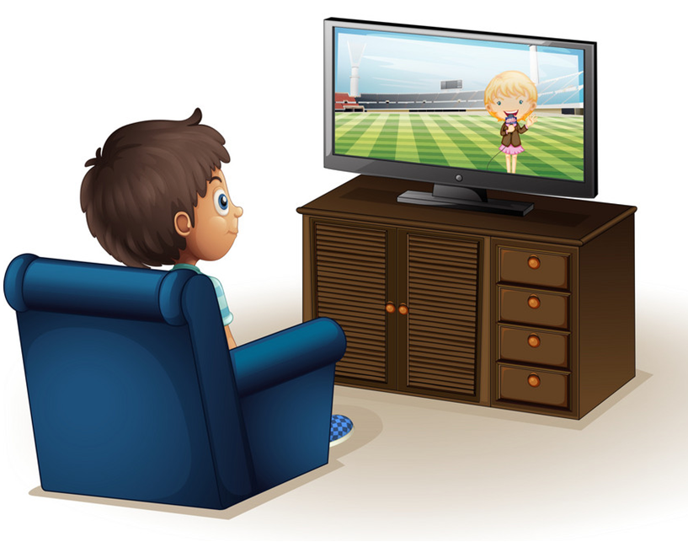
Watch TV

Slide 8
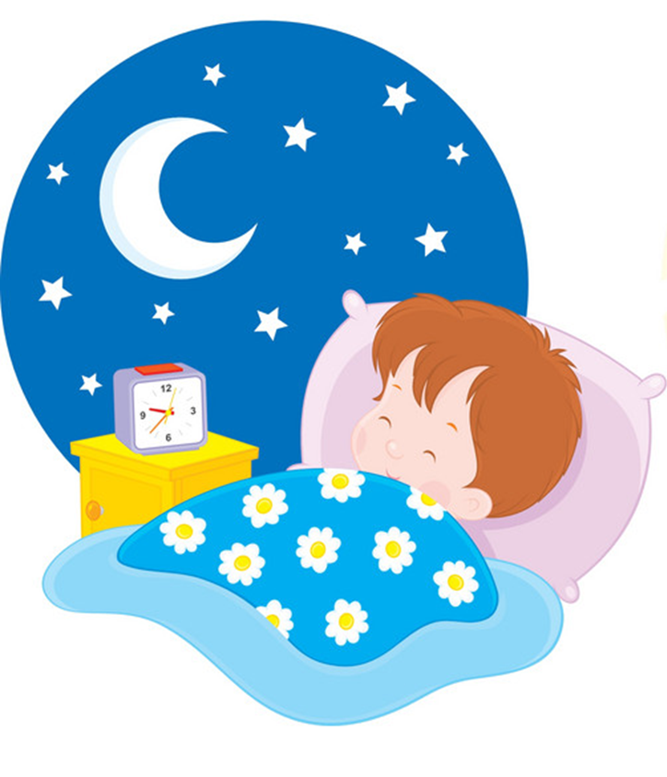
Go to bed

Slide 9

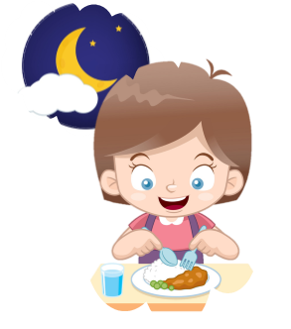
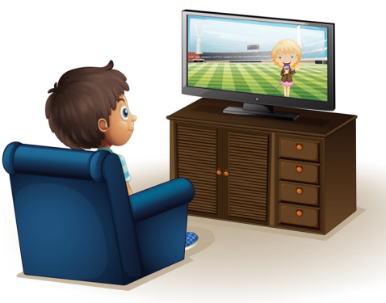

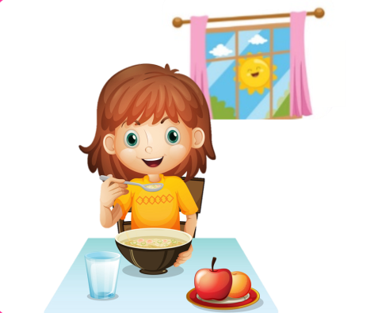

Match
Watch TV
Go to bed
Have breakfast
Have dinner
Get up
Go to school

Slide 10

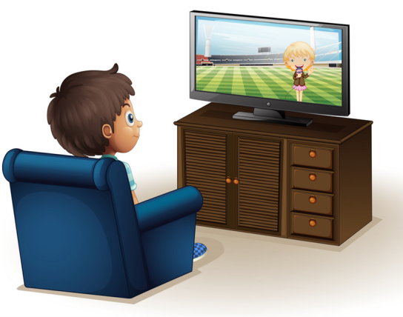


Read and tick
2
3
✔
1
6
4
5
Watch TV

Slide 11
Read and tick
2
3
1
✔
6
4
5
Have breakfast

Slide 12
Read and tick
2
3
1
✔
6
4
5
Go to bed

Slide 13
Read and tick
2
✔
3
1
6
4
5
Have dinner

Slide 14
Read and tick
✔
2
3
1
6
4
5
Go to school

Slide 15
Read and tick
2
3
1
6
4
✔
5
Get up

Slide 16

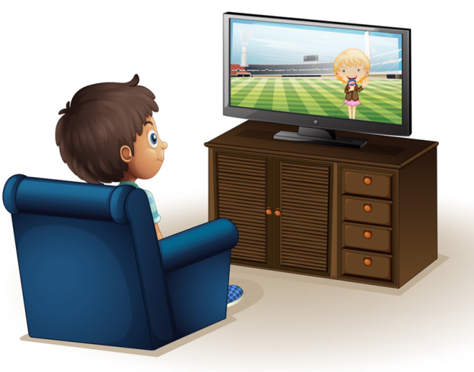


Review
Go to school
Watch TV
Have dinner
Get up
Go to bed
Have breakfast

Slide 17
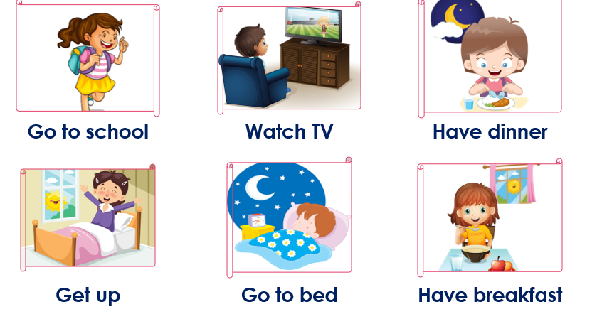
Tuesday, January 15th 2022
Unit 11:What time is it ?
Lesson 2
New words:
II. Model sentences
What time do you + động từ chỉ hành động _____?
I + ĐỘNG TỪ_______ at + (giờ).
III. Homelink

Slide 18
GRAMMAR

Slide 19

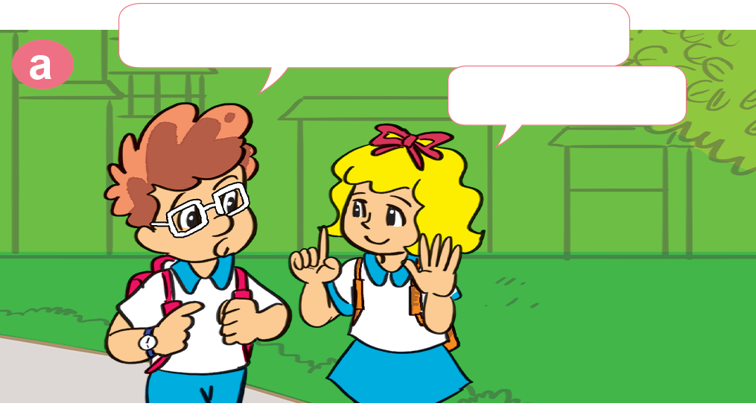
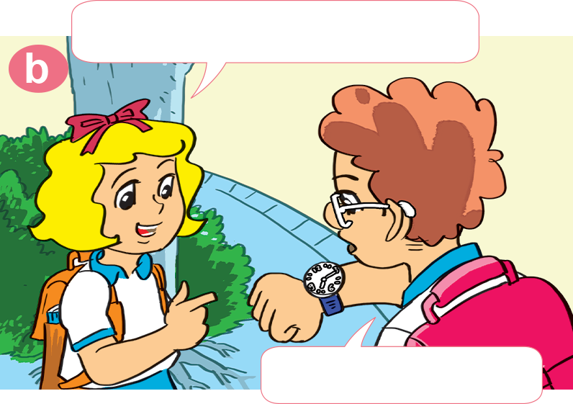
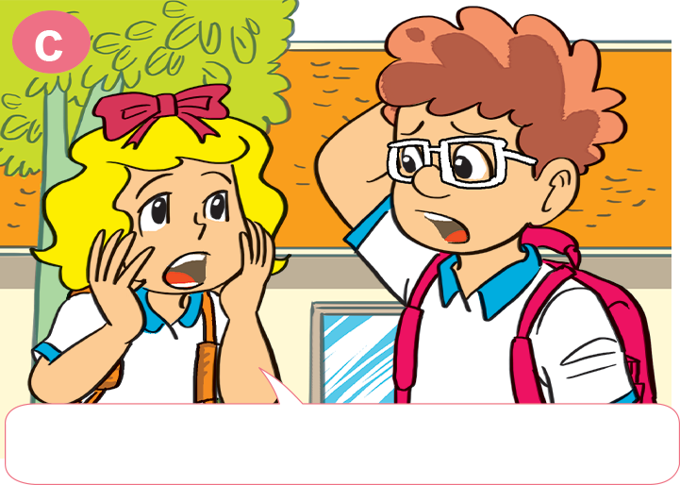
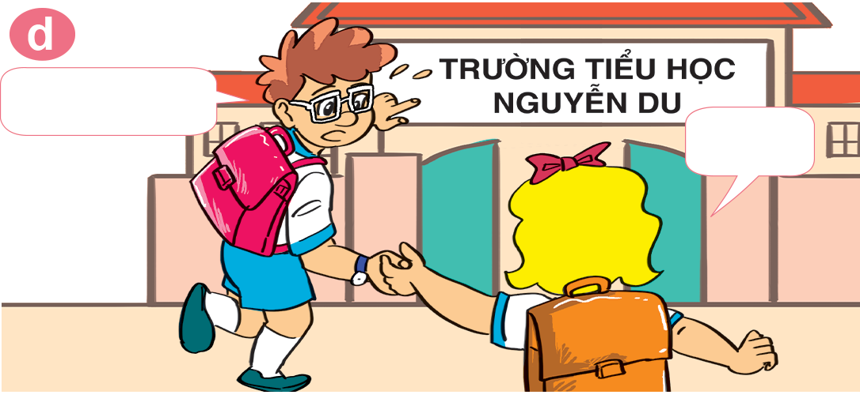
1. Look, listen and repeat.
What time do you get up?
What time is it now?
Six o'clock.
Seven fifteen.
Let's run.
Yes!
Oh no! We're late for school.

Slide 20
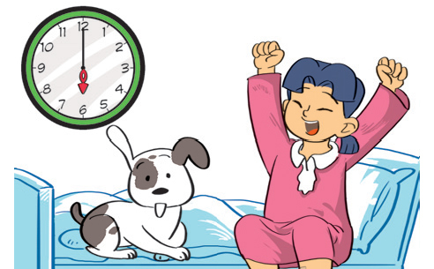
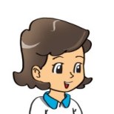

2. Point and say.
get up
What time do you _____________?
get up
six o’clock
I __________ at ____________.

Slide 21
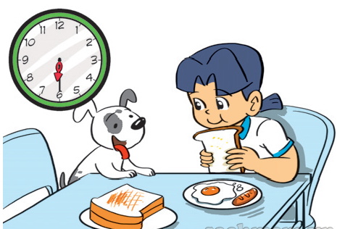
2. Point and say.
What time do you ________________?
have breakfast
I _______________ at ____________.
have breakfast
six thirty

Slide 22
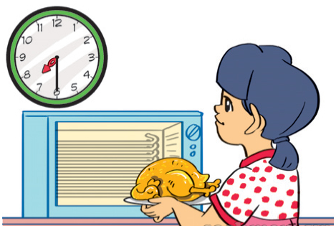
2. Point and say.
have dinner
What time do you _____________?
have dinner
I _____________ at ____________.
seven thirty

Slide 23
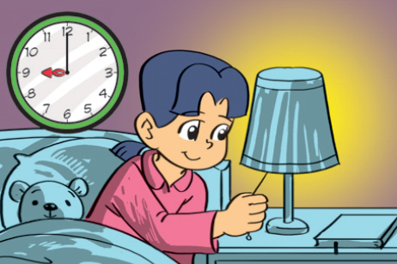
2. Point and say.
go to bed
What time do you _____________?
go to bed
I ____________ at ____________.
nine o’clock

Slide 24

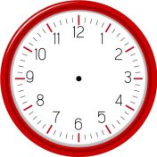





3. Let’s talk
What time do you _____?
I _______ at + (giờ).
Go to bed
Get up
Watch TV
Have breakfast
Have dinner
Go to school

Slide 25


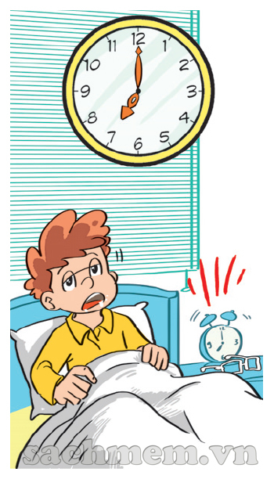
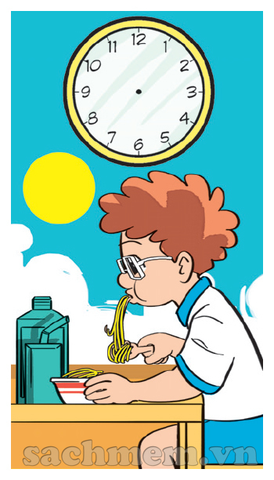

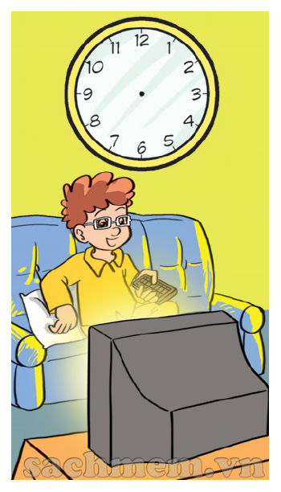
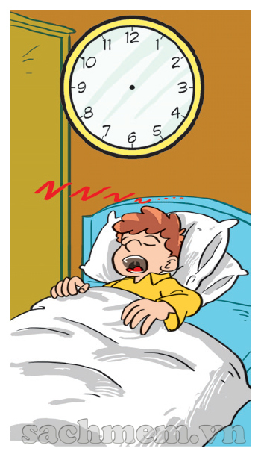
3. Listen draw the time.
1
2
3
4
5
7:00
7:30
8:15
8:00
9:00

Slide 26
Model sentence
What time do you _____?
I _______ at + (giờ).
Go to bed
Get up
Watch TV
Have breakfast
Have dinner
Go to school

Slide 27
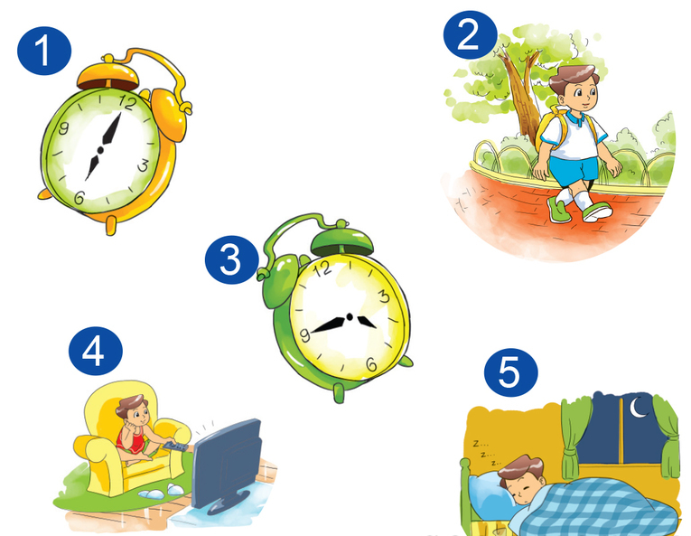
5. Read and write
Hello. My name is Nam. I study at Nguyen Du Primary School. Every day I get up at (1) __________. I (2) __________ at seven fifteen. School starts at
six o'clock
go to school
seven thirty in the morning and finishes at four thirty in the afternoon. I go home at (3) ____________. After dinner, I (4) ________ or listen to music. I (5) __________ at nine forty-five.
four forty-five
watch TV
go to bed

Slide 28
Extra sentence
What time does he/she _____?
He/she _______ at + (giờ).
Goes to bed
Gets up
Watches TV
Has breakfast
Has dinner
Goes to school

