Slide 1
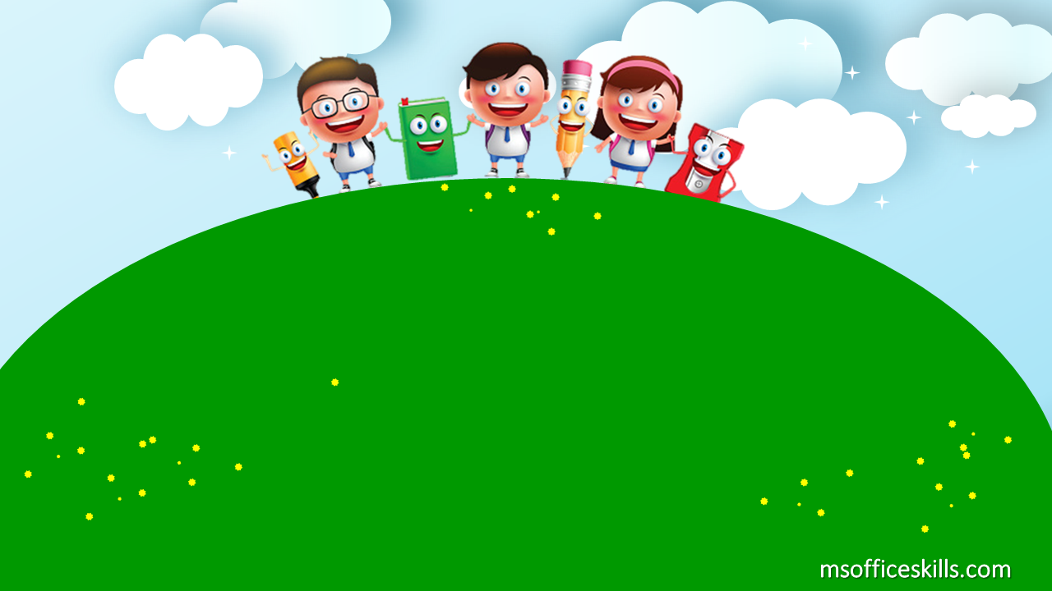
Welcome to our class
2A1

Slide 2
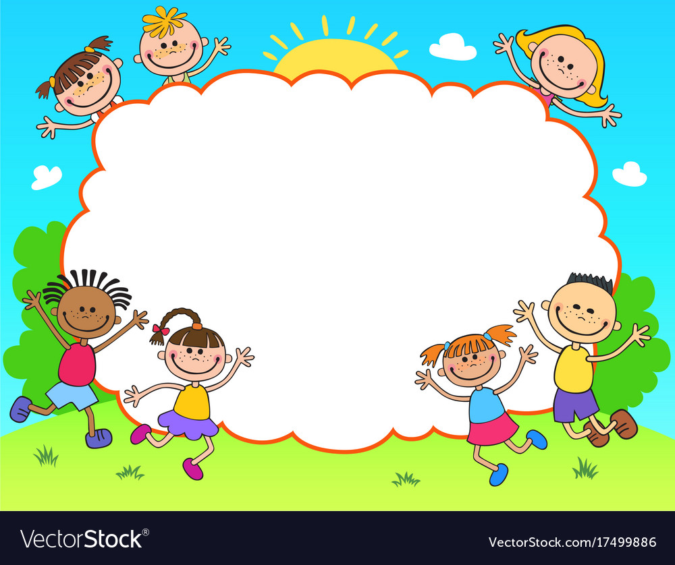
Warm up
Where’s the bee?

Slide 3
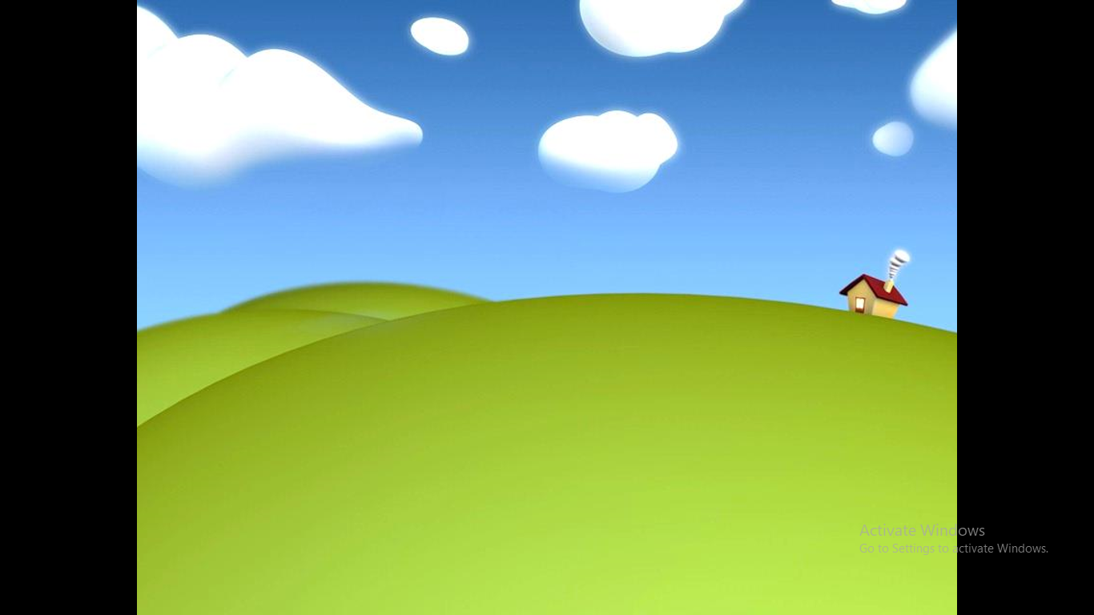


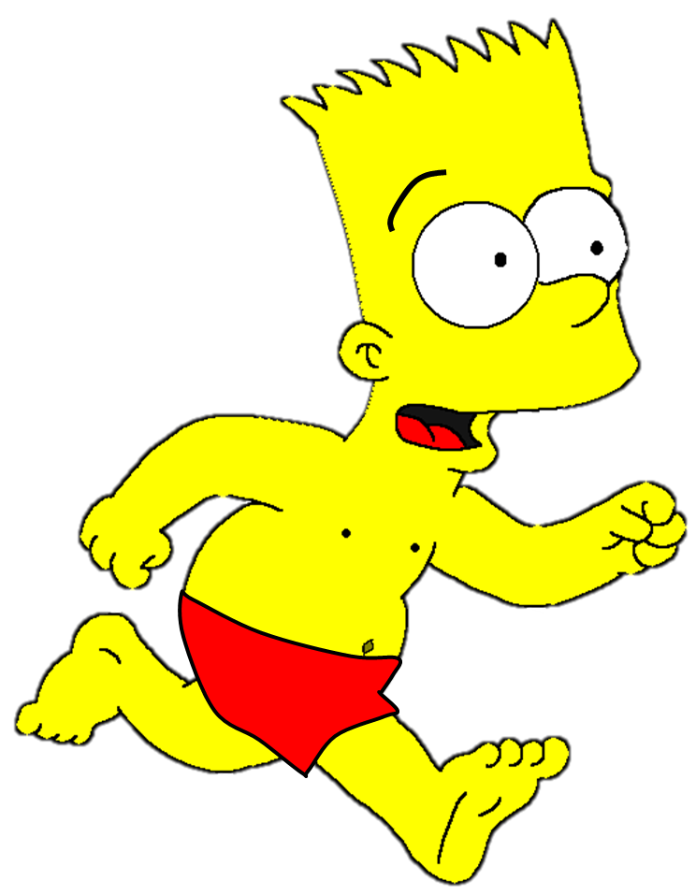
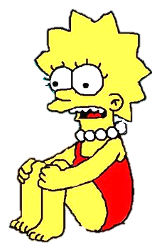




Slide 4
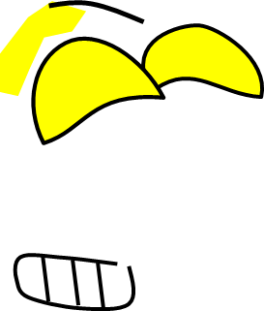


The bee stung Bart’s …
eye
mouth
nose
1/8

Slide 5
The bee stung Bart’s …
hand
head
arm
2/8

Slide 6
The bee stung Bart’s …
leg
foot
toe
3/8

Slide 7
The bee stung Bart’s …
arm
hand
ears
4/8

Slide 8
The bee stung Bart’s …
finger
hand
toe
5/8

Slide 9
The bee stung Bart’s …
arm
neck
face
6/8

Slide 10
The bee stung Bart’s …
mouth
eye
shoulder
7/8

Slide 11
The bee stung Bart’s …
ear
nose
mouth
8/8

Slide 12
Bài 6: Hoạt động gắn với
bộ phận cơ thể

Slide 13
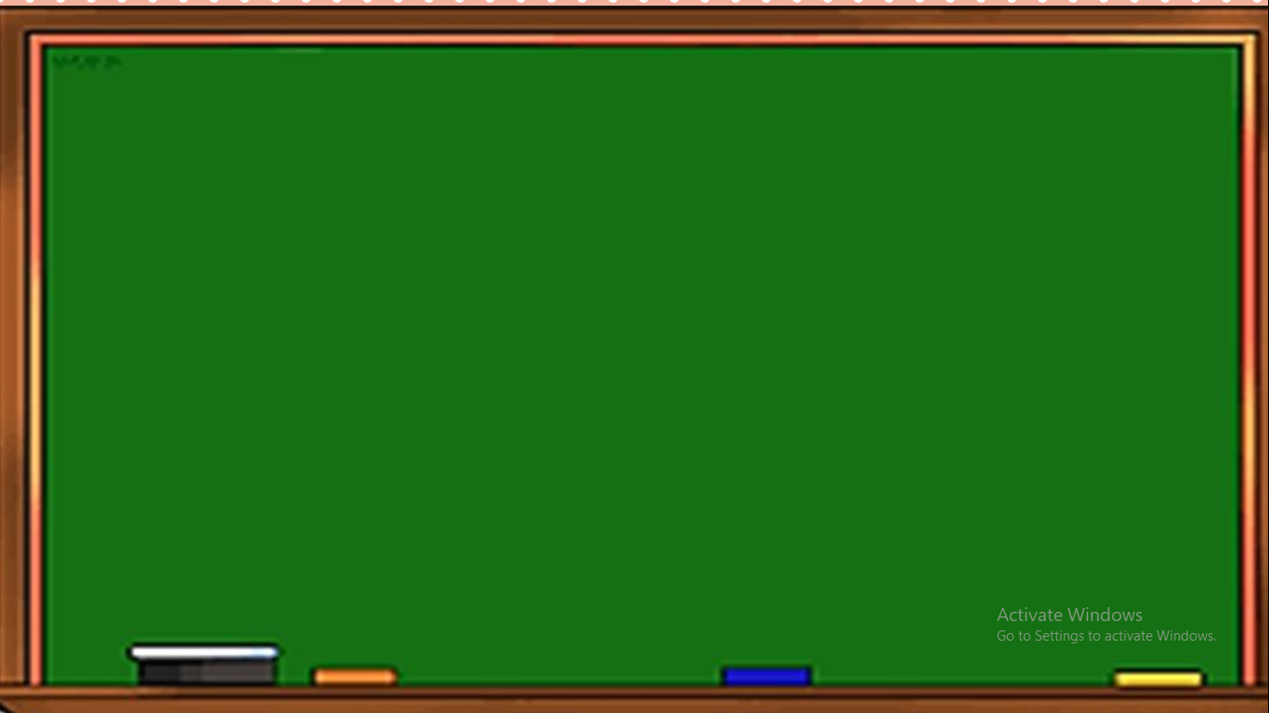
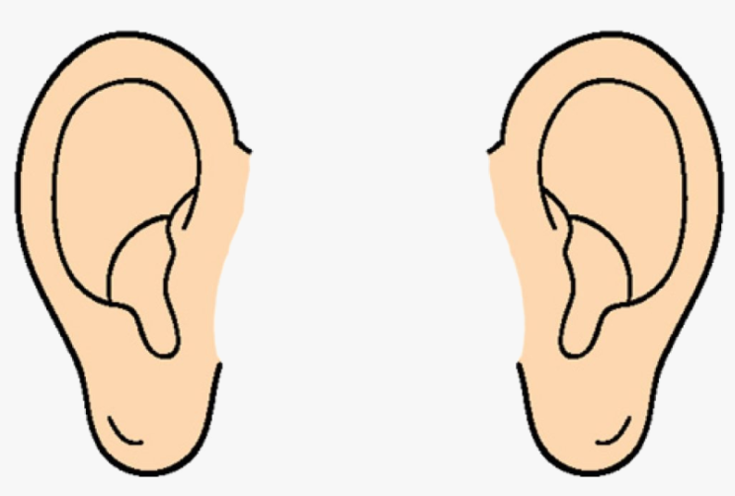

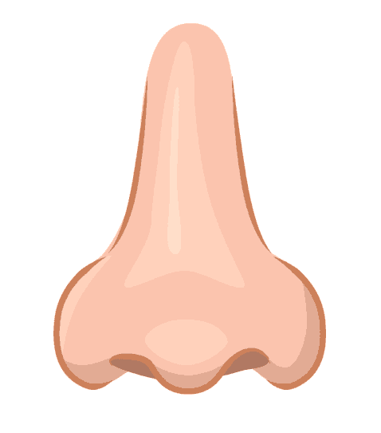
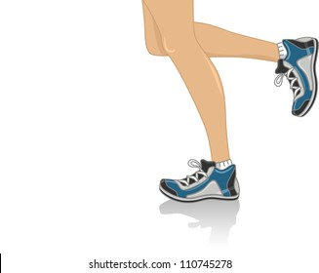
eyes
ears
nose
legs

Slide 14
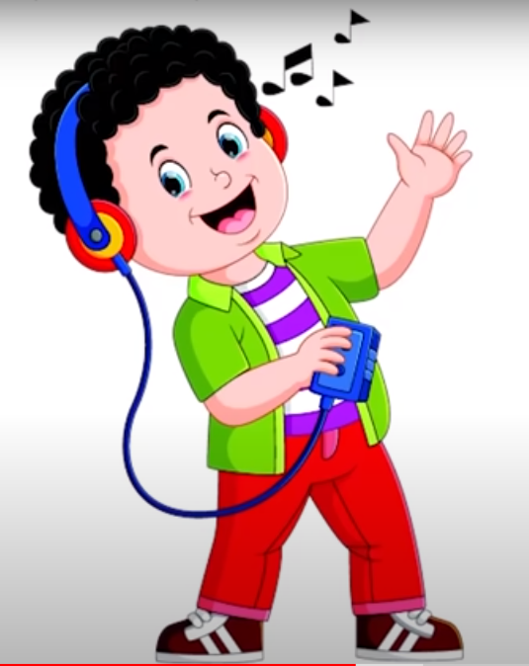
ears
I listen with my ears.

Slide 15
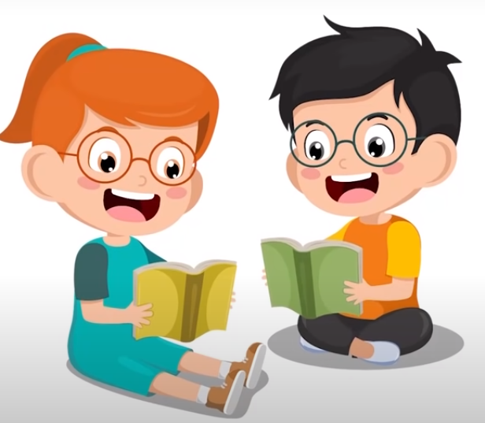
eyes
I see with my eyes.

Slide 16
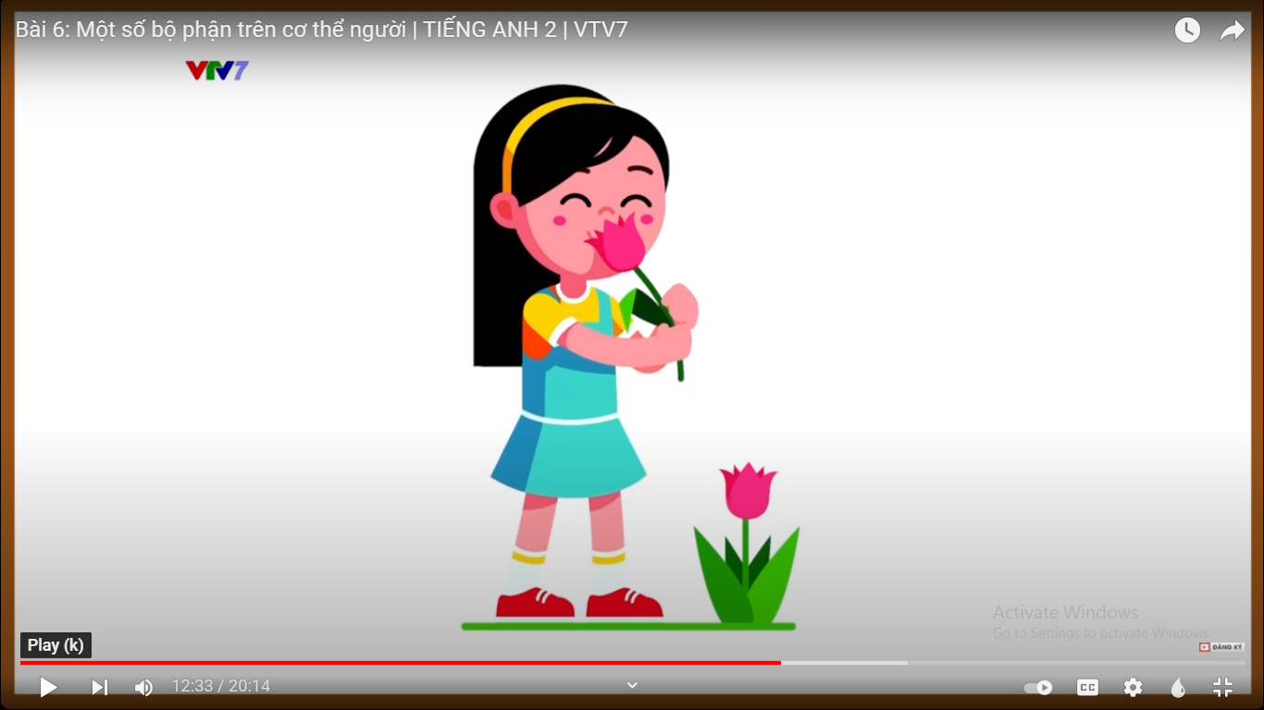
nose
I smell with my nose.

Slide 17
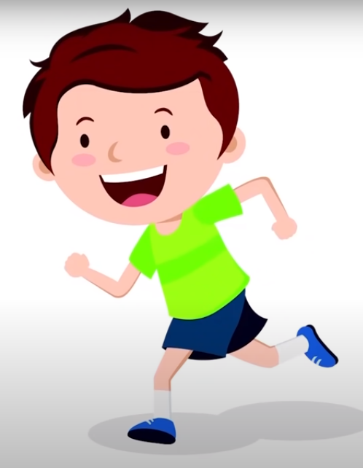
legs
I run with my legs.

Slide 18
I listen with my ears.
I see with my eyes.
I smell with my nose.
I run with my legs.

Slide 19
Who’s faster?

Slide 20





Who’s Faster?

Slide 21
I see with my eyes.

Slide 22
I smell with my nose.

Slide 23
I run with my legs.

Slide 24
I listen with my ears.

Slide 25
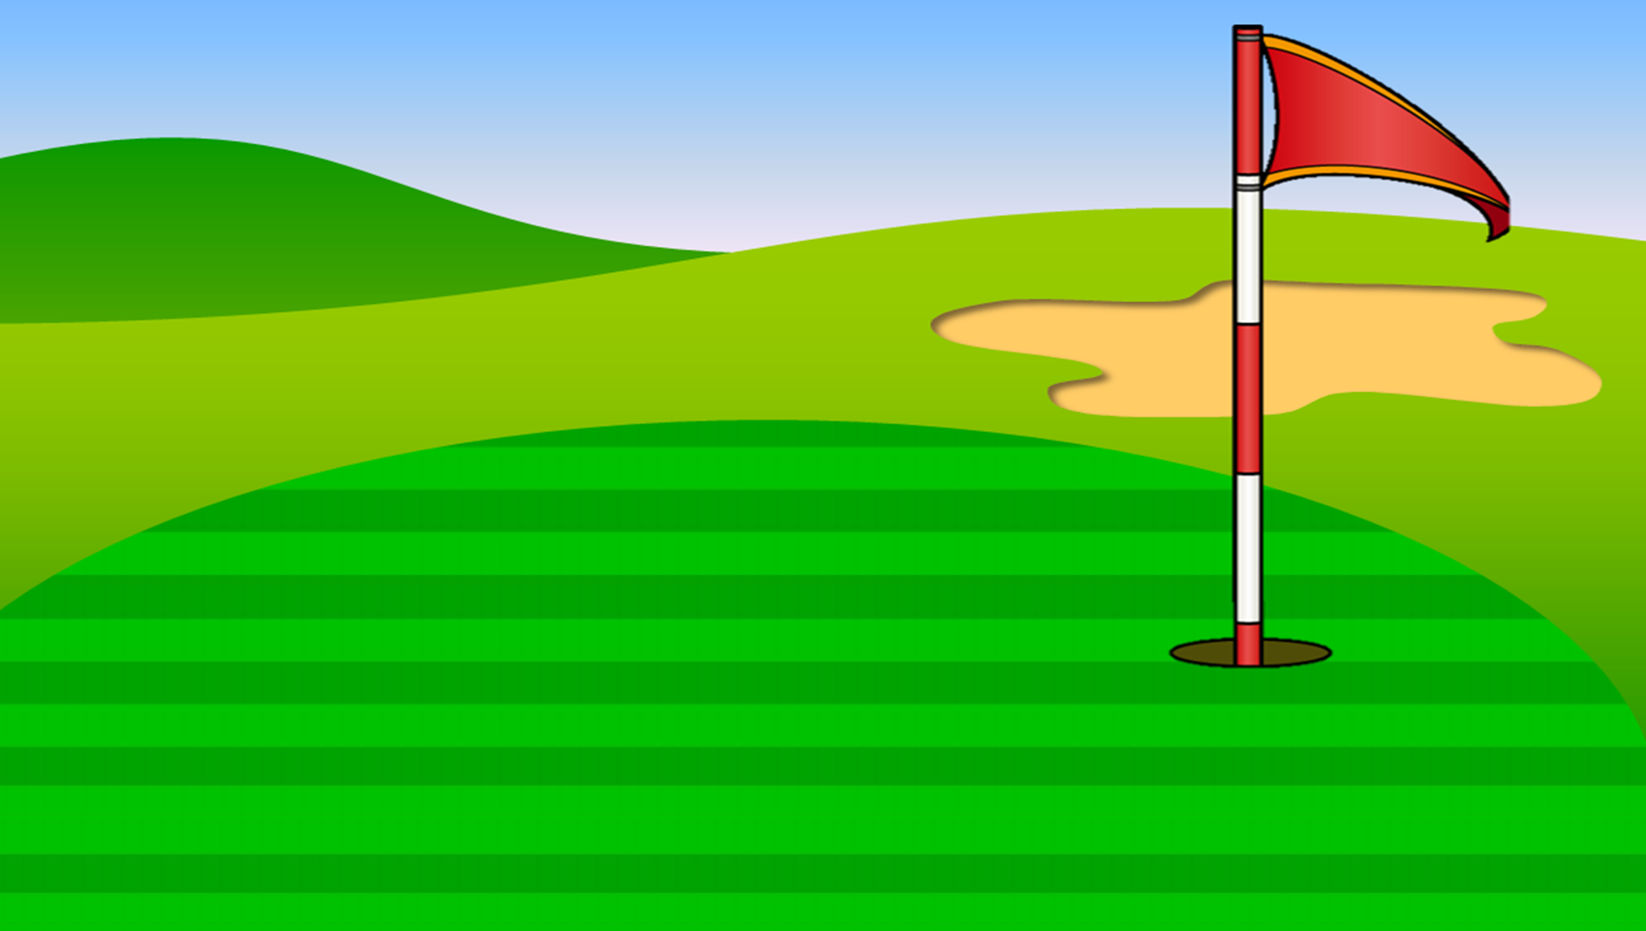
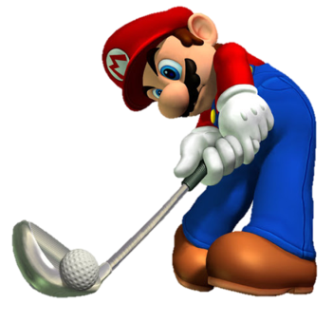
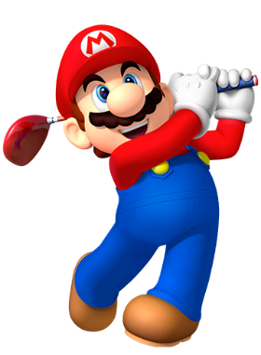

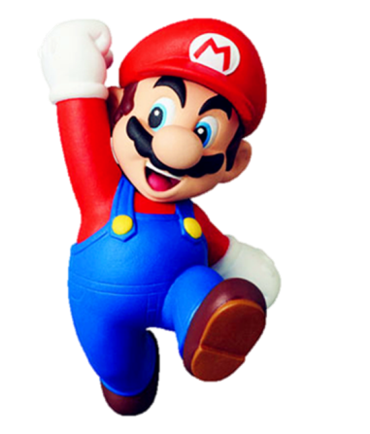


Slide 26





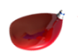



A. neck
B. nose
C. eyes

Slide 27
A. eyes
B. ears
C. legs

Slide 28
I _____ with my ears.
A. listen
B. smell
C. see

Slide 29
I ____ with my nose.
A. see
B. smell
C. run

Slide 30
I ____ with my legs.
A. see
B. listen
C. run

Slide 31
I see with my _____.
A. eyes
B. ears
nose

Slide 32
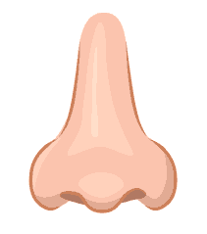
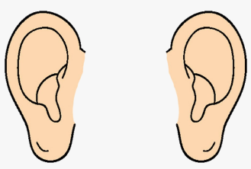
I listen with my _____.
A.
B.
C.

Slide 33
I ___ with my _____.
A. listen/nose
B. smell/ legs
C. see/ eyes

Slide 34
I ___ with my _____.
A. touch/ fingers
B. run/ eyes
C. smell/ legs

Slide 35



Slide 36
GOODBYE!

