Slide 1
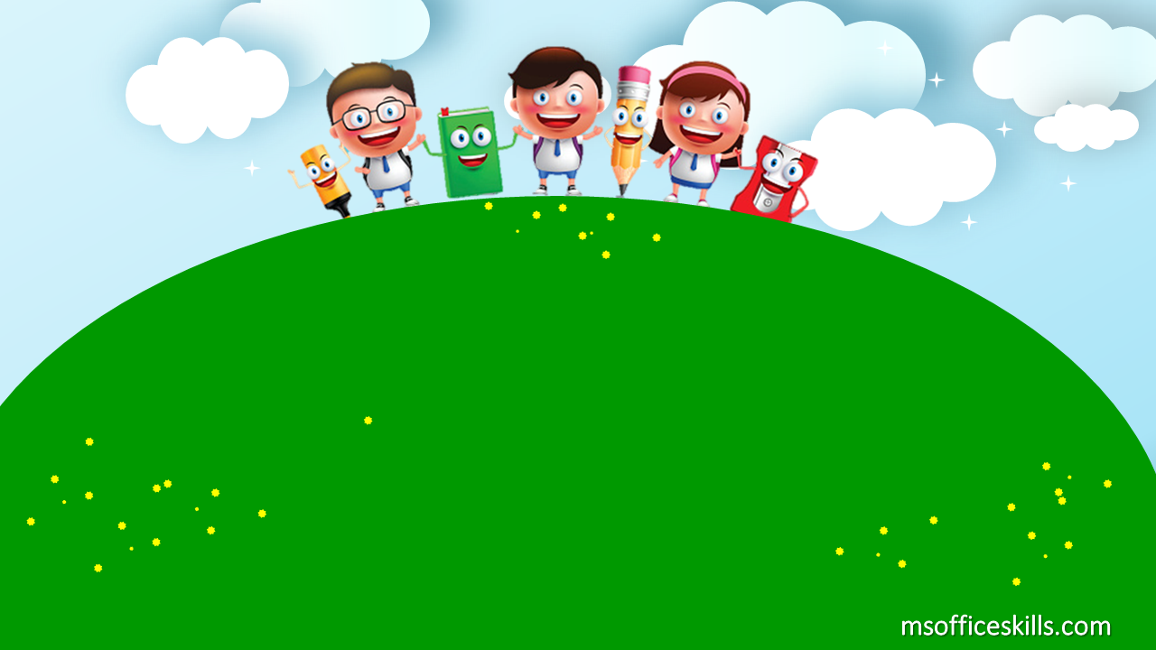
Welcome to our class
2A1

Slide 2
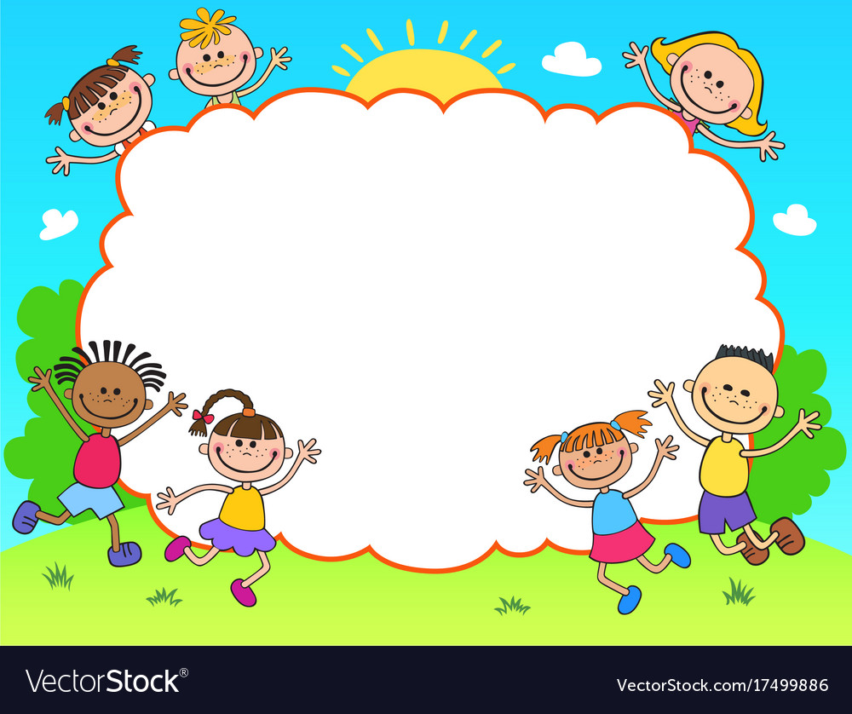
Let’s sing!

Slide 3
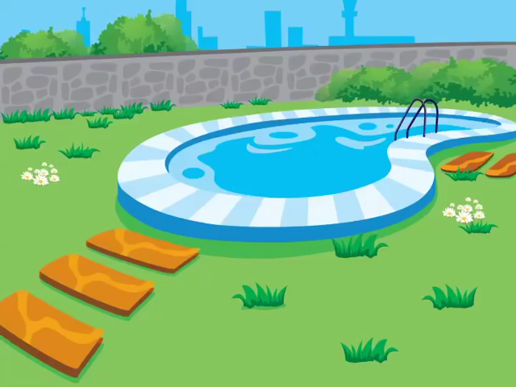

Slide 4

Bài 9: Diễn Đạt Hoạt Động trong
Thời Gian Rảnh

Slide 5
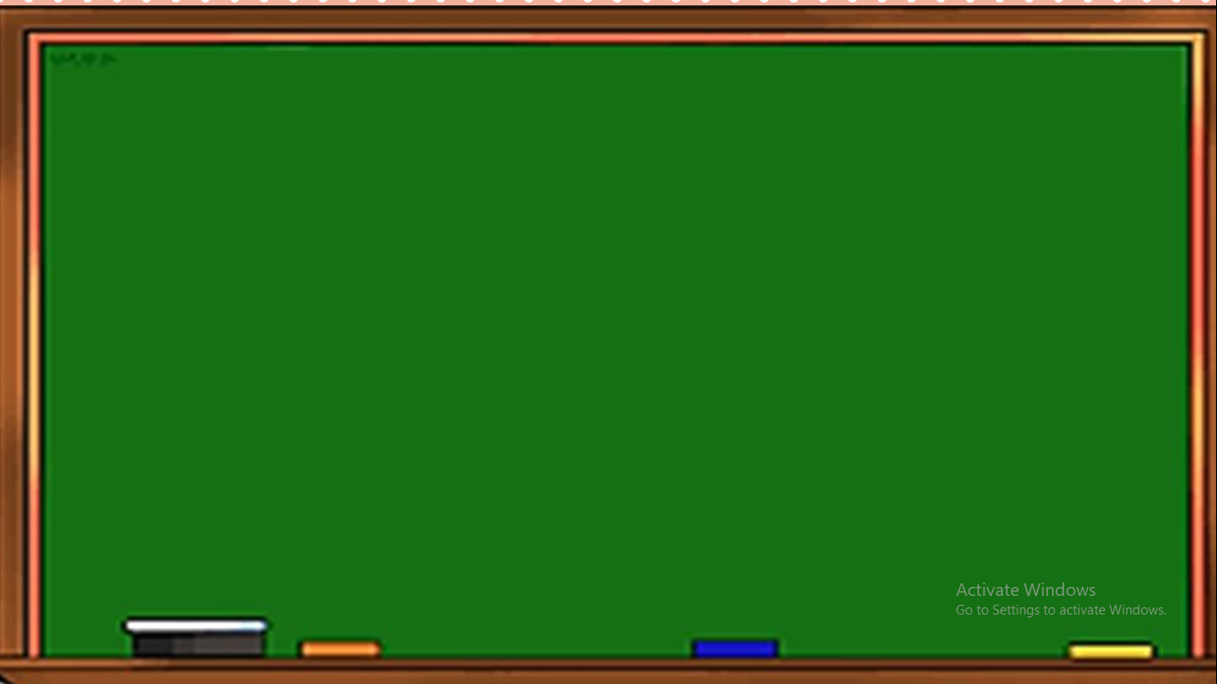

sing a song

Slide 6
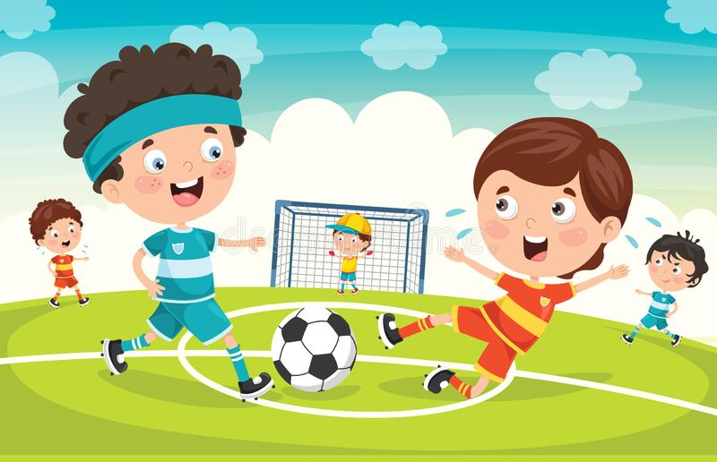
play football

Slide 7
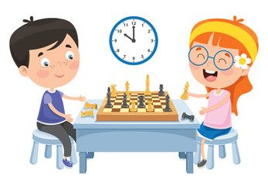
play chess

Slide 8
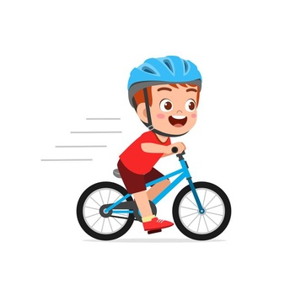
ride a bike

Slide 9
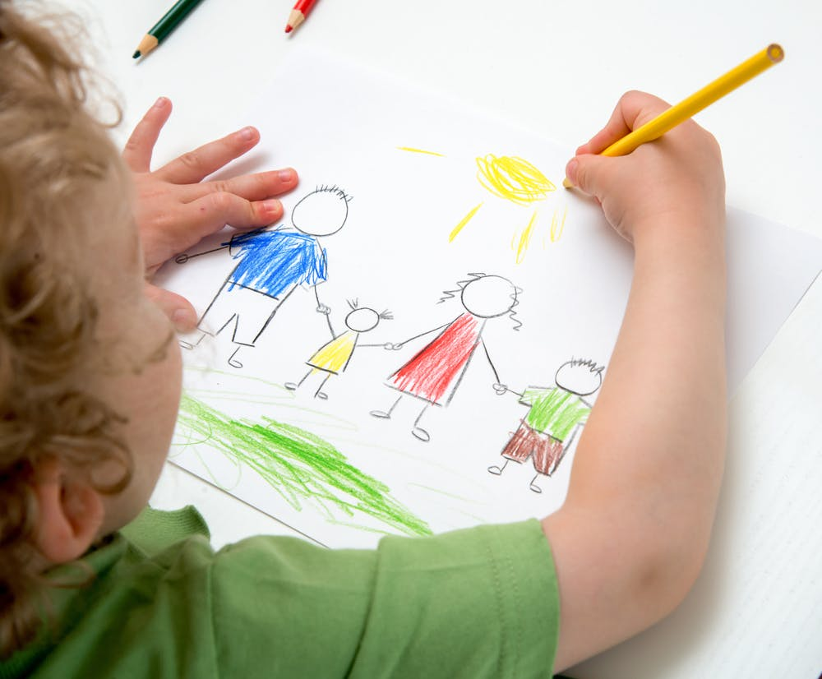
draw a picture

Slide 10
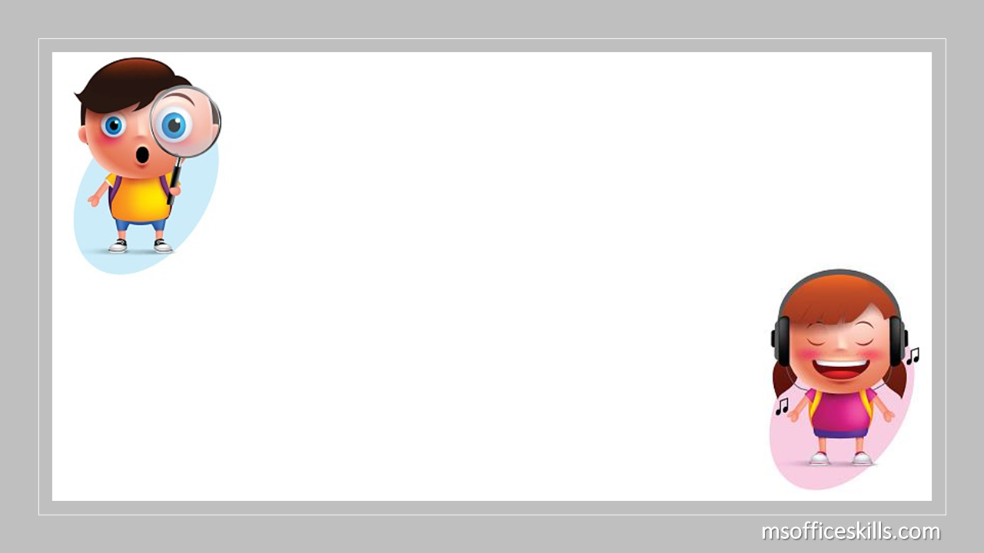

sing a song
play football
play chess
ride a bike
draw a picture

Slide 11
Fishing Game

Slide 12











FISHING GAME
GO

Slide 13




C. play
NEXT
_____ football
A. sing
D. ride
B. draw
C. play

Slide 14
A. ride
NEXT
_____ a bike
A. ride
D. draw
C. sing
B. play

Slide 15
B. sing
NEXT
A. play
_____ a song
C. ride
B. sing
D. draw

Slide 16
NEXT
D. play
A. draw
____ chess
C. ride
D. play
B. sing

Slide 17
C. draw
NEXT
____ a picture
A. sing
D. ride
B. play
C. draw

Slide 18
Cách diễn đạt về hoạt động trong thời gian rảnh

Slide 19
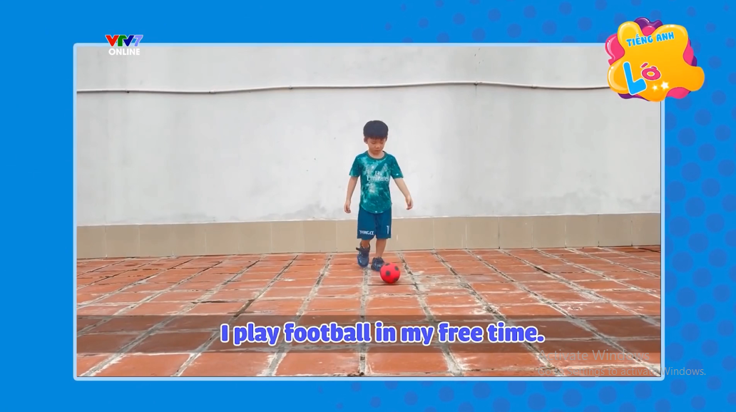
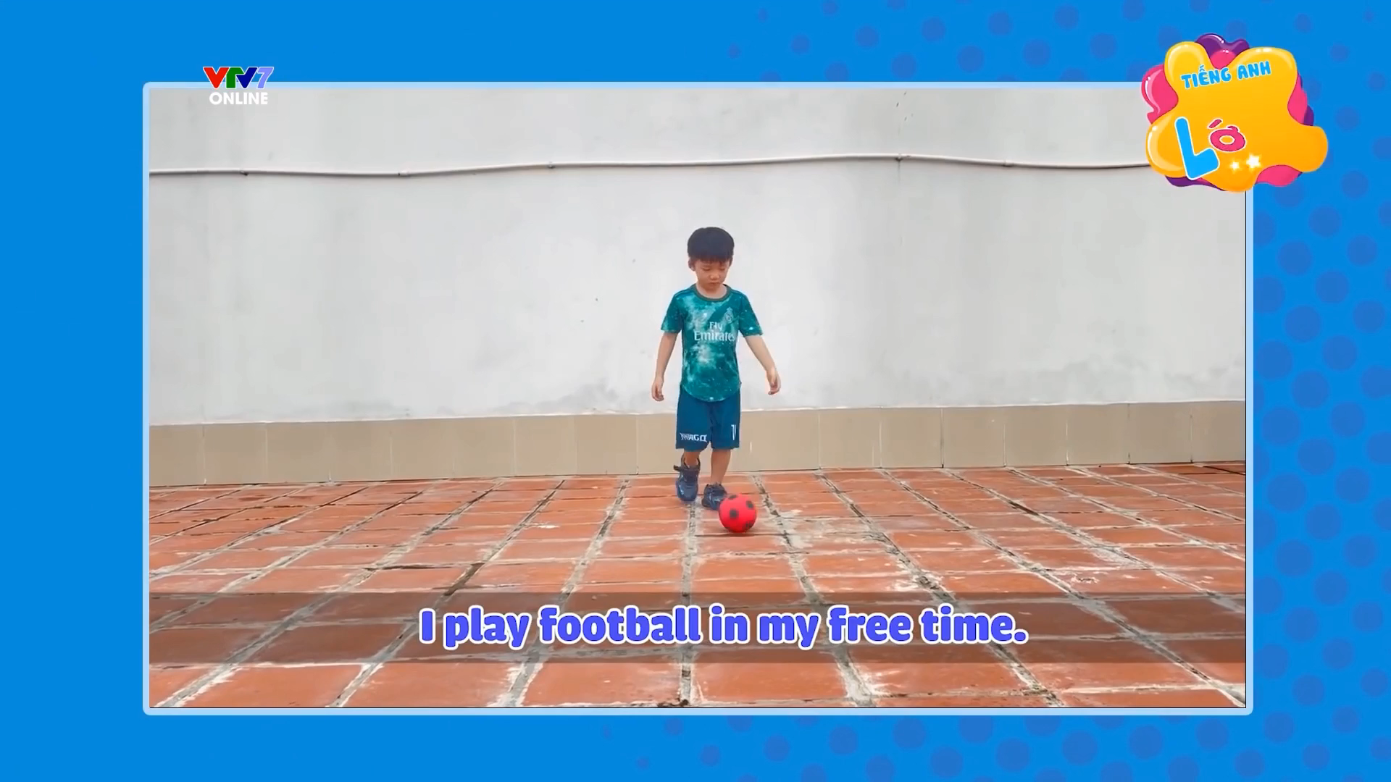

I play football in my free time.

Slide 20
I sing a song in my free time.

Slide 21
I play football in my free time.

Slide 22
I play chess in my free time.

Slide 23
I ride a bike in my free time.

Slide 24
I draw a picture in my free time.

Slide 25
UNSCRAMBLE
THE
wordS

Slide 26
unscramble
play chess
I
in my free time
I
play chess
in my free time

Slide 27
unscramble
play
in my free time
I
football
I
play
football
in my free time

Slide 28
unscramble
sing
I
in my free time
a song
I
sing
a song
in my free time

Slide 29
unscramble
a bike
I
in my free time
ride
I
ride
a bike
in my free time

Slide 30
unscramble
my
I
free time
draw
in
a picture
I
draw
a picture
in
my
free time

Slide 31


