Slide 1
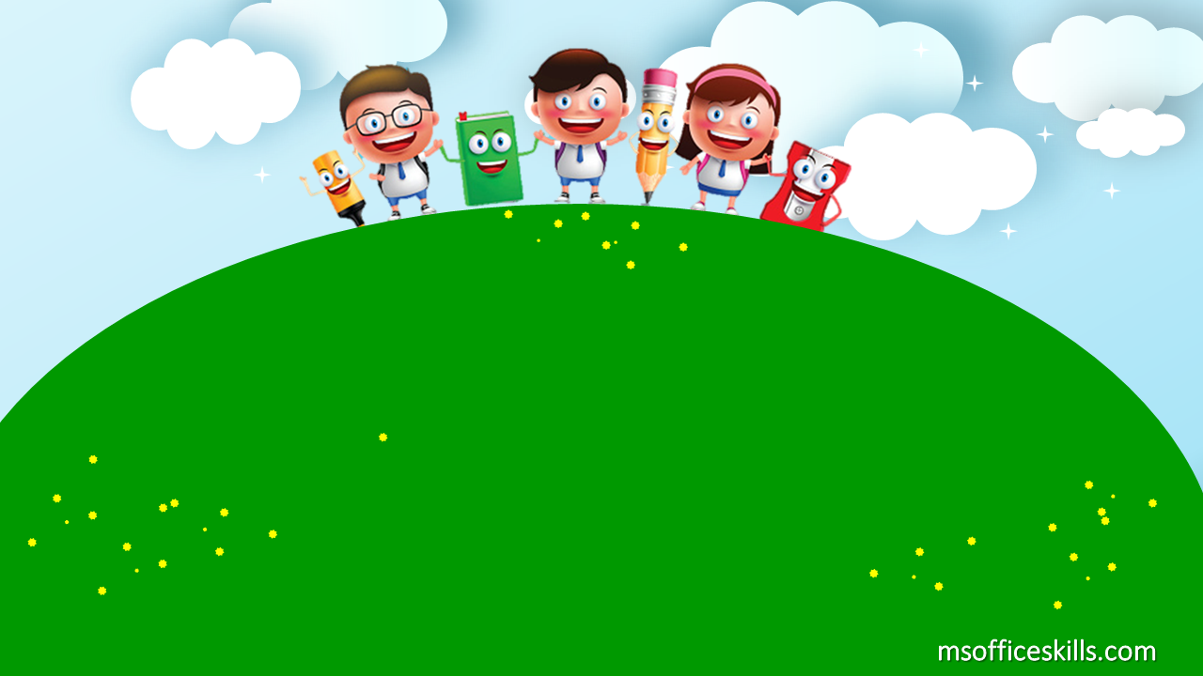
Welcome to our class
1A3

Slide 2



Slide 3


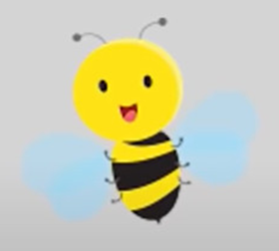

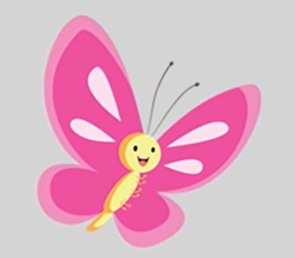
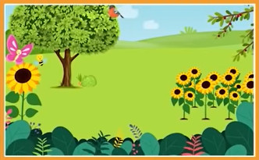
my garden

Slide 4

Bài 6: Học cách hỏi đáp mẫu câu:
What’s this?

Slide 5
What’s this?
It’s a bee.

Slide 6
What’s this?
It’s a butterfly.

Slide 7
What’s this?
It’s a bird.

Slide 8
What’s this?
It’s a tree.

Slide 9
What’s this?
It’s a flower.

Slide 10
What’s this?
It’s a garden.

Slide 11
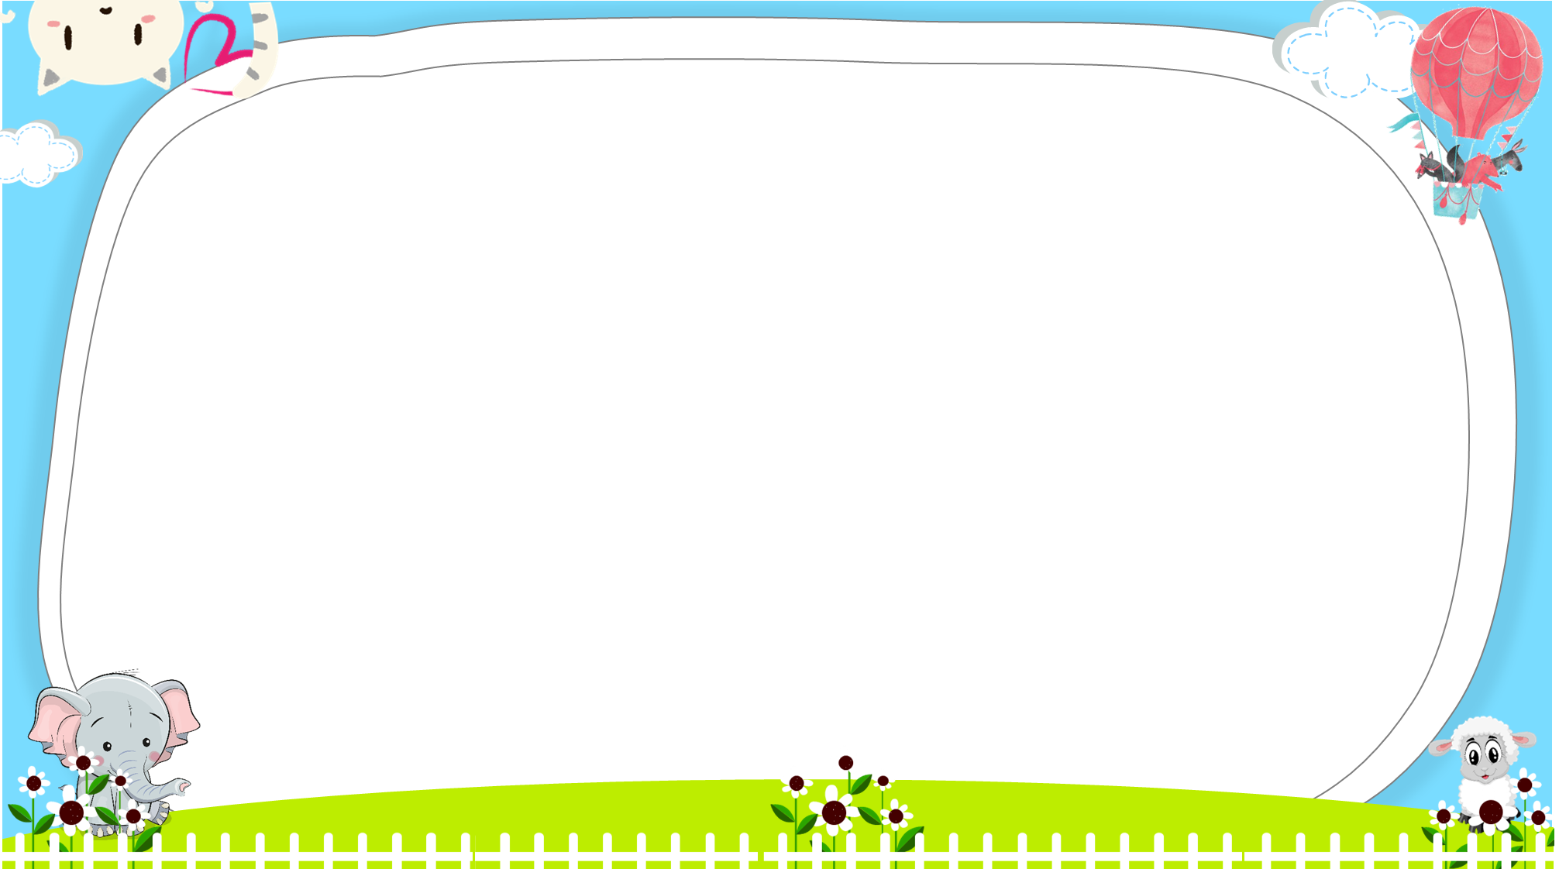
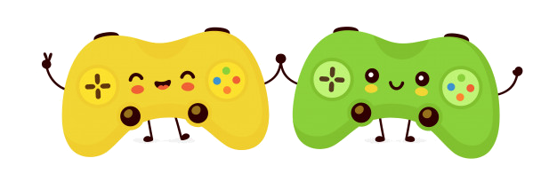




AND
GAME
PLAY
Notes:
Ms Huyền Phạm - 0936.082.789 – YOUTUBE: MsPham. Facebook: Dạy và học cùng công nghệ.

Slide 12
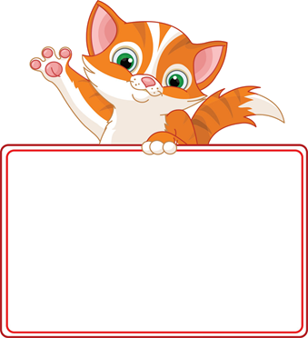


What’s this?
It’s a flower.
It’s a tree.
Next
Notes:
Ms Huyền Phạm - 0936.082.789 – YOUTUBE: MsPham. Facebook: Dạy và học cùng công nghệ.

Slide 13
What’s this?
It’s a bee.
It’s a tree.
Next
Notes:
Ms Huyền Phạm - 0936.082.789 – YOUTUBE: MsPham. Facebook: Dạy và học cùng công nghệ.

Slide 14
What’s this?
It’s a garden.
It’s a flower
Next
Notes:
Ms Huyền Phạm - 0936.082.789 – YOUTUBE: MsPham. Facebook: Dạy và học cùng công nghệ.

Slide 15

Look and tick
It’s a bird.
It’s a butterfly.
Next
Notes:
Ms Huyền Phạm - 0936.082.789 – YOUTUBE: MsPham. Facebook: Dạy và học cùng công nghệ.

Slide 16
Look and tick
It’s a bee.
It’s a bird.
Next
Notes:
Ms Huyền Phạm - 0936.082.789 – YOUTUBE: MsPham. Facebook: Dạy và học cùng công nghệ.

Slide 17
What’s this?
It’s a bee.
It’s a bird.
Next
Notes:
Ms Huyền Phạm - 0936.082.789 – YOUTUBE: MsPham. Facebook: Dạy và học cùng công nghệ.

Slide 18
Look and tick
It’s a garden.
It’s a bird.
Next
Notes:
Ms Huyền Phạm - 0936.082.789 – YOUTUBE: MsPham. Facebook: Dạy và học cùng công nghệ.

Slide 19

Look and tick
It’s a butterfly.
It’s a flower.
Next
Notes:
Ms Huyền Phạm - 0936.082.789 – YOUTUBE: MsPham. Facebook: Dạy và học cùng công nghệ.

Slide 20


Notes:
Ms Huyền Phạm - 0936.082.789 – YOUTUBE: MsPham. Facebook: Dạy và học cùng công nghệ.

