Slide 1
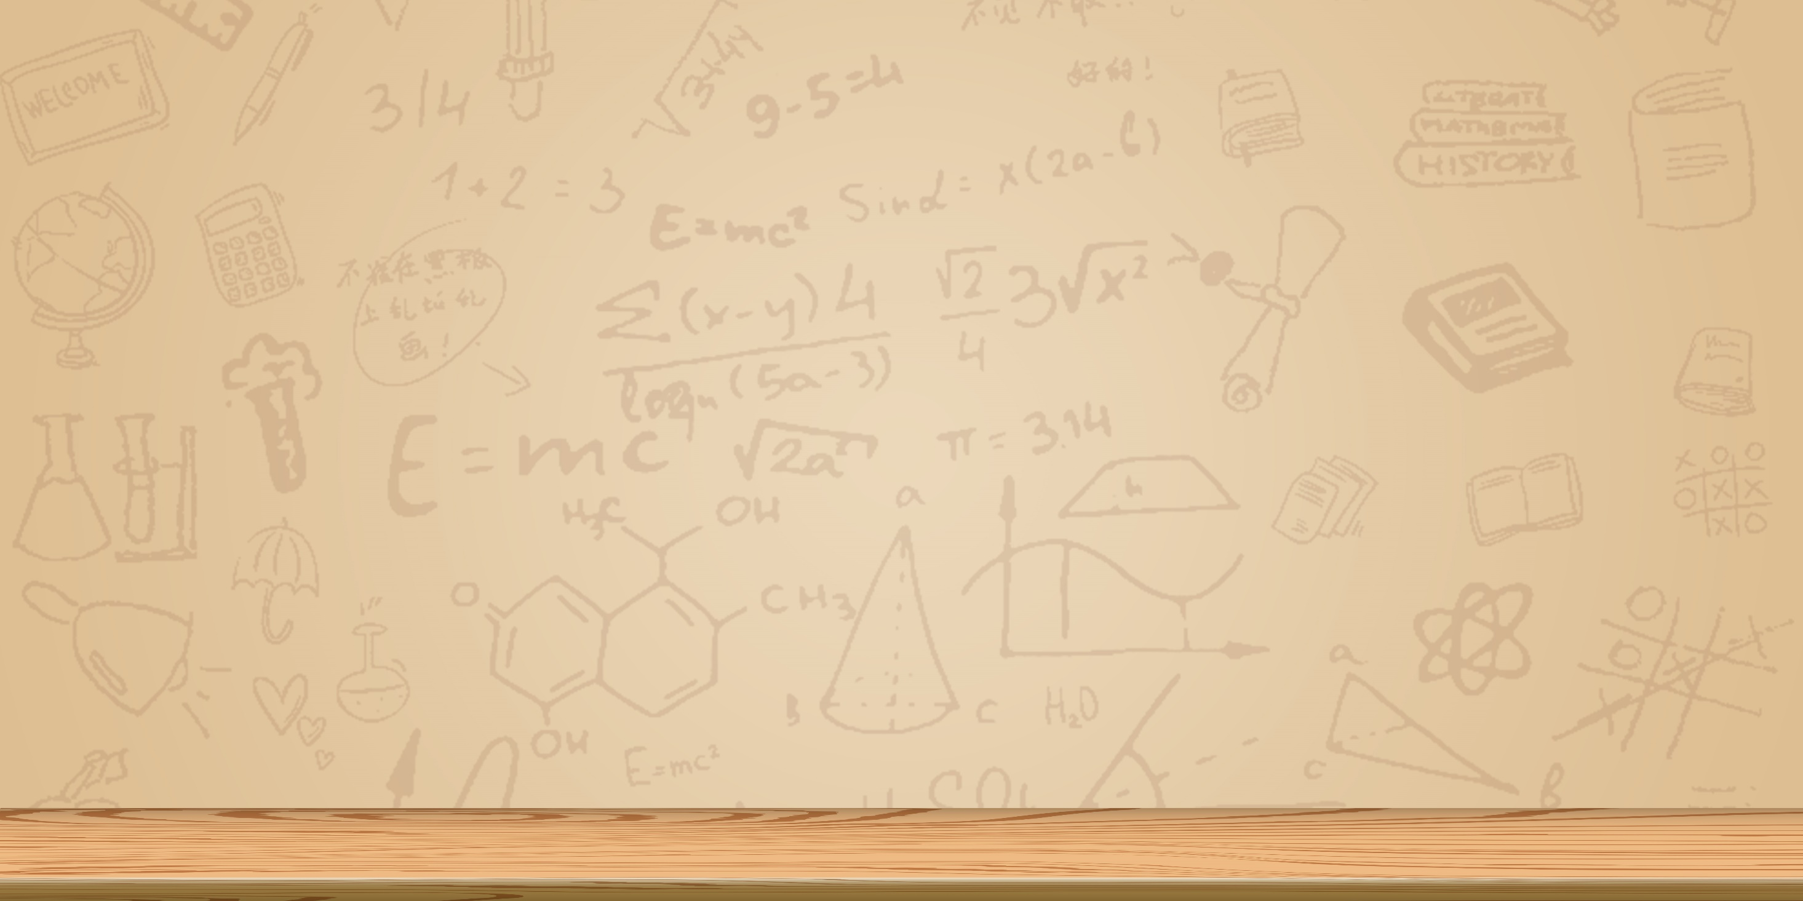
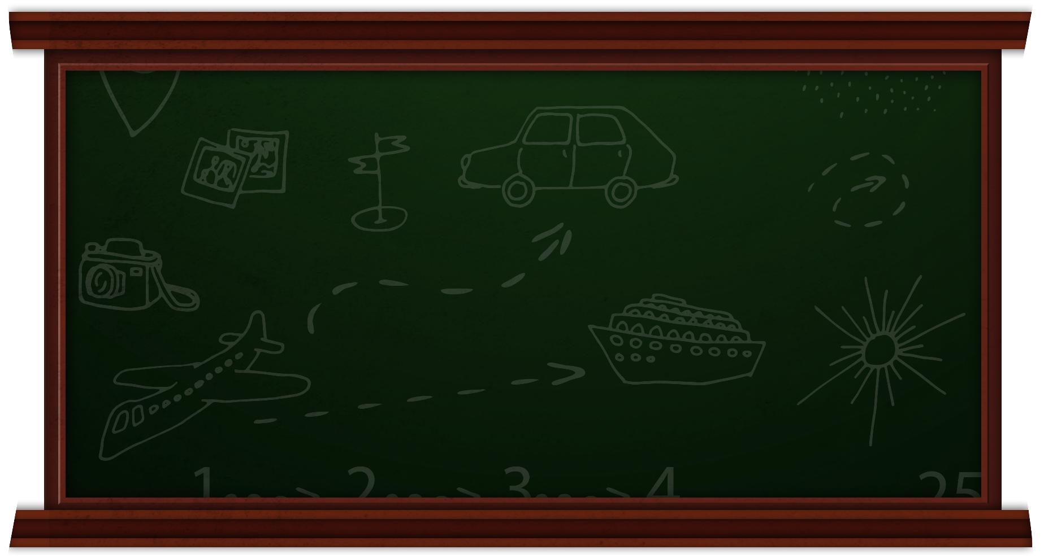


English 4
Unit 3_ Teacher : Linh

Slide 2
Welcome my class !

Slide 3
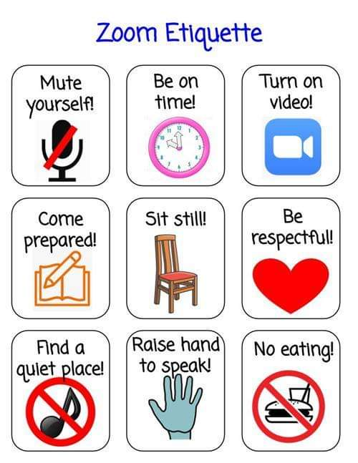
Nội quy lớp học:

Slide 4
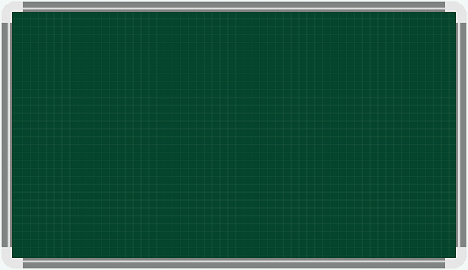
Tuesday, September 21st 2021 Unit 3: What day is it today? Lesson 1
I.New words:
Monday: Thứ 2
Tuesday : Thứ 3
Wednesday Thứ 4
Thursday : Thứ 5
Friday : Thứ 6
Saturday : Thứ 7
Sunday : Chủ nhật
II. Structures:
What day is it today ?
It’s = It is….+ (Danh từ ngày)

Slide 5
Warm up:
Tuesday, September 7th 2021
Tuesday, September 7th 2021

Slide 6
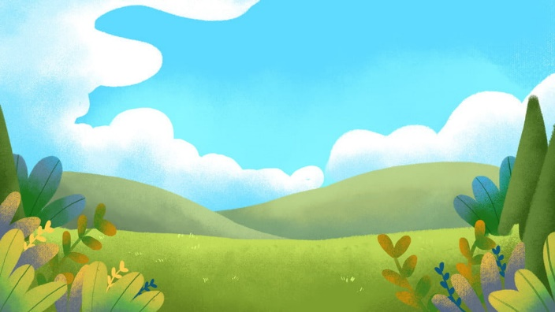

Can you guess?
Ms Huyền Phạm
0936.082.789
START

Slide 7
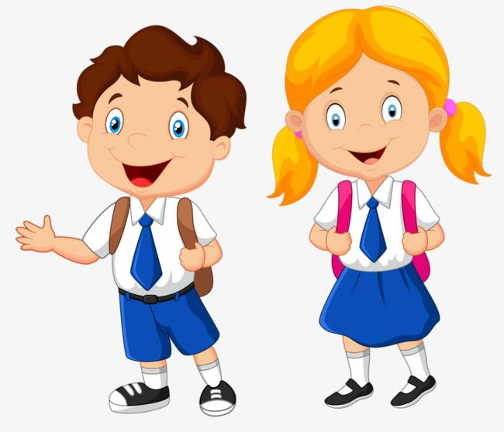



Ms Huyền Phạm
0936.082.789
Doctors
Teachers
Pupils

Slide 8
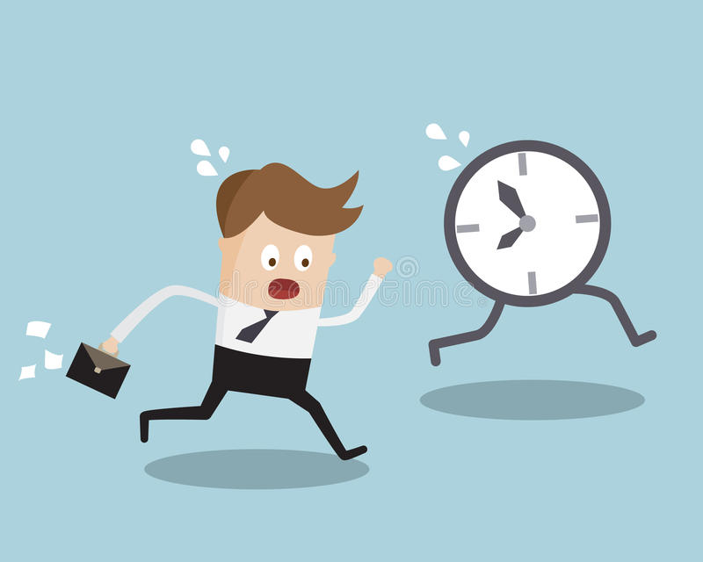
Ms Huyền Phạm
0936.082.789
Early
Late
Go

Slide 9
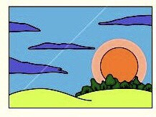
Ms Huyền Phạm
0936.082.789
Morning
Afternoon
Evening

Slide 10
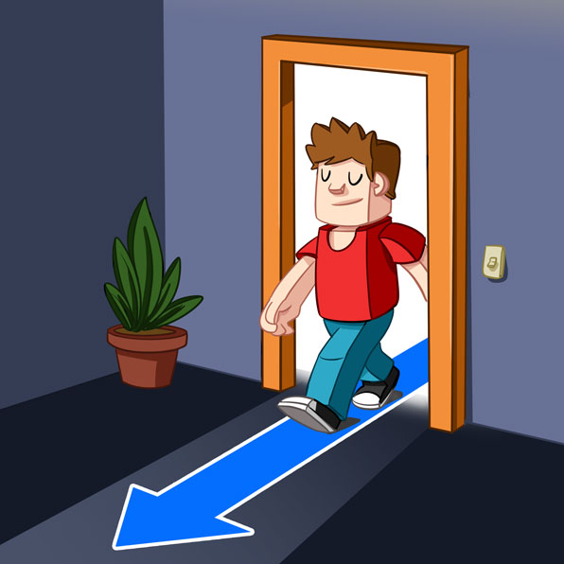
Ms Huyền Phạm
0936.082.789
Come out
Come in
Go down

Slide 11

Ms Huyền Phạm
0936.082.789
Morning
Evening
At night

Slide 12
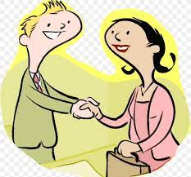
Ms Huyền Phạm
0936.082.789
Goodbye
See you later
Nice to meet you

Slide 13

Ms Huyền Phạm
0936.082.789
Afternoon
Morning
At night

Slide 14

Ms Huyền Phạm
0936.082.789
Evening
Afternoon
Morning

Slide 15
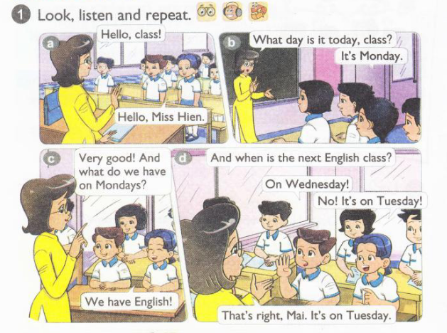


Slide 16
Vocabulary :

Slide 17
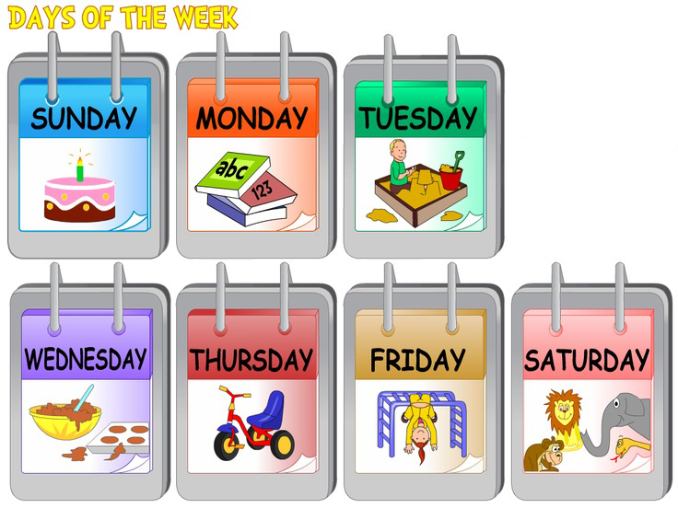
Thứ hai

Slide 18
Thứ ba

Slide 19
Thứ tư

Slide 20
Thứ năm

Slide 21
Thứ sáu

Slide 22
Thứ bảy

Slide 23
CHỦ NHẬT

Slide 24
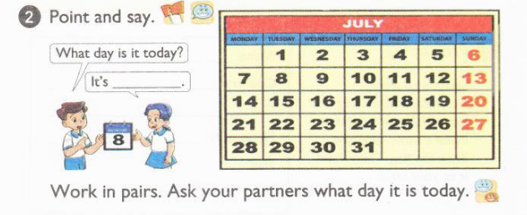
2.Point and say
What day is it today?
Monday, Tuesday…..
It’s= It is _________________.
Monday

Slide 25
II. Structures: Question : What day is it today? Hôm nay là ngày gì …? Answer : It’s= It is + Danh từ ngày ( Monday. Tuesday…) Nó là ngày….

Slide 26
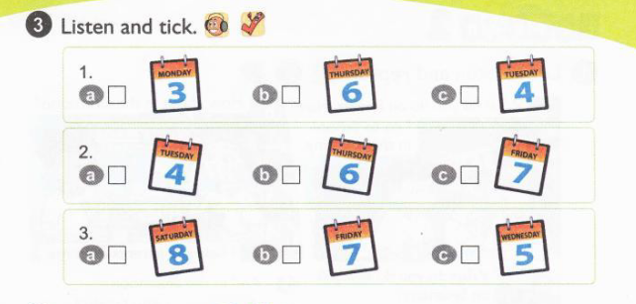

Key : 1. b 2. a 3. c

Slide 27
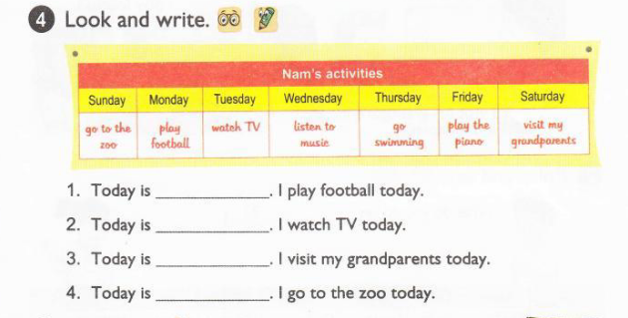
Answer : 1. Today is Monday. I play football today. 2. Today is Tuesday. I watch TV today. 3. Today is Saturday. I visit my grandparents today. 4. Today is Sunday. I go to the zoo today.

Slide 28
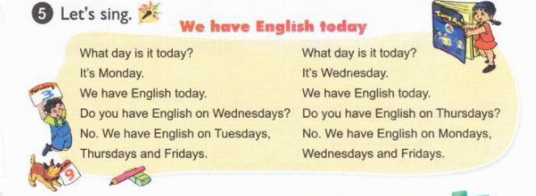

Slide 29
Unit 3: What day is it today? Lesson 2: I. New words: Go swimming Play football Listen to music Watch TV Visit my grandparents Help my parents Visit my grandparents Play the guitar II.Structures: Qs : What do you do on/in….? Ans: I + động từ ….

Slide 30
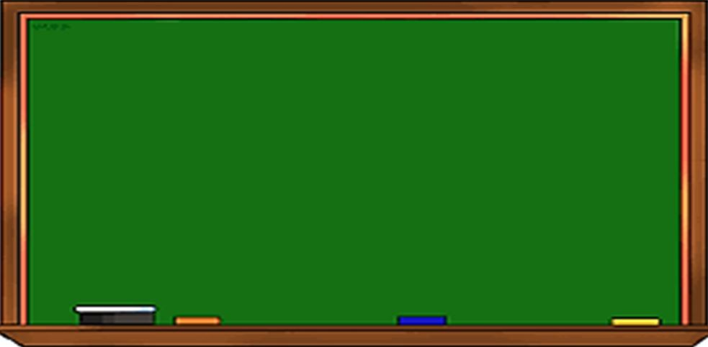
Tuesday, October 5th 2021
Unit 3: Lesson 2,3(P.20,22)
I. New words: từ mới
II. Model sentences: mẫu câu
go swimming: đi bơi play football: chơi đá bóng listen to music: nghe nhạc watch TV: xem TV visit my grandparents: thăm ông bà help my parents: giúp đỡ bố mẹ play the guitar: chơi đàn ghi-ta
1- What do you do on Saturdays?
- I visit my grandparents.
2- What do you do in the afternoon?
- I play football.
IV. Homelink: BTVN
I. Phonics: ngữ âm
1-Luyện đọc hội thoại P20, viết từ mới 2 dòng+
Mẫu câu(2d), chụp vở +SBT gửi vào nhóm, lưu ý chính tả, chữ viết sạch đẹp +PH kí
2- Làm SBT P14,15, làm link bài Test + Luyện tập trên OLM.VN
ir - first, bird, shirt,… ur – Thursday, curly,… er - her, teacher, …

Slide 31
Vocabulary:

Slide 32
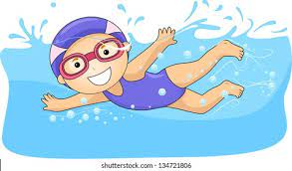
Go swimming : Đi bơi

Slide 33
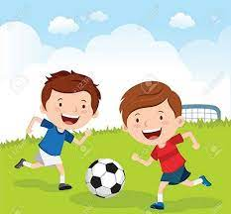
Play football : Chơi đá bóng

Slide 34
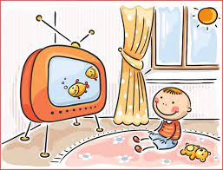
Watch Tv : Xem TV

Slide 35
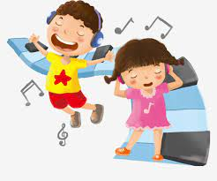
Listen to music : Nghe nhạc

Slide 36
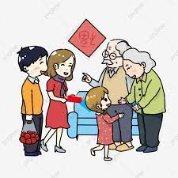
Visit my grandparents: Thăm ông bà của tôi

Slide 37
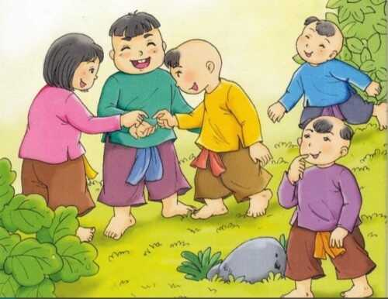
Visit my friends : Thăm bạn bè của tôi

Slide 38
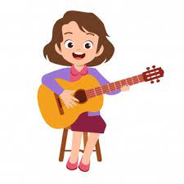
Play the guitar :Chơi đàn ghi ta

Slide 39
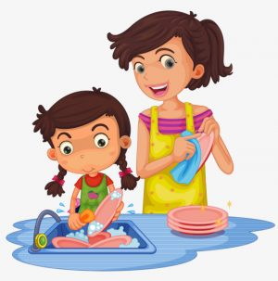
Help my parents : Giúp đỡ bố mẹ của tôi

Slide 40
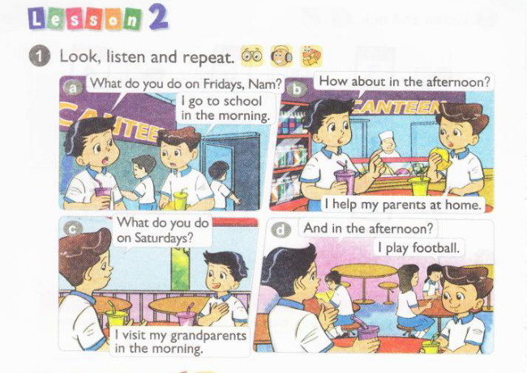

Slide 41
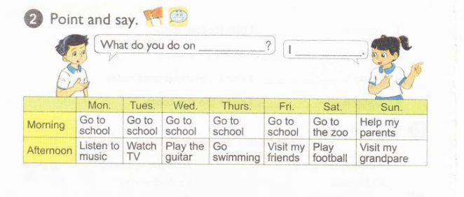
2. Point and say
What do you do on_________ ?
Monday
Go to school
in the morning
I__________.
____

Slide 42
II. Structures: Question : What do you do +on …( Day) ? + In …( Month ,Year..) ? Bạn làm cái gì vào ….? Answer: I + ( động từ ) : Tôi ….

Slide 43
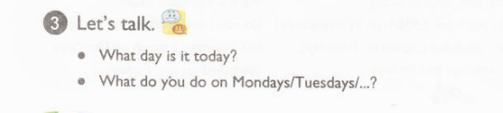
Ans: It’s Monday I go to school in the morning …

Slide 44
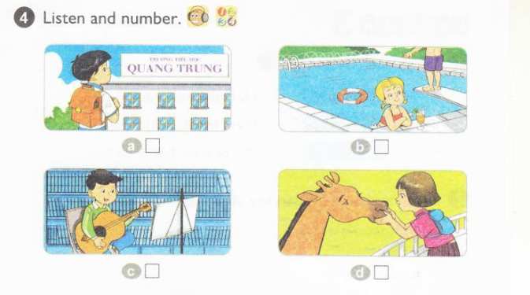
Ans : a. 3 b. 2 c. 4 d. 1

Slide 45
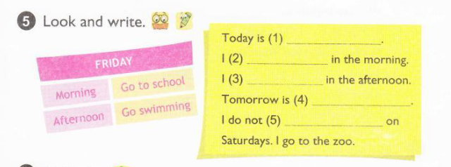
Ans : Today is (1) Friday. I (2) go to school in the morning. I (3) go swimming in the afternoon. Tomorrow is (4) Saturday I do not (5) go to school on Saturdays. I go to the zoo.

Slide 46
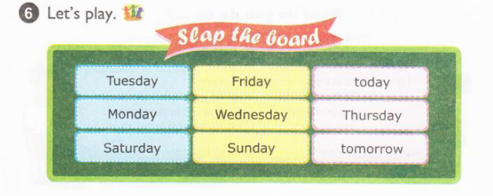

Slide 47
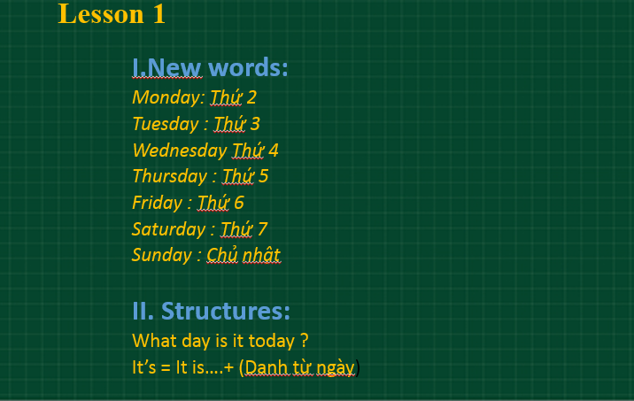
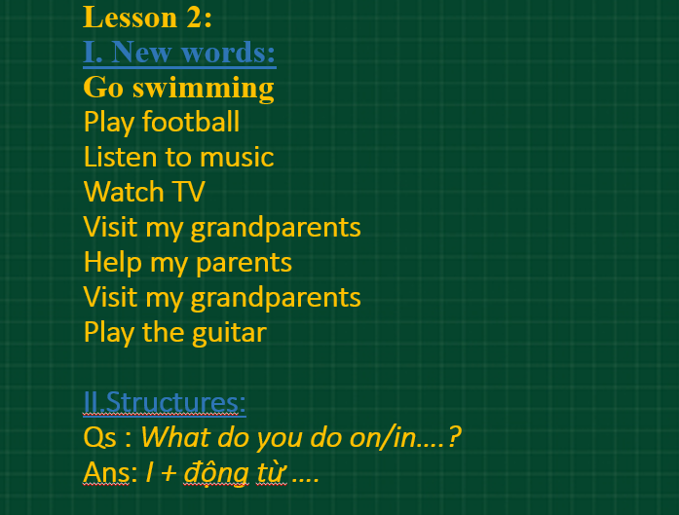
1.Summary : 2.Homework: (link)
Thank you for listening

Slide 48
Tuesday, September 28th 2021 Unit 3: What day is it today? Lesson 3: Pronunciation and Practise IR –First UR-Thursday ER-Her

Slide 49
Warm up

Slide 50
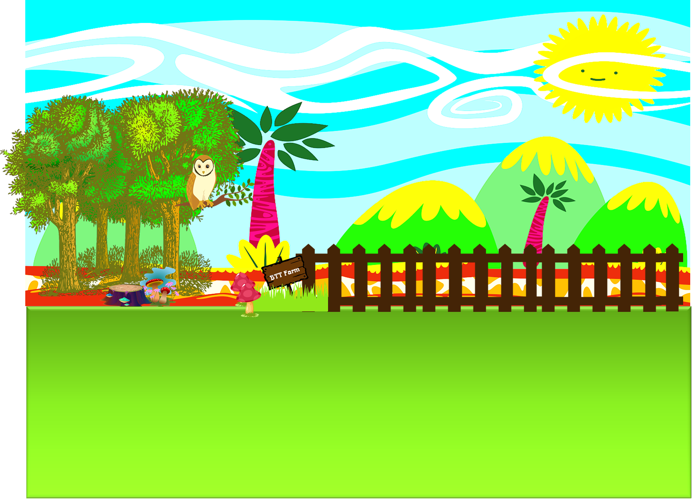

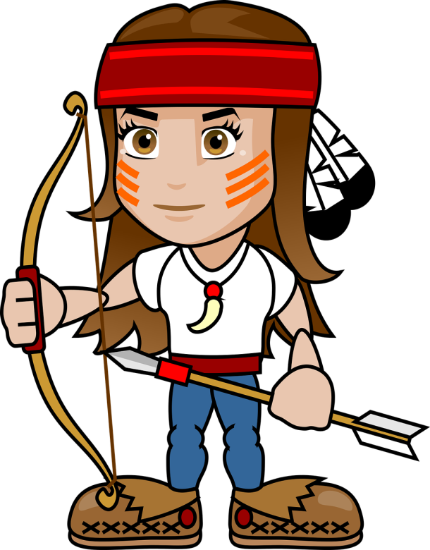
CUNG THỦ

Slide 51


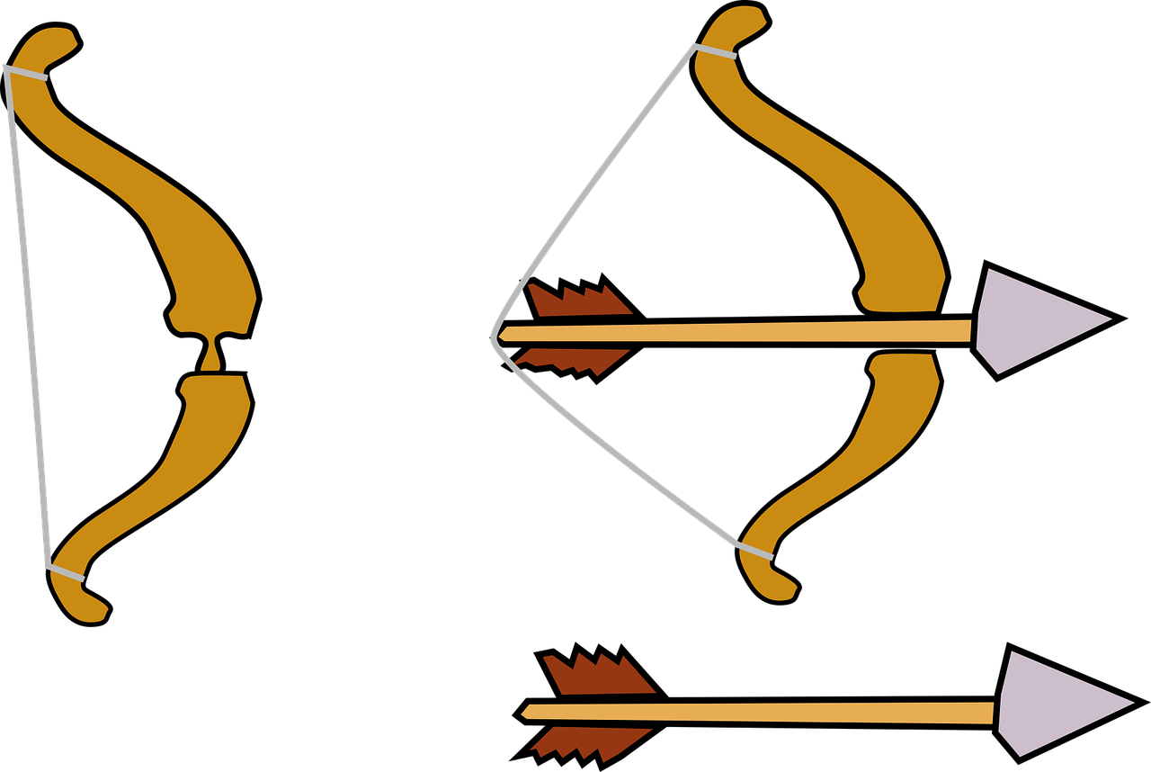



Question 1: Thu….day
RS
SR

Slide 52
Câu 2:
Visit my grandparents
Help my parents

Slide 53
Câu 3: What do you do ….Monday?
On
In

Slide 54
Câu 4:
Play football
Play the guitar

Slide 55
Câu 5:
Watch Tv
Listen to music

Slide 56
Câu 6:
Go Swimming
Visit my friends

Slide 57
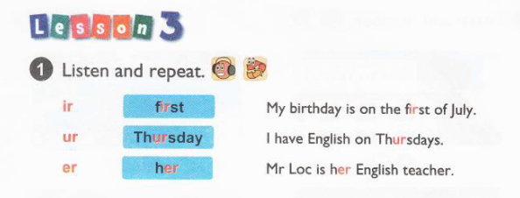

Slide 58
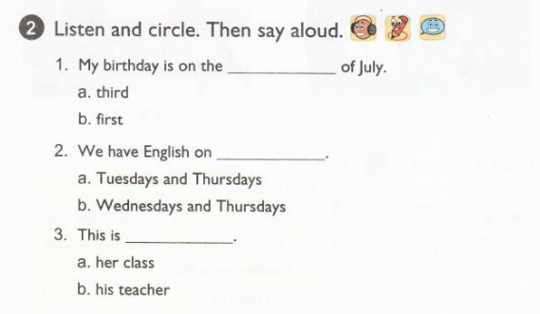
Ans: 1. b 2. b 3. a

Slide 59
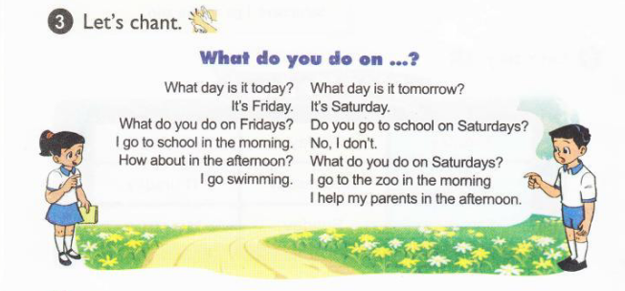

Slide 60
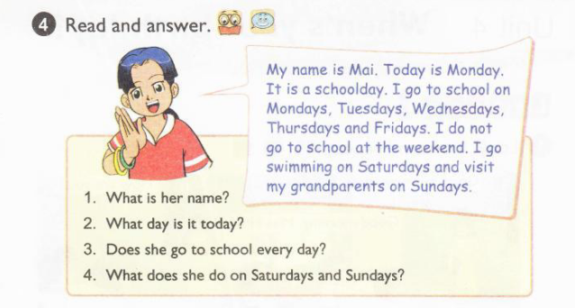
Ans : 1. Her name is Mai. 2. Today is Monday 3. No. She goes to school on Mondays, Tuesdays, Wednesdays, Thursdays and Fridays. 4. She goes swimming on Saturdays and visit her grandparents

Slide 61
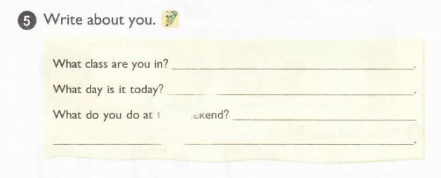
Example : - What class are you in? - I'm in 4A. - What day is it today? - Today is Wednesday. _What do you do at this weekend ? – I play the guitar.

Slide 62
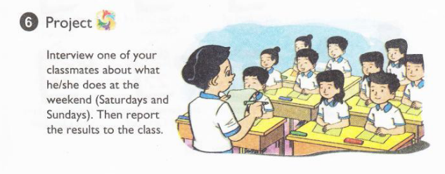
Example : Qs: What do you do at this weekend ? What do you do on Saturdays or Sundays ? Ans :I +………( động từ )

