Slide 1
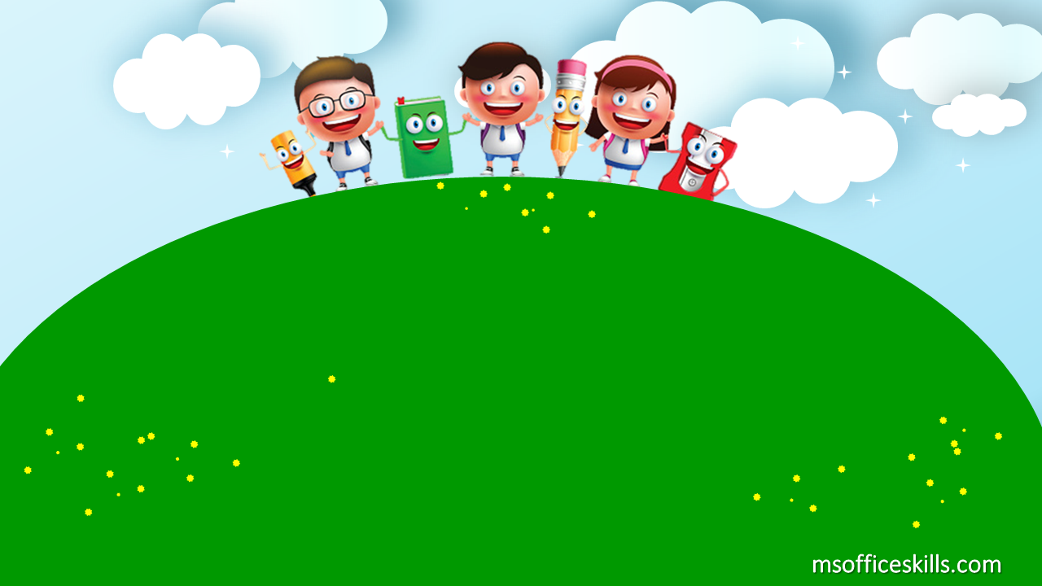
Welcome to our class
2A1

Slide 2

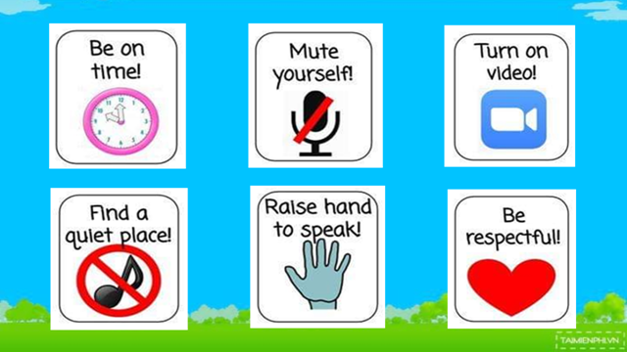

Slide 3

Warm up
https://www.youtube.com/watch?v=nKYCy4ZNBpU

Slide 4
Bài 1: Học phát âm phonic N

Slide 5



Slide 6

N- n- nose

Slide 7

N- n- nine

Slide 8

N- n- one

Slide 9
Bài 2: Học các số từ 11→15

Slide 10
Number song 1-10
https://www.youtube.com/watch?v=Yt8GFgxlITs

Slide 11

Eleven

Slide 12

Twelve

Slide 13

Thirteen

Slide 14

Fourteen

Slide 15

Fifteen

Slide 16
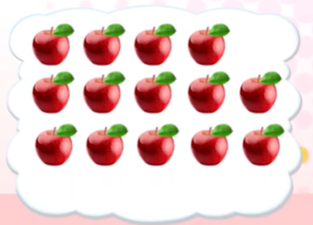

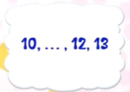
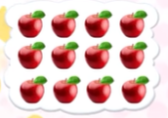
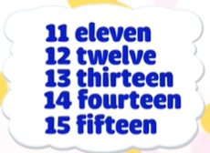
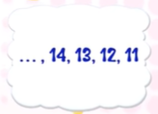
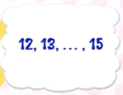

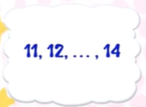

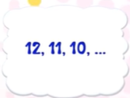


Slide 17
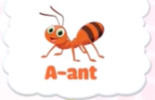
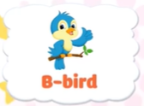
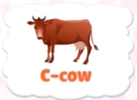
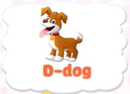
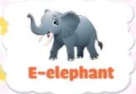

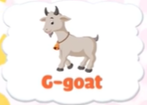



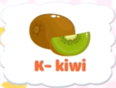
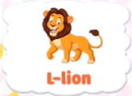
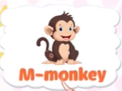

Slide 18


Slide 19




FOOTBALL
QUIZ

Slide 20
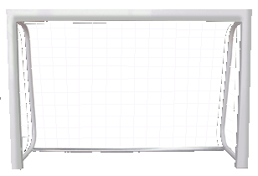



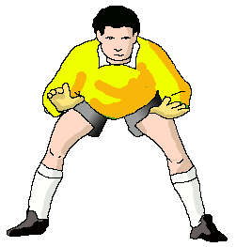
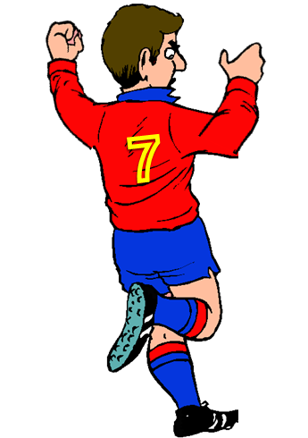
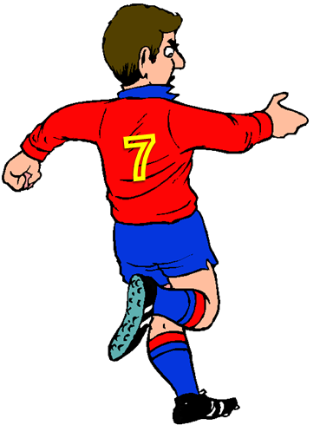

FAIR PLAY
NO TO RACISM
NEXT
Fifteen
Eleven
One

Slide 21
FAIR PLAY
NO TO RACISM
NEXT
Fourteen
Ten
Thirteen

Slide 22
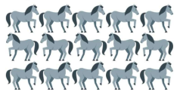

How many horses are there?
FAIR PLAY
NO TO RACISM
NEXT
Fifteen
Twelve
Fourteen

Slide 23
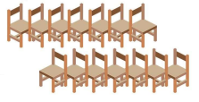
How many chairs are there?
FAIR PLAY
NO TO RACISM
NEXT
Fifteen
Fourteen
Eleven

Slide 24
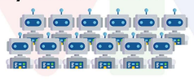
How many robots are there?
FAIR PLAY
NO TO RACISM
NEXT
Twelve
One
Eleven

Slide 25

FAIR PLAY
NO TO RACISM
NEXT
Ten
Eleven
Fifteen

Slide 26
FAIR PLAY
NO TO RACISM
NEXT
Eleven
Nine
Ten

Slide 27

FAIR PLAY
NO TO RACISM
NEXT
Two
Eight
Eleven

Slide 28
Good Job

