Slide 1
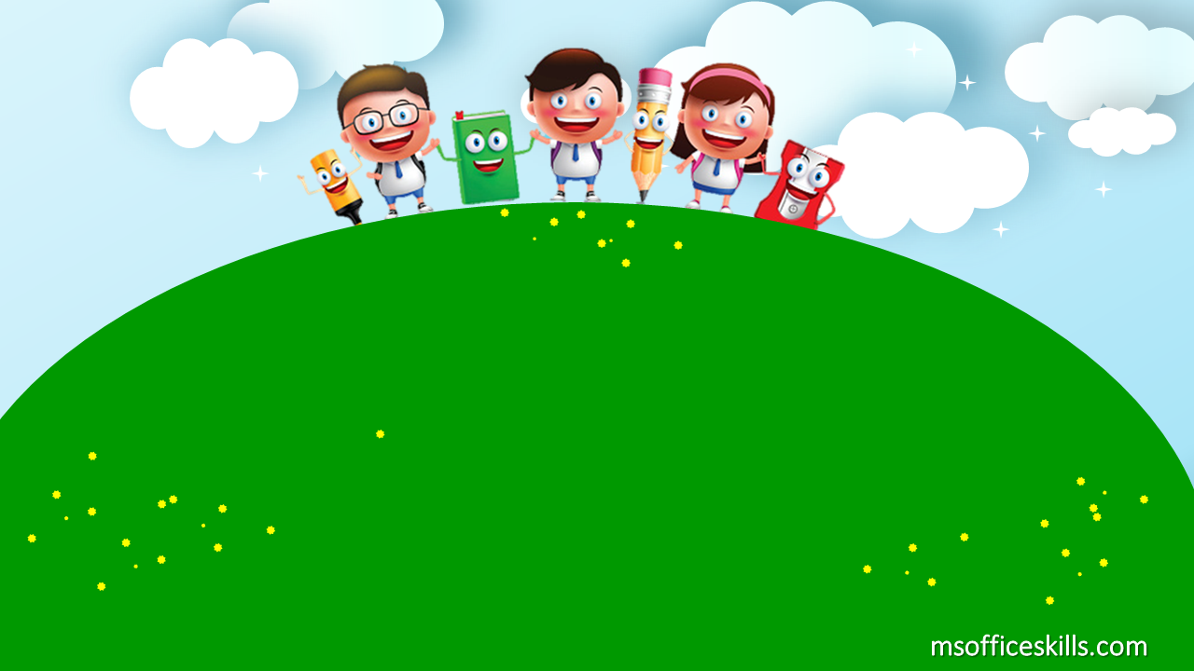
Welcome to our class
2A1

Slide 2
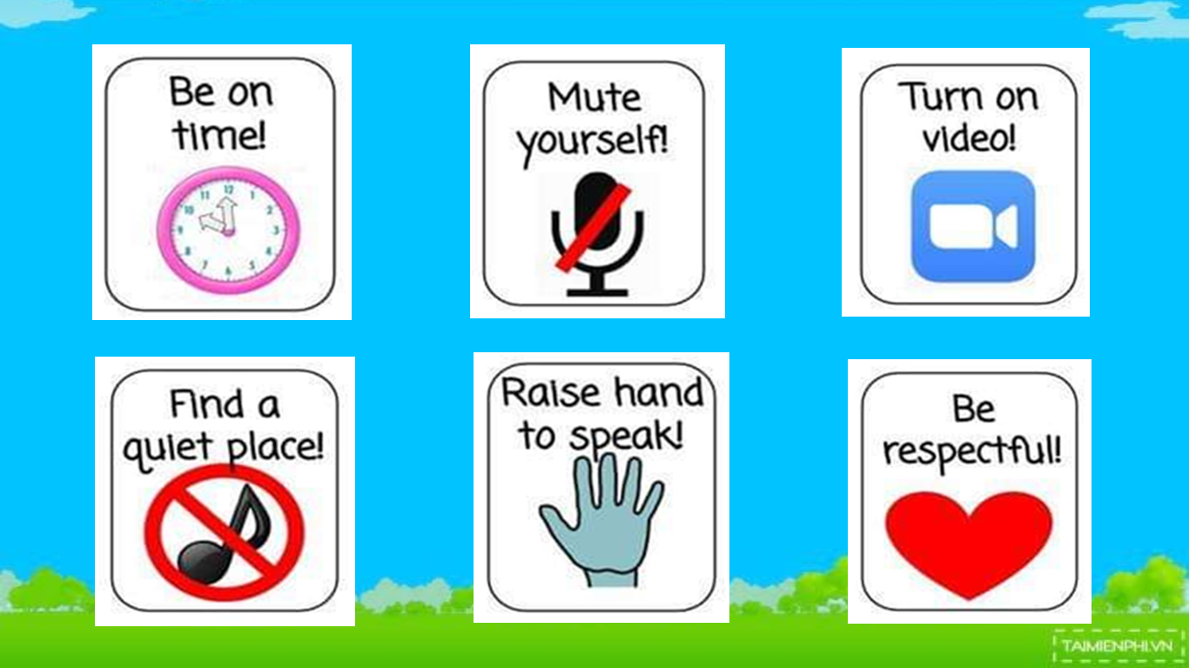

Slide 3
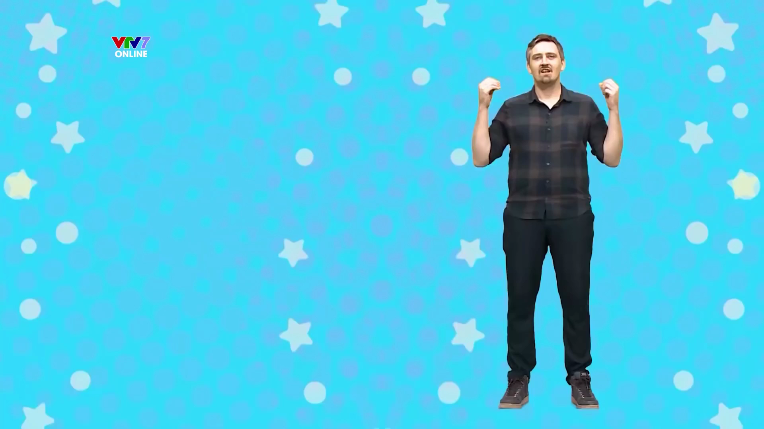

Slide 4

Bài 1: Cách chào hỏi trong ngày

Slide 5

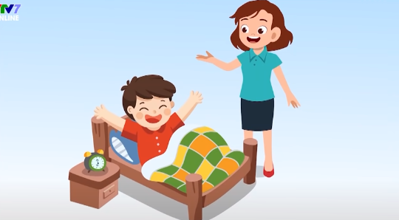
Good morning!

Slide 6
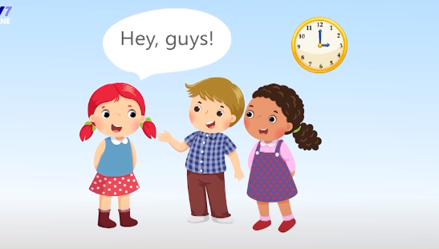
Good afternoon!

Slide 7
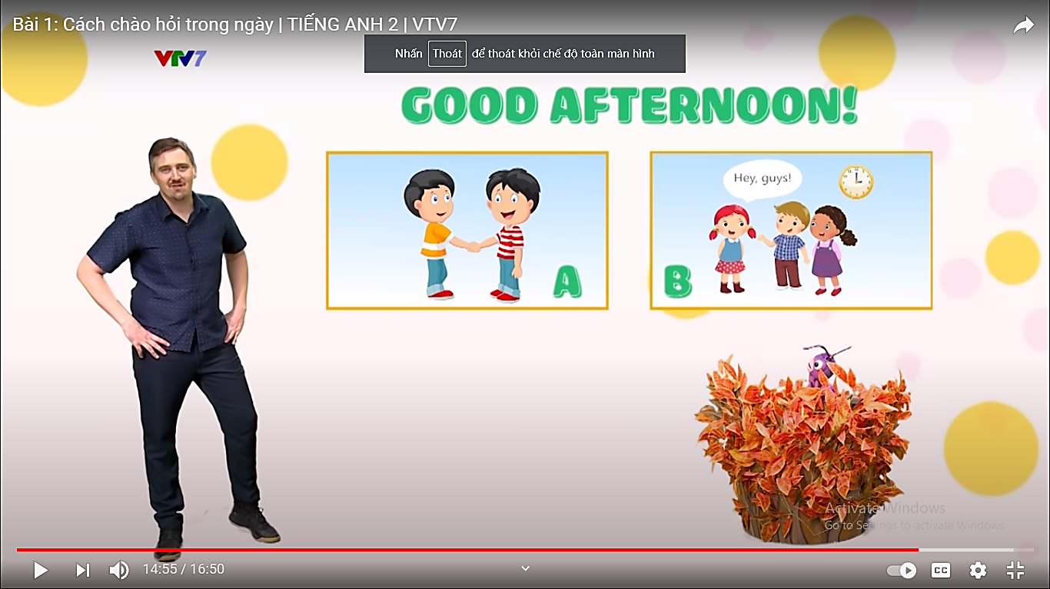
Nice to see you again

Slide 8
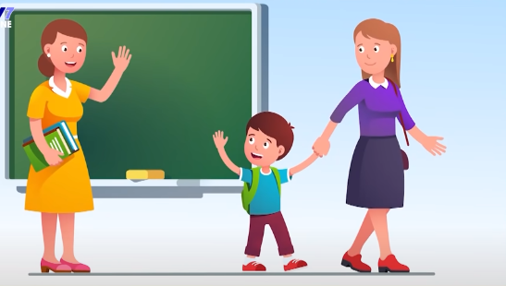
Goodbye!
Bye!

Slide 9
A
B
Good morning!

Slide 10
A
B
Goodbye!

Slide 11
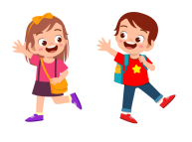
A
B
Nice to see you again

Slide 12

A
B
Good afternoon!

Slide 13
Bài 2: Các câu khẩu lệnh quen thuộc trong lớp học

Slide 14
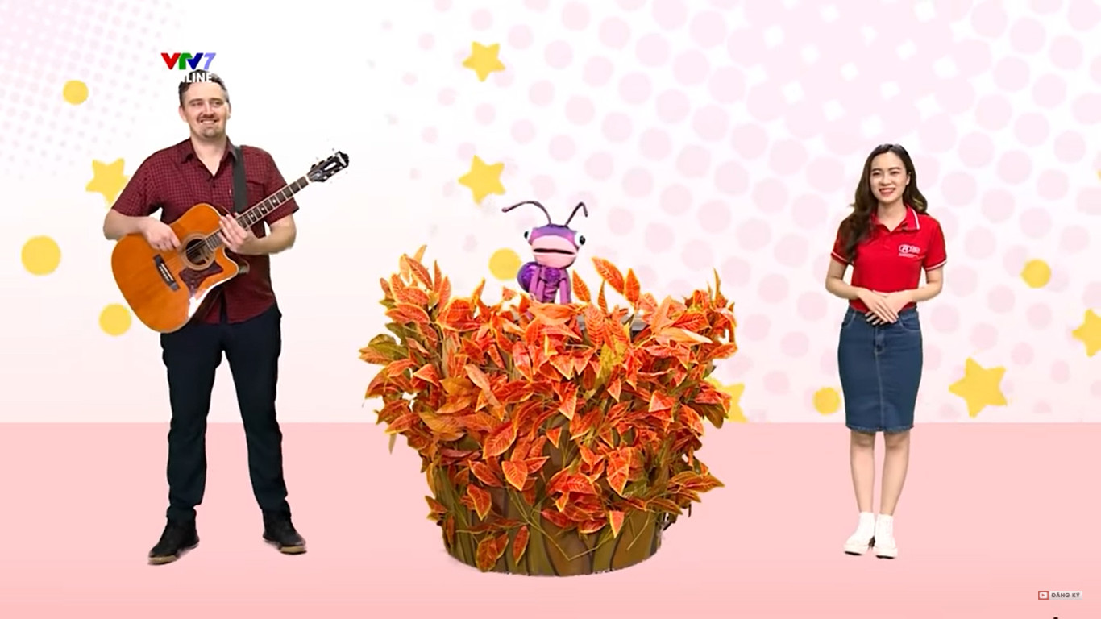
Mr.Ryan
Ms.Luy
Billy

Slide 15
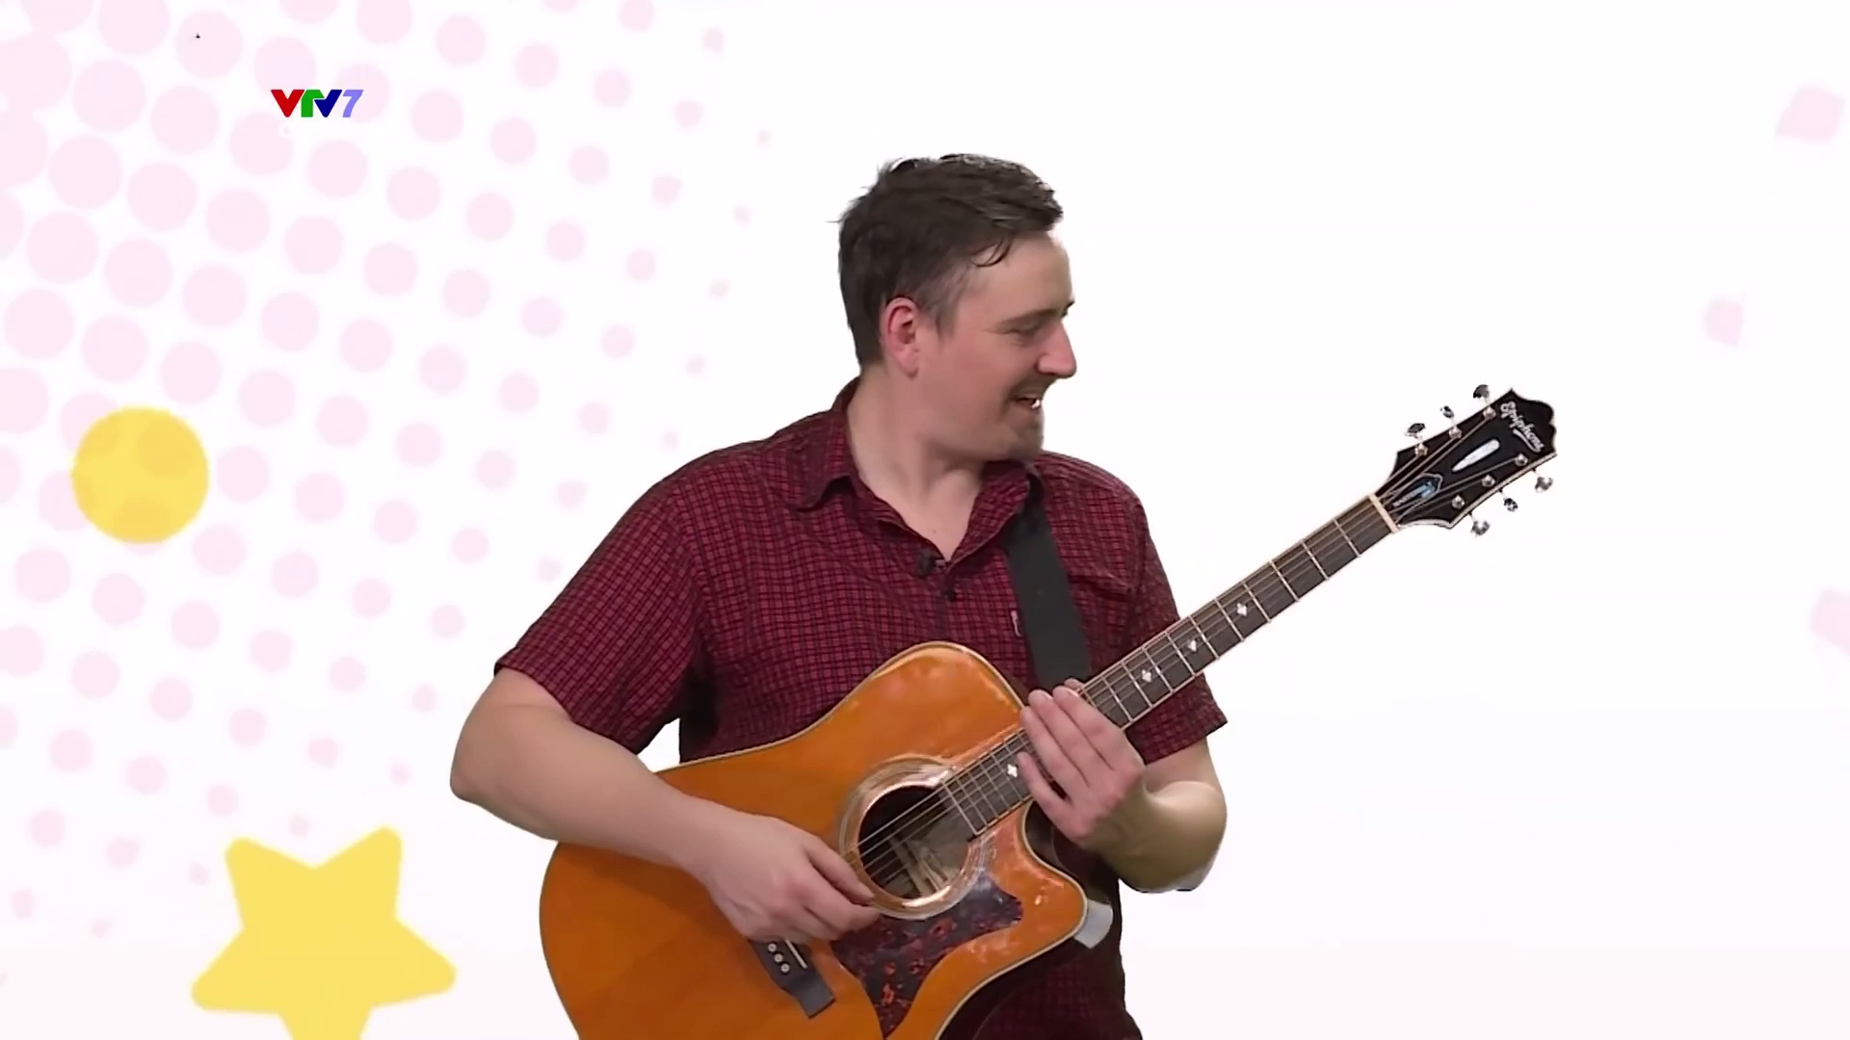

Slide 16

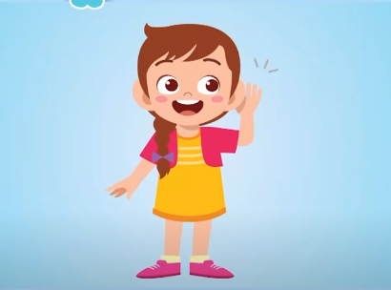
Listen carefully!

Slide 17
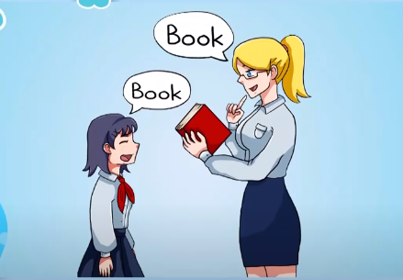
Repeat after me!

Slide 18
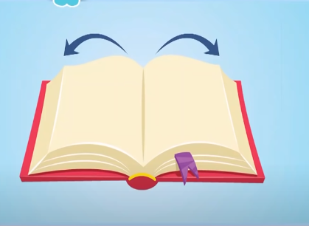
Open your book!

Slide 19
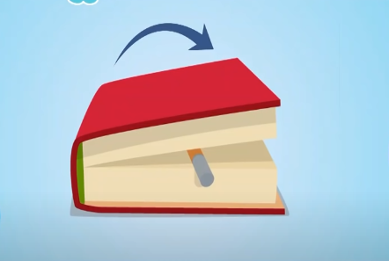
Close your book!

Slide 20
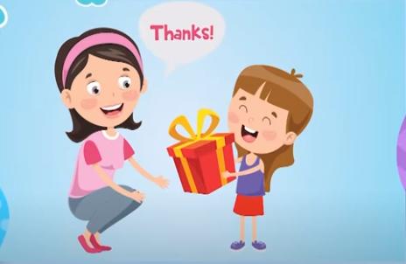
Thank you!

Slide 21
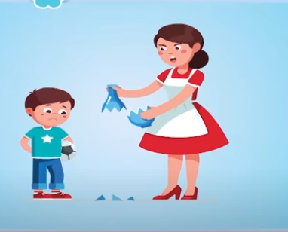
I’m sorry!

Slide 22

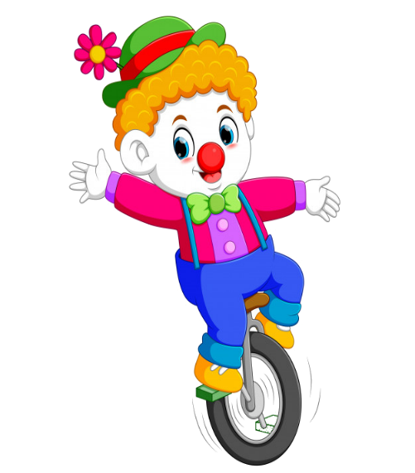



PLAY

Slide 23



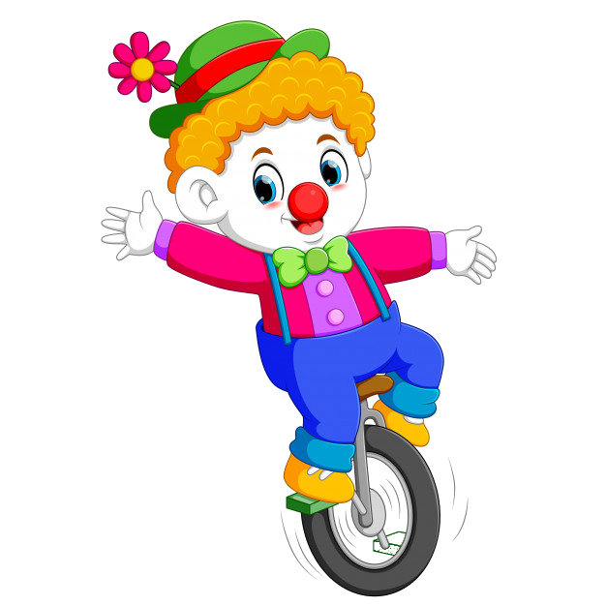
A. Open your book
B. Goodbye
C. Nice to meet you
D. Hello

Slide 24
A. Nice to meet you
B. Hi
C. Hello
D. Repeat after me

Slide 25
A. I’m sorry
B. Hi
C. Hello
D. Goodbye

Slide 26
Mai : Good afternoon! Nam: _______ .
A. Good morning
B. Bye
C. Good afternoon
D. Thank you

Slide 27
A. Bye
B. Listen carefully
C. Repeat after me
D. Goodbye

Slide 28
This gift is for you.
_______!
A. Bye bye
B. I’m sorry
C. Thank you
D. Nice to see you again

Slide 29
A. Listen
B. Good morning
C. Goodbye
D. I’m sorry

Slide 30


EXIT

Slide 31

Goodbye song

Slide 32

Who am I?

Slide 33
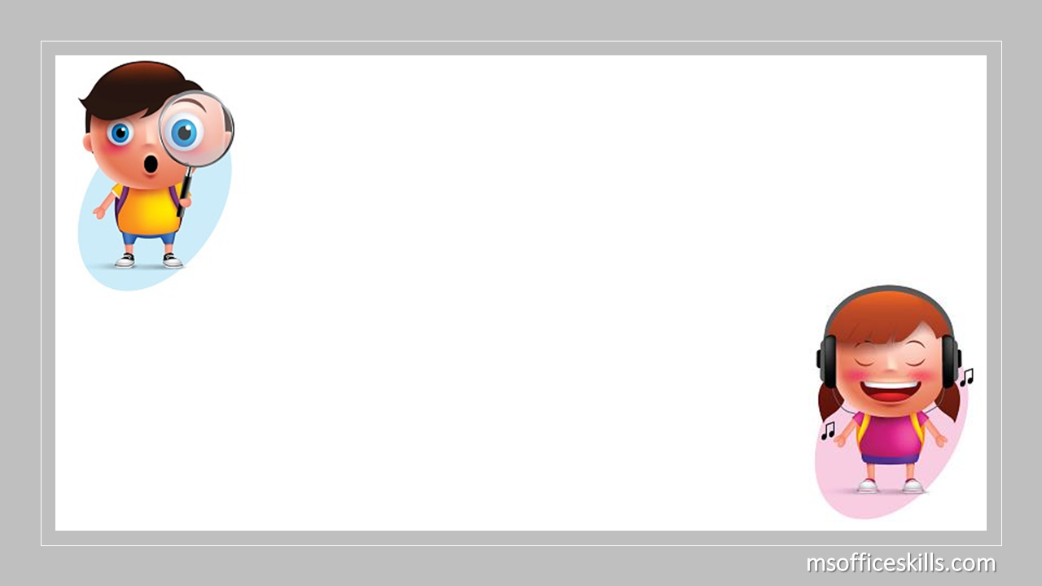
1
2
3
4
Repeat after me!

Slide 34
1
2
3
4
Thank you!

Slide 35
1
2
3
4
Listen carefully!

Slide 36
1
2
3
4
I’m sorry!

Slide 37
1
2
3
4
Open your book!

Slide 38
1
2
3
4
Close your book!

Slide 39
1
2
3
4
Good morning!

Slide 40
1
2
3
4
Good afternoon!

Slide 41
1
2
3
4
Goodbye!

Slide 42
