Slide 1
Welcome to our class
Unit 2: I’m from Japan
Lesson 1+2

Slide 2

I. New words:
England

Slide 3

I. New words:
Malaysia

Slide 4

I. New words:
America

Slide 5

I. New words:
Australia

Slide 6

I. New words:
Japan

Slide 7

I. New words:
Vietnam

Slide 8


1.
2.
3.
4.
5.
England
Australia
Japan
Malaysia
America

Slide 9
II. Model sentence
Where are you from ?
I’m from Japan.

Slide 10

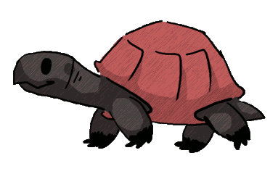





Rotation Luck
30
20
1
2
3
40
10
50
80
4
5
6
60
70
Spin
Next

Slide 11


Where are you from ?
1
9
8
1
7
2
6
10
4
5
3
Time out
I’m from Japan.

Slide 12
Where are you from ?
I’m from Australia.
2
1
5
4
3
2
6
7
10
9
8
Time out

Slide 13
Where are you from ?
I’m from America.
3
1
5
4
3
2
6
7
10
9
8
Time out

Slide 14
Where are you from ?
I’m from England.
4
1
5
4
3
2
6
7
10
9
8
Time out

Slide 15
Where are you from ?
I’m from Vietnam.
5
1
5
4
3
2
6
7
10
9
8
Time out

Slide 16
Where are you from ?
I’m from Malaysia.
6
1
5
4
3
2
6
7
10
9
8
Time out

Slide 17
Tuesday, September 7th 2021
Unit 2: Where are you from?
Lesson 1
New words:
Vietnam
Japan
Australia
England
America
II. Model sentences
Where are you from?
I’m from Vietnam.
III. Homelink
-Learn by heart new words/ model sentences and write x2 lines.
Do exe A, B in WB

Slide 18
Welcome to our class
Unit 2: I’m from Japan
Lesson 2

Slide 19
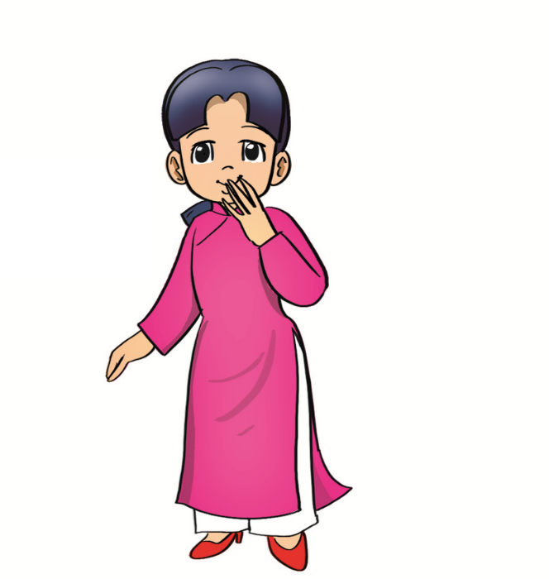
I. New words:
Vietnam
Vietnamese

Slide 20

I. New words:
England
English

Slide 21
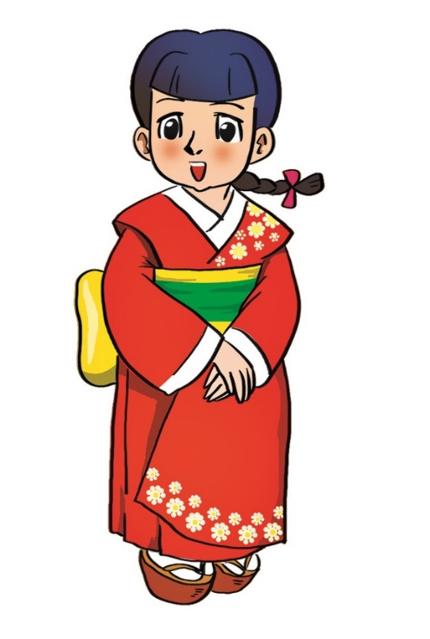
I. New words:
Japan
Japanese

Slide 22

I. New words:
Australia
Australian

Slide 23
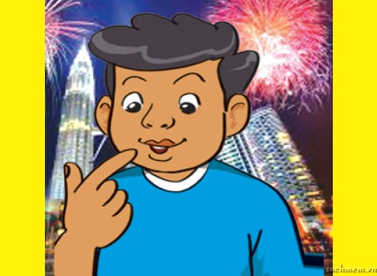
I. New words:
Malaysia
Malaysian

Slide 24

America
American

Slide 25




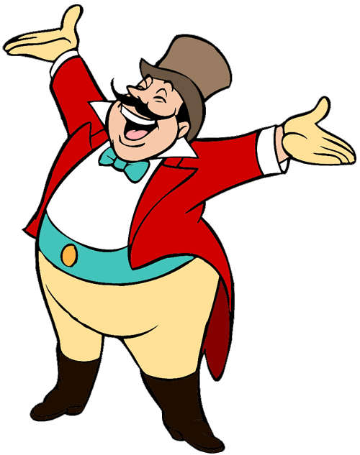
Ms Huyền Phạm
0936.082.789
START

Slide 26
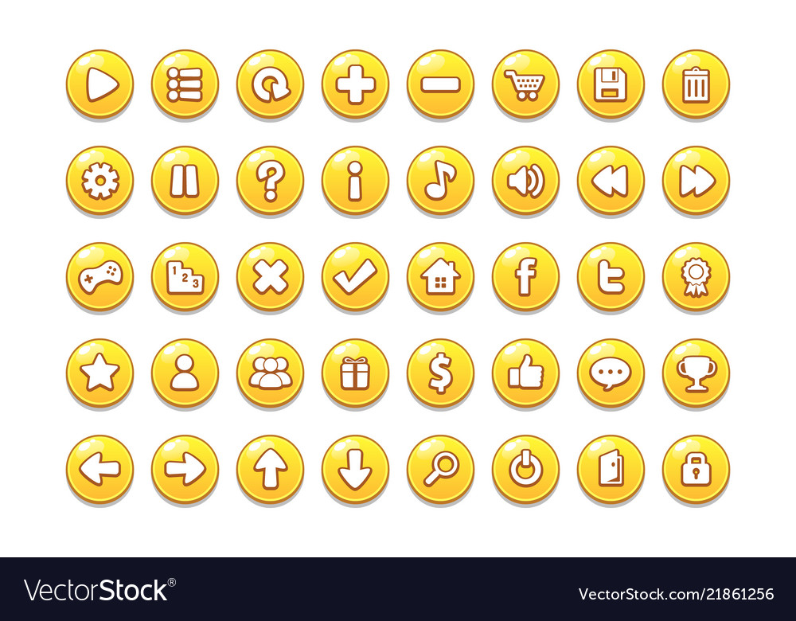



Japanese
Vietnamese
American

Slide 27
Ms Huyền Phạm
0936.082.789
Malaysian
American
Australian

Slide 28
Ms Huyền Phạm
0936.082.789
Australian
English
Malaysian

Slide 29
Ms Huyền Phạm
0936.082.789
English
Australian
Japanese
Next

Slide 30
Ms Huyền Phạm
0936.082.789
English
VietNamese
Japanese

Slide 31
Ms Huyền Phạm
0936.082.789
Malaysian
American
Australian

Slide 32

Ms Huyền Phạm
0936.082.789
Japanese
Vietnamese
English
Next

Slide 33


GOOD JOB!
Ms Huyền Phạm
0936.082.789

Slide 34
II. Model sentence
What nationality are you ?
I’m Vietnamese.

Slide 35
Unit 2: Where are you from?
Lesson 2
New words:
Vietnamese
Japanese
Australian
English
American
Malaysian
II. Model sentences
What nationality are you ?
I’m Vietnamese.
III. Homelink
Learn by heart new words/ model sentences and write x2 lines.
Do exe C,D in WB

Slide 36
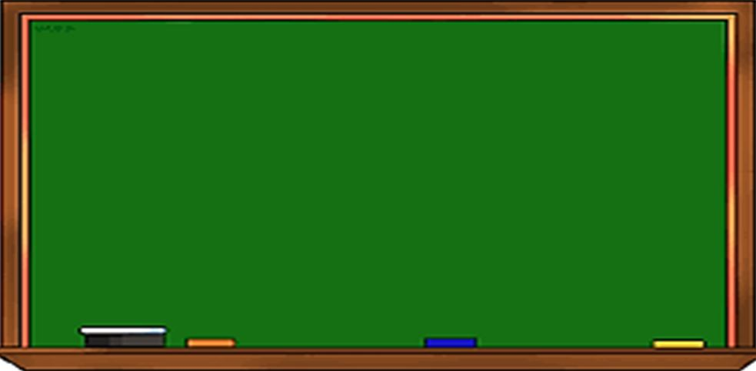
Tuesday, September 21st 2021
Unit 2: Lesson 1+2 (P12-15)
I. New words: từ mới
II. Model sentences:
1- Where are you from?
-I’m from America.
Country: đất nước - Nationality: quốc tịch
Vietnamese
Japanese
Australian
English
American
Malaysian
2- What nationality are you?= What is your nationality?
-I’m American.
Vietnam
Japan
Australia
England
America
Malaysia
IV. Homelink: BTVN
1-Luyện đọc hội thoại P12,14, viết từ mới 2 dòng+ Mẫu câu(2d), chụp vở +SBT gửi vào nhóm, lưu ý chính tả, chữ viết sạch đẹp +PH kí
2- Làm SBT P8-10 + Luyện tập trên OLM.VN hết Unit 2

Slide 37
Welcome to our class
Unit 2: I’m from Japan
Lesson 3

Slide 38
/j/
Japan
I’m from Japan.
/v/
Vietnamese
I’mVietnamese.

Slide 39
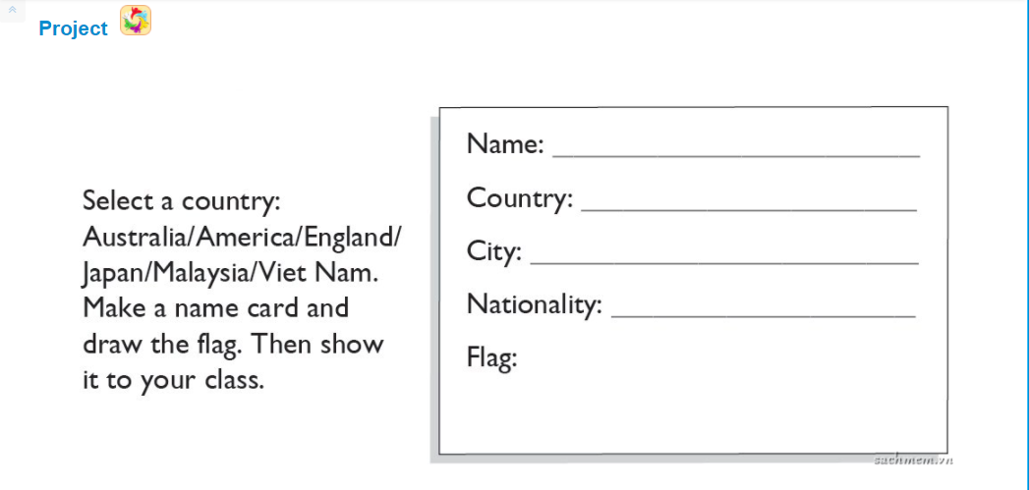
Hau Le
England
London
English

Slide 40
Unit 2: Where are you from?
Lesson 3
I. Sound
/j/ : jam, juice, jump…
/v/ : van, violin, vase, violet…
II. Homelink
Practice how to pronounce /j/ & /v/
Do exe E,F in WB

Slide 41
Tuesday, September 28th 2021
Unit 2: Lesson 3(P16) + Unit 3: Lesson1(P.18)
I. Phonics: ngữ âm
/j/ : Japan, jam, juice, jump,…
I’m from Japan.
II. Model sentences: mẫu câu
* Hỏi hôm nay là thứ mấy:
- What day is it today?
→ It’s Tuesday.
*Chú ý: It’s = It is
/v/ : Vietnamese, van, violin, …
I’m Vietnamese.
II. New words: từ mới
Monday: thứ 2
Tuesday: thứ 3
Wednesday: thứ 4
Thursday: thứ 5
Friday: thứ 6
Saturday: thứ 7
Sunday: chủ Nhật
IV. Homelink: BTVN
1-Luyện đọc hội thoại P18, viết từ mới 2 dòng+
Mẫu câu(2d), chụp vở +SBT gửi vào nhóm, lưu ý chính tả, chữ viết sạch đẹp +PH kí
2- Làm SBT P12,13 + Luyện tập trên OLM.VN

Slide 42
https://quizizz.com/join/quiz/6112a44197eb48001cb52f39/start?studentShare=true

