Slide 1
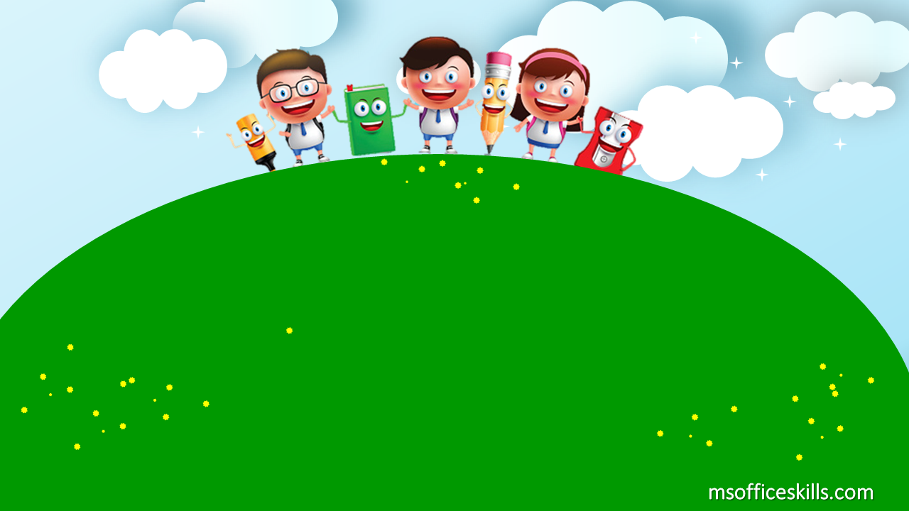
Welcome to our class
2A1

Slide 2

Warm up
Phonics song!

Slide 3


Slide 4
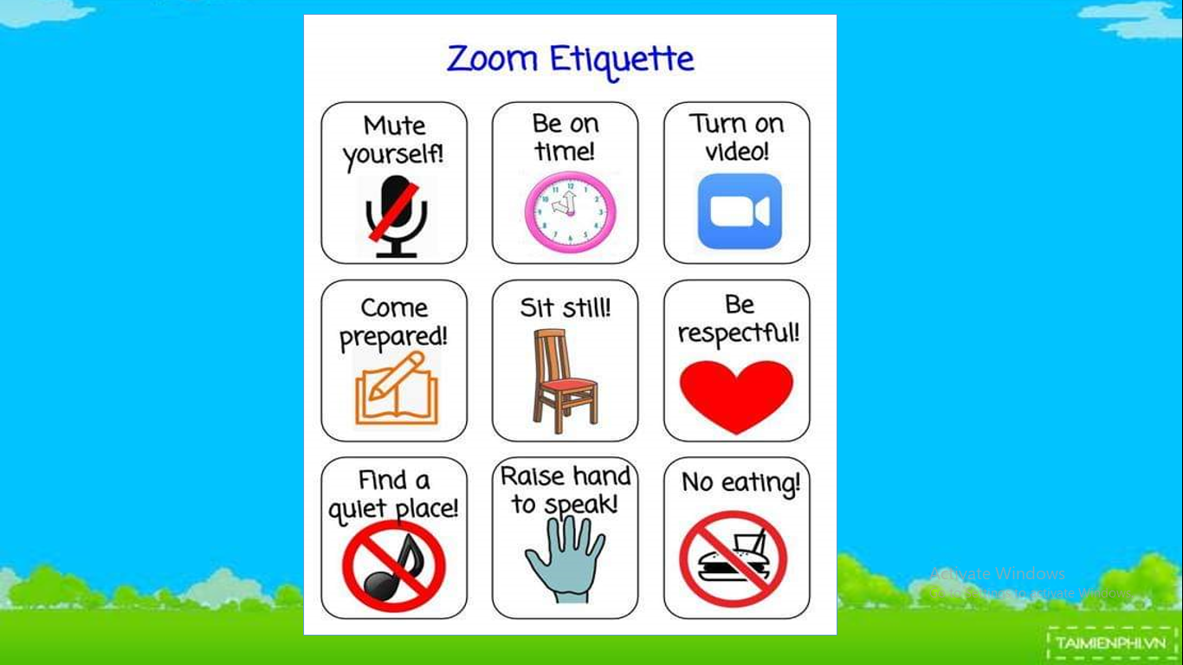

Slide 5
Bài 5: Học về letter O

Slide 6
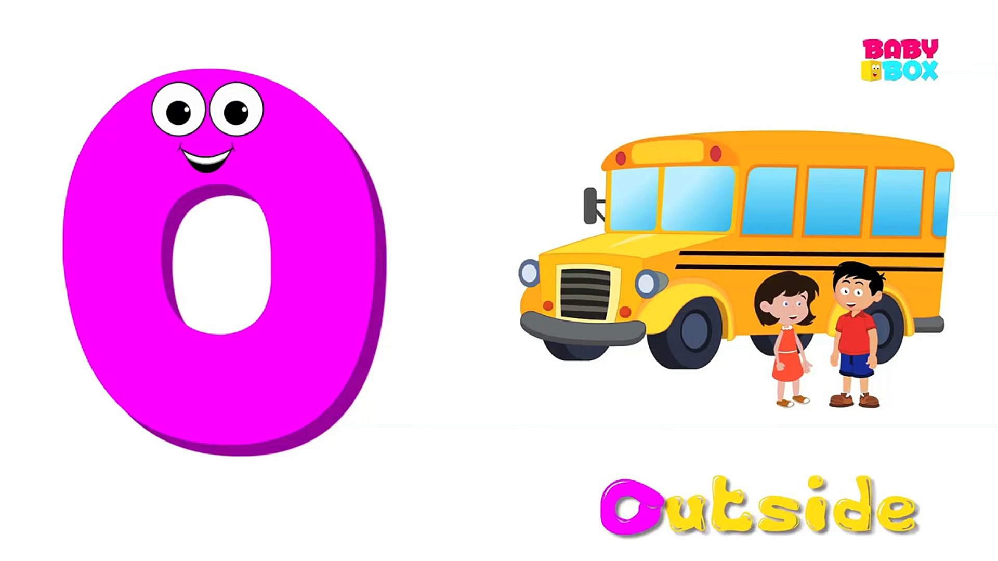

Slide 7
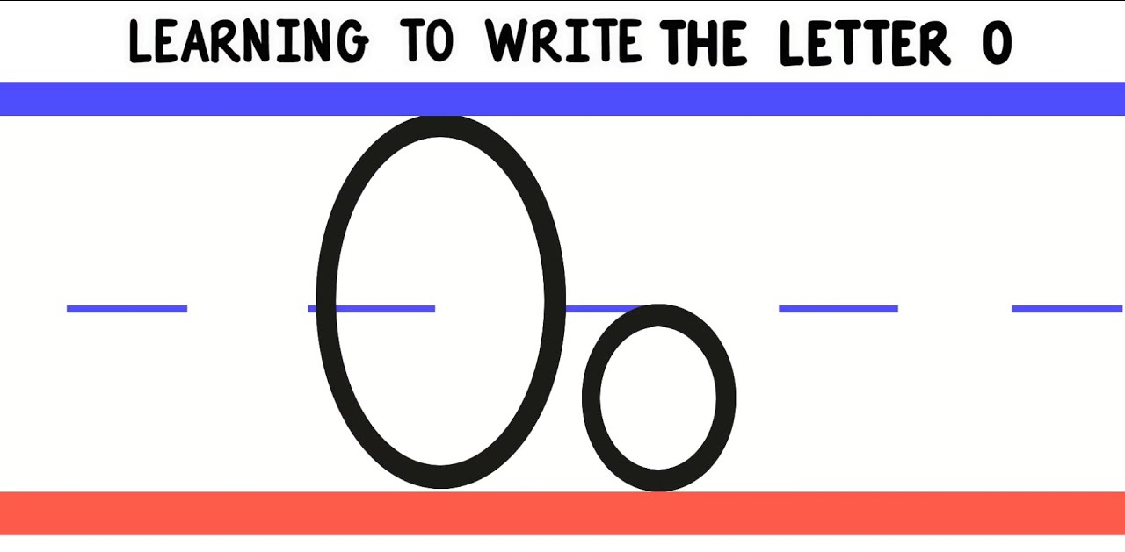
Make the letter O

Slide 8

big O
small O

Slide 9
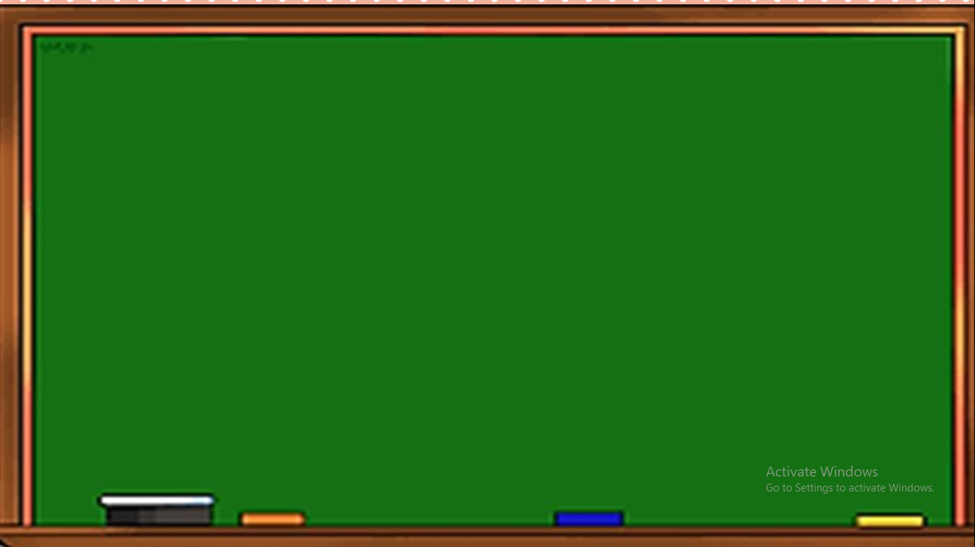
Listen and Repeat

Slide 10
O o o
a big O
O o o
This is a big O.

Slide 11
O o o
a small O
O o o
This is a small O.

Slide 12

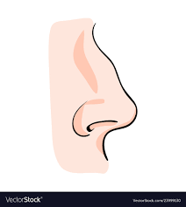

nose
Point to your nose.

Slide 13
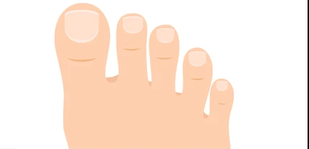

toes
Touch your toes.

Slide 14
Touch your toes !

Slide 15

Point to your nose !

Slide 16
More “O”

Slide 17

go

Slide 18

hello

Slide 19

open

Slide 20

close

Slide 21



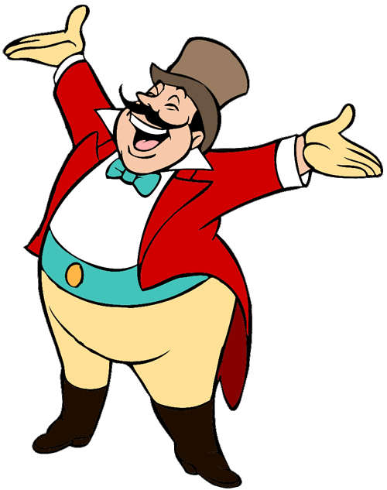
START

Slide 22

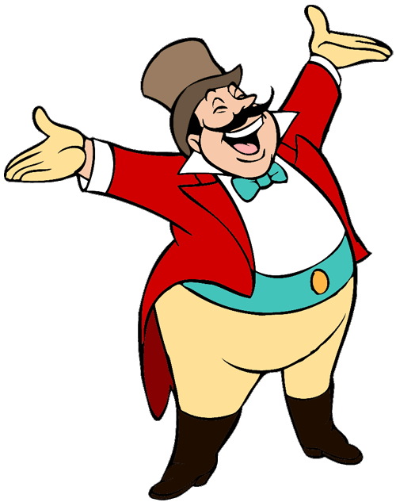


A. Open
B. Close
C. Nose

Slide 23
A. Hello
B. Go
C. Close

Slide 24

A. This is a big O.
B. This is a small O.
C. It is big.

Slide 25
A. Open
B. Close
C. Go

Slide 26
A. Touch your nose!
B. Touch your toes!
C. Touch your Eyes !

Slide 27
B. Touch your toes!
A. Look at your nose!
C. Point to your nose!

Slide 28
GOODBYE!

Slide 29


Slide 30

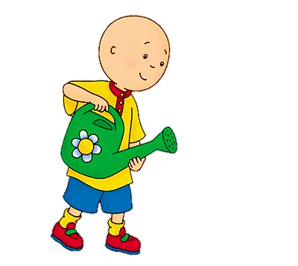



Can you hear O?

Slide 31


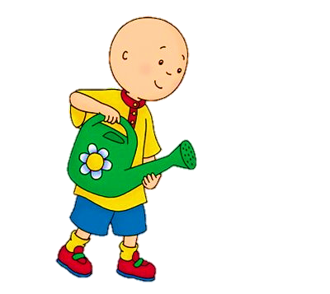
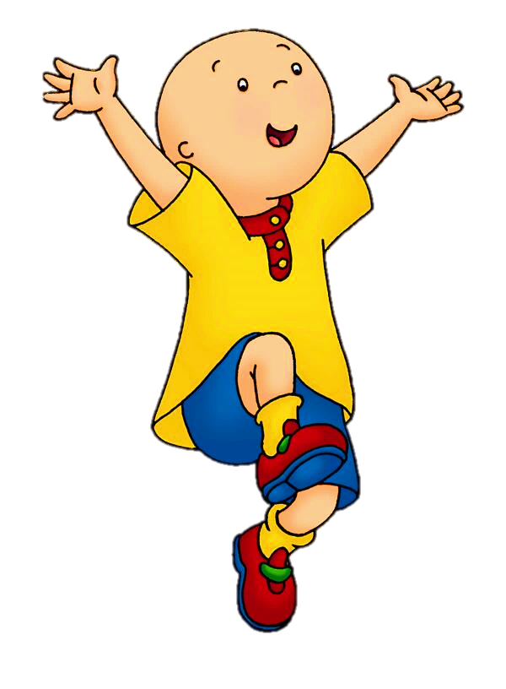
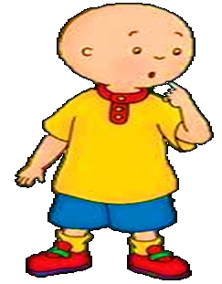


Can you hear O?
Yes
No
NEXT
hello

Slide 32


Can you hear O?
Yes
No
NEXT
neck

Slide 33
Can you hear O?
Yes
No
NEXT
nose

Slide 34

Can you hear O?
Yes
No
NEXT
eyes

Slide 35
Can you hear O?
Yes
No
NEXT
toes

Slide 36
Can you hear O?
Yes
No
NEXT
open

Slide 37

Can you hear O?
Yes
No
NEXT
apple

Slide 38

Can you hear O?
Yes
No
NEXT
face

Slide 39
Can you hear O?
Yes
No
NEXT
close

