Slide 1
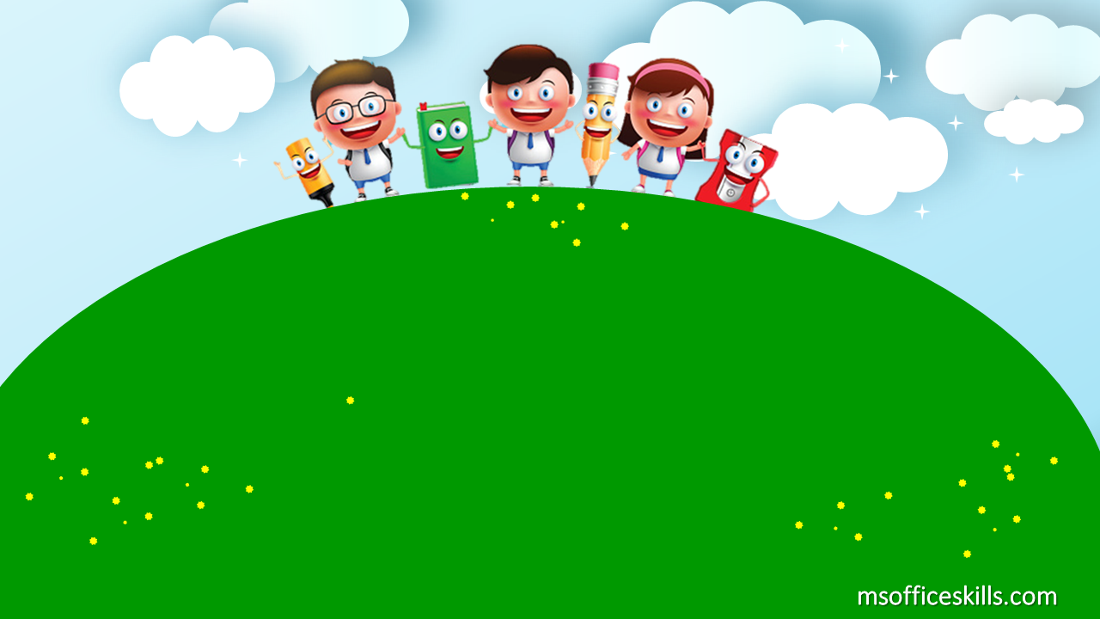
Welcome to our class
1A3

Slide 2







Slide 3

Bài 3: Học phát âm phonic A

Slide 4
Warm up
https://www.youtube.com/watch?v=nKYCy4ZNBpU

Slide 5
Let’s trace with me letter A
https://www.youtube.com/watch?v=n5gPlhG_d1E&t=1s

Slide 6



Slide 7


A- a- apple

Slide 8
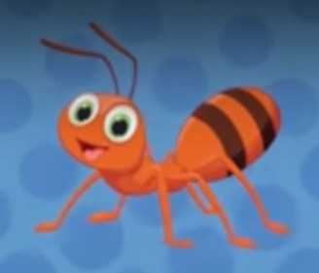
A- a- ant

Slide 9
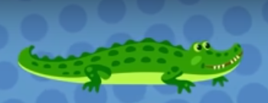
A- a- alligator

Slide 10
https://azota.vn/de-thi/ei8ctx
https://wordwall.net/play/20616/390/651

Slide 11
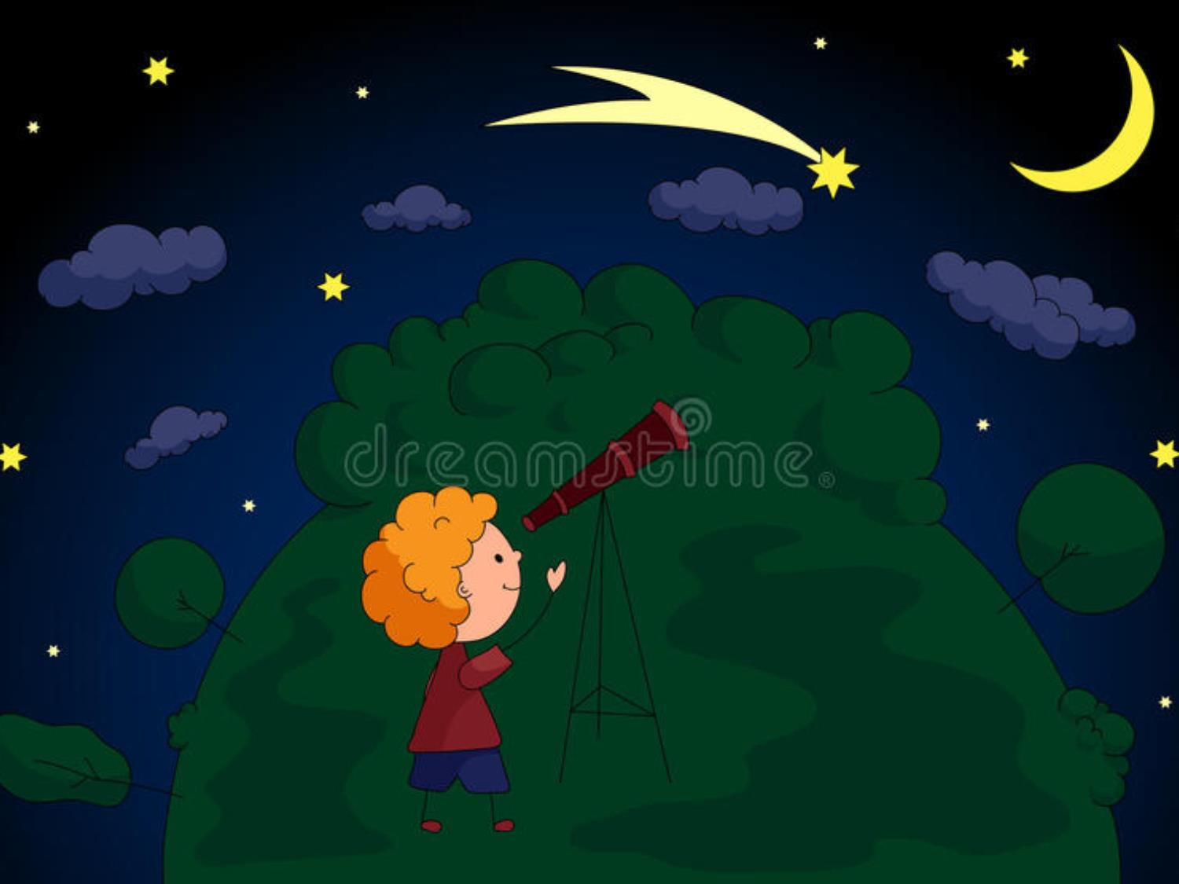
STAR IN MY HEART

Slide 14
a. a. alligator
a. a. apple
a. a. ant

Slide 15
a. a. alligator
a. a. ant
a. a. apple

Slide 16
a. a. ant
a. a. apple
a. a. alligator

Slide 17
small
big

Slide 18
Big or small
Big
small
Big

Slide 19
a small ant

Slide 20
a big alligator

Slide 21
a small apple

Slide 22




Slide 23


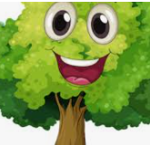


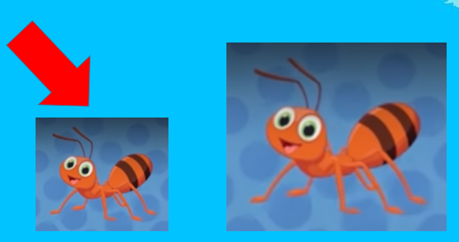
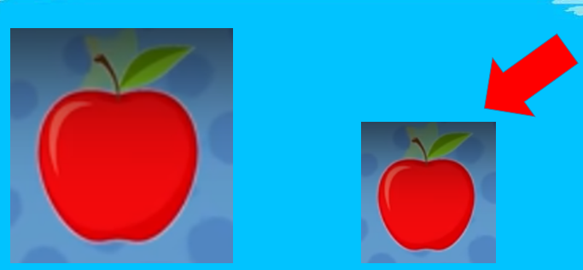
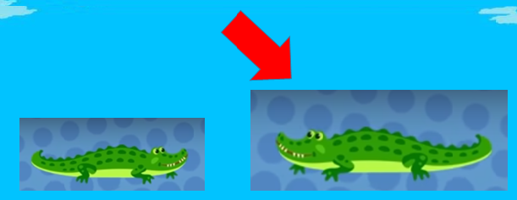


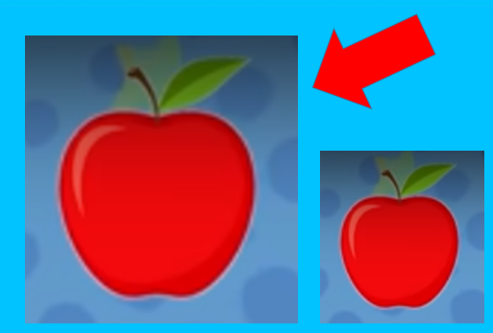
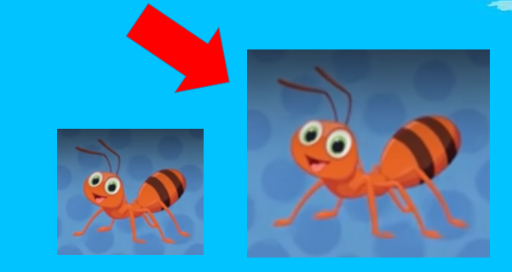

Slide 24
Wednesday, October 13th 2021
Lesson 3
I. New words:
apple
ant
alligator
big
small

