Slide 1
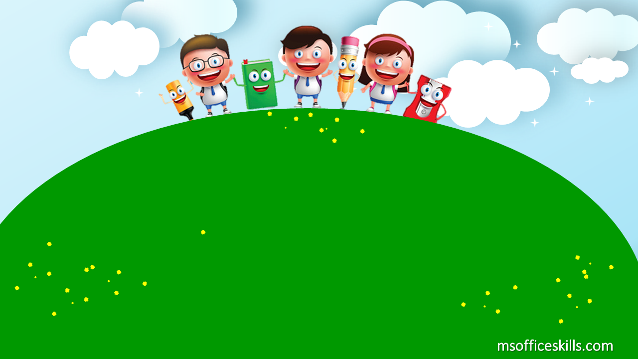
Welcome to our class
1A3

Slide 2








Slide 3
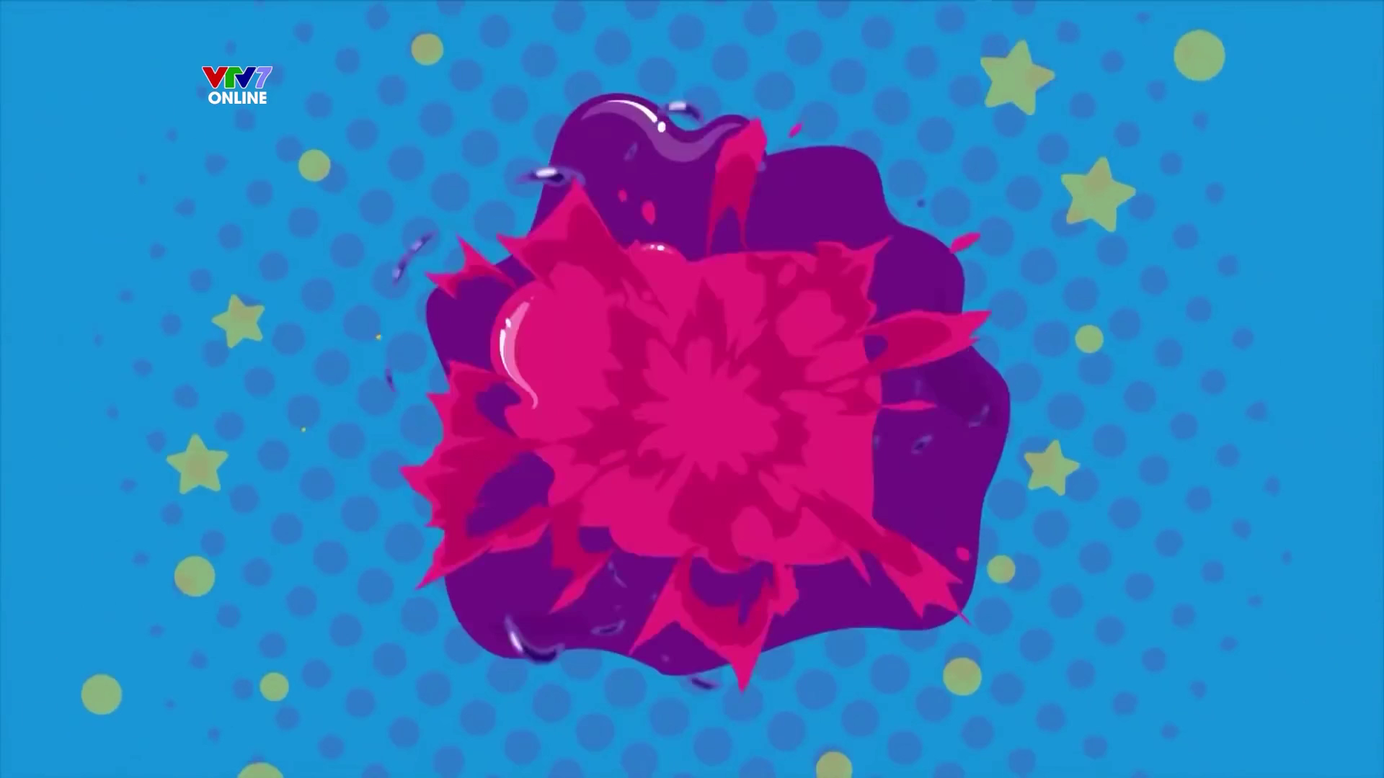

Slide 4

Hello
- Hi

Slide 5
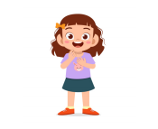
I’m Hau.

Slide 6

Nice to meet you.

Slide 7
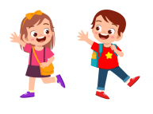
Goodbye
- Bye

Slide 8
A
B
I’m Hau.

Slide 9
A
B
Hello

Slide 10
A
B
Nice to meet you.

Slide 11
A
B
Goodbye

Slide 12

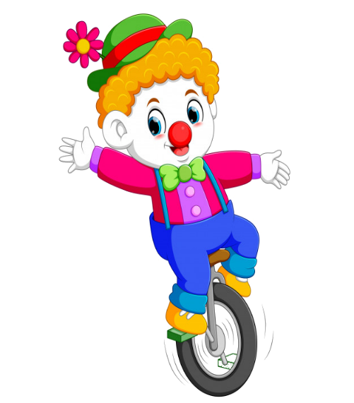



PLAY

Slide 13



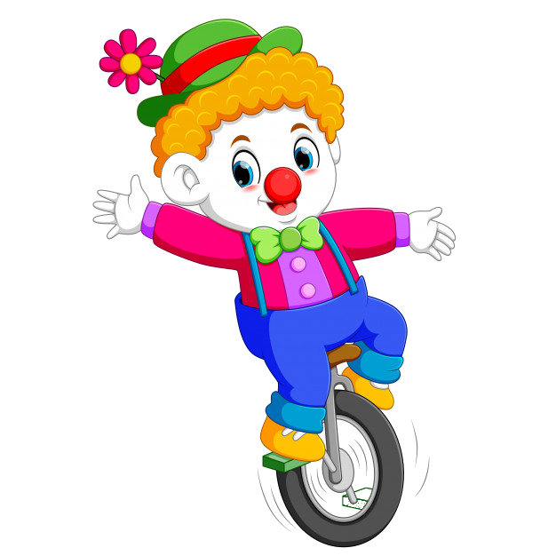
A. I’m Hoa.
B. Goodbye!
C. Nice to meet you!
D. Hello!

Slide 14
A. Nice to meet you.
B. Hi
C. Hello
D. Goodbye

Slide 15
A. Nice to meet you.
B. Hi
C. Hello
D. Goodbye

Slide 16
A. Bye
B. Hello
C. Nice to meet you
D. Goodbye

Slide 17
Hello, I'm Hau.
A-Bye, Van.
B-This is Quan.
C-Hi, Hau. I’m Quan.
D-Hello Quan.

Slide 18
Nice to meet you.
A. I’m An.
B. Hi
C. Nice to meet you too.
D. Hello?

Slide 19
Hello.
..........
A. Nice to meet you.
B. Hello
C. I’m Trang.
D. Goodbye

Slide 20
meet – to – nice - you
A. Nice to meet you
C. Meet you to nice
B. To nice meet you
D. Nice you meet to

Slide 21


EXIT

Slide 22
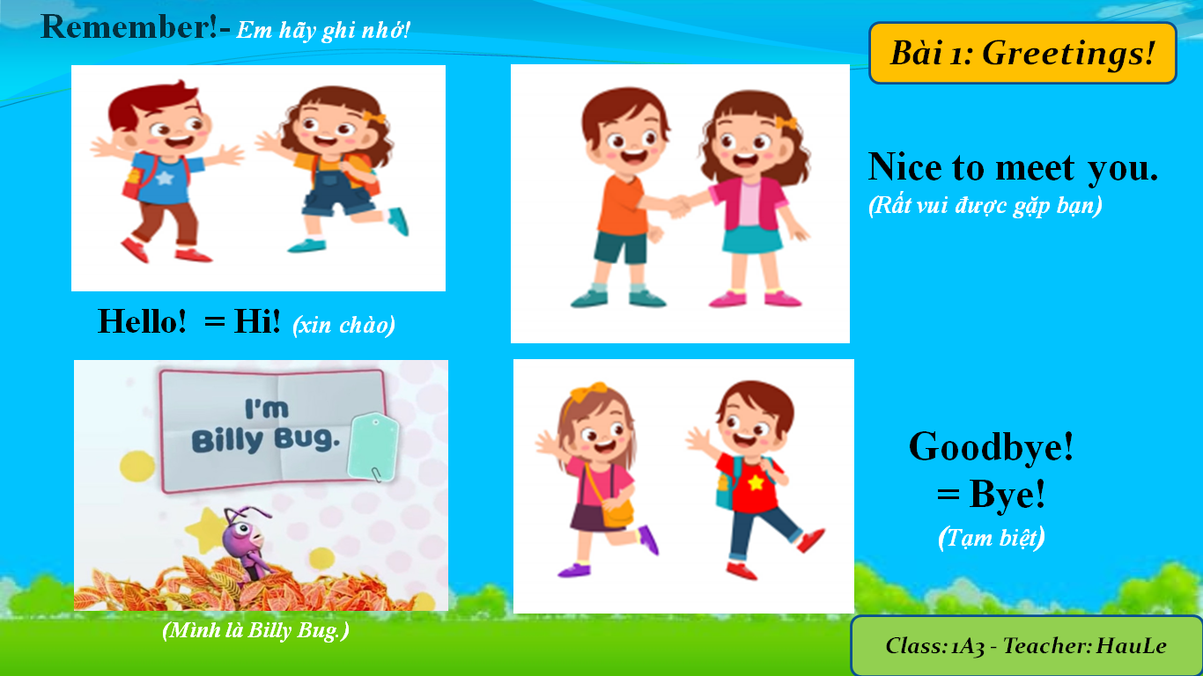

Slide 23


