Slide 1




UNIT 11: THIS IS MY FAMILY
LESSON 1: PART 1,2,3

Slide 2






1.LOOK, LISTEN AND REPEAT
2.POINT AND SAY
3.LET’S TALK
Title 4

Slide 3
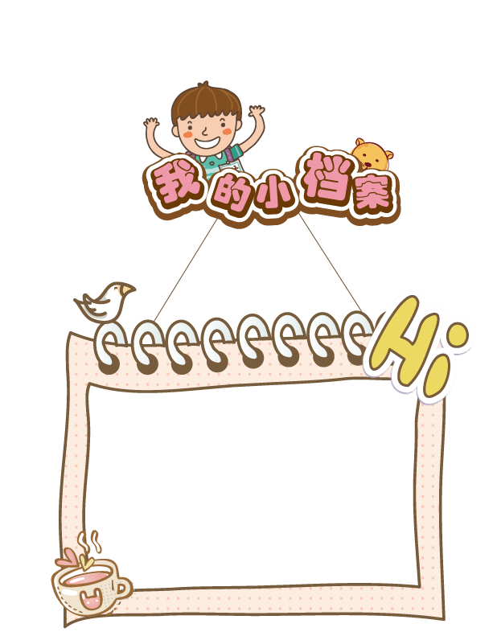

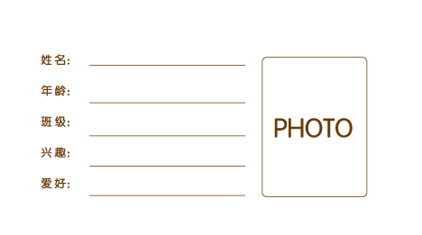
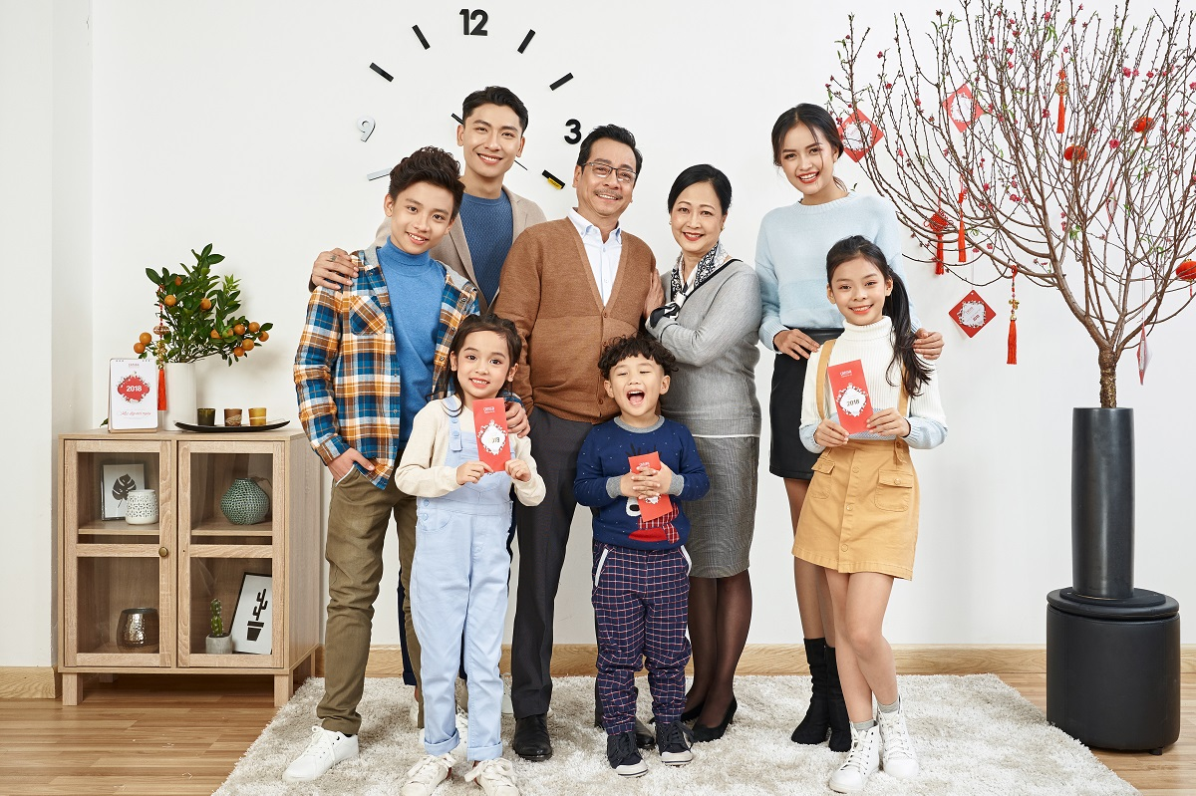
FAMILY TREE
GRANDFATHER
GRANDMOTHER
FATHER
MOTHER
BROTHER
SISTER
BABY

Slide 4

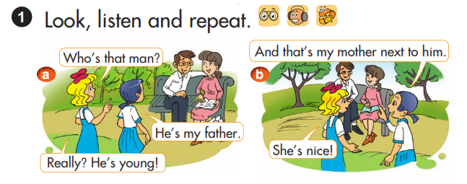


Slide 5
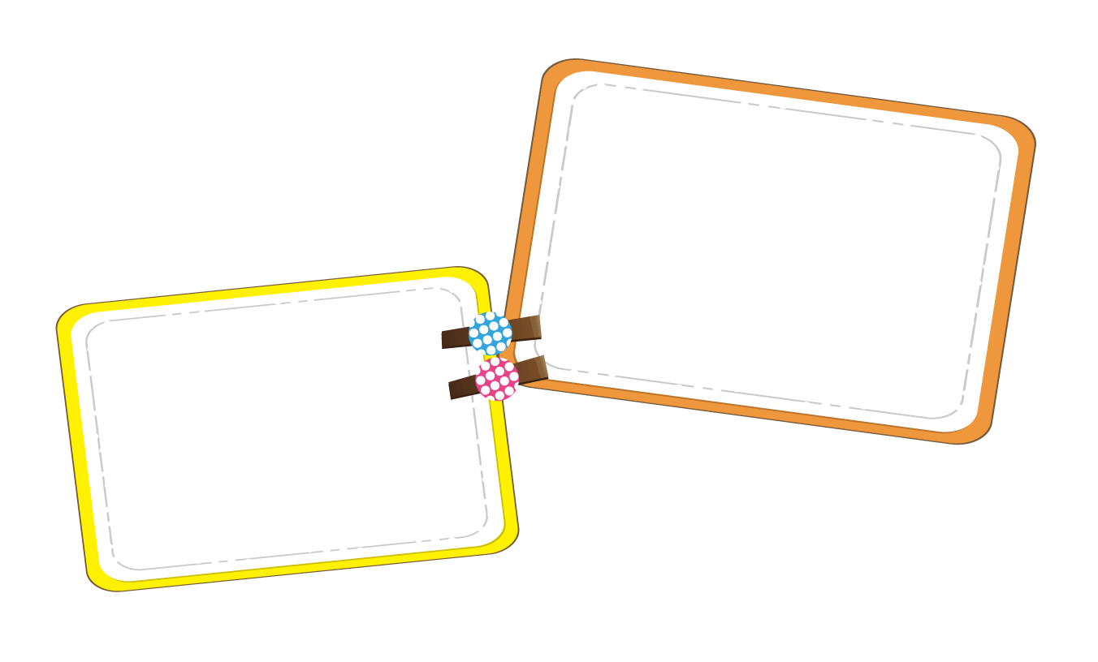


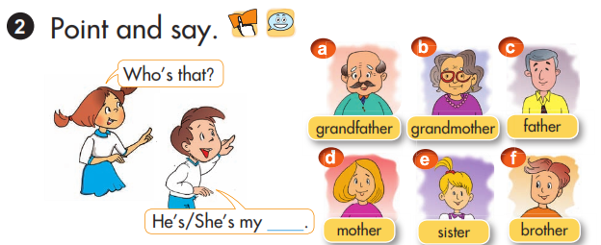

Example;
Who’s that?
He’s my grandfather.
SENTENCE PATTERNS:
Who’s that?
He’s /She’s my ……

Slide 6




Slide 7
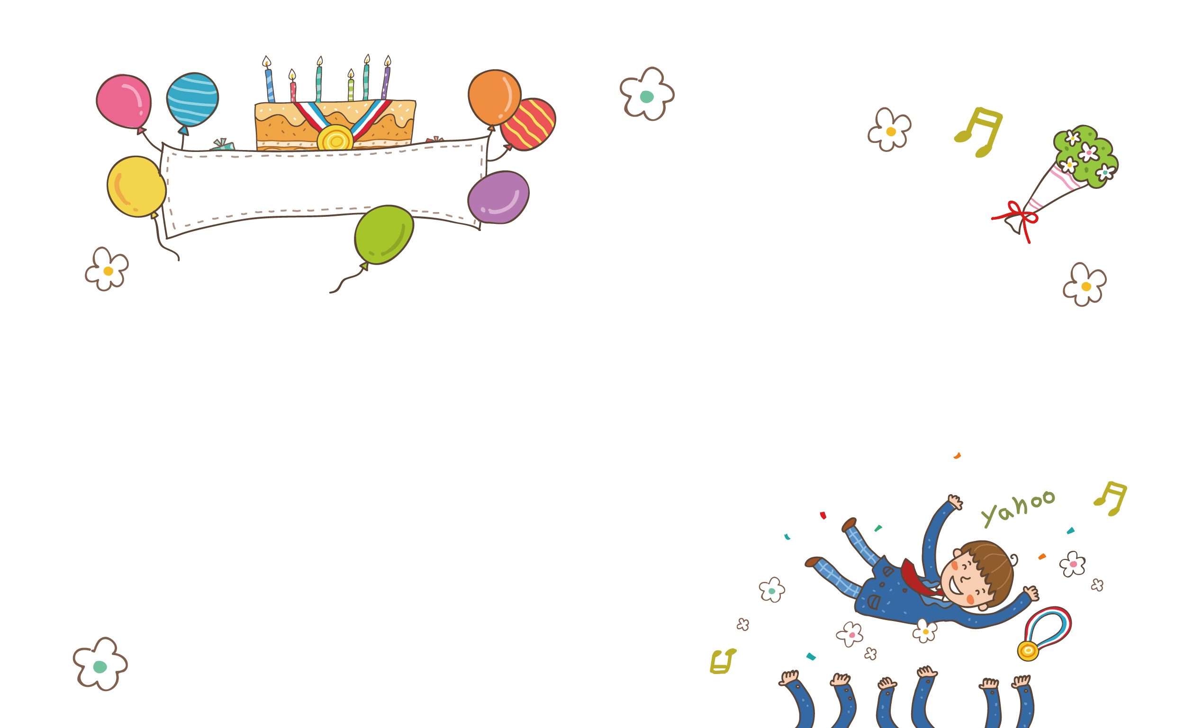

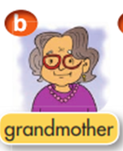
2.Point and say

Slide 8


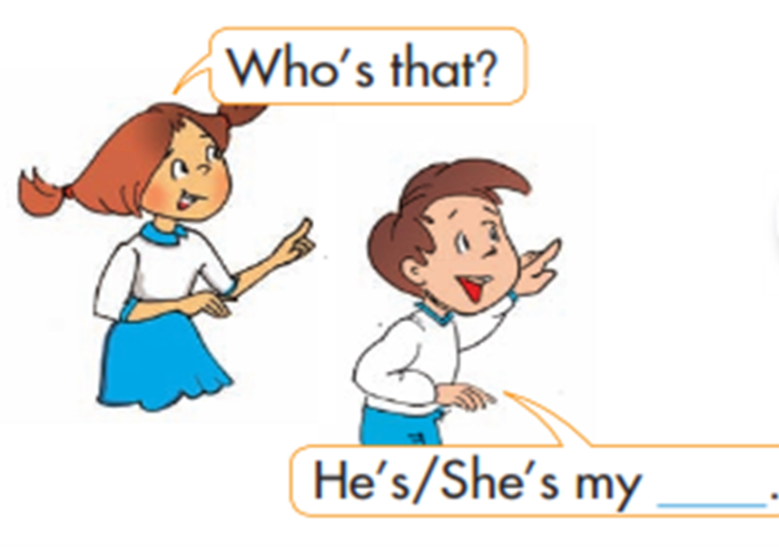

Slide 9


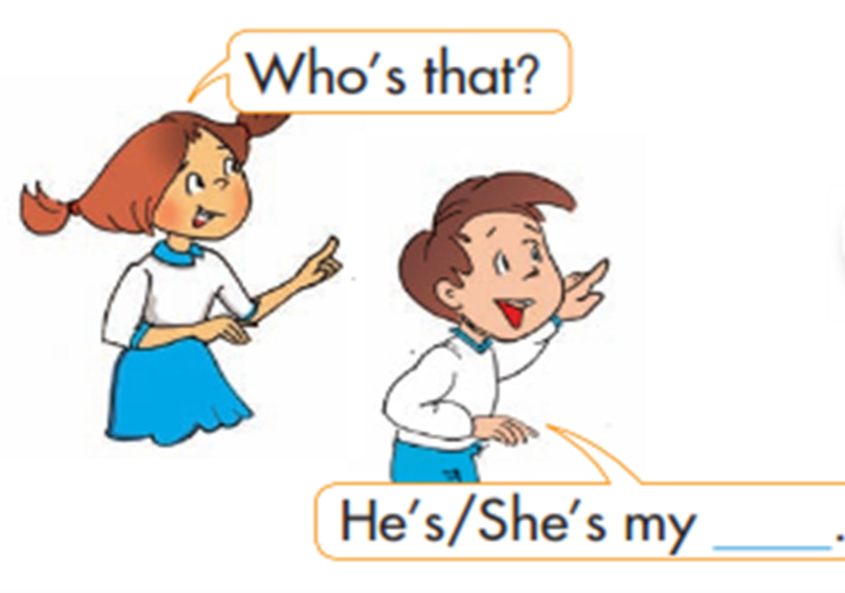

Slide 10


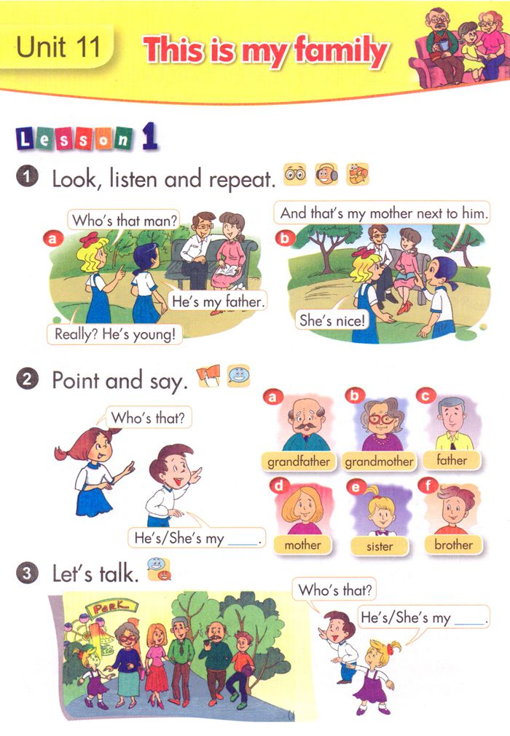


Slide 11




Slide 12


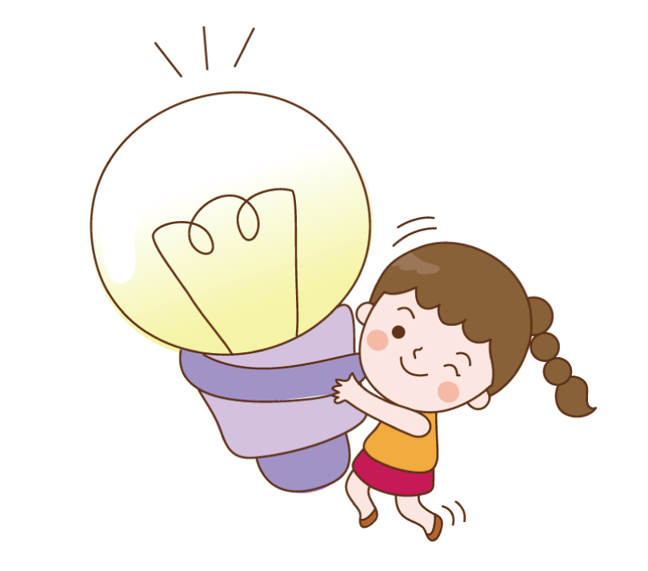
Learn by heart the new words
Listen a sing:
A Happy Family
Do the exercise
Homework
Learn by heart the sentence patterns
Prepare the next lesson

Slide 13
Thank you for listening

